Slide 1

Mega Goal 1.3
U: 2
I Wonder What Happened
Grammar
By: Yousef Hilal Alyazedi

Slide 2
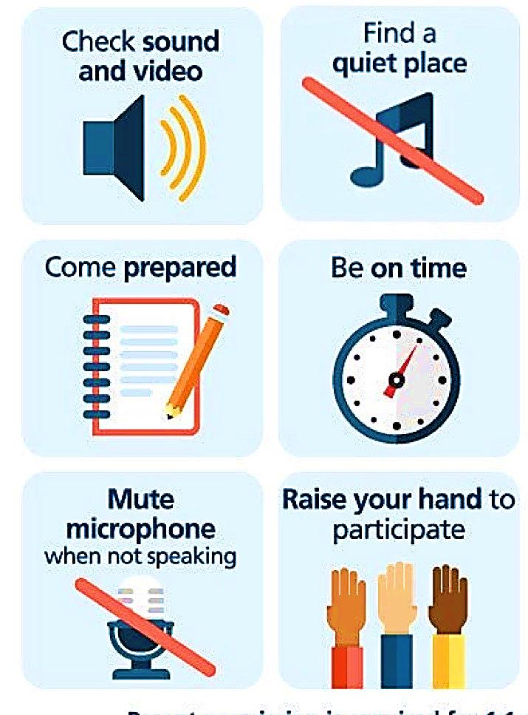
Online Classroom Rules

Slide 3



Slide 4

Lesson Objectives
T
The students will be able to :
1 – use the past perfect to show the order of two past events .
2 – use “ must " to assure an information .
3 – use “ can’t / couldn’t " to negate a statement .
4 – use “ may / might // could " correctly .

Slide 5
I had never seen such beautiful sights before I visited Paris in 2012. I had saved money for 5 years before I booked my trip to Paris. I was very excited ! Before my trip to Paris, I had never been out of the United States. When I went to Paris, I spent many days touring the city. The city was big. Sometimes I got lost and asked for directions. I asked for directions in French. That was easy because I had studied French for 2 years before I visited Paris. By the time I left Paris, I had toured many beautiful places. The Eiffel Tower, Notre Dame Cathedral, and Luxembourg Gardens were just a few of the places I saw. Before I visited Paris, I had only seen those places on television.

Slide 6
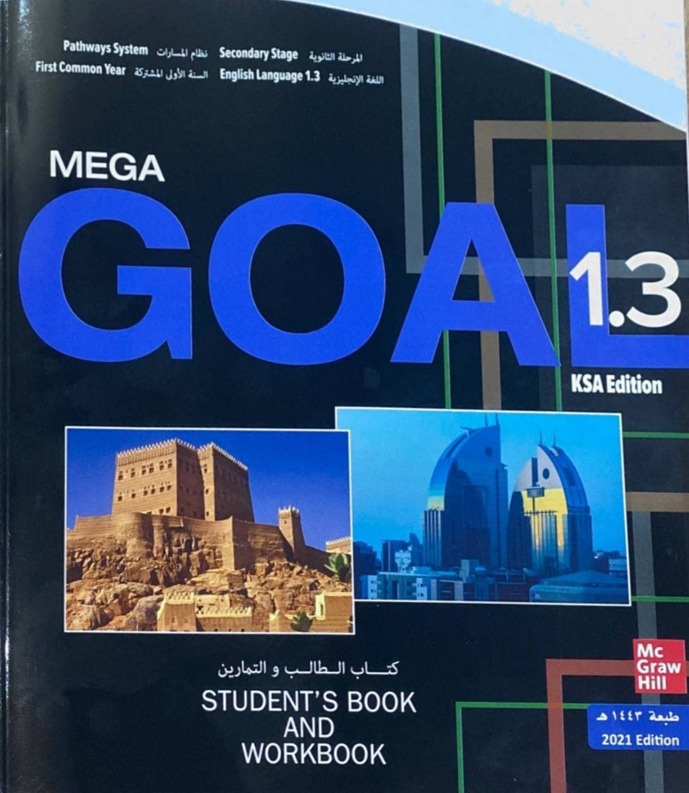

Open your Student’s book at page: 22

Slide 7
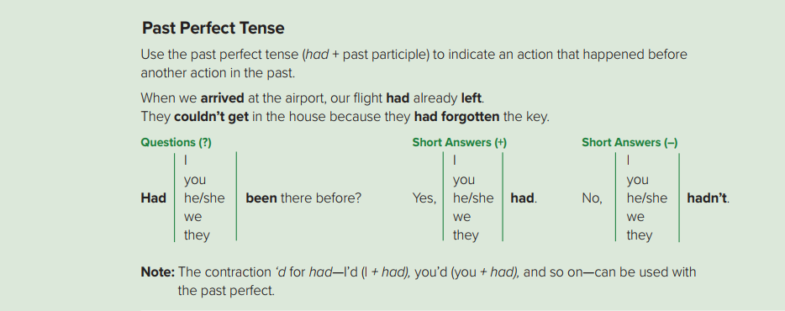
The thief had escaped when the police arrived .
They left before I’d spoken to them .
When I got to the cinema, the film had already started .

Slide 8
Form
Subject + had + V3
She had finished the test .
Negative
Subject + had + not + V3
She hadn’t finished the test .
Question
Had + subject + V3 + ?
Had she finished the test ?

Slide 9
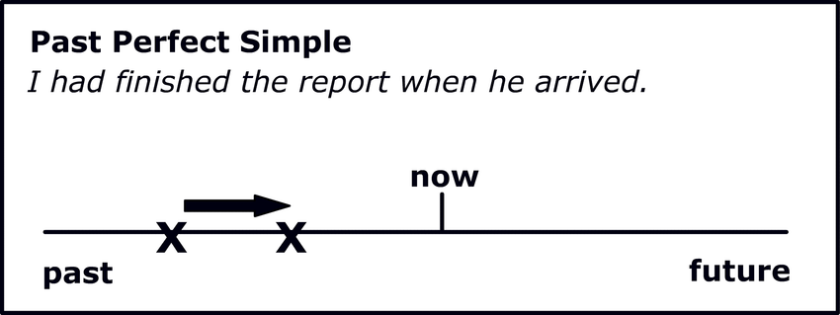

Slide 10

When I got out the car, I bought a parking ticket .
Connected: A follows B
When I had got out the car, a dog ran over to me .
unconnected

Slide 11
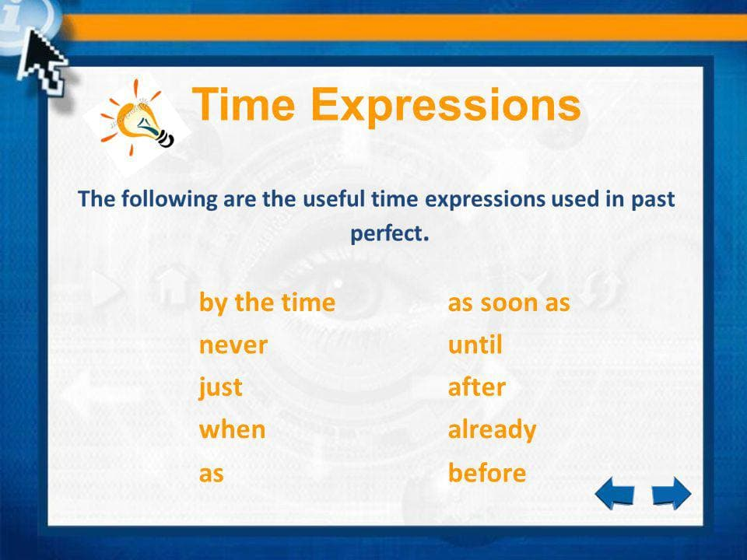

Slide 12
Write ( C ) if a sentence has the correct verb form and ( I ) for incorrect .
C
Ali had left home before Sami arrived .
I
I returned home because I had forget my books at home .
I
Had lived they in London before I moved to Paris ?
I
He had finished not when the bell rang .

Slide 13

Quick Check
https://wordwall.net/resource/12118423

Slide 14
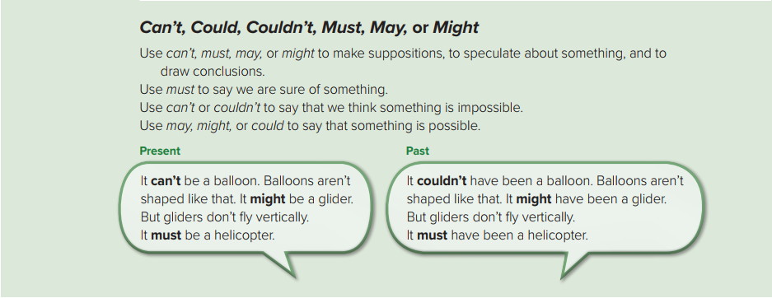
He must live near here because he always walks to work .
They’re not answering. They could have been in class .
She’s not here yet. She might have been stuck in traffic .
It can’t be far now . We’ve been driving for hours .

Slide 15
can’t
might
must
Present
couldn’t have been
might have been
must have been
Past

Slide 16
Present
Form
Subject + modal verb + main verb
He might go to the party .
Negative
Subject + modal verb + not + main verb
He might not go to the party .

Slide 17
Past
Form
Subject + modal verb + have + V3
He must have stayed at home .
Negative
Subject + modal verb + not + have + V3
He must not have stayed at home .

Slide 18
Write ( C ) if a sentence has the correct verb form and ( I ) for incorrect .
I
I think I must have left the air conditioning on please can you check ?
C
His car is here. He must have come home earlier than planned .
I
She have can’t cleaned the whole house on her own in one hour.
C
I don’t know if she’s here or not. She was feeling well so she might go home.

Slide 19
Quick Check
https://www.liveworksheets.com/1-ao1794782ox

Slide 20
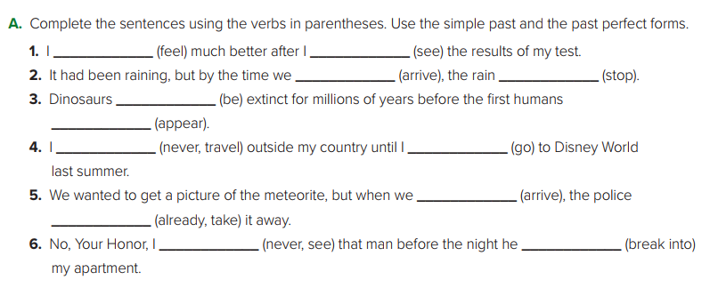
felt
had seen
arrived
had stopped
had been
appeared
went
had never traveled
arrived
had already taken
broke into
had never seen

Slide 21
Open your WORKBOO at page: 92 10

Slide 22
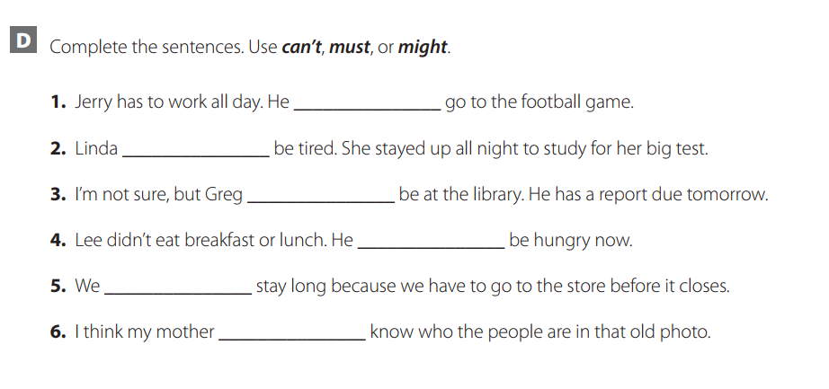
can’t
must
might
must
can’t
might

Slide 23
Open your Student’s book at page: 23

Slide 24
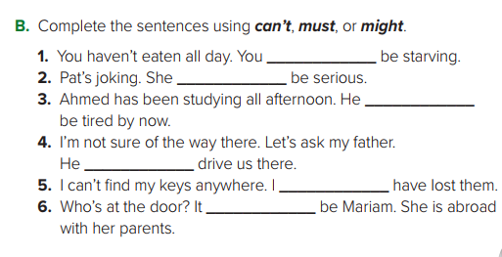

must
can’t
must
might
must
can’t

Slide 25
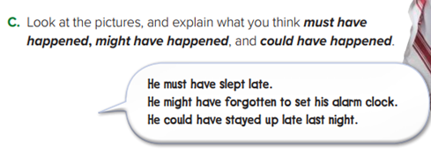
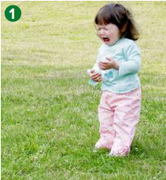

1- Something must have scared the girl. The girl might have hurt herself. The girl could be hurt.
2- The man must have heard some good news. The man might have heard a funny joke. The man could have gotten an A on his test.

Slide 26
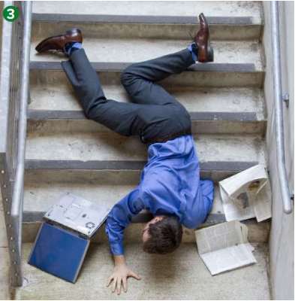
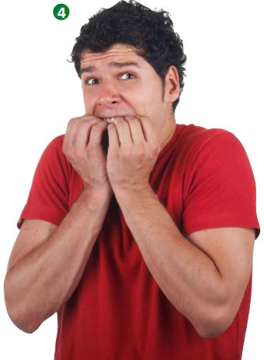
3- The man must have tripped on something and fallen. The man might have fallen while he was running. The man could have slipped on some water.
4- The boy must have seen a ghost. There could be an earthquake. The boy might have seen a horror film.

Slide 27

Workbook P. 92 ( E )

Slide 28
