Slide 1


Slide 2


Slide 3


Warm Up
Unit -1-
Complaints ,Complaints
12 Form ,Meaning& Function

Slide 4

Warm Up
Lets Check What you Know
Give the past participle of the verbs
Past participle | Present Simple
check
Checked
crash
crashed
Dry-clean
Dry-cleaned
purchase
purchased
repaint
repainted
sew
sewn

Slide 5
Present perfect simple
Verb +Gerund
Present perfect with Already, Yet , Just
Object pronoun
Need/Want/Like + Infinitive
Imperatives ( two-word verb )

Slide 6
Objectives
The students will be able to :
1 – form sentences using the present perfect tense .
2 – use gerund after certain verbs .
3 – differentiate between subject pronoun & object pronoun .
4 – form sentences using infinitive after ( want / like / need ) .
5 – use two-word verbs as imperative .

Slide 7
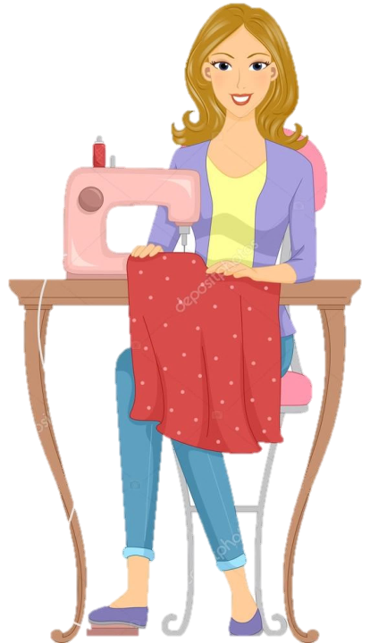
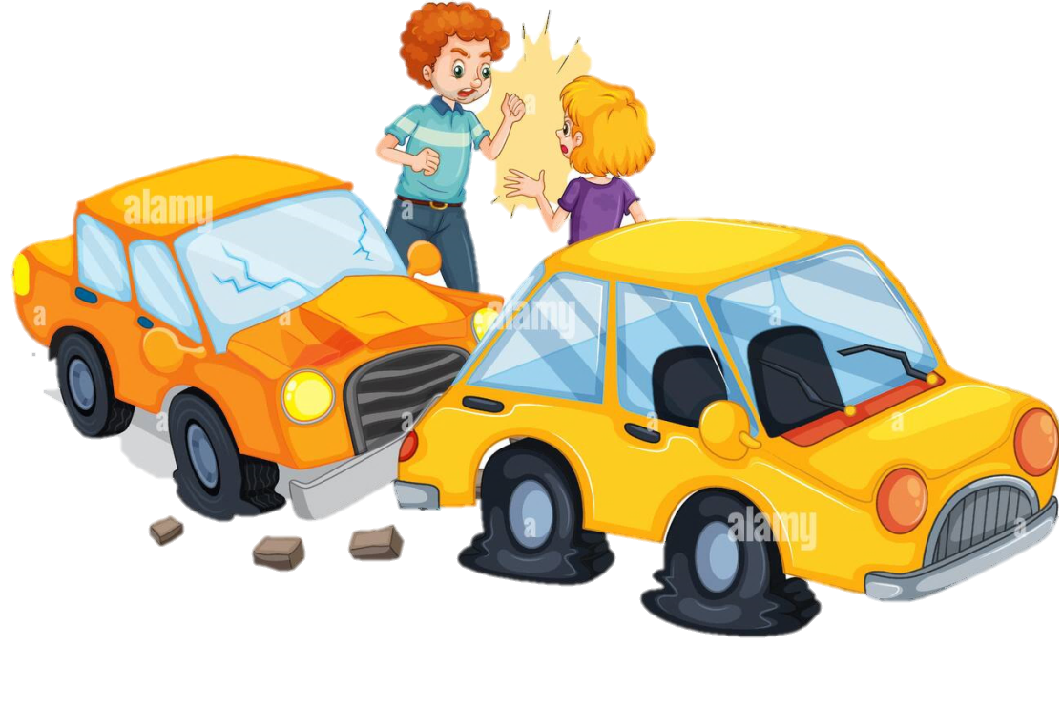
Present perfect simple

Slide 8
She has sewn her dress
They have crashed

Slide 9

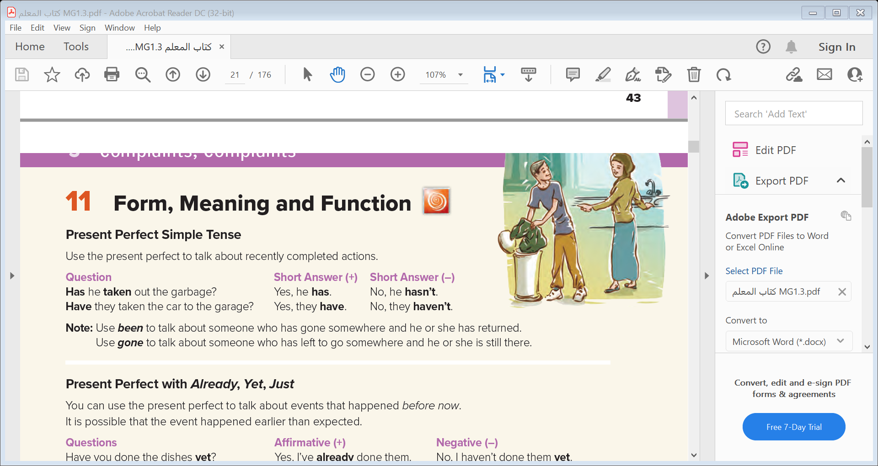
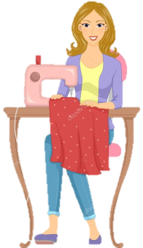

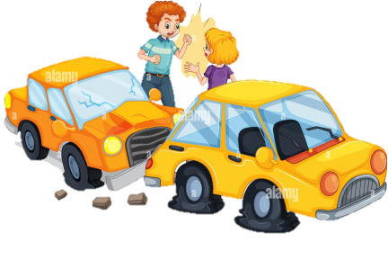
Use the present perfect to talk about recently completed actions.
Note: Use been to talk about someone who has gone somewhere and he or she has returned.
Use gone to talk about someone who has left to go somewhere and he or she is still there.
She has sewn her dress
Now
They have crashed

Slide 10
I
They
We
you
have
He
She
It
has

Slide 11
Form
Subject + has / have + V3
He has developed a new app .
Negative
Subject + has / have + not + V3
He hasn’t developed a new app .
Has / Have + subject + V3 + ?
Question
Has he developed a new app ?

Slide 12
Present Perfect with Already, Yet, Just

Slide 13
She has sewn already her dress
They have just crashed
Notes:
just = a short time ago
not yet = something expected hasn’t happened but we
expect it will
yet = in questions, this asks whether something
expected has happened
already = something happened before we
expected it to

Slide 14
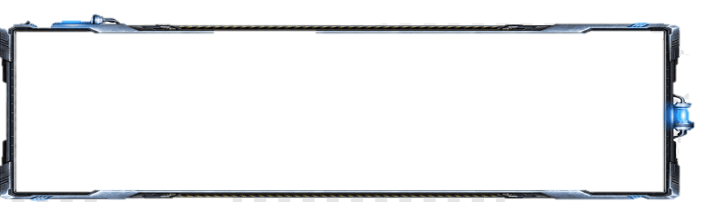

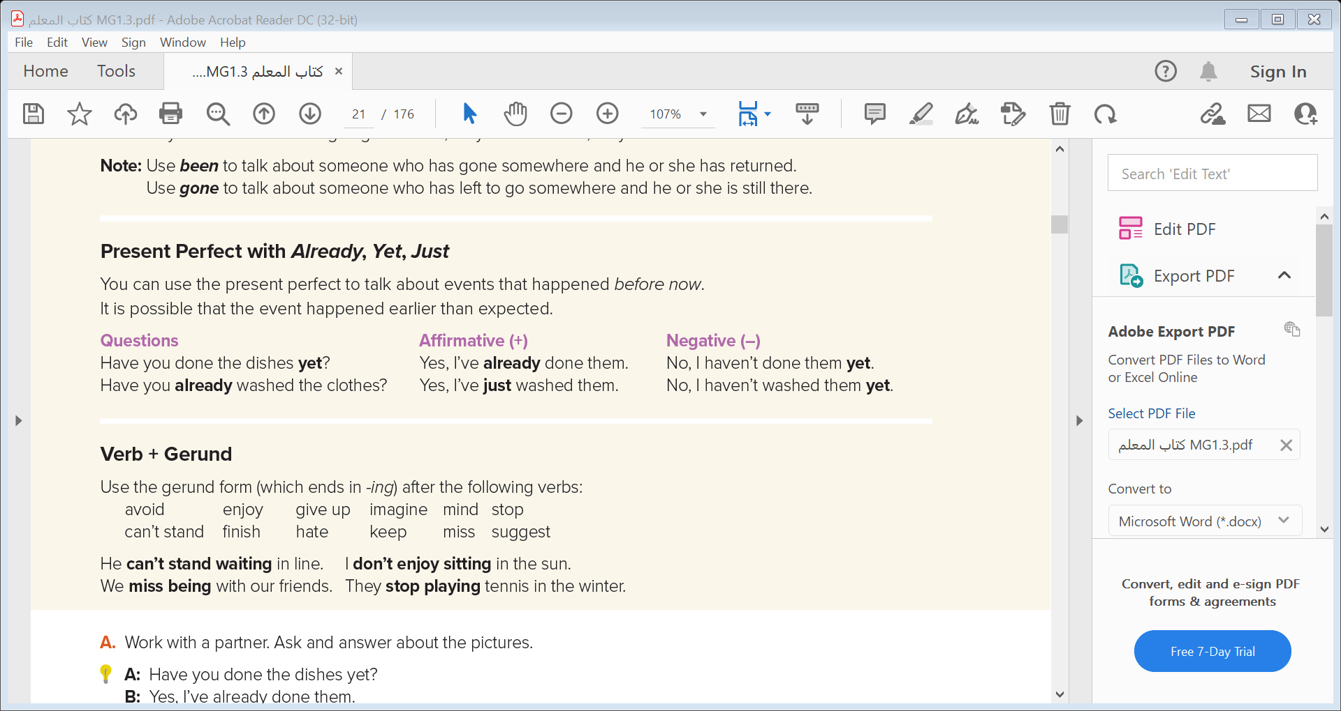

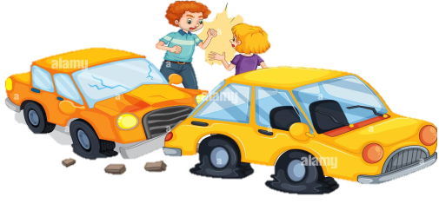
Time Expressions
You can use the present perfect to talk about events that happened before now.
It is possible that the event happened earlier than expected
Now
She has sewn already her dress
They have just crashed
Notes:
just = a short time ago
not yet = something expected hasn’t happened but we
expect it will
yet = in questions, this asks whether something
expected has happened
already = something happened before we
expected it to

Slide 15
Time Expressions
yet
At any time up to now
Questions & negative sentences
comes at the end
Questions & positive sentences
comes between the auxiliary verb and the past participle
or at the end of the clause
already
Before now
Questions & positive sentences
comes between the auxiliary verb and the past participle
just
A short time before

Slide 16

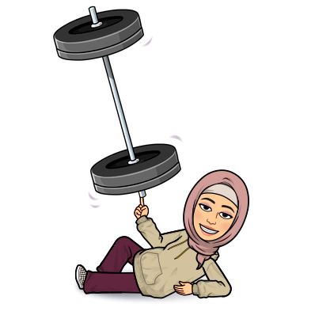
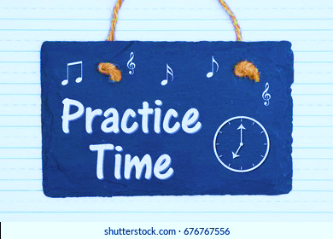

Slide 17
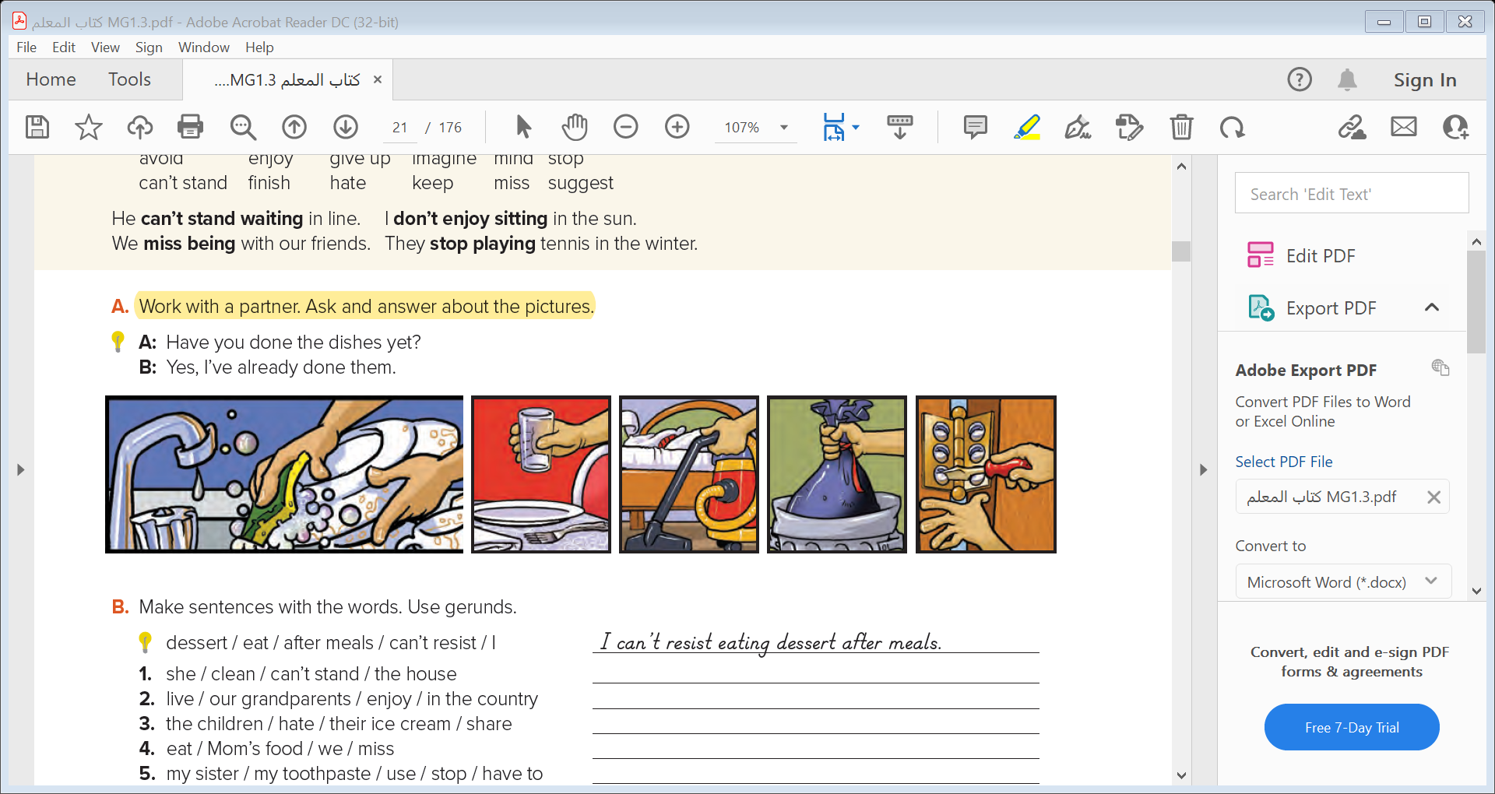
A: Have you cooked dinner yet ?
B: Yes. I’ve already eaten it .
A: Have you cleaned your room ?
B: Yes. I’ve already done it .
A: Have you taken out the garbage ?
B: Yes. I’ve already done it .
A: Have you fixed the door ?
B: Yes. I’ve already done it .

Slide 18
Verb +Gerund

Slide 19
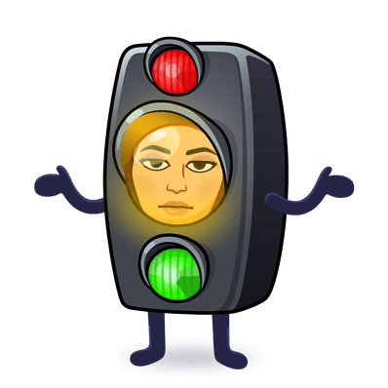
He can’t stand waiting in line.
. I don’t enjoy sitting in the sun.
We miss being with our friends
They stop playing tennis in the winter
Use the gerund form (which ends in -ing) after the following verbs:
avoid ,
give up
imagine
finish
enjoy
miss
mind
hate
suggest
can’t stand
stop
keep

Slide 21
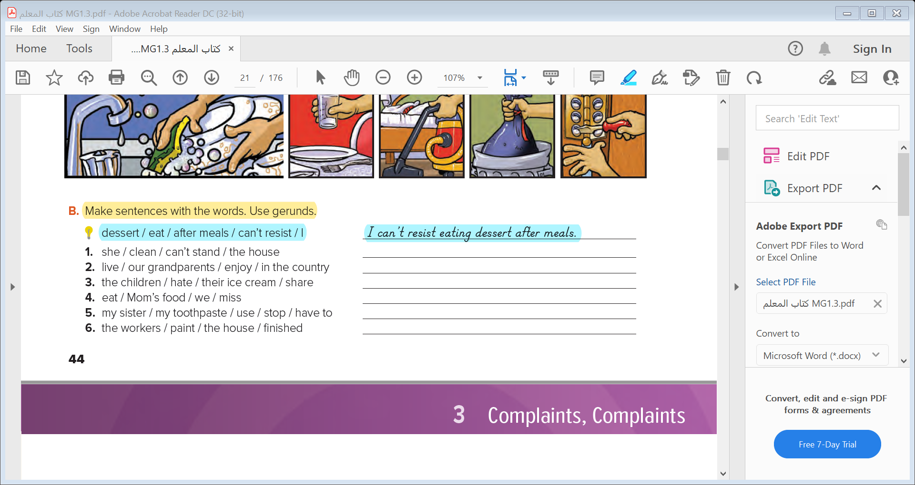
She can’t stand cleaning the house .
Our grandparents enjoyed living in the country .
The children hated sharing their ice cream .
We missed eating Mom’s food .
My sister has to stop using my toothpaste .
The workers have finished painting the house .

Slide 22




Slide 23
Object pronoun

Slide 24

Subject Pronouns | Object pronouns
I
he
she
it
you
we
they
me
him
her
it
you
us
them

Slide 25
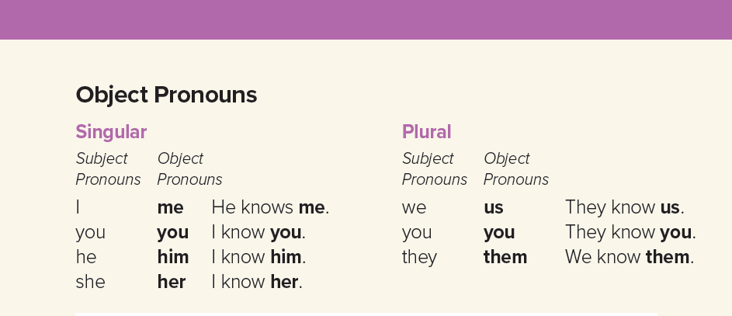
He told me the new story .
She teaches us English .
I like them because they are always funny .

Slide 27
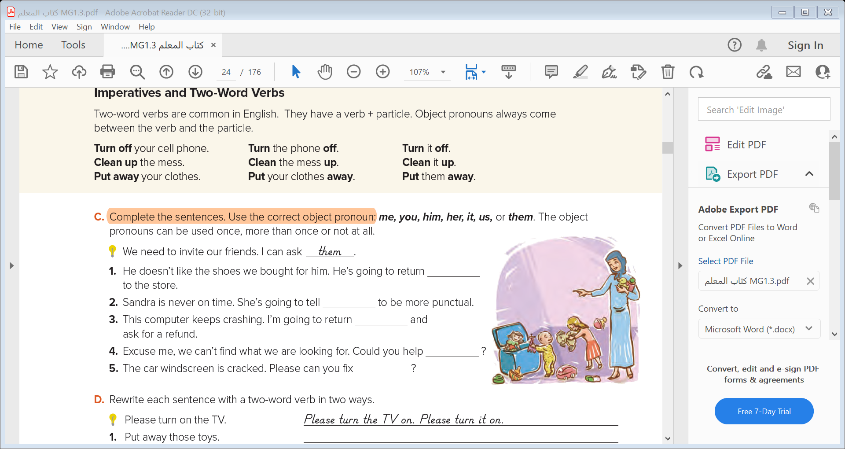
them
her
it
us
it

Slide 28
Need/Want/Like + Infinitive

Slide 29
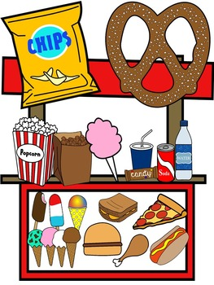
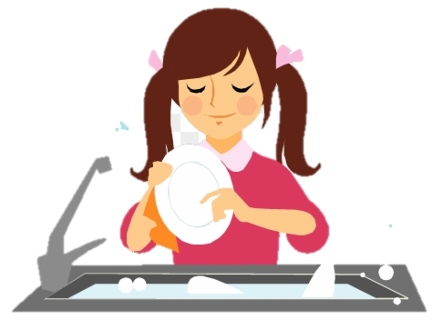
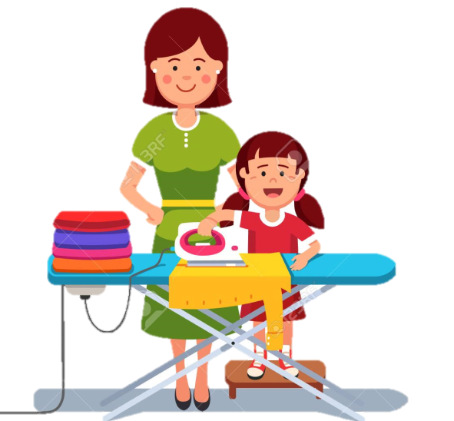
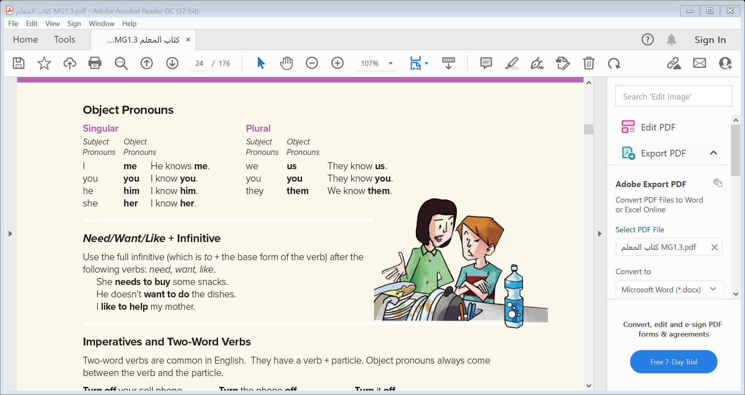
She needs to buy some snacks.
He doesn’t want to do the dishes.
I like to help my mother.

Slide 30
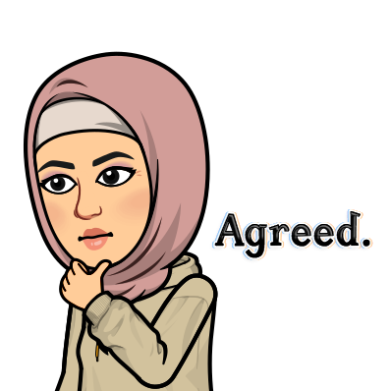
Imperatives ( two-word verb )

Slide 31
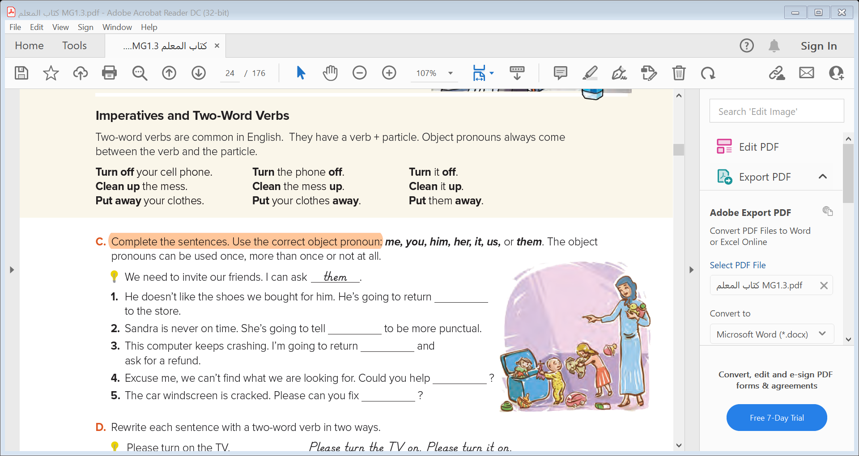
Turn off the light .
Turn the light off .
Turn it off .

Slide 33
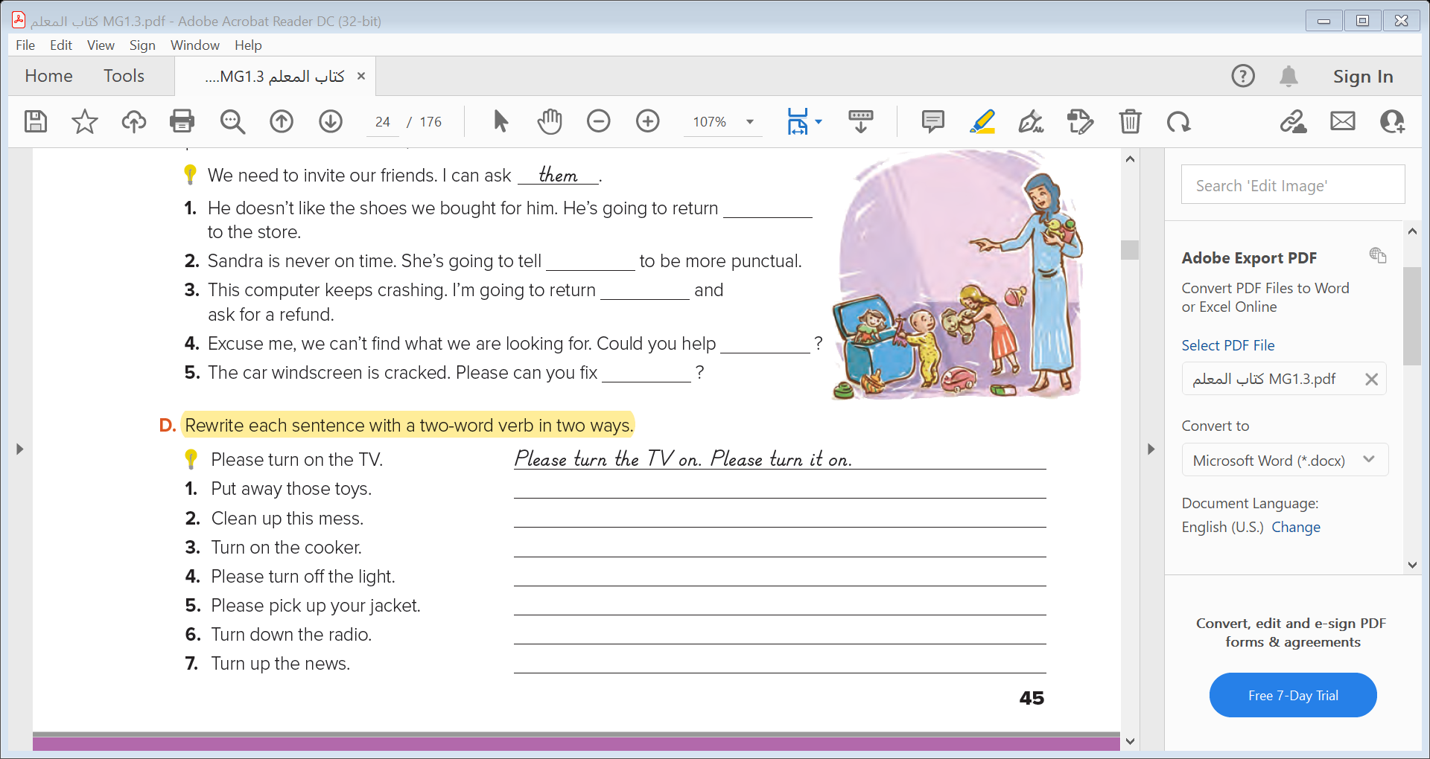
Put those toys away. Put them away .
Clean this mess up. Clean it up .
Turn the cooker on. Turn it on .
Please turn the light off. Please turn it off .
Turn the radio down. Turn it down .
Please pick your jacket up. Please pick it up .
Turn the news up. Turn it up .

Slide 35
