Slide 1


Slide 2


Slide 3

Revision
Unit -1-
Complaints ,Complaints
9- Reading

Slide 4
Objectives
The students will be able to :
Recognize the sentences that talk about something that went wrong .
Write descriptive sentences about a text .
Illustrate what Murphy’s Law means .
Answer comprehension questions about the text .
Find the main idea of each paragraph .
Identify the meaning of new words in the text .

Slide 5


Warm Up
Have they ever heard of Murphy’s Law?

Slide 6
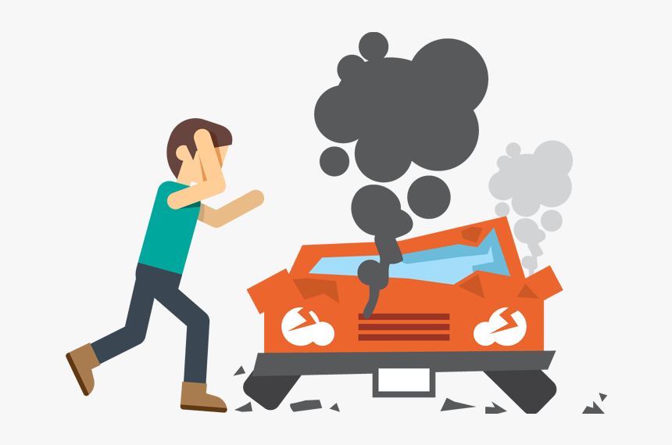
A 22-year-old guy has been driving for five years, but he has already been involved in six car accidents.
Does he simply have bad luck, or are there other factors that might have caused him to have so many accidents ?

Slide 7

Students Book P. 12-13

Slide 8
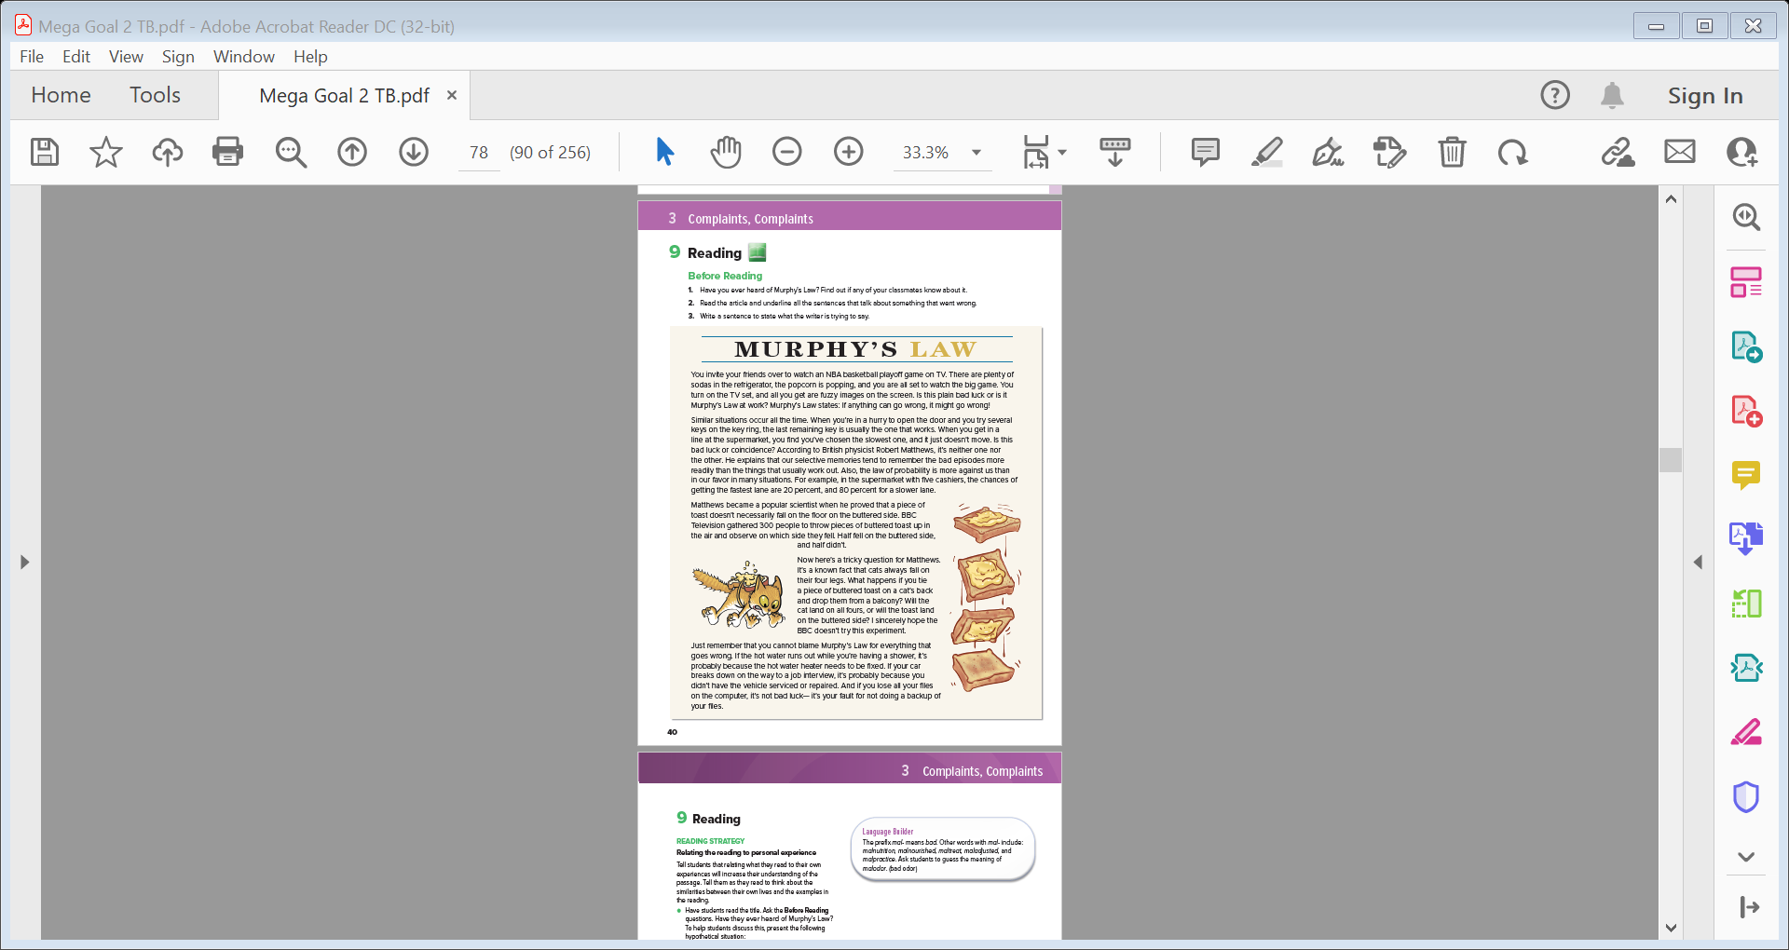
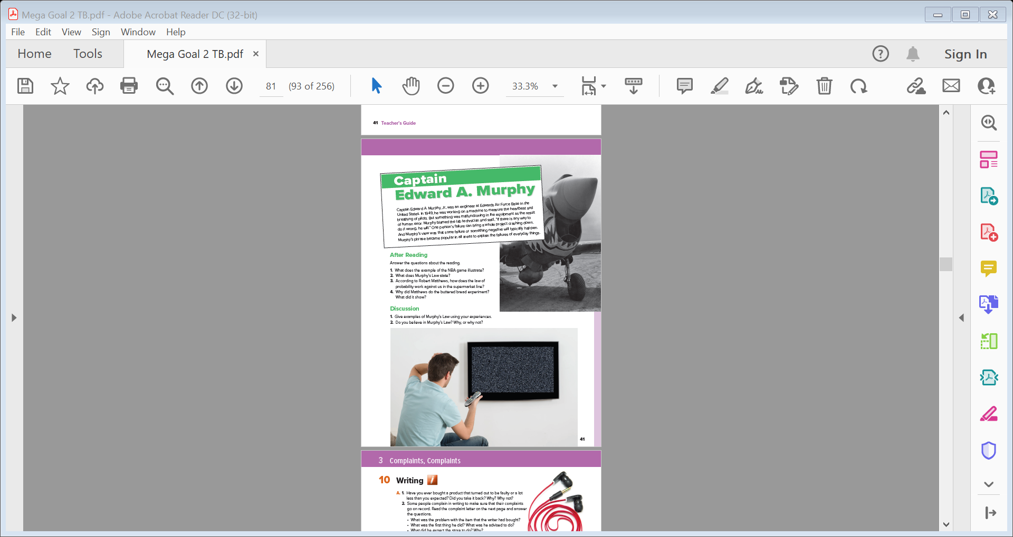
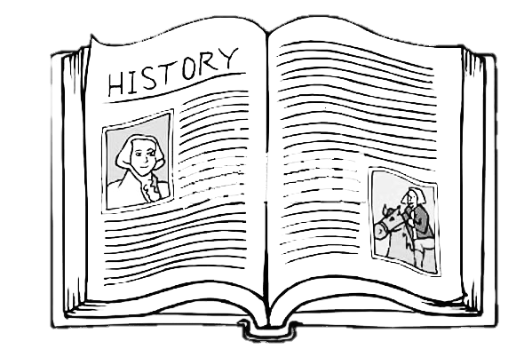

Skimming
Students Book P. 12-13

Slide 9

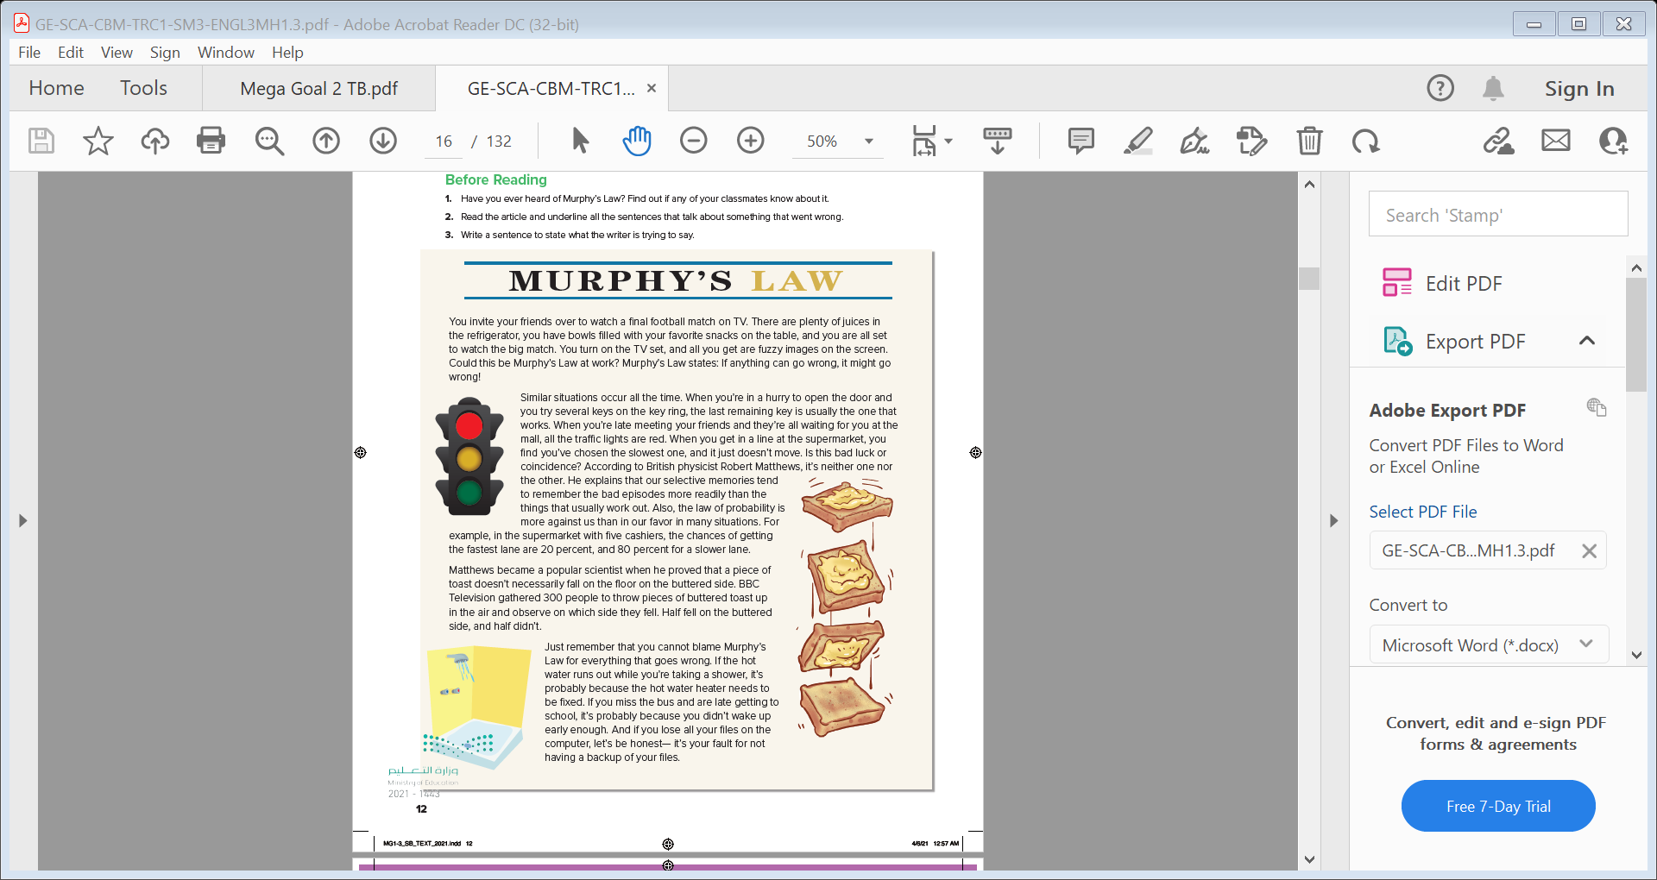
Listen & Read
Skimming
1
2
What’s the title?
How many paragraphs are there ?
3
What do the pictures show ?
4

Slide 10

Listen & Read
Read along as you listen

Slide 11
What is the main idea of this paragraph ?
Murphy’s law

Slide 12
Which key does usually work when you try to open the door in a hurry according to the text ?
What does Mathew explain ?
What is the main idea of this paragraph ?
Examples & Matthews explanation

Slide 13
When did Matthews become a popular scientist ?
What is the main idea of this paragraph ?
Matthew’s experiment

Slide 14
Can we blame Murphy’s Law for everything that goes wrong ?
Give examples ?
What is the main idea of this paragraph ?
It’s not always Murphy’s Law

Slide 15
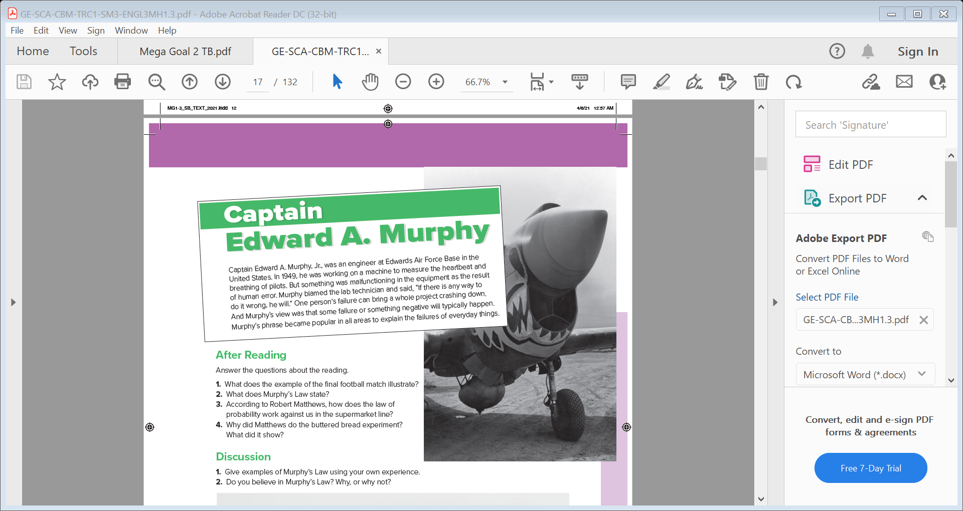
After Reading
Why was Murphy working on a machine ?
What did Murphy do when something malfunctioning in the equipment ?
Why did Murphy’s phrase become popular in all areas ?

Slide 16

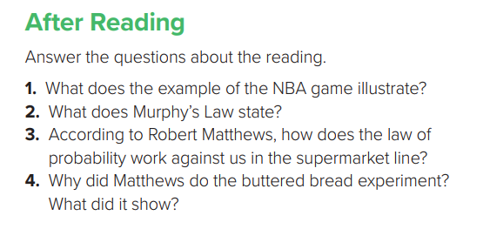
After Reading
1- It illustrates that things seem to go wrong at precisely the wrong time .
2- If anything can go wrong, it will .
3- Because the chances of getting in the fastest lane aren’t that high. For example, if there are five lines, our chance of getting a slower lane is four out of five, or 80 percent .
4- He wanted to show that although people think that bad things always happen, things happen according to the law of probability .

Slide 17
Practice the new vocabulary

Slide 18
episode
fuzzy
event
unclear
coincidence
gather
When two things happen at the same time in the same place
To come together and form a group
malfunctioning
backup
Not working correctly
On all fours
copy
failure
On four feet
A lack of success in doing something

Slide 19




Slide 20
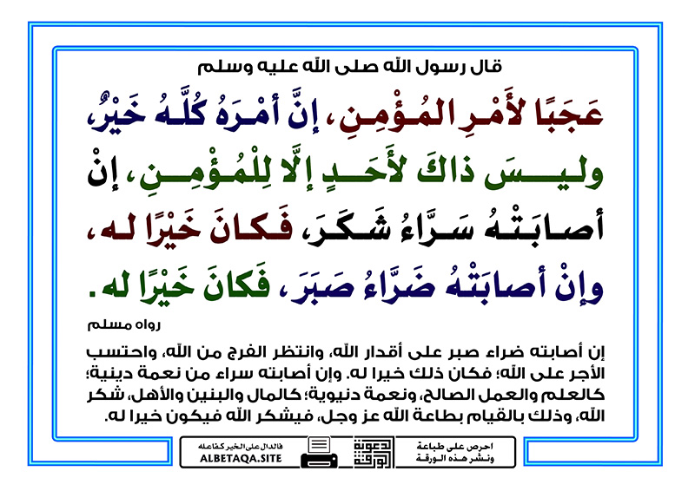

Slide 21
