Slide 1
Unit 3
If It Haden’t Happenrd Form , Meaning & Function
Mega Goal 1.3
Done by : Entisar Al-Obaidallah

Slide 2
Lesson Objectives
01
03
Form
Practice
02
04
Practice
Use
Sentences using present perfect and simple past correctly
Expressing : Ability, Permission and Request correctly
Using time expressions : Ago , For & Since
If with past perfect and Would Be Able / Would Have Been Able

Slide 3

Open
Your bookp. 44-45

Slide 4
01
Present Perfect Tense versus Simple Past

Slide 5
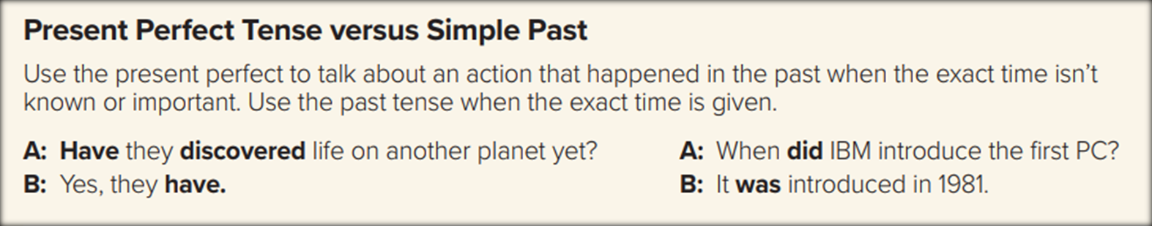
Examples
I phoned Ali 2 minutes ago.
They moved to Riyadh in 2001.
Simple Past
She has been a teacher since December .
They have lived in Riyadh for three years.
Present Perfect

Slide 6
Present Perfect vs Simple Past
Present perfect simple
Simple Past
Use
Use it When the exact time isn’t known, or isn’t important
Example:
I have lived in Damam
Use it WHEN the exact time is given
Example:
I lived in Dammam in 1999
Indefinite time
Definite time

Slide 7
Do you still remember the structure?
Affirmative(+)
Subject
Has/ have
V(P.P.3)
I
You
We
They
She
He
It
Has
Have
He has washed the car.
I have washed the car.

Slide 8
Do you still remember the structure?
Negative(-)
Subject
Has/ have
not
V(P.P.3)
I
You
We
They
She
He
It
Has not
Have not
He has not washed the car.
I have not washed the car.

Slide 9
Do you still remember the structure?
Question(?)
Has/ have
Subject
V(P.P.3)
I
You
We
They
She
He
It
Has
Have
Has he washed the car ?
Have you washed the car ?

Slide 10
Time Expressions
for
since
For + A period of time
For + number + time word
Since + starting point
Since + a time / a date
It has rained for three days
Sara has been sick since Friday

Slide 11
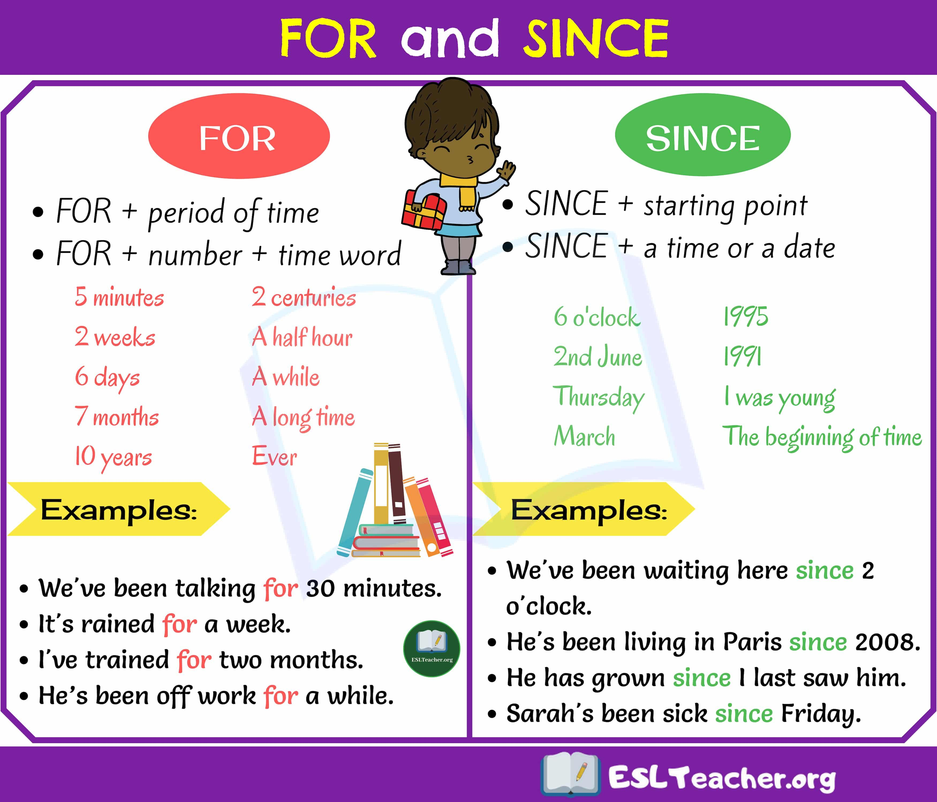

Slide 12
The Simple Past Form
Affirmative(+)
Regular (V -ed)
Subject
V-ED (V 2 )
Irregular (base form)
She cleaned the room last night.
She went to the market last night.
Negative(-)
Subject
did
not
V1 ( base form )
She did not clean the room.
Question (?)
Did
Subject
V1 ( base form )
Did she clean the room?

Slide 13
Time Expressions
yesterday
last
ago
He went to the hospital yesterday
Sara didn’t study last week
They travelled to Dubai two weeks ago

Slide 14
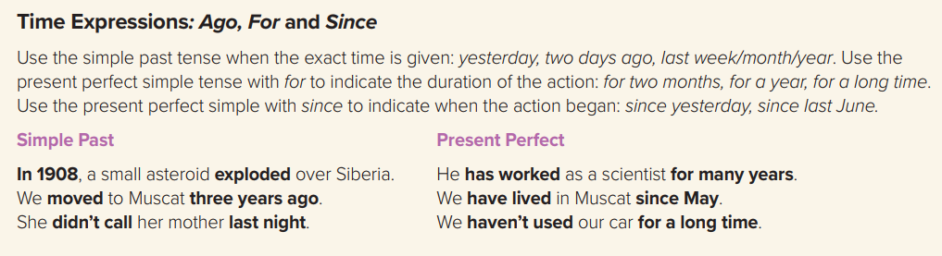

Slide 15



Slide 16
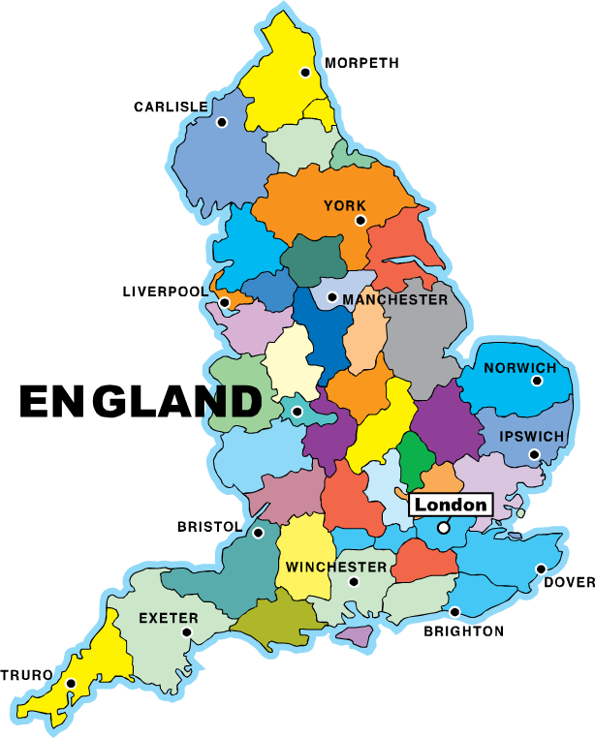
Use Present Perfect or Past Simple
lived
I _________ (live) in England for 30 years, but I live in France now.

Slide 17

Use Present Perfect or Past Simple
Sara, your package _________________ (just/arrive)
has just arrived

Slide 18

Use Present Perfect or Past Simple
We ________________ (go) shopping
have gone

Slide 19
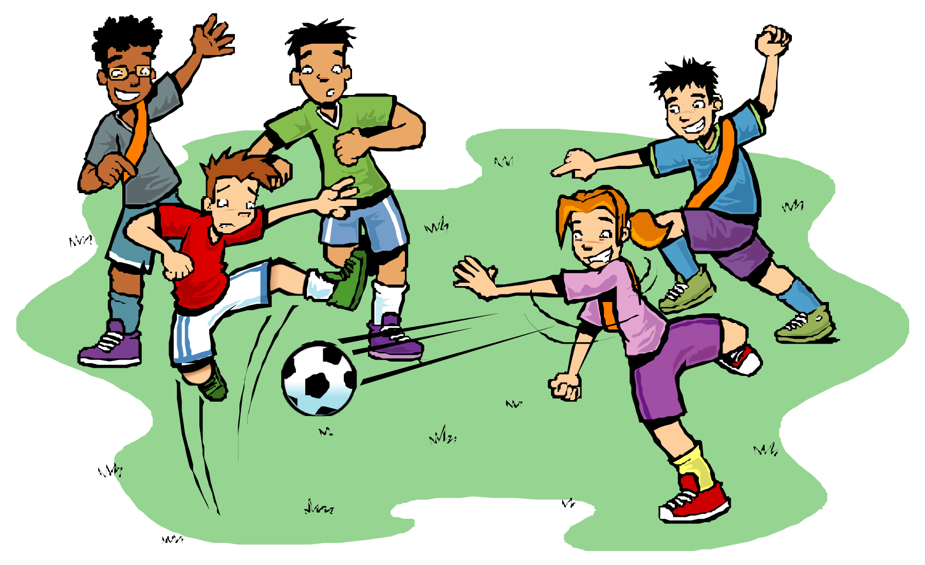
Use Present Perfect or Past Simple
I ________ (play) football with my friends yesterday.
played

Slide 20
Open
Your s book p. 45

Slide 21
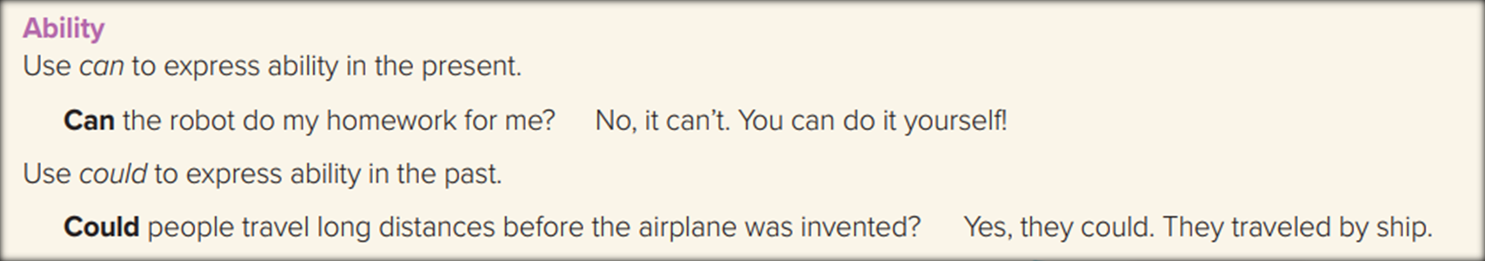
We use ( can’t ) to express a lack of general ability in the present .
Example
Ali can’t speak English fluently.
We use (could & couldn’t ) to express general ability in the past .
Example
Ali could ride a bike when he was 6.
Ali couldn’t swim when he was a child.

Slide 22
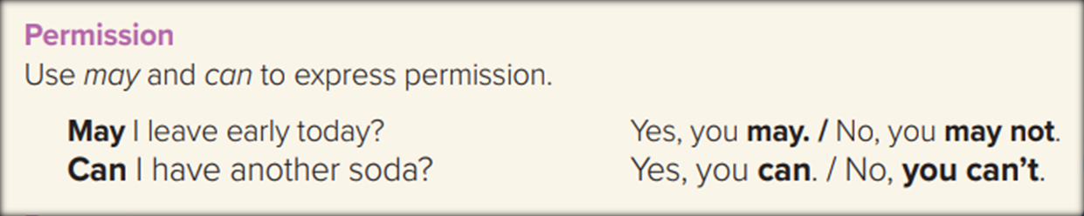
We use ( can & may ) to give permission .
Example
Can I borrow your book?
May I use your phone?
We use ( can’t & may not ) to refuse permission .
Example
You couldn’t smoke in the hospital.
Rubbish may not be left here.

Slide 23
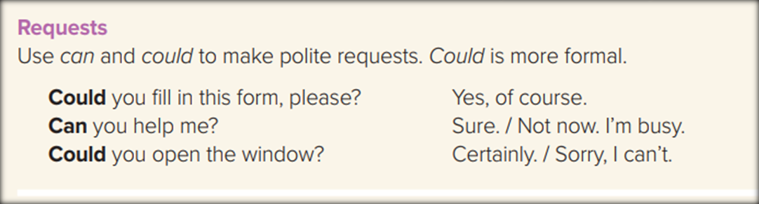
Example
Could you fill this form please?
Could you please bring me more coffee?
Polite
Polite
Example
Can you help me?.
Can you lend me your book?
Less Polite
Less Polite

Slide 25

Complete with can , could , may:
I _________ ride a Scooter .
( ability)
can

Slide 26
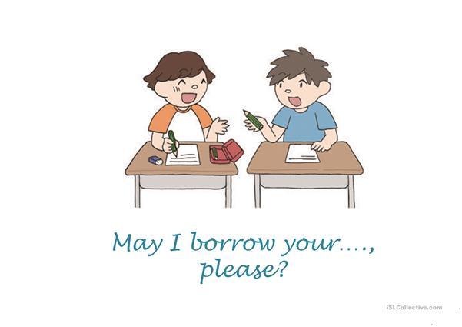
Complete with can , could , may:
______ I borrow your pen please?
( Request)
May

Slide 27

Complete with can , could , may:
You _________ borrow this book.
can
( give permission)

Slide 28

Complete with can , could , may:
Ali _________ swim when he was 5
could
( ability)

Slide 29
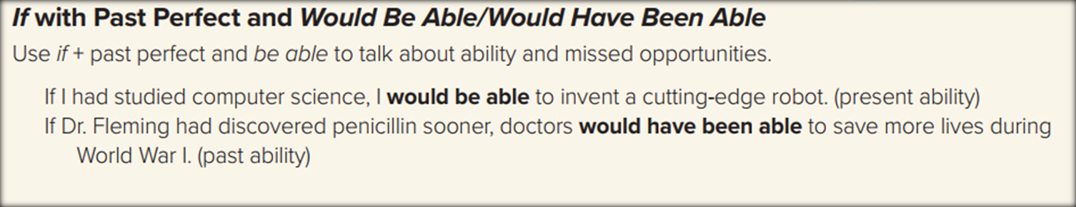
If I had bought a car , I would be able to travel anywhere .
If he had worked harder, he would have been able to get A at the exam.

Slide 30
If conditional- Present ability
Past Perfect
Would be able to
V-infinitive
If
➔We use would be able for hypothetical ability for the present and in the future
If conditional- Past ability
If
Past Perfect
Would have been able to
V-infinitive
➔We use would have been able to describe a missed opportunity in the past .

Slide 31

THANKS!

