Slide 1


Hello My lovely students
I’m your teacher
Hanan AlShobaily

Slide 2




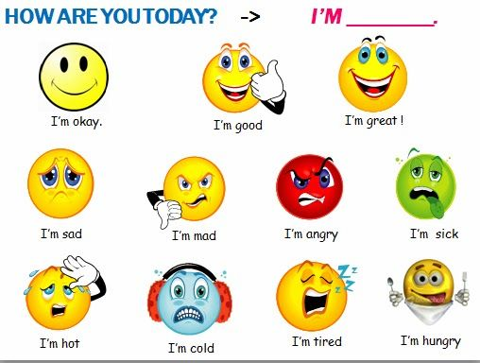
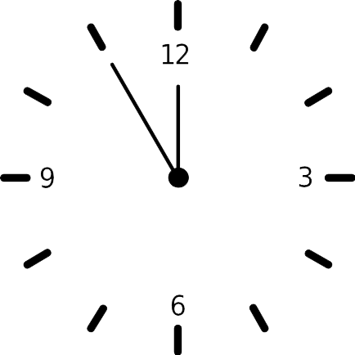



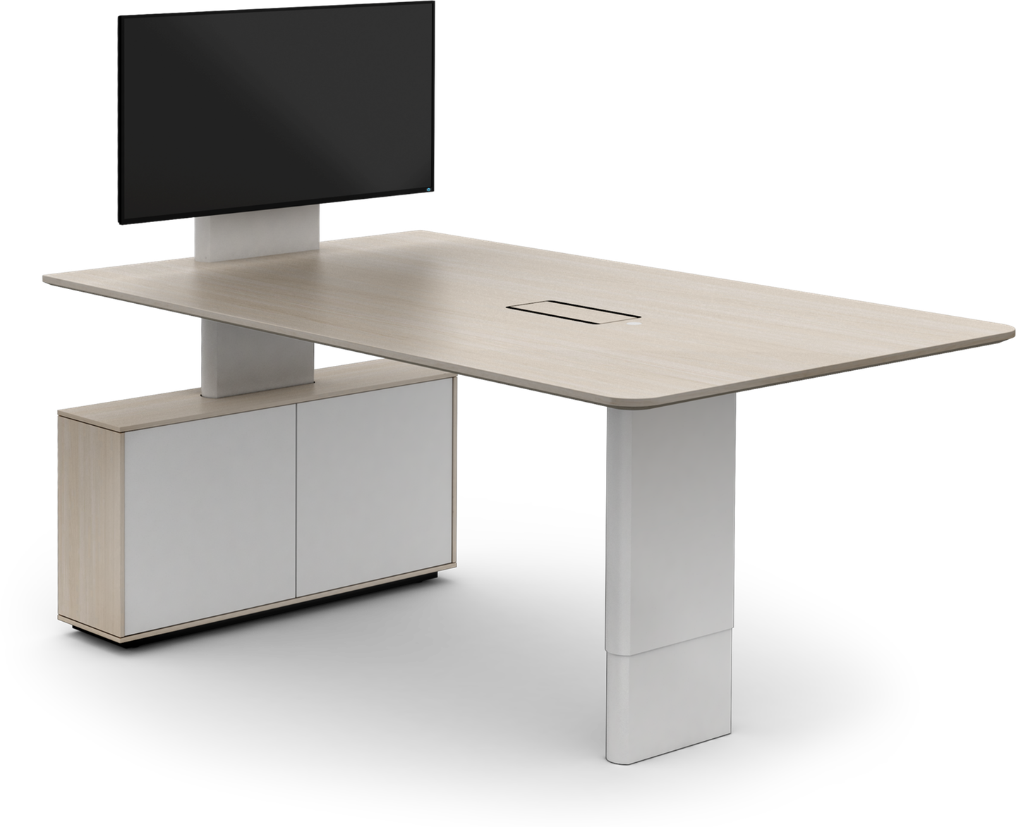
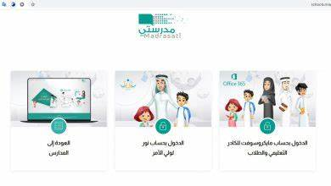







I love English

Slide 3


I love English

Slide 4
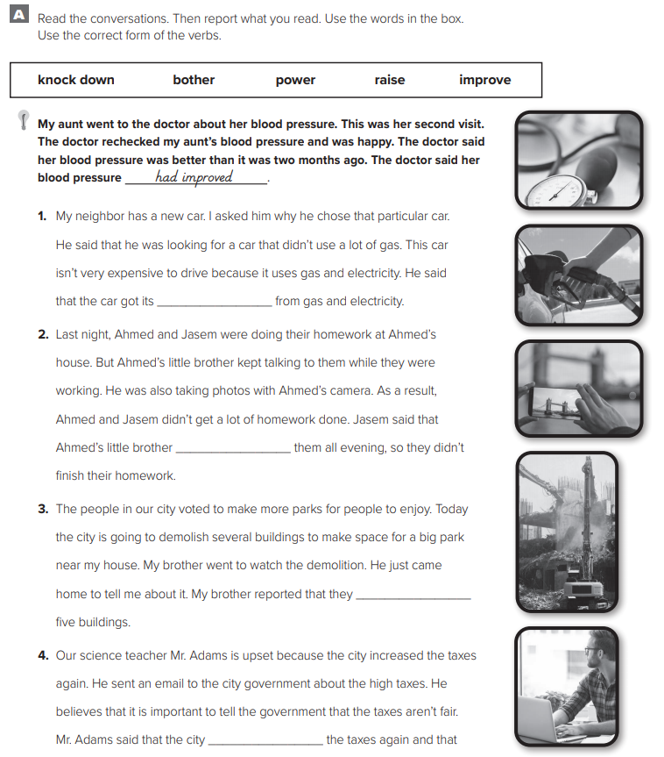
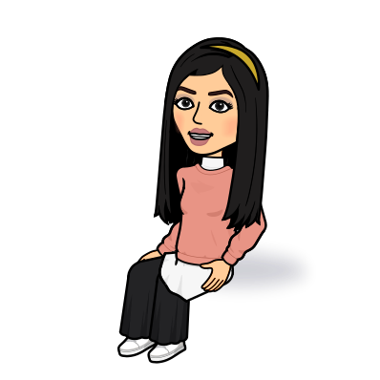
I love English
power
Let’s do the homework before starting the lesson.
Mega Goal 2 .. WB (57)
had bothered
had knocked down
had raised

Slide 5

I love English
Revising the previous lesson
bother
candidate
proof
universe
scan
Sorry incorrect answer ☹
Try again.
Next
Person trying to be elected
Evidence
Make the effort
Get an image with a computer
All space, including all the stars and planets.

Slide 6

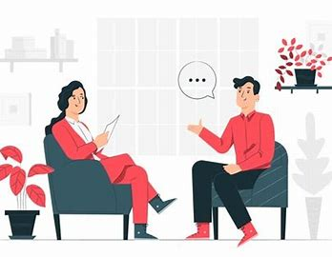


I love English
Mega Goal 2
Unit 5
(What They Said)
Grammar
Thursday
19/8/1442

Slide 7

I love English
Lesson Objectives
Students will be able to:
Report a speech in the correct tense.
Use the correct tense to report a question.
Change pronouns/ adverbs of time correctly in reported speech.
Replace the word "say" with suitable words.

Slide 8
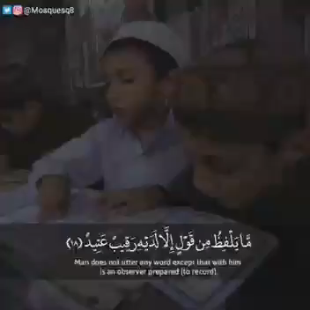


Slide 9
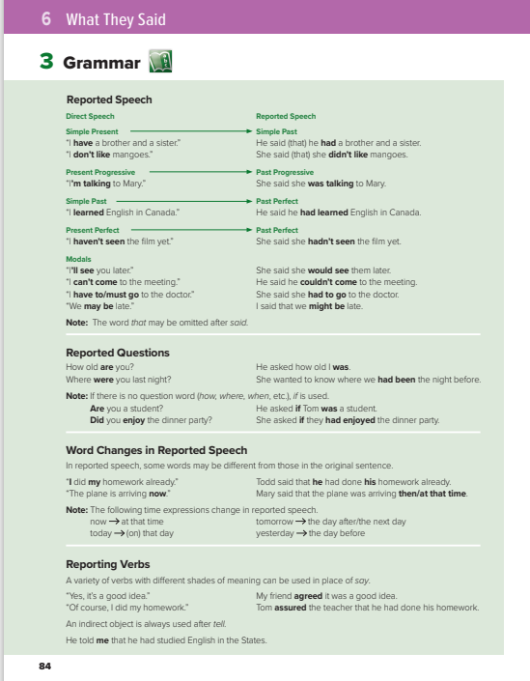

I love English
Open your Student’s book page: 84

Slide 10
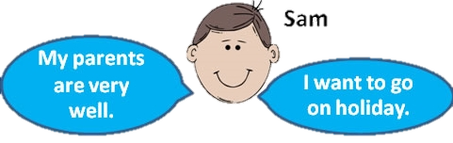

Reported Speech
Use it when we are telling someone what another person said or thought, but do not use their exact words.
e.g.
Sam said (that) his parents were very well.
He said (that) he wanted to go on holiday.
NOTES
Question marks are not used in reported speech.
Verb tenses, pronouns and some “time“ and “place“ words may change because of the time, place and speaker may be different.
When we report a statement, we use reported verbs such as say, tell, explain, inform, answer often followed by ( that ) .

Slide 11
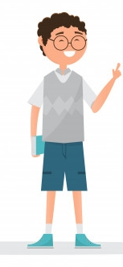

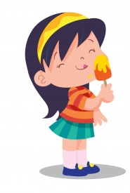
Simple Present
Simple Past
What did she say?
She said (that) she liked ice cream.
I like ice cream.

Slide 12

Present Progressive
Past Progressive
What did he say?
He said he was waiting for his friend.
I’m waiting for my friend.

Slide 13
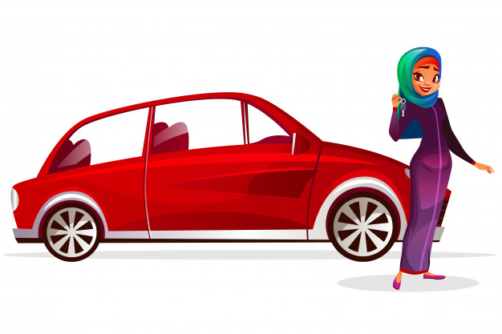
Simple Past
Past Perfect
What did she say?
She said she had bought a car.
I bought a car.

Slide 14
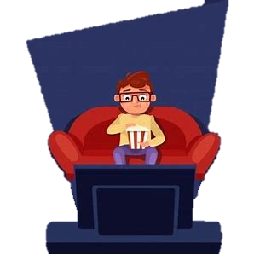
Present Perfect
Past Perfect
What did he say?
He said he had seen the film before.
I have seen the film before.

Slide 15

Modals
What did he say?
He said he could speak six languages.
I can speak six languages.

Slide 16
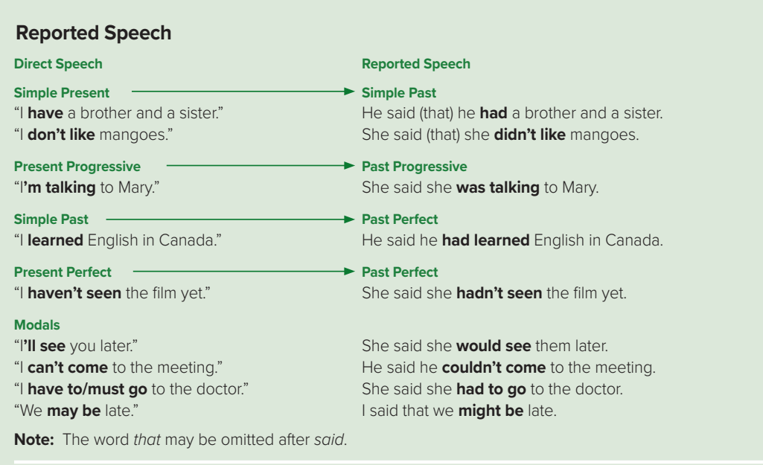

Slide 17
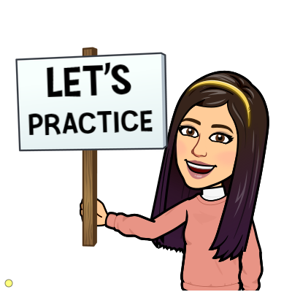

Interactive Worksheet
https://www.liveworksheets.com/xc720807nk

Slide 18
Reported Questions
❍ We usually introduce reported questions with the verb "ask"
He asked (me) if/whether... (Yes/No questions)
He asked (me) why/when/where/what/how... (Wh Questions)
e.g.
❍ We may need to change pronouns and tense (backshift) as well as time and place in reported questions.
❍ We also need to change the word order. After we report a question, it is no longer a question, no question marks are used. The word order is like that of a normal statement (subject-verb-object).
e.g.
how
was.
He asked “How old is she?”
old
she
He asked

Slide 19

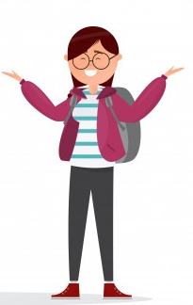
Yes/No Questions
We introduce reported YES/NO questions with ask + if
What did she say?
What did she say?
Are you living here?
Do you have a mobile phone?
She asked if I was living here.
She asked if I had a mobile phone.
Yes, I am.
Yes, I have.
NOTES
The reported question has no auxiliary "do".

Slide 20
Wh Questions
We introduce reported Wh questions with ask + question word
What did she say?
Where do you live?
She asked where I lived.
I live here.

Slide 21
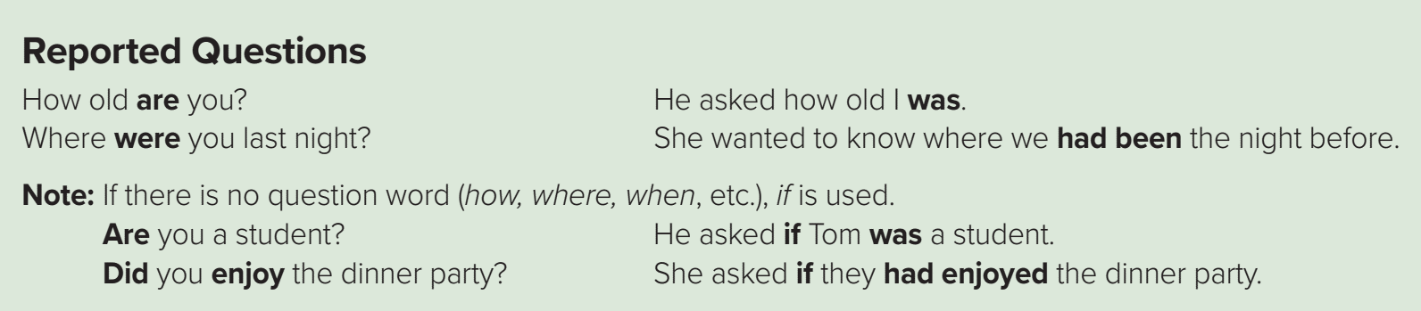

Slide 22
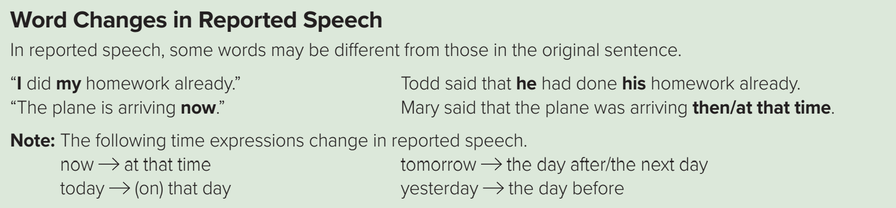
Personal pronouns changes
Possessive pronouns changes
I
He, She
my
his, her
You
I, he, she, we, they
Your
my, his, her, our, their
we
they
our
their
me
him, her
mine
his, hers
you
him, her, us, them
yours
mine, his, hers, ours, theirs
us
them
ours
theirs

Slide 23

https://wordwall.net/resource/13714917

Slide 24
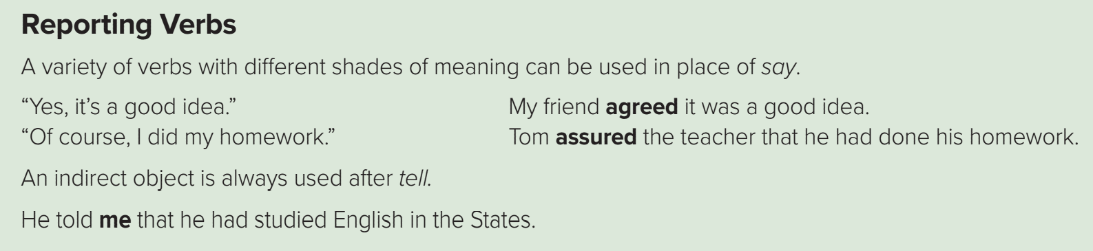

Slide 25

https://wordwall.net/resource/13716404

Slide 26
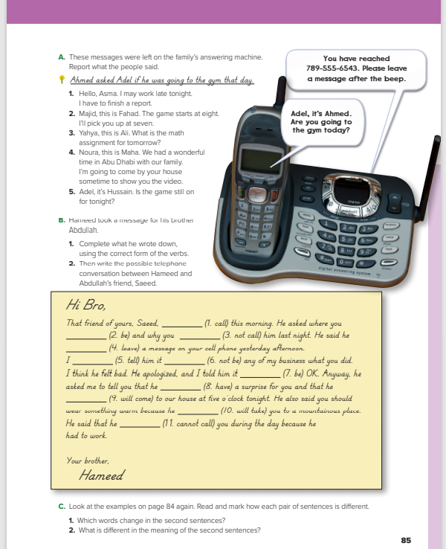
I love English
Open your Student’s book page: 85

Slide 27
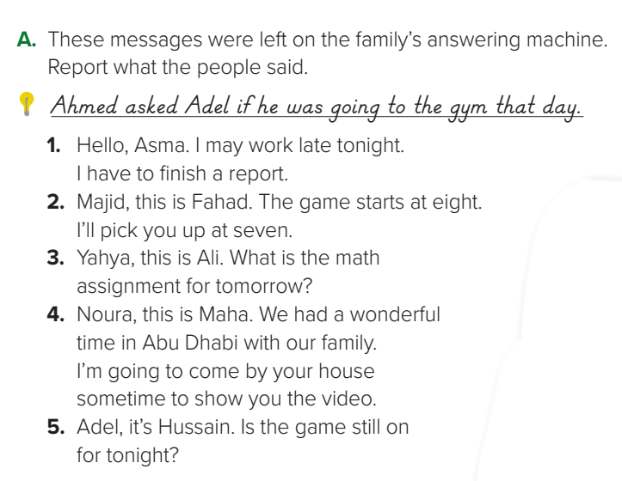
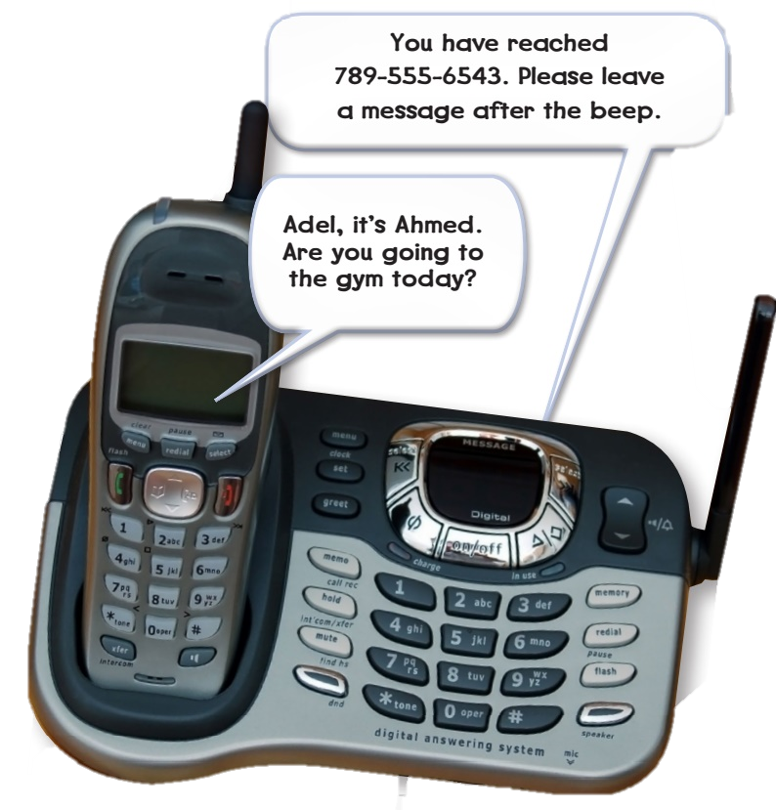
1- He said that he might work late that night and that he had to finish a report.
2- Fahad told Majid that the game started at eight and that he would pick him up at seven.
3- Ali asked Yahya what the math assignment for the next day was.
4- Maha told Noura that she had had a wonderful time in Abu Dhabi. She said that she was going to come by Noura’s house to show her the video.
5- Hussain asked Adel if the game was still on for that night.

Slide 28
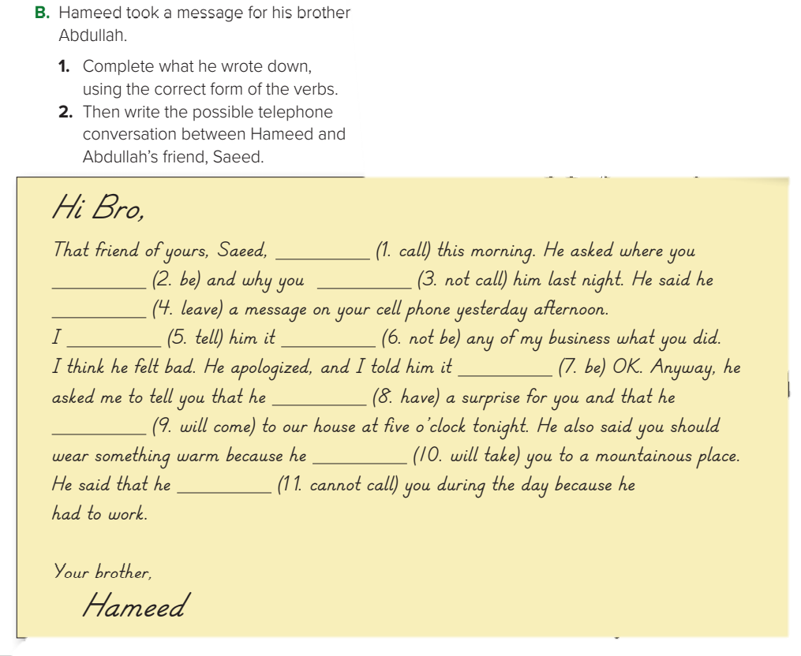
could
were
didn’t call/
hadn’t call
left/ had left
told
wasn’t
was
had
would come
would take
couldn’t call

Slide 29
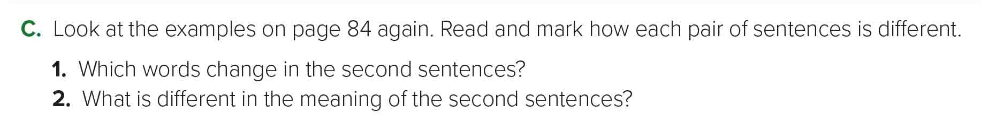

Slide 30


I love English

Slide 31




Homework
I love English
Work Book: Page 58, C

Slide 32
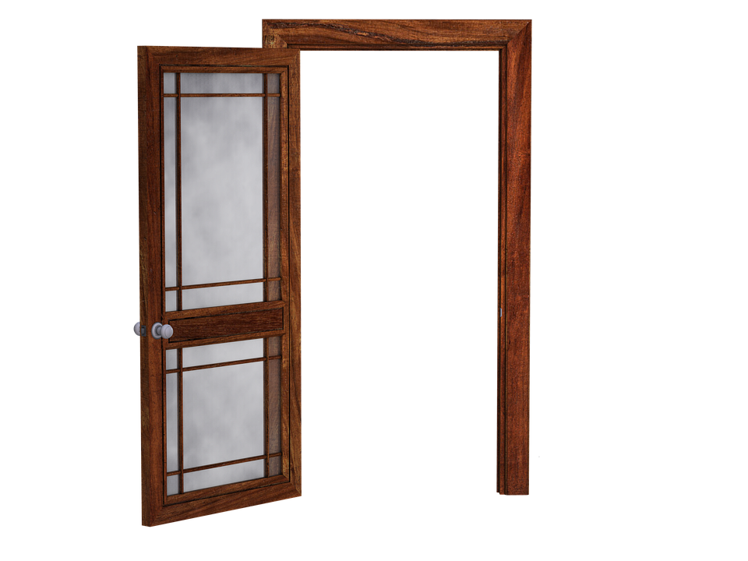
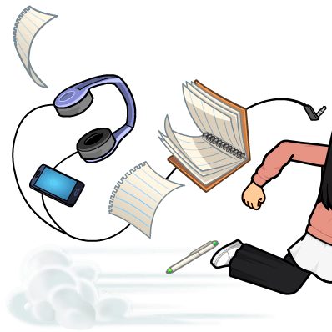
Homework
Work Book: Page 58, C

Slide 33
Homework
Work Book: Page 58, C

Slide 34
Homework
Work Book: Page 58, C

Slide 35
Homework
Work Book: Page 58, C

Slide 36
Homework
Work Book: Page 58, C

Slide 37

Homework
Work Book: Page 58, C

