Slide 1


Hello My lovely students
I’m your teacher
Hanan AlShobaily

Slide 2




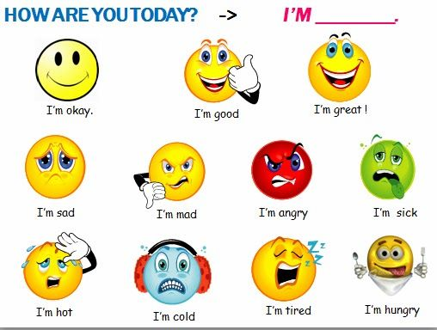
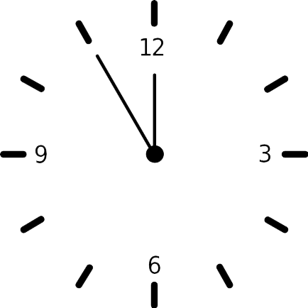



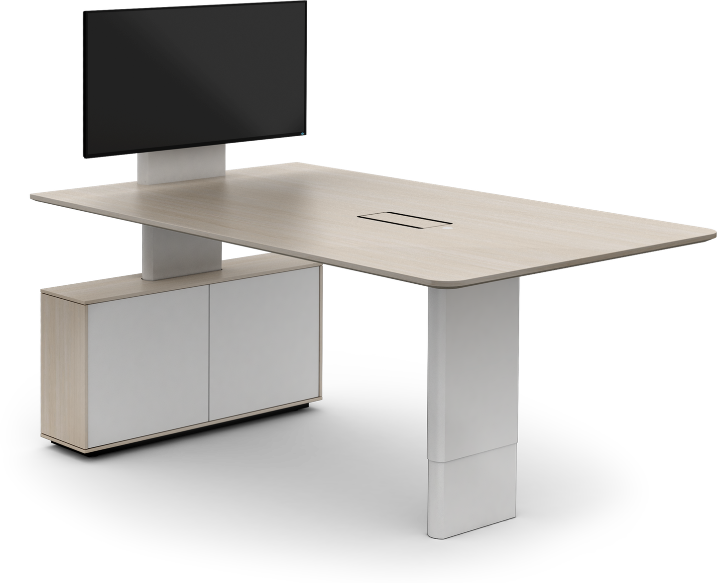








I love English

Slide 3
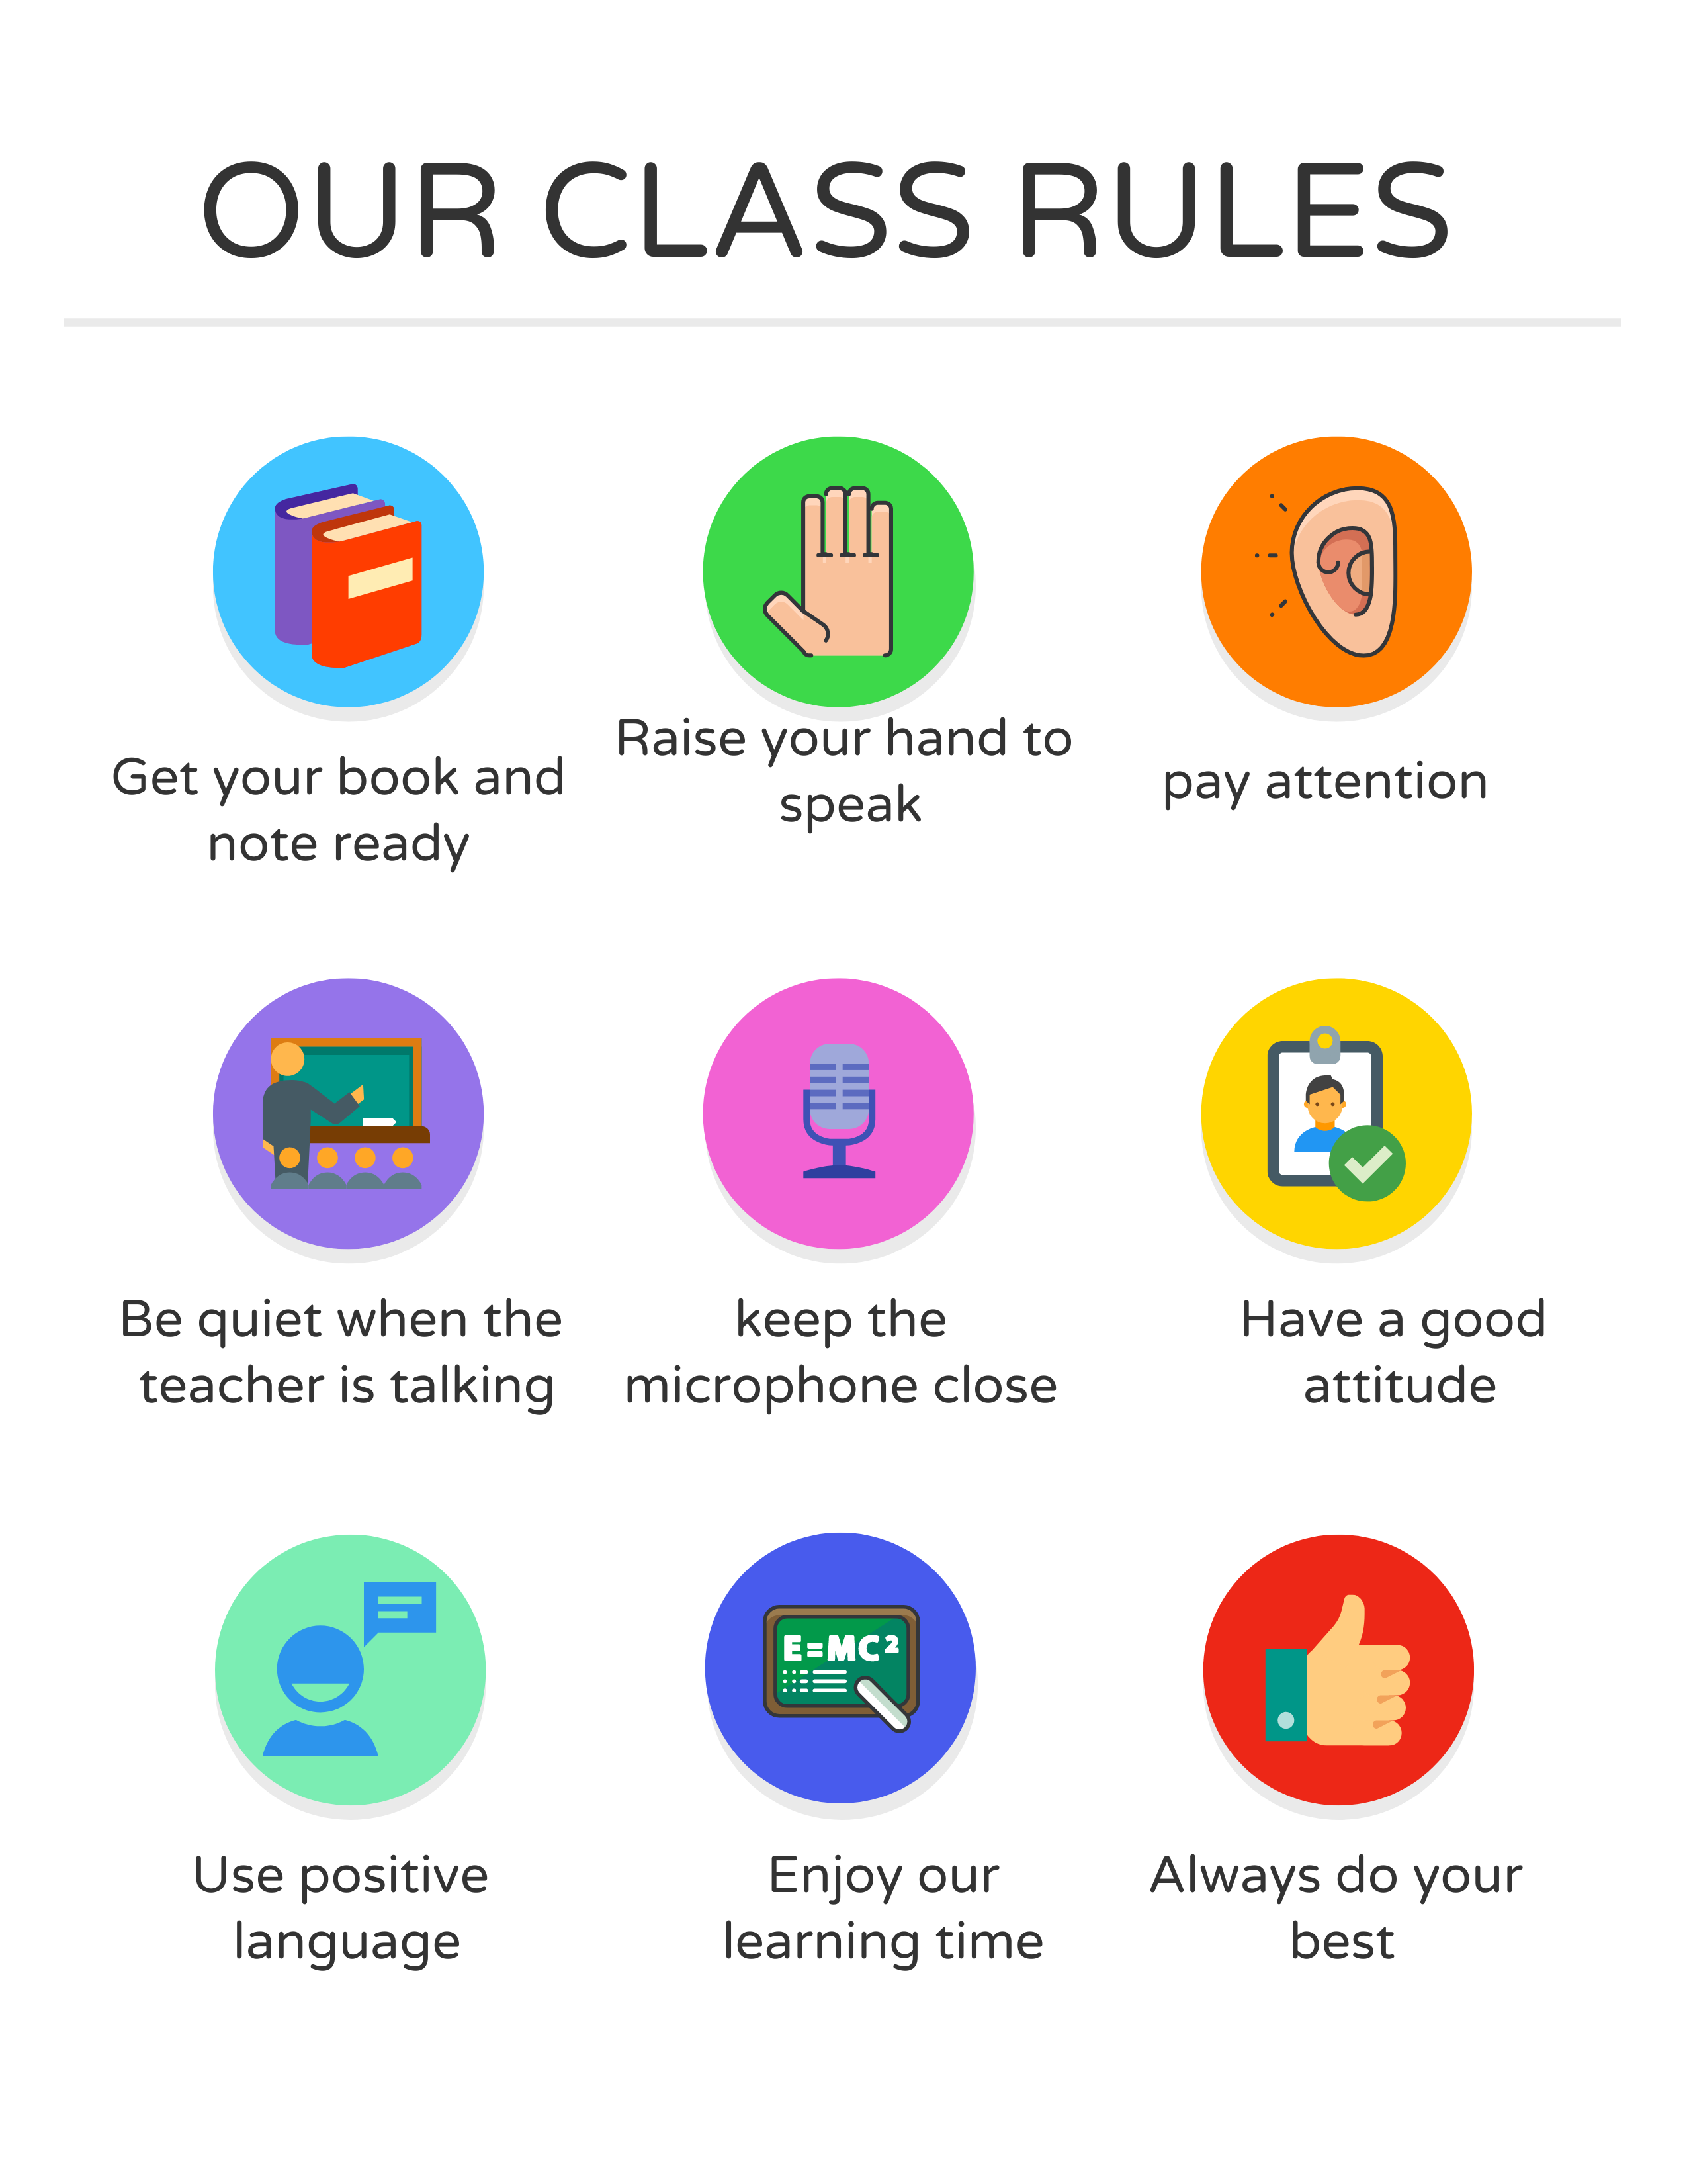

I love English

Slide 4
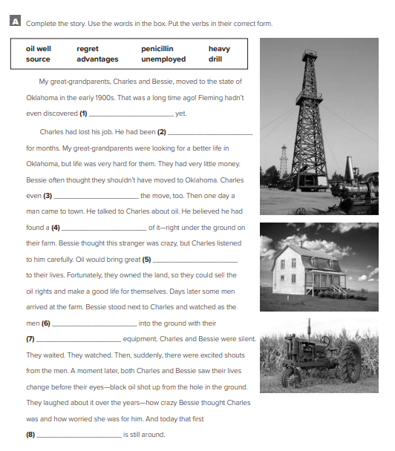

I love English
penicillin
unemployed
Let’s do the homework before starting the lesson.
regret
Mega Goal 2 .. WB (47)
source
advantages
drill
heavy
oil well

Slide 5

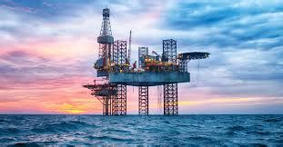




I love English
Revising the previous lesson
Sorry incorrect answer ☹
Try again.
Next
airplane
oil
computer
wheel
Light bulb

Slide 6

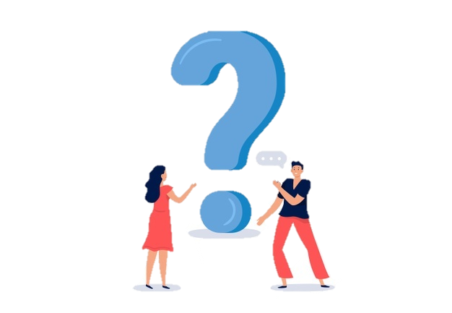
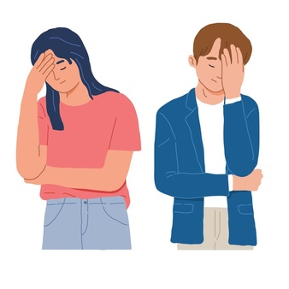
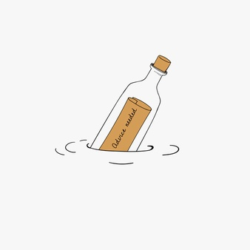

I love English
Mega Goal 2
Unit 5
(If It Hadn’t Happened)
Grammar
Monday
9/8/1442

Slide 7

I love English
Lesson Objectives
Students will be able to:
Express regret with should have + past participle.
Correlate a situation and result.
Originate a regret according to a given situation.
Write about a situation in the past using the past perfect + would.
Form a sentence about missing opportunity using if-clause + could/would

Slide 8
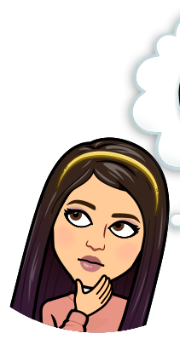
Warm Up
1
❍ You should study hard.
Advice
Read the two sentences, then tell me what’s the difference between them?
Infinitive
2
❍ You should have studied hard.
Regret
have + past participle

Slide 9


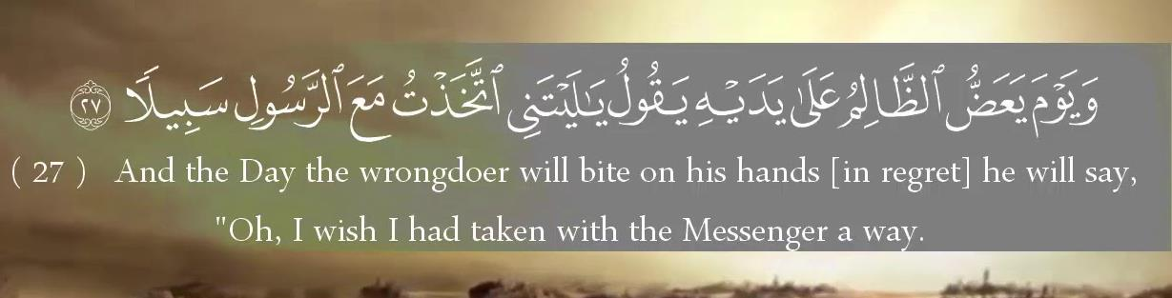
“Regret” example in Quran

Slide 10
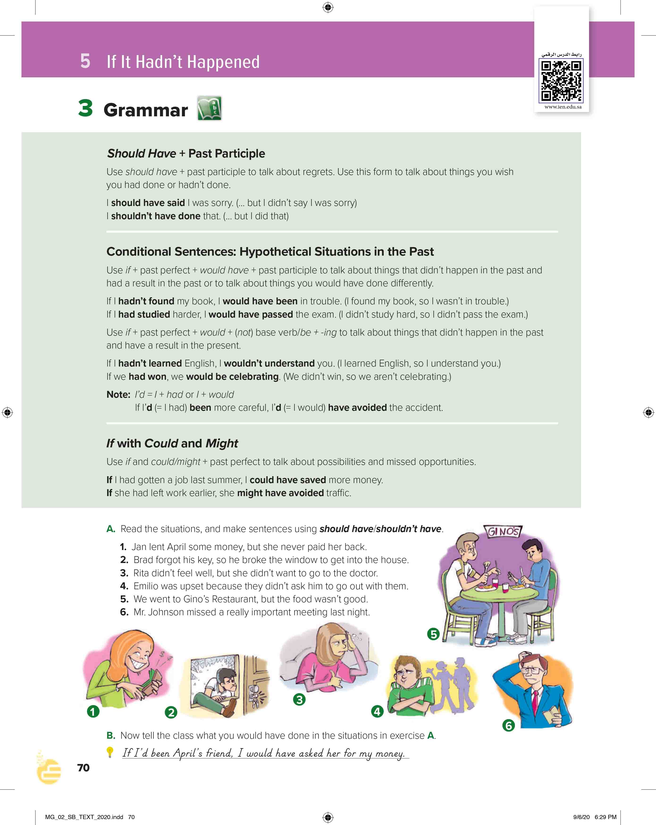

I love English
Open your Student’s book page: 70

Slide 11
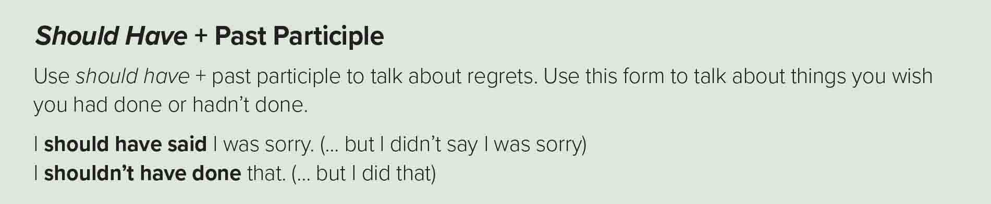

Should have (Positive)
Shouldn’t have (Negative)
Use it when you mean that something (in the past) was a good idea, but you didn’t do it.
Use it when you mean that something (in the past) wasn’t a good idea, but you did it anyway.
+
+
+
+
p.p
Form
Subject
should
have
+
p.p
Form
Subject
should
not
+
have
+
I should have gone to bed early.
I shouldn’t have eaten so much.
e.g.
e.g.
(I didn’t go to bed early and now I’m tired.)
(I did eat too much and I don’t feel good.)

Slide 12
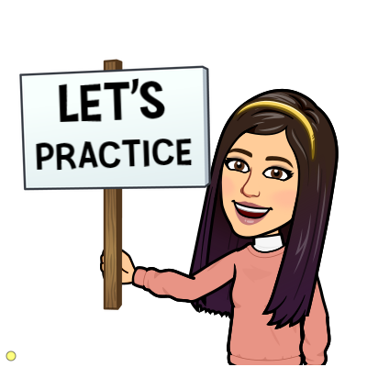

https://wordwall.net/resource/13047060

Slide 13
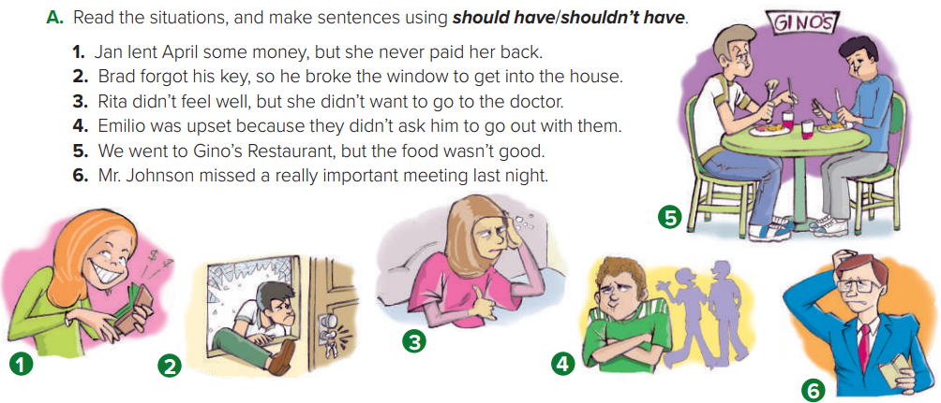
1- Jan shouldn’t have lent April the money.
2- Brad should have had an extra key.
3- Rita should have gone to the doctor.
4- They should have asked Emilio to go out with them.
5- We shouldn’t have gone to Gino’s Restaurant.
6- Mr. Johnson should have been at the meeting last night.

Slide 14
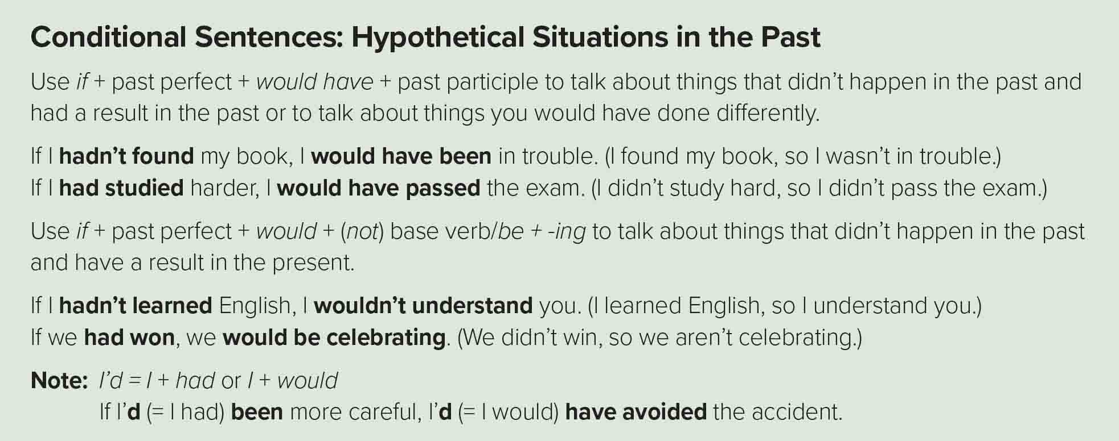

Slide 15

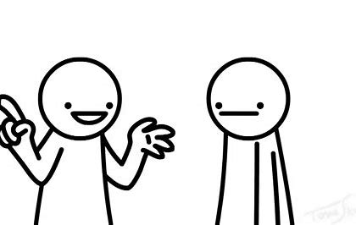
Conditional Sentences: Hypothetical Situations in the past
Use it to talk about things that didn’t happen in the past and had a result in the past or to talk about things you would have done differently.
If conditional
A result in the past
,
+
If
Past Perfect
would have
Form
+
+
p.p
e.g.
If I had studied harder, I would have passed my exam.
(I didn’t study hard, so I didn’t pass the exam.)
If you hadn’t lied to me before, I would have believed you.
(You lied to me, so I didn’t believe you.)
I would have believed you if you hadn’t lied to me before.

Slide 16

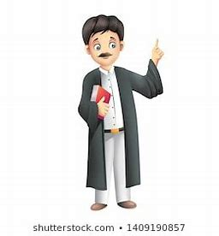
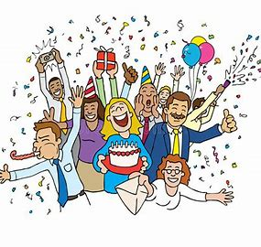
Conditional Sentences: Hypothetical Situations in the past
Use it to talk about things that didn’t happen in the past and have a result in the present.
If conditional
A result in the present
,
+
If
Past Perfect
would
+
Form
+
infinitive
,
+
If
Past Perfect
would
+
+
be + v-ing
If I hadn’t learned English, I wouldn’t understand you.
e.g.
(I learned English, so I understand you.)
If I had gone to university, I would be a lawyer now.
(I didn’t go to university, so I’m not a lawyer.)
If you had won, we would be celebrating.
(We didn’t win, so we aren’t celebrating.)

Slide 17
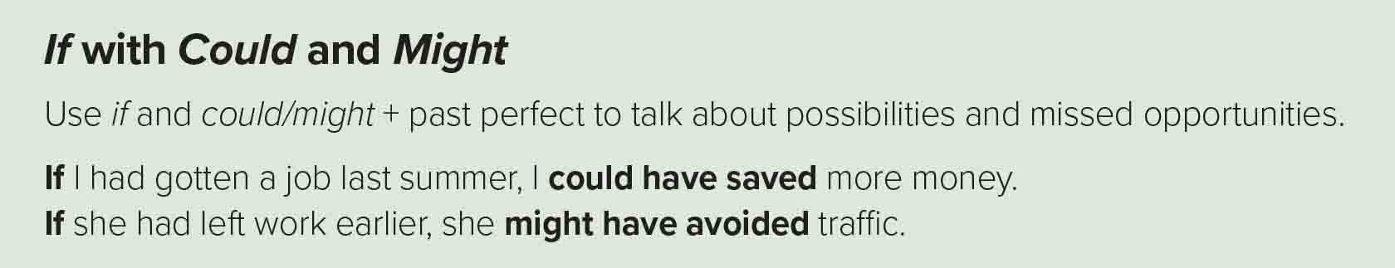
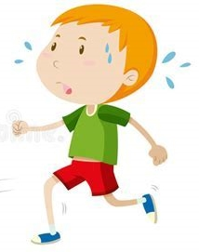

+
If
Past Perfect
might / could
Form
+
+
have
+
p.p
e.g.
If you hadn’t run slowly, you might have won the race.
Possibility
If you had won the prize, you could have been famous.
Ability

Slide 18
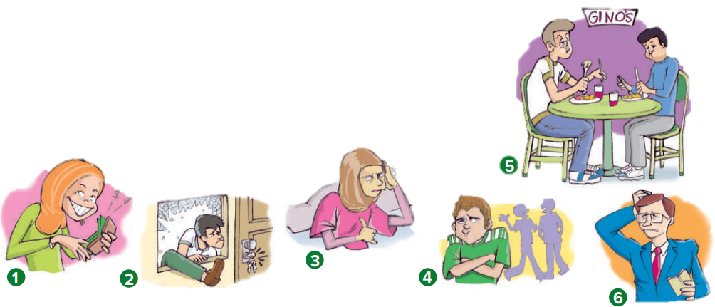
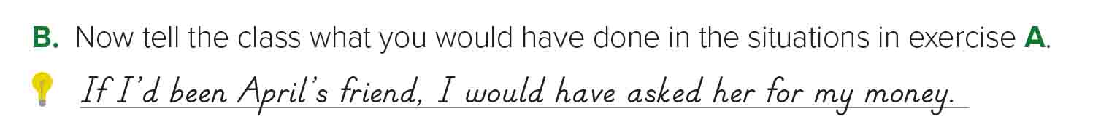

1- If I’d been April’s friend, I would have asked her for my money.
2- If I’d forgotten my key, I would have climbed in the window.
3- If I’d been sick, I would have gone to the doctor right away.
4- If I’d been Emilio, I would have been upset too.
5- If I’d gone out to eat, I would have gone to a French restaurant.
6- If I’d been Mr. Johnson, I would have gone to the meeting.

Slide 19

https://wordwall.net/resource/12872603

Slide 20
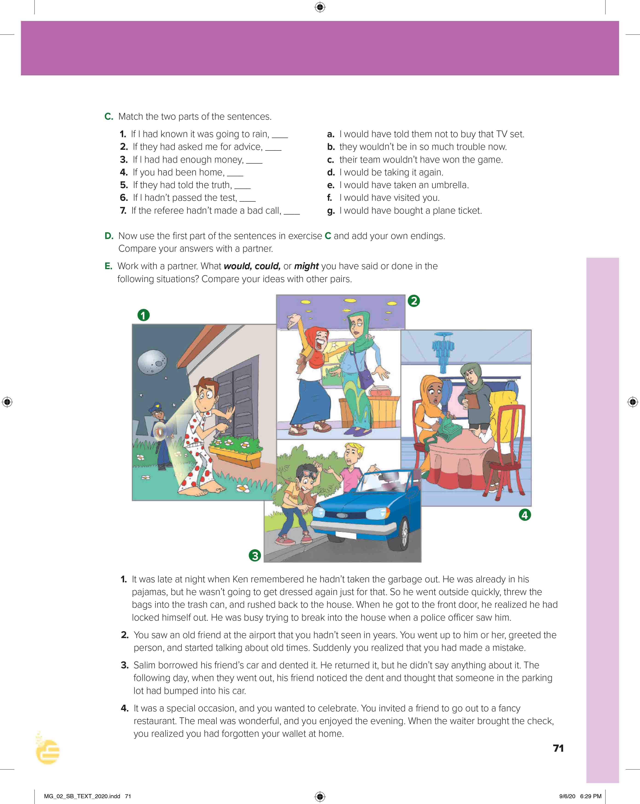
I love English
Open your Student’s book page: 71

Slide 21
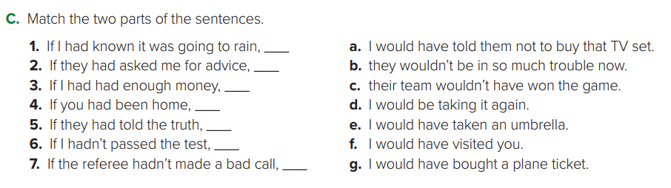
e
a
g
f
b
d
c

Slide 22
1- If I had known it was going to rain, I wouldn’t have gone to the beach.
2- If he had asked me for advice, I would have told him not to buy that TV set.
3- If I had had enough money, I would have gone to Spain last summer.
4- If you had been home, I would have shared the cookies with you.
5- If they had told the truth, their parents wouldn’t have grounded them.
6- If I hadn’t passed the test, my parents would have been upset.
7- If the referee hadn’t made a bad call, our team would have won the big game.

Slide 23
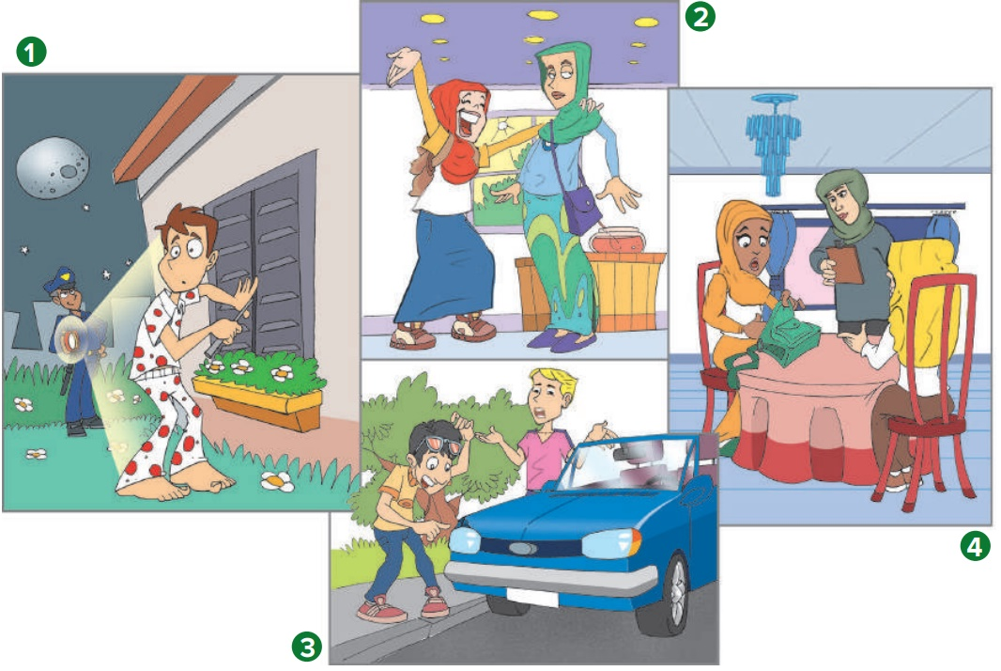
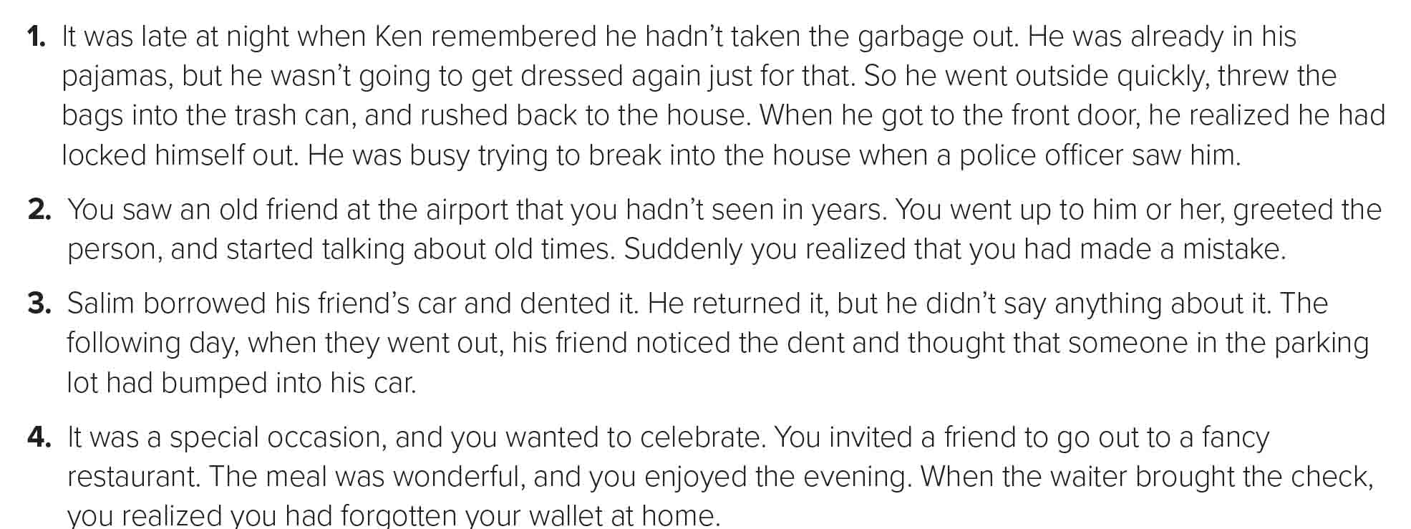

Slide 24
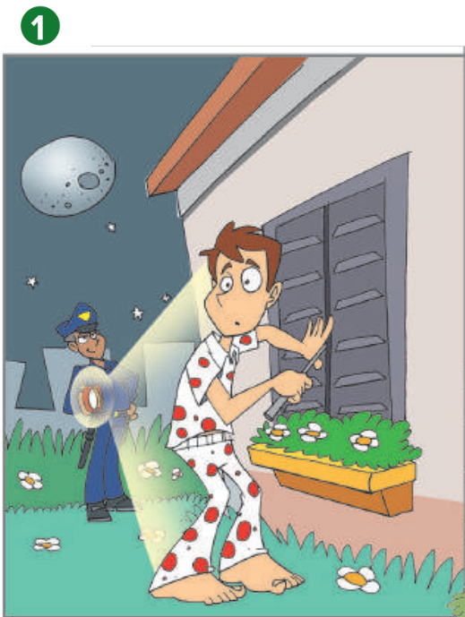
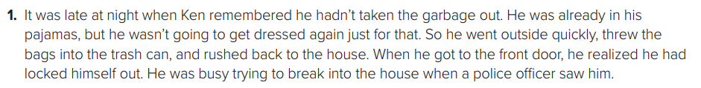
I would have taken my key if I had gone out at night.
I might have waited until morning to take out the garbage.
I would have explained the situation to the police officer.

Slide 25
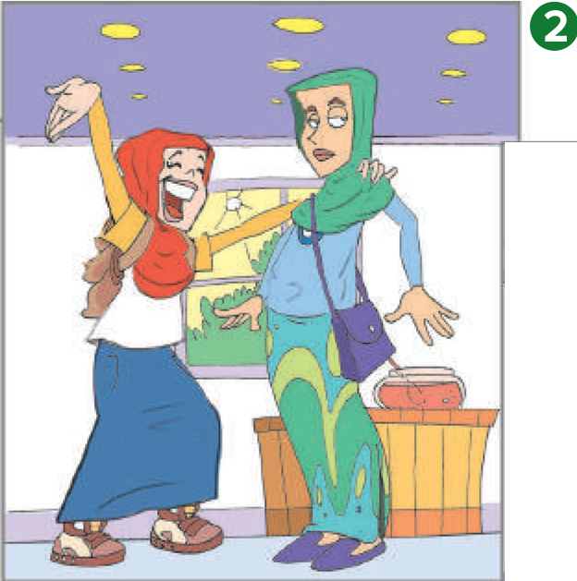
I would have apologized to the person.
I would have said that the person looked like a friend of mine.
I might have continued the conversation and introduced myself to the person.

Slide 26
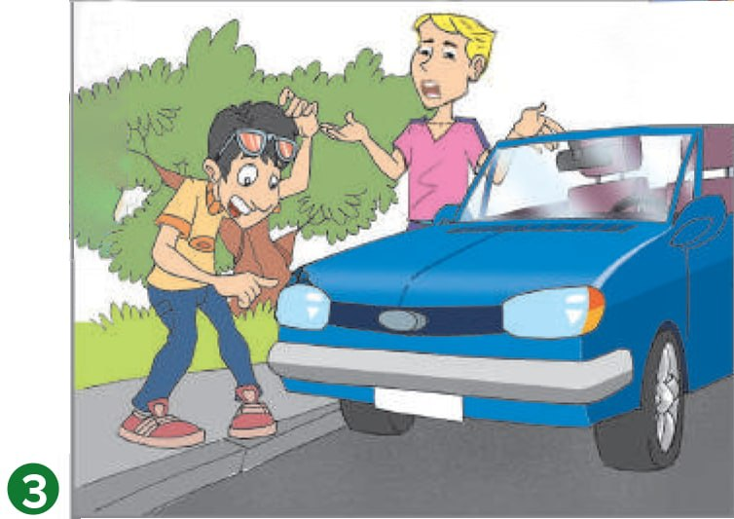
I would have told my friend the truth about the dent.
I might have had the dent fixed.

Slide 27
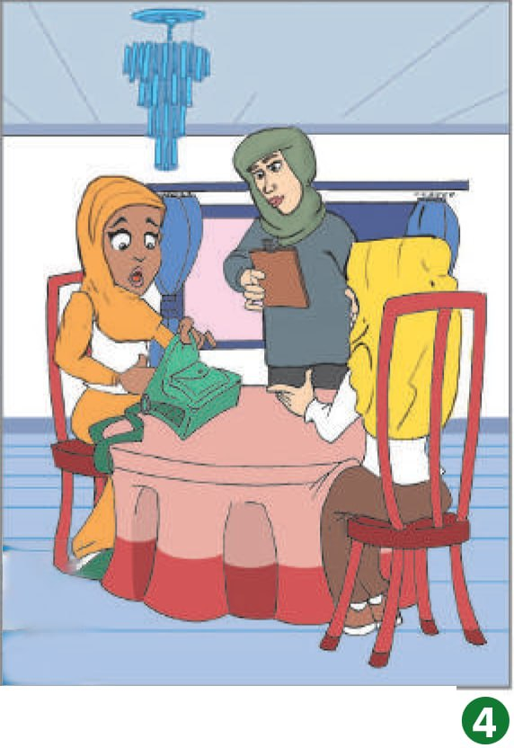
I would have explained the situation to my friend and asked her to pay.
I might have asked the restaurant if it accepted checks.
I could have called my brother and asked him to bring my wallet to the restaurant.

Slide 28



Learn from your mistakes because if you don’t learn from your mistakes, then they become regrets.

Slide 29

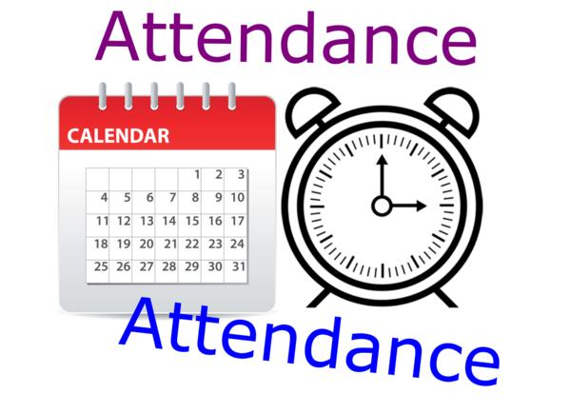
I love English

Slide 30




Homework
I love English
Work Book: Page 50

Slide 31
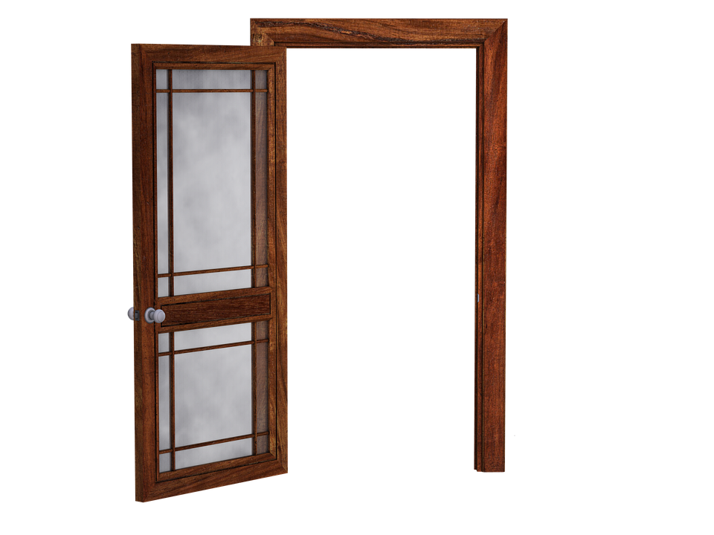
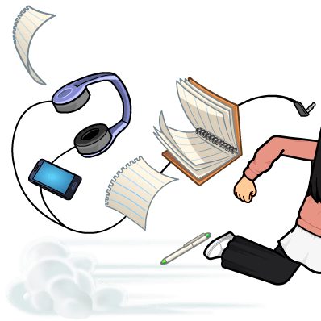
Homework
Work Book: Page 50

Slide 32
Homework
Work Book: Page 50

Slide 33
Homework
Work Book: Page 50

Slide 34
Homework
Work Book: Page 50

Slide 35
Homework
Work Book: Page 50

Slide 36

Homework
Work Book: Page 50

