Slide 1
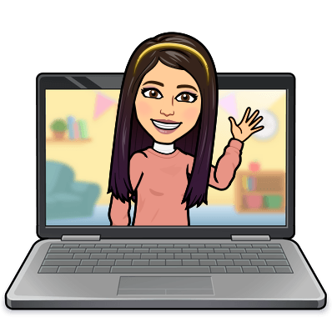

Hello My lovely students
I’m your teacher
Hanan AlShobaily

Slide 2
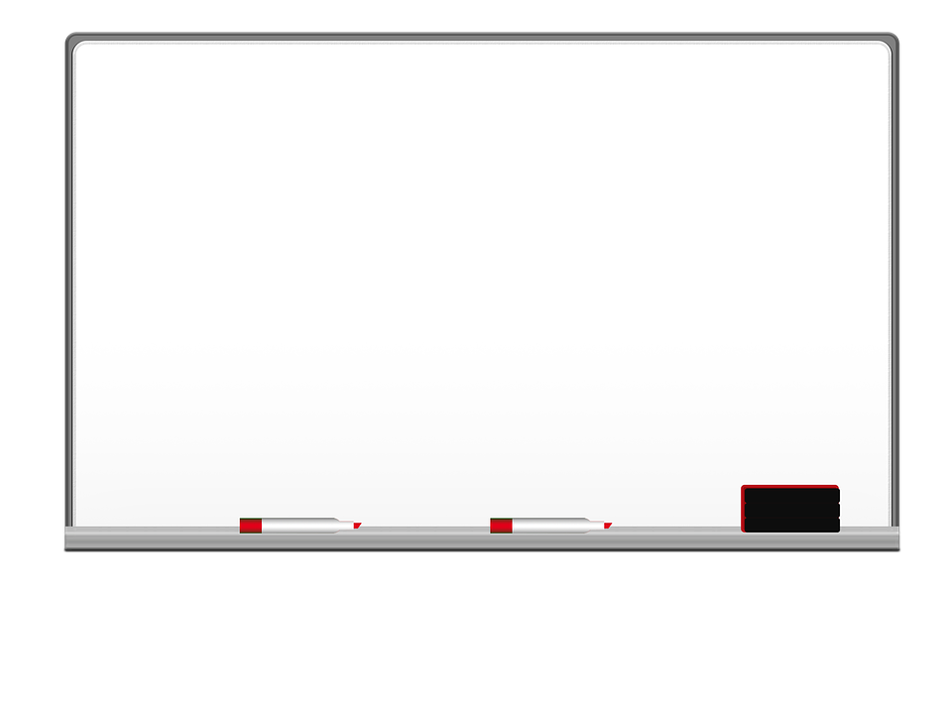
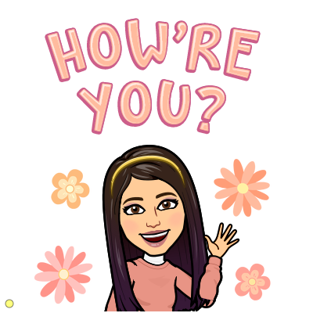
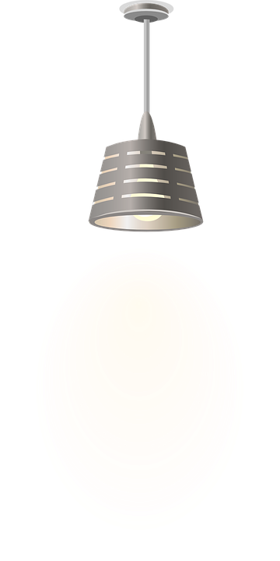

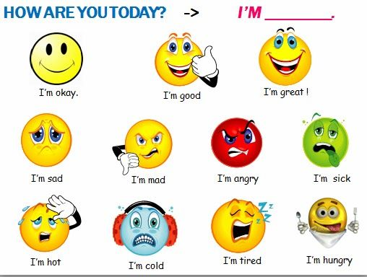
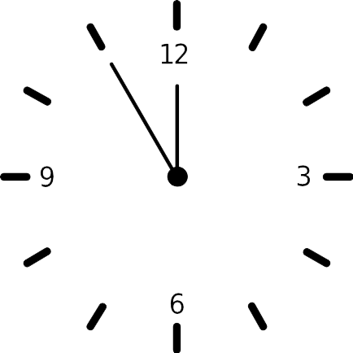



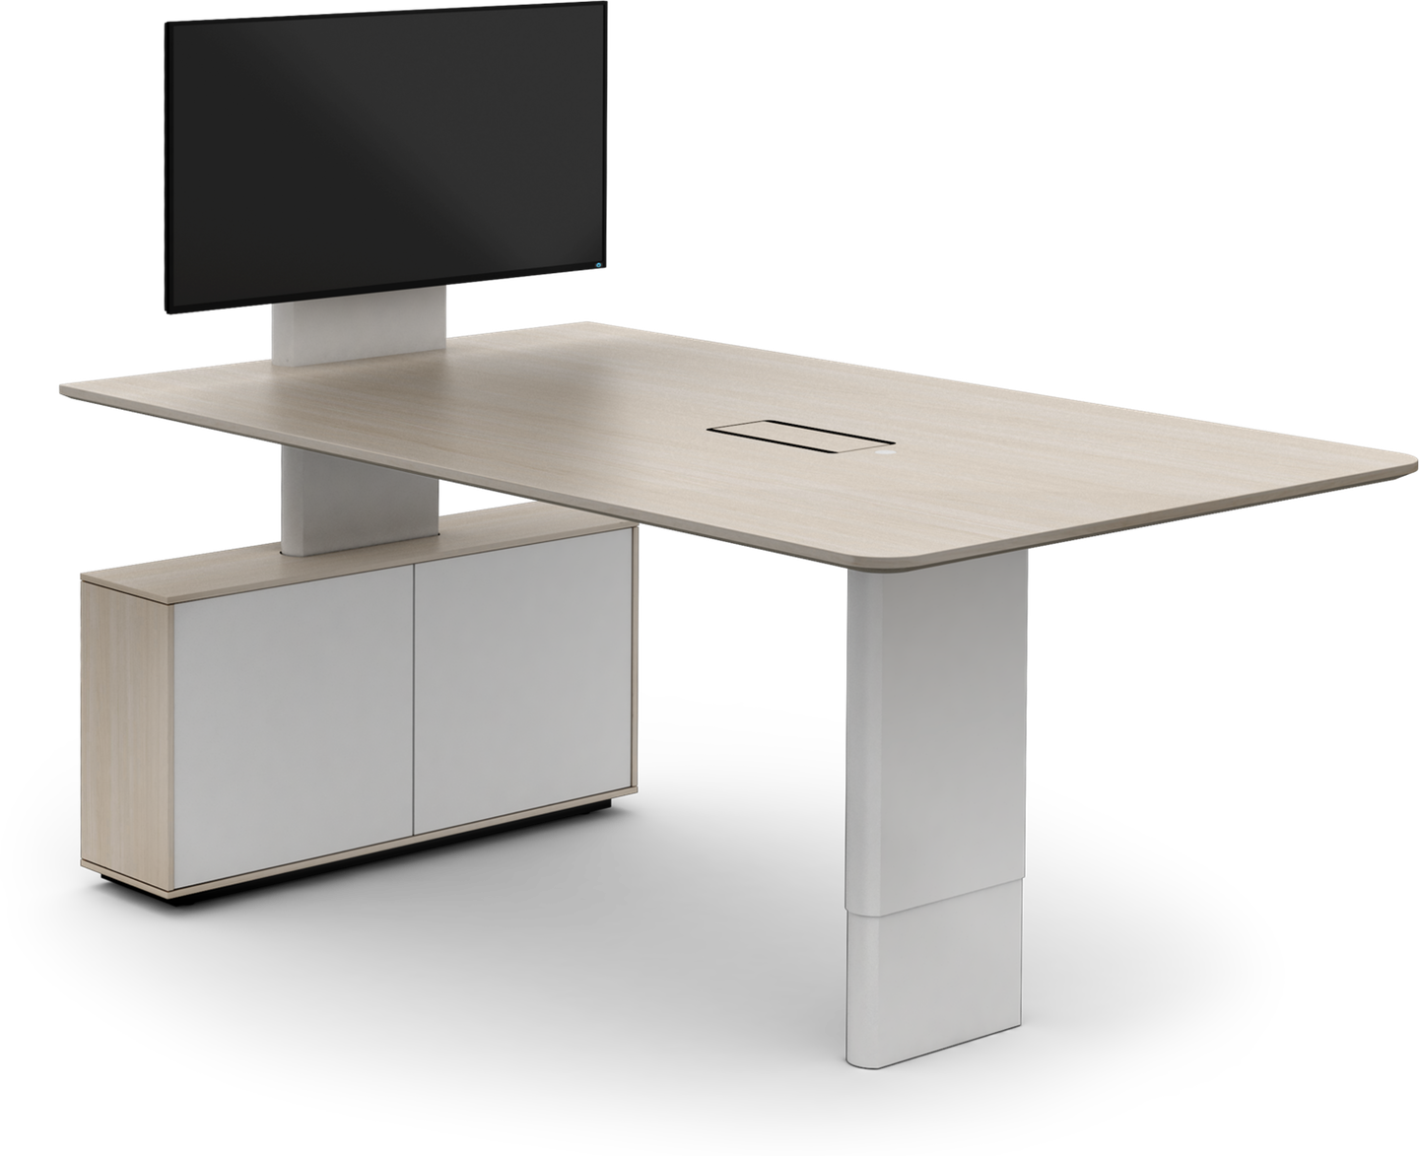
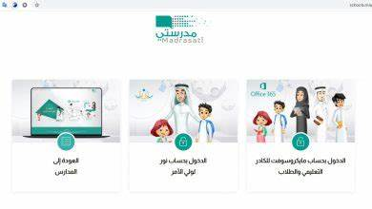



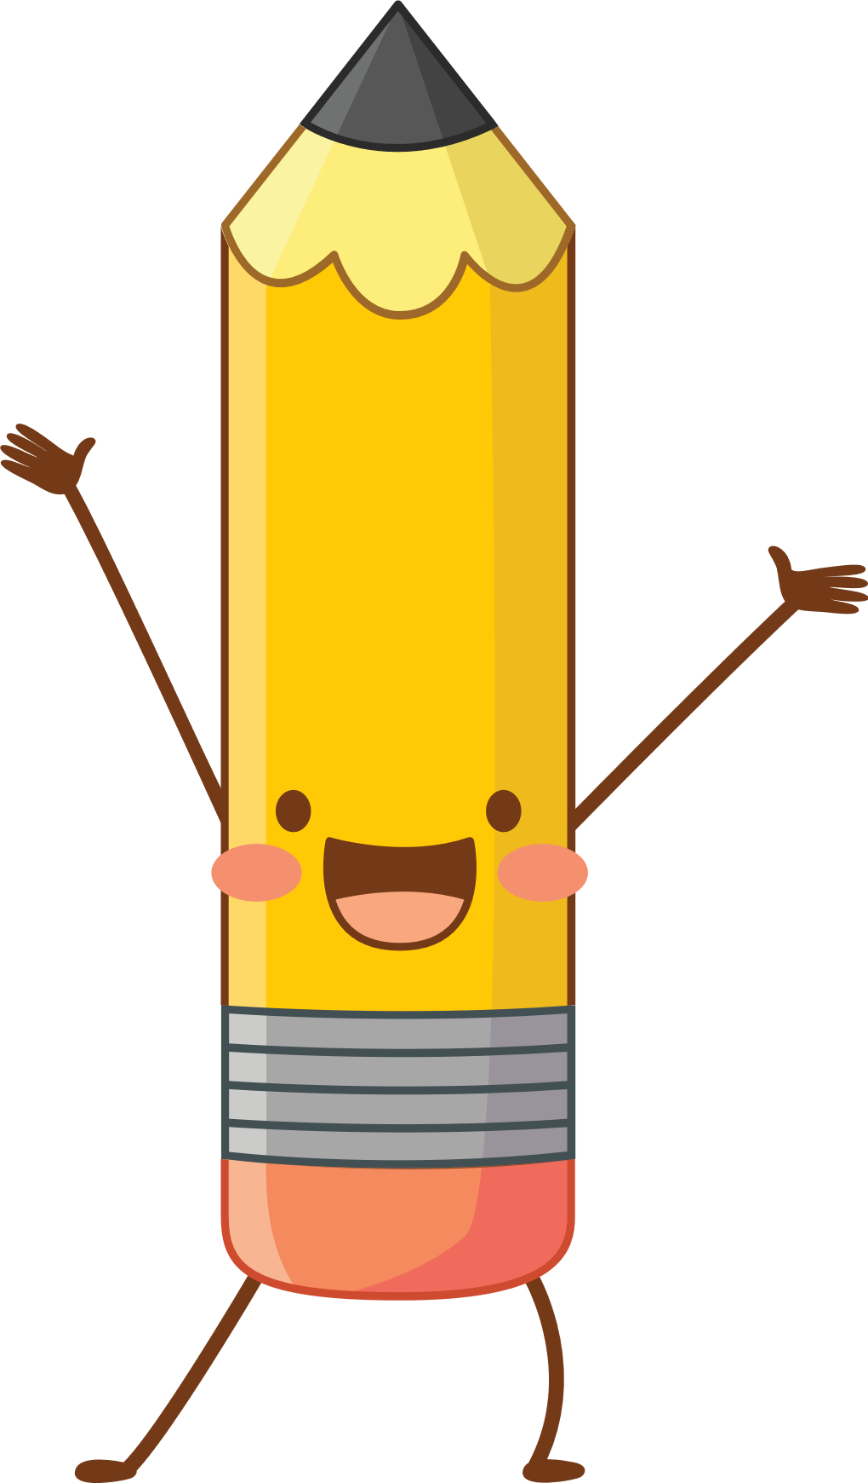
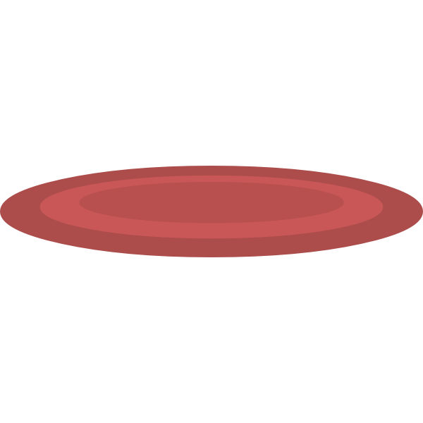


I love English

Slide 3
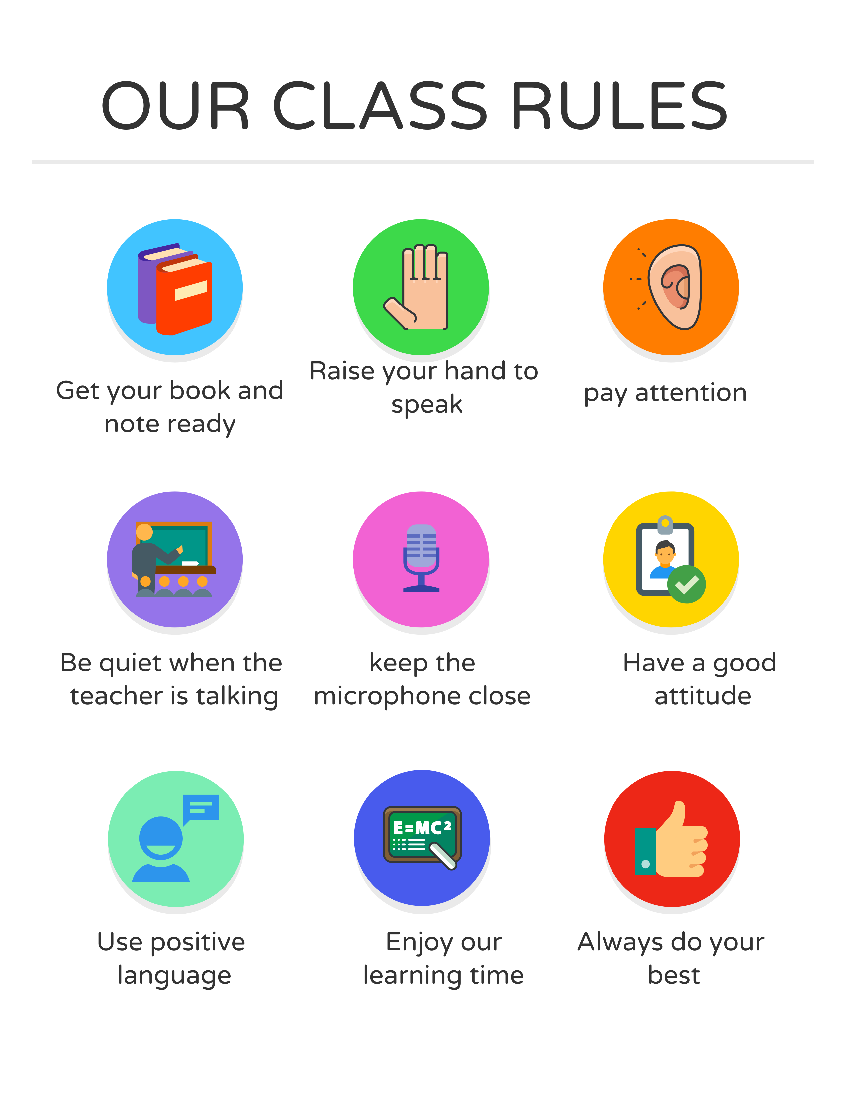
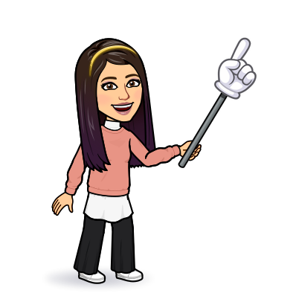
I love English

Slide 4




Let’s revise the previous lesson
https://wordwall.net/resource/13540562

Slide 5
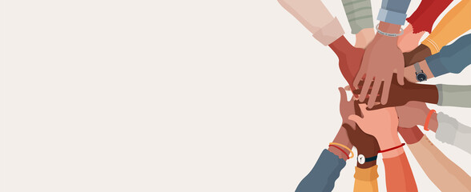

I love English
Mega Goal 2
Unit 5
(If It Hadn’t Happened)
Project
Tuesday
17/8/1442

Slide 6
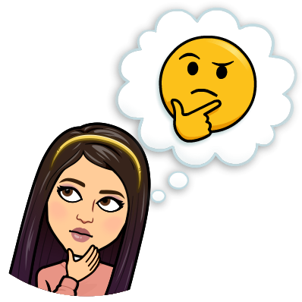



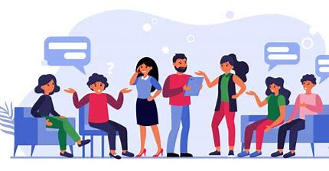

Warm Up
How do people gather information about a problem
Books
Internet
documents
people
Previous researches

Slide 7

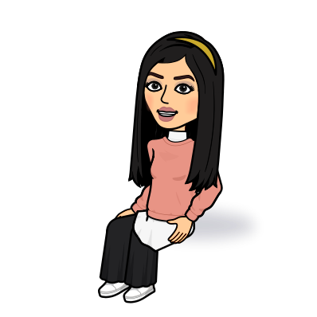
I love English
Lesson Objectives
Students will be able to:
Form a survey about most common regrets.
Write the results of a survey about regrets.
Revise Unit 5.

Slide 8
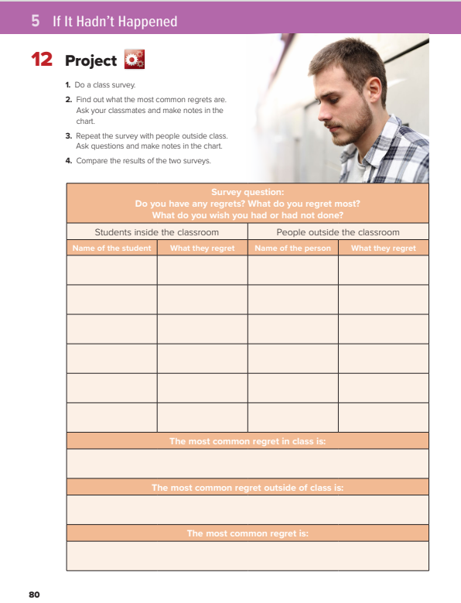
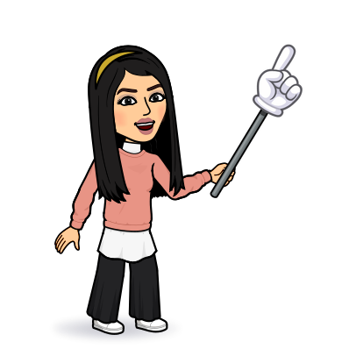
I love English
Open your Student’s book page: 80

Slide 9
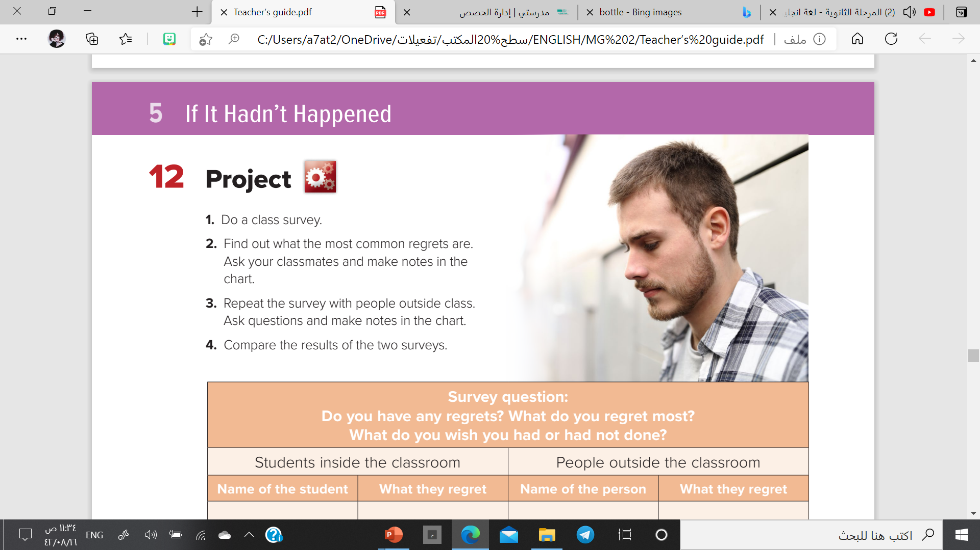

Slide 10
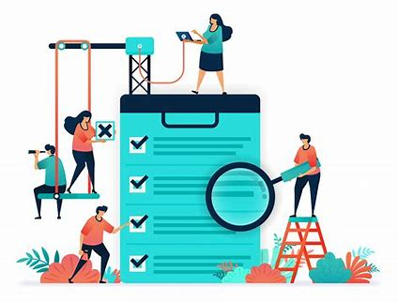
What’s a survey?
A survey is a method of gathering information from a sample of people,
the generalize the results to a large population.

Slide 11

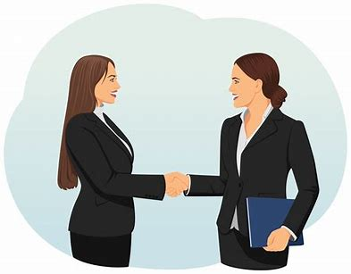
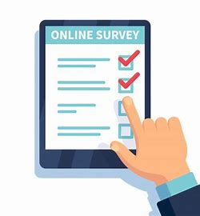
There are three modes of survey data collection that are commonly used
Face-to-face survey
Telephone survey
Online
survey

Slide 12
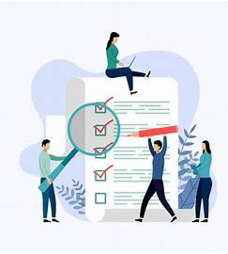
How to design a survey?
1
Define your goal
2
Identify who you’ll be surveying
3
Design and pre-test your survey
4
Select a sample to survey
5
Send out your survey
6
Analyze your data

Slide 13
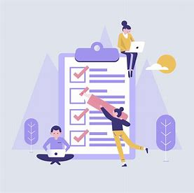
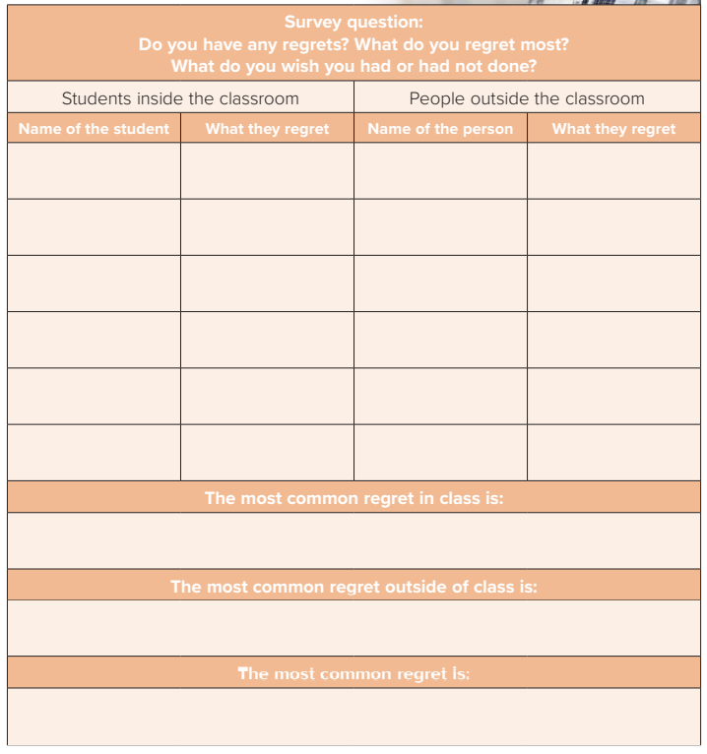
Amal
I chose a bad major
Khalid
I regret fighting with my friend, I lost him
Maha
I regret I didn’t study hard.
School problems
Choose the wrong way in life
Not paying attention at school

Slide 14

6
Analyze your data

Slide 15
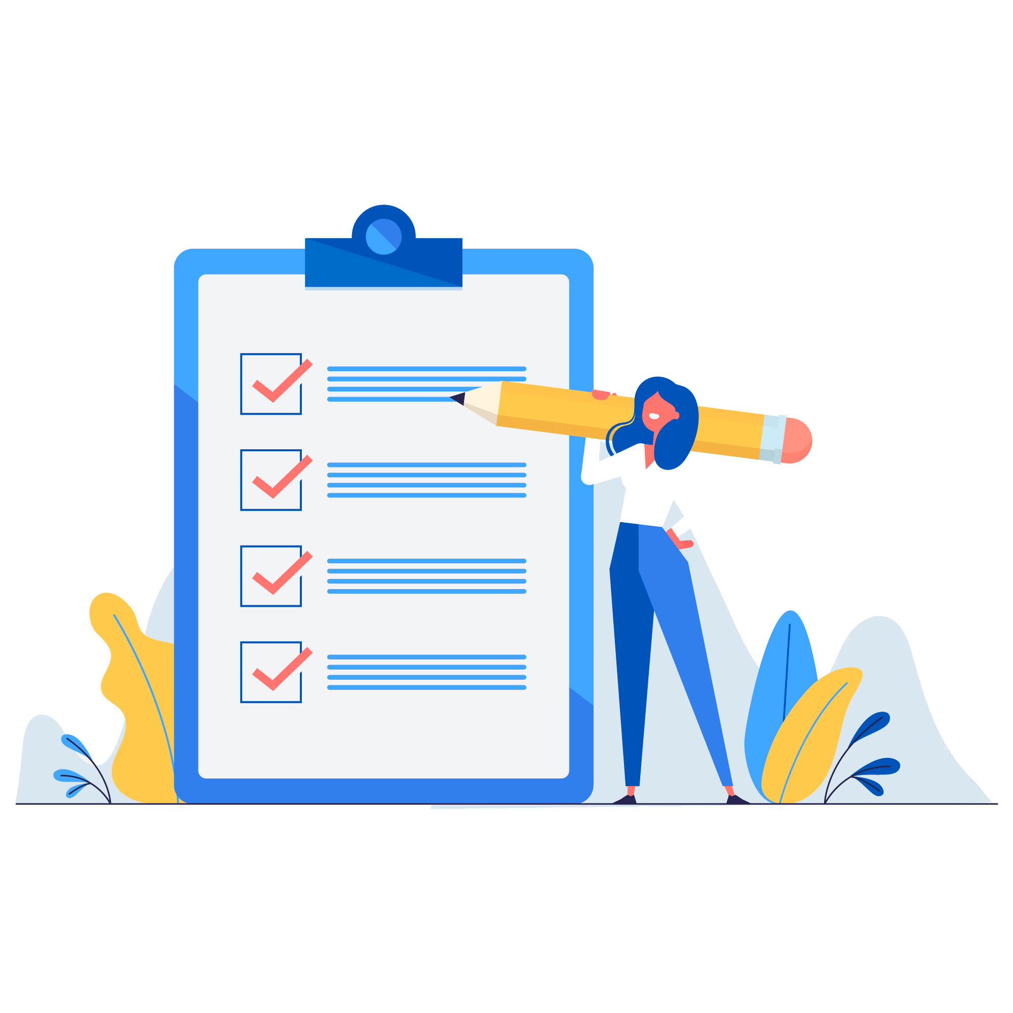
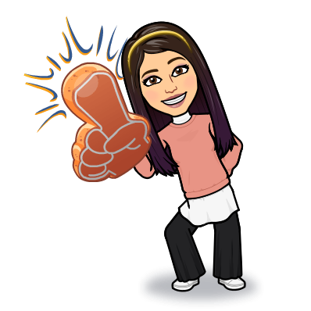
Now design your own survey
Send it out and share your results with your family.

Slide 16


REVISION
UNIT 5

Slide 17
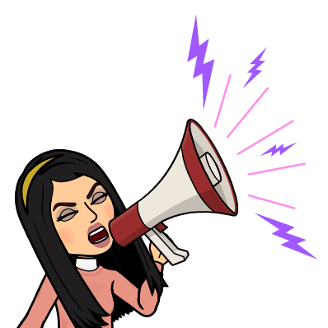
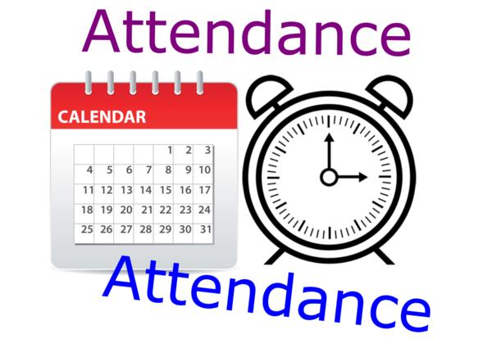
I love English

Slide 18
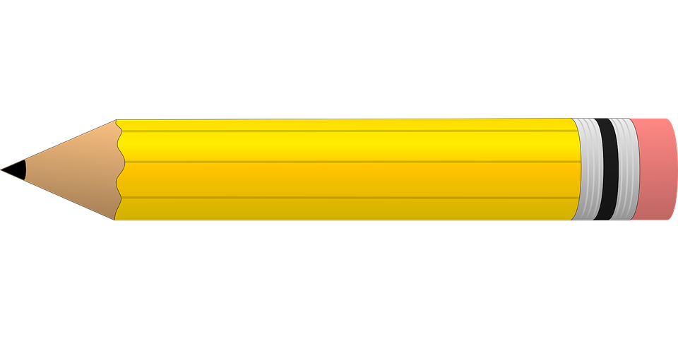


Homework
I love English

Slide 19
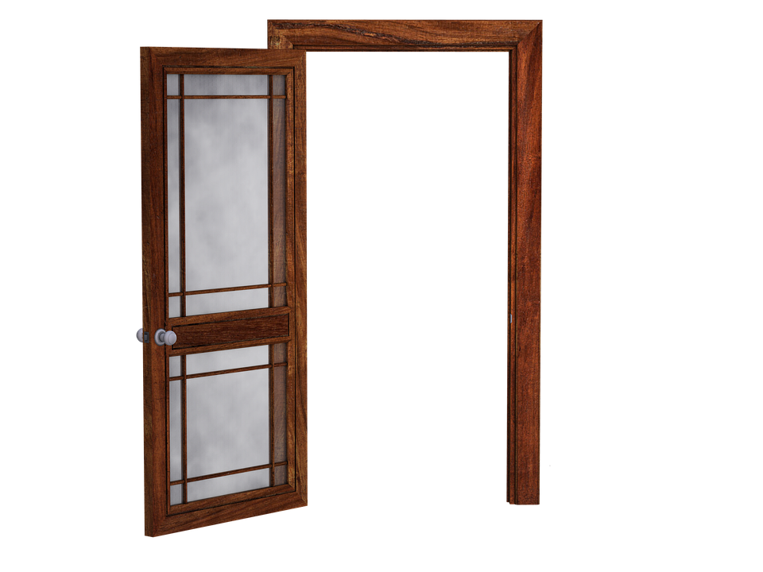
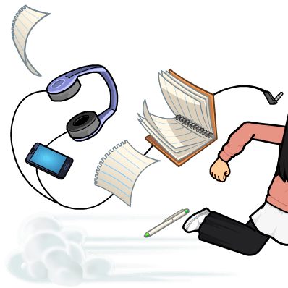
Homework

Slide 20
Homework

Slide 21
Homework

Slide 22
Homework

Slide 23
Homework

Slide 24

Homework

