Slide 1
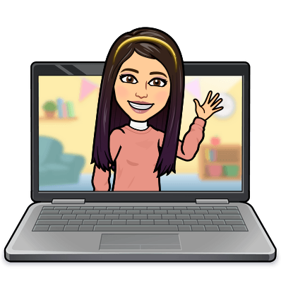

Hello My lovely students
I’m your teacher
Hanan AlShobaily

Slide 2
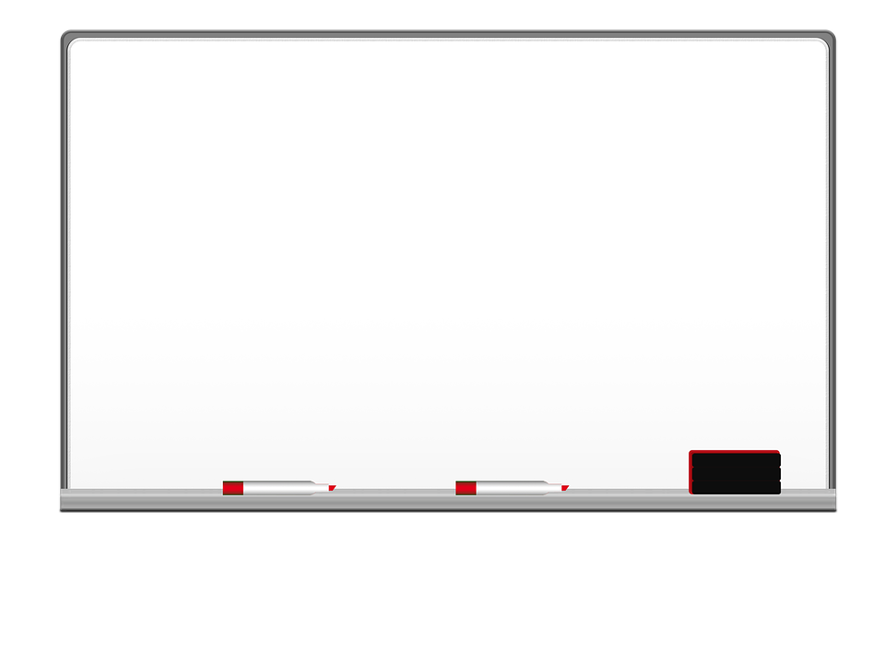
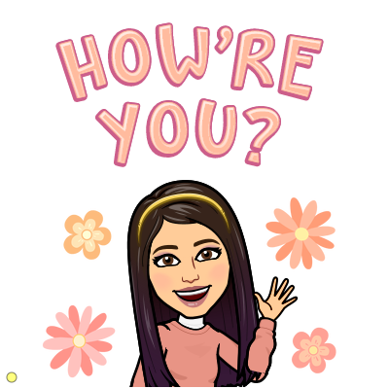


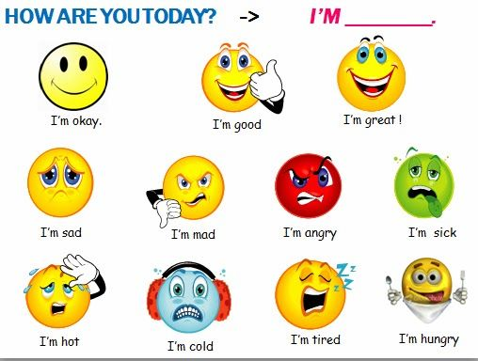
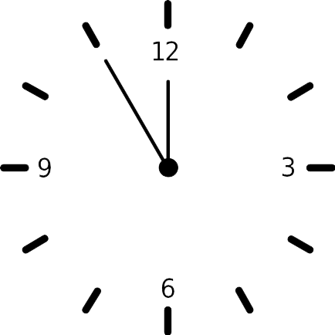



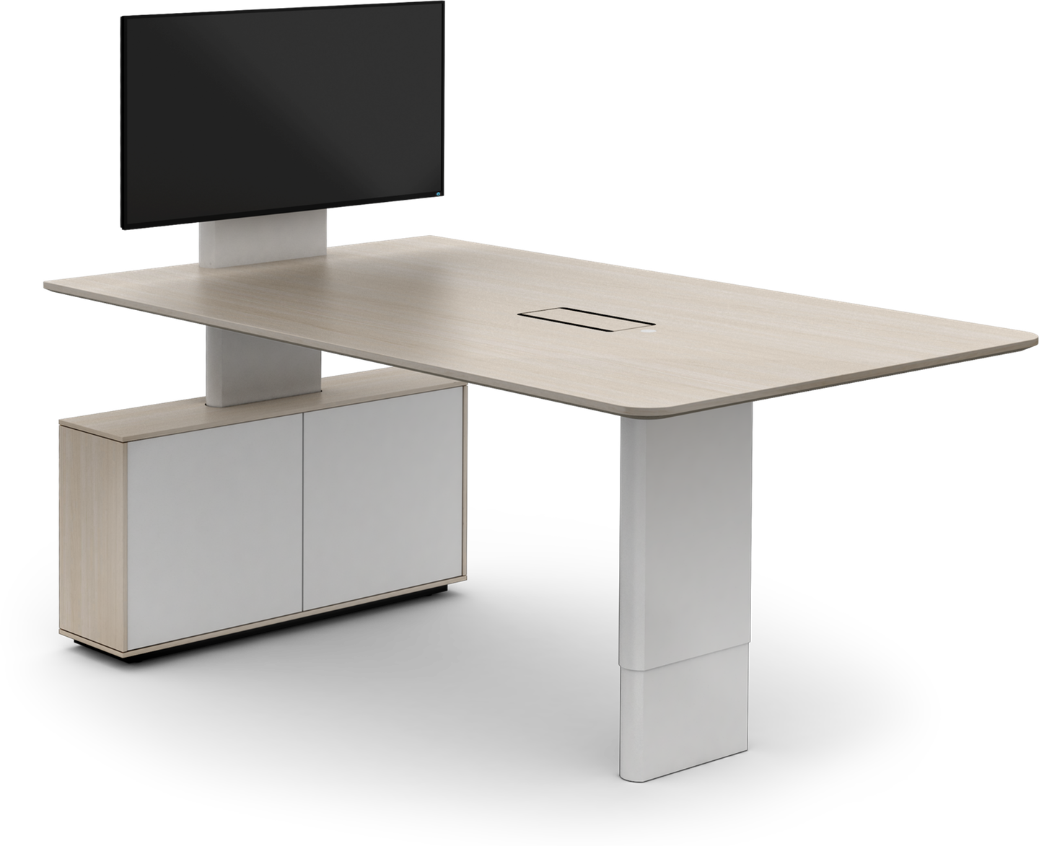
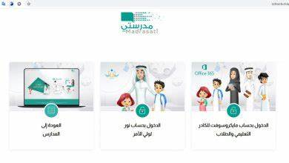
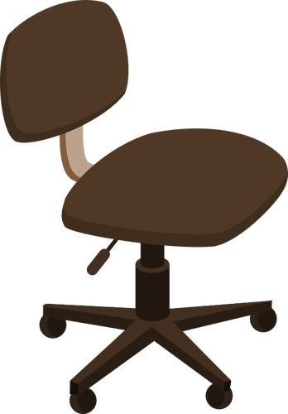






I love English

Slide 3
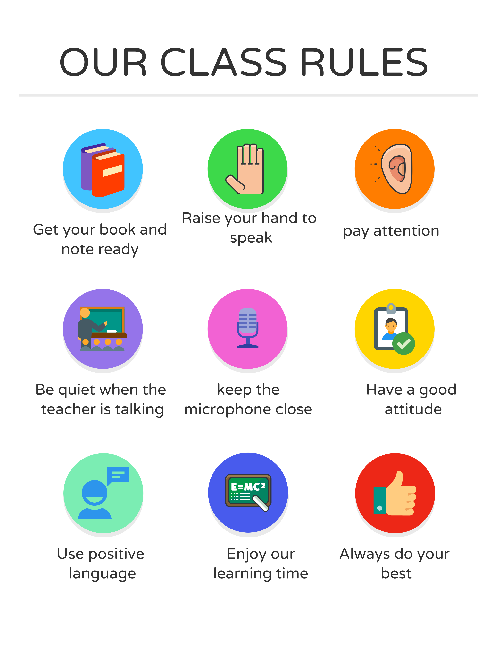
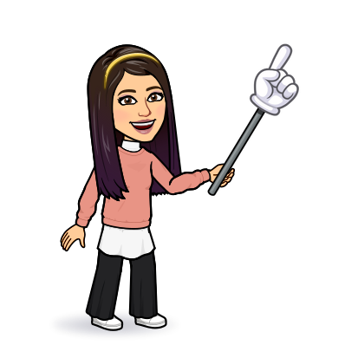
I love English

Slide 4




Let’s revise the previous lesson
https://wordwall.net/resource/13343800

Slide 5

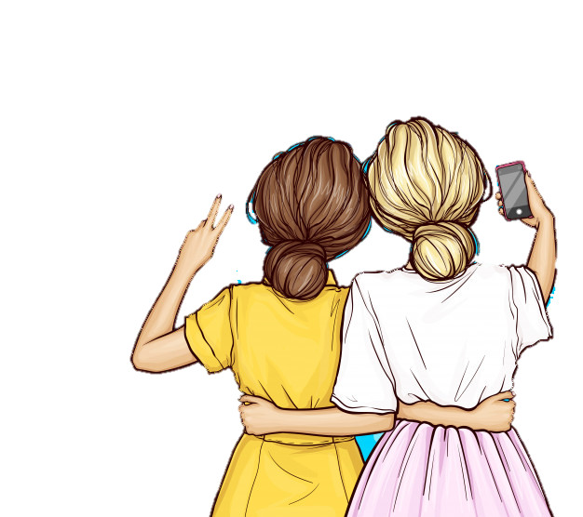
I love English
Mega Goal 2
Unit 5
(If It Hadn’t Happened)
Writing
Sunday
15/8/1442

Slide 6

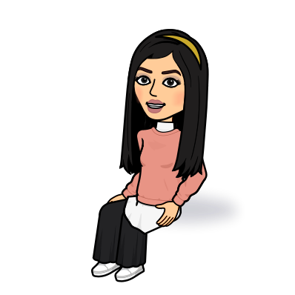
I love English
Lesson Objectives
Students will be able to:
Read the advice column and answer some questions.
Make notes in the organizer including their own advice.
Write a response for an advice column.
Write a letter of advice.

Slide 7
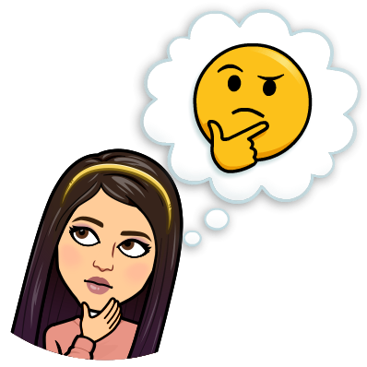
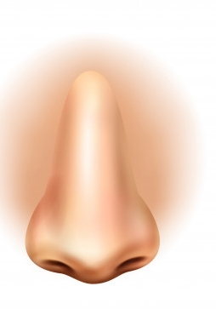


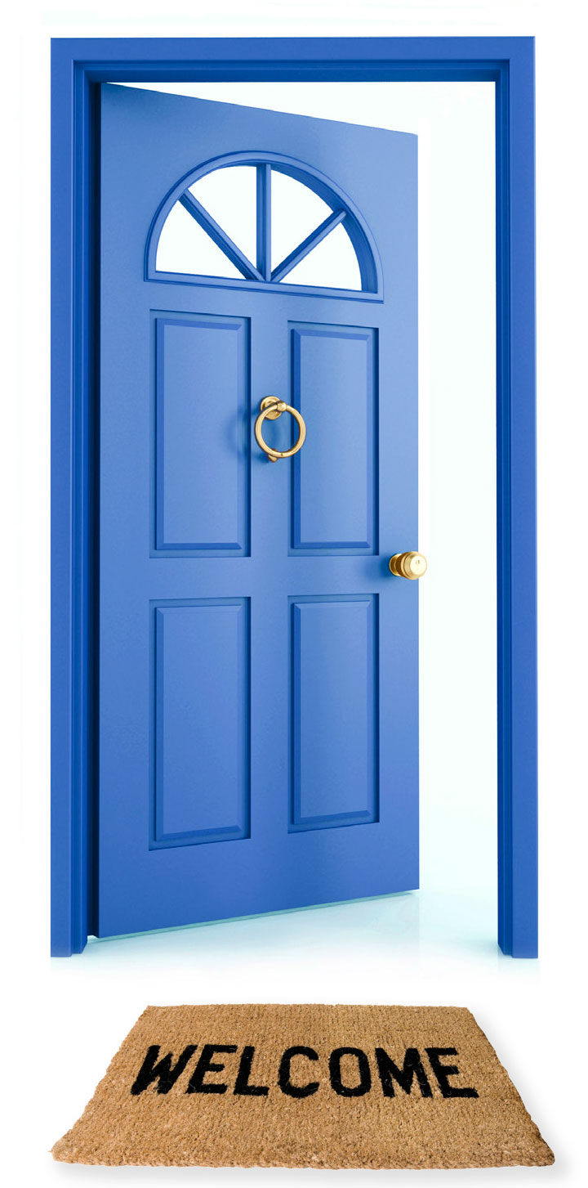


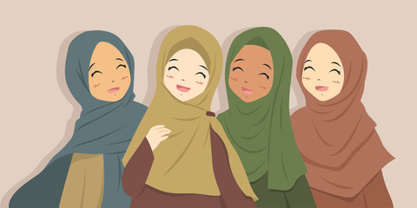
Warm Up
Find the name of each picture
Now take the first letter of each one to get the topic
F
R
I
E
N
D
Fire
Room
Ice cream
Eggs
Nose
Door

Slide 8

When you have problems with your friends
What do you do?
Ask for advice
sisters
parents
brothers

Slide 9
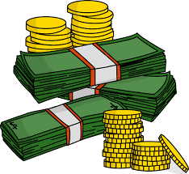
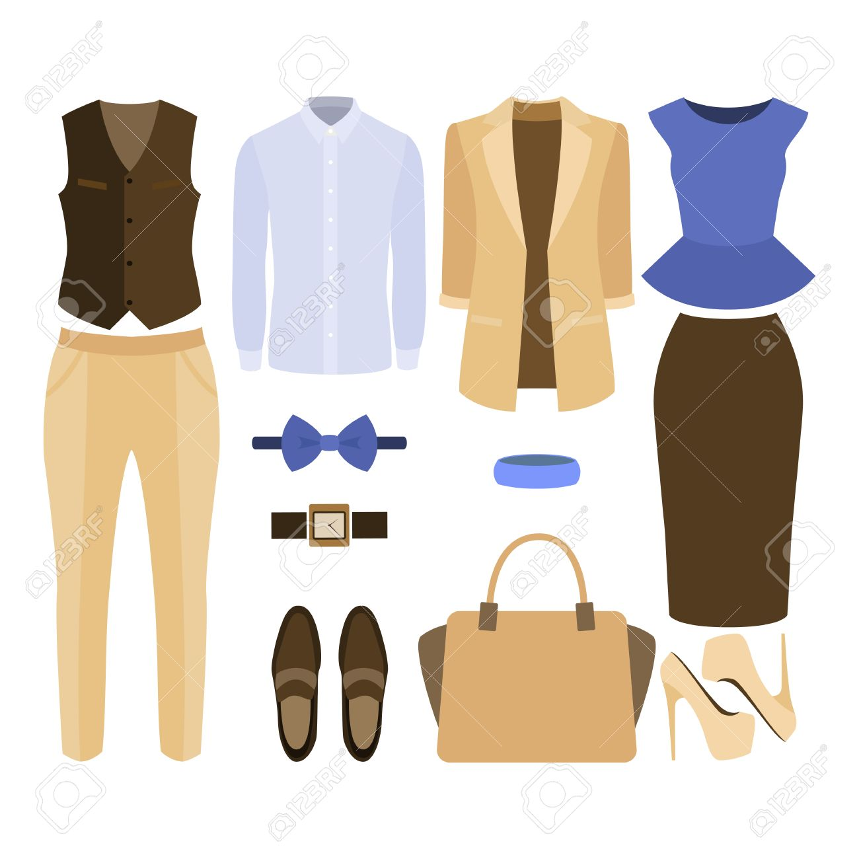
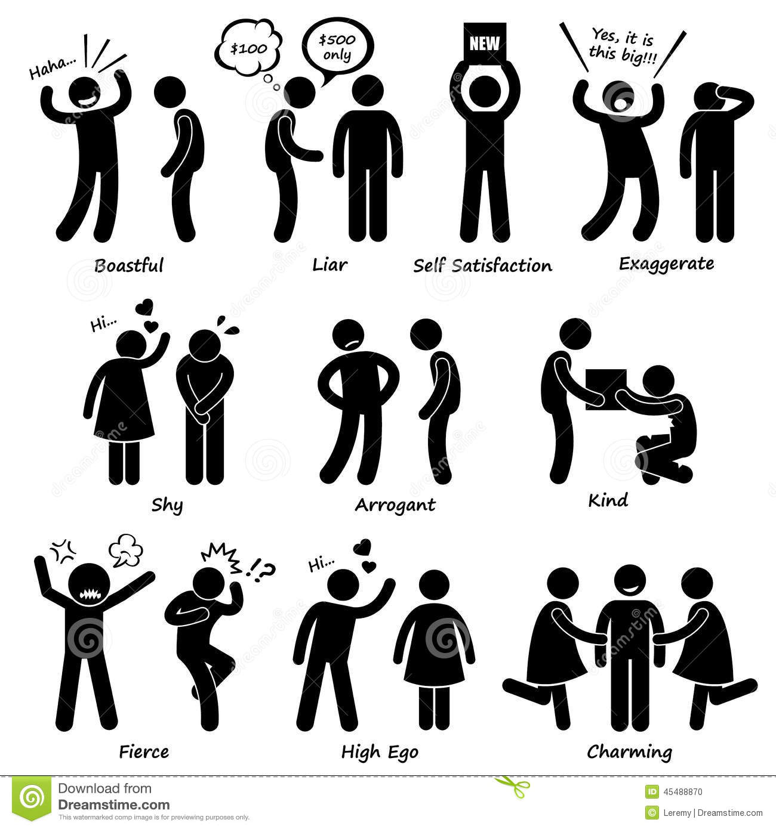
What kind of problems do friends usually have?
Money
Exchanging things
Friend’s behaviour

Slide 10
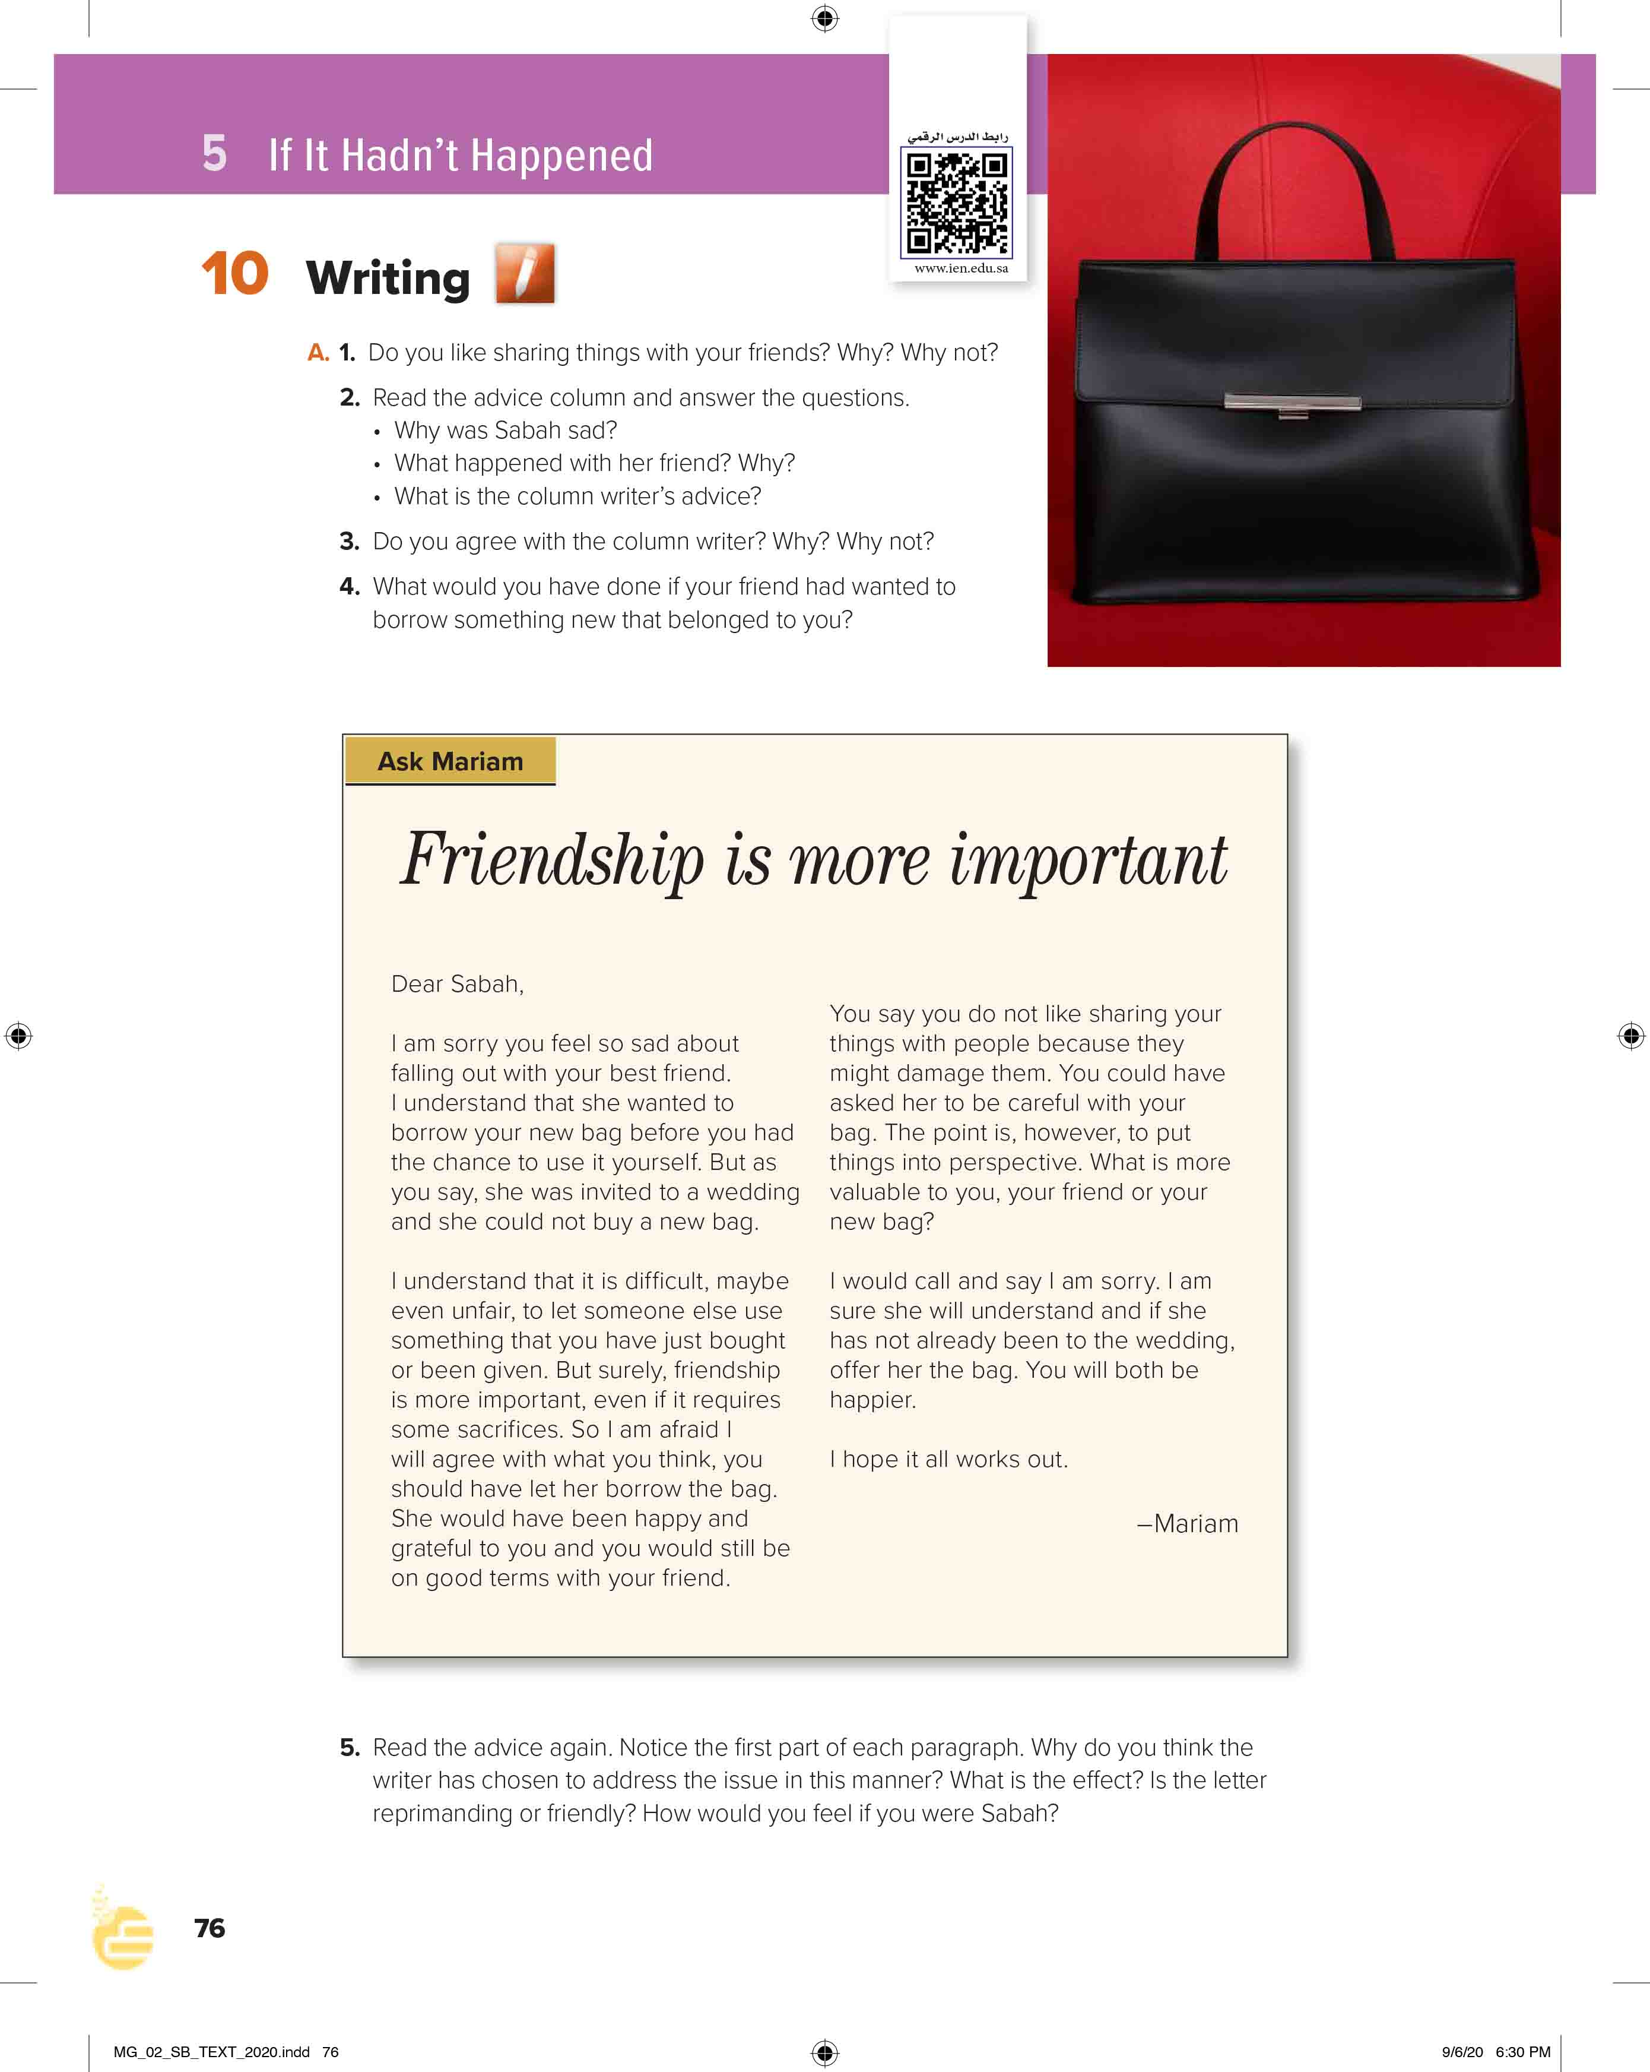
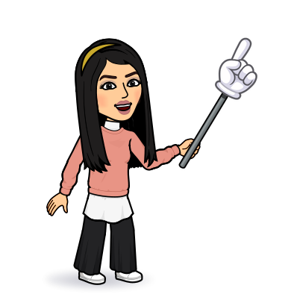
I love English
Open your Student’s book page: 76

Slide 11

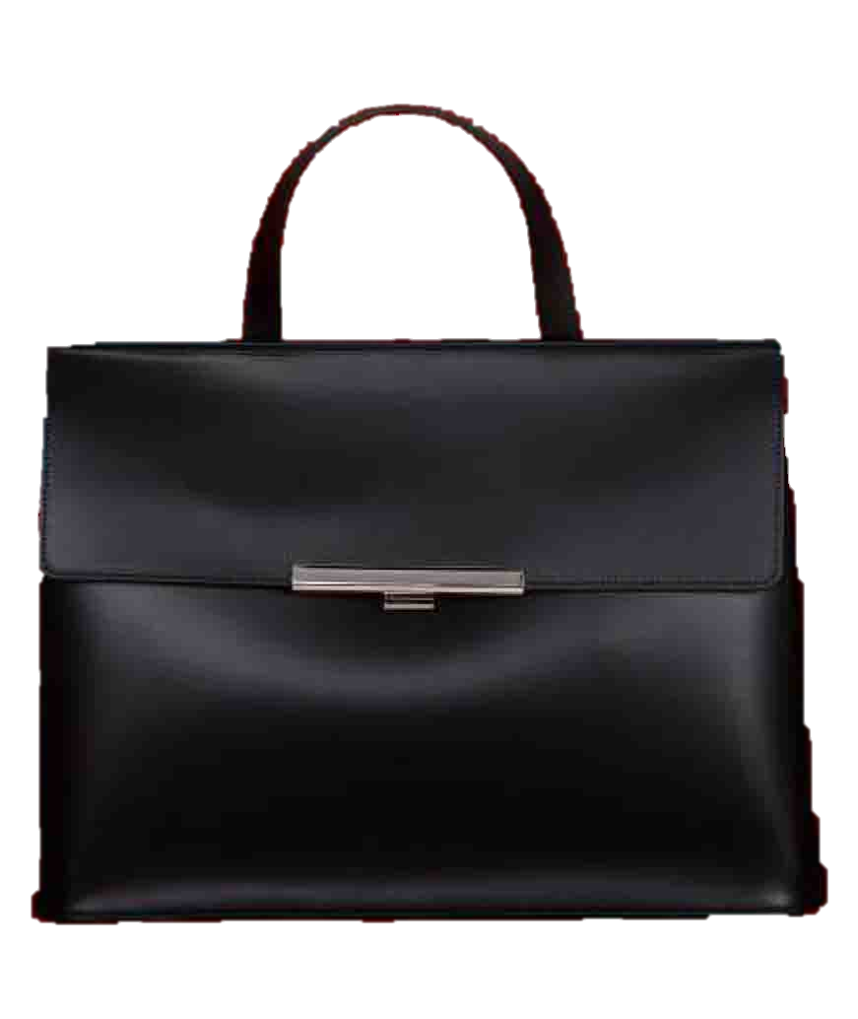

Slide 12
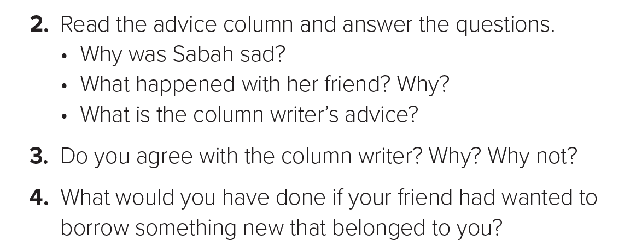

Slide 13
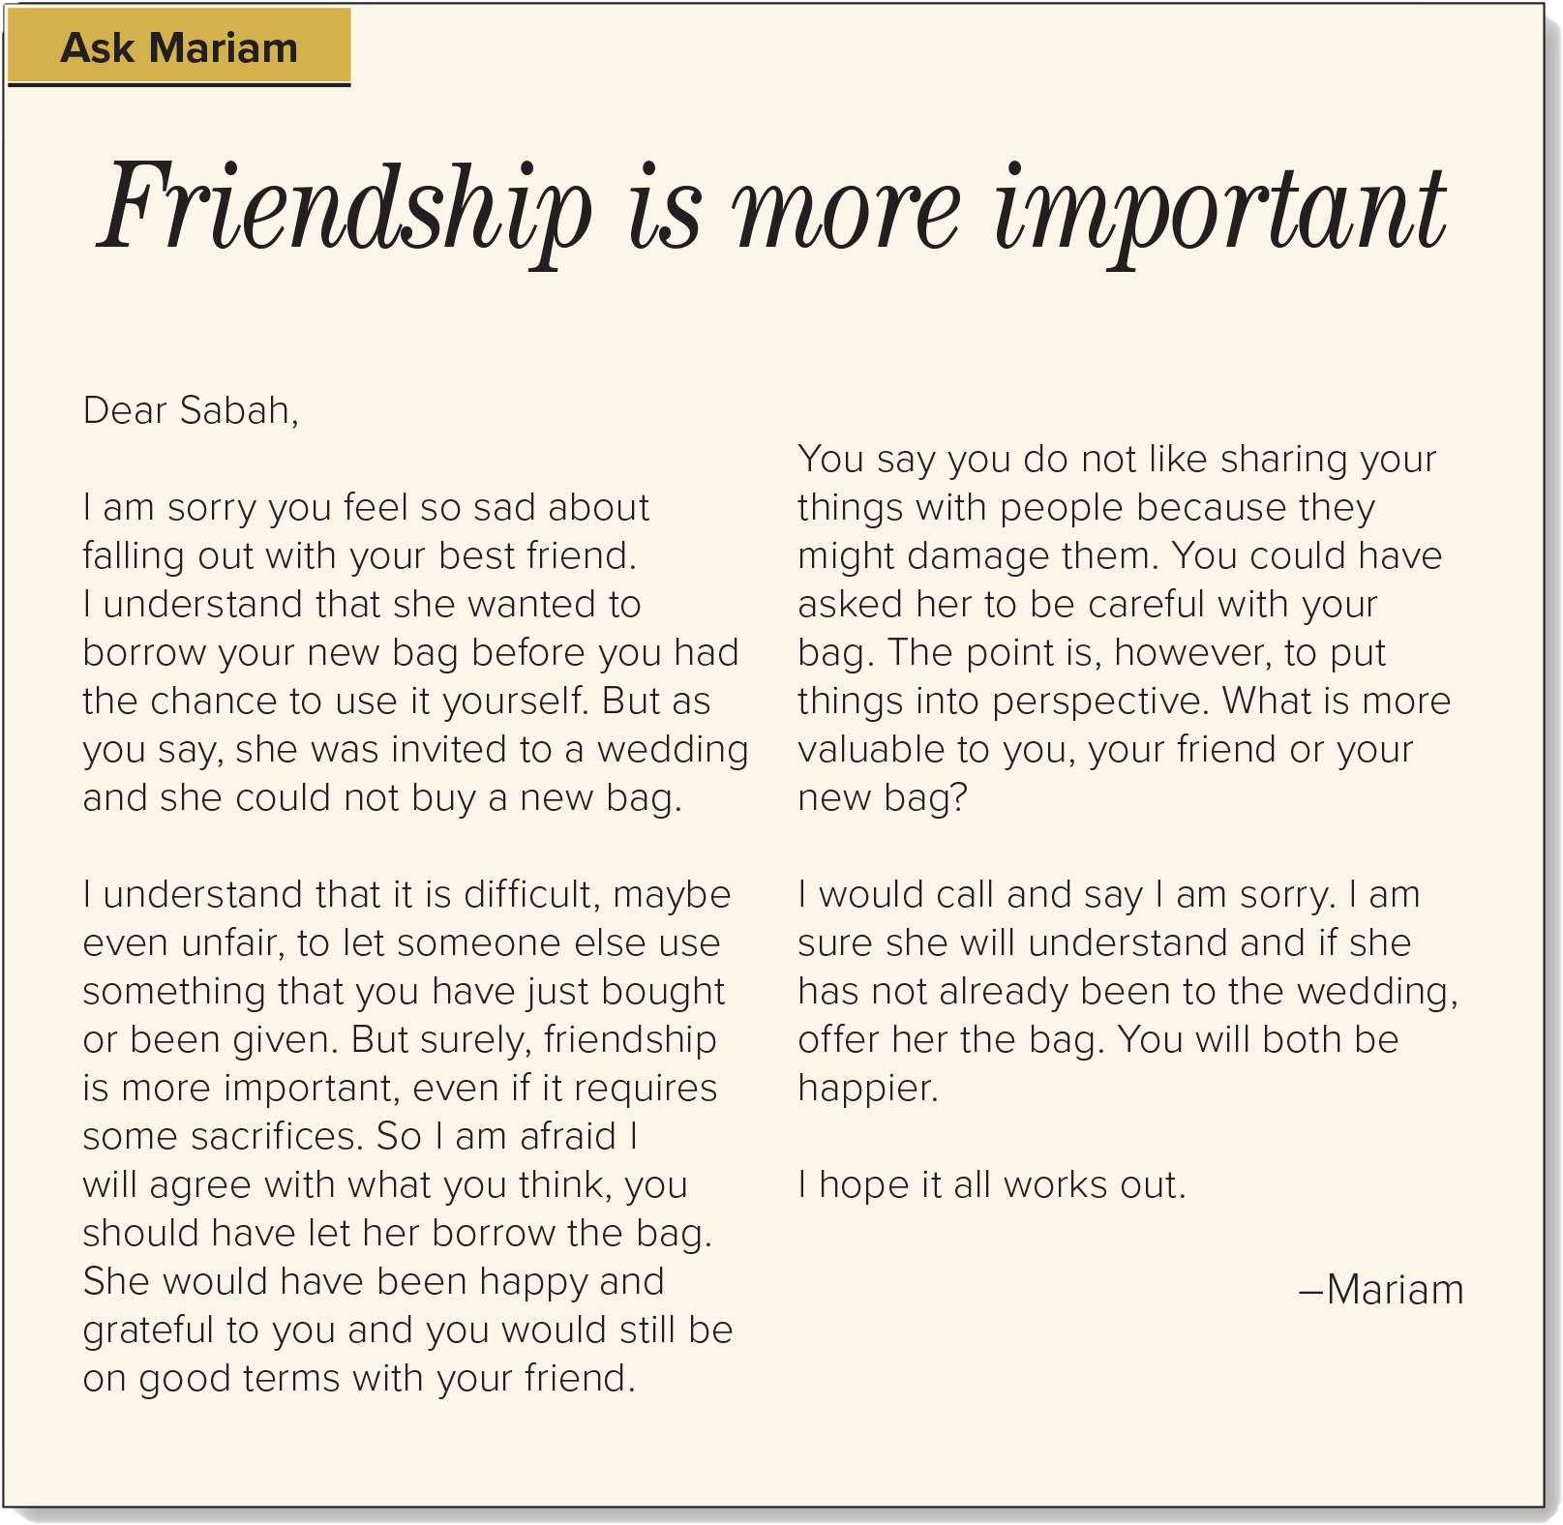


What’s the title?
Friendship is more important
Who wrote the letter of advice?
Mariam
Who asked for the advice?
Sabah

Slide 14
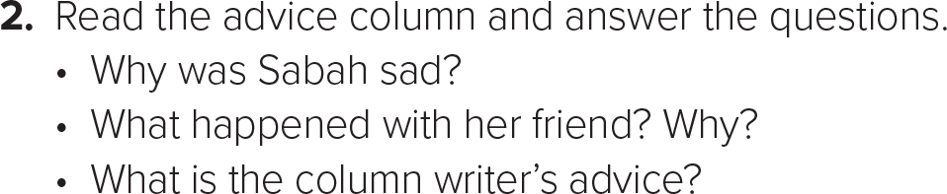
Because she had fallen out with her best friend.
Sabah’s friend asked to borrow her new bag because she had a wedding to go to and could not afford to buy a new bag.
The column writer advised Sabah to call her friend and apologize/say she was sorry and offer to lend her bag to her friend if she still needed it.

Slide 15
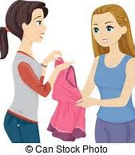

Slide 16
The writer has used mostly 1st and in some cases 2nd person.
This makes the reply a lot more personal.
The opening lines of the first two paragraphs intend to show understanding and make Sabah feel that Mariam knows how she feels.

Slide 17
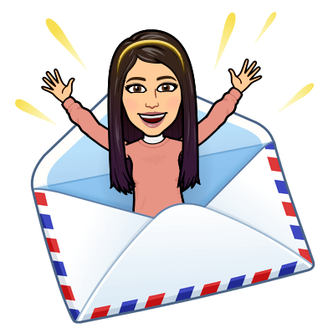

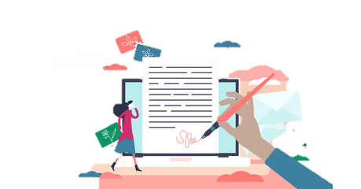
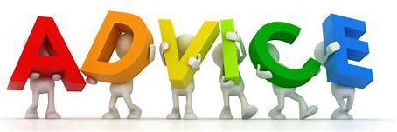
How to write a letter of advice?

Slide 18
How to write a letter of advice?
Opening
She has read the letter very carefully
Understanding
advice her without patronizing her
Reason
Conclusion

Slide 19
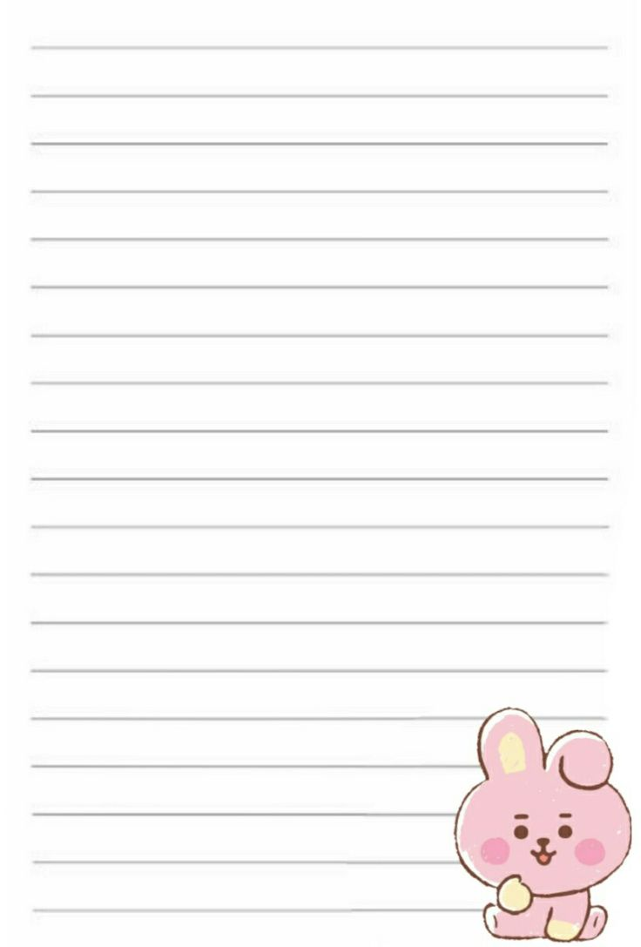
Your Letter Should look like this
Dear ,………………………
Show understanding of the problem and feeling:
I understand ………..I know how do you feel ……
Give advice without sounding reprimanding or patronizing
Closing

Slide 20
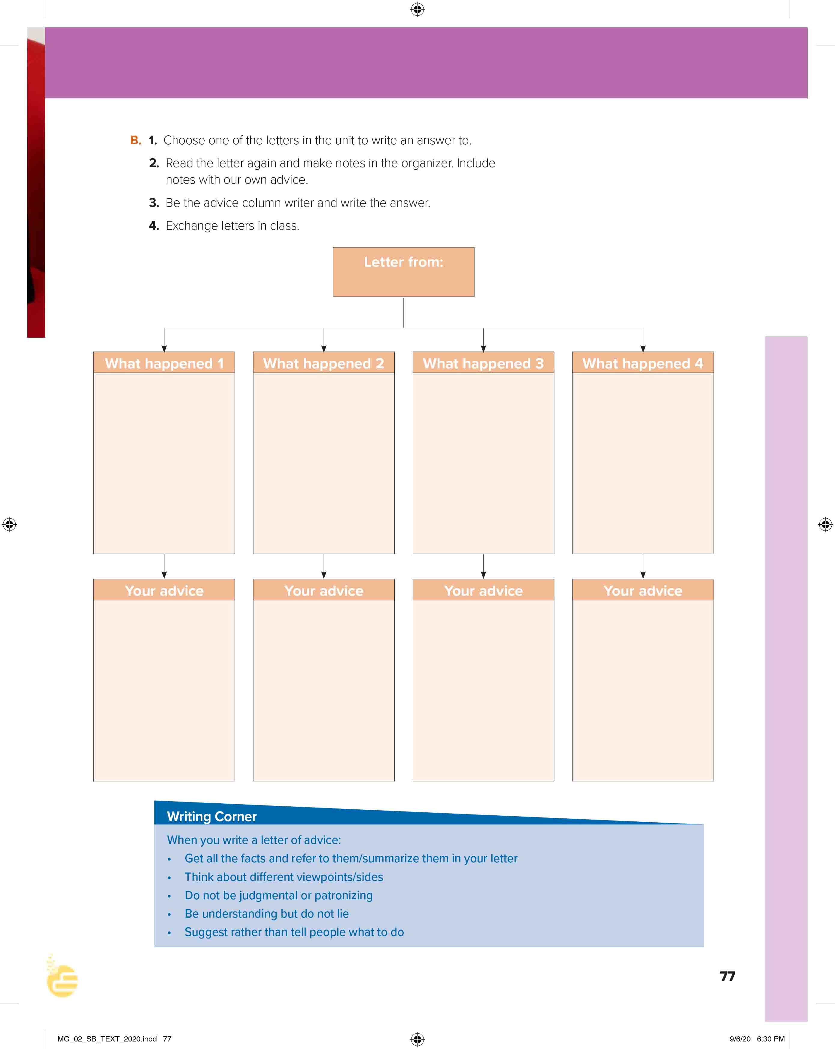
I love English
Open your Student’s book page: 77

Slide 21
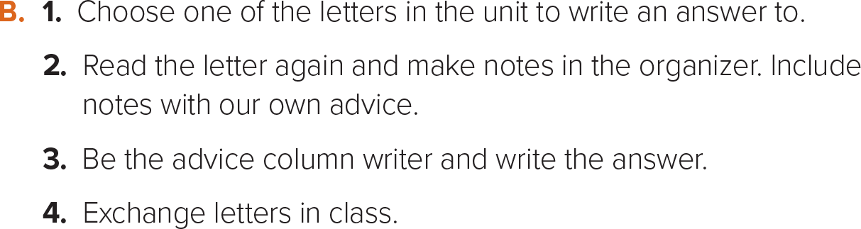

Slide 22
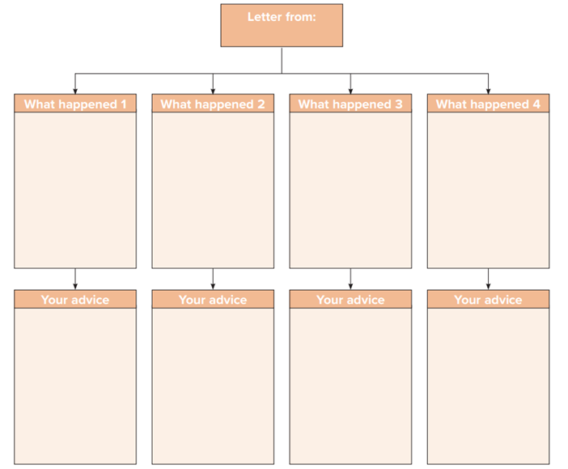
A confused Friend
He lent his friend money.
He asked his friend to give him back the money in public but his friend was embarrassed by that.
His friend threw a twenty-dollar bill at him and walked away.
The writer wishes he didn’t do that with his friend.
I think that was great to lend him the money.
If I were you, I would call him and apologize for my behavior.
He shouldn’t do that till he understands what you said.
You shouldn’t blame yourself for that. One day, you will meet again and become good friends.

Slide 23
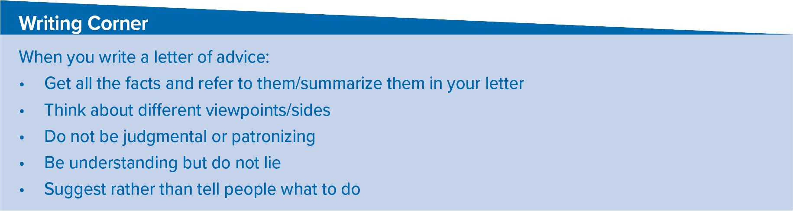
Follow these steps to write a letter of advice

Slide 24

https://wordwall.net/resource/13480120

Slide 25

“A true friend is who sees a fault, gives you advice and who defends you in your absence”

Slide 26

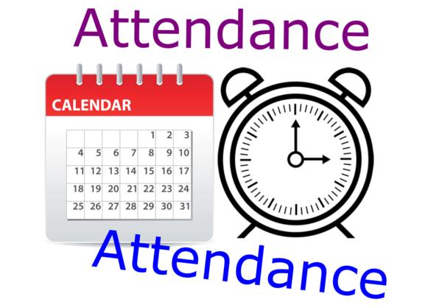
I love English

Slide 27



Homework
I love English
Work Book Page 54

Slide 28
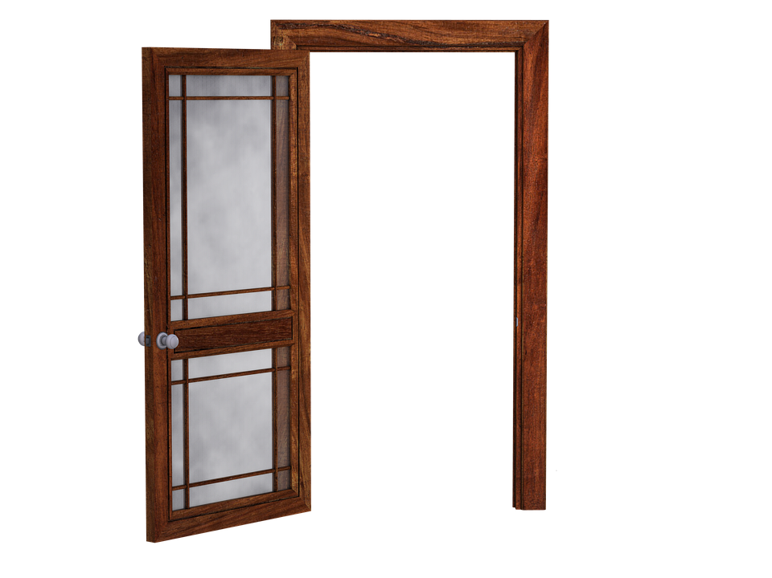
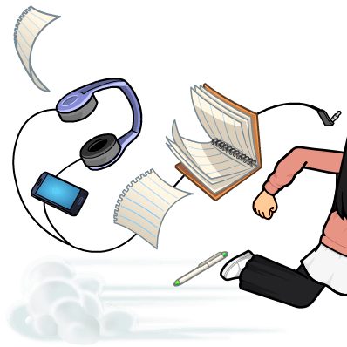
Homework
Work Book Page 54

Slide 29
Homework
Work Book Page 54

Slide 30
Homework
Work Book Page 54

Slide 31
Homework
Work Book Page 54

Slide 32
Homework
Work Book Page 54

Slide 33

Homework
Work Book Page 54

