Slide 1


Hello My lovely students
I’m your teacher
Hanan AlShobaily

Slide 2
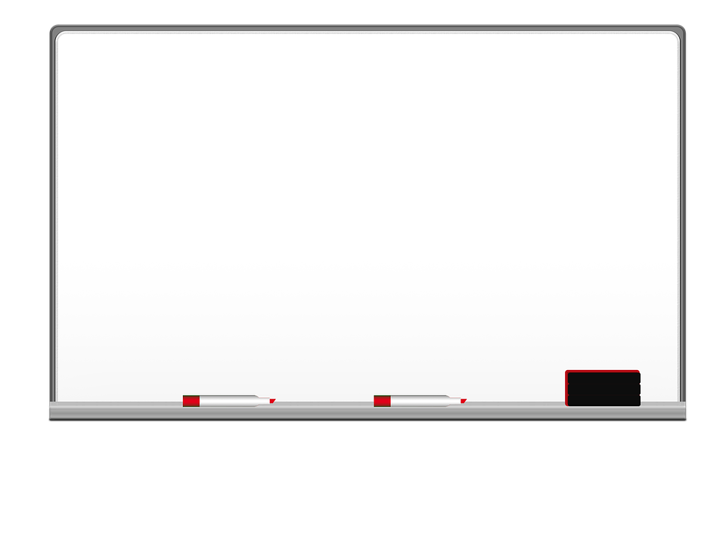

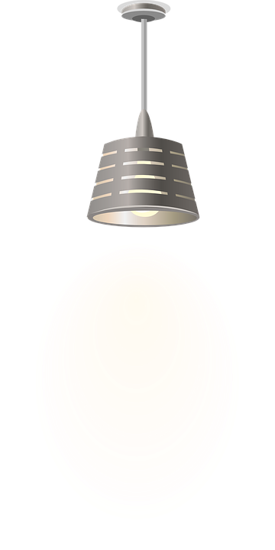
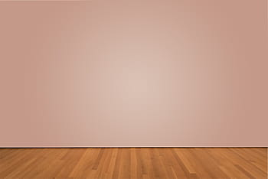
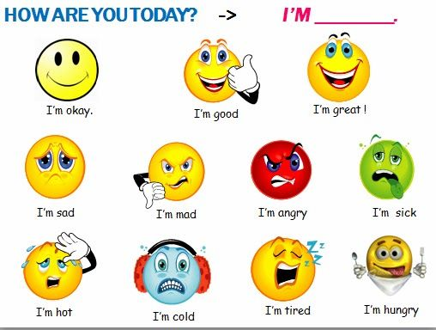
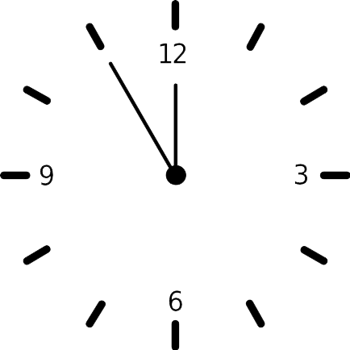
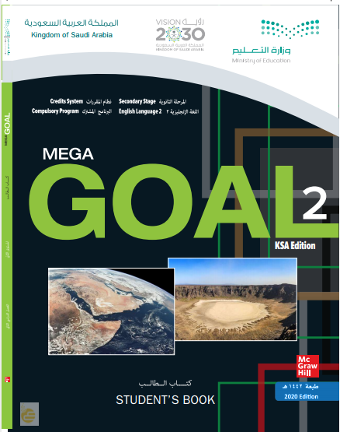

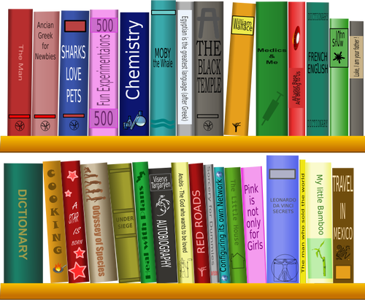
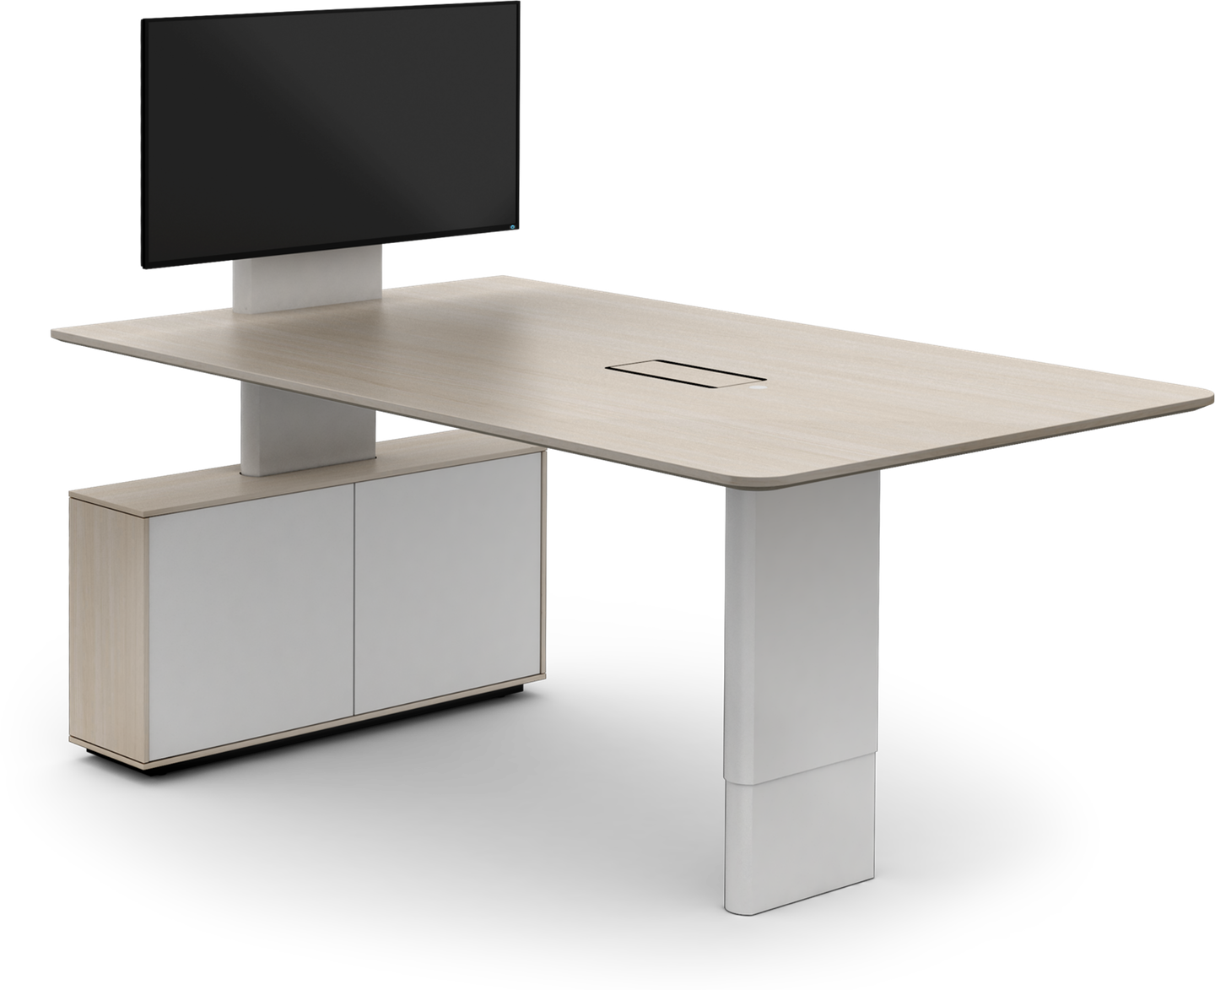
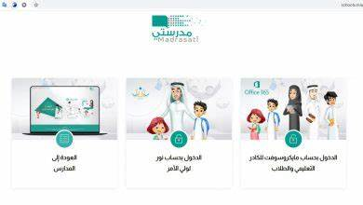
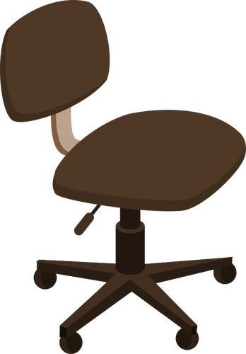



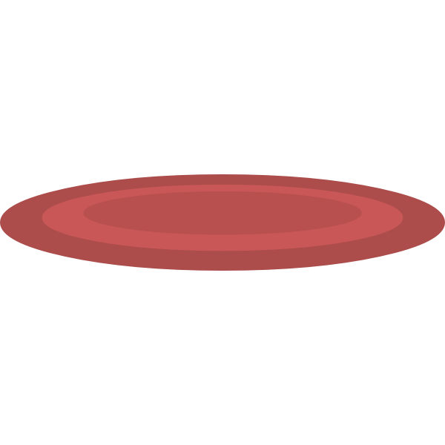


I love English

Slide 3


I love English

Slide 4




I love English
Revising the previous lesson
1
I went to the store, [or/but/so] I forgot to bring my shopping list.
2
I don’t like guessing, [so/and/or] I will wait for the facts.
3
The cake was [very/extremely/absolutely] delicious
Done
Done
Done
NEXT
4
He was sad after he [loose/loosing/lost] the game.
5
If you don’t leave now, you [be/would be/ will be] late.
6
You have to [studied/study/studying] hard.
Done
Done
Done

Slide 5



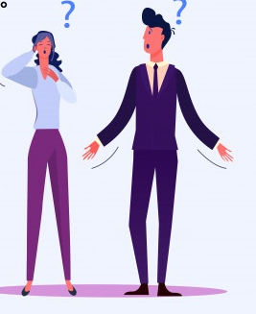


I love English
Mega Goal 2
Unit 4
(I Wonder What Happened)
Project
Wednesday
4/8/1442

Slide 6

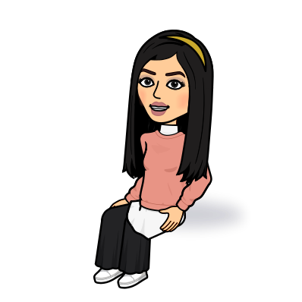
I love English
Lesson Goals
Students will be able to:
Design a poster about meteorite.
Form sentences to describe the meteorite.

Slide 7
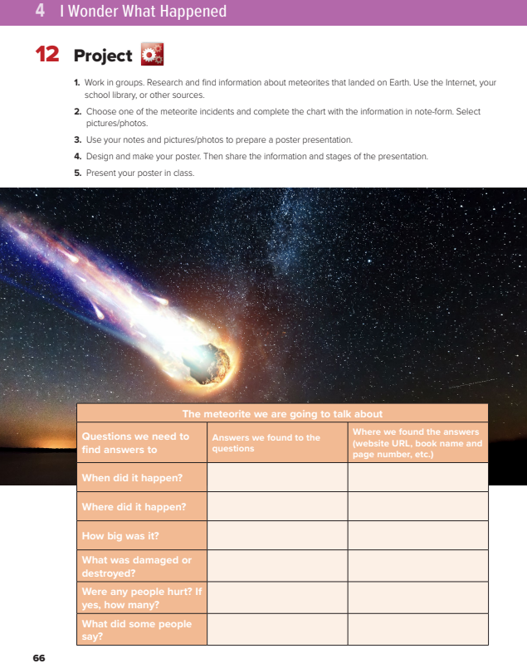

I love English
Open your Student’s book page: 66

Slide 8
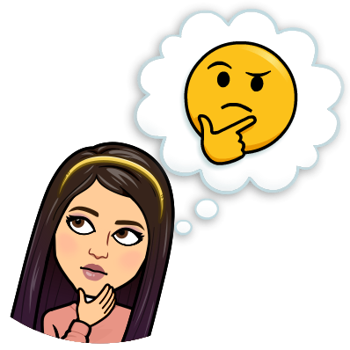
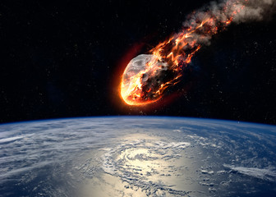

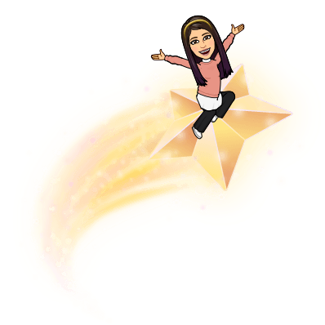

Warm Up
What do you know about meteorites?
How often do they fall on earth?
Have they caused any damage by landing on earth?
How large is the largest meteorite that has hit earth?

Slide 9
Warm Up
What do you know about meteorites?
A meteorite is a solid piece of debris from an object that comes form outer space.
How often do they fall on earth?
Every year, the Earth is hit by about 610 meteors.
Have they caused any damage by landing on earth?
It can fall through the roof of the house or shatter a car windshield.
How large is the largest meteorite that has hit earth?
Hoba the largest meteorite (66 tones)

Slide 10
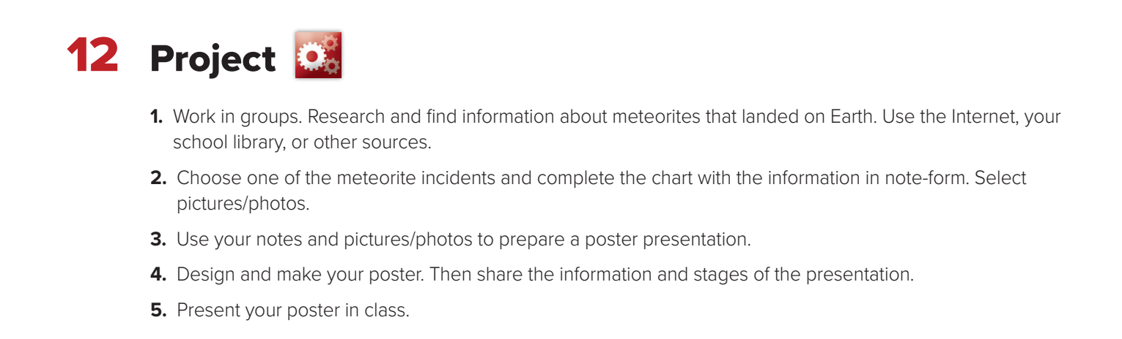

Slide 11

Watch the video then complete the chart with the information

Slide 12
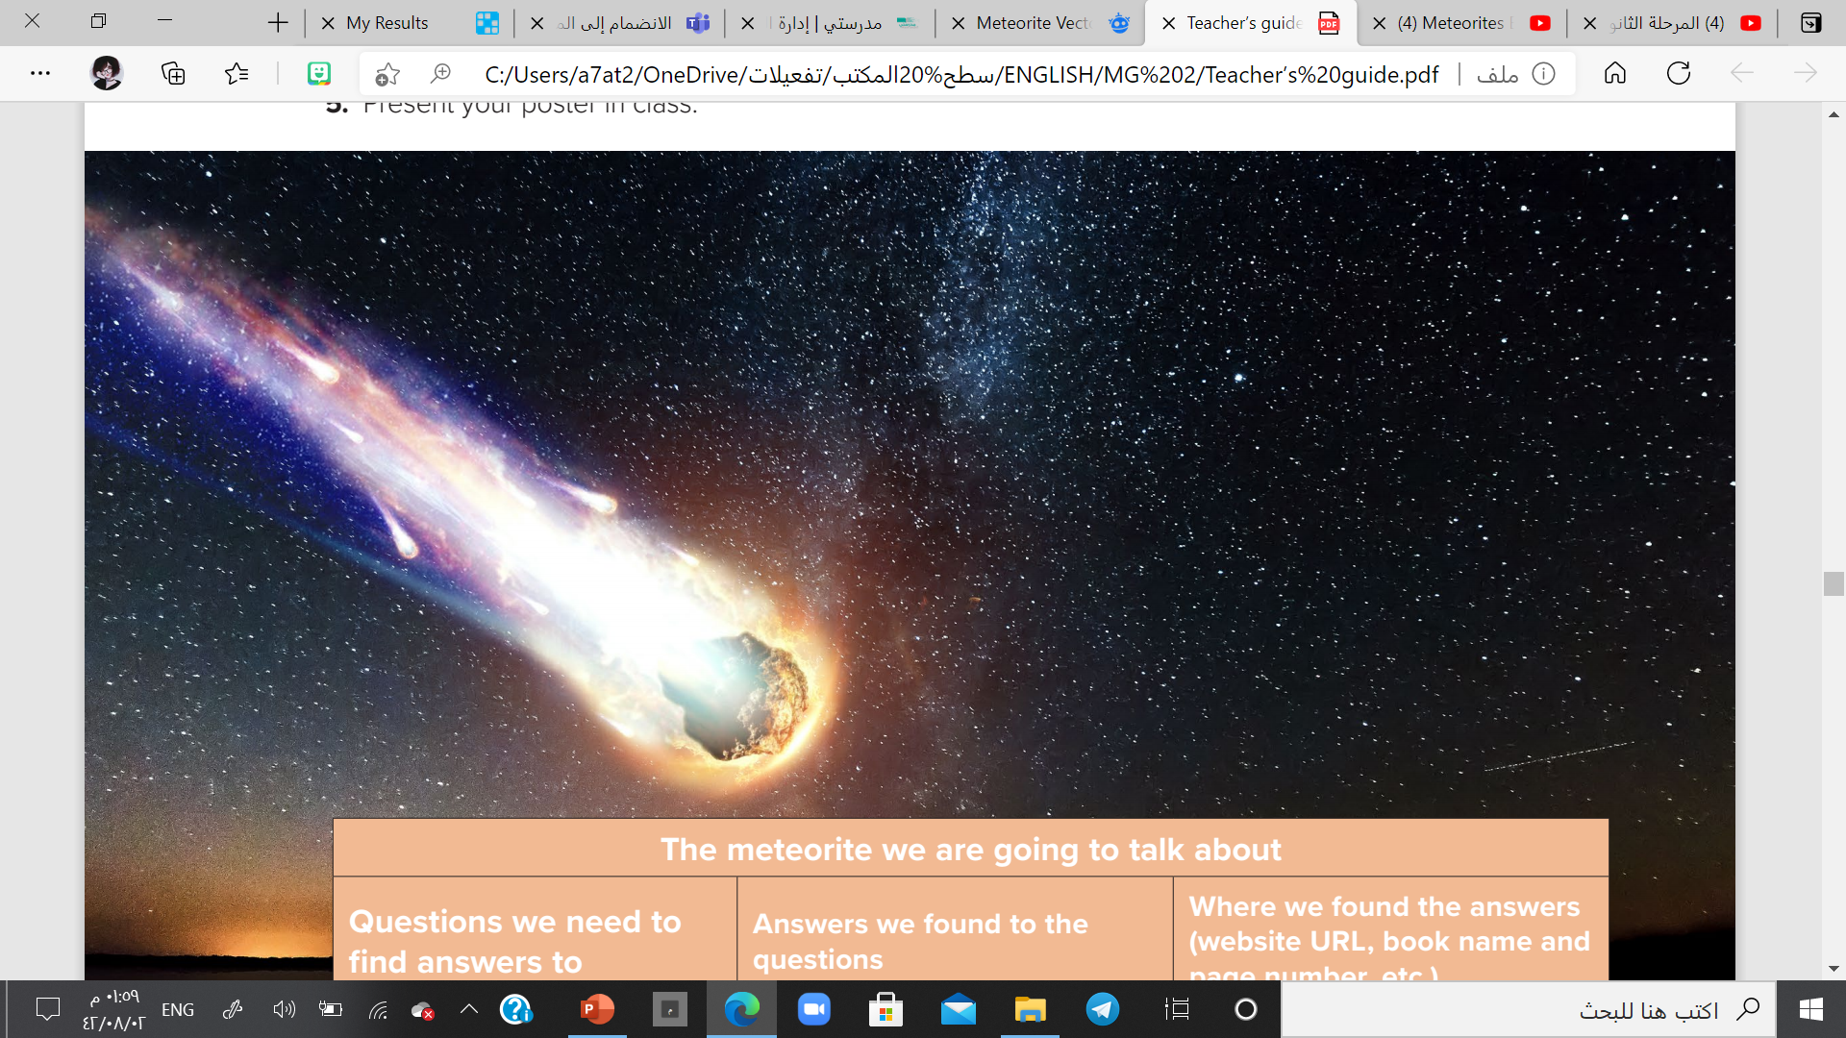
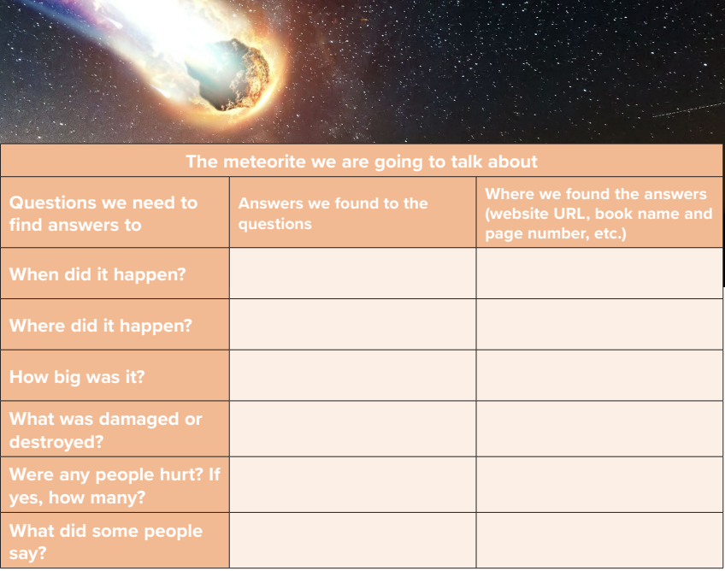
The Hobe Meteorite
1920
website
A field in Namibia
website
About 66 tons
website
It has fallen in an empty field
website
No one was hurt
website
There’s a great history to its discovery and it’s worth the drive if you fascinated by geological events
website

Slide 13

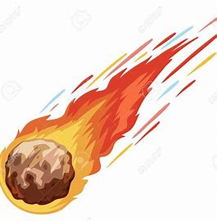
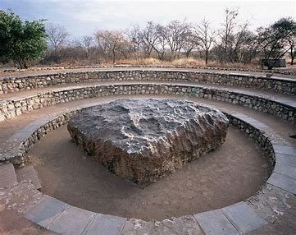
Let’s design an attractive poster
1
Design a poster, Make attractive decorations.
The Hoba Meteorite
2
Add your pictures.
1920
3
Add the name of the meteorite.
A field in Namibia
It weights 66 tons
4
Give information about it.
No one was hurt

Slide 14


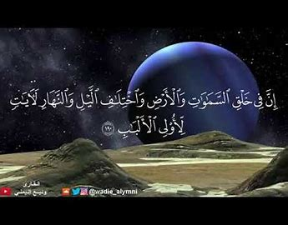

Slide 15

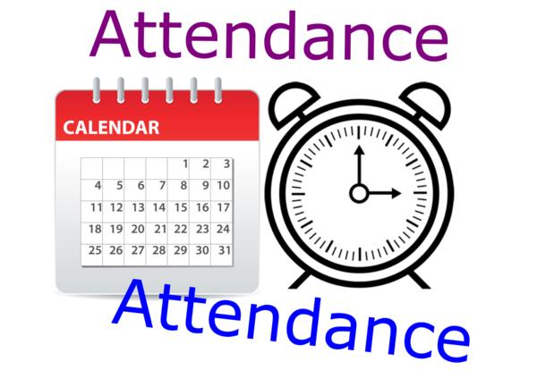
I love English

Slide 16
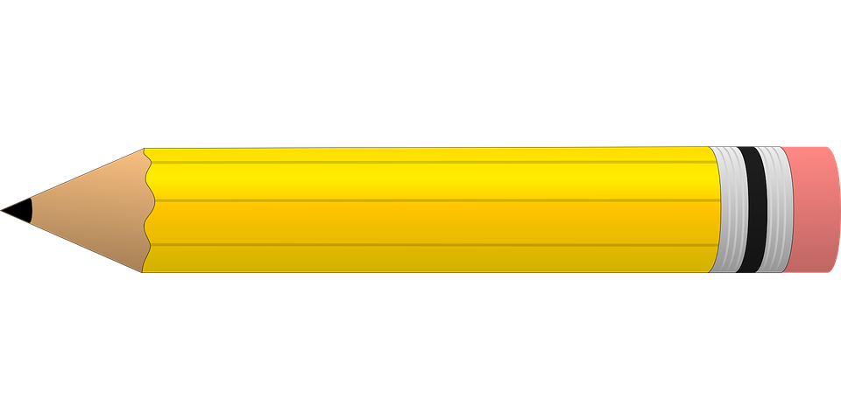


Homework
I love English

Slide 17
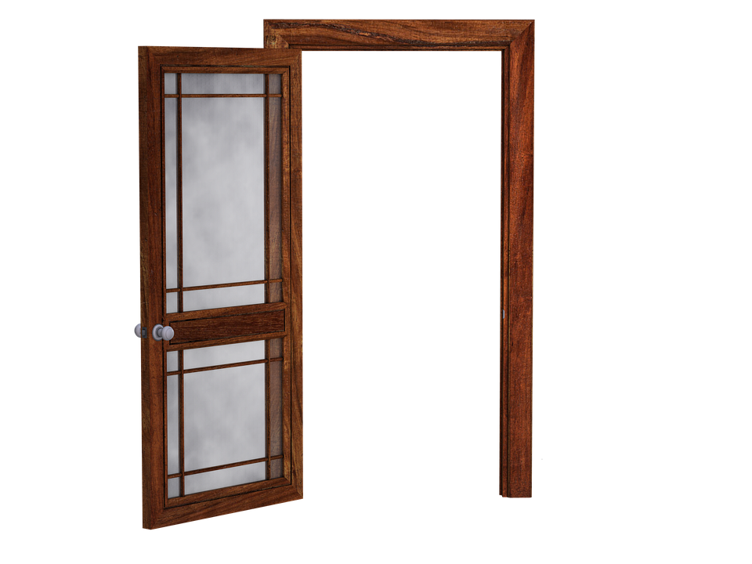
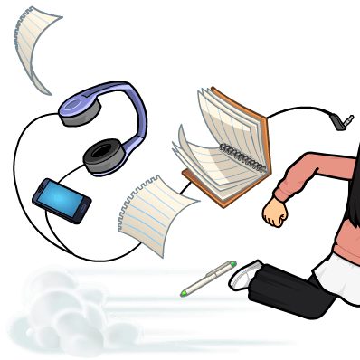
Homework

Slide 18
Homework

Slide 19
Homework

Slide 20
Homework

Slide 21
Homework

Slide 22

Homework

