Slide 1


Hello My lovely students
I’m your teacher
Hanan AlShobaily

Slide 2




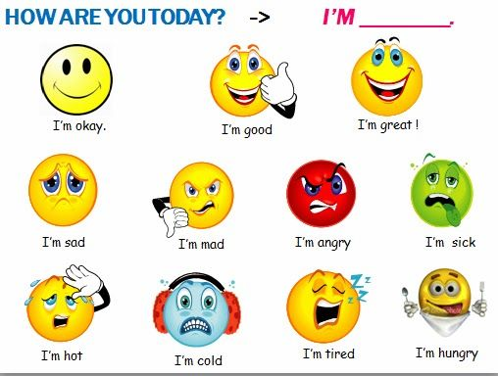

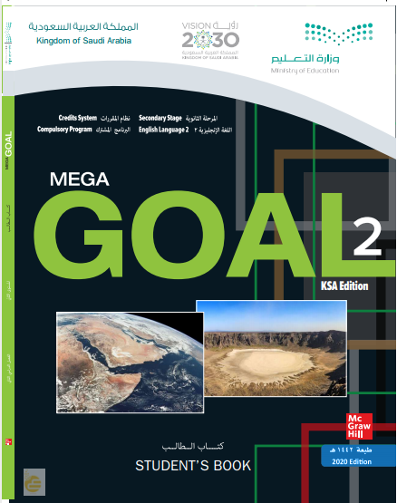


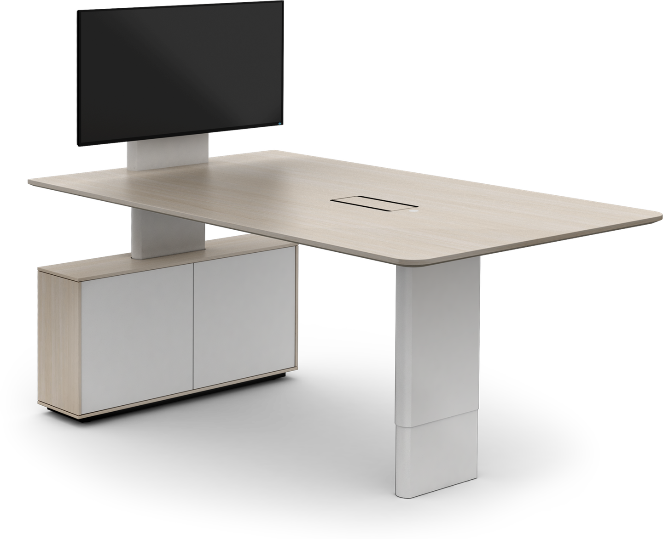








I love English

Slide 3


I love English

Slide 4

I love English
Revising the previous lesson
remote
investment
dynamic
enterprise
sustainable
Sorry incorrect answer ☹
Try again.
Next
the act of spending money
far away
a business organization
lasting
Always active

Slide 5



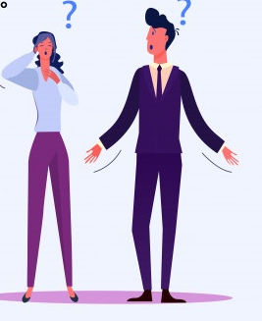


I love English
Mega Goal 2
Unit 4
(I Wonder What Happened)
Writing
Sunday
1/8/1442

Slide 6


I love English
Lesson Goals
Students will be able to:
Breakdown the text into stages.
Find the topic sentence of each paragraph.
Debate the conclusion of the paragraph.
Search for a voyage or an expedition.
Write a description of a vessel.

Slide 7
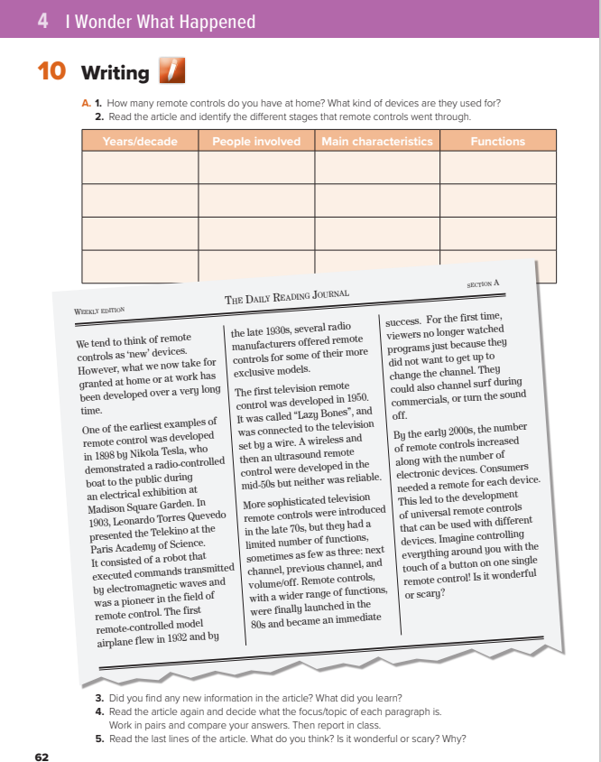

I love English
Open your Student’s book page: 63

Slide 8

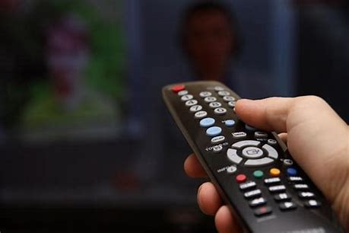
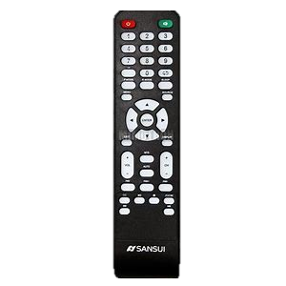

Warm Up
What do you use for searching channels on your TV?

Slide 9

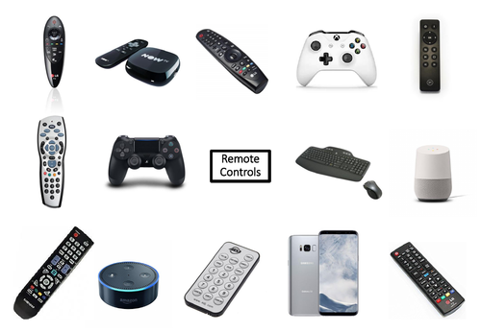

Slide 10
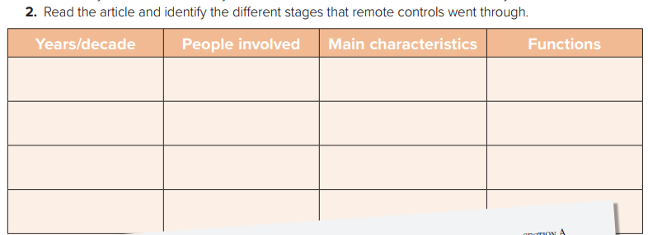

Slide 11


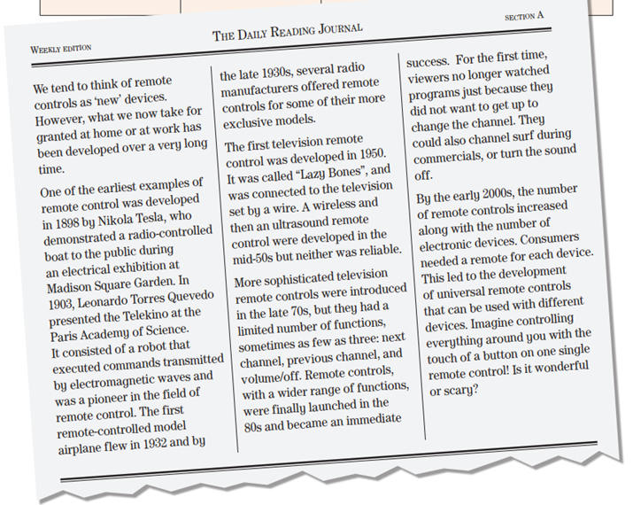
What’s the article about?
1
Remote Control
How many paragraphs are there?
3
2
5
The history of remote control
4

Slide 12
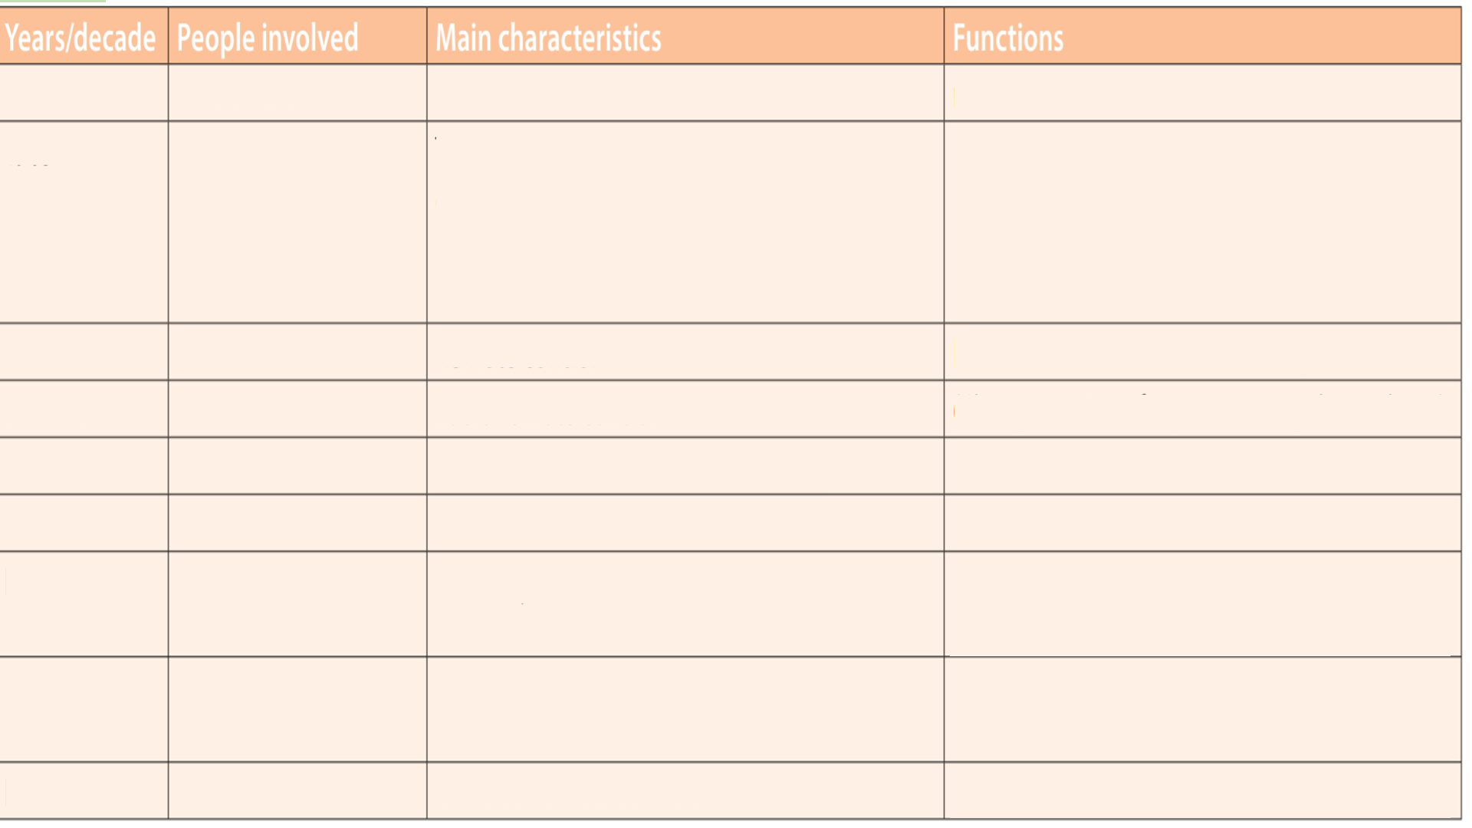
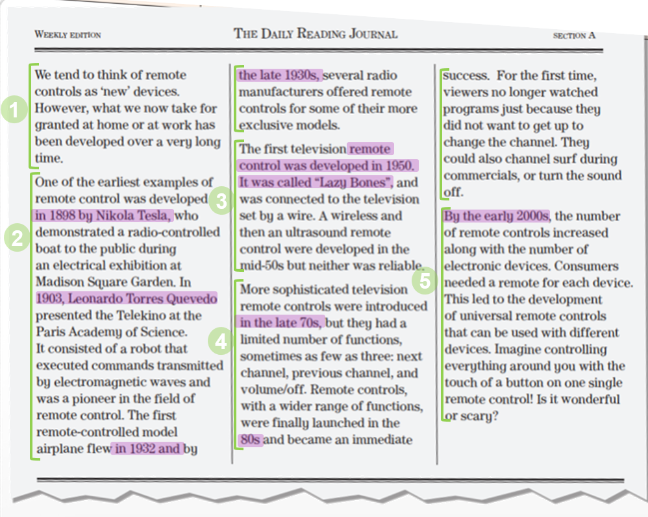
1898
Nikola Tesla
remote control of movement
radio-controlled boat
Leonardo Torres
Quevedo
Transmitted commands to a robot by electromagnetic waves
Pioneer in remote control
The Telekino robot executed commands transmitted by electromagnetic waves
1903
1932
Remote control
Flew remote controlled model airplanes
Late 1930s
Radio remote control
(Change stations, frequencies, regulate volume)
1950
Connected to television set by wire
Television remote control
mid 50s
Wireless and then ultrasound remote control
Television remote control
More sophisticated television remote controls
Limited: next channel, previous channel, and volume/off.
Late 70s
Television remote controls with wider range of functions
Wider range of functions allowed channel surfing and muting (turning the sound off)
80s
Early 2000s
Universal remote controls
Can be used with different devices

Slide 13
introduce article theme/remote control
the first television remote control
early examples of remote control
Developments in the 2000s,universal remote control
More sophisticated remote controls,70 onwards

Slide 14
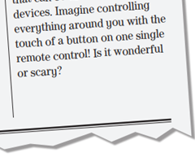

Slide 15


https://wordwall.net/resource/12426638

Slide 16
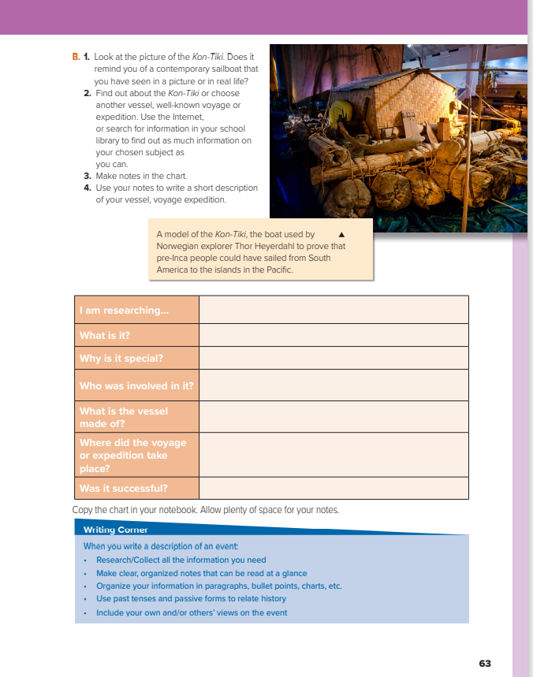
I love English
Open your Student’s book page: 63

Slide 17
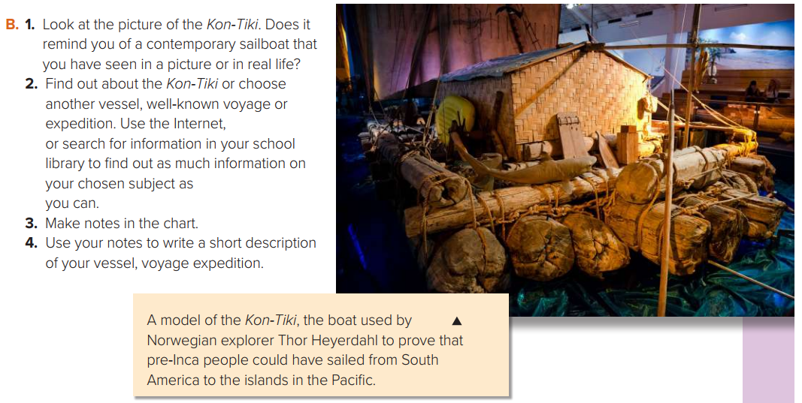

Slide 18
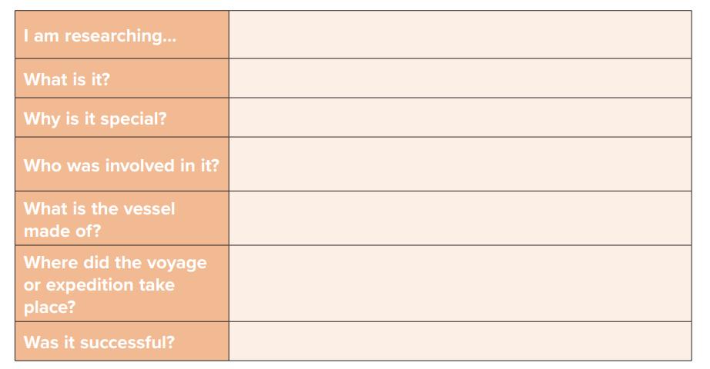
EXAMPLE
Christopher Columbus’s Voyage
First sea voyage
Discovering new places
Columbus and his crew
Wood
The Bahamas
Yes, it was.

Slide 19
What is a descriptive essay?
Descriptive writing creates a picture of a person, place, thing, or event. A well-written description should arouse the reader's imagination. Description tells what something looks, sounds, smells, tastes, or feels like. It works with all of the senses, i.e. Big Sight, smell, taste, touch hearing.

Slide 20
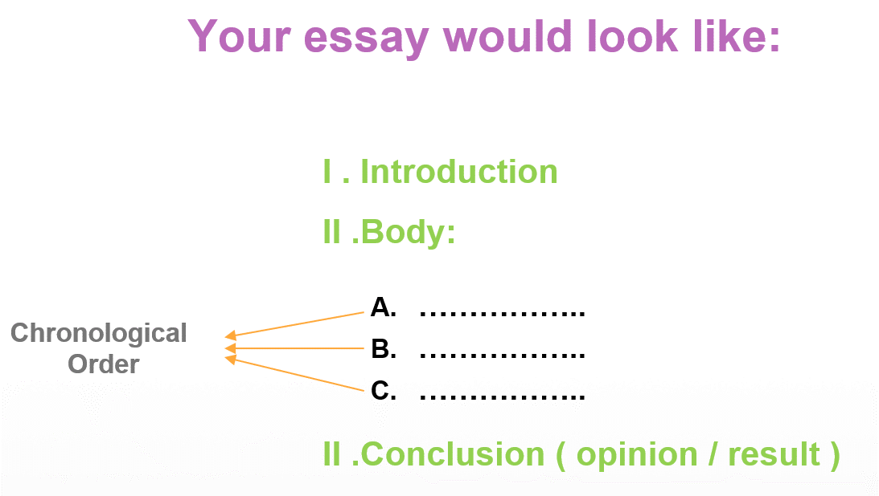
How to write a descriptive essay?
The introduction in which you give name, time, place, and reasons for celebrating
The body (3 paragraphs) in which you describe the preparations and the actual events in separate paragraphs. Use the past tenses to illustrate those you attended some time ago.
The conclusion which includes people’s feelings comments or final thoughts about the event.

Slide 21
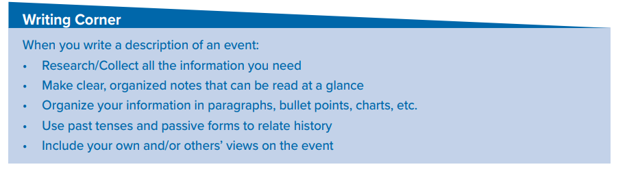

Slide 22

Now It’s your turn. Write a description of a famous expedition or voyage.

Slide 23


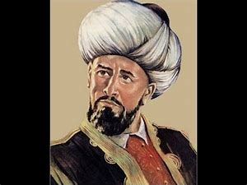
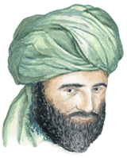
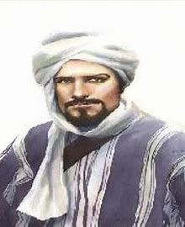
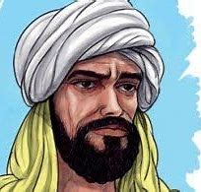
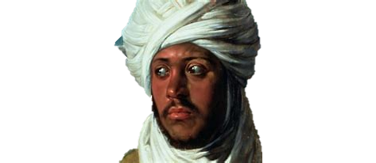
Our history is full of Muslim explorers
Search, read, and explore.

Slide 24


I love English

Slide 25
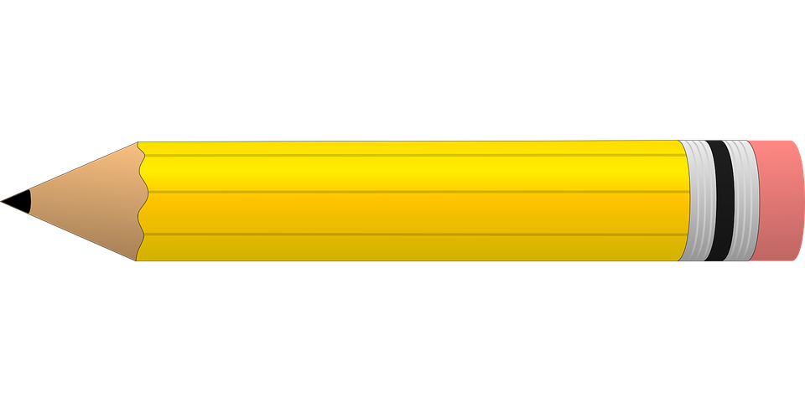


Homework
I love English
Work Book: Page 44

Slide 26
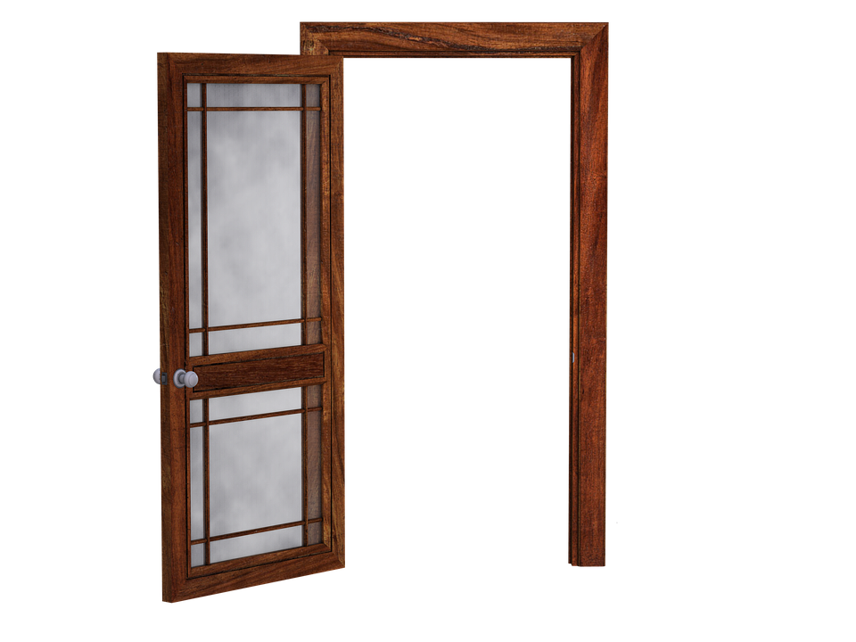

Homework
Work Book: Page 44

Slide 27
Homework
Work Book: Page 44

Slide 28
Homework
Work Book: Page 44

Slide 29
Homework
Work Book: Page 44

Slide 30
Homework
Work Book: Page 44

Slide 31

Homework
Work Book: Page 44

