Slide 1


Hello My lovely students
I’m your teacher
Hanan AlShobaily

Slide 2
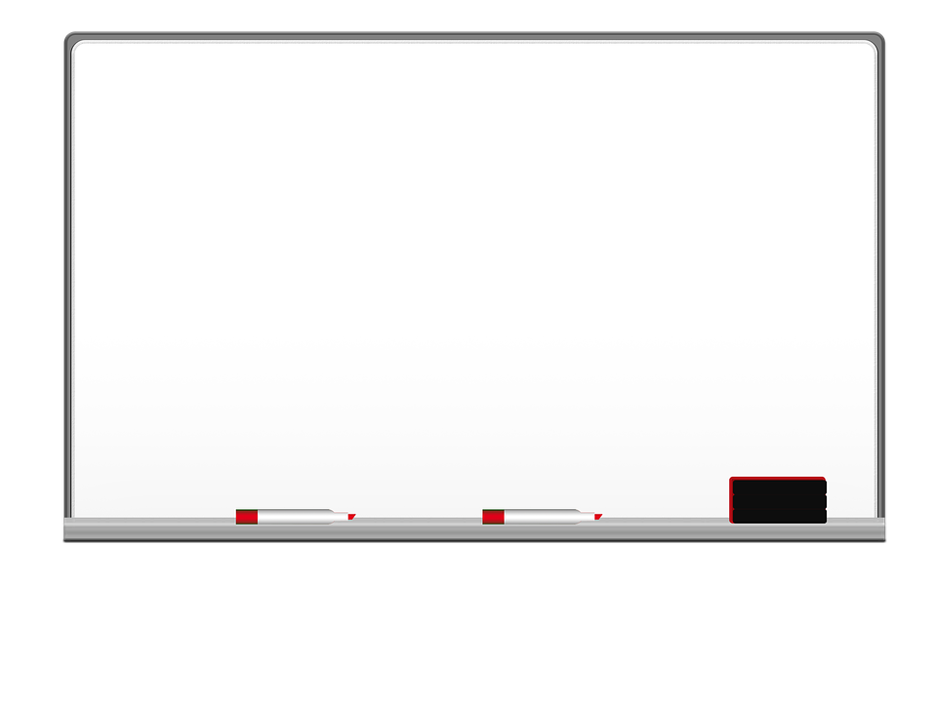



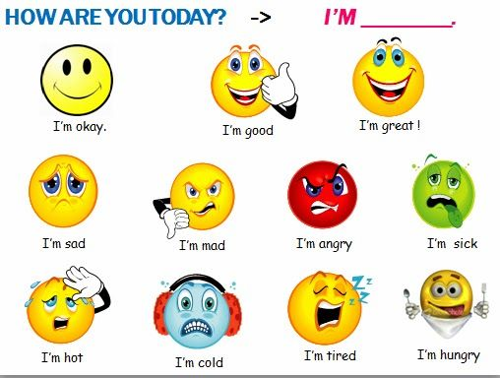
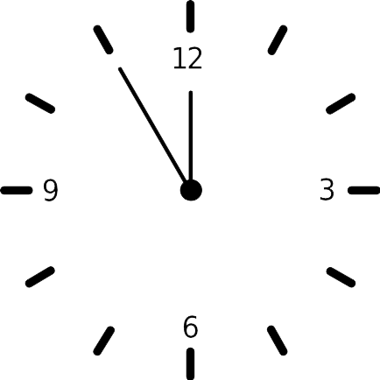



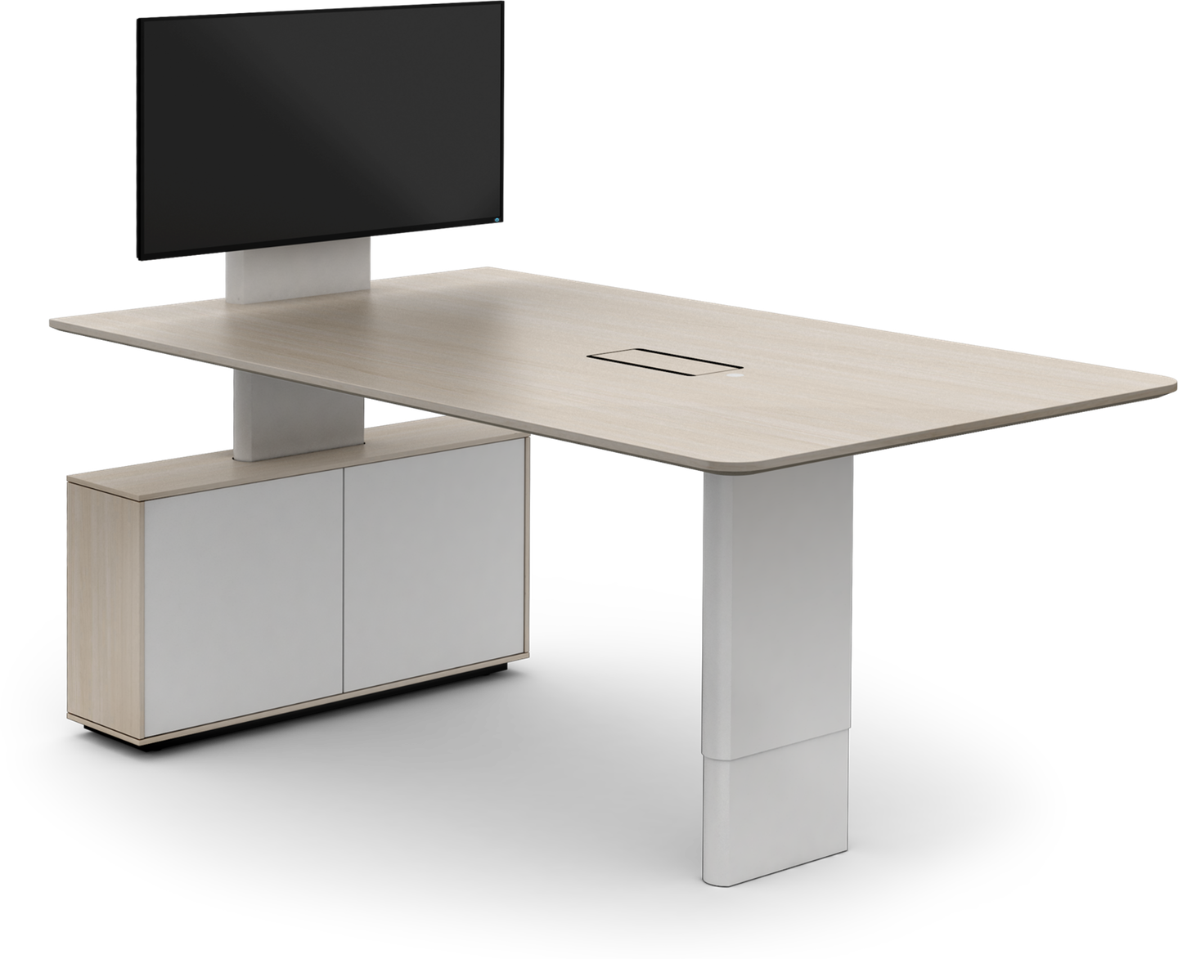
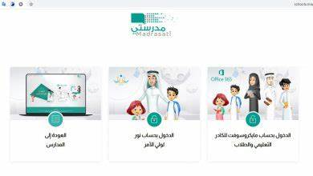







I love English

Slide 3

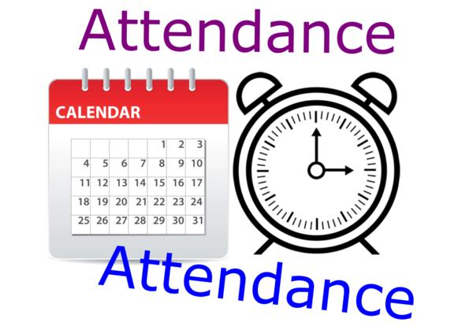
I love English

Slide 4
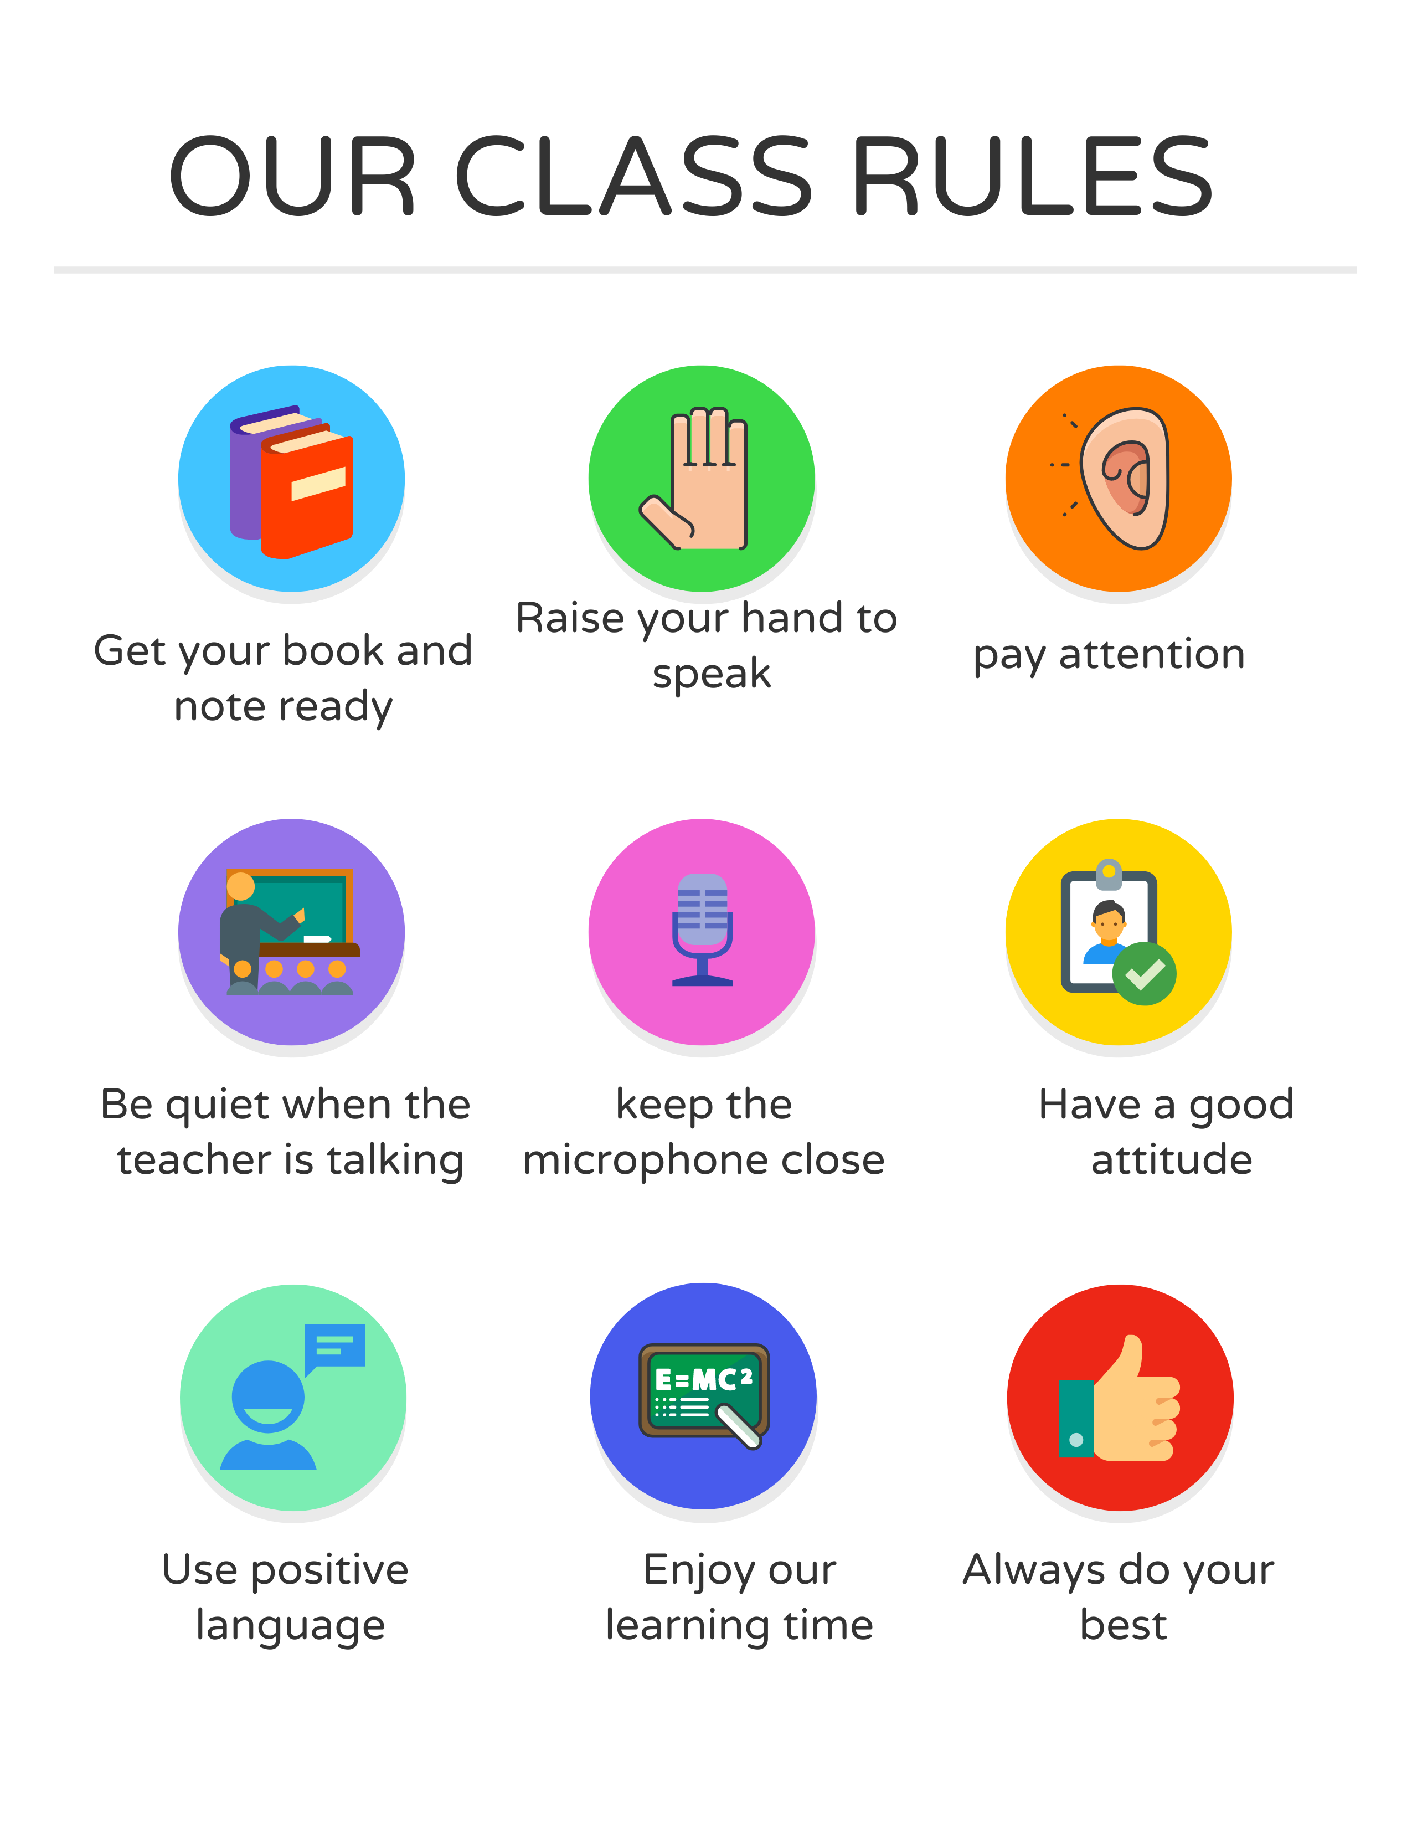

I love English

Slide 5

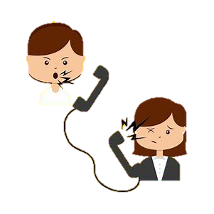

I love English
Mega Goal 2
Unit 3
Listen and Discuss
Thursday
6/7/1442

Slide 6

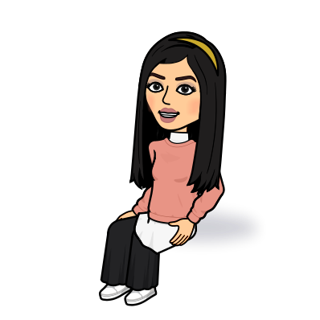
I love English
Lesson Goals
Students will be able to:
Identify the complaint sentence.
Find the problem in each category.
Answer questions about complaints.
Model a complaint according to the text.
Form a conversation about the complaints.

Slide 7
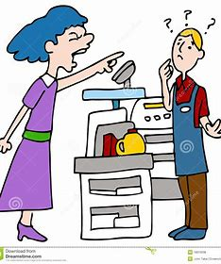
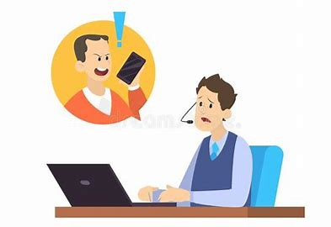
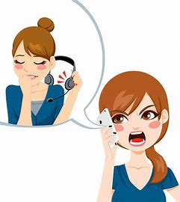
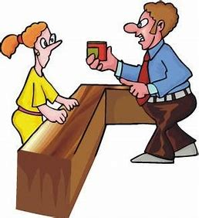
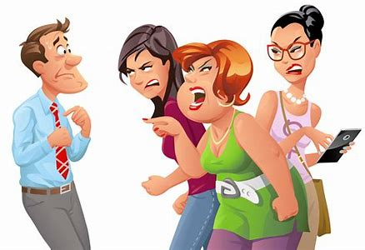

I love English
Look at the pictures then discuss

Slide 8
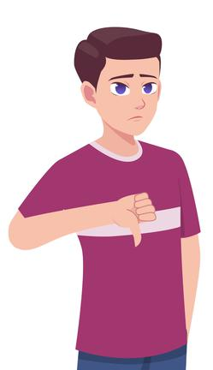

I love English
Have you ever bought or paid for something that you weren’t happy with?
What did you do?
Where do you go if you have any problems or complaints?

Slide 9


Serving and looking after customers

Slide 10





What’s the title of the unit?
Complaints, Complaints
What does complaint mean?
A statement that something is unsatisfactory or unacceptable
unhappy
angry
unsatisfied
Complaints

Slide 11

How do you handle customer complaints?
❍ Listen carefully
❍ Ask questions in a caring and concerned manner
❍ Apologize
❍ Don't take it personally
❍ Solve the problem

Slide 12
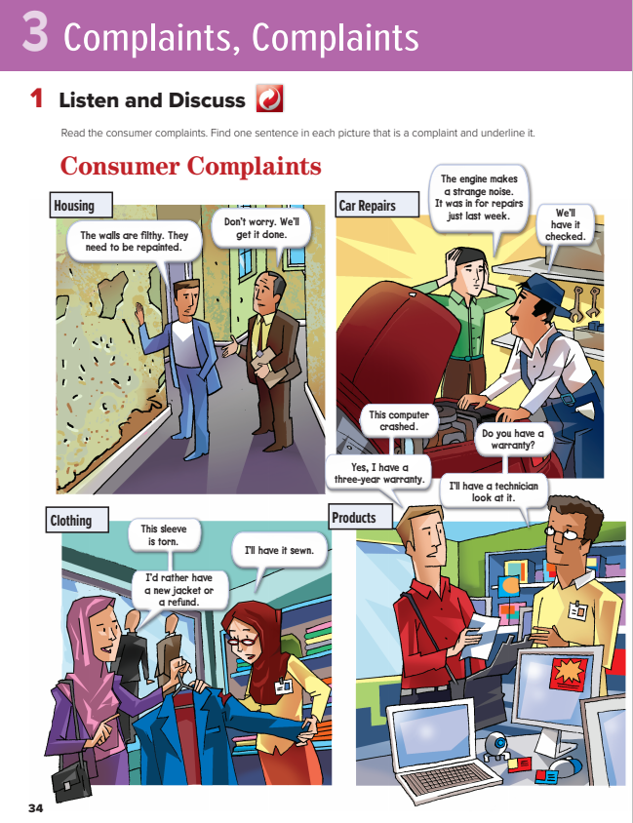

I love English
Open your Student’s book page: 34

Slide 13
How many pictures are there?
How many persons?
What do these pictures have in common?
Each picture contains an item that is broken or damaged in some way.

Slide 14

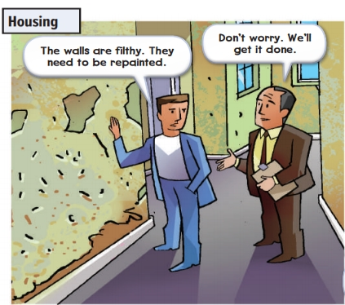

1- Housing
(problem about house)
Where does this happen?
In the apartment/house.
What’s the problem?
filthy = very dirty

Slide 15
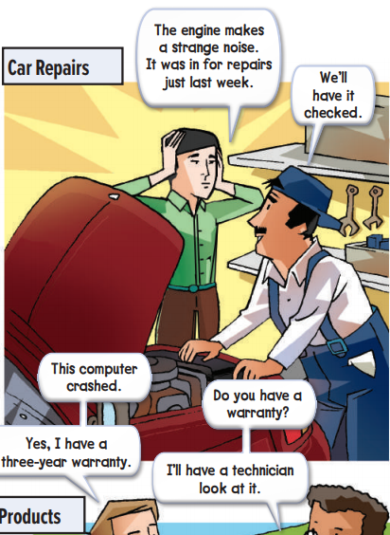
2- Car Repairs
(problem with car repairs)
Where is the problem?
What’s the problem?

Slide 16
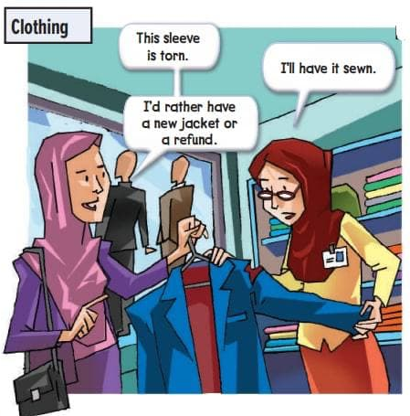
3- Clothing
(problem with the jacket)
What’s the problem with the jacket?
Does she need her money back?
Yes, she does.
torn = shredded
refund = get one’s payment back

Slide 17
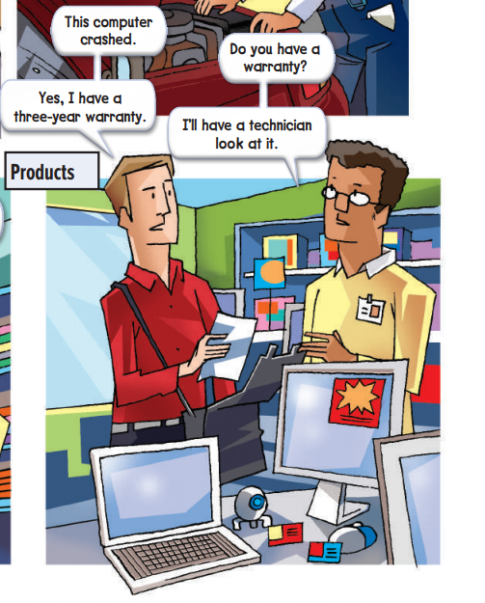
4- Products
(problem with computer)
What’s the problem with the computer?
Does he fix it for him?
Yes, he does.
crashed = broken
technician = someone who makes repairs

Slide 18
Which sentence in each conversation is a complaint?
❍ The walls are filthy.
❍ The engine makes a strange noise.
❍ This sleeve is torn.
❍ This computer crashed.

Slide 19
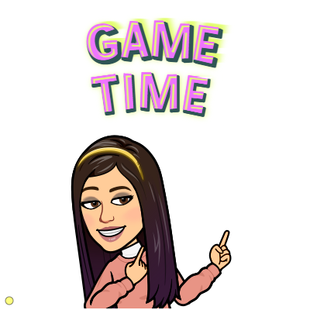

https://wordwall.net/resource/10908719

Slide 20
Match the words to their meaning
Meaning | Word
broken
someone who makes repairs
get one’s payment back
shredded
very dirty
filthy
torn
crashed
refund
technician

Slide 21
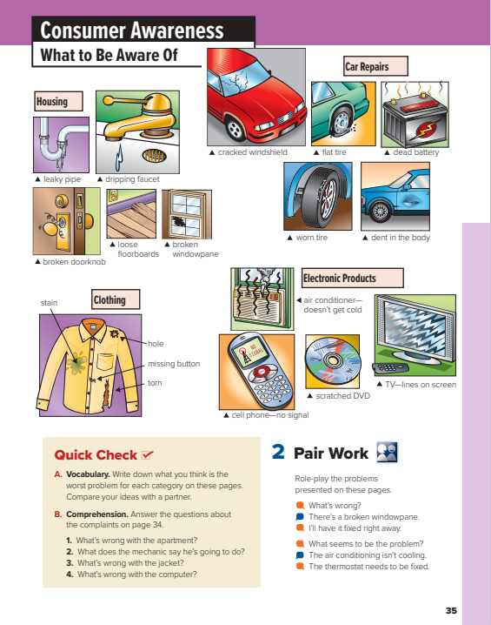
I love English
Open your Student’s book page: 35

Slide 22
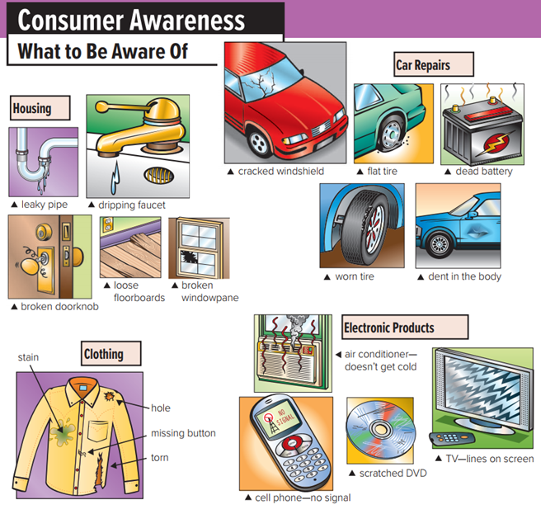



How many pictures are there?
What are the four categories of consumer problems shown?

Slide 23
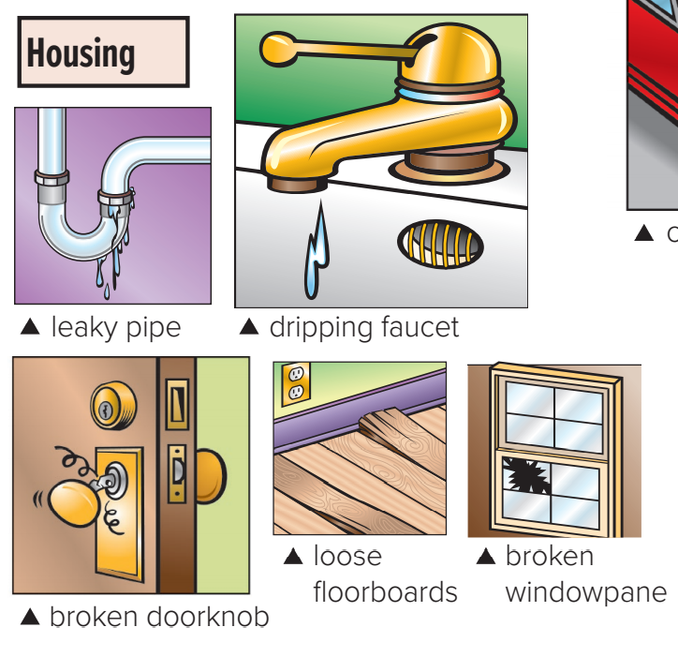
What to be aware of?

Slide 24
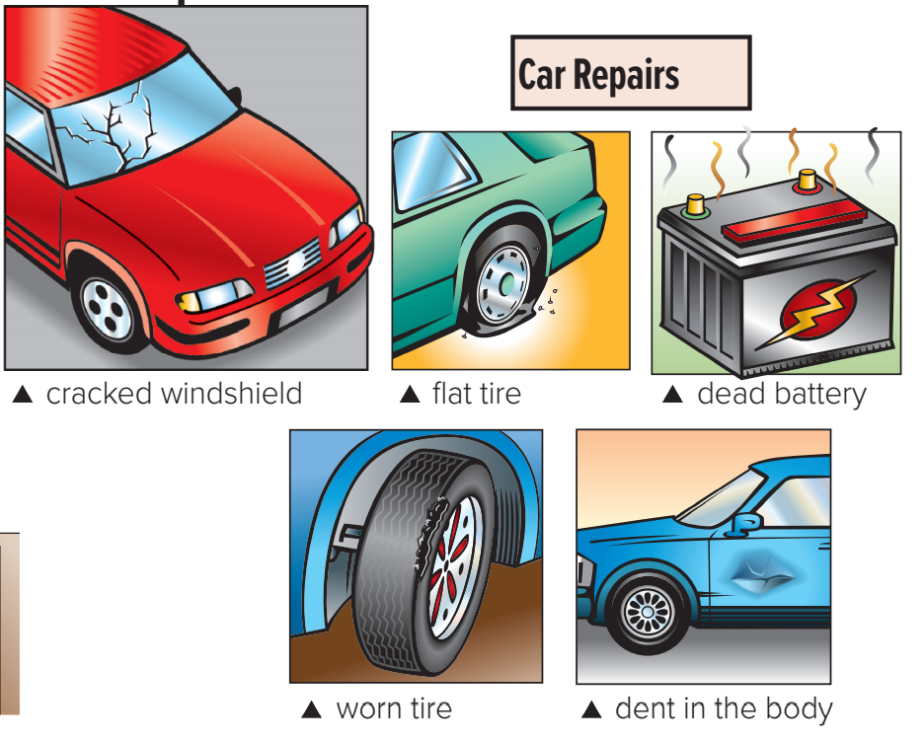
What to be aware of?
Flat tire = = a tire that has no air in it
dead battery = no power in the battery
Dent = surface of car is bent in from being hit

Slide 25
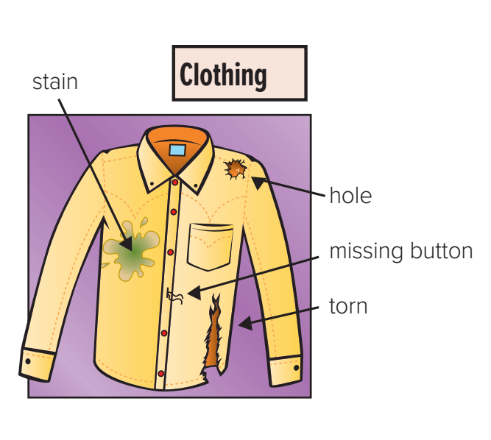
What to be aware of?

Slide 26
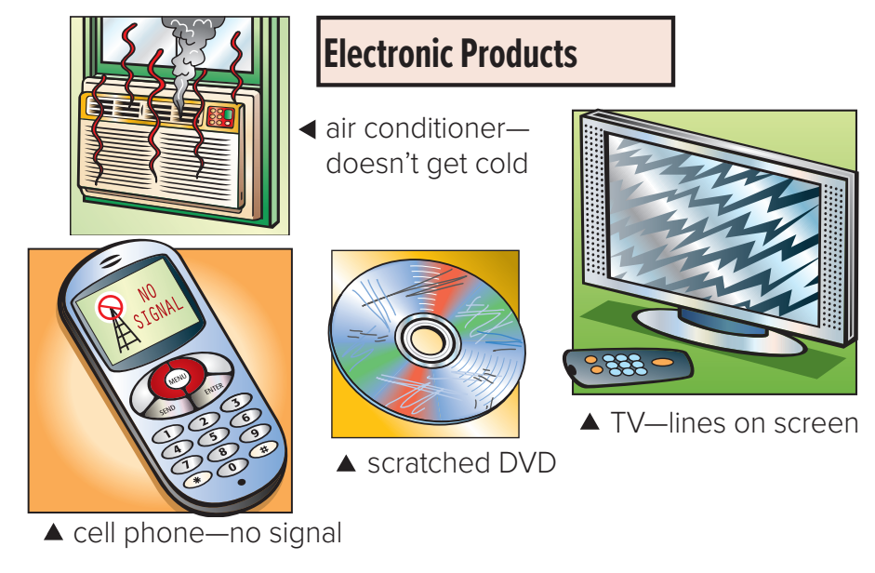
What to be aware of?

Slide 27
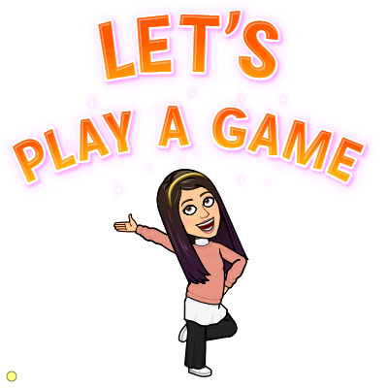
https://wordwall.net/resource/10909166

Slide 28
Match the words to their meaning
Meaning | Word
surface of car is bent in from being hit
a tire that has no air in it
no power in the battery
dead battery
dent
flat tire

Slide 29
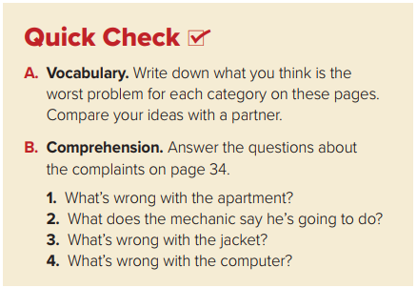

1- The walls are dirty and need to be repainted.
2- He says he’ll have the engine checked.
3- The sleeves are torn.
4- The computer crashed.

Slide 30
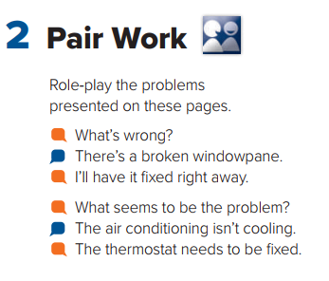


Slide 31
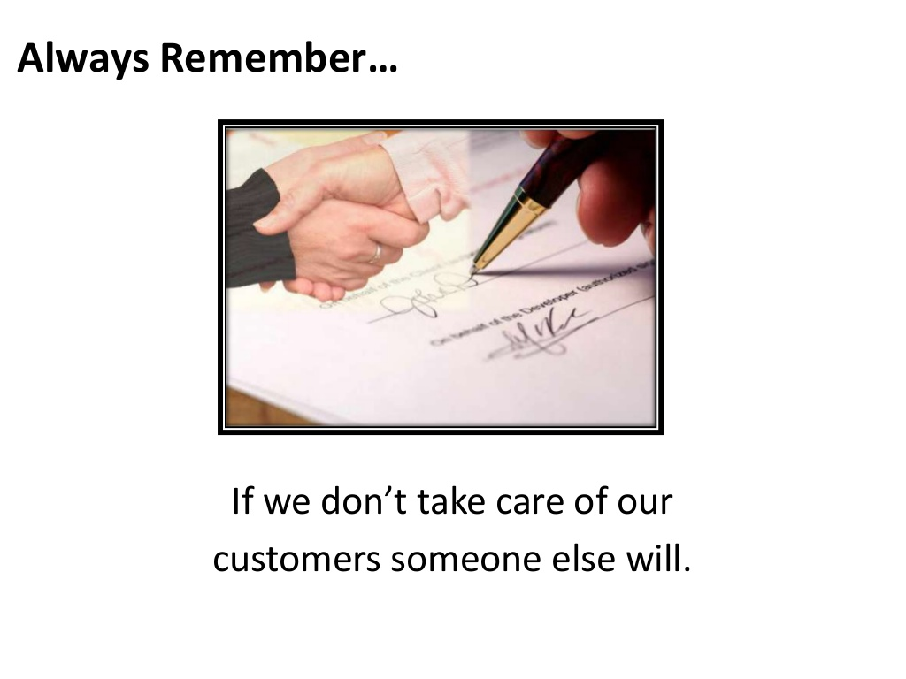


Slide 32



Homework
I love English
WORKBOOK Page21

Slide 33
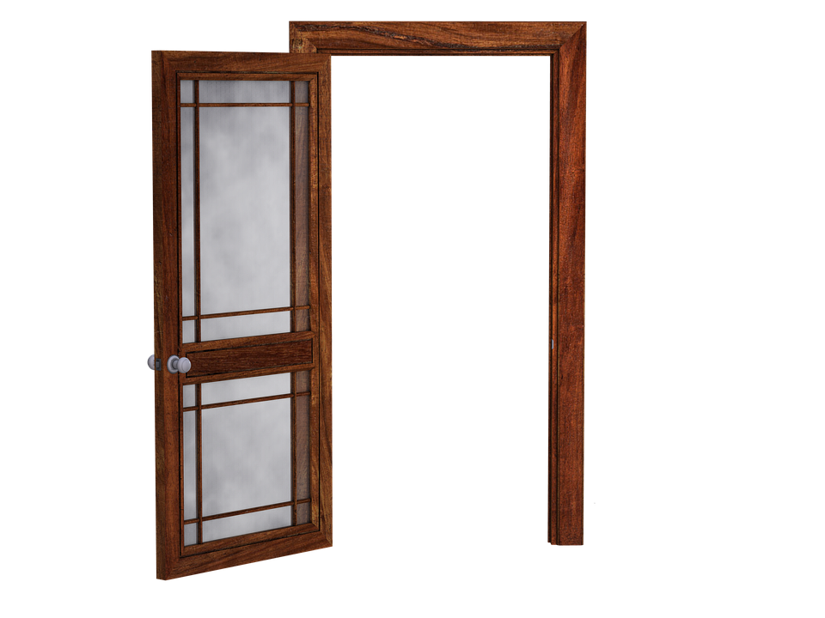
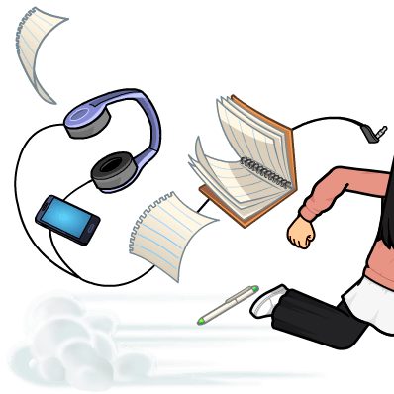
Homework
WORKBOOK Page21

Slide 34
Homework
WORKBOOK Page21

Slide 35
Homework
WORKBOOK Page21

Slide 36
Homework
WORKBOOK Page21

Slide 37
Homework
WORKBOOK Page21

Slide 38

Homework
WORKBOOK Page21

