Slide 1


Hello My lovely students
I’m your teacher
Hanan AlShobaily

Slide 2



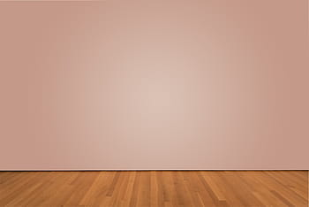
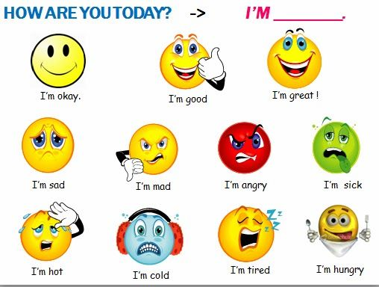
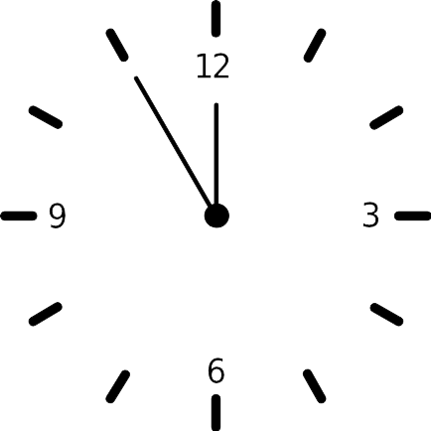












I love English

Slide 3


I love English

Slide 4

I love English
Revising the previous lesson
Match the words with their meaning:
1
fade
flimsy
2
trend
It sounds like
3
4
A
B
D
Thin/light/not strong
style
C
To lose color or brightness
It seems to be

Slide 5

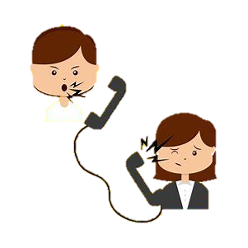

I love English
Mega Goal 2
Unit 3
(Complaints, Complaints)
Reading
Wednesday
12/7/1442

Slide 6

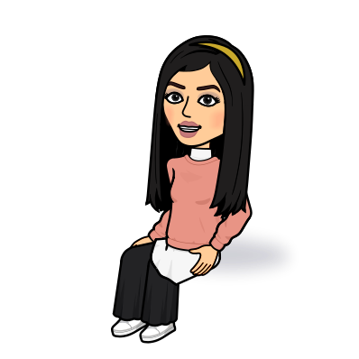
I love English
Lesson Goals
Students will be able to:
Answer specific questions based on a reading text.
Recognize the sentences that talk about something that went wrong.
Illustrate what Murphy’s Law means
Identify the meaning of new words in the text.

Slide 7
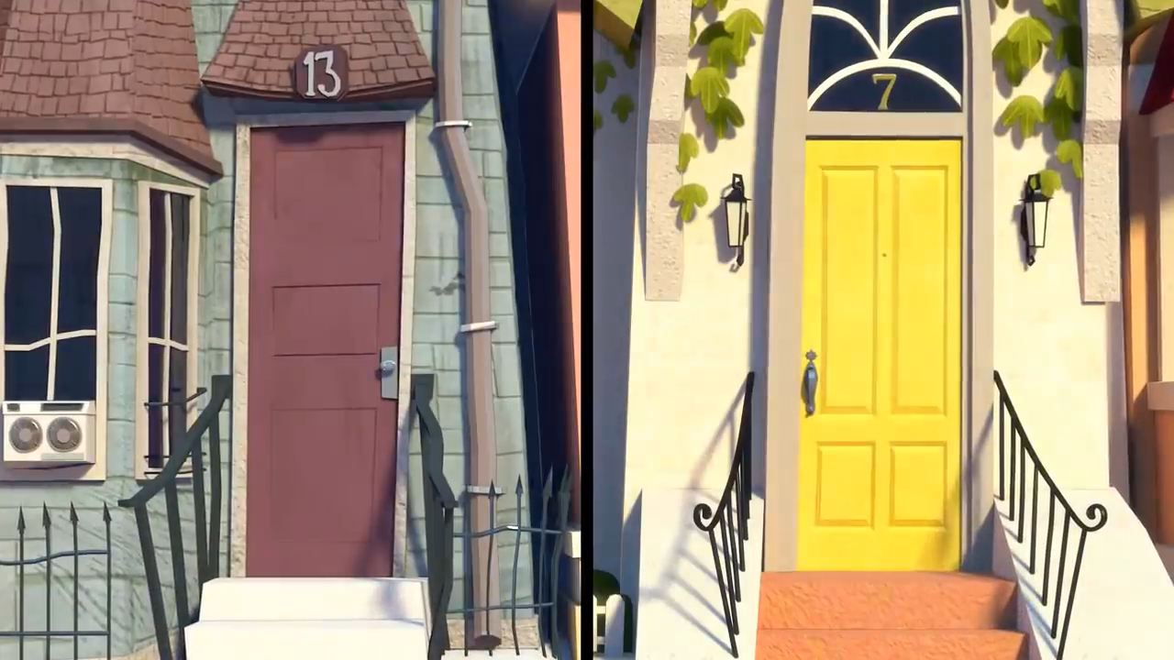

I love English
Watch this video then tell me what do you think about?

Slide 8


I love English
Have You Ever Heard of Murphy’s Law?

Slide 9
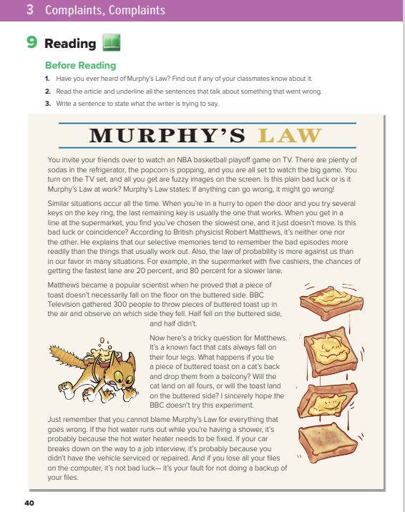

I love English
Open your Student’s book page: 40

Slide 10
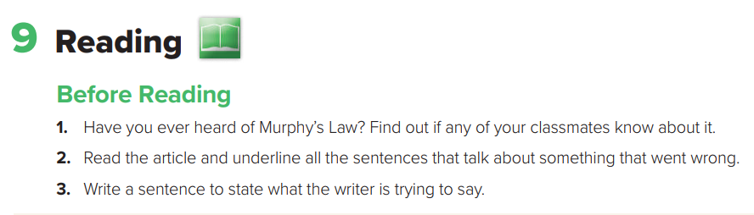
Before Reading

Slide 11
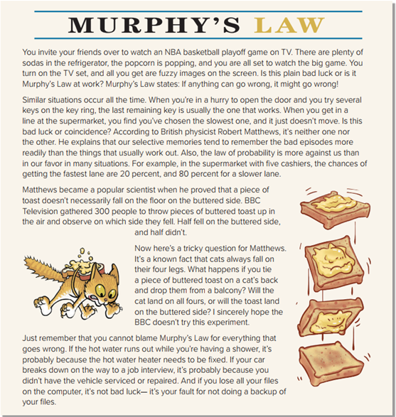
Skimming
What’s the title?
How many paragraphs are there?
How many pictures are there?
What do the pictures show?

Slide 12


I love English
Watch this video then guess what it is about?

Slide 13

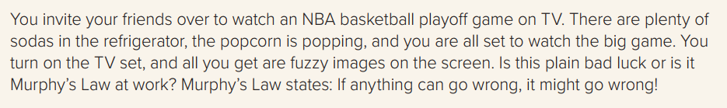

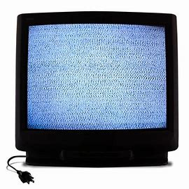
What does Murphy’s Law state?
fuzzy = not clear

Slide 14
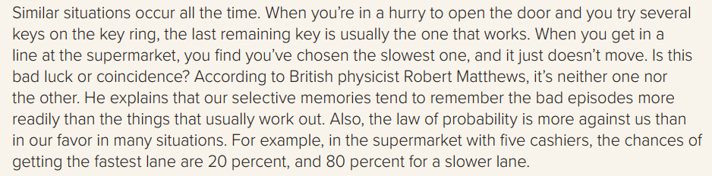
Which key does usually work when you try to open the door in a hurry according to the text?
What’s the main idea of this paragraph?
Matthews explanation
Who’s Matthews?
What is Mathews opinion?
episode = event
What does Matthews explain?

Slide 15
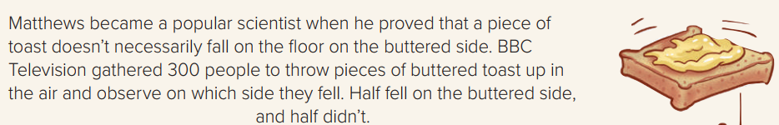
When did Matthews become a popular scientist?
How many people did BBC Television gather to the toast experiment?
Why did BBC Television do that?
What was the result?

Slide 16
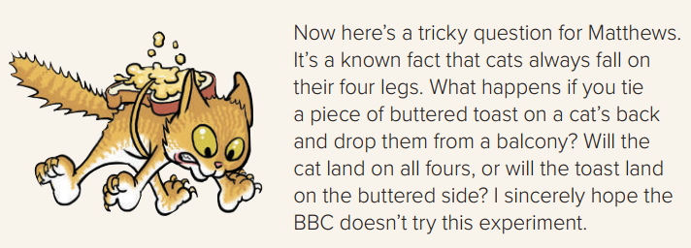
What is the writer’s question for Matthews?
On all four = on four feet

Slide 17
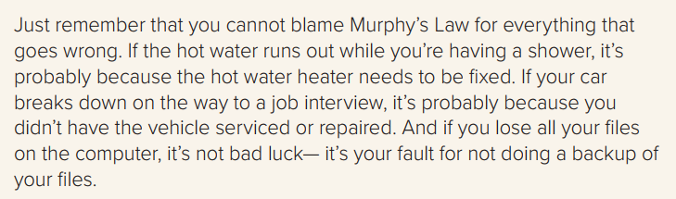
Can we blame Murphy’s Law for everything that goes wrong?
No, we can’t
Give Examples.
Backup = copy

Slide 18
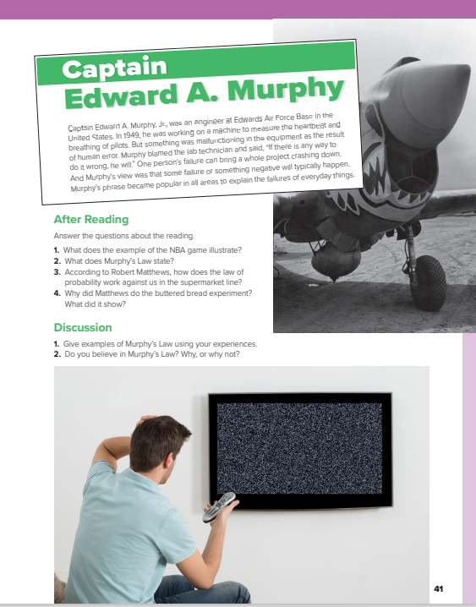
I love English
Open your Student’s book page: 41

Slide 19
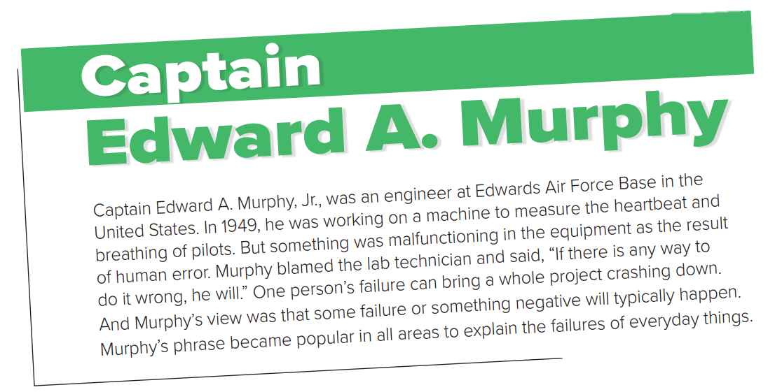
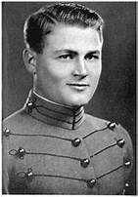
Why is it called Murphy’s Law?
Because Edward A. Murphy first used it to talk about a situation in his lab.
What’s his job? Where did he work?
What happened in 1949?
What did Murphy do when that happened?
malfunctioning = not working correctly
Why did Murphy’s phrase become popular in all areas?

Slide 20
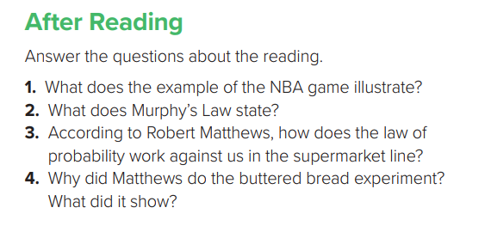

1- It illustrates that things seem to go wrong at precisely the wrong time.
2- If anything can go wrong, it will.
3- Because the chances of getting in the fastest lane aren’t that high. For example, if there are five lines, our chance of getting a slower lane is four out of five, or 80 percent.
4- He wanted to show that although people think that bad things always happen, things happen according to the law of probability.

Slide 21
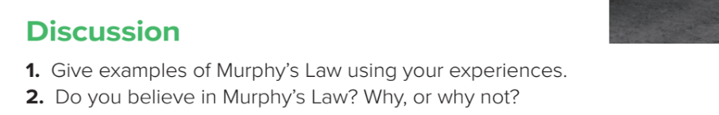
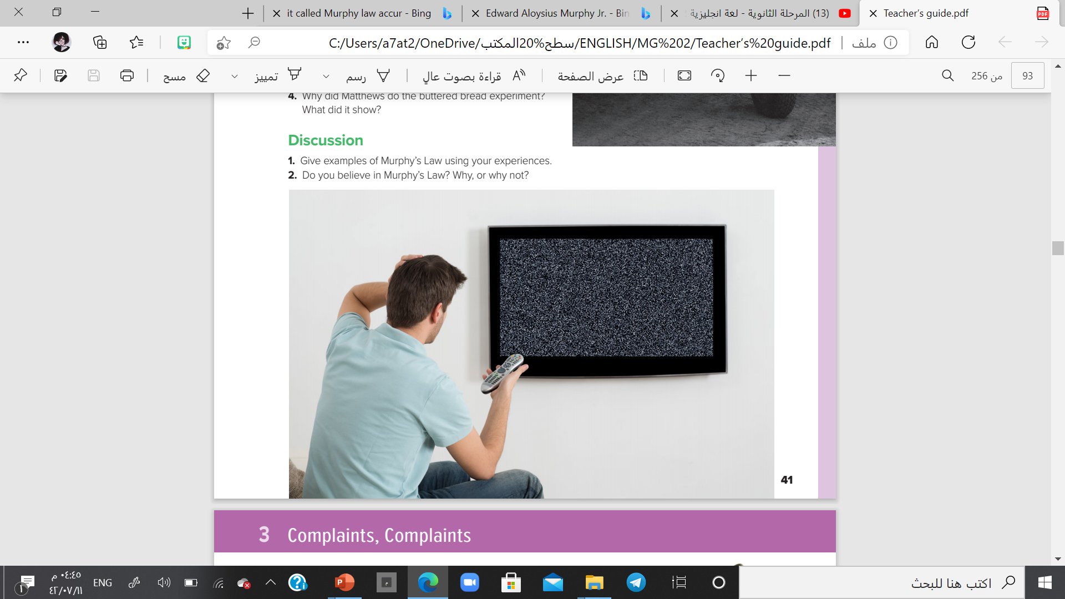

Slide 22
Match the words to their meaning
Meaning | Word
copy
not working correctly
Not clear
event
On four feet
fuzzy
episode
on all fours
backup
malfunctioning

Slide 23


https://wordwall.net/resource/11279064

Slide 24

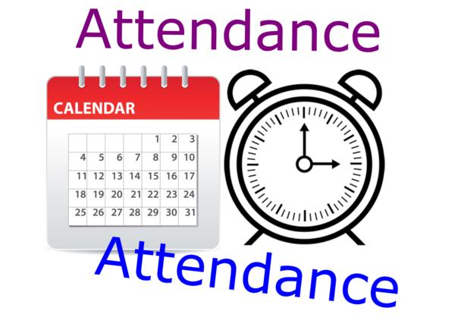
I love English

Slide 25



Slide 26



Homework
I love English

Slide 27

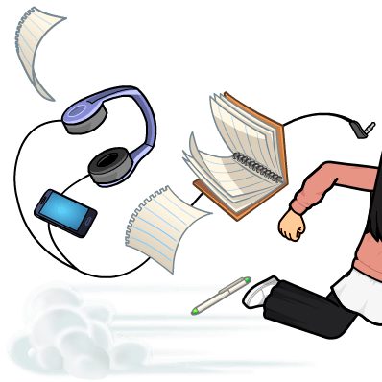
Homework

Slide 28
Homework

Slide 29
Homework

Slide 30
Homework

Slide 31
Homework

Slide 32

Homework

