Slide 1
Unit5
If It Haden’t Happened
Reading
Done by : Entisar Al-Obaidallah

Slide 2

Lesson Objectives
Read
Discuss
Mario’s Advice Column for specific information
The most common problems that people write to advice column
Answer
Discuss
comprehension questions about the letters
Whether advice from advice columns is helpful or not

Slide 3
Warm Up!

Slide 4

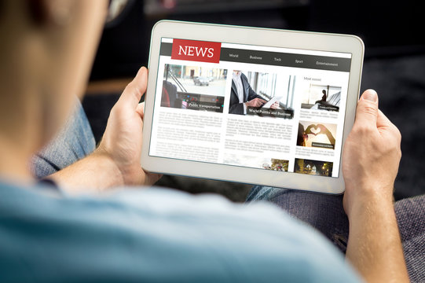
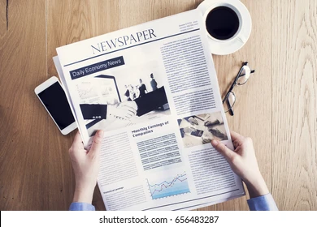
Do you like reading newspaper and magazine?
Digital ( online)
paper

Slide 5






What is the first column you read in a newspaper?
Medical Column
Advice Column
Sport Column
Gossip Column
Fashion Column
Food Column

Slide 6
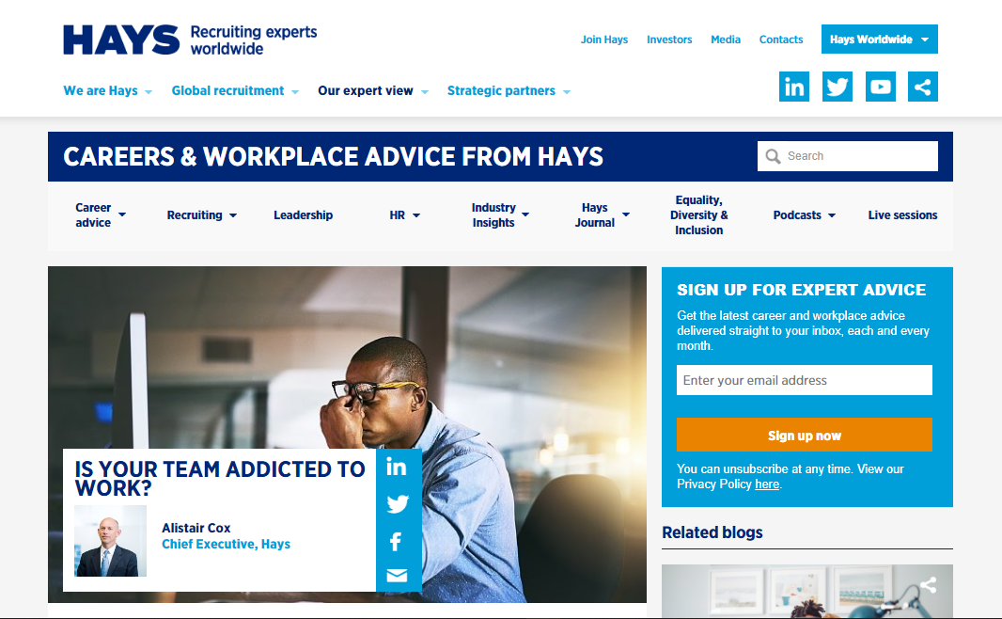
Advice Column
online

Slide 7
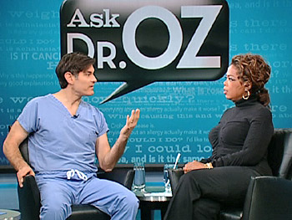
Advice Column
TV show

Slide 8
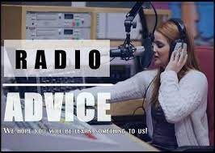
Advice Column
Radio shows

Slide 9
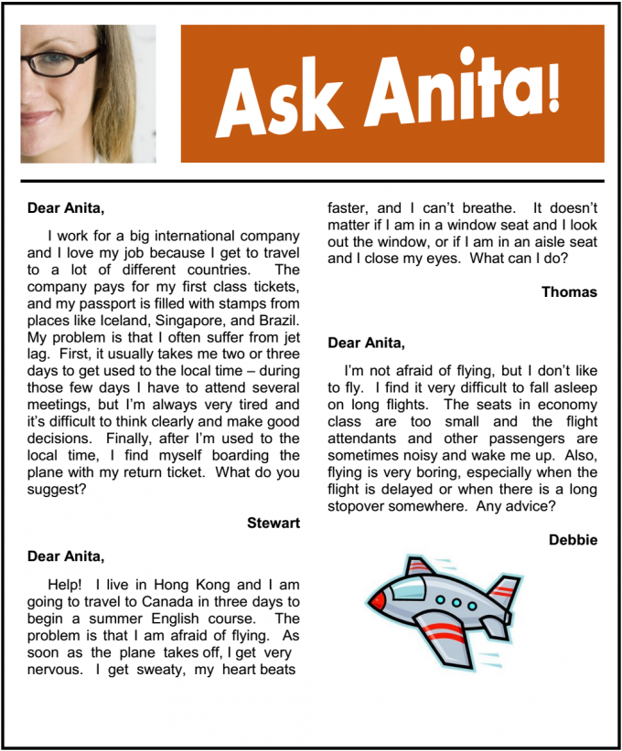
Advice Column
Newspaper

Slide 10
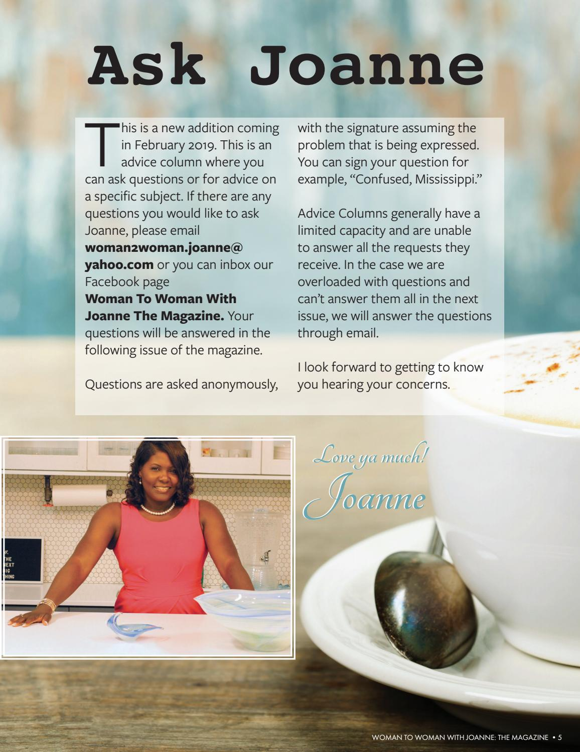
Advice Column
Magazines

Slide 11

Open your book p. 40-41

Slide 12
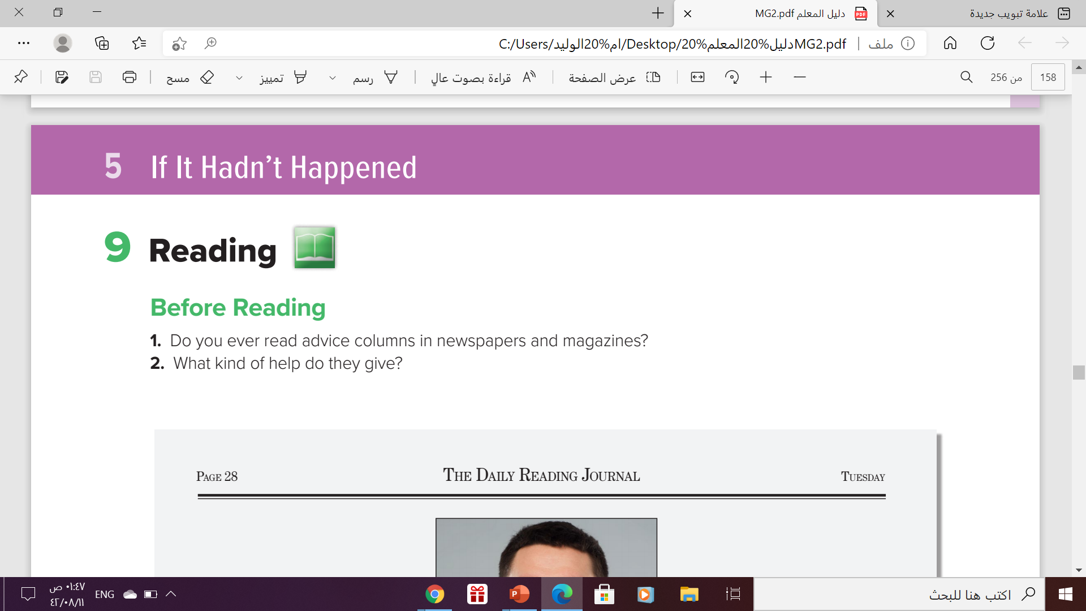
Before Reading

Slide 13

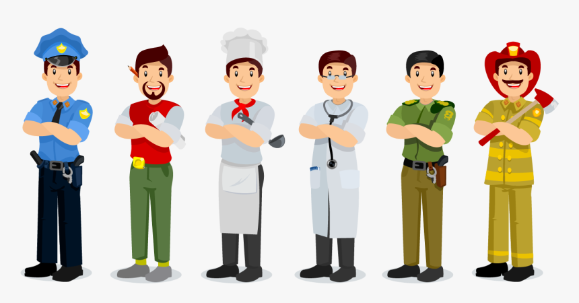


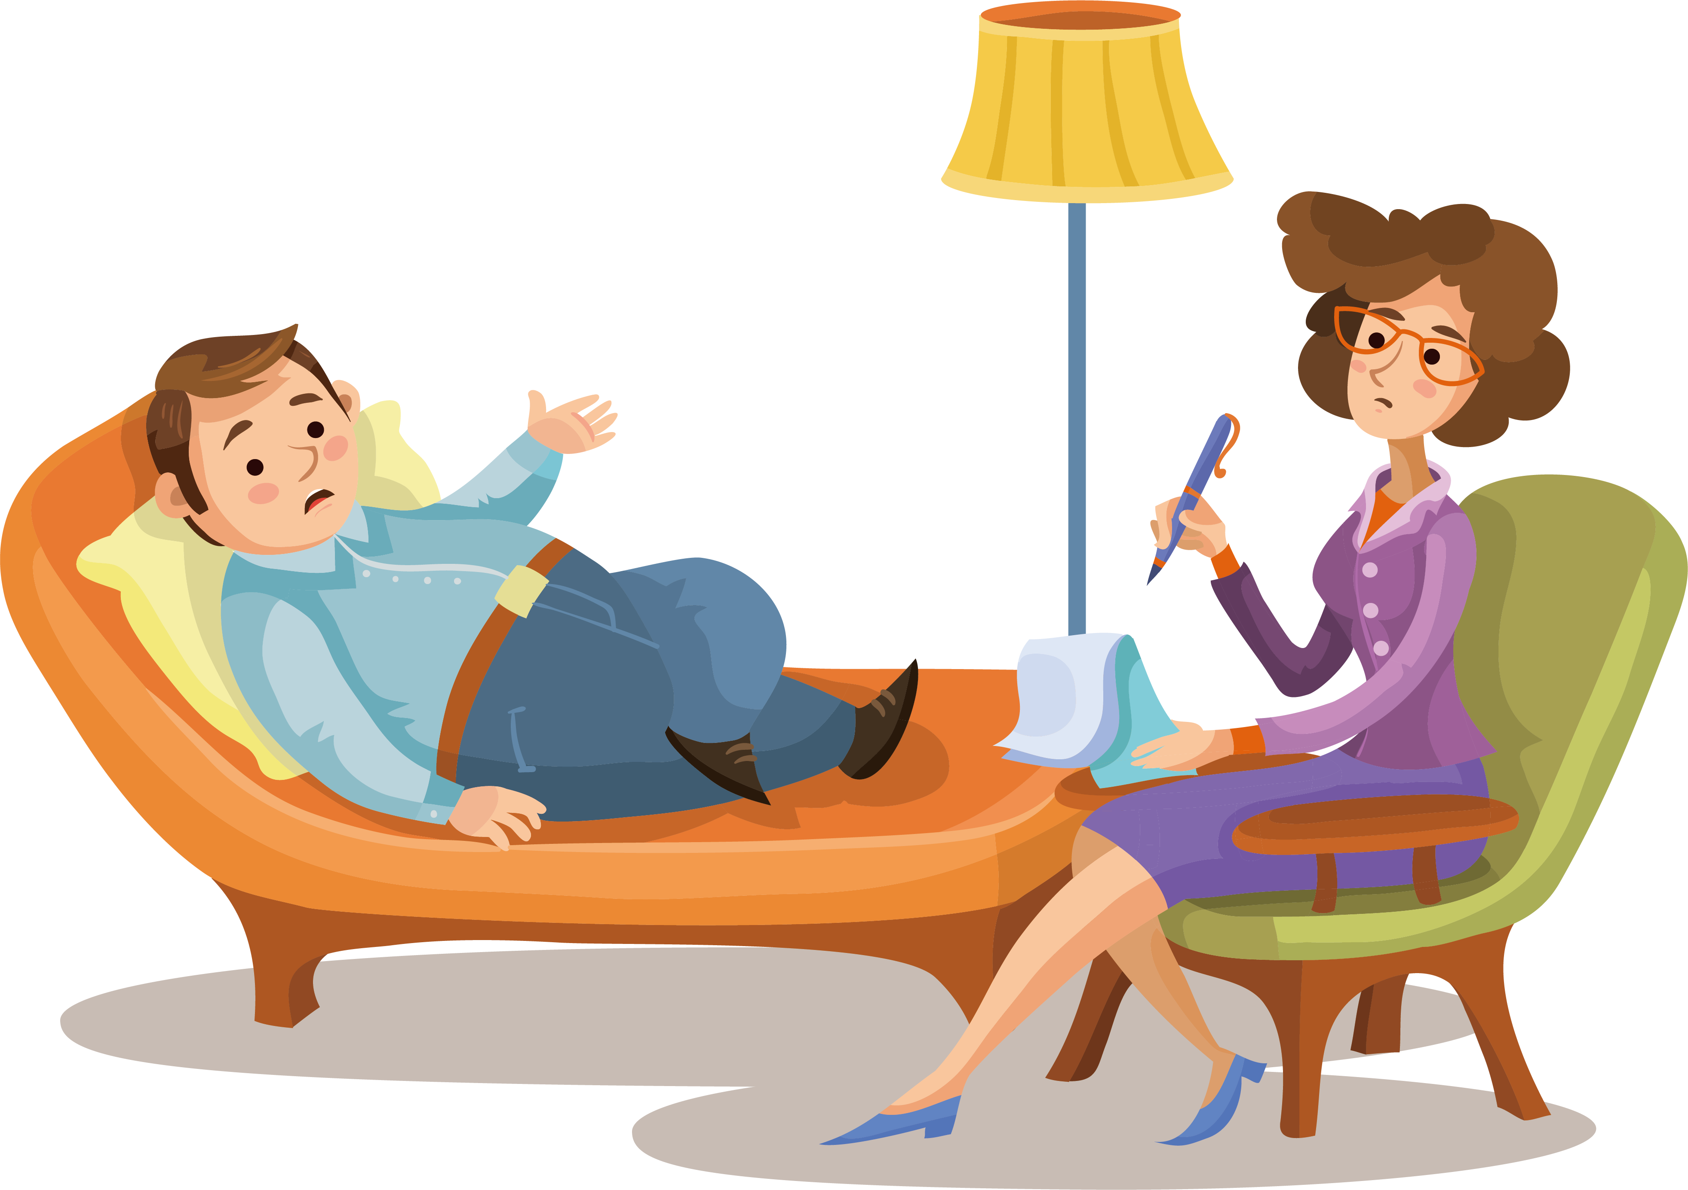
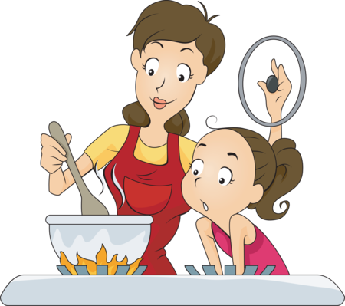
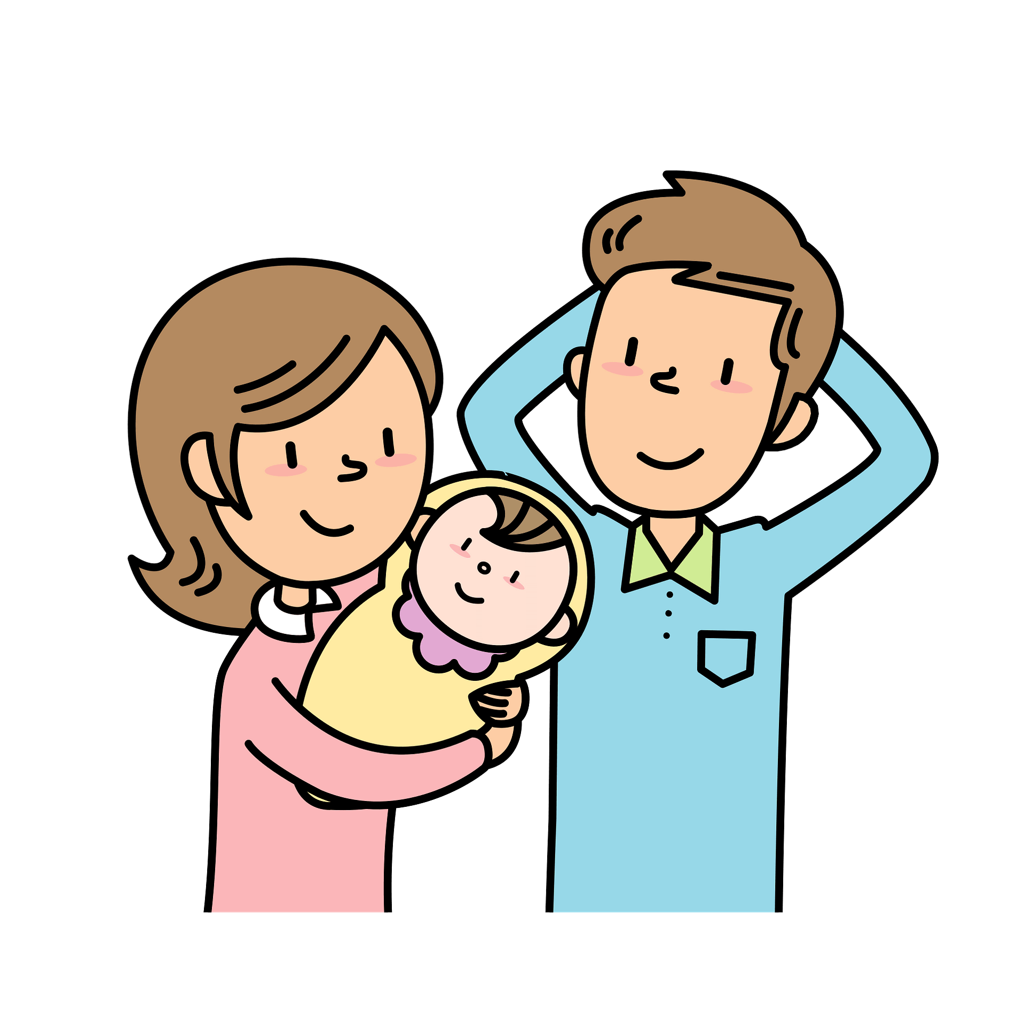
What kind of help do they give?
Health
jobs
Cosmetics ( makeup)
Household
psychology
Raising children
cooking

Slide 14

Advice Columns
The real purpose
of advice columns is to entertain people, NOT to give actual advice.

Slide 15
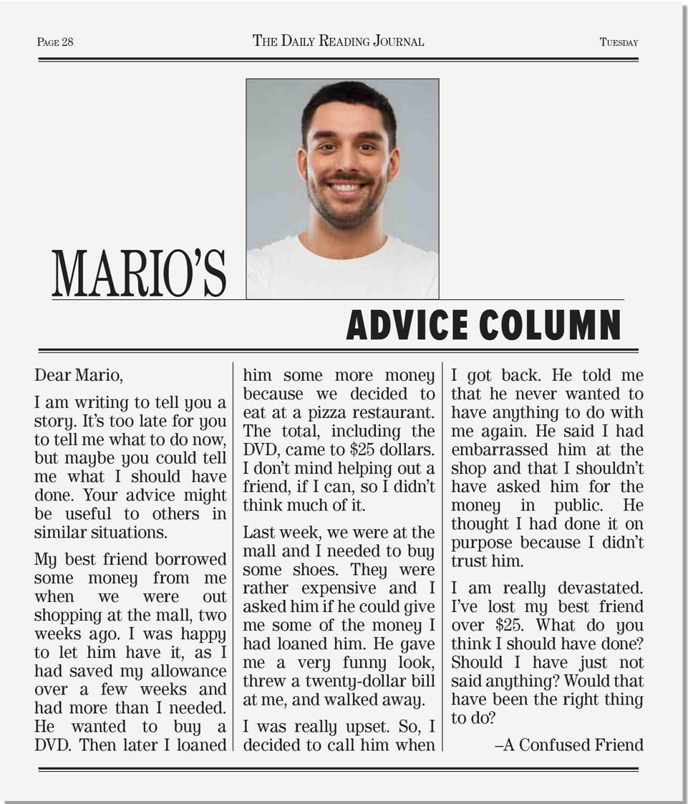
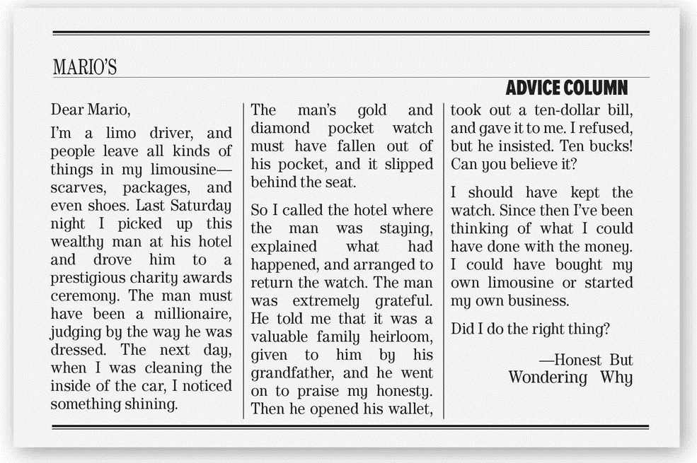
scanning
What is the title ?
Mario’s Advice Column
How many letters are there ?
Two
What do the pictures show ?
Mario + a limo driver

Slide 16


Listen and Answer
What is the main idea of this letter?
A problem with a friend
skimming

Slide 17
What happened at the mall two weeks ago?
The writer lent his friend some money
Why was the writer’s friend angry?
He was embarrassed because his friend asked him in public
What does the writer wish he hadn’t done?
He wish he hadn’t asked for a money in public

Slide 18
What is the main idea of this letter?
A missing watch

Slide 19
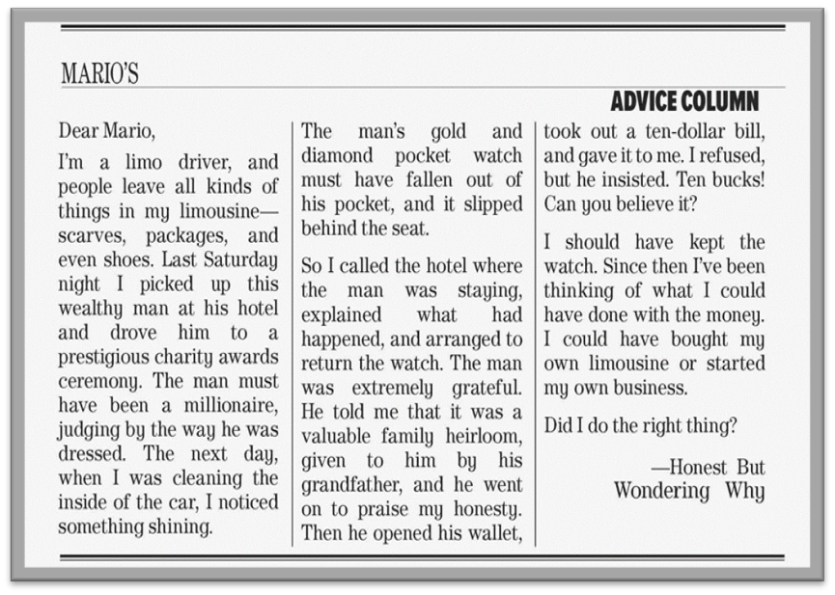
What did the limo driver find?
He found gold and diamond pocket watch
What did he do?
He returned the watch to the passenger
What does the limo driver think he should have done?
He thinks that he should have sold the watch and bought his own limo or started his own business

Slide 20
Guessing meaning from context
Can you guess the meaning of the following words??

Slide 21
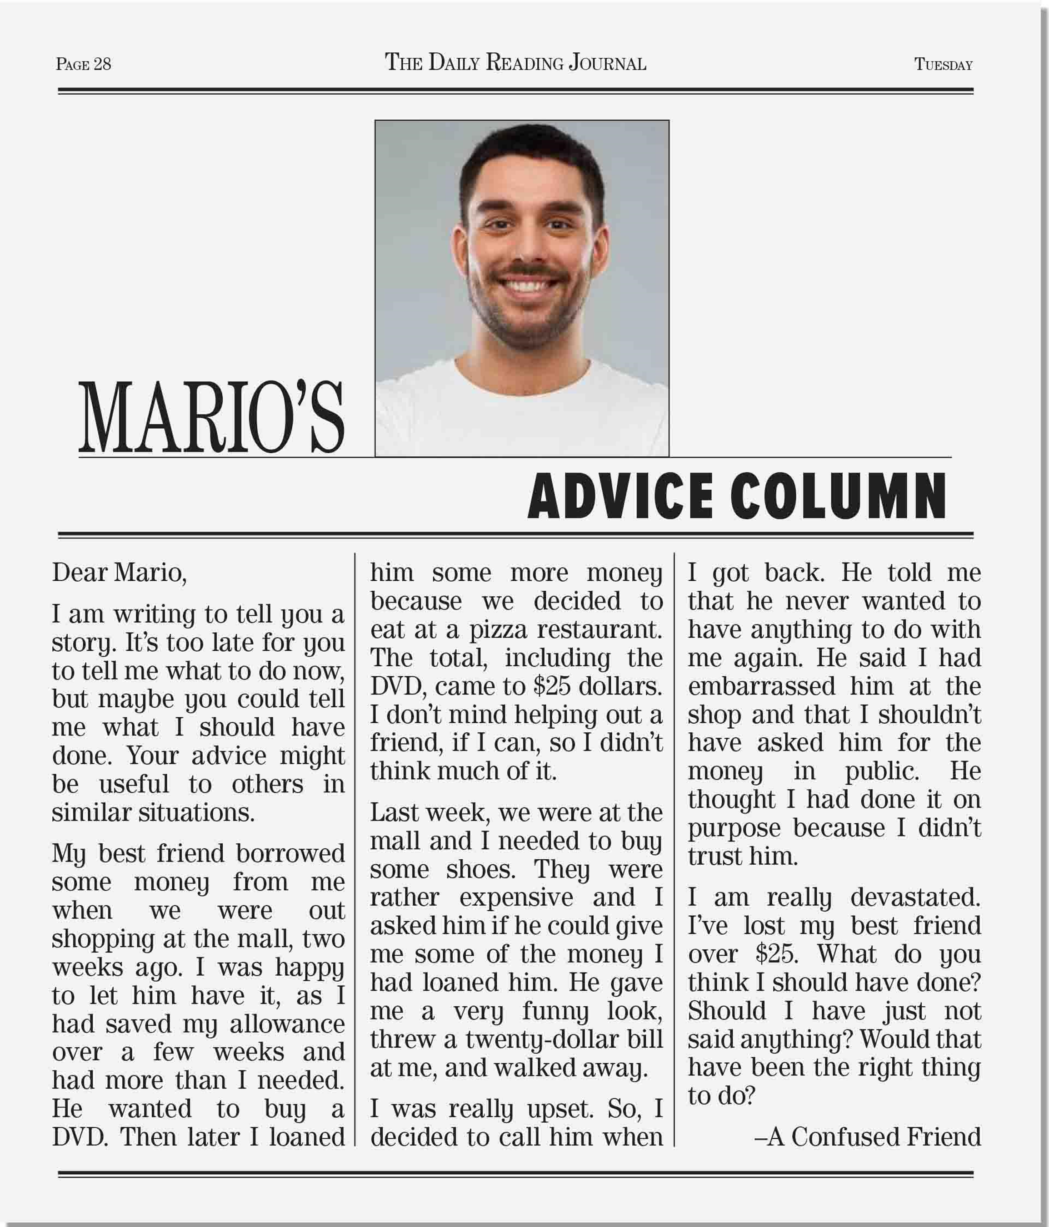
money that a parent regularly gives to the child

Slide 22
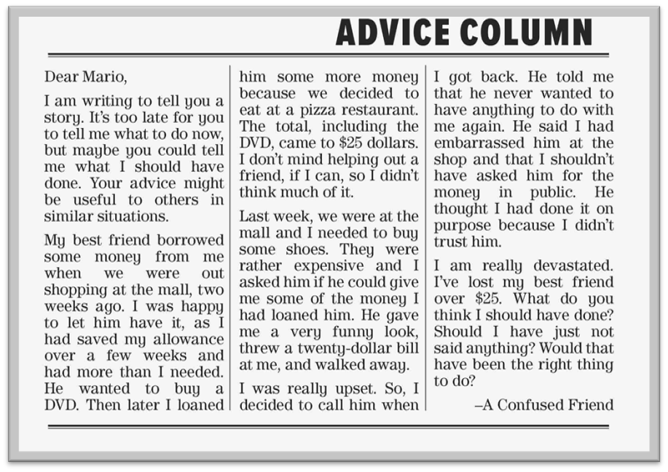
Show displeasure

Slide 23
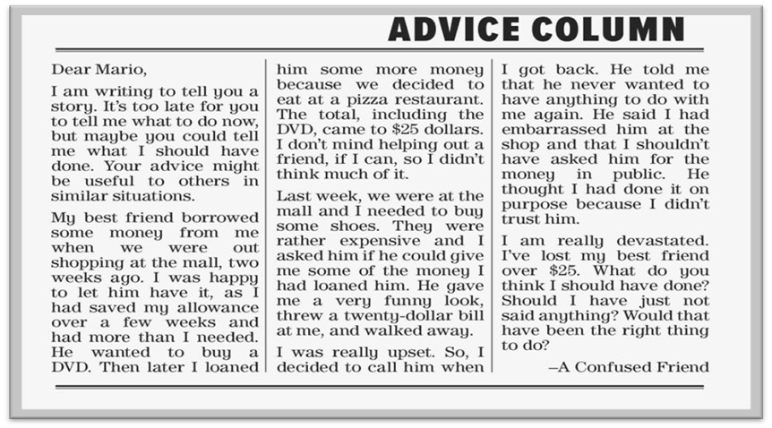
Not to have any social contact

Slide 24

Feeling very shocked and upset

Slide 25

greatful
praise
thankful
To say you admire

Slide 26
Scanning
Scan the second letter and underline the verb phrases with must, should, and could

Slide 28
Lanuage Builder
I’ve been thinking of and I’ve been thinking about can be used interchangeably in most contexts.
For example:
I’ve been thinking about taking a trip and I’ve been thinking of taking a trip mean exactly the same thing.

Slide 29
Remember
Must have
Should have
must have is used to make a conclusion.
should have and could have are used to express regret about possibilities in the past.

Slide 30
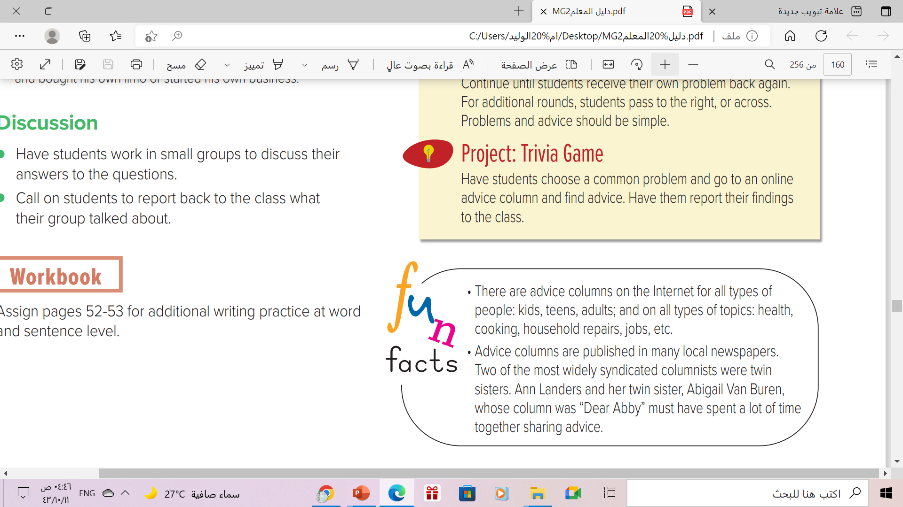
FunFacts

Slide 31
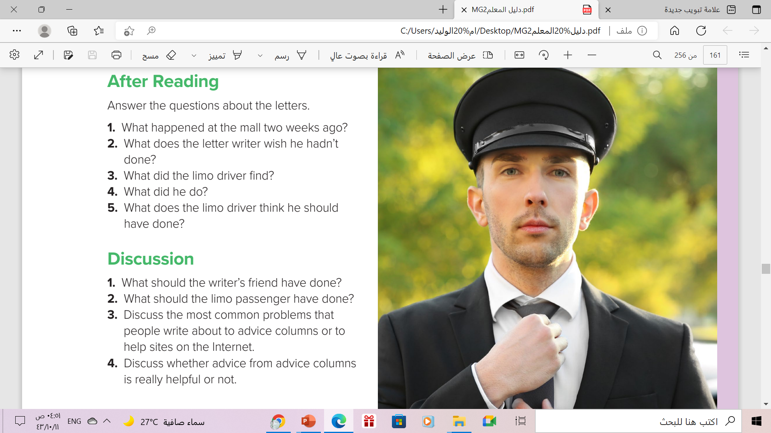
After Reading :
1- The letter writer lent some money to his friend
2-The letter writer wishes that he hadn’t asked for the money in public.
3-The driver found a passenger’s diamond pocket watch.
4-The driver returned the watch to the passenger.
5-The driver thinks that he should have sold the watch and bought his own limo or started his own business

Slide 32
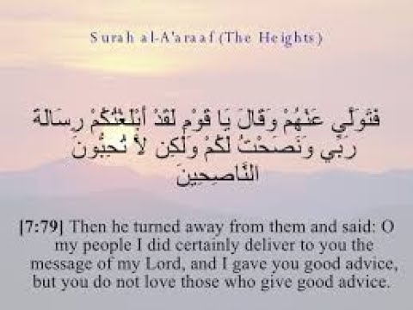
From The Holy Qura’an

Slide 33
Homework
Workbook p. (103) , exercise (G)

Slide 34

Thanks

