Slide 1


Welcome to class
T.

Slide 2


Unit 1
كتاب ثاني وثالث
Unit 8
كتاب رابع وخامس

Slide 3





workbook
2^{nd &} 3^{rd Grade}
Pages 39 , 40
workbook
^{4th & 5th Grade}
Pages 179 , 180

Slide 4

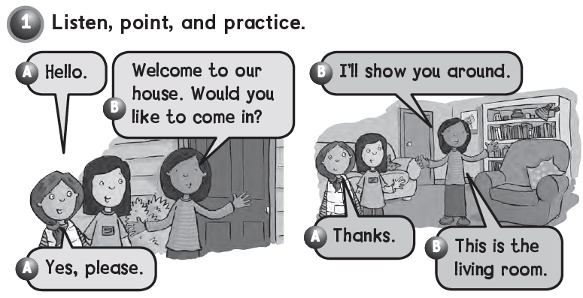

Slide 5
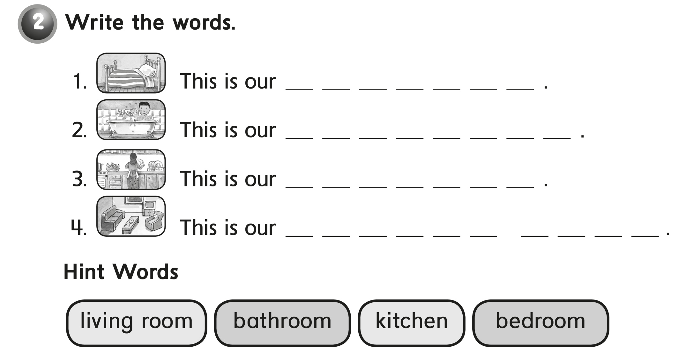
b e d r o o m
b a t h r o o m
K i t c h e n
L i v i n g r o o m

Slide 6

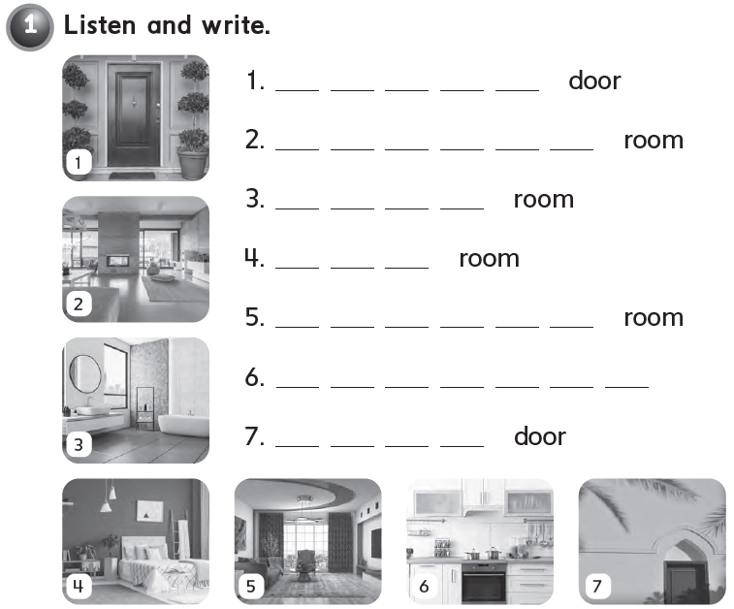
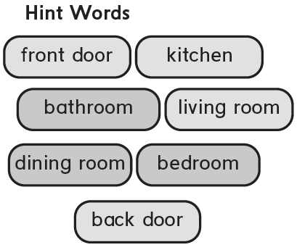
F r o n t
D i n i n g
B a t h
B e d
L i v i n g
K i t c h e n
B a c k

Slide 7
workbook
2^{nd &} 3^{rd Grade}
Pages 41 , 42
workbook
^{4th & 5th Grade}
Pages 181 , 182

Slide 8
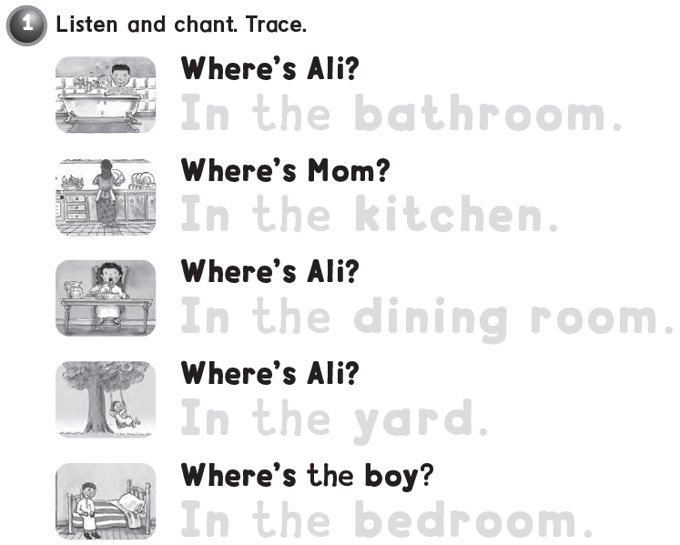

In the bathroom .
In the kitchen .
In the dining room .
In the yard .
In the bedroom .

Slide 9

mouse
bed

Slide 10
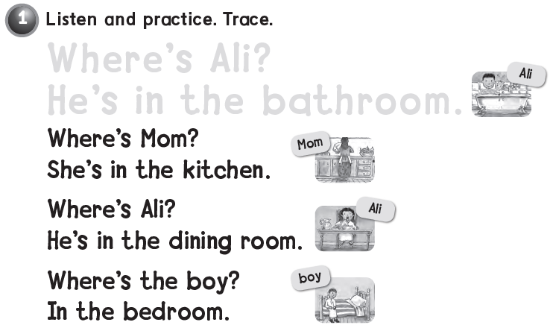

Where’s Ali ?
He’s in the bathroom .

Slide 11
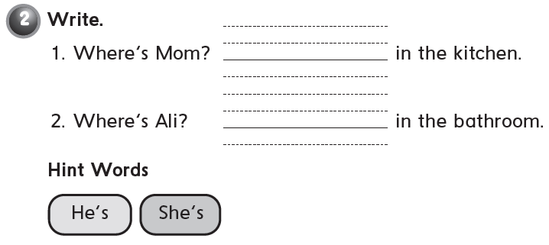
She’s
He’s

Slide 12
workbook
2^{nd &} 3^{rd Grade}
Pages 43 , 44
workbook
^{4th & 5th Grade}
Pages 183 , 184

Slide 13

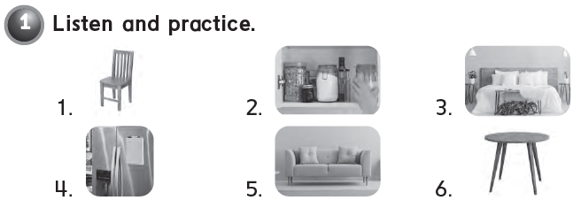

Slide 14
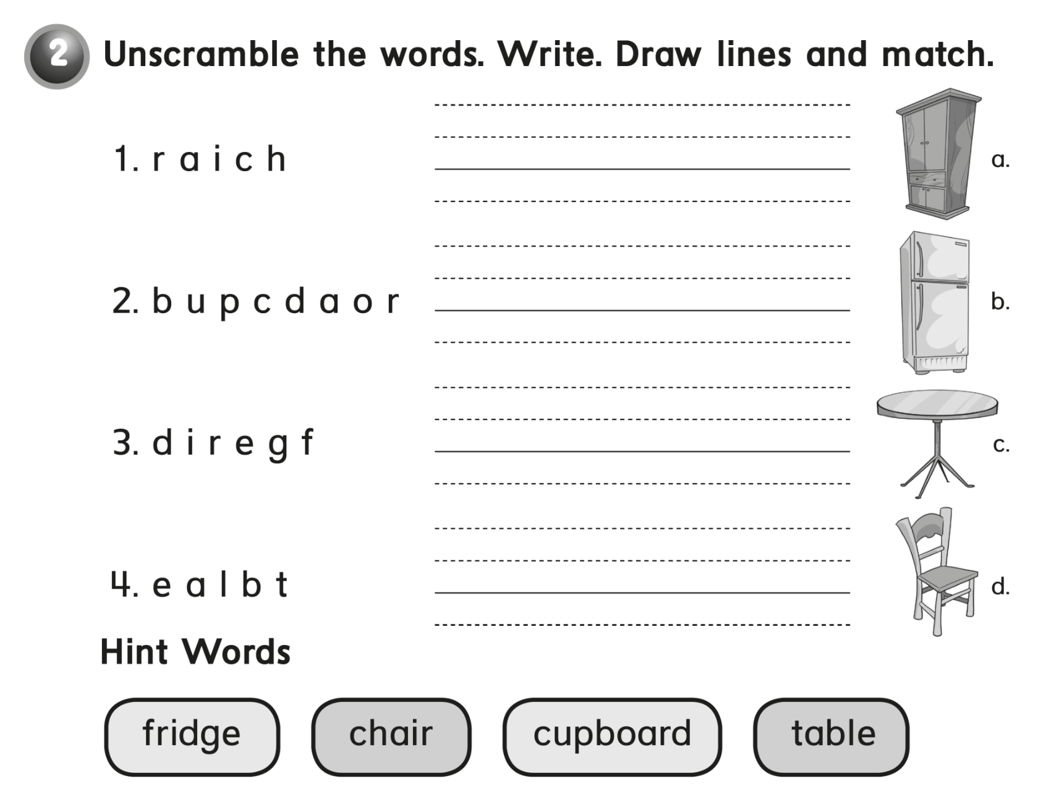
chair
cupboard
fridge
table

Slide 15
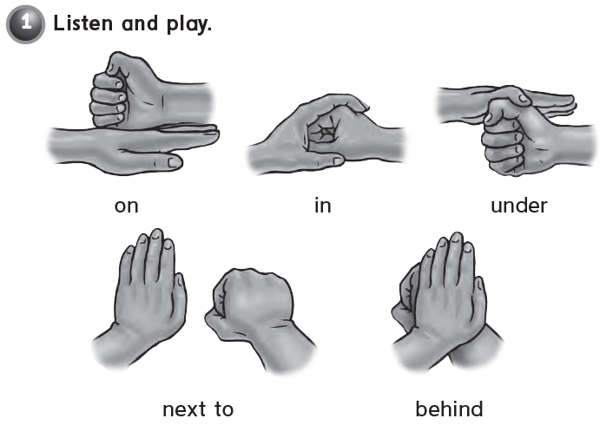


Slide 16
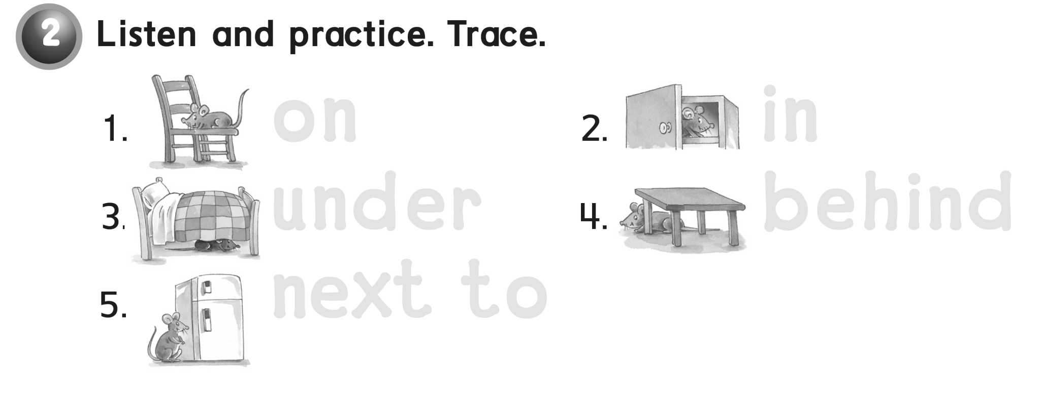
on in
under behind
next to

Slide 17
workbook
2^{nd &} 3^{rd Grade}
Pages 45 , 46
workbook
^{4th & 5th Grade}
Pages 185 , 186

Slide 18
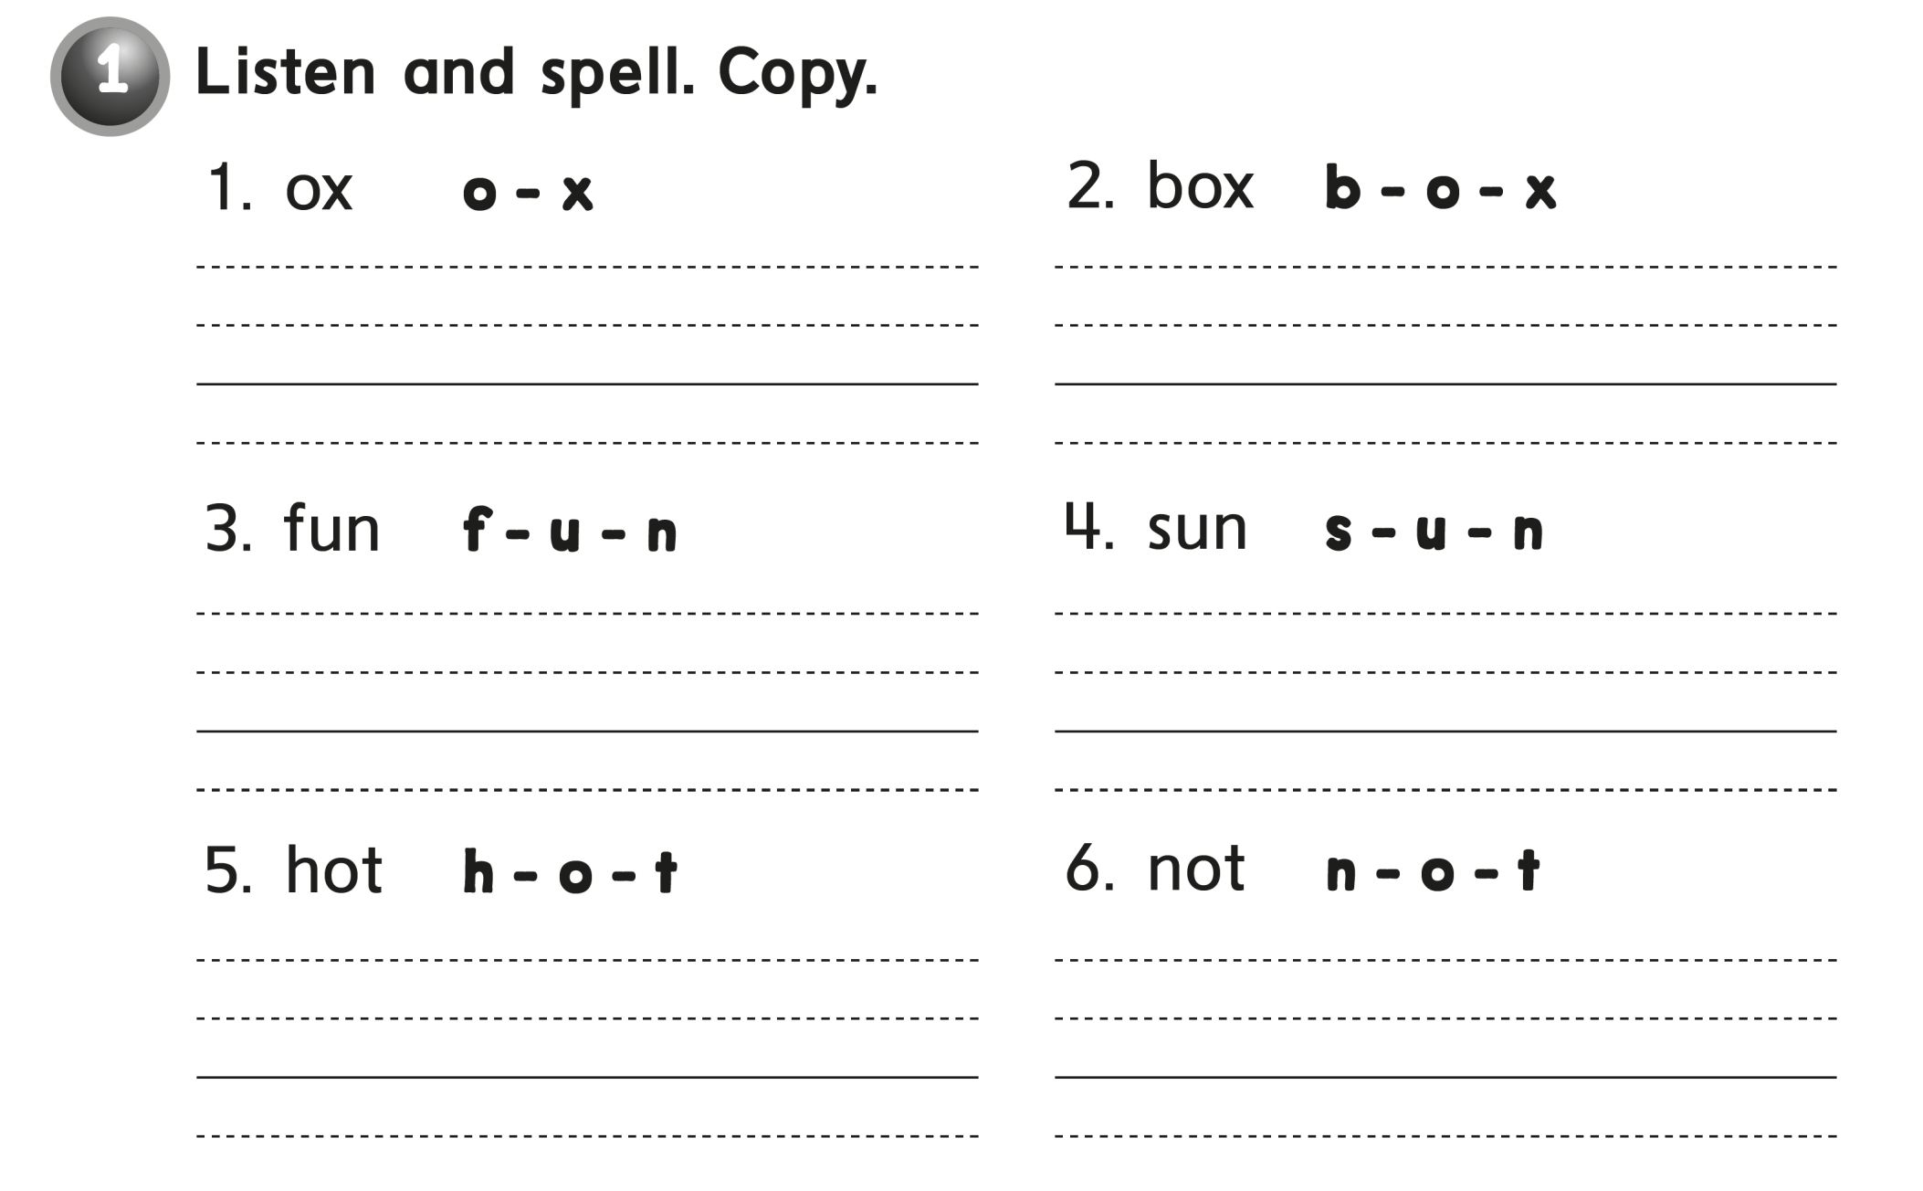

ox o – x box b – o - x
fun f – u – n sun s – u – n
hot h – o – t not n – o – t

Slide 19
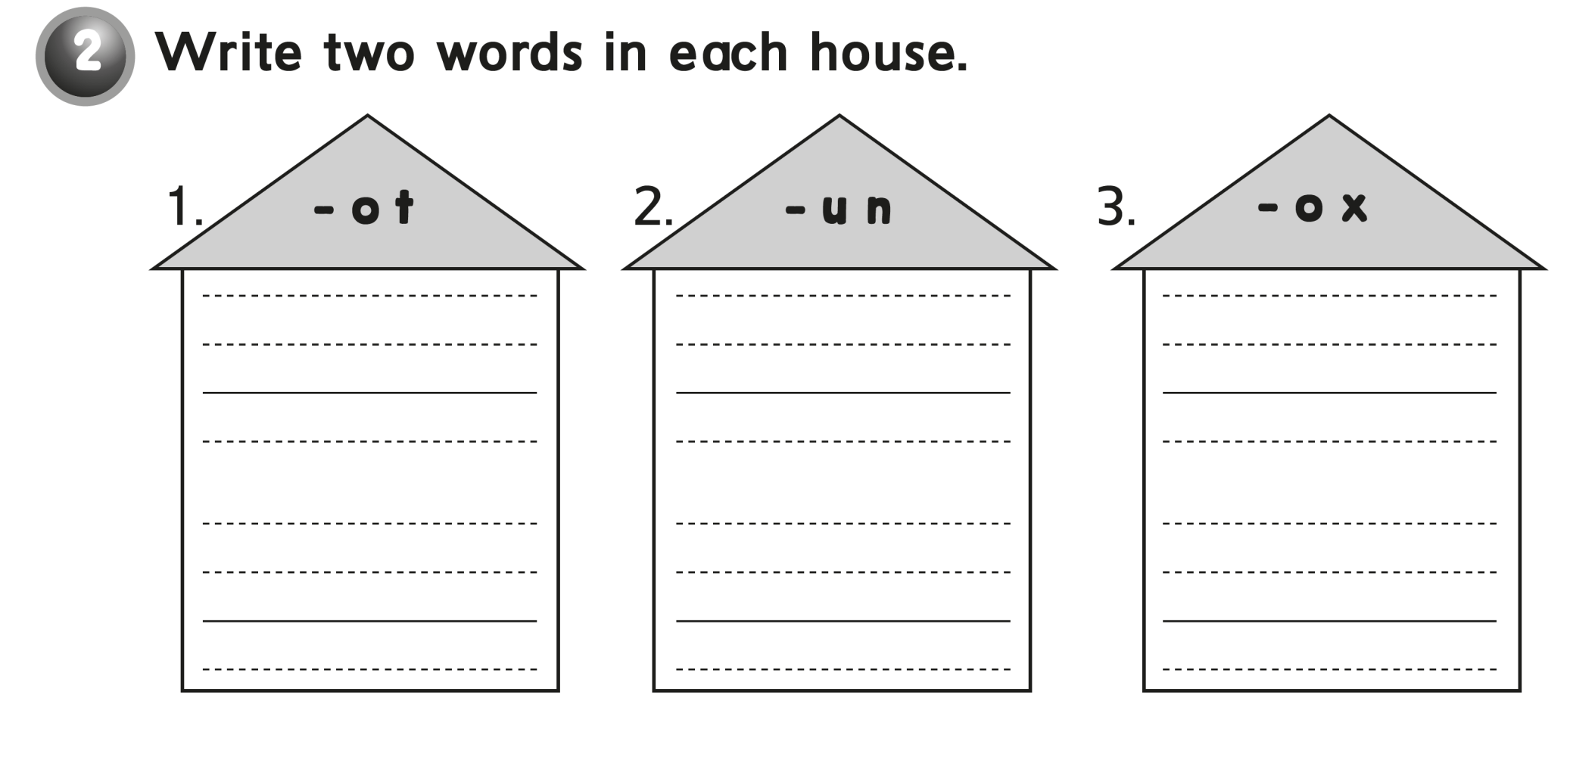
dot
fun
box
hot
run
fox

Slide 20

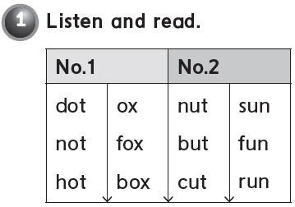

Slide 21
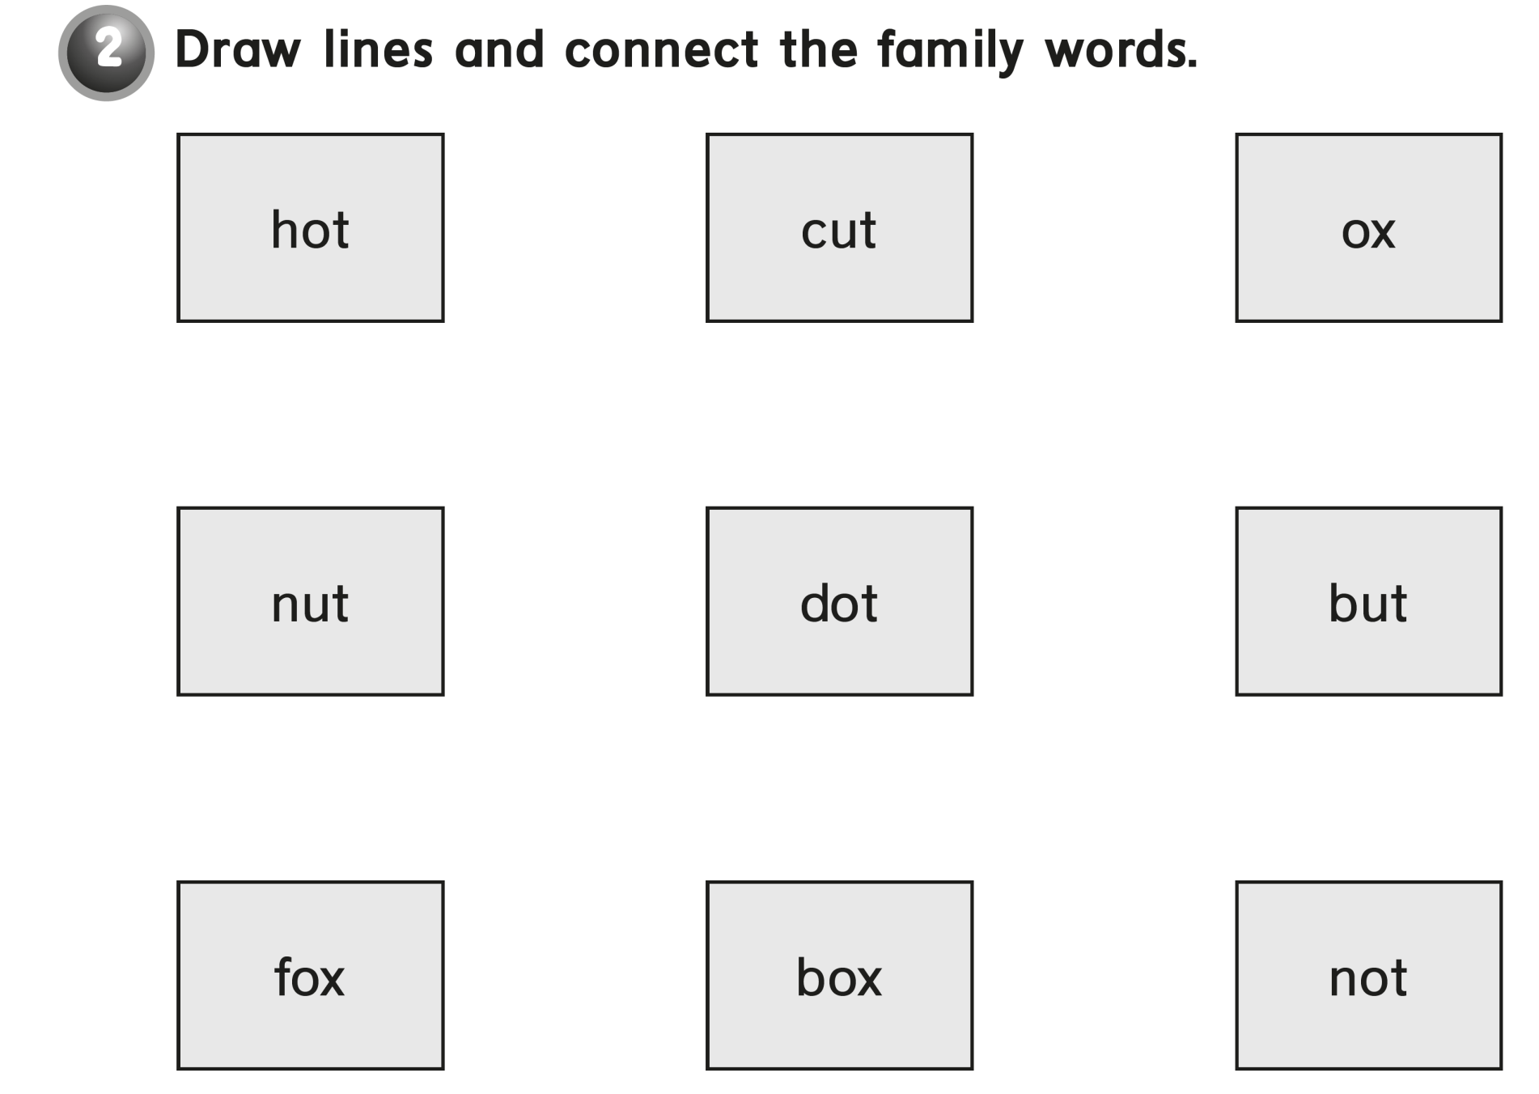

Slide 22


