Slide 1


Welcome to class
T.

Slide 2

3
Unit 9

Slide 3





workbook
Pages 203 , 204

Slide 4
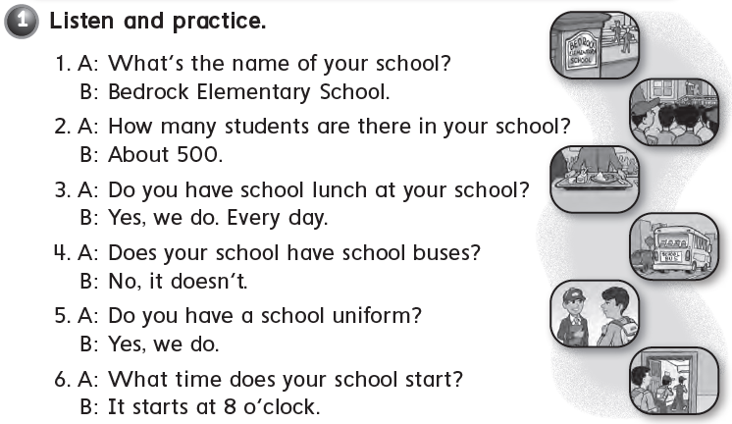


Slide 5
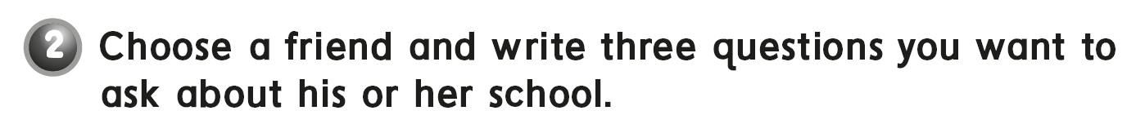
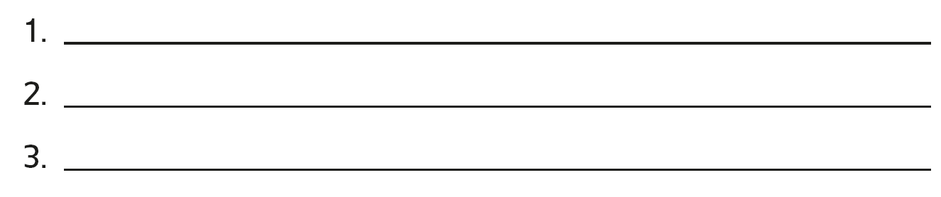

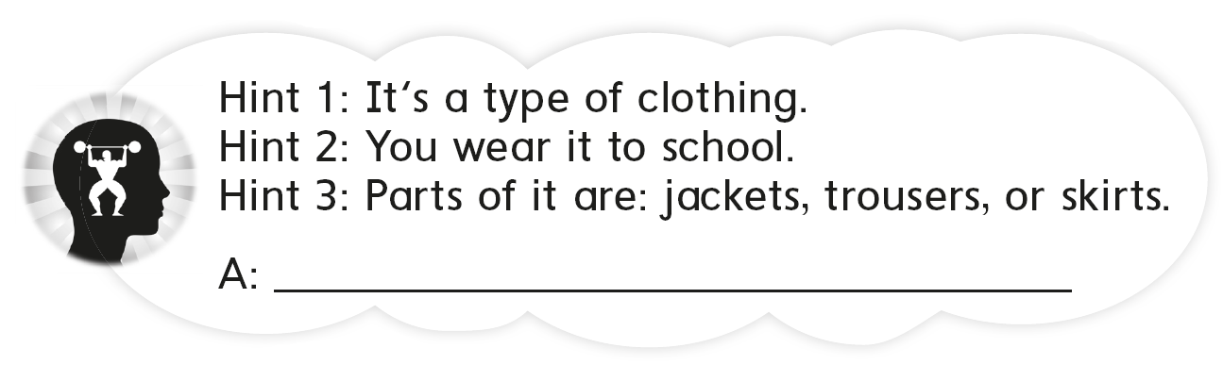
What’s the name of your school?
Do you have a school uniform?
Does your school have a school bus?
Uniform

Slide 6
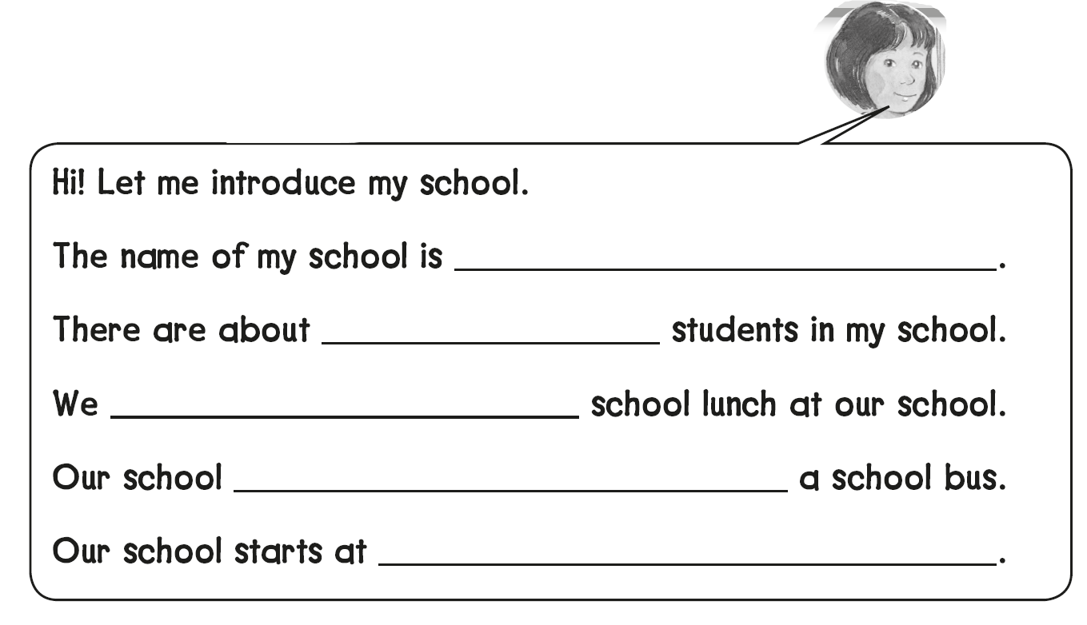
River View Elementary School
350
don’t have
has
8:30

Slide 7

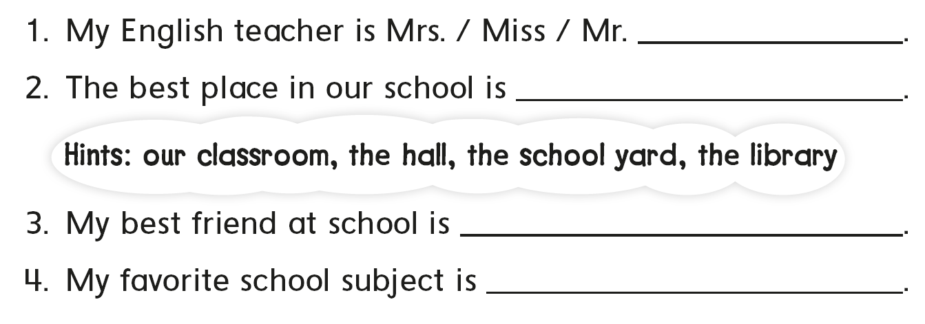
………….
the school yard
Ali
Science

Slide 8

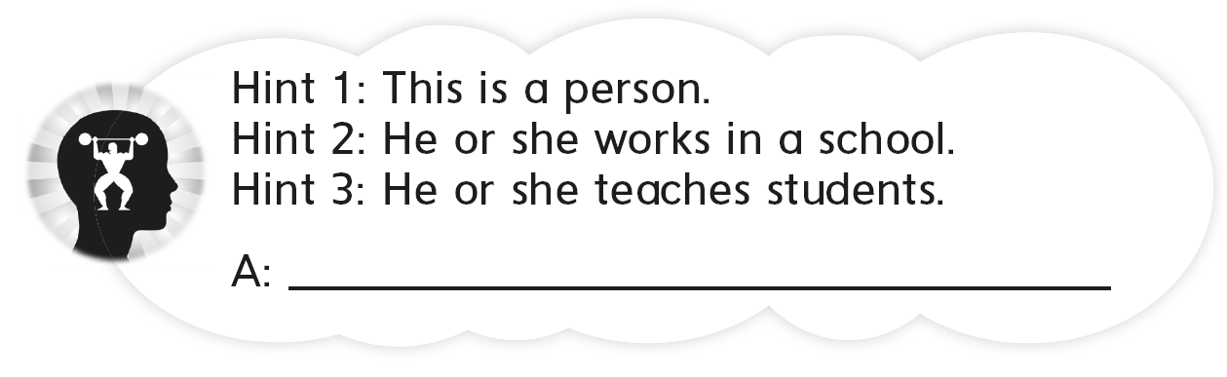
A teacher

Slide 9
workbook
Pages 205 , 206

Slide 10

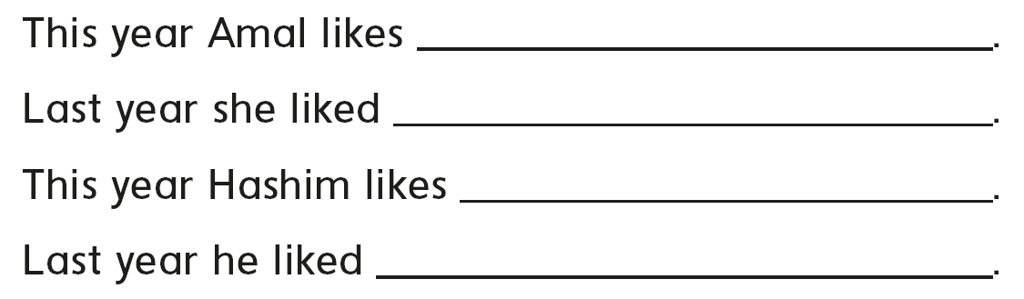
Science
Art
Math
English

Slide 11

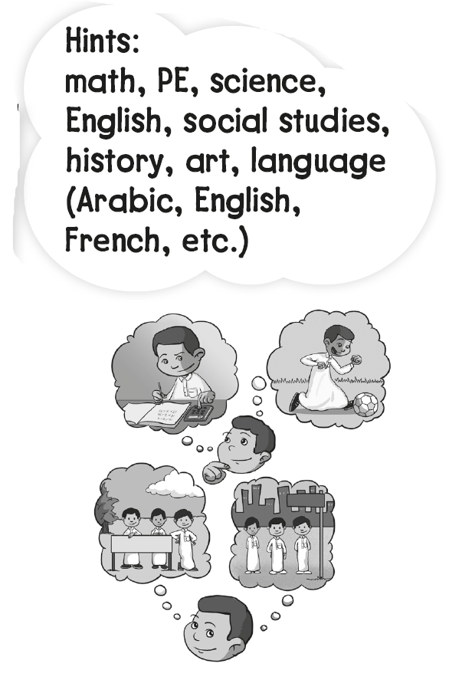
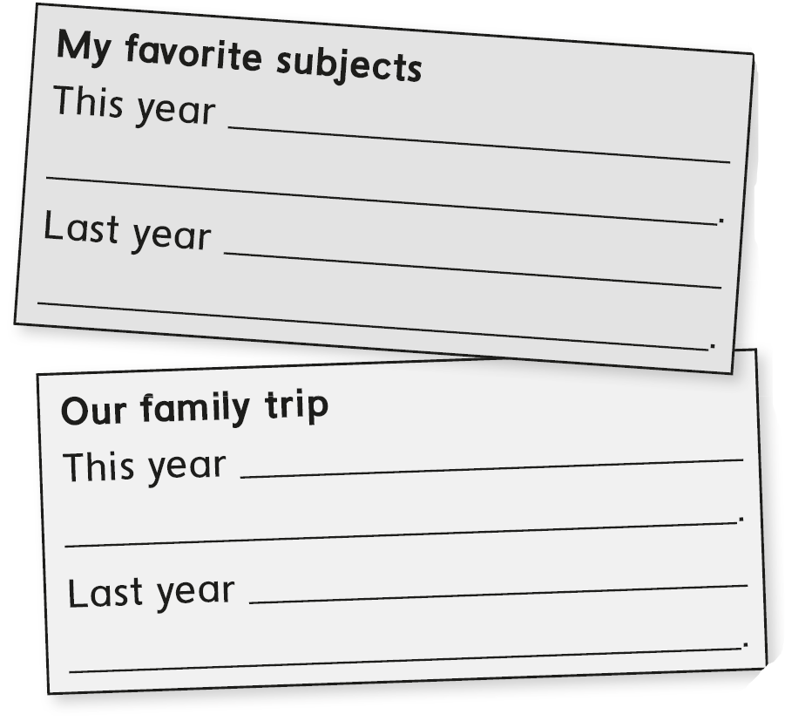
science
math
Dubai
Jeddah

Slide 12

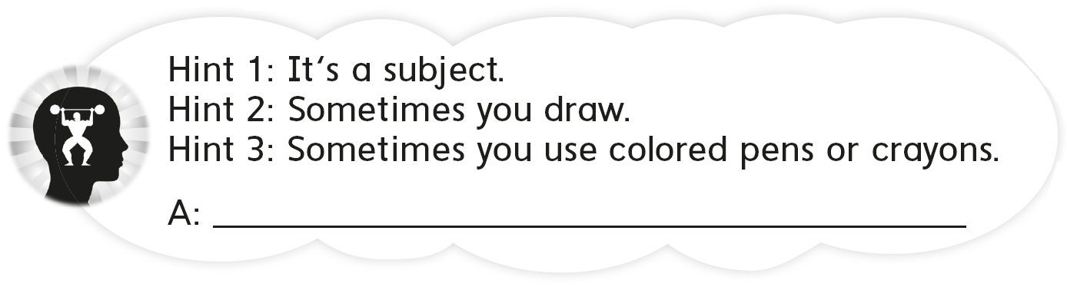
Art

Slide 13
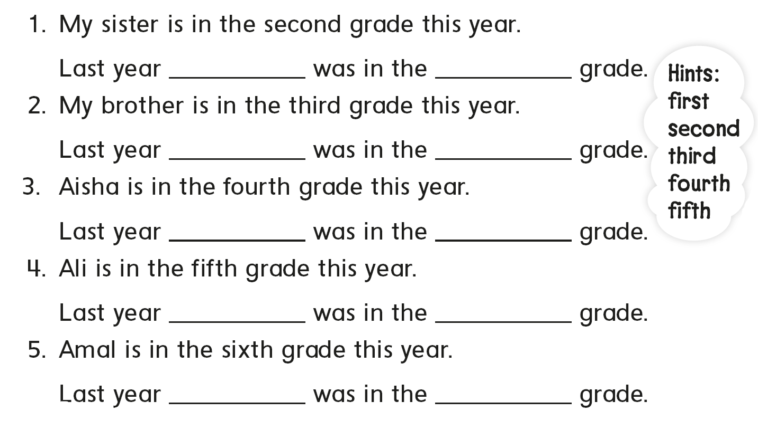
she
first
he
second
she
third
he
fourth
she
fifth

Slide 14
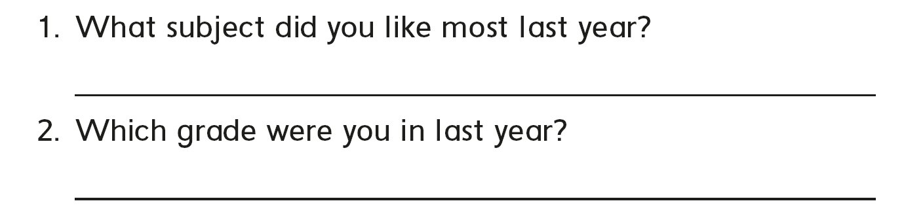

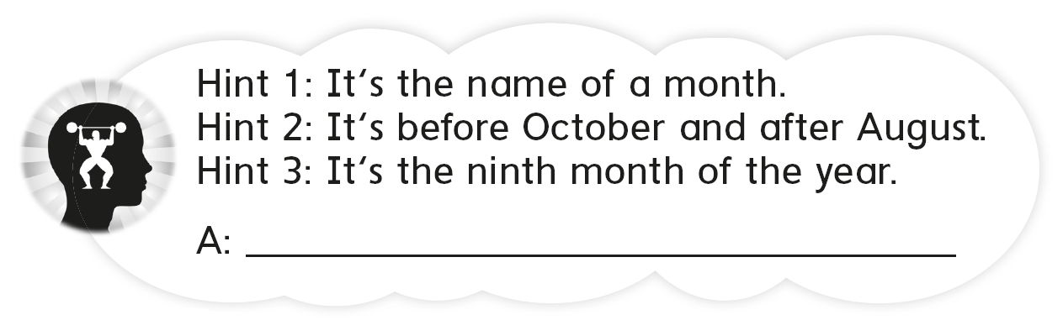
PE
Fifth grade
September

Slide 15
workbook
Pages 207 , 208

Slide 16
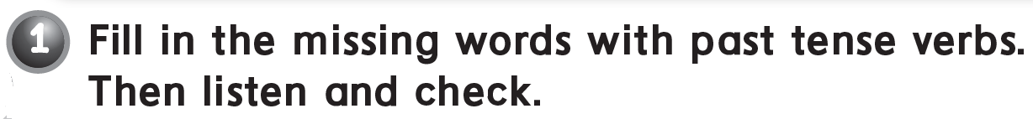
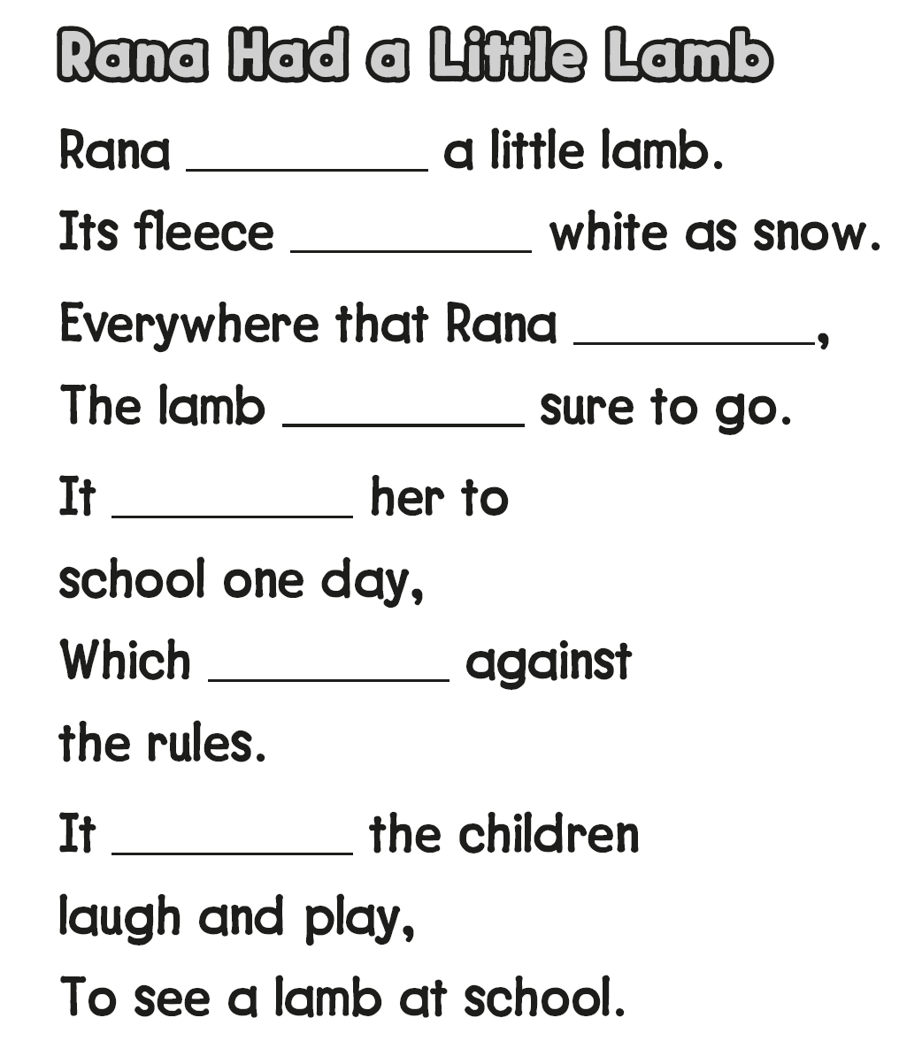
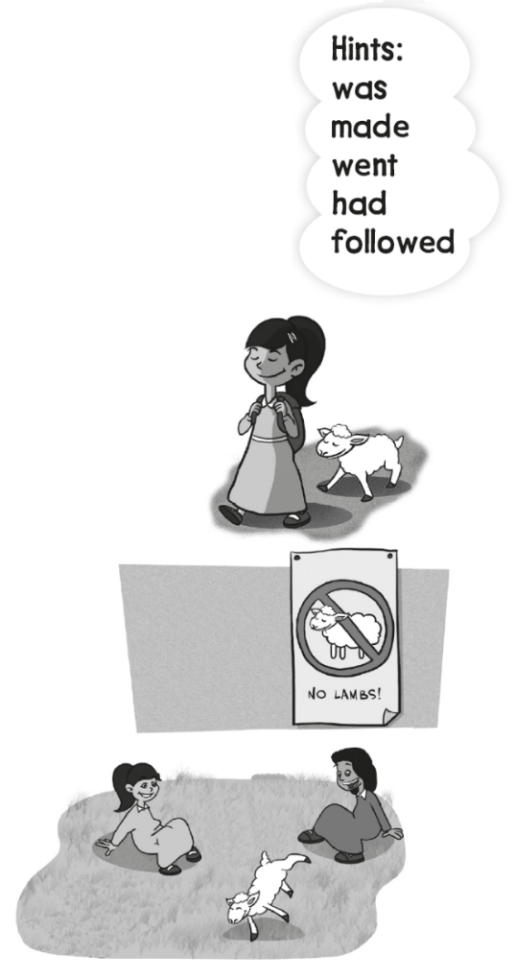
had
was
went
was
followed
was
made

Slide 17

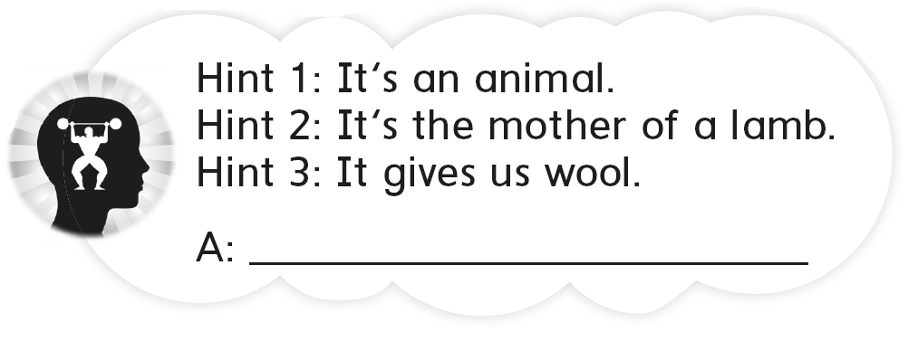
sheep

Slide 18

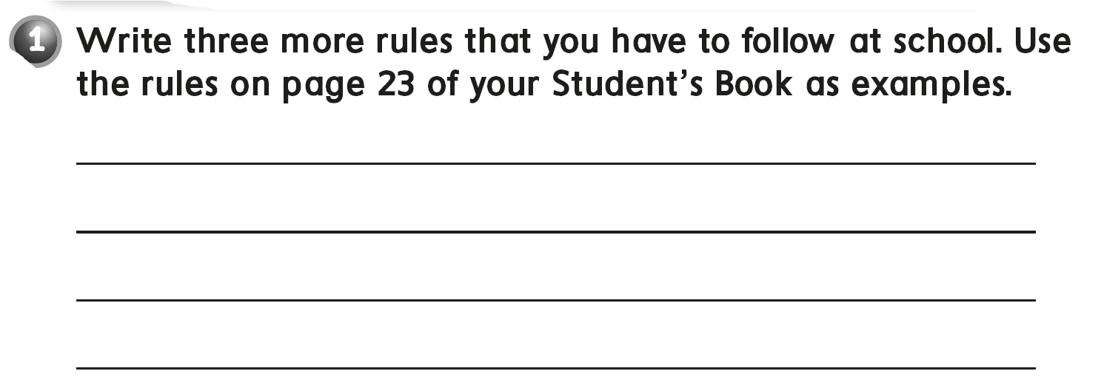
Don’t shout , speak clearly
Stand up when you present
Don’t make too much noise when you play games
Listen to the teacher

Slide 19
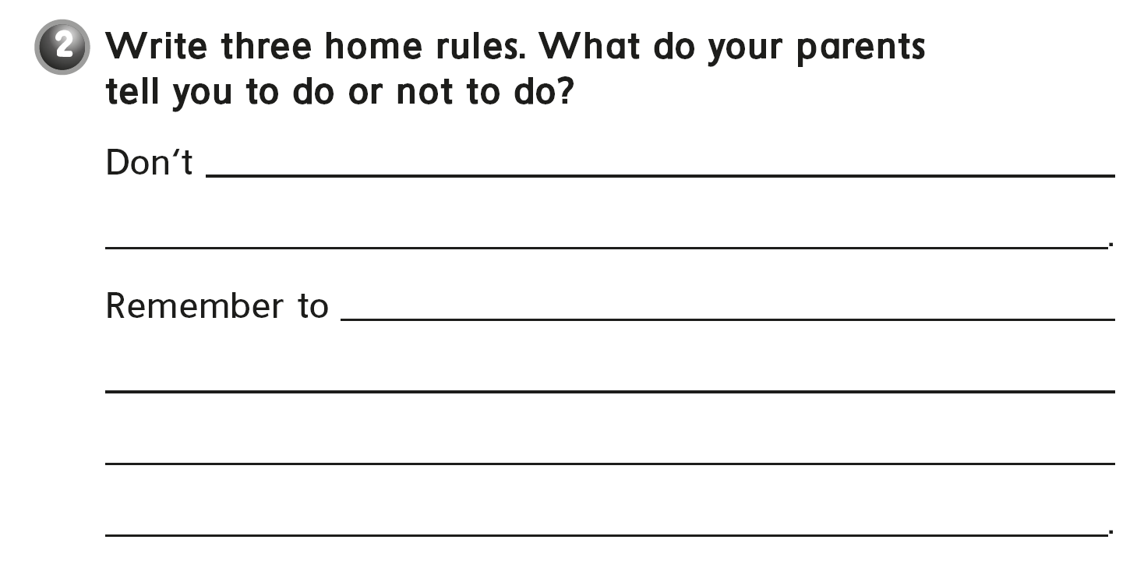
stay up late
make noise
do your prayers on time
brush your teeth
do your homework

Slide 20

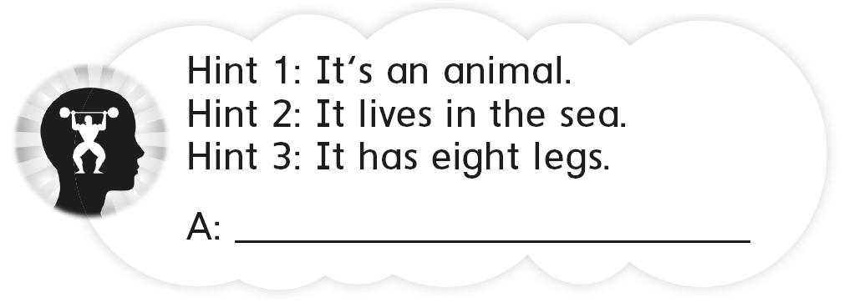
Octopus

Slide 21
workbook
Pages 209 , 210

Slide 22

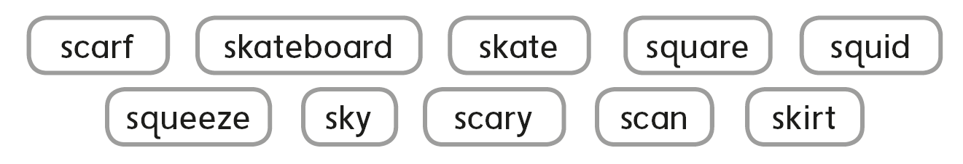

Slide 23

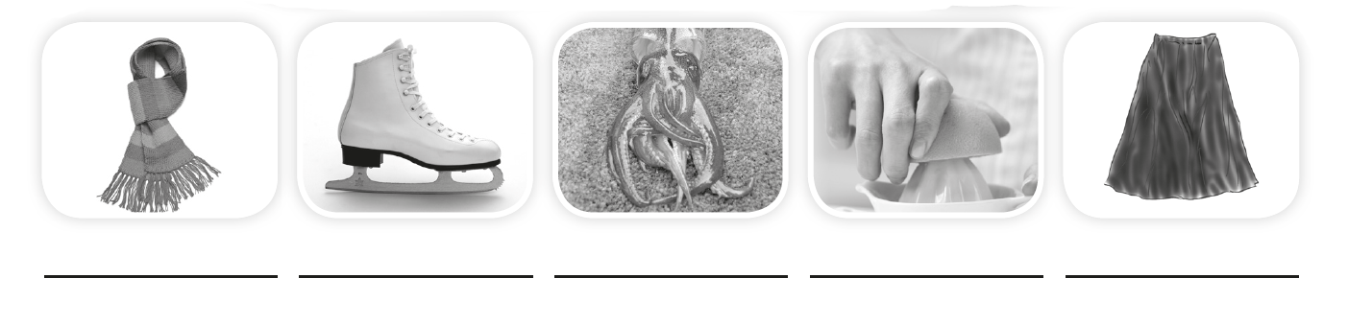
scarf
skate
squid
squeeze
skirt

Slide 24

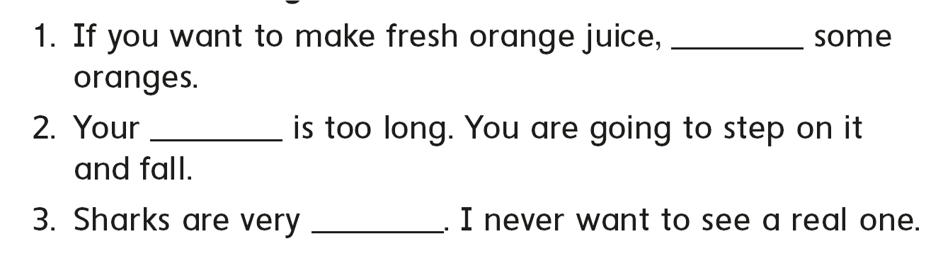

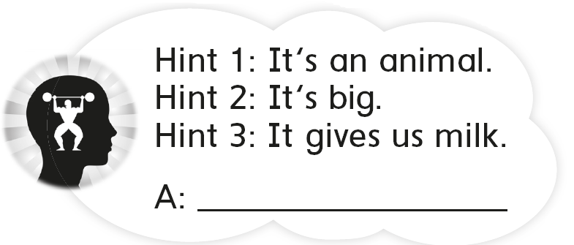
squeeze
skirt
scary
A cow

Slide 25

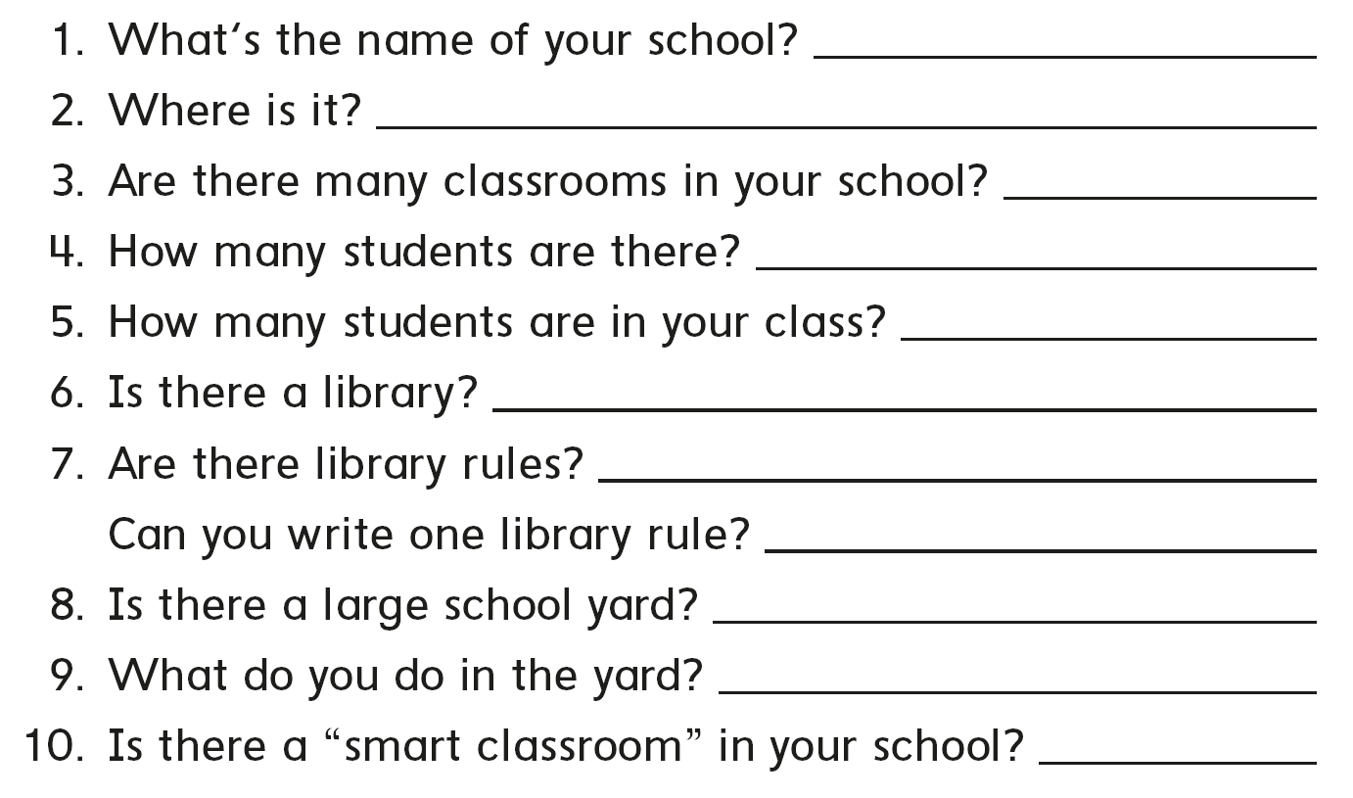
أجب عن مدرستك

Slide 26



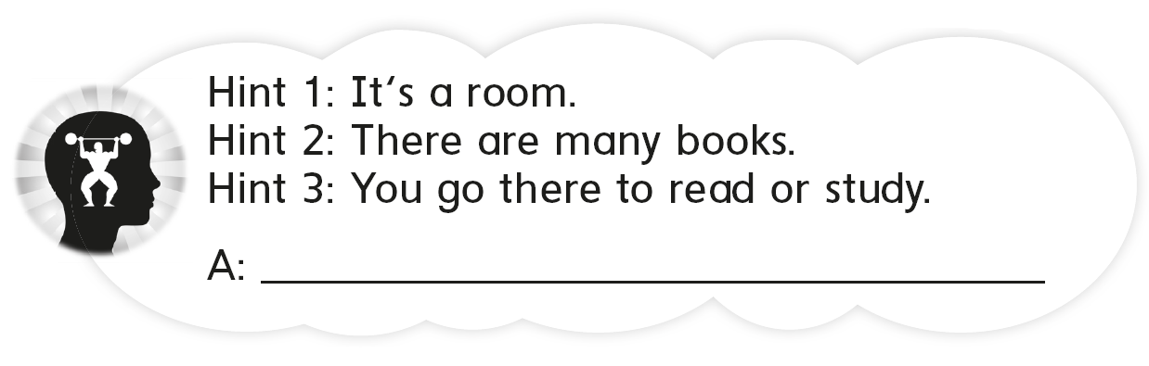
What’s the name of your school ?
Do you have a school bus ?
What time does your school start ?
Library

Slide 27


