Slide 1

Unit 3
If It Hadn’t Happened
Grammar
Mega Goal 1.3
Done by : Entisar Al-Obaidallah

Slide 2

Lesson Objectives
01
02
03
04
Practice
Use
Should have + past participle correctly
Conditional sentences: hypothetical situations in the past
Make
Apply
Sentences using :If with could and might correctly
The rules to do the exercises

Slide 3


Open
Your book p. ( 36 )

Slide 4

01
Should Have + Past Participle

Slide 5
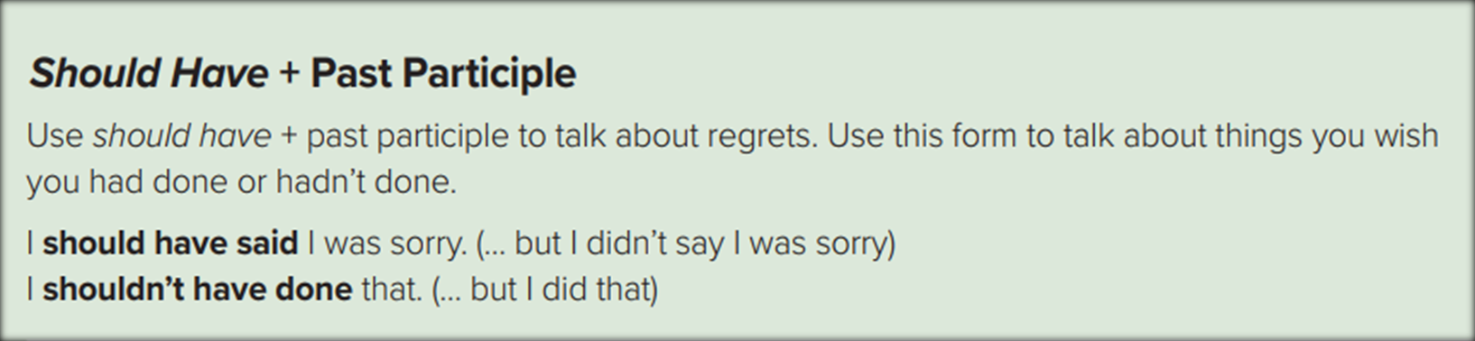
➔We use this structure to talk about things we wish we had done or had not done
For example
I should have called you earlier. (But, I didn’t.)
I shouldn’t have left my book outside in the rain. (But, I did.)

Slide 6

Form : Affermative
Subject
should
have
V.P.P(3)
I should have studied harder! = (I didn't study very hard and so I failed the exam).
Form : Negative
Subject
should
not
have
V.P.P(3)
I shouldn't have eaten so much cake! (= I did eat a lot of cake and now I don’t
feel good)

Slide 7

Let’s
Practice

Slide 8
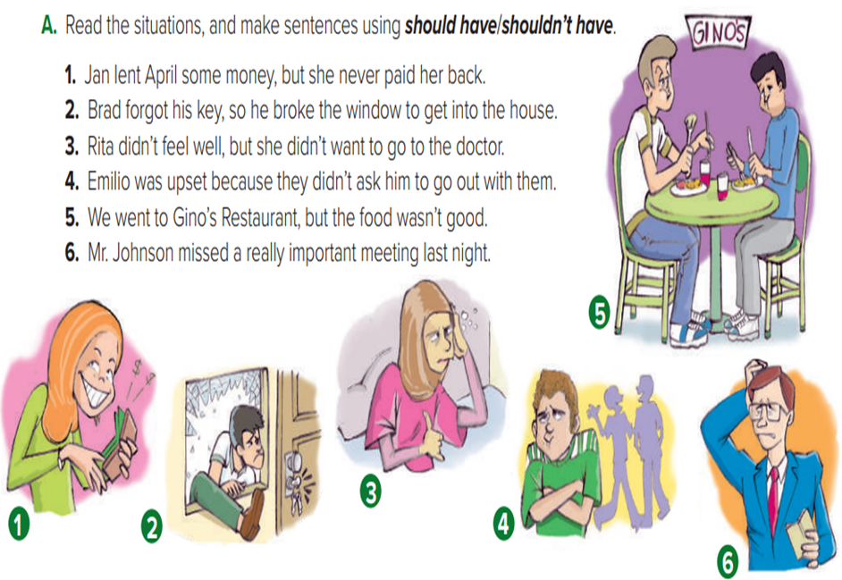
1- Jan shouldn’t have lent April the money.
2- Brad should have had an extra key.
3- Rita should have gone to the doctor.
4- They should have asked
Emilio to go out with them.
5- We shouldn’t have gone to Gino’s Restaurant.
6- Mr. Johnson should have been at the meeting last night.

Slide 9

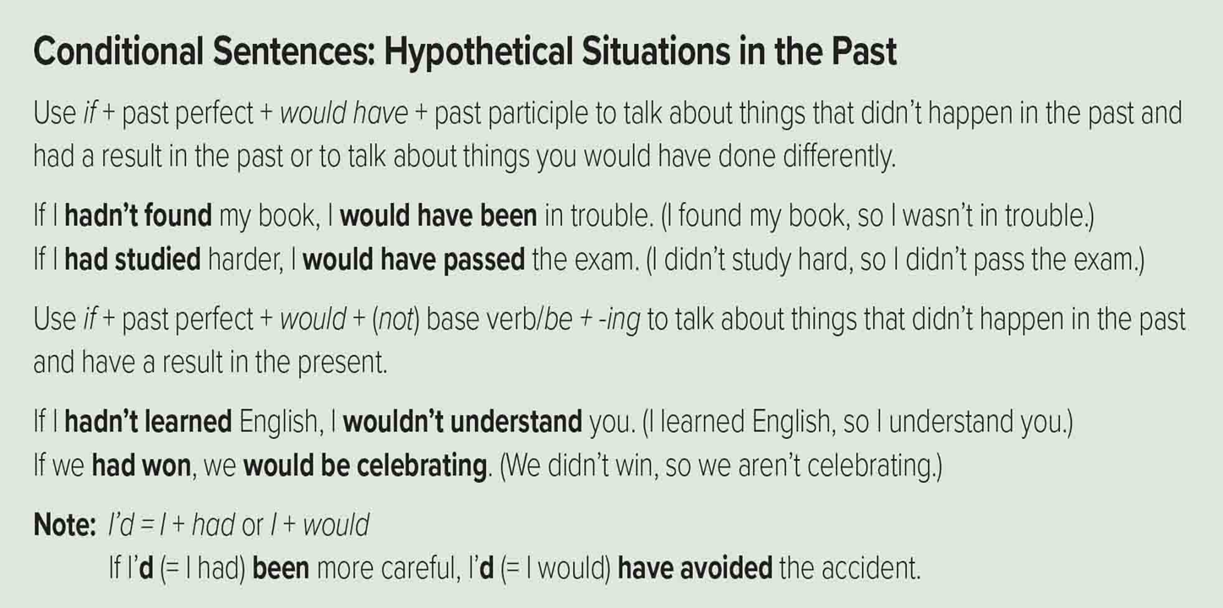
Conditional Sentences

Slide 10

Conditional Sentences
➔Use it to talk about things that didn’t happen in the past and had a result in the past or to talk about things you would have done differently.
If conditional …………… , A result in the past
If
Past Perfect(had +p.p.3
Would have
Vp.p(3)
For example
If you had called me, I would have come.
If conditional
A result in the past

Slide 11

Conditional Sentences
➔Use it to talk about things that didn’t happen in the past and have a result in the present.
If conditional …………… , A result in the present
If
Past Perfect(had +p.p.3
would
infinitive
Example
If we had gone to that new restaurant, we wouldn't be hungry now.
would
be
V-ing
If
Past Perfect(had +p.p.3
Example
If you had graduated , we would be celebrating.

Slide 12

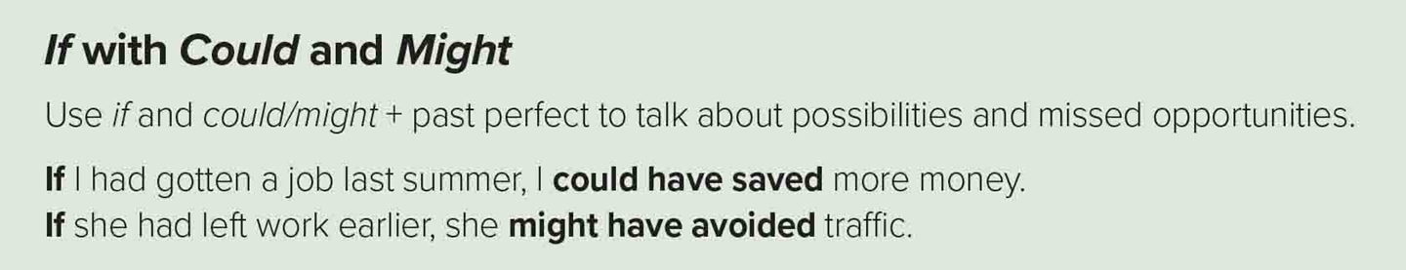
Form
If
Past Perfect(had +p.p.3
might/ could
have
p.p(3)
Example
If I had studied hard , I might have passed the exam.
Possibility
Example
ability
If I had gotten the right tools , I could have repaired my car.

Slide 13
Open
Your book p. ( 37)

Slide 14
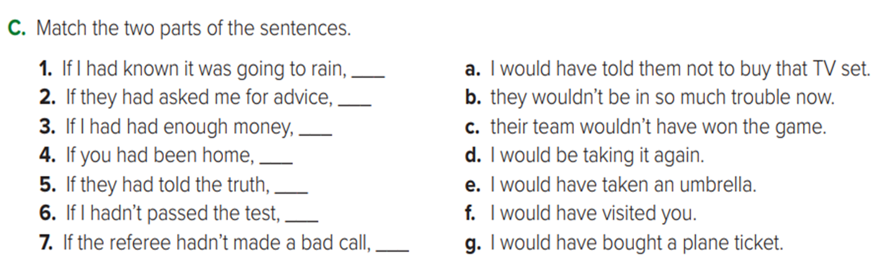
Let’s Practice
e
a
g
f
b
d
c

Slide 15
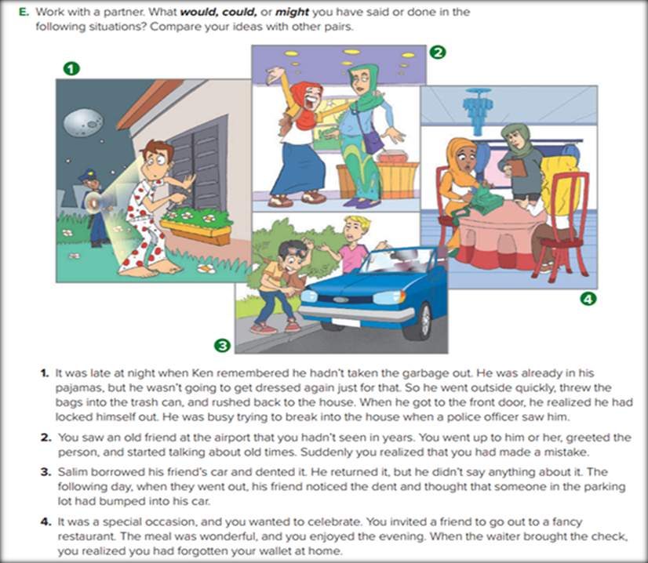
Let’s Practice
What have you said or done in the following situation?

Slide 16
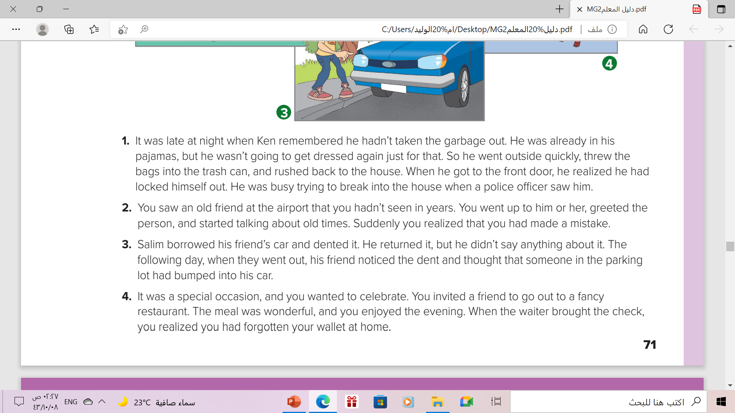
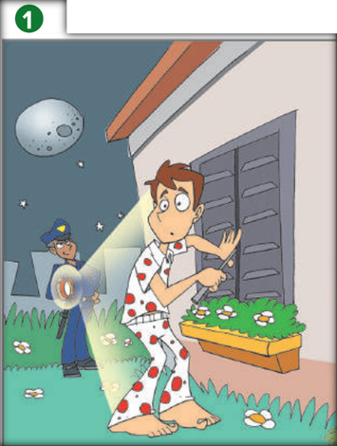
➔ I would have taken my key if I had gone out at night.
➔ I might have waited until morning to take out the garbage.
➔ I would have explained the situation to the police officer.

Slide 17

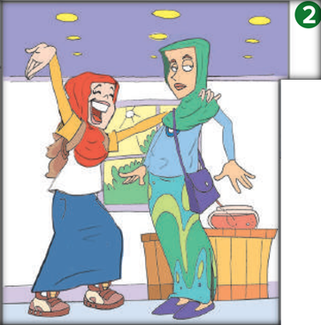
➔I would have apologized to the person.
➔I would have said that the person looked like a friend of mine.
➔ I might have continued the conversation and introduced myself to the person.

Slide 18

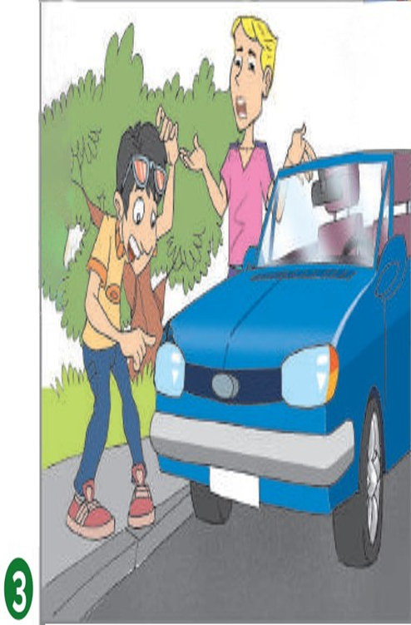
➔I would have told my friend the truth about the dent.
➔I might have had the dent fixed.

Slide 19
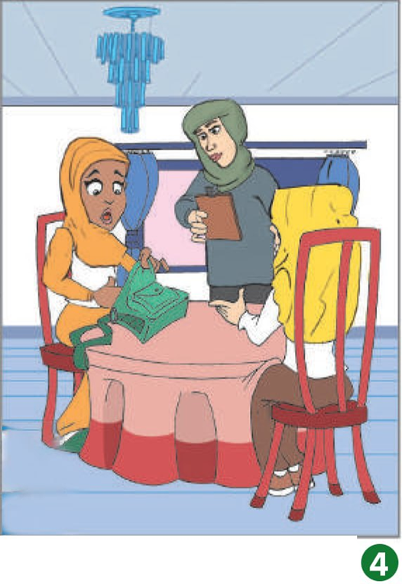
➔I would have explained the situation to my friend and asked her to pay.
➔I might have asked the restaurant if it accepted checks.
➔I could have called my brother and asked him to bring my wallet to the restaurant.

Slide 20


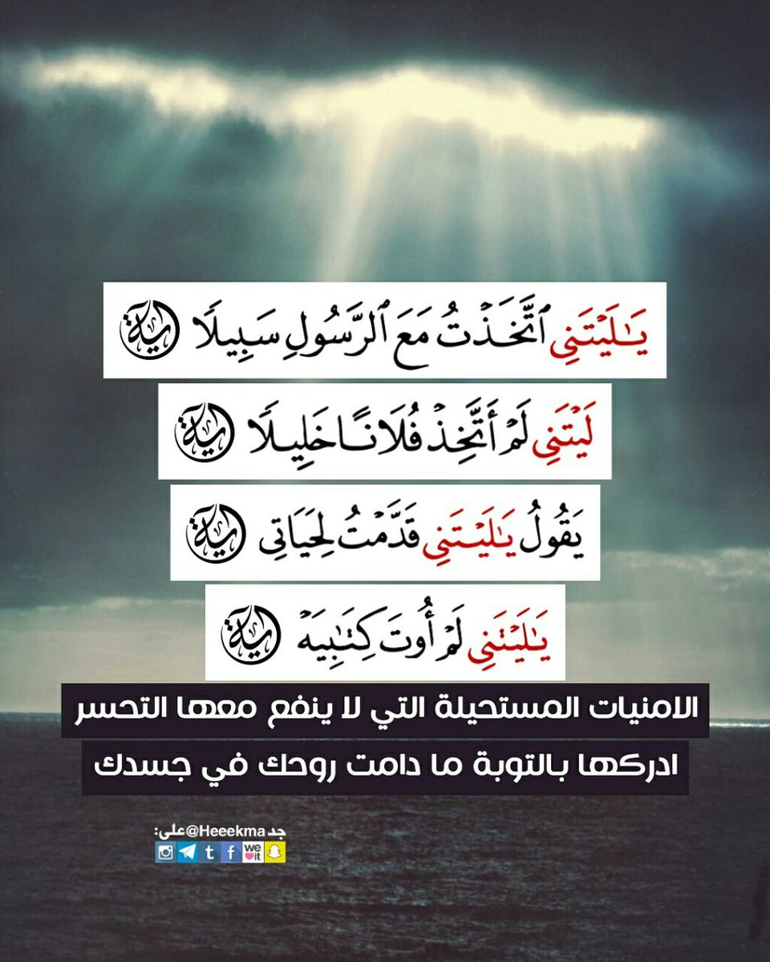
From the Holy Qura’an

Slide 21

Home work
exercise (F),p. (102)
P.50

Slide 22


Thanks!

