Slide 1


Good Morning

Slide 2

Unit -2-
I Wonder What Happened

Slide 3
9-Reading

Slide 4


Slide 5


What does 2030 remind you of ?

Slide 6


Slide 7

Lesson Objectives
The students will be able to :
Predict the reading topic .
Provide answers for specific questions through scanning the text.
Find the main idea of each paragraph .
answer specific questions based on a reading text .
match words to their meanings .

Slide 8
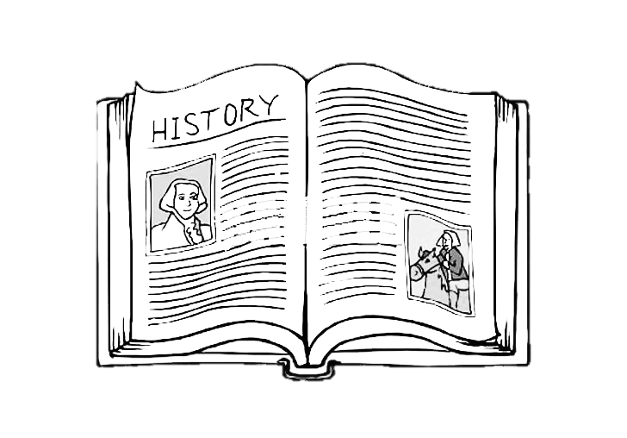

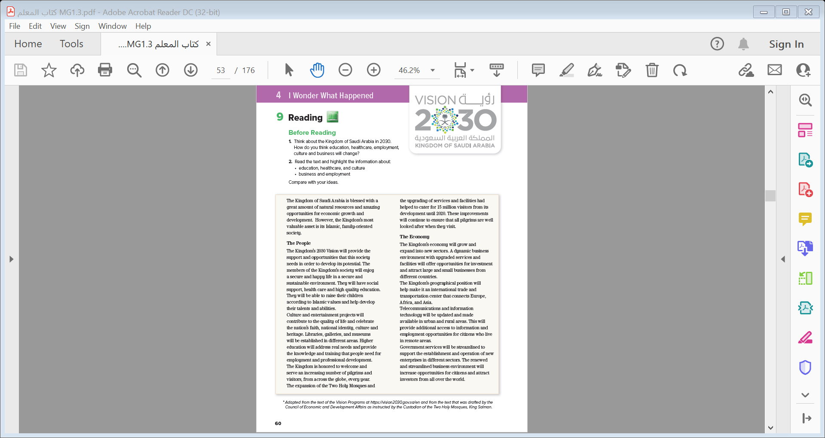
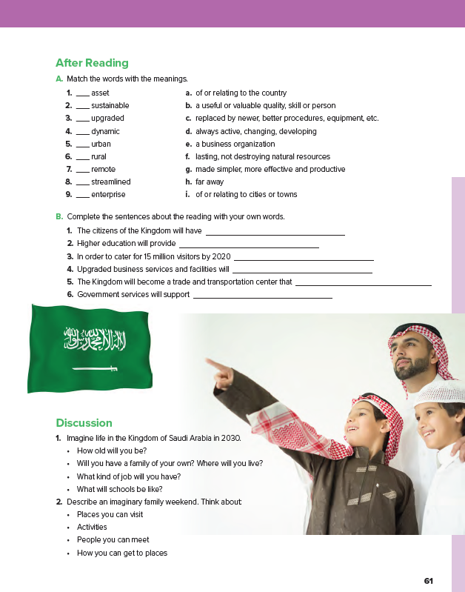
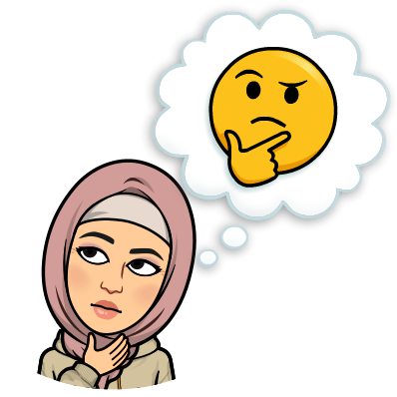
Students Book P. 26-27

Slide 9
Before Reading
1. Think about the Kingdom of Saudi Arabia in 2030.
How do you think education, healthcare, employment,
culture and business will change?

Slide 10


How many paragraphs are there ?
How many subheadings are there?
1
2
5
2. Read the text and highlight the information about:
• education, healthcare, and culture
• business and employment
Compare with your ideas.
6
3
7
8
4

Slide 11
READING STRATEGY
Reading for general understanding
Notes:
Mv

Slide 12


Slide 13

What is the kingdom’s most valuable asset ?
What is the main idea of this paragraph ?
The kingdom most valuable asset .

Slide 14
What ?
Why ?
What will the members of the kingdom enjoy according to 2030 vision?
What is the main idea of this paragraph ?
The society potential

Slide 15
What will culture and entertainment project contribute ?
Will the higher education address real needs ?
Yes, it will .
What will higher education provide ?
What is the main idea of this paragraph ?
Culture and entertainment

Slide 16
How many visitors did the expansion of the Two Holy Mosques provide with in 2020 ?
What is the main idea of this paragraph ?
Services to the Holy Mosques

Slide 17
What will the dynamic business environment with upgraded services offer ?
What is the main idea of this paragraph ?
Economy growth

Slide 18
Does the kingdom have a strategic position ?
Explain ?
What is the main idea of this paragraph ?
Trade

Slide 19
What will the telecommunication sector provide ?
What is the main idea of this paragraph ?
Telecommunication & employment

Slide 20
Why will the government services be streamlined ?
What is the main idea of this paragraph ?
business

Slide 21
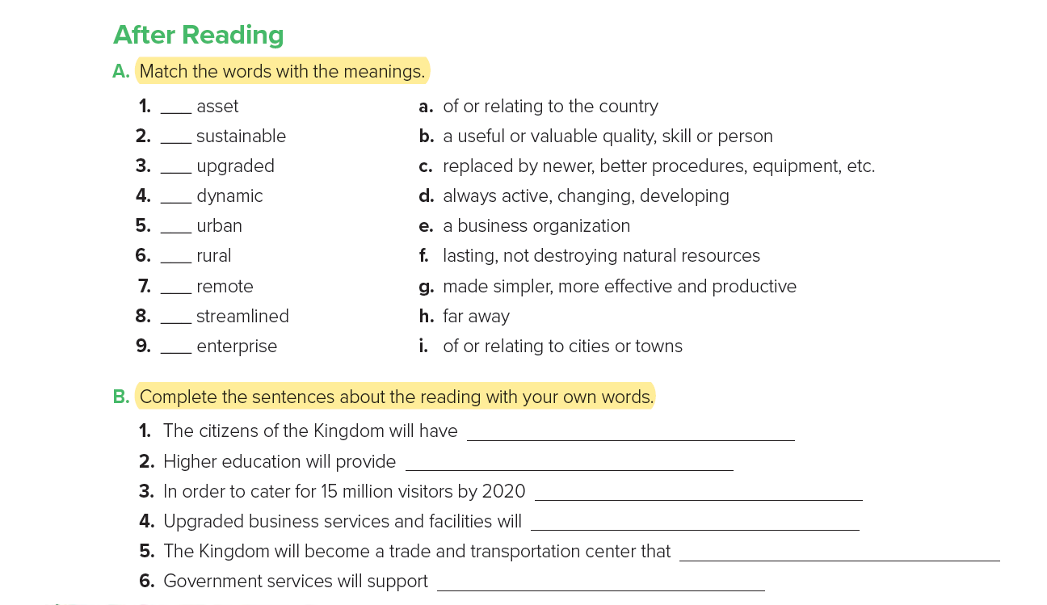

b
f
c
d
i
a
h
g
e
many job opportunities, health care and high quality education .
the training that people need for professional development.
services and facilities have been upgraded .
attract large and small businesses from different countries .
connects Europe, Africa, and Asia.
new businesses in different sectors .

Slide 22
Discussion
1. Imagine life in the Kingdom of Saudi Arabia in 2030.
• How old will you be?
• Will you have a family of your own? Where will you live?
• What kind of job will you have?
• What will schools be like?
2. Describe an imaginary family weekend. Think about:
• Places you can visit
• Activities
• People you can meet
• How you can get to places

Slide 23

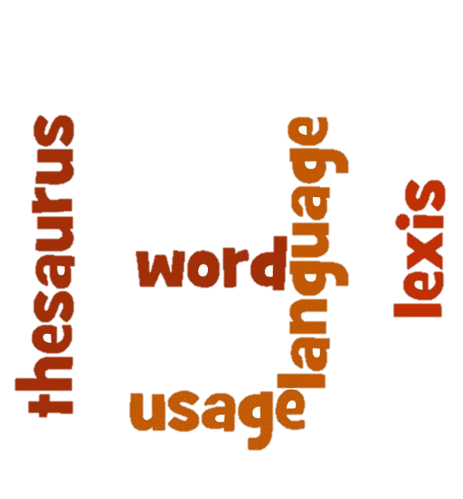
Practice New Vocabularies

Slide 24
The ability to imagine how a country , society etc. could develop in the future and to plan for this
potential
vision
an ability that can be developed to help a person or group of people to become successful
how good or bad something is
quality
play a significant part/ role in causing a result, making something happen.
contribute
address
attract
to start trying to solve it
to make someone interested in something
areas of an economy such as, manufacturing, production, services, private sector, public sector, etc.
investment
sectors
the act of spending money/making money available for profit.

Slide 25
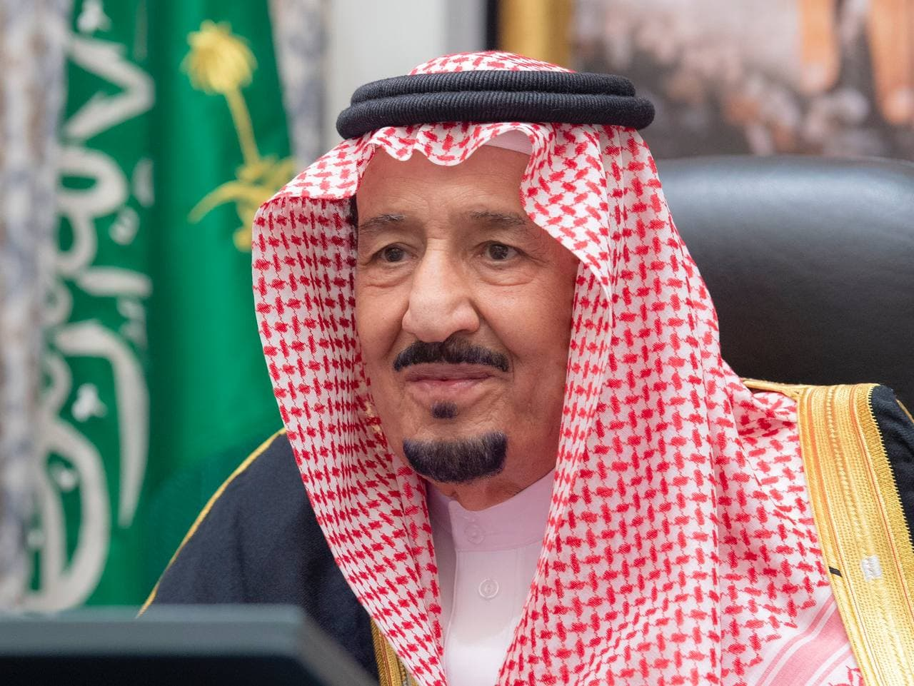
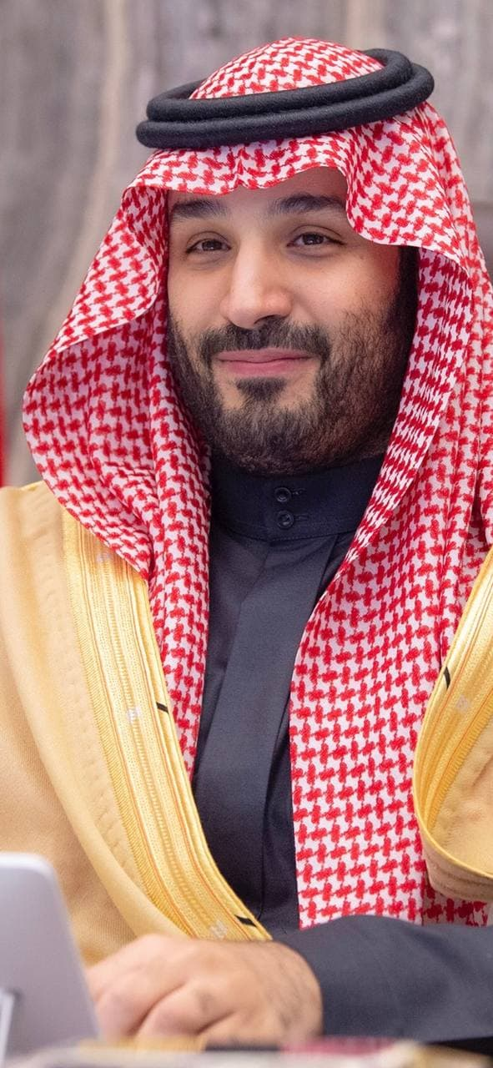
In your Own Words Show your support to King Salman and
Crown Prince Mohmmad

Slide 26


Quick Check

Slide 27


