Slide 1


Good Morning

Slide 2

Unit -2-
I Wonder What Happened

Slide 3
8-Conversation

Slide 4



Who do you see?
Skimming
What do you think happened?
Where are they?
Lesson Objectives
The students will be able to :
perform an interview using “ have/ever ‘.
Practice reading the conversation in pairs .
employ "real talk" phrases in new sentences .
Answer comprehension questions about the conversation
Share positively in pair work .

Slide 5
Who do you see?
Skimming
What do you think happened?
Revision
Samir: Excuse me. What’s going on?
Greg: When I got to the park, a crowd had
already gathered around that weird thing
over there.
Samir: Gee! I wonder what it is.
Greg: Beats me! It must have fallen from the sky.
Do you have any idea what it might be?
Samir: Whatever it is, it’s man-made. It looks like
part of a satellite to me.
Greg: Or it might be the remains of a weather
balloon.
Samir: No, it can’t be. I’ve seen weather
balloons before, and that’s not the type of
equipment they have.
Greg: You see those lights flashing? And there’s
a humming sound coming from it. It must
be a communications satellite.
Samir: Or maybe one of those UFOs.
You never know.
Where are they?
Find and underline examples of er at the end of words

Slide 6
Listen & Read
Skimming
Who do you see?
What do you think happened?
Where are they?

Slide 7


Scanning
can’t/might/must
speculate.
Listen & Read
Samir: Excuse me. What’s going on?
Greg: When I got to the park, a crowd had
already gathered around that weird thing
over there.
Samir: Gee! I wonder what it is.
Greg: Beats me! It must have fallen from the sky.
Do you have any idea what it might be?
Samir: Whatever it is, it’s man-made. It looks like
part of a satellite to me.
Greg: Or it might be the remains of a weather
balloon.
Samir: No, it can’t be. I’ve seen weather
balloons before, and that’s not the type of
equipment they have.
Greg: You see those lights flashing? And there’s
a humming sound coming from it. It must
be a communications satellite.
Samir: Or maybe one of those UFOs.
You never know.

Slide 8
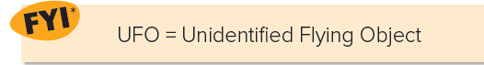
Scanning
Samir: Excuse me. What’s going on?
Greg: When I got to the park, a crowd had
already gathered around that weird thing
over there.
Samir: Gee! I wonder what it is.
Greg: Beats me! It must have fallen from the sky.
Do you have any idea what it might be?
Samir: Whatever it is, it’s man-made. It looks like
part of a satellite to me.
Greg: Or it might be the remains of a weather
balloon.
Samir: No, it can’t be. I’ve seen weather
balloons before, and that’s not the type of
equipment they have.
Greg: You see those lights flashing? And there’s
a humming sound coming from it. It must
be a communications satellite.
Samir: Or maybe one of those UFOs.
You never know.
Samir: Excuse me. What’s going on?
Greg: When I got to the park, a crowd had
already gathered around that weird thing
over there.
Samir: Gee! I wonder what it is.
Greg: Beats me! It must have fallen from the sky.
Do you have any idea what it might be?
Samir: Whatever it is, it’s man-made. It looks like
part of a satellite to me.
Greg: Or it might be the remains of a weather
balloon.
Samir: No, it can’t be. I’ve seen weather
balloons before, and that’s not the type of
equipment they have.
Greg: You see those lights flashing? And there’s
a humming sound coming from it. It must
be a communications satellite.
Samir: Or maybe one of those UFOs.
You never know.
can’t/might/must
speculate.

Slide 9
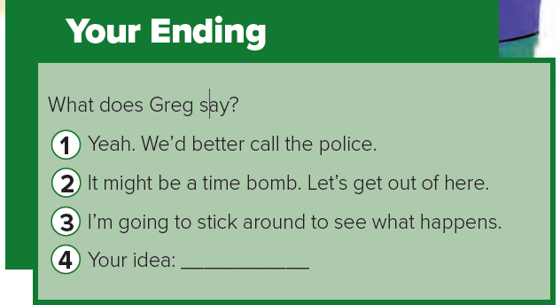
Real Talk

Slide 10

Real Talk
a way to start a conversation with a stranger
an exclamation to express surprise
I have no idea!
Anything is possible
Excuse me.
Gee!
Beats me!
You never know.
What’s going on ?
that looks like fun .
It must be a call for you .
he might change his mind .

Slide 11




1- A crowd had gathered around a weird object .
2- Samir thought the object could be a satellite .
3- At first Greg thought it might be a weather balloon. But then he changed his mind and thought it must be a communications satellite .

Slide 12
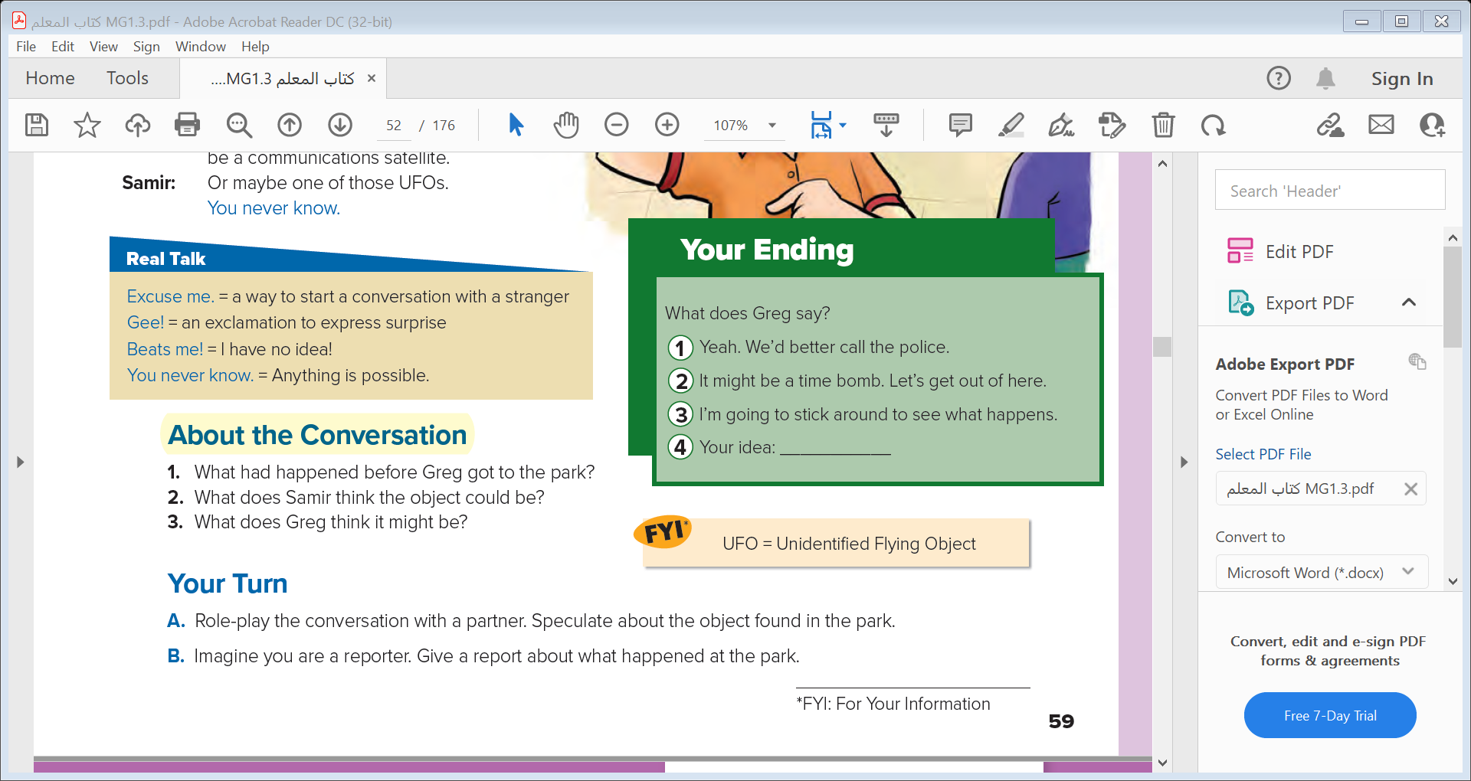

Slide 13



Quick Check

Slide 14


Slide 15


