Slide 1



Slide 2
Good Morning

Slide 3

Unit-4-
What They Said

Slide 4
11-Form , Meaning and Function

Slide 5
Words Connected with the Environment and Natural Disasters
Negative Questions
Relative Adverb: Where
Indirect Questions
Expressing Agreement with So, Neither, Either, Too
Expressing Disagreement

Slide 6

Objectives
The students will be able to :
1–identify the words that are connected with the environment and natural disasters .
2–express surprise through negative questions .
3–use relative adverb (where) to refer to places .
4–ask for information using indirect question .
5–express agreement .
6–express disagreement.
7-Share positively in pair work.

Slide 7
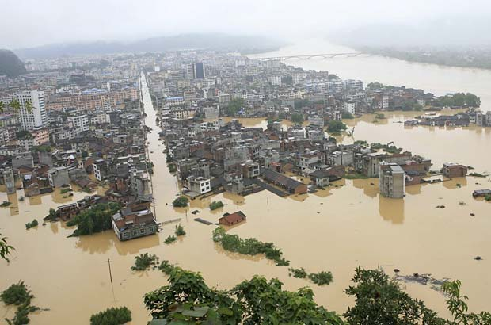
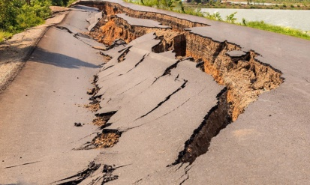
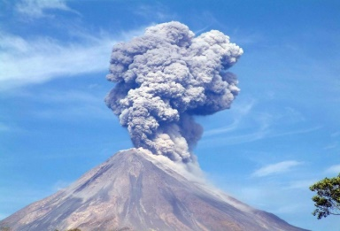
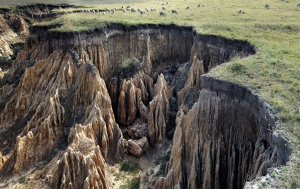
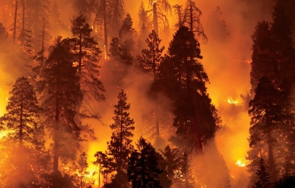
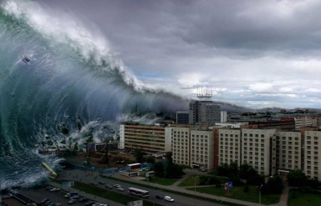
Words Connected with the Environment and Natural Disasters

Slide 8
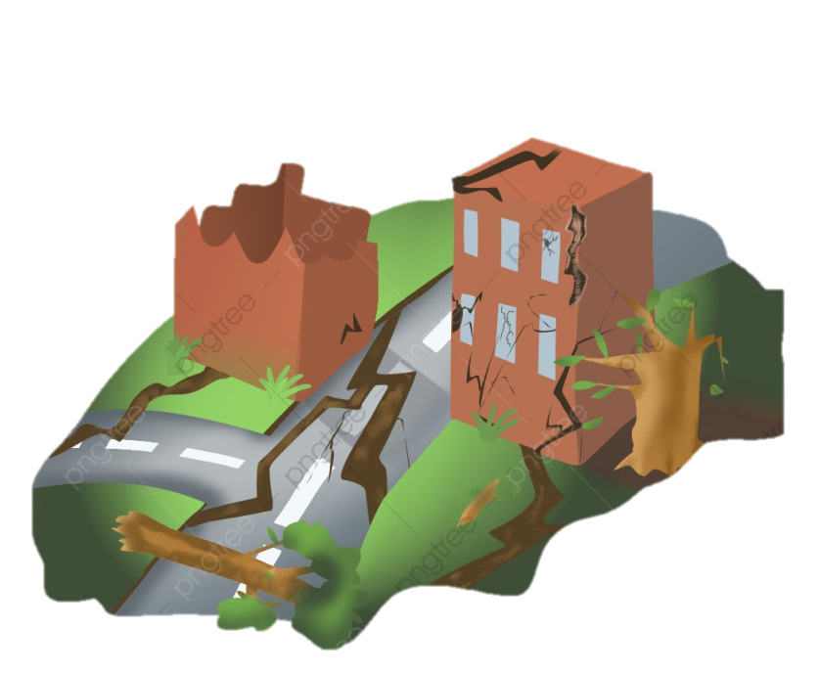
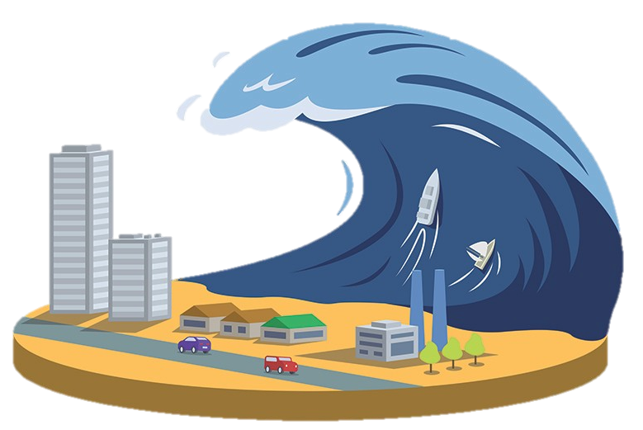
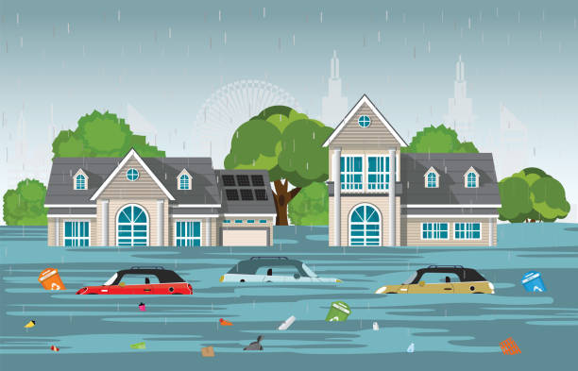
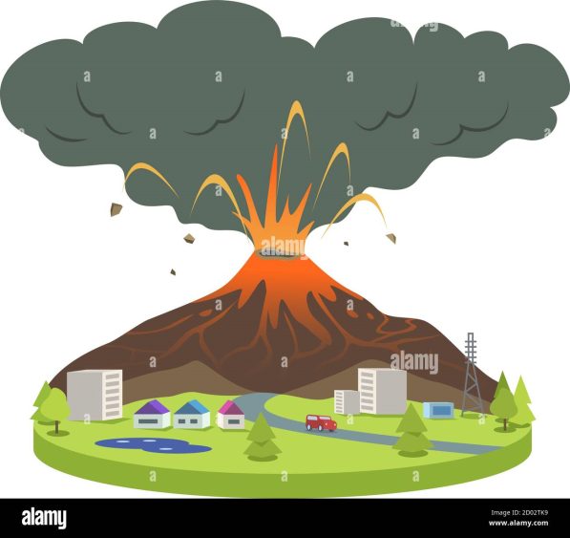
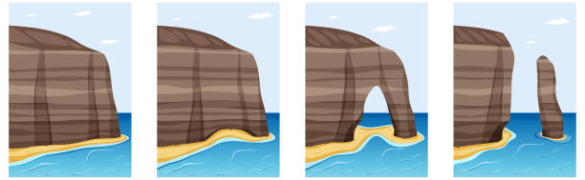
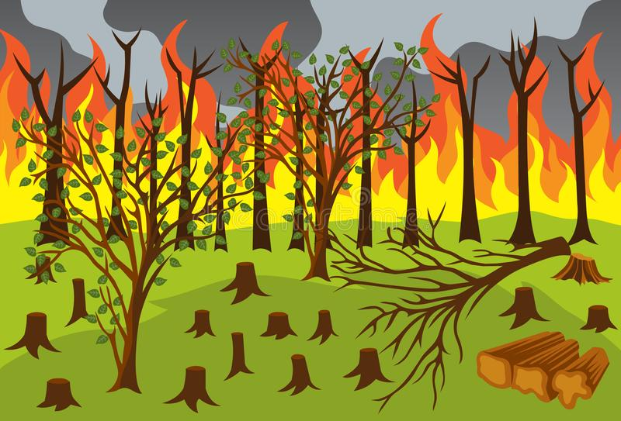
Natural Disaster
Tsunami
Floods
Earthquake
Volcanic eruption
Erosion
Forest fire

Slide 9
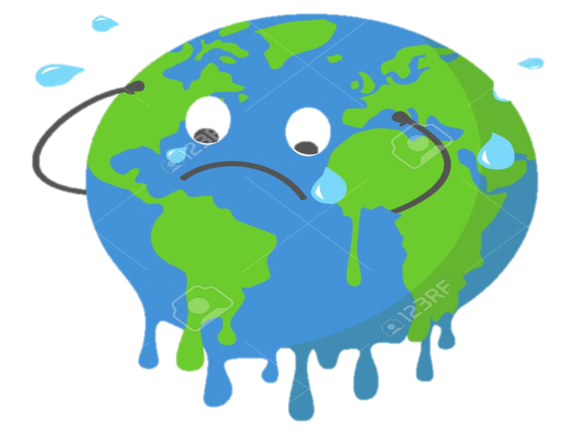
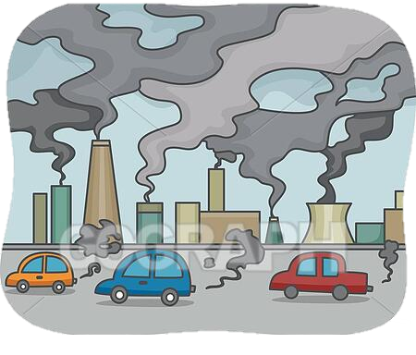
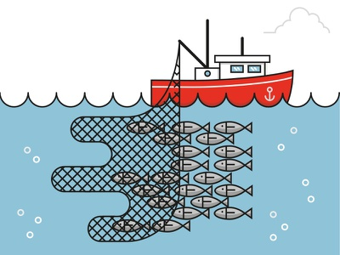
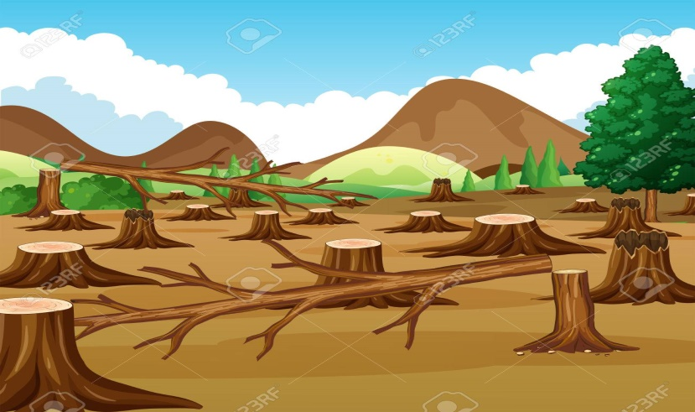
Environmental Issues
Global warming
Pollution
Overfishing
Deforestation

Slide 10

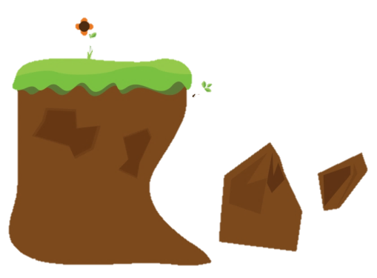
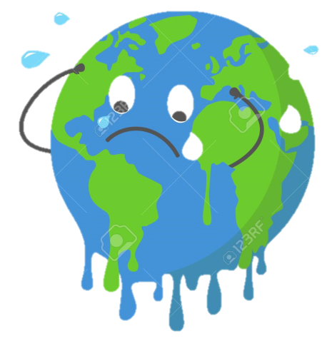
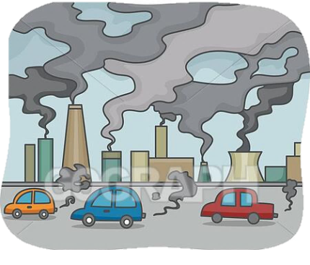
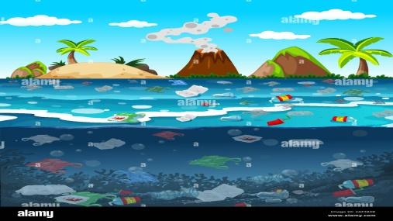

Some words that we commonly use when we talk about environmental problems and natural disasters are:
global warming flood damage
erosion earthquake threaten
air pollution tornado rescue
water pollution tsunami protect
over fishing volcanic eruption hit
deforestation forest fire research

Slide 11
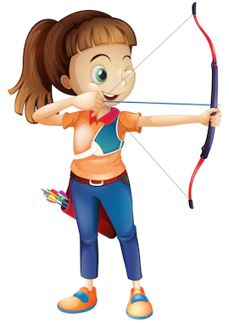


News Reporter:
Al Gore said that there were many who still did not believe that global warming was a problem.
The Japanese Fishing industry assured the media that they were fishing whales for research purposes.
The National Weather Service has reported that a tornado will hit the West Coast at 4 p.m. today.
PRACTICE TIME

Slide 12
PRACTICE TIME

Slide 13
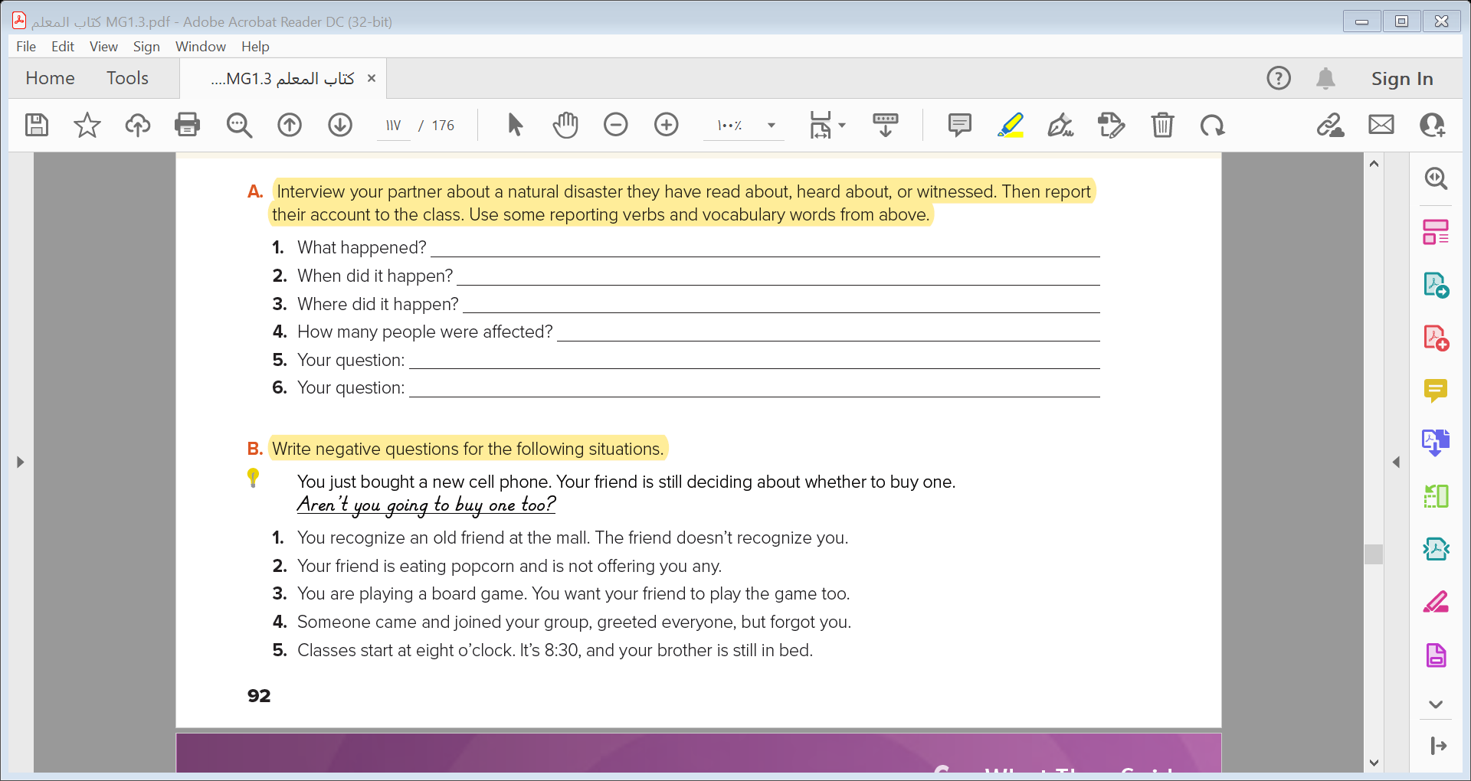

Indian Ocean tsunami
In 2004
In the Indian Ocean near the west of Sumatra .
The tsunami resulted in at least 227,898 fatalities .
What is a tsunami ?
How many countries were affected ?

Slide 14
Negative Questions

Slide 15
We can use negative questions to check information
or express surprise.
Isn’t there something we can do?
Aren’t you going to help?
Don’t you want to know what happened?
Haven’t you seen the news?
Didn’t you ask them about the damage?
Weren’t you there to offer support?
PRACTICE TIME

Slide 16
PRACTICE TIME

Slide 17


Slide 18

1- Don’t you recognize me ?
2- Aren’t you going to offer me any ?
3- Don’t you want you play ?
4- Aren’t you going to say ‘hello’ to me, too ?
5- Aren’t you going to get up today ?

Slide 19
Relative Adverb: Where

Slide 20
The TV journalist who reported on the breaking news story said that the.
earthquake which took place yesterday caused a great damage .
These pictures shows the place where the earthquake happened .
Who
Which
person
Where
thing
Place

Slide 21

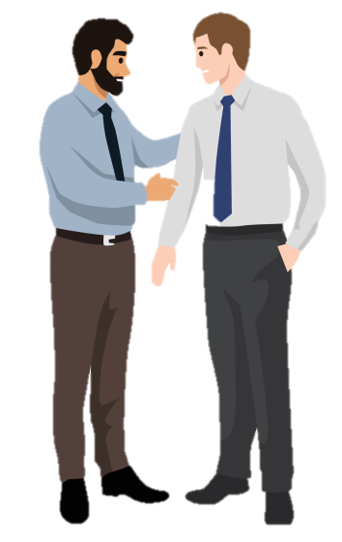


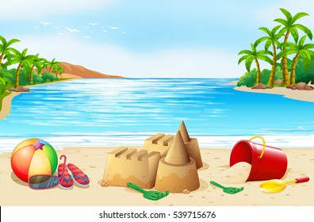

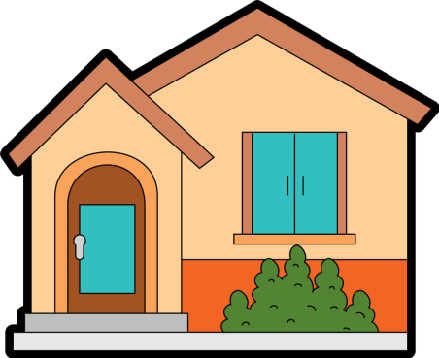
Who
Which
Where
person
thing
Place

Slide 22
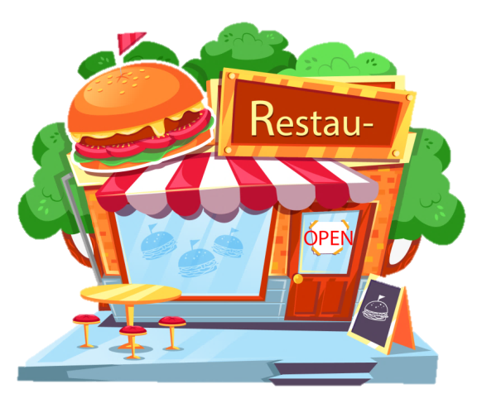
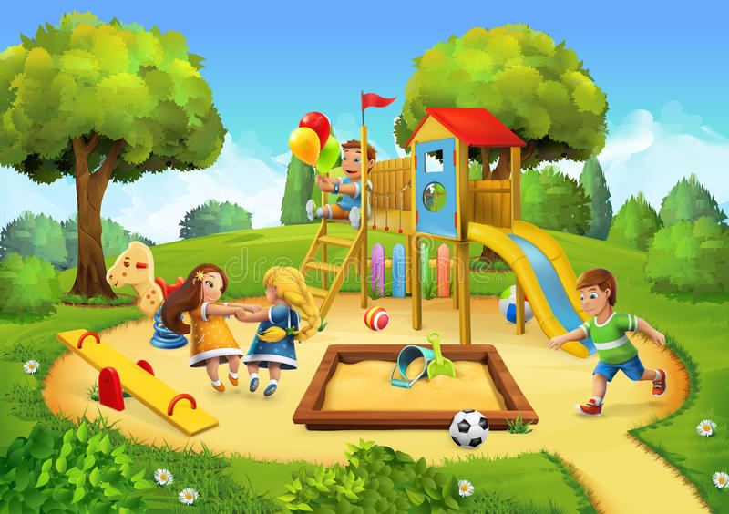
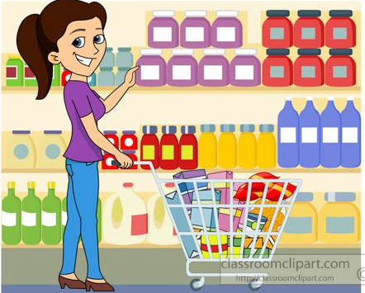
That’s the restaurant where we met for the first time .
This is the park where he proposed to me .
A grocery store is a place where you can by food .

Slide 23



Quick Check

Slide 24
Indirect Questions

Slide 25
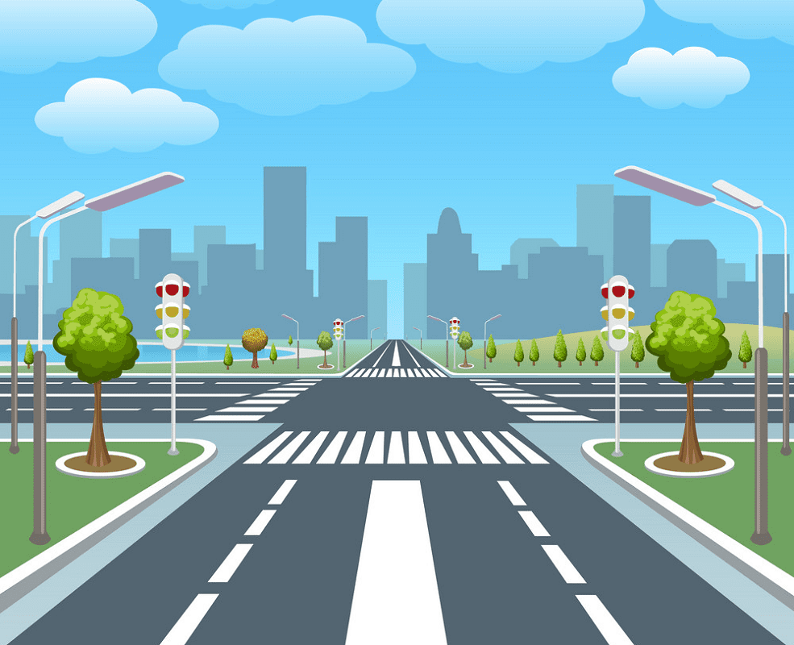
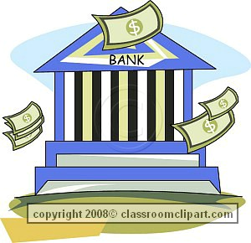
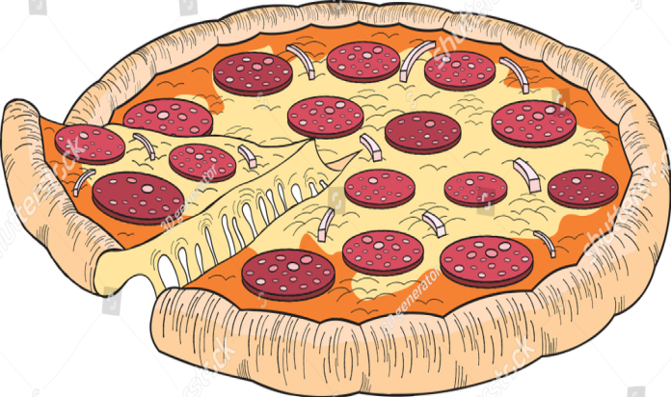
Direct Questions
What’s the name of the street?
Where is the nearest bank?
When does the store open?
Where can I get good pizza?

Slide 26
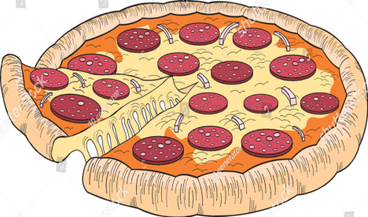
Indirect Questions
Do you know what the name of the street is?
Do you know where the nearest bank is?
Do you know when the store opens?
Could you tell me where I can get good pizza?

Slide 27
Direct Question
Question Word
Verb
Subject
Where is the post office ?
Indirect Question
Introductory phrase
Question Word
Subject
Verb
Do you know where the post office is ?

Slide 28

Negative (+)
Affirmative (+)
Expressing Agreement with
So , Neither , Either , Too

Slide 29
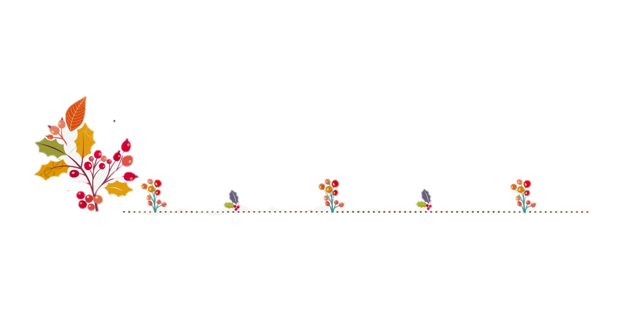
Negative (-)
Affirmative (+)
A: I ate at the new pizza restaurant.
B: So did I. / I did too.
A: I will visit my family on the weekend..
B: So will I. / I will too
. A: I don’t know the answer.
B:Neither do I. / I don’t either.
A: I won’t go to school tomorrow.
B: Neither will I. / I won’t either.
PRACTICE TIME

Slide 30
PRACTICE TIME

Slide 31
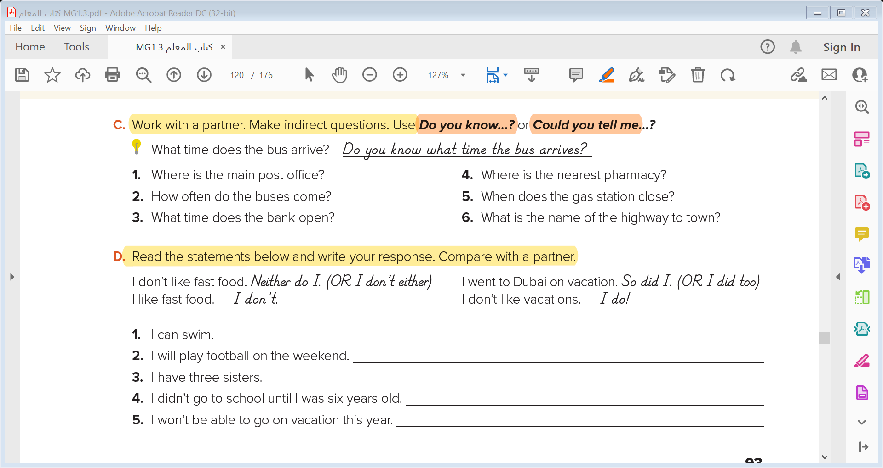
1- Do you know where the main post office is ?
2- Do you know how often the buses come ?
3- Do you know what time the bank opens ?
4- Could you tell me where the nearest pharmacy is ?
5- Do you know when the gas station closes ?
6- Could you tell me the name of the highway to town ?

Slide 32
Expressing Disagreement

Slide 33
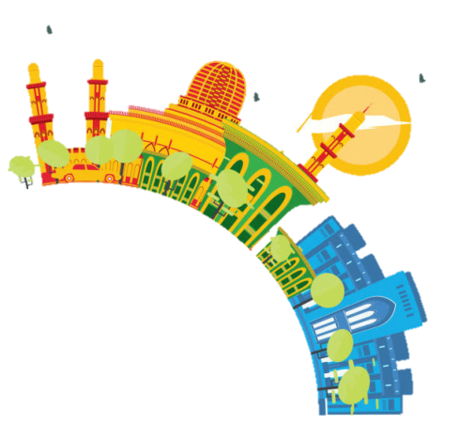
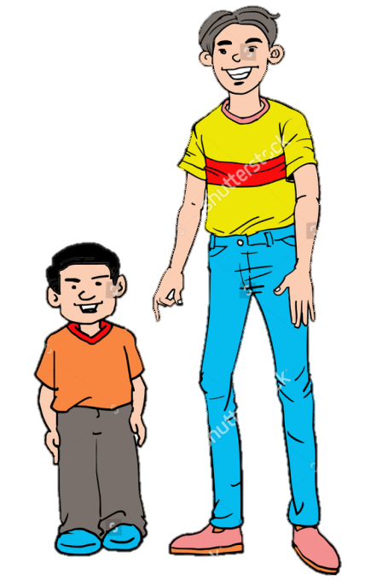
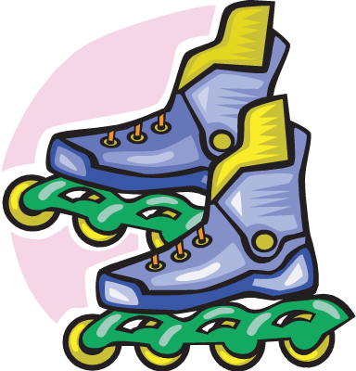
A: I didn’t like the pizza.
B: I did.
A: I can rollerblade.
B: I can’t.
A: I’ve been to Muscat.
B: I haven’t.
A: I am not very tall.
B: I am.
PRACTICE TIME

Slide 34
PRACTICE TIME

Slide 35
So can I / I can too
So will I / I will too
So have I / I have too
Neither did I / I didn’t either
Neither will I / I won’t either

Slide 36
Quick Check

Slide 37


