Slide 1

Mega Goal 1.3
Revision unit 2
ابدأ
Done by :
Entiasr AL-Obaidallah
معاً نتعلم لأجل الإمارات
تصميم المعلمة: عفراء الخاطري

Slide 2
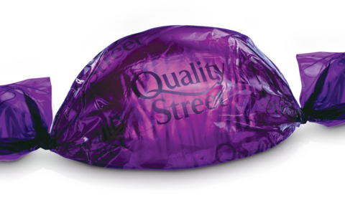
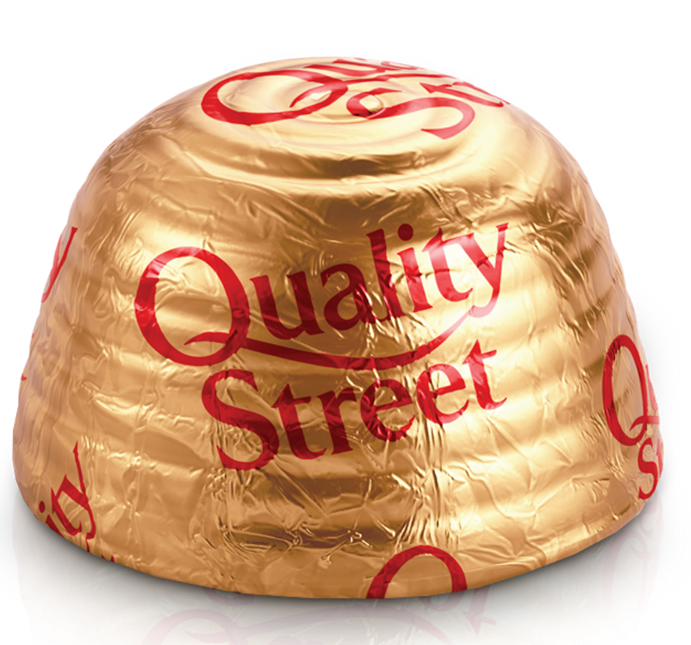
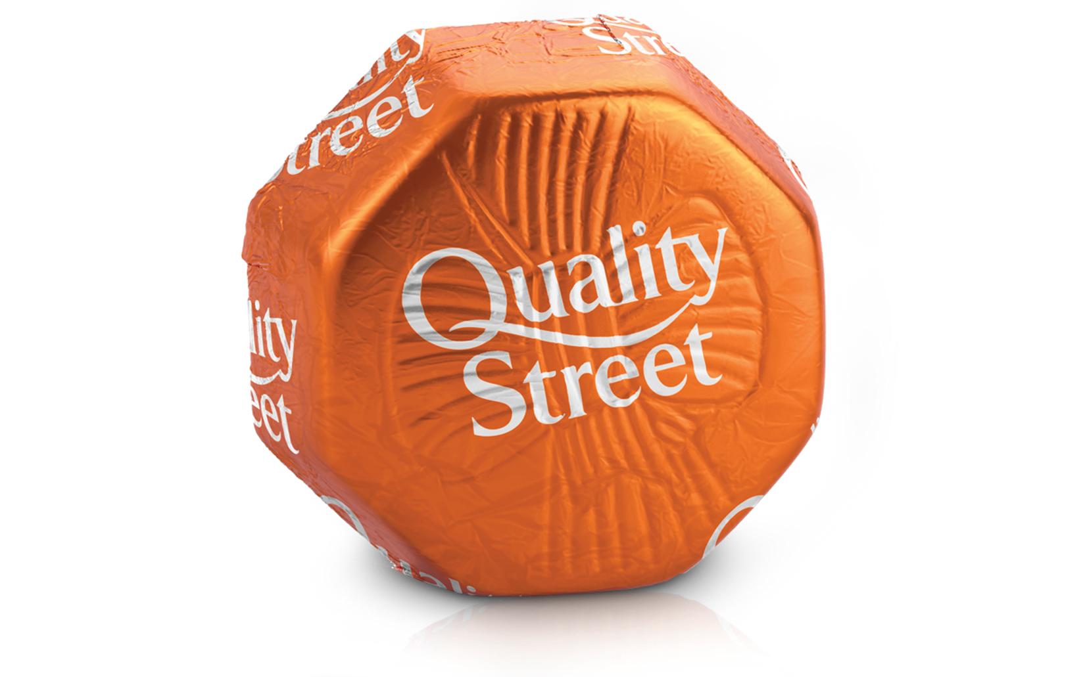
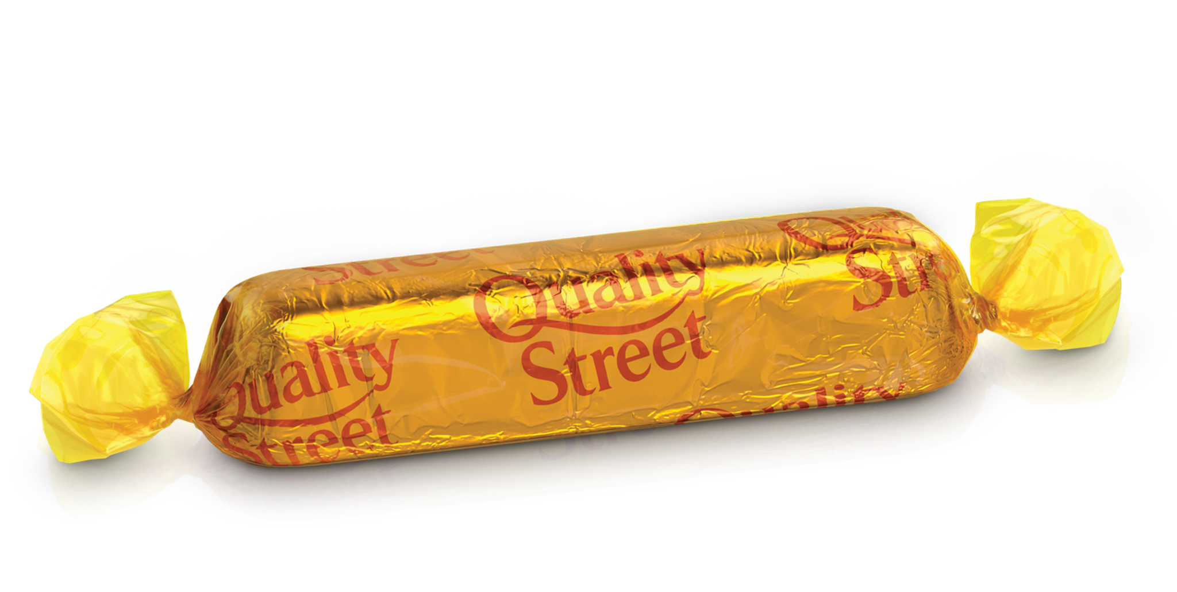
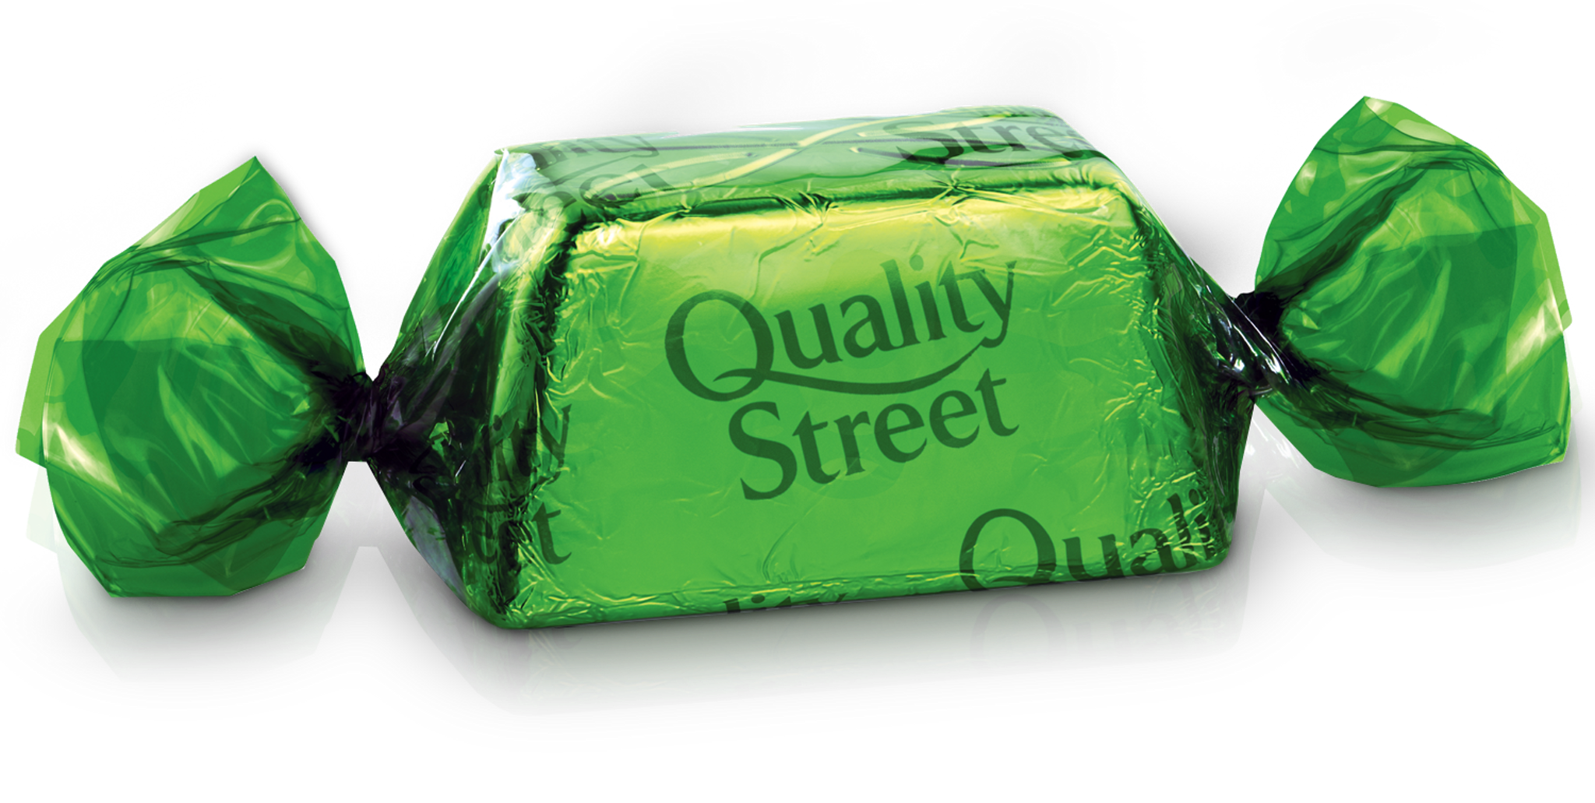
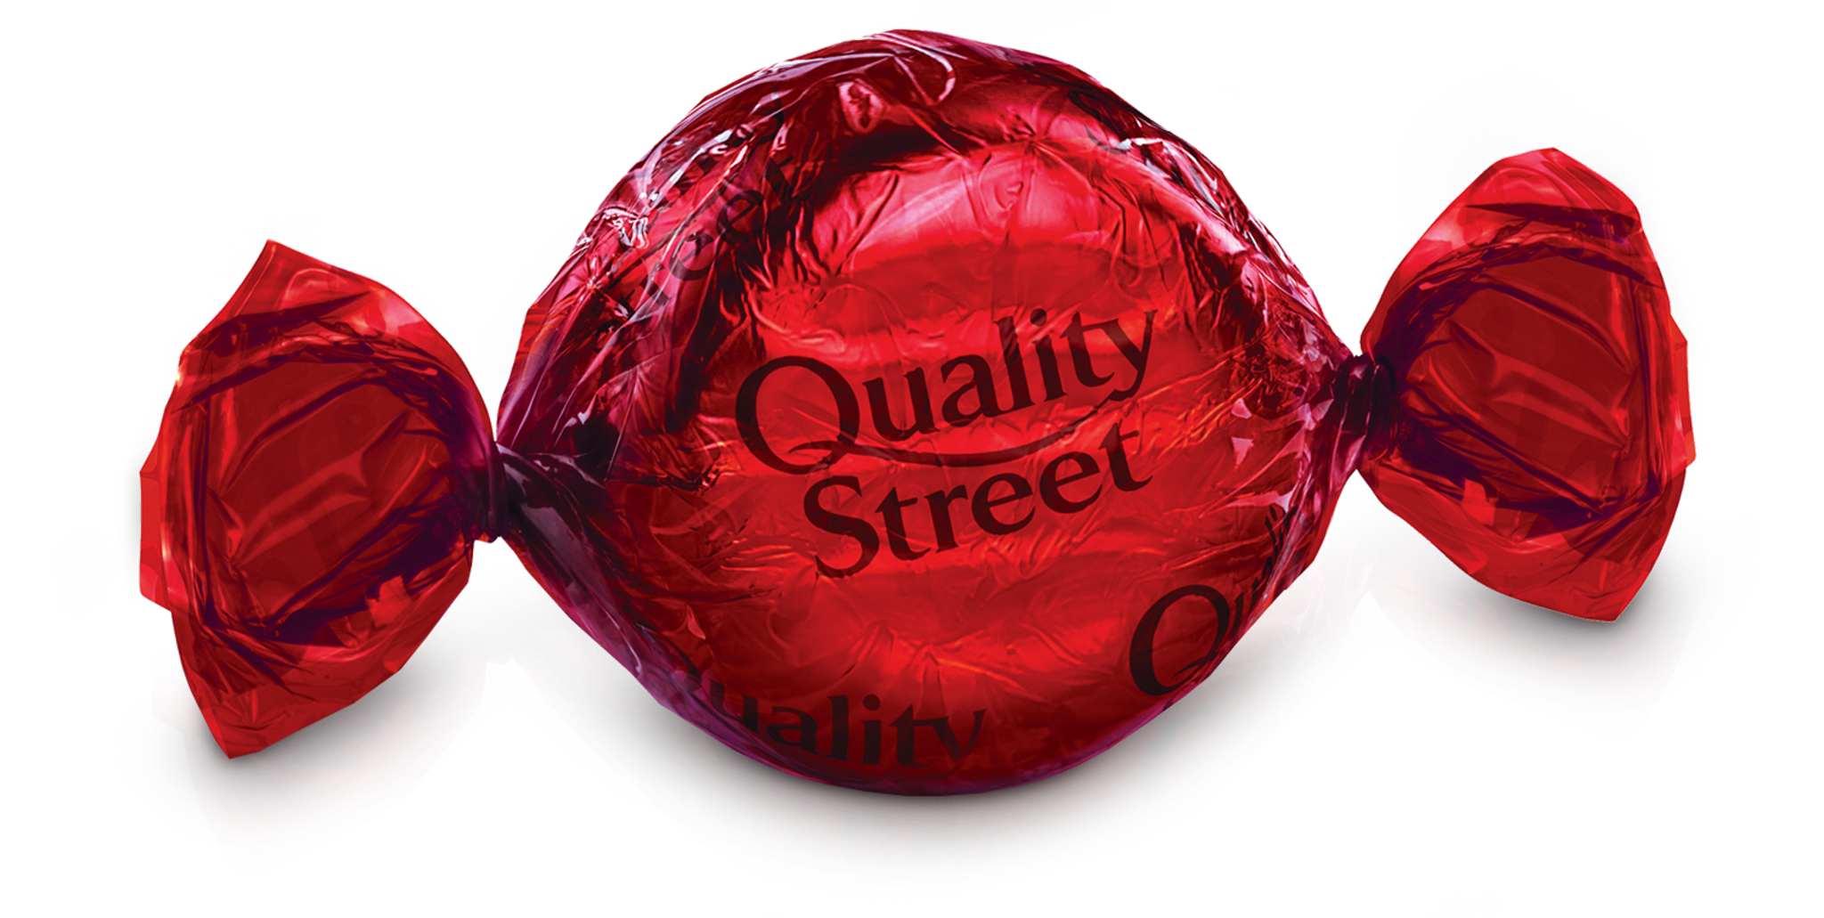
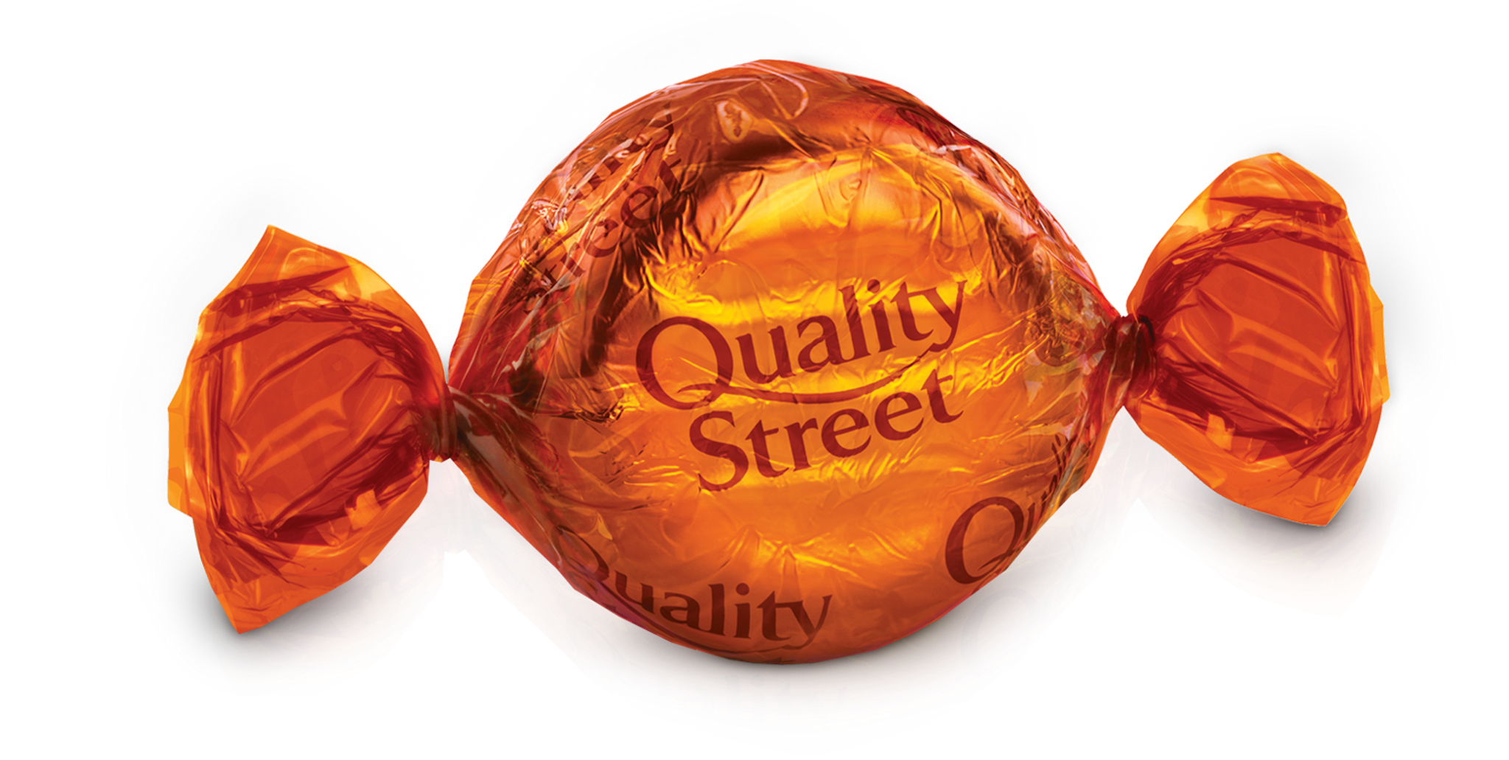
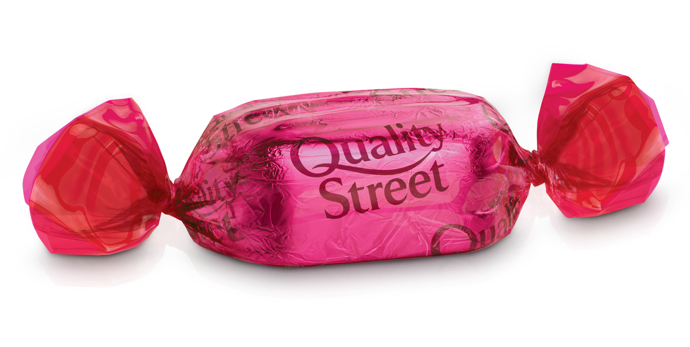
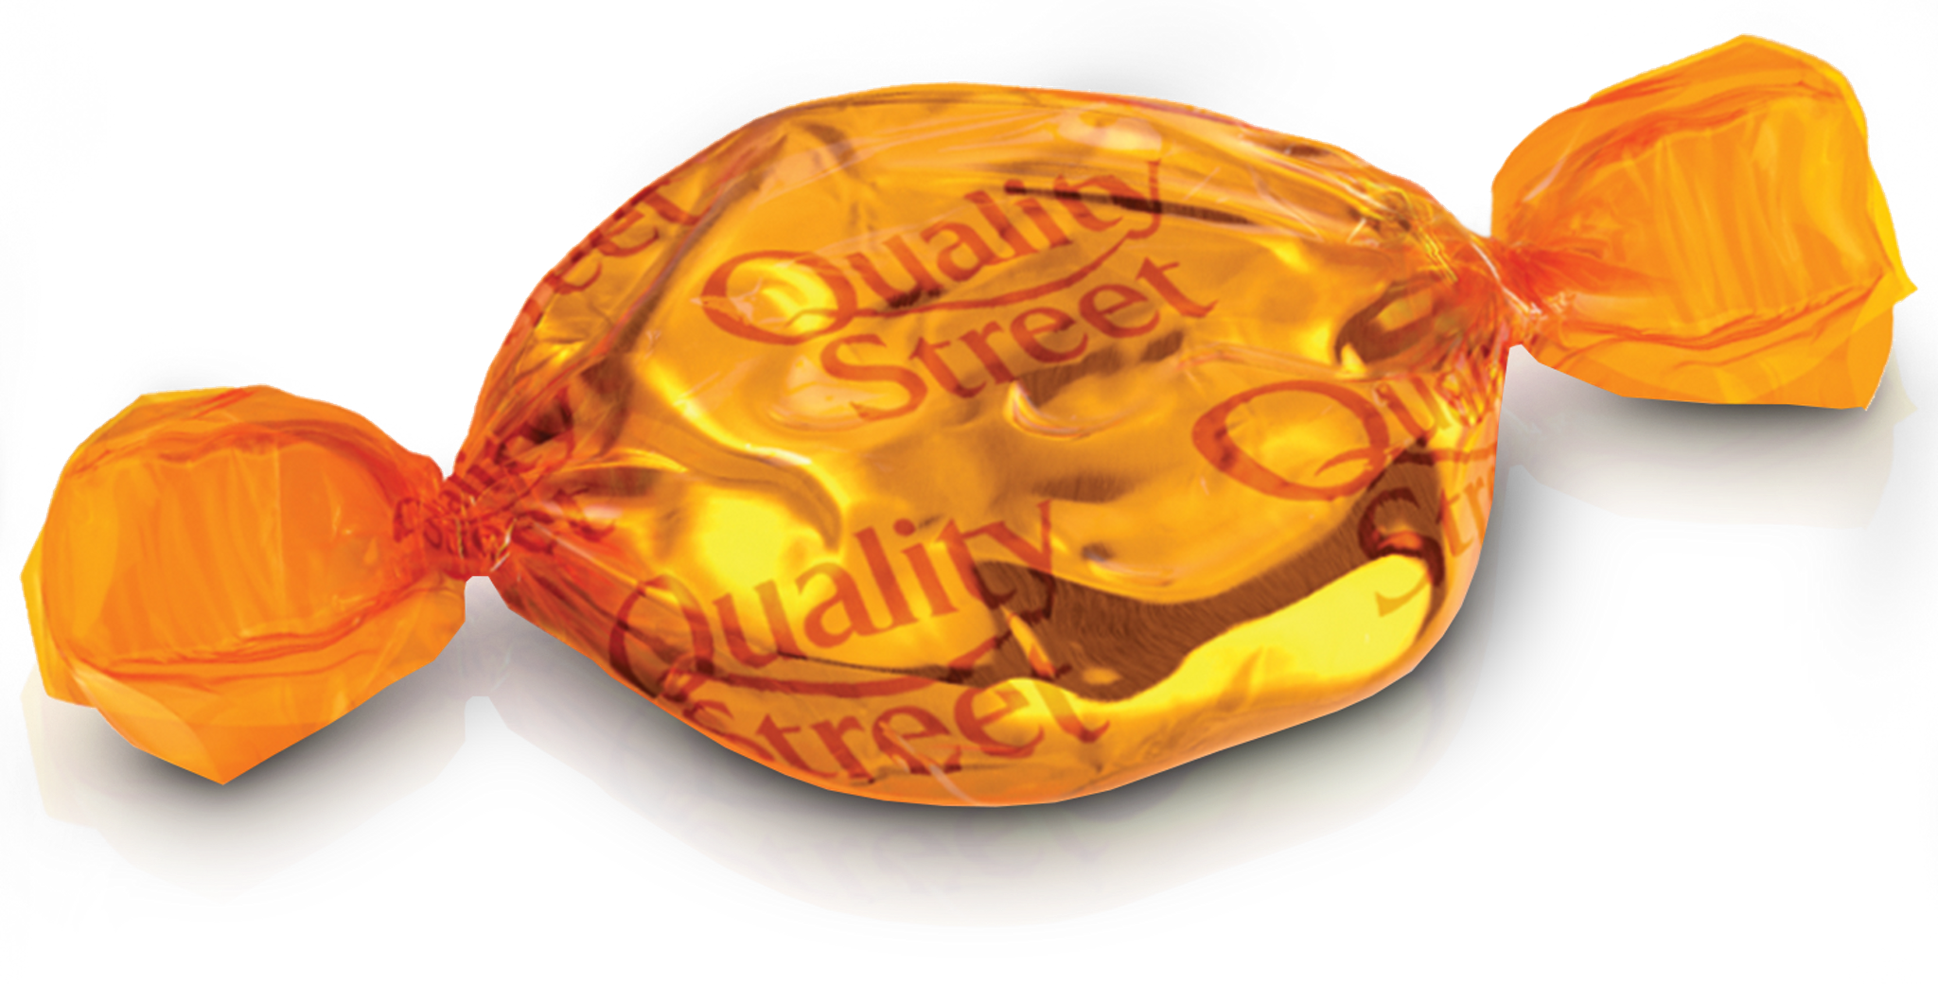
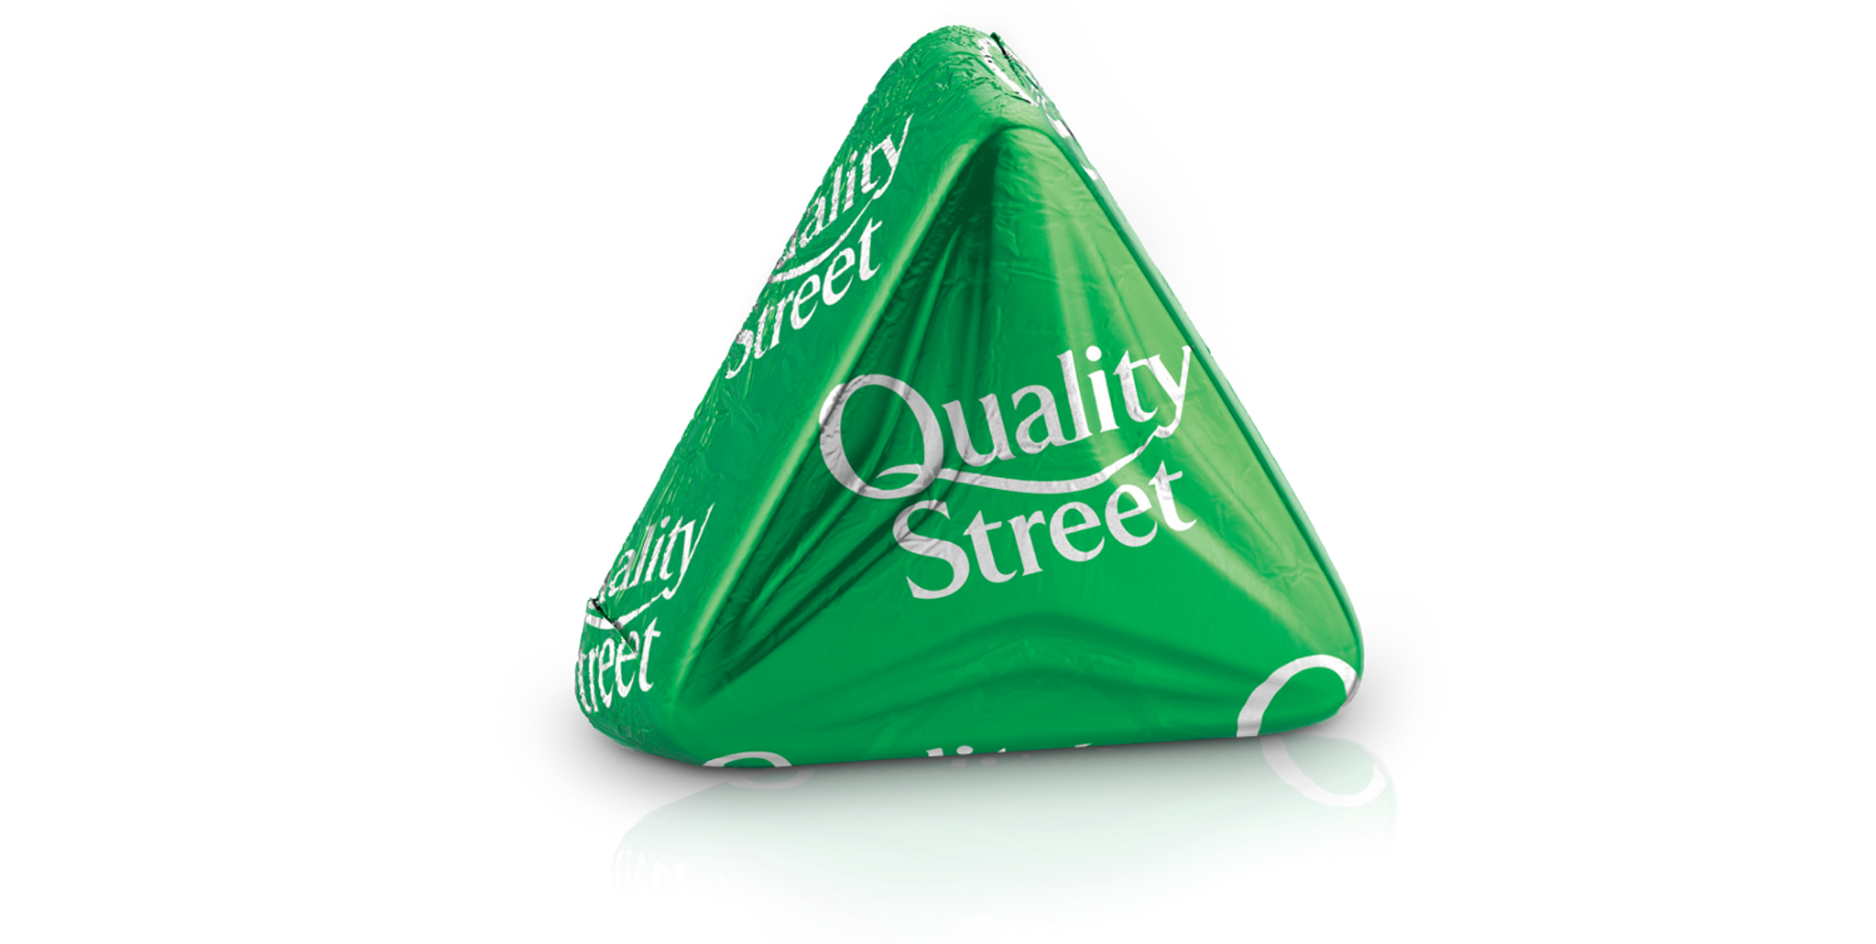
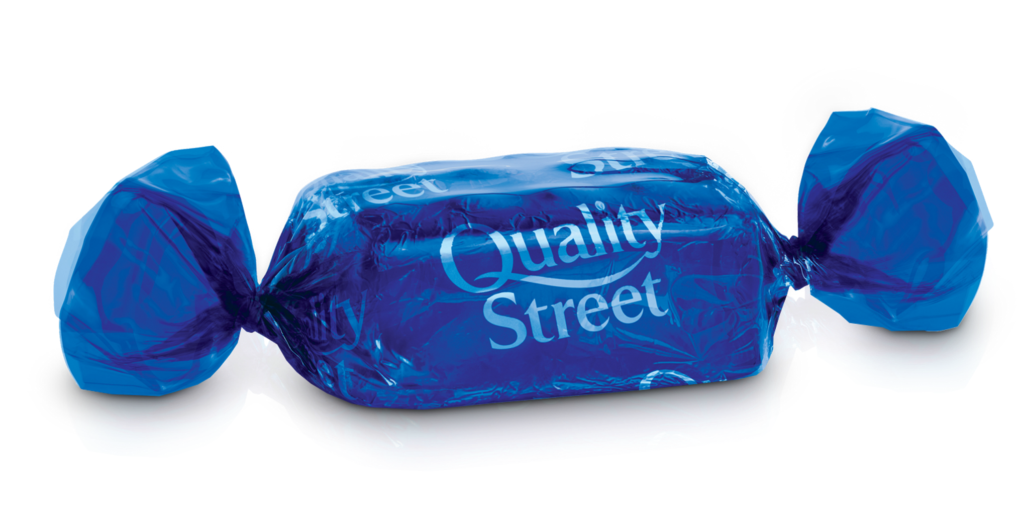

Slide 3
Choose:
Would you like drink a cup of tea , ( and – but – so – or ) coffee.
or
Back

Slide 4
Choose:
If you heat ice, it ( melt - melting - melted - melts) .
melts
Back

Slide 5
Choose:
If you ( wake up - wakes up – woke up – waking up) late , you will miss the bus
Wake up
Back

Slide 6
Choose:
Sara didn't' eat breakfast or lunch. She (can’t - must - might - can) be hungry now.
must
Back

Slide 7
Choose:
I think my mother (can’t - must - might - can) know who the people are in that old photo .
might
Back

Slide 8
Choose:
When the police arrived, the thief had ( escape – escapes – escaping - escaped).
escaped
Back

Slide 9
Correct :
We ( can ) ………………………..stay long because we have to go to the store before it close .
Can’t
Back

Slide 10
Correct :
I thought that TV program was (very) ………………………………fantastic.
absolutely
quite
really
Back

Slide 11
Correct :
If you freeze water , it ( turn ) …………………………………into ice .
turns
Back

Slide 12
( Combine into one )
- He didn’t want to walk in the rain. He took a taxi.
He didn’t want to walk in the rain , so he took a taxi.
Back

Slide 13
( What is the odd word )
tornado – hurricane – dome – storm
dome
Back

Slide 14
Choose:
(Had - Do - Are - Has) you ever visited London when you moved there ?
had
Back

Slide 15
I want to buy a phone, (and - but –
or - so ) I don’t have enough money.
but
Back

Slide 16
( Fill in the space :)
( serve - debris - dynamic – crashed )
The meteorite had left a lot of…………………………………in its path.
debris
Back

Slide 17
( Fill in the space :)
( serve - debris - dynamic – crashed )
The Kingdom is honored to ……………… pilgrims and visitors.
serve
Back

Slide 18
WHICH OF THE FOLLOWING adjectives IS NOT RELATED TO THE CATEGORY OF “ Gradable” ?
cold – sick – amazing – ugly
amazing
Back

Slide 19
WHICH OF THE FOLLOWING adjectives IS NOT RELATED TO THE CATEGORY OF “ Non-Gradable” ?
amazing – fascinating – ugly- freezing
ugly
Back

Slide 20
WHICH IS THE correct meaning of “remote”
Relating to a city – far away – always active
Far away
Back

Slide 21
WHICH IS THE correct meaning of “dynamic”
Relating to a city – far away – always active
Always active
Back

Slide 22
WHICH IS THE CORRECT OPPOSITE OF THE WORD “urban”
Normal – degrade – rural
rural
Back

Slide 23
WHICH IS THE CORRECT OPPOSITE OF THE WORD “weird”
Normal – degrade – rural
normal
Back

Slide 24

WHAT DOES THIS PICTURE SHOW ?
( snowball – meteorite )
meteorite
Back

Slide 25
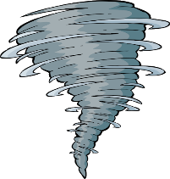
WHAT DOES THIS PICTURE SHOW ?
( tornado – volcano )
tornado
Back

Slide 26

WHAT DOES THIS PICTURE SHOW ?
( Locomotive – UFO )
UFO
Back

Slide 27
WHICH OF THE FOLLOWNG DOES THIS SENTENCE EXPRESS ?
- If it rains , we will stay at home
( present facts – future facts - possibility )
future facts
Back

Slide 28
Choose:
I don't ( need to - must - needn't ) write the report myself. My secretary can do that for me.
need to
Back

Slide 29


