Slide 1
Unit 4
If It Haden’t Happened
Writing
Mega Goal 1.3
Done by:Entisar Al-Obaidallah

Slide 2
Lesson Objectives
Describe the pictures using their own words.
Answer some questions about the text.
Read the text for specific information.
Write an email to give information and directions to a plce .

Slide 3

Open
Your student’s book p.(56)

Slide 4

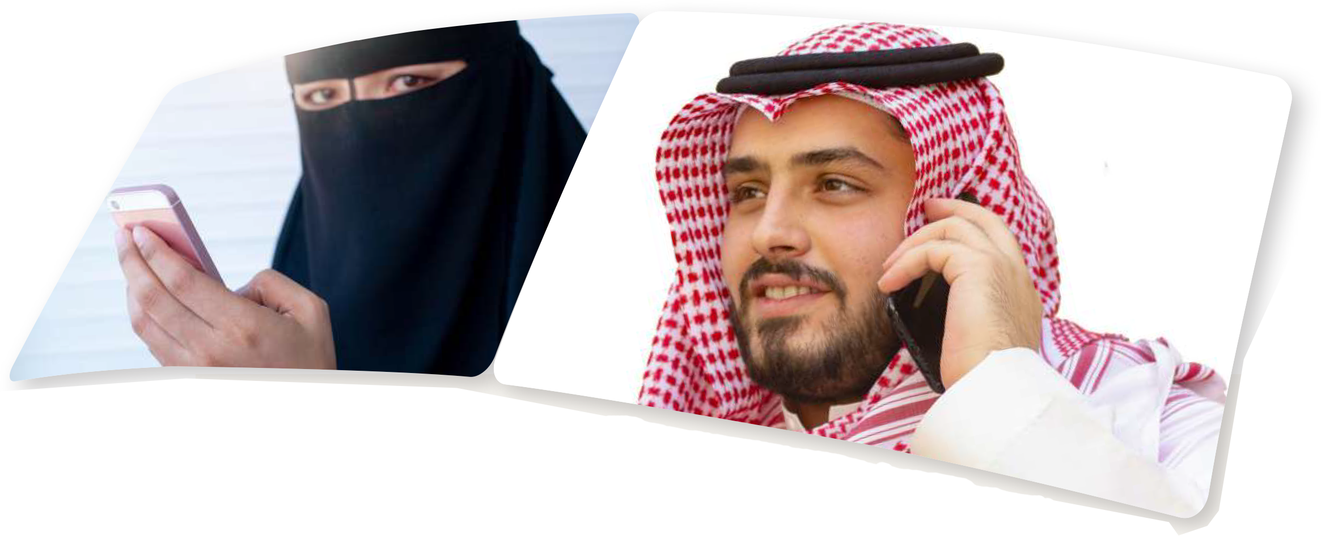

Slide 5
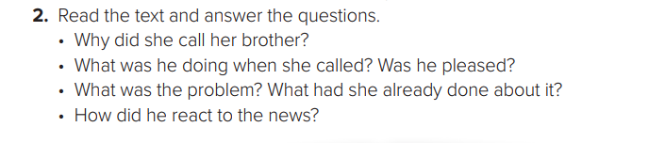
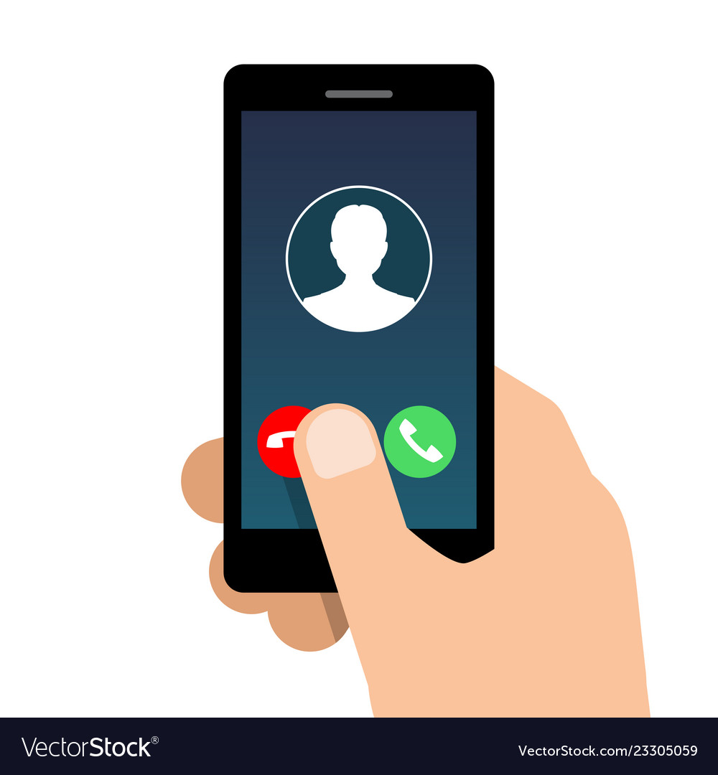

Slide 6

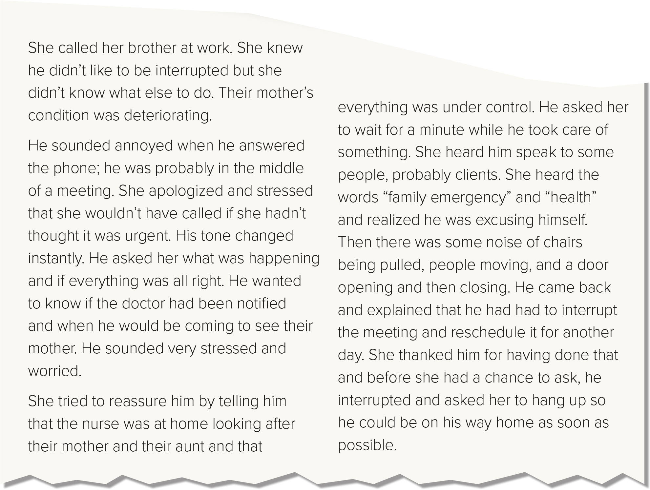
Because their mother’s condition was deteriorating.
He was in the middle of a meeting.
No, he wasn’t. He was annoyed.
Their mother was sick. She called the nurse, and the nurse was at home looking after their mother and their aunt and that everything was under control.
He rescheduled the meeting for another day and went back home to see his mother.

Slide 7
Read and analyze the sentences
Strong adjectives
Verb tenses
Describe the events clearly
Describing in detail what we smell, hear and feel

Slide 8

How to report an event?
1- Organize your event (order of incidents)
2- Putting the right content in your writing
3- Use strong adjectives and correct tenses

Slide 9
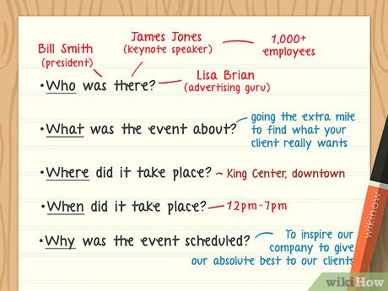

Slide 10
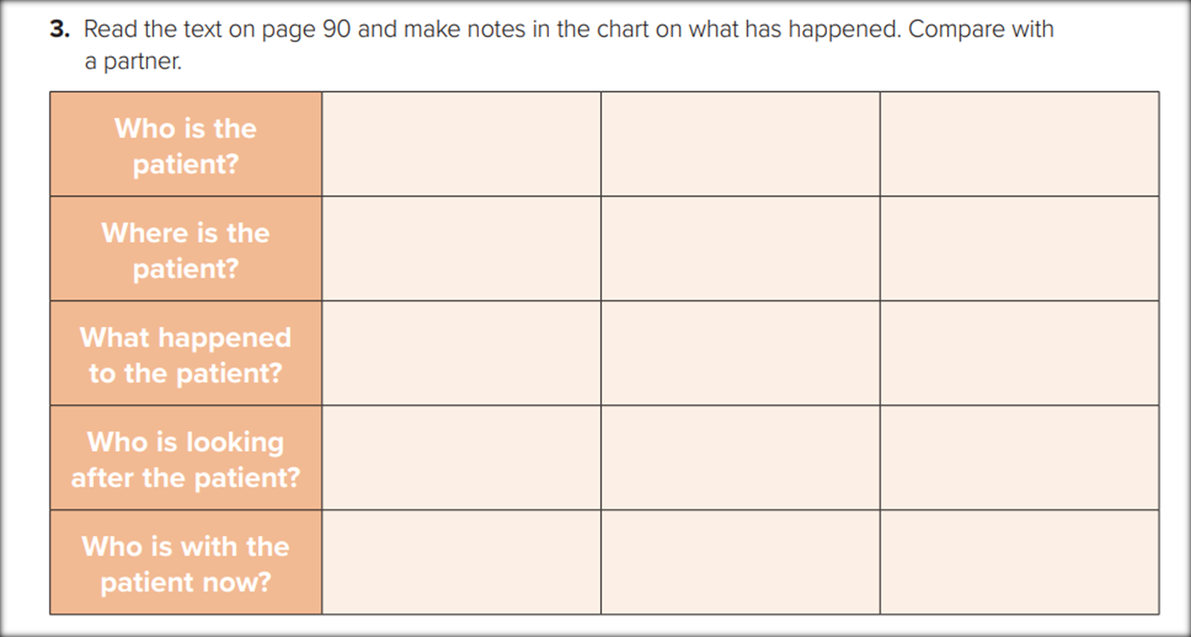
The mother
At home
Her condition was deteriorating
The nurse
The daughter and the aunt
her sister
a nurs

Slide 11
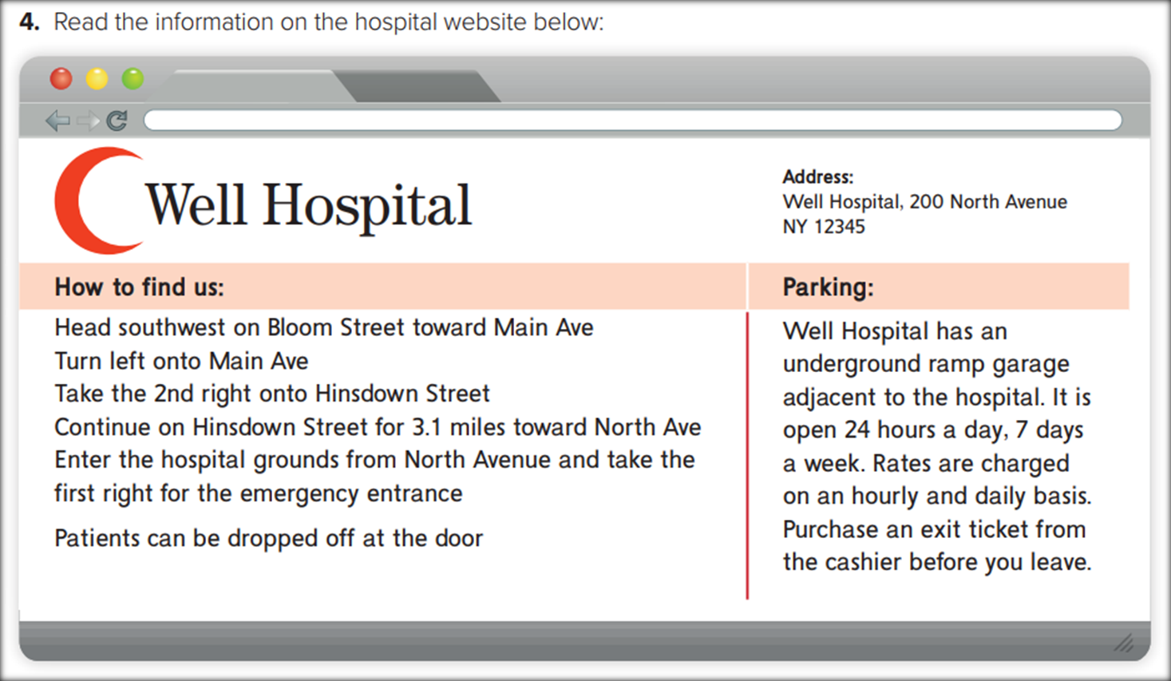
How to Give Directions?

Slide 12
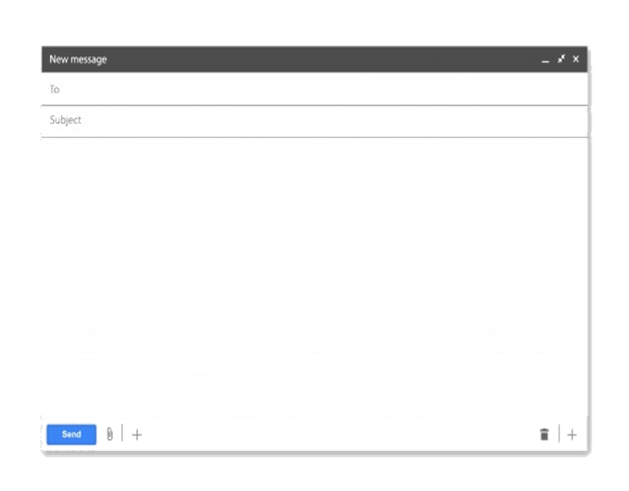
Your email should look like this
opening
Dear ,………………………
1st paragraph
Report the event
2nd paragraph
Give directions to the hospital
Signing off
See you soon

Slide 13
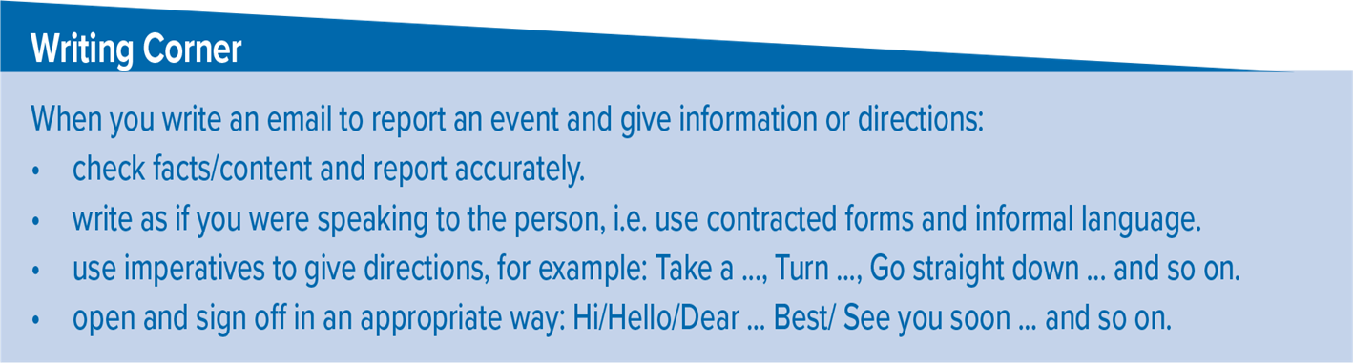
Follow these steps to write a comparative / contrastive essay:

Slide 14

Home work
workbookbook p.(116), exercise (j)

Slide 15
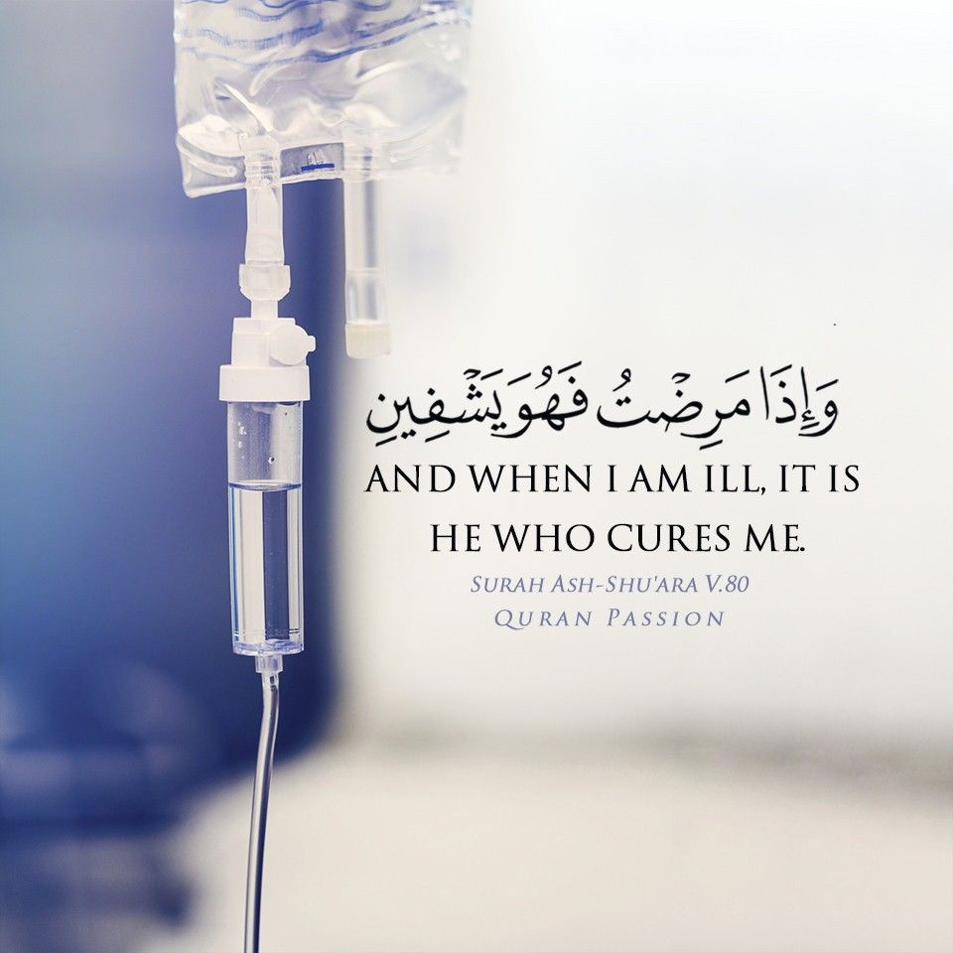
From The Holy Quraan

Slide 16

THANKS!

