Slide 1
Unit 4
What They Said
Reading
Mega Goal 1.3
Done by: Entisar Al-Obaidallah

Slide 2



Lesson Objectives
01
02
03
04
05
06
identify humor and irony in the quotes .
Deduce the meaning of the new words
Read the quotes for specific information
Answer True –False questions about the quotes
Report some quotes correctly.
Discuss the topic of quets

Slide 3

Open your student’s book p. (54-55)

Slide 4
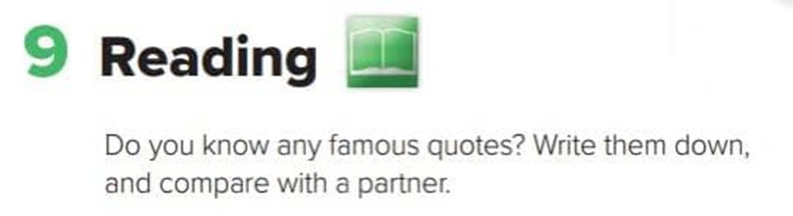
Before Reading

Slide 5
What does “ Quote” mean?
“Tha quote, words full of wisdom that someone important said and can make the reader get inspired.”

Slide 6
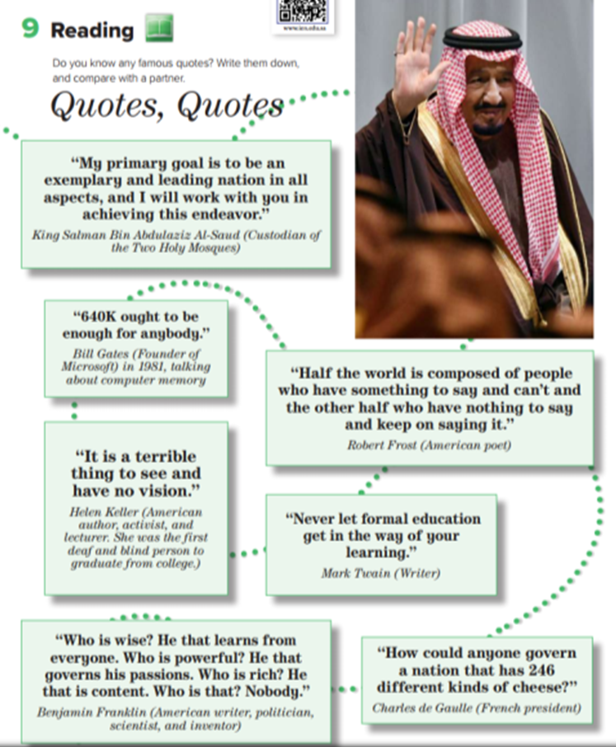

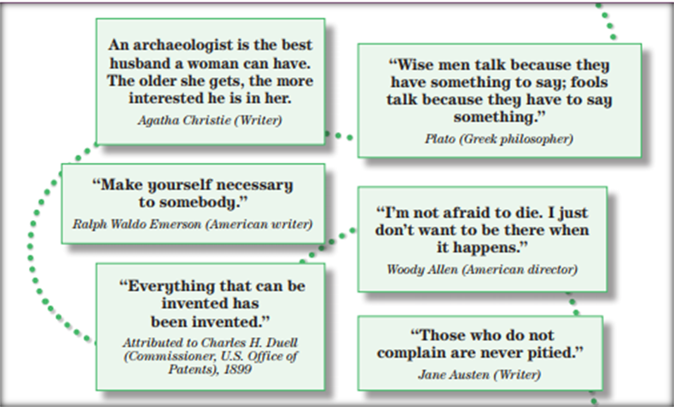
8
9
1
11
10
2
King Salman
12
3
13
4
5
What is the title of the lesson?
6
7
How many quotes are there ?
What does the picture show ?

Slide 7
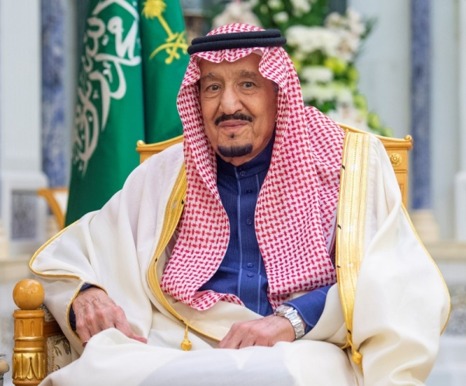

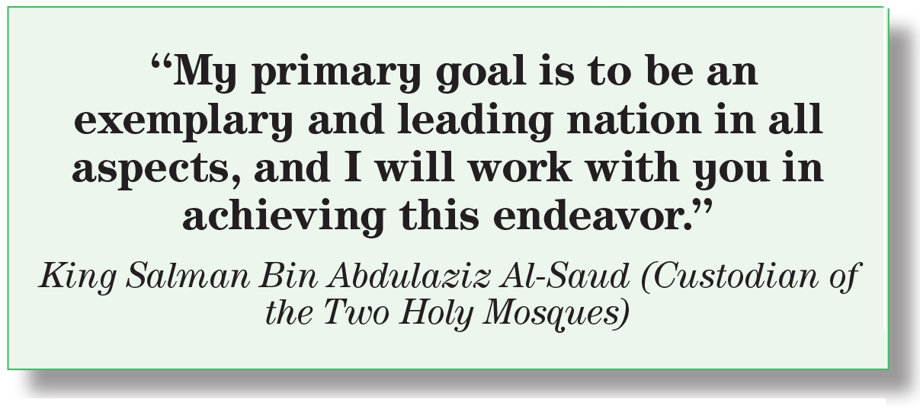


What was this quote about ?
Leading Saudi Arabia to be the best nation .

Slide 8
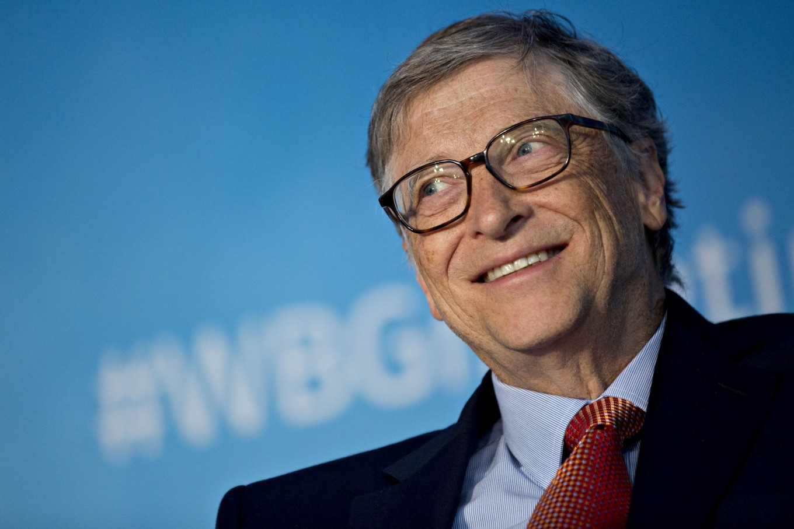
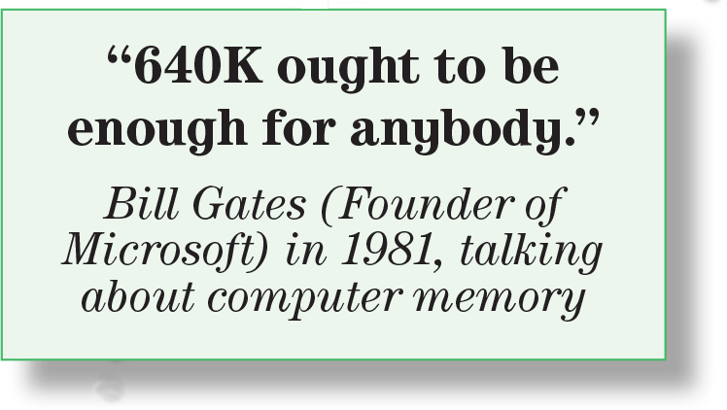
What was this quote about ?
Is it enough now ?
Computer
No, it isn’t . It changes a lot .

Slide 9
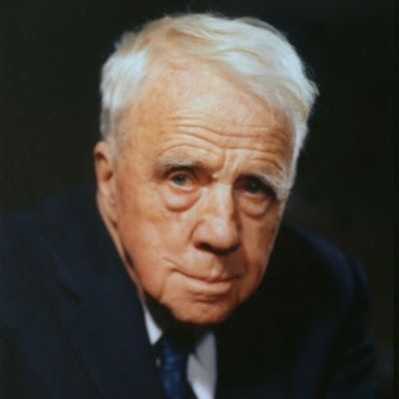
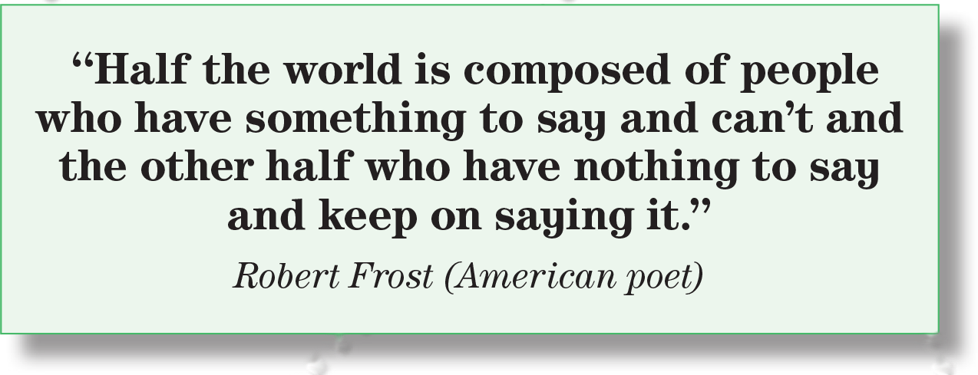
Half of the world who have experienced things that are worthwhile for the world to hear cannot express what they want to say .and half of the world talk a lot but nothing comes out (rubbish)

Slide 10
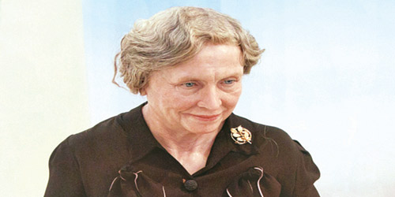

What does she mean by vision here?
(creativity, insight, or understanding)

Slide 11
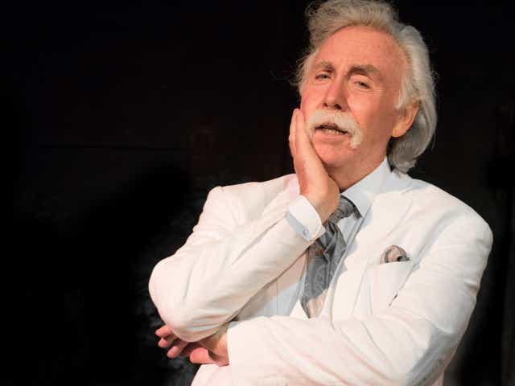
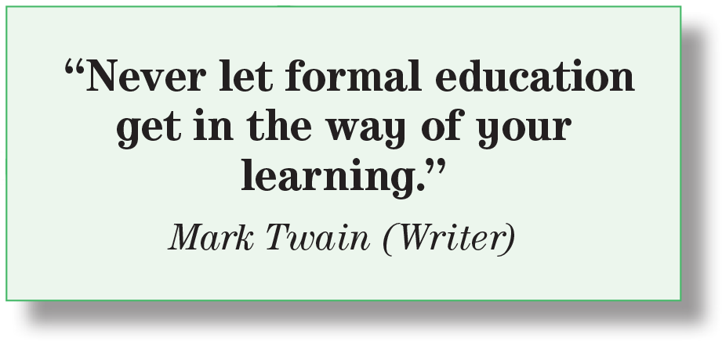
Don’t stop at the formal education . Try to expand your knowledge by reading, experimenting and benefiting from other people experiences .

Slide 12
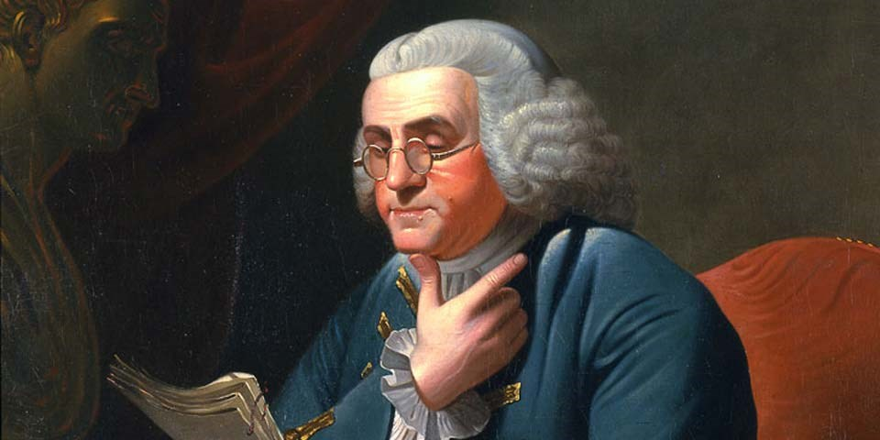
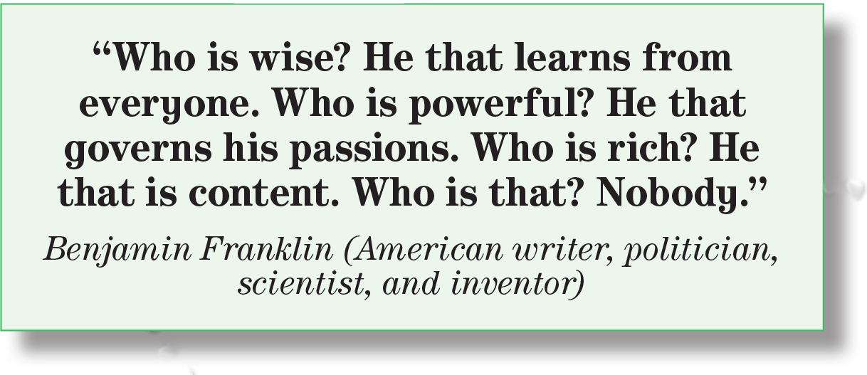
What is the meaning of content ?
To be satisfied & pleased with your situation
A person is more contented with the wealth of nature rather than the artificial wealth (money, gold etc.)

Slide 13
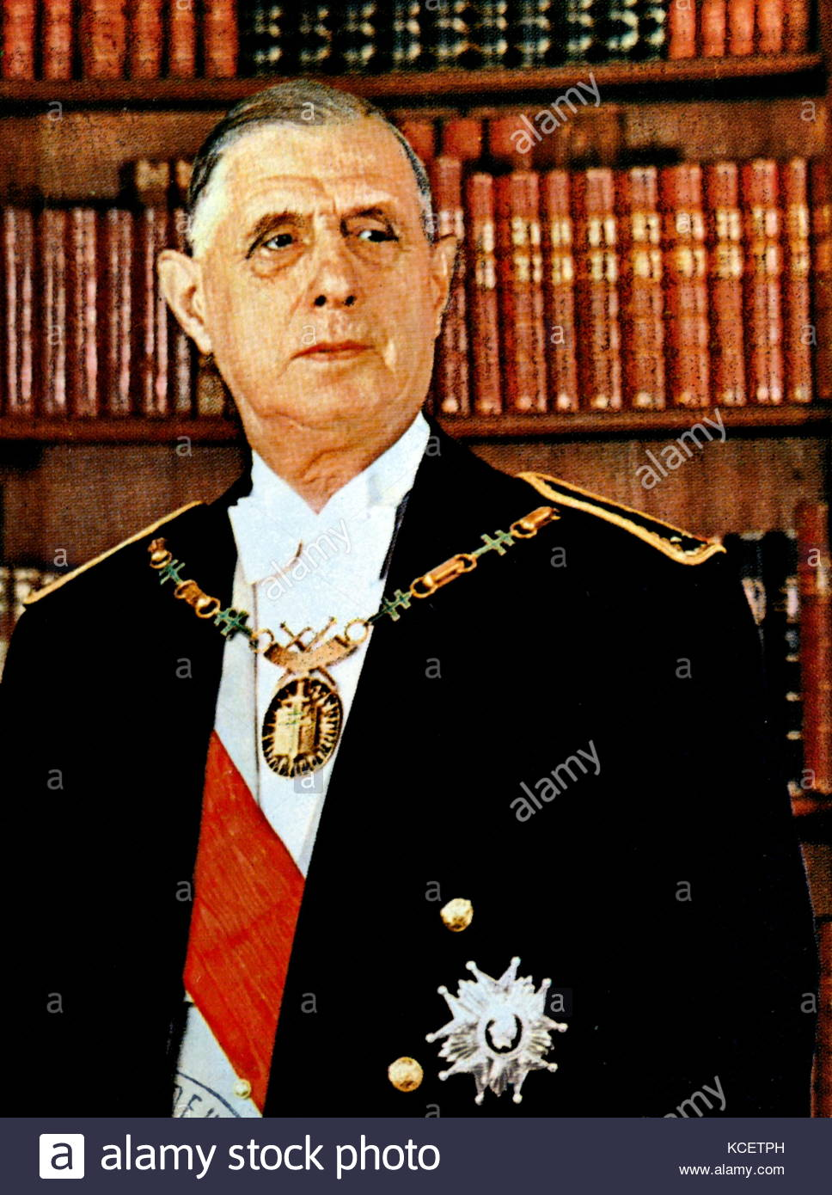
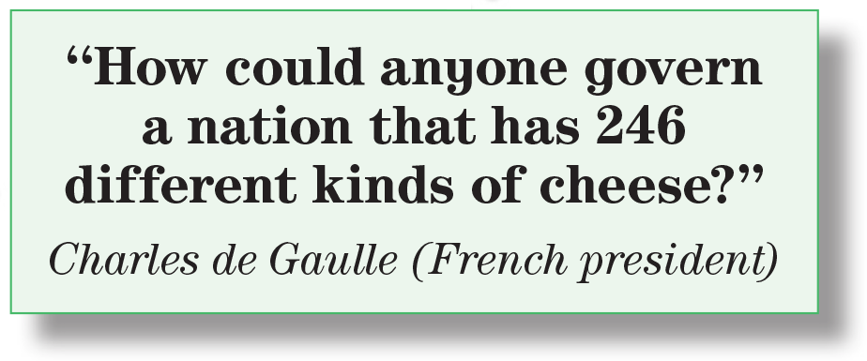
Who was Charles de Gaulle ?
He was the president of France from 1959 to 1969.

Slide 14
Open your student’s book p. (54)

Slide 15
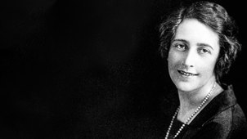
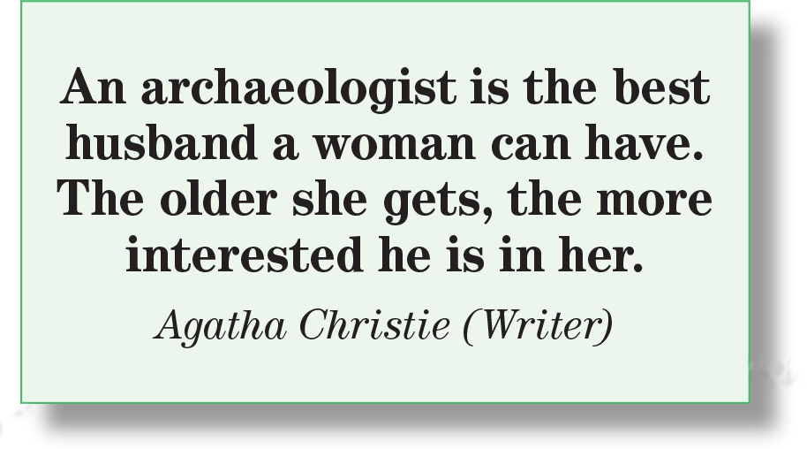
What is the meaning of archaeologist ?
a person who studies ancient societies by studying the remains of old buildings, graves.

Slide 16
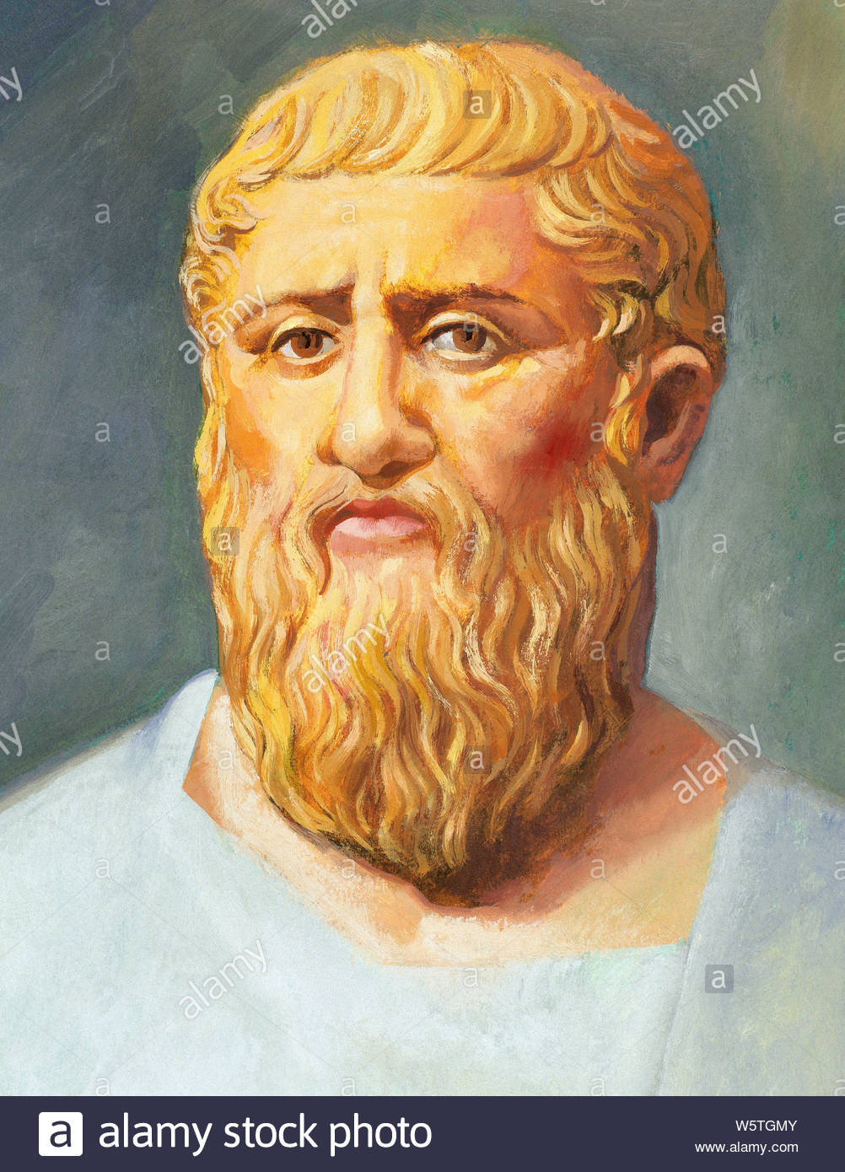
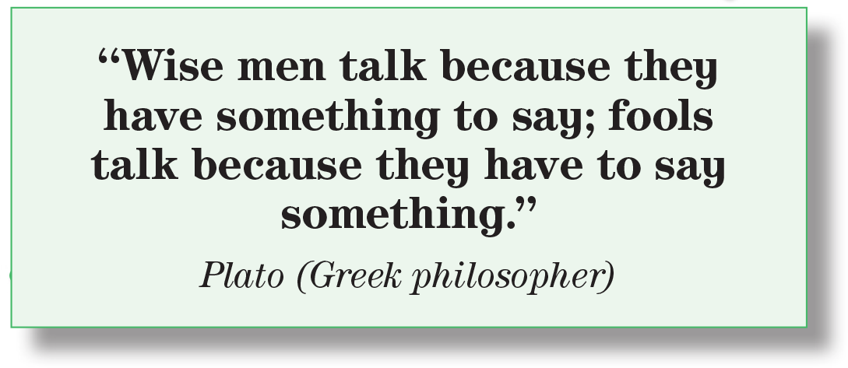
What is the meaning of wisemen ?
a man of unusual learning, judgment, or insight
Wisemen # fools

Slide 17
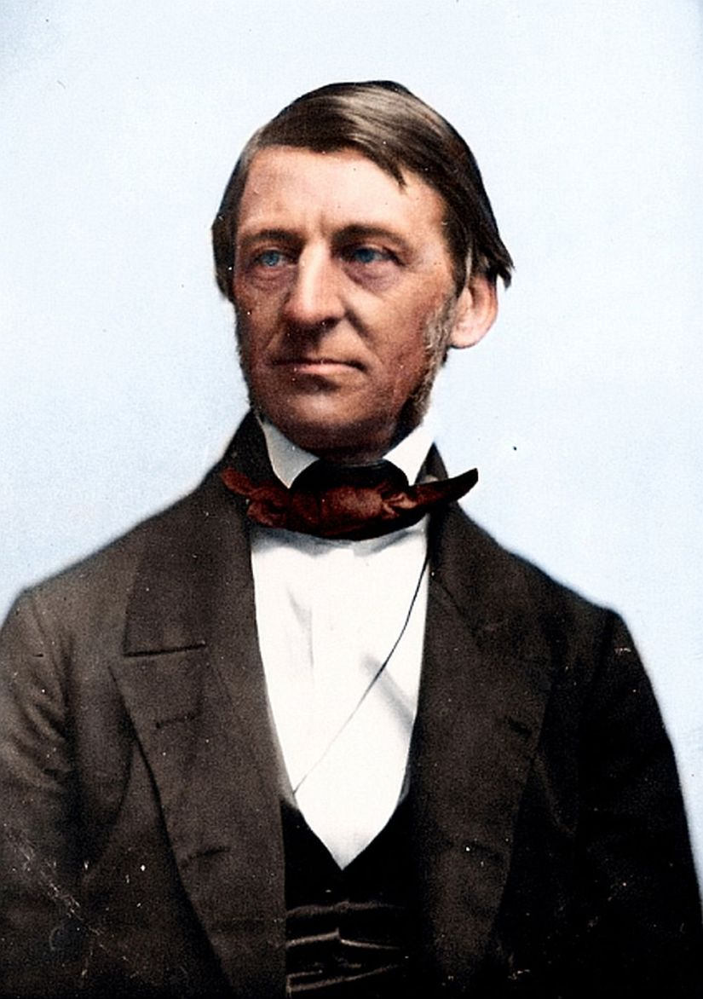
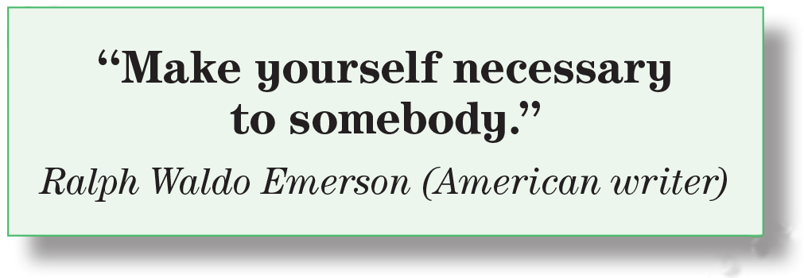
What is the meaning of necessary?
Helpful, important person

Slide 18
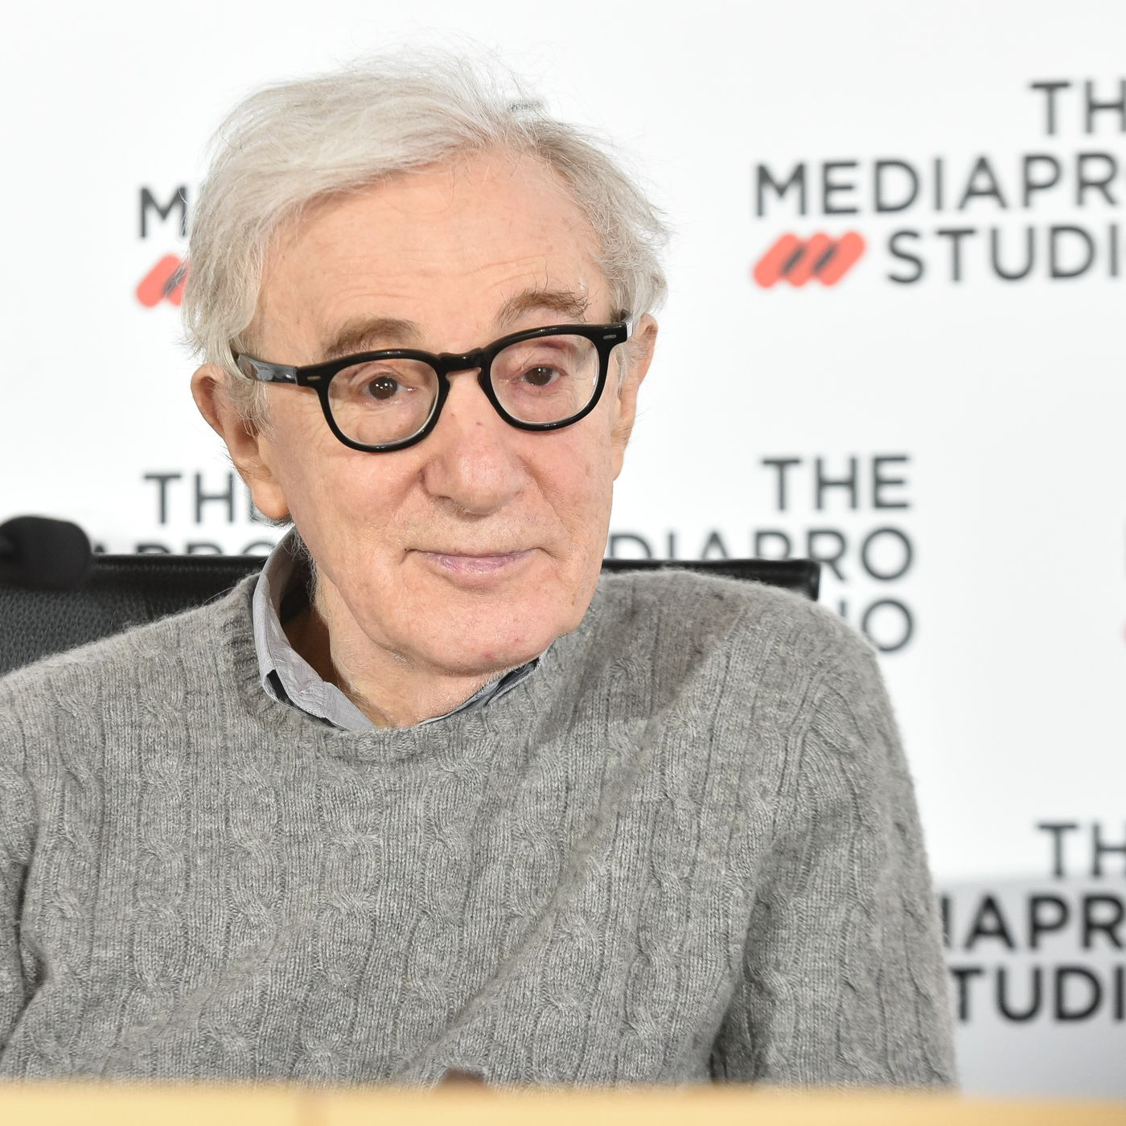
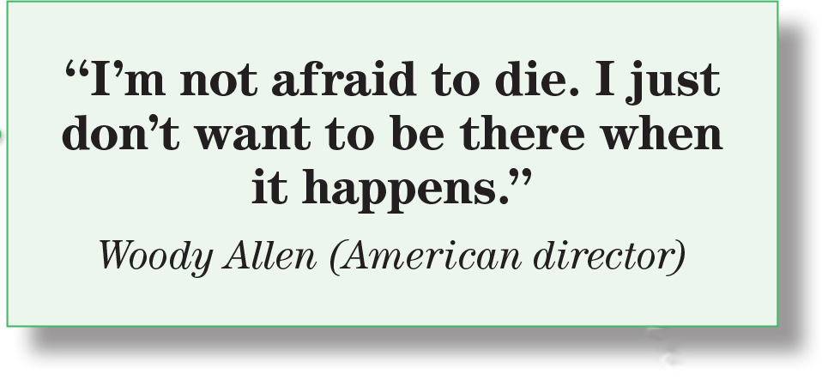
An example of humor .The humor is that a person must be present when he or she is dying.

Slide 19
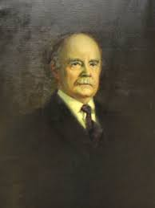
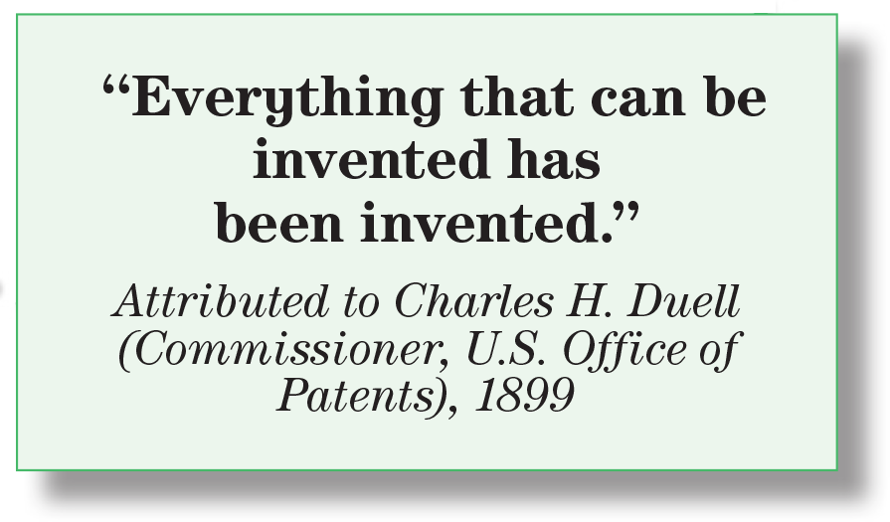
Hers is an irony because invention is still going on . It doesn’t stop .

Slide 20
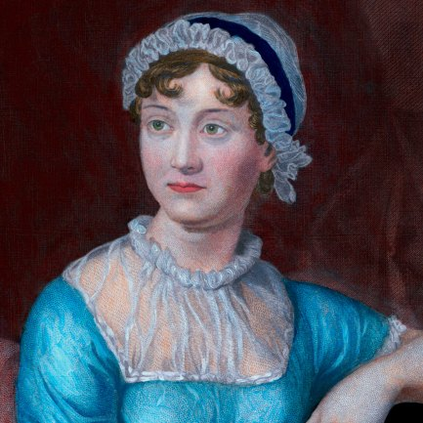
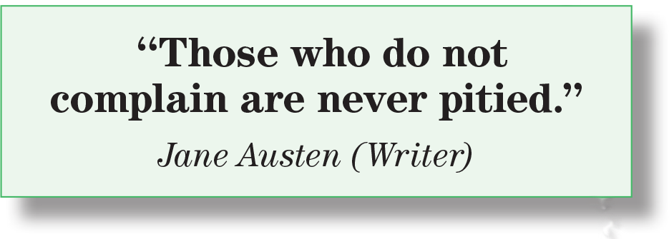
What is the meaning of to be pitied ?
(when someone feels sympathy for you because of a bad situation)

Slide 21
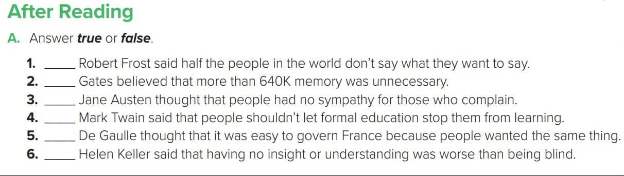
False
True
False
True
False
True

Slide 22
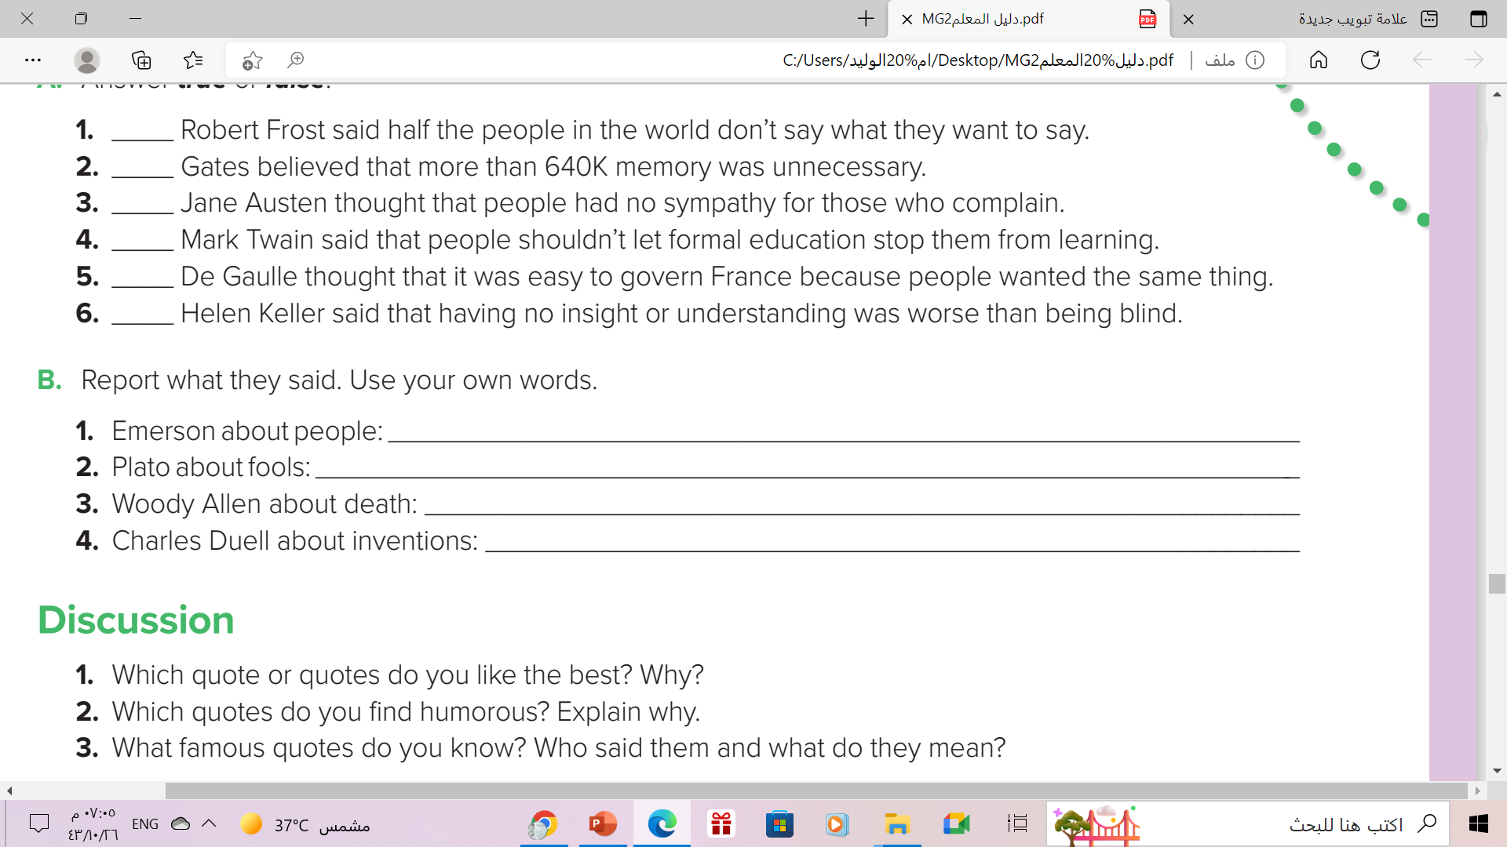
Emerson said to make yourself necessary to somebody .
Plato said that fools talked because they had to say something even if it was worthless .
Woody Allen said he was not afraid of death but that he didn’t want to be there when he died.
Charles Duell said in 1899 that everything that could be invented had been invented .

Slide 23
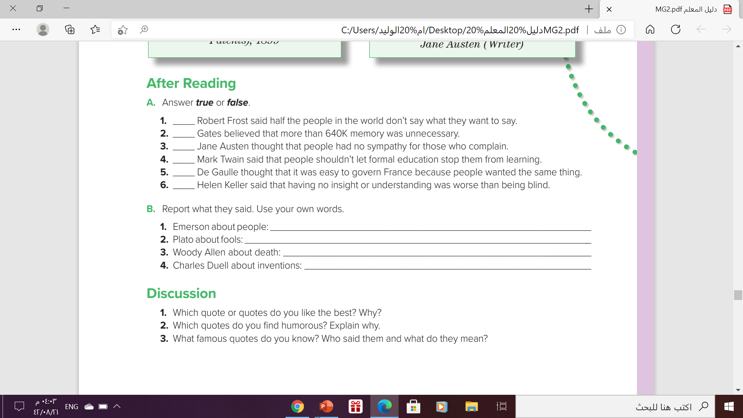

Slide 24
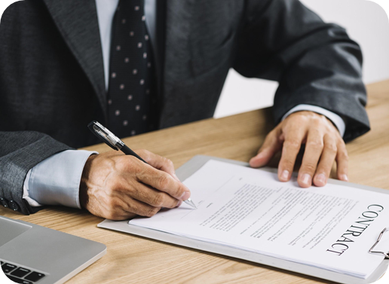
Homework
Workbook p. ( 113) , exercise
( F)

Slide 25

From The Holy Qura’an

Slide 26

Thanks!

