Slide 1
TV
Unit 4
The World of TV
Listen & Discuss
Done by : Entisar Al-Obaidallah

Slide 2
01
02
Lesson
Objectives
03
04
Talk
About TV films and documentaries
Identify
genres of TV films
Listen
For specific information
Answer
Some comprehension questions

Slide 3

Open
Your
student’s book
p. 54

Slide 4
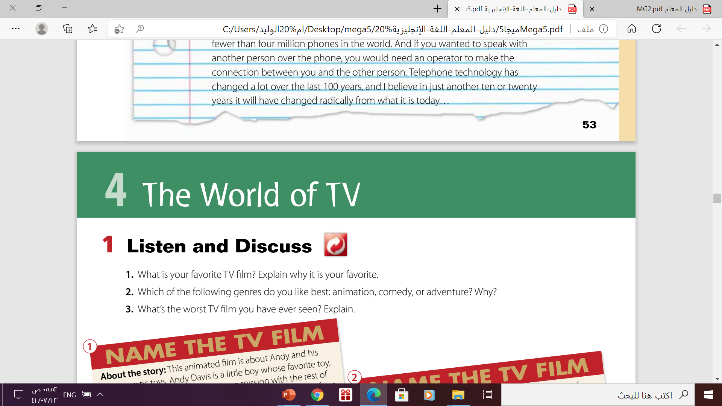
TV films
What is your favorite TV film ? Why ?

Slide 5
TV films
What is your worst TV film you have ever seen ? Why ?

Slide 6
Which of the following genres do you like the best ?
Adventure
animation
reality
comedy
fantasy
Drama
Horror
Science fiction
policy
Romance

Slide 7
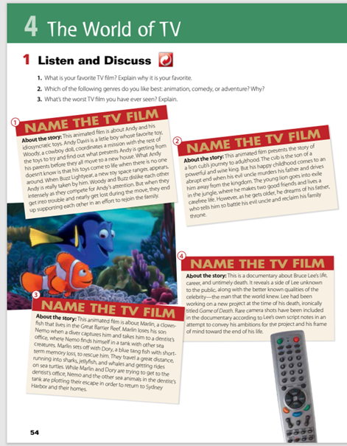
1

Slide 8

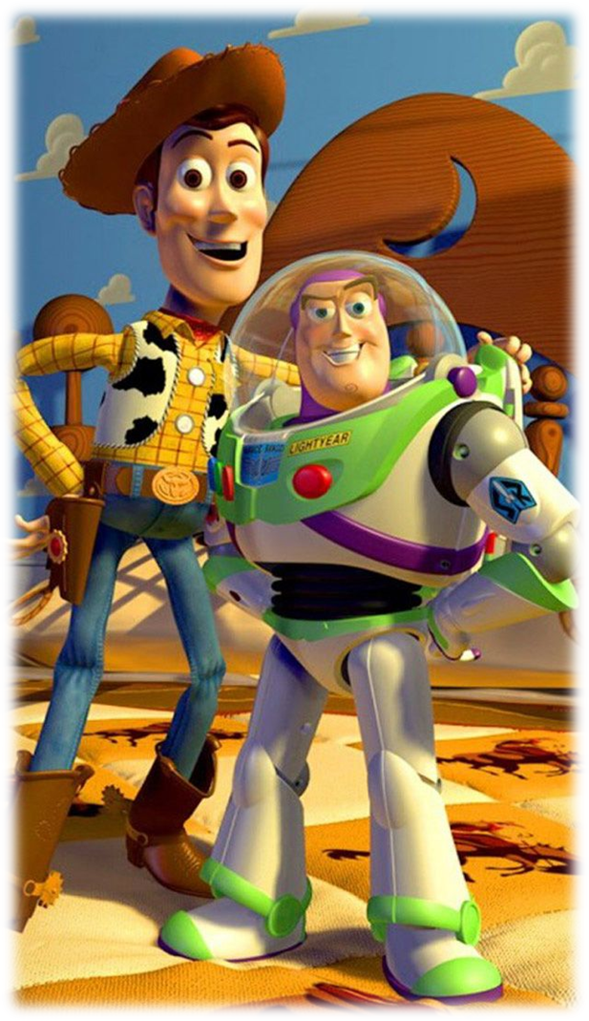
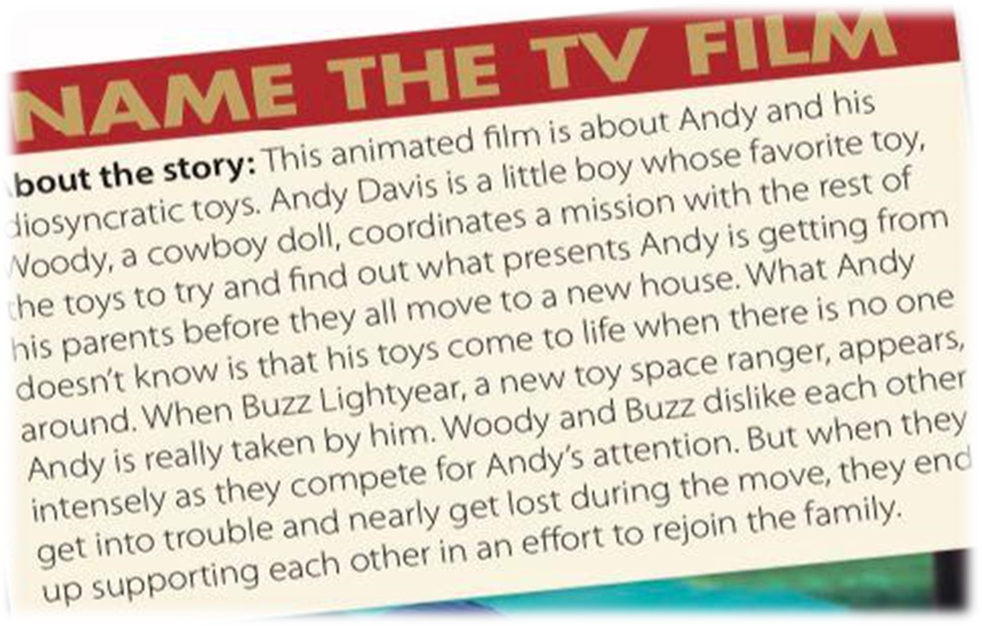
01

Slide 9
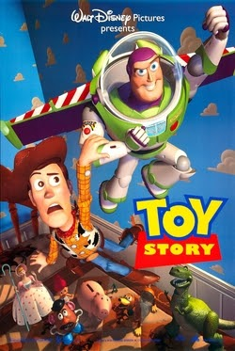
The film is : Toy Story

Slide 10
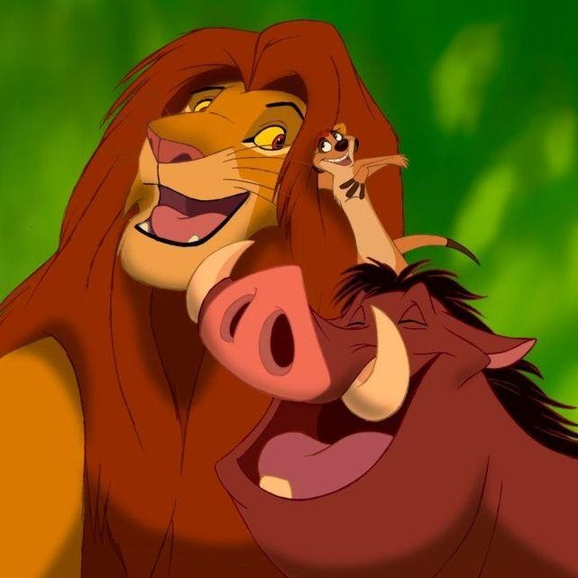
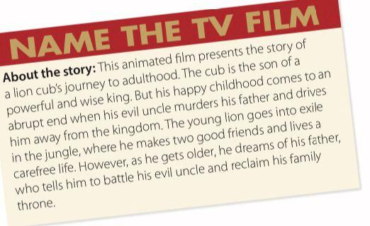
02

Slide 11

The film is :
The Lion King

Slide 12
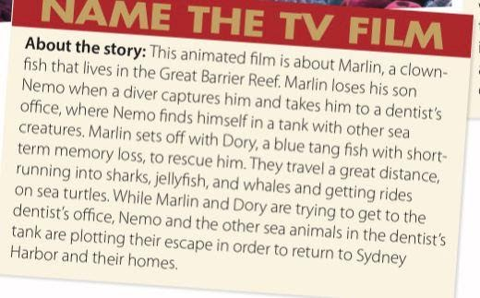
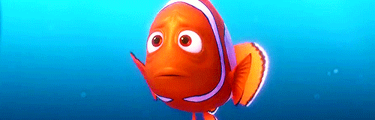

03

Slide 13


The film is :
Finding Nemo

Slide 14
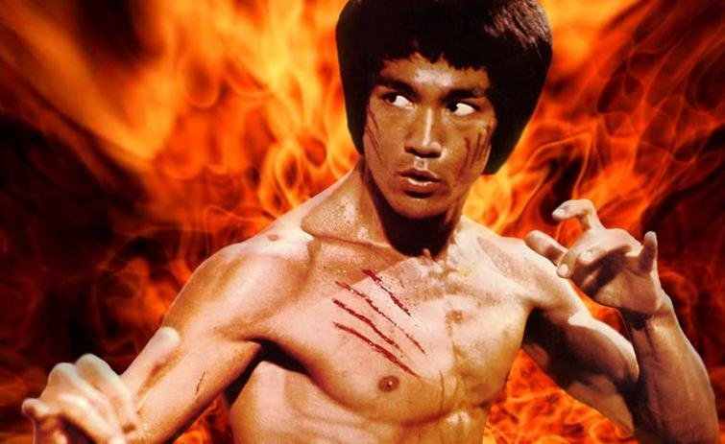

04

Slide 15

The film is :
Bruce Lee: A Warrior’s Journey

Slide 16
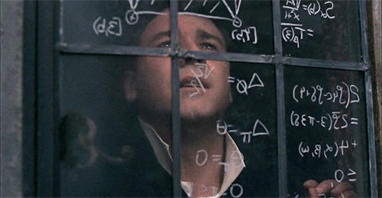
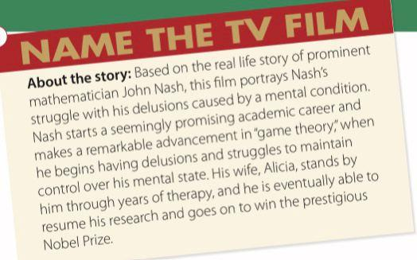
05

Slide 17

The film is :
A beautiful Mind

Slide 18
Or three columns?
01
02
03
Mars
Jupiter
Venus
Despite being red, Mars is actually a cold place full of iron oxide dust
Jupiter is actually a gas giant, and also the biggest planet in our Solar System
Venus has a beautiful name and is the second planet from the Sun

Slide 19





Films genres are :
animation
animation
animation
documentary
biography

Slide 20
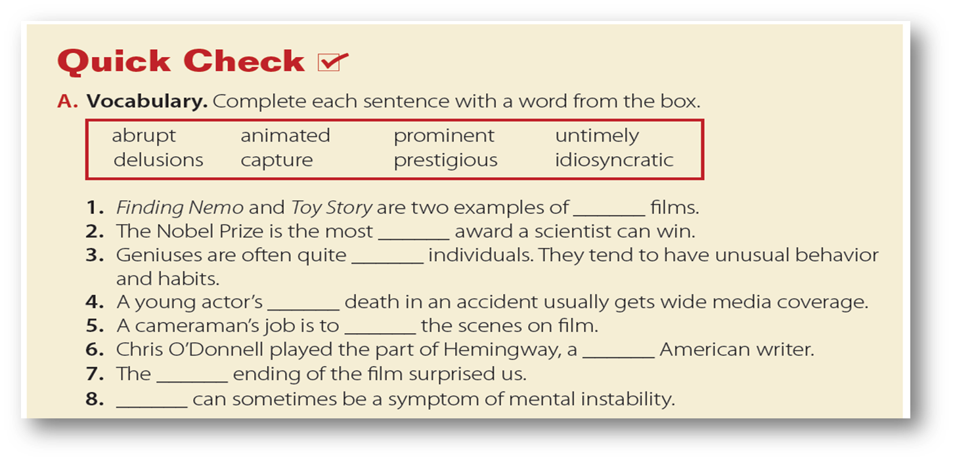
animated
prestigious
idiosyncratic
untimely
capture
prominent
abrupt
delusion

Slide 21
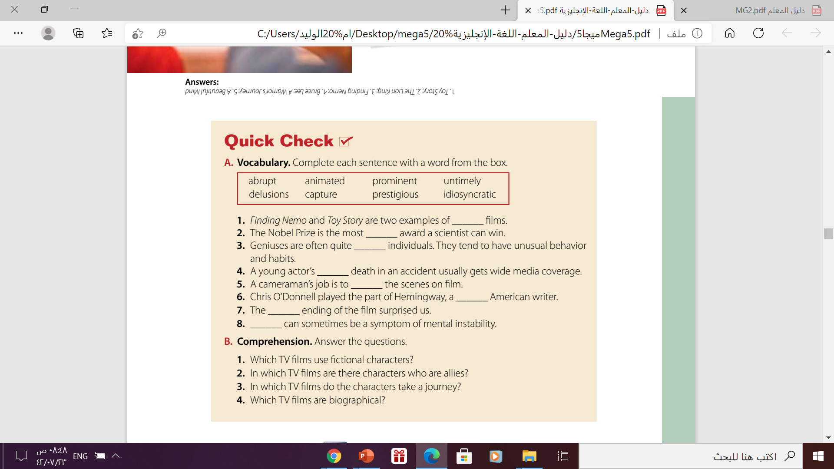
Animated ,science fiction
War films ,scientific films
Adventures, documentary films .
Documentaries , biographical , drama , s films

Slide 22
Lets practice
https://wordwall.net/resource/8539519
https://wordwall.net/play/12132/061/71

Slide 23


Slide 24

Homework
Your workbook p.37
exercise(A)

Slide 25
Thank you!

