Slide 1


Unit 4
The World of TV
Conversation + Listening
Mega Goal 5
Done by: Entisar AL-Obaidallah

Slide 2
Lesson Objectives
01
03
02
04
Answer
Listen
Some comprehension questions about the conversation
For specific information from a TV interview about office design
Practice
Deduce
agreeing and disagreeing with opinion
The meaning of the new words

Slide 3


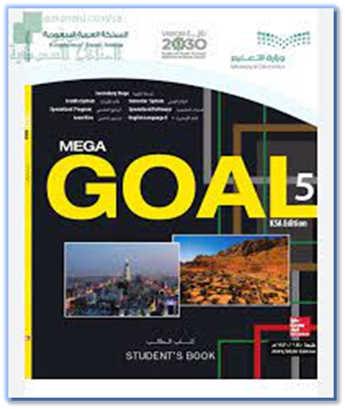
Open
Your student’s book , p.(58)

Slide 4
01
Conversation

Slide 5

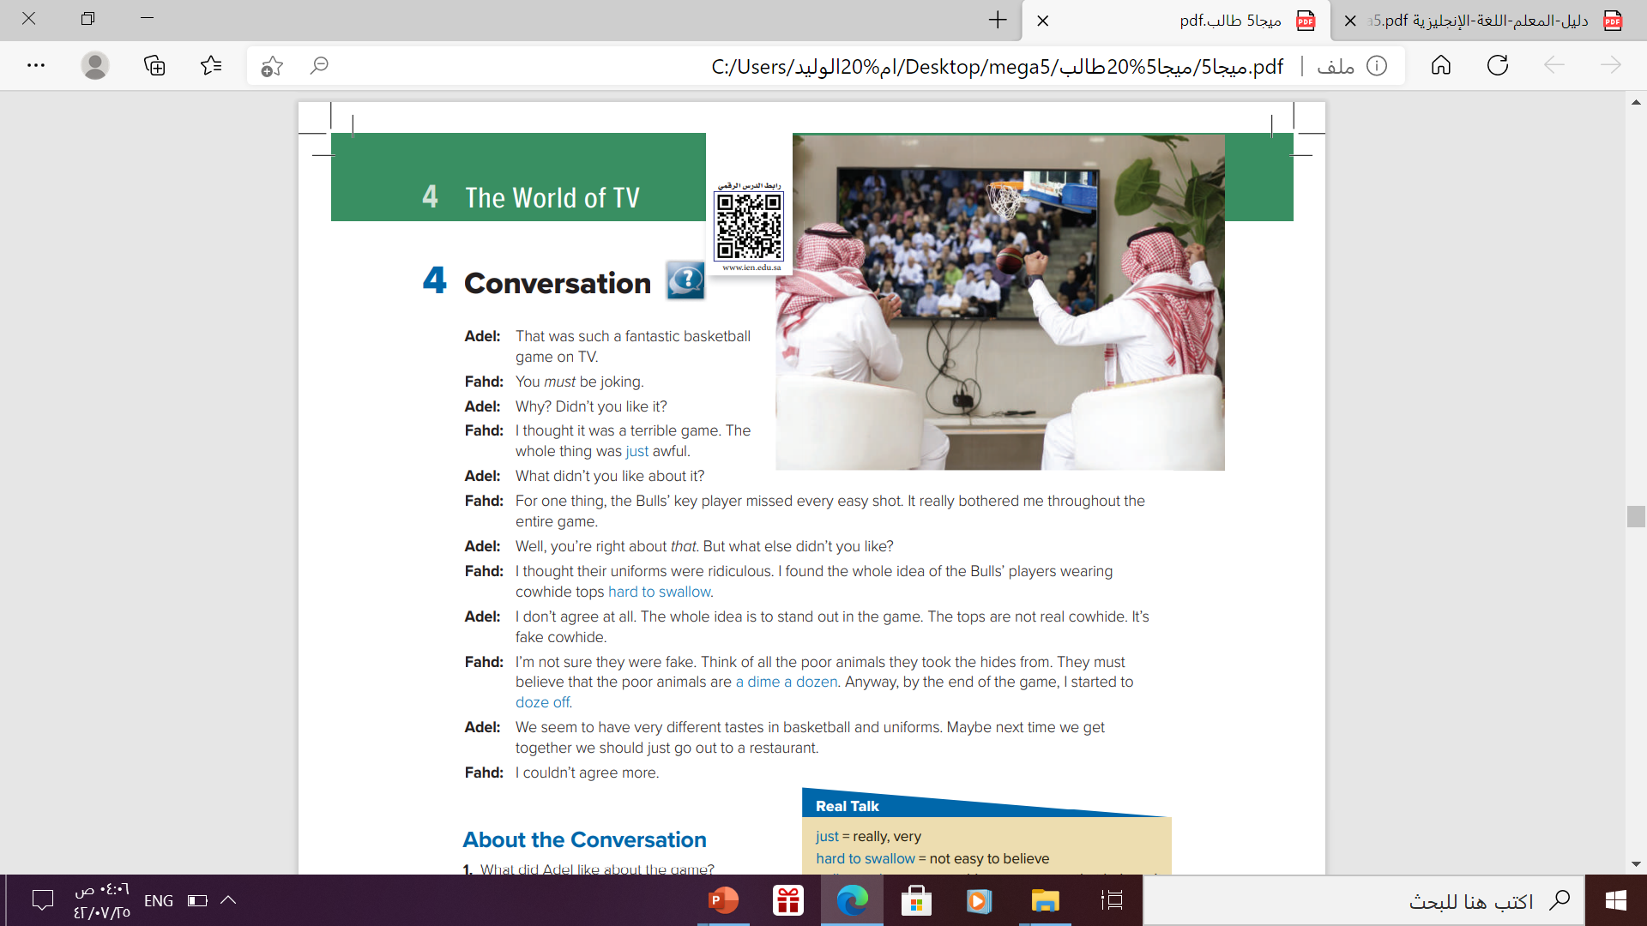
Listen and answer the questions

Slide 6
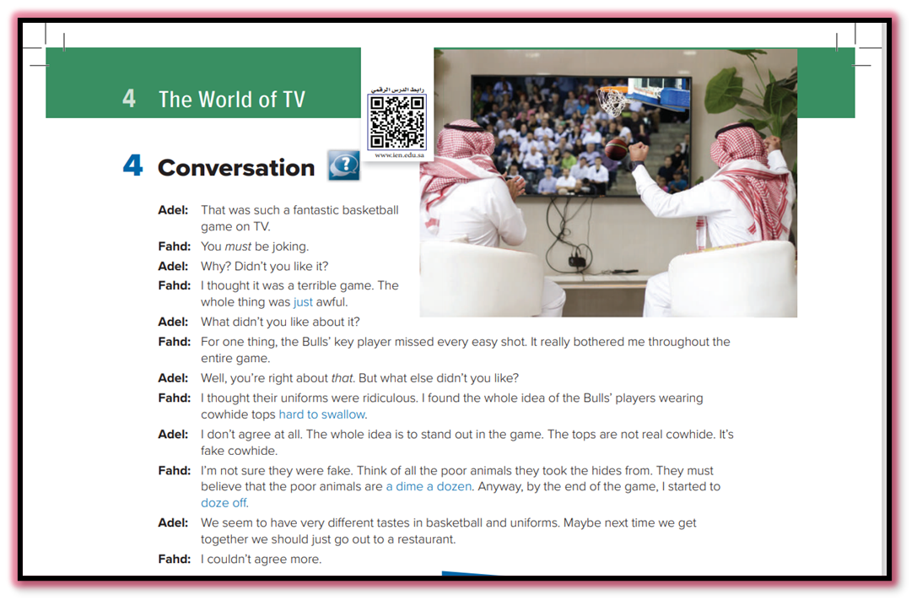
About the Conversation
How many persons are there ?
20%
70%
There are two persons : Fahed and Adel
What are they watching ?
10%
They are watching a basketball game

Slide 7
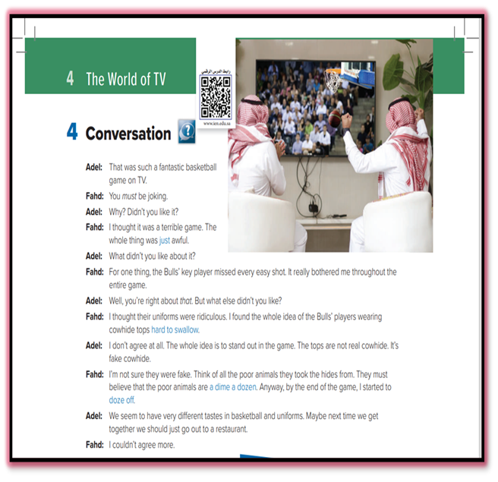
About the Conversation
1- What did Adel like about the game ?
He thought it was exciting
2- What did Fahd dislike about the players?
He thought the Bull’s key player didn’t play well and Bull’s cowhide tops were ridiculous.

Slide 8
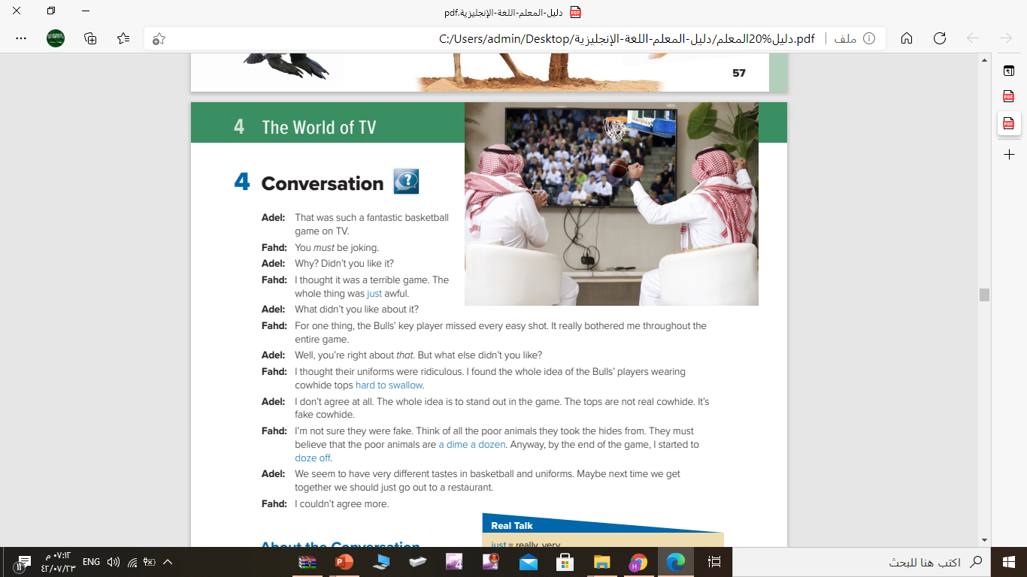

Listen to the conversation again
and underline the expressions
written in blue

Slide 9

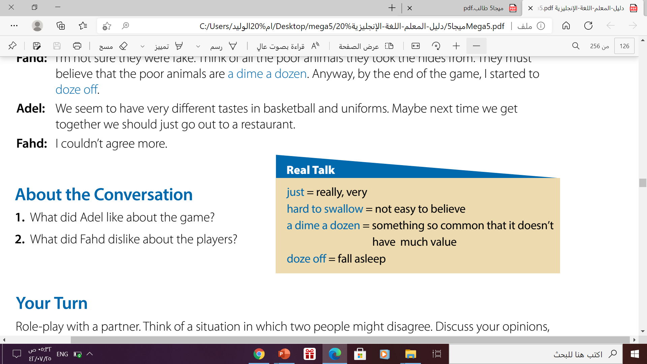

Slide 10
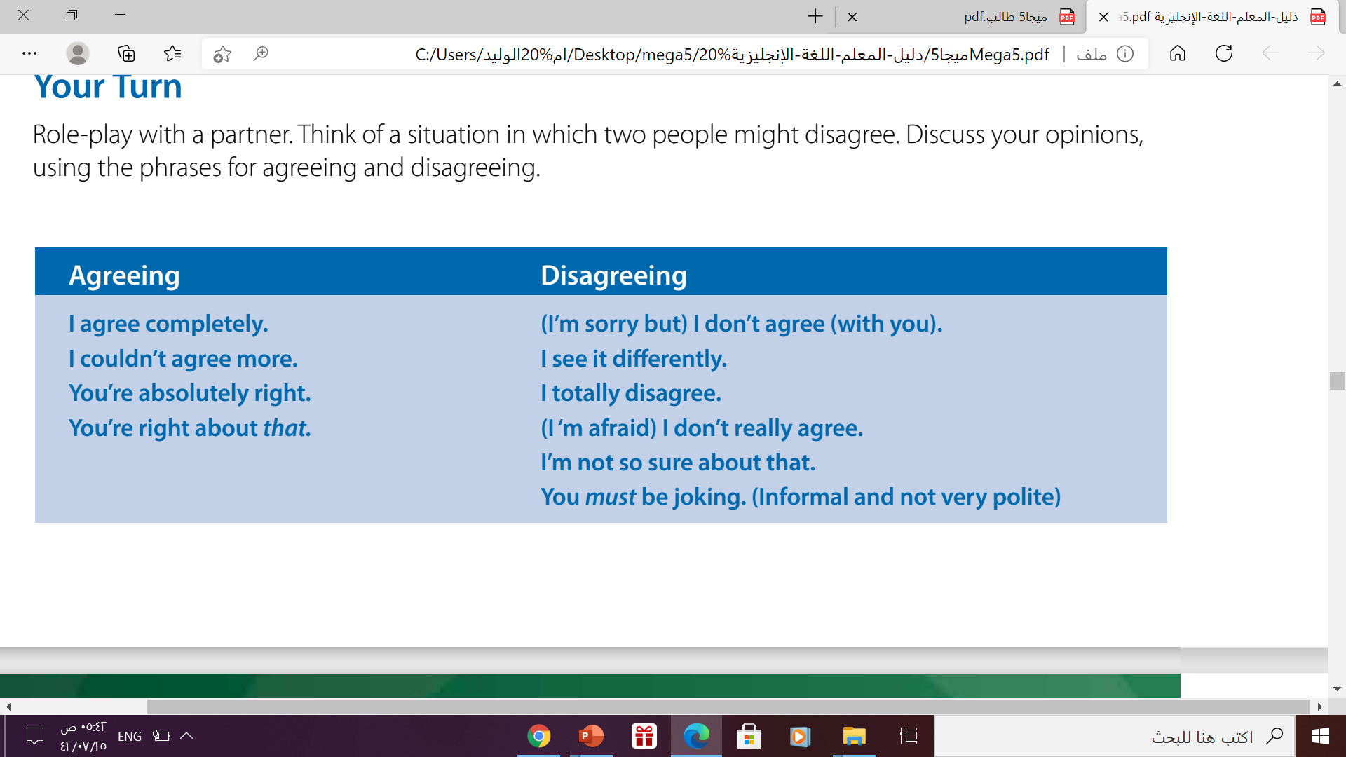
Your Turn

Slide 11
02
Listening

Slide 12
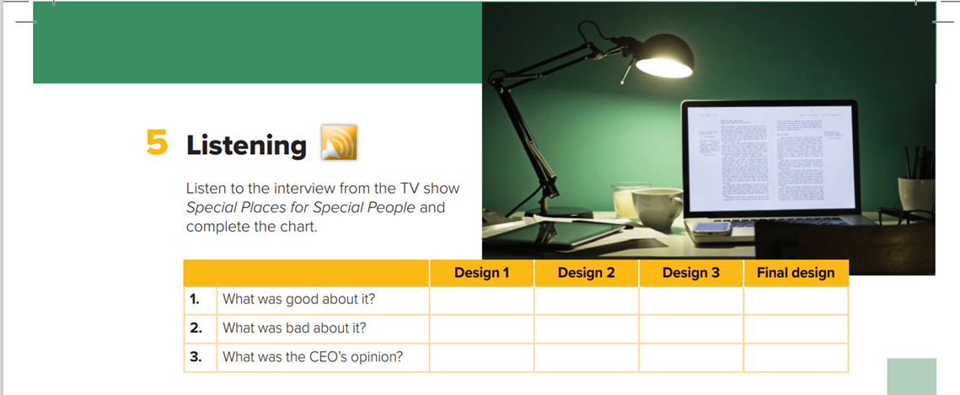

Listening

Slide 13
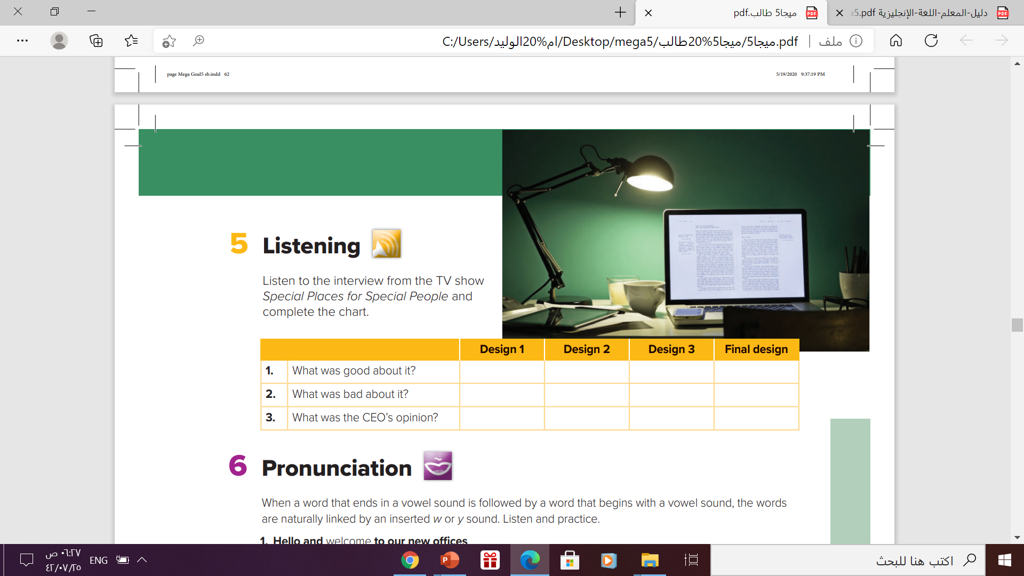
Listening
stylish
Aesthetically
suburb
Nothing good
What they
needed
Functional
problems
Staff isolated in cubicles
Not modern enough
Doesn’t meet need
Superb style
but not
functional
Neither stylish
nor functional-
disappointing
Satisfying

Slide 14
03
Pronunciation

Slide 15

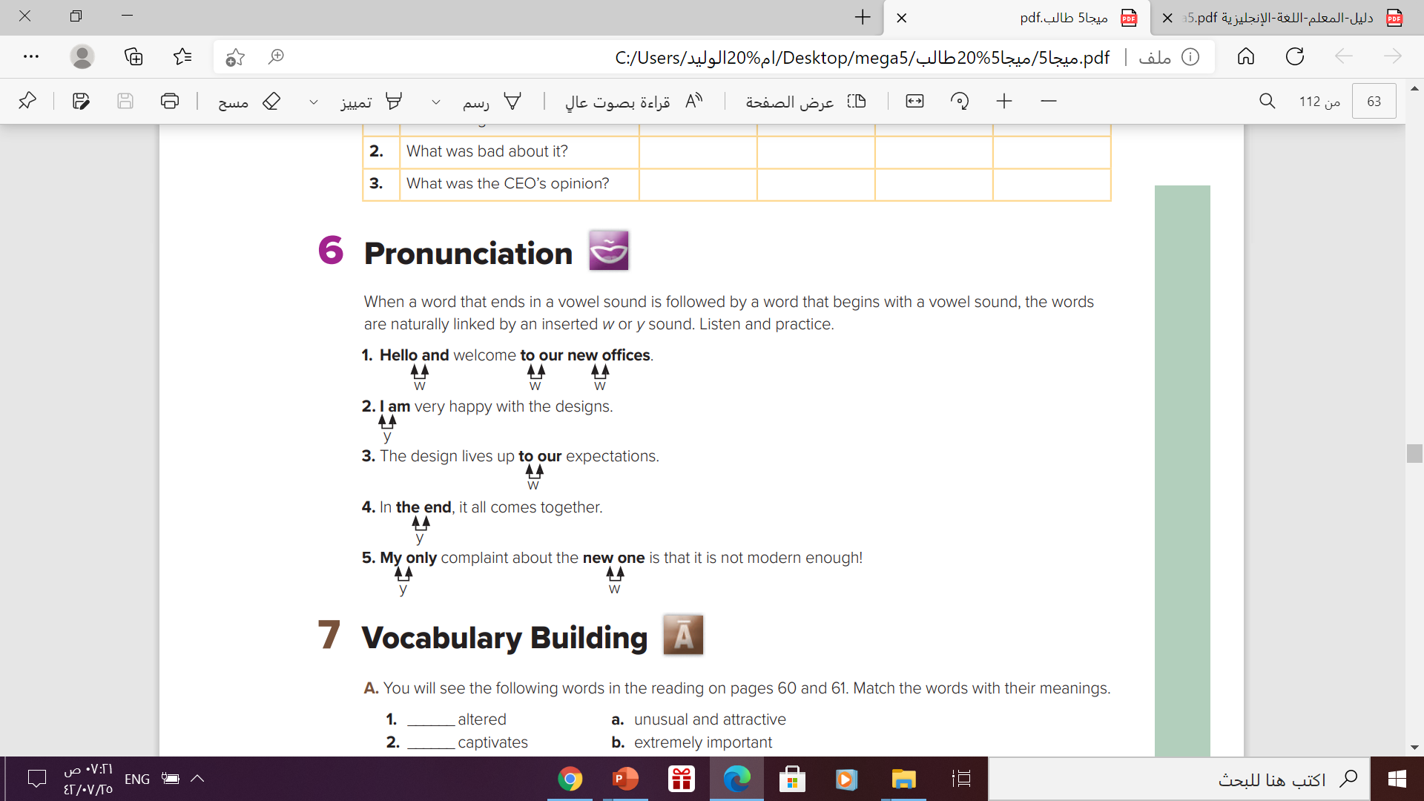

Slide 16
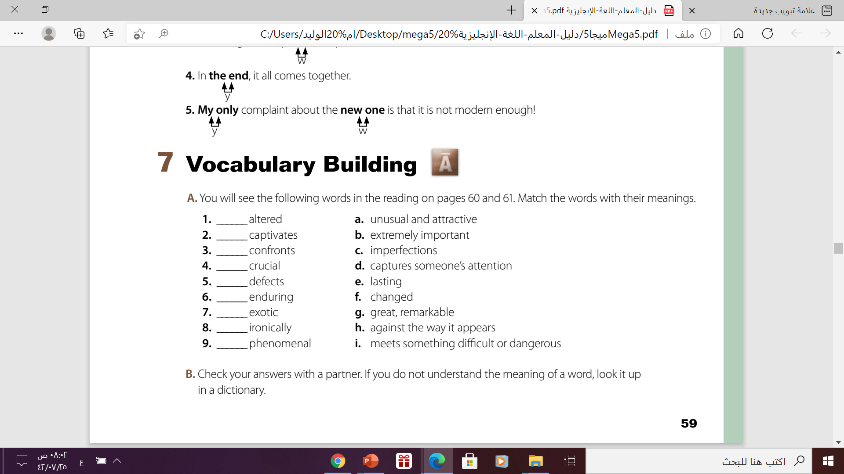
f
d
i
b
c
e
a
h
g

Slide 17

https://wordwall.net/play/12239/717/710

Slide 18


Thanks

