Slide 1
Unit3
What Will They Think of Next
Form , Meaning & Function
Mega Goal 5
Done by: Entisar Al-Obaidallah

Slide 2
Lesson Objectives
01
02
Form
Practicce
03
04
Differentiate
Use
Yes /No questions & Wh question using Simple present tense
Using past simple of the Verb Be and Be Born
between regular and irregular verbs in the past
words connected with space and the planetary system Correctly.

Slide 3

Open
Your studen’s book p. 44

Slide 4
01
Simple Present Tense

Slide 5
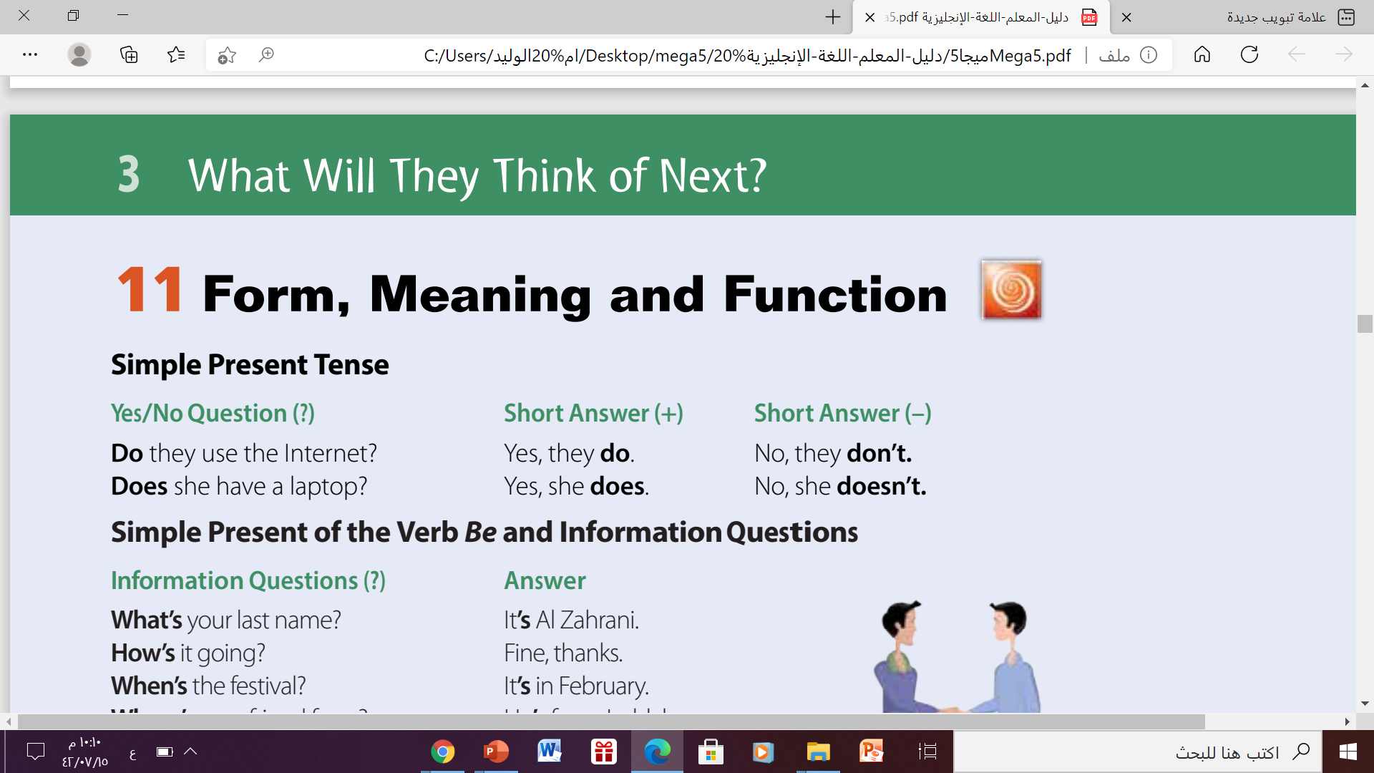
Simple Present Tense:

Slide 6
Simple Present Tense:
Use
To express habits, general truths, repeated actions or fixed arrangements, emotions and wishes:
Example
He drinks tea at breakfast.
For habits
We catch the bus every morning.
For repeated actions or events
Water freezes at zero degrees.
For general truths
His mother arrives tomorrow.
For fixed arrangements

Slide 7
Form:
Affirmative(+)
Subject (She- He –It – singular)
V ( s- es- ies)
He goes to school by car.
Subject (I -you - we - They - plural)
V ( infinitive)
We go to school by car.

Slide 8
Form:
Negative (-)
Subject (She- He-It -singular)
Doesn’t +V ( base form)
He doesn’t speak English.
Subject (I -you - we - They - plural)
Don’t + V ( base form)
I don’t speak English.

Slide 9
Form:
Question (?)
Does
Subject (She- He-It -singular)
V( base form)
Does he speak English?
Do
Subject (I -you - we - They - plural)
V ( base form)
Do you speak English?

Slide 10
02
Simple Present of the Verb Be and
Information Questions

Slide 11
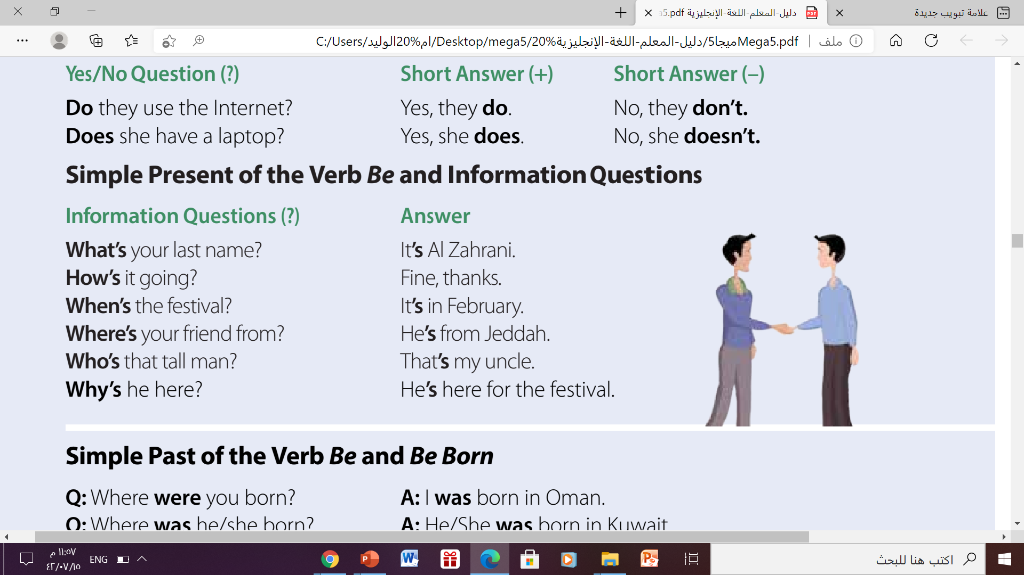
Simple Present of the Verb Be and Information Questions

Slide 12
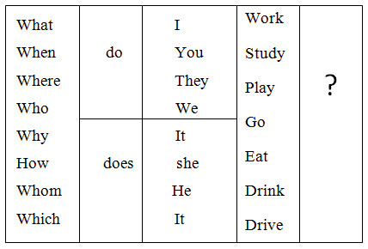
Simple Present of the Verb Be and Information Questions

Slide 13
03
Simple past of the VerbBe & Be Born

Slide 14
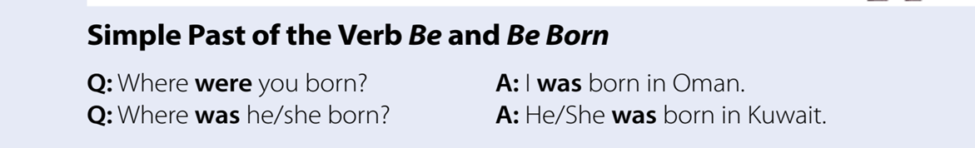
Simple Past of the Verb Be & Be Born:

Slide 15
Simple Past of the Verb Be and Be Born
The past tense of To Be in English has two forms: WAS and WERE
To Be - Affirmative
I
She
He Was
It
You
We Were
They
Example
He was poor .
They were happy with their test results.

Slide 16
Simple Past of the Verb Be and Be Born
The negative of To Be can be made by adding not after the verb (was or were).
To Be - Negative
I
She
He Was not
You
We Were not
They
Example
He was not poor .
They were not happy with their test results.

Slide 17
Simple Past of the Verb Be and Be Born
To create questions with Be, you put the Verb before the Subject.
To Be - Question
WH
Was - were
subject
complement
Example
when was she sick ?
Where were you yesterday ?

Slide 18
Simple Past of the Verb Be and Be Born
Be born- Question
WH
was - were
born
?
Example
when was she born ?
She was born in 1999
Where were you born ?
I was born IN Al-Khobar

Slide 19
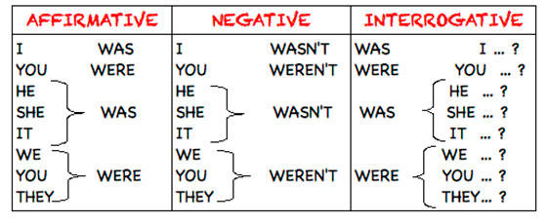
In brief

Slide 20

04
Simple Past with Regular and Irregular Verbs

Slide 21
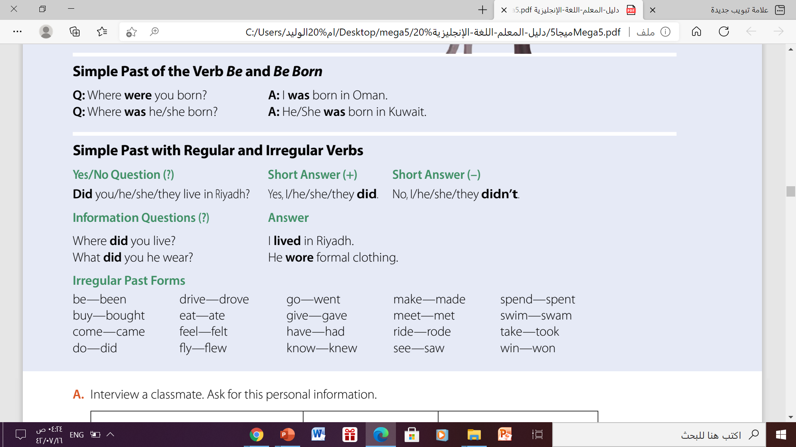
Simple Past with Regular and Irregular Verbs

Slide 22
Simple Past with Regular and Irregular Verbs
Use ‘did’ and the verb, but don’t change the verb to the past form!
1-Yes- No Question ?
Did
Subject
V( base form)
Example
Irregular verb
Did you have a nice weekend?
regular verb
Did you play a game yesterday?

Slide 23
Simple Past with Regular and Irregular Verbs
Use ‘did’ and the verb, but don’t change the verb to the past form!
2- WH- Question ?
WH
did
Subject
V( base form)
Example
Where did you go for your last holiday?
Irregular verb
What did you watch on TV last night?
regular verb

Slide 24
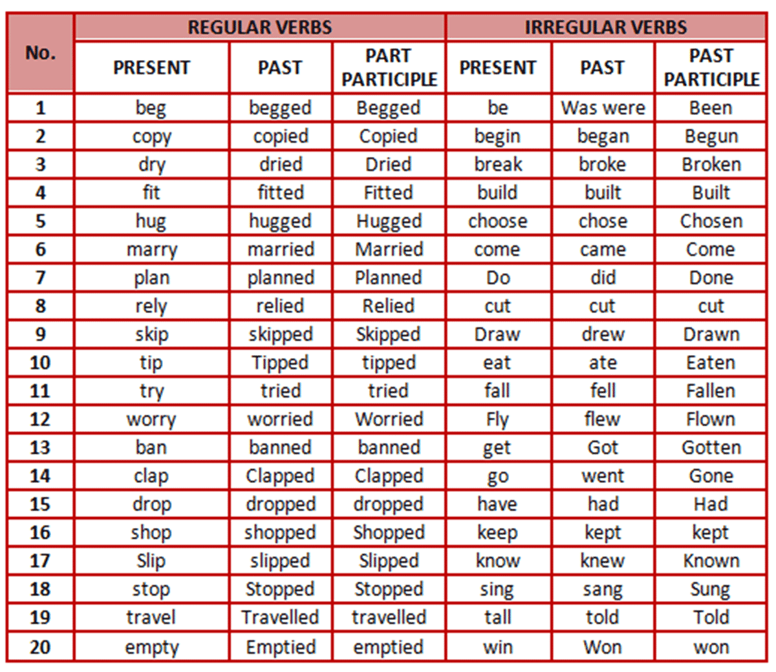
List of regular and irregular verbs

Slide 25

Let’s Practice

Slide 26
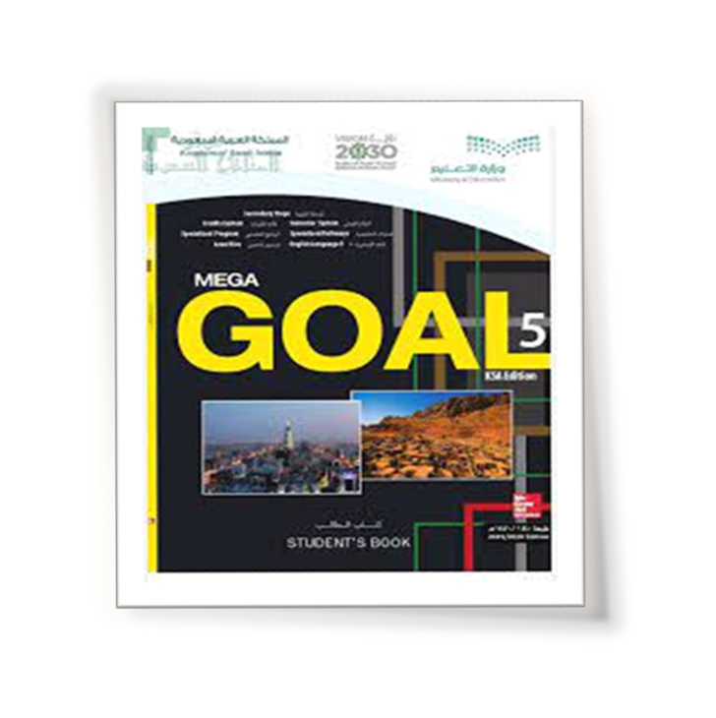
Open your student’s book p.29

Slide 27
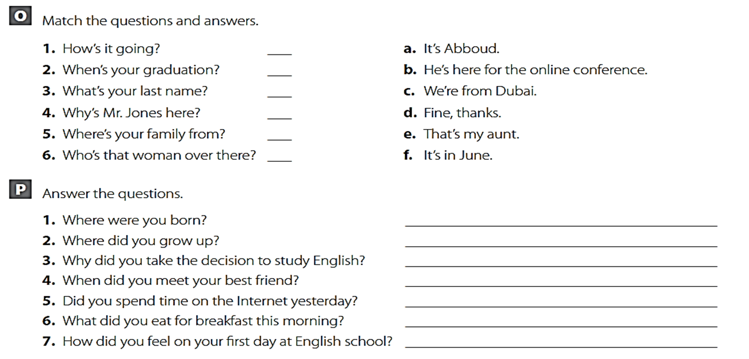
d
f
a
b
c
e

Slide 28

Open
Your student’s book p.45

Slide 29

05
Hi!
Words Connected
with Space and the
Planetary System:
Part1

Slide 30
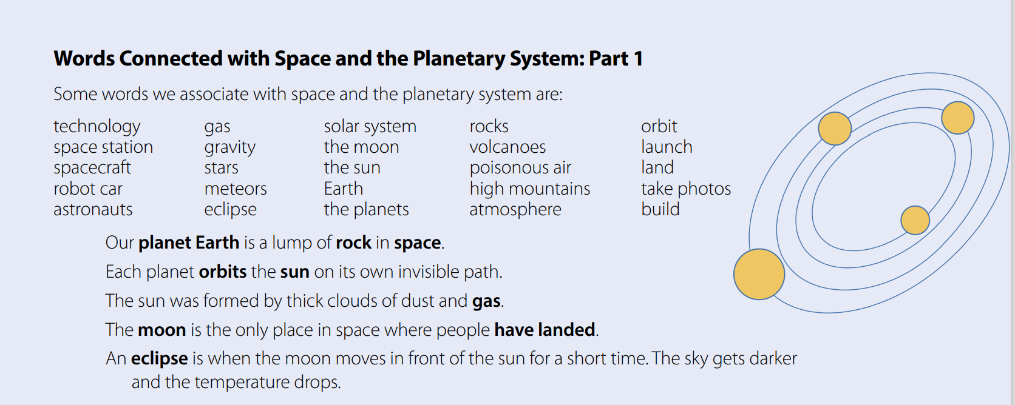
Words Connected with Space and the PlanetarySystem

Slide 31
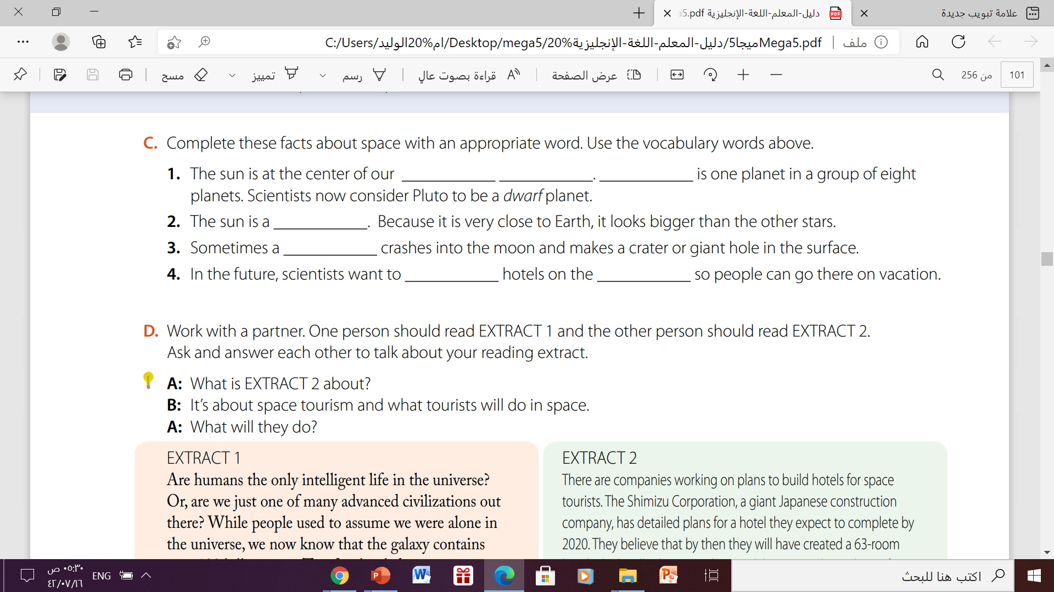
Complete these facts about space:
Solar system
Earth
star
meteor
build
moon

Slide 32

Thanks!

