Slide 1
Unit 1 Two is Better Than One Conversation+ Listening
Done by: Entisar Al-Obaidallah

Slide 2
Lesson Goals
1
2
3
4
Listen
Answer
use
Match
for specific information
some questions about the conversation
“Real Talk” in correct sentences .
the words with their meanings

Slide 3
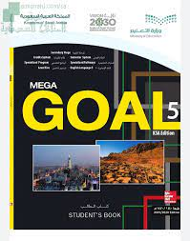
Book Open
Student’s book ,
Page ( 10 )

Slide 4
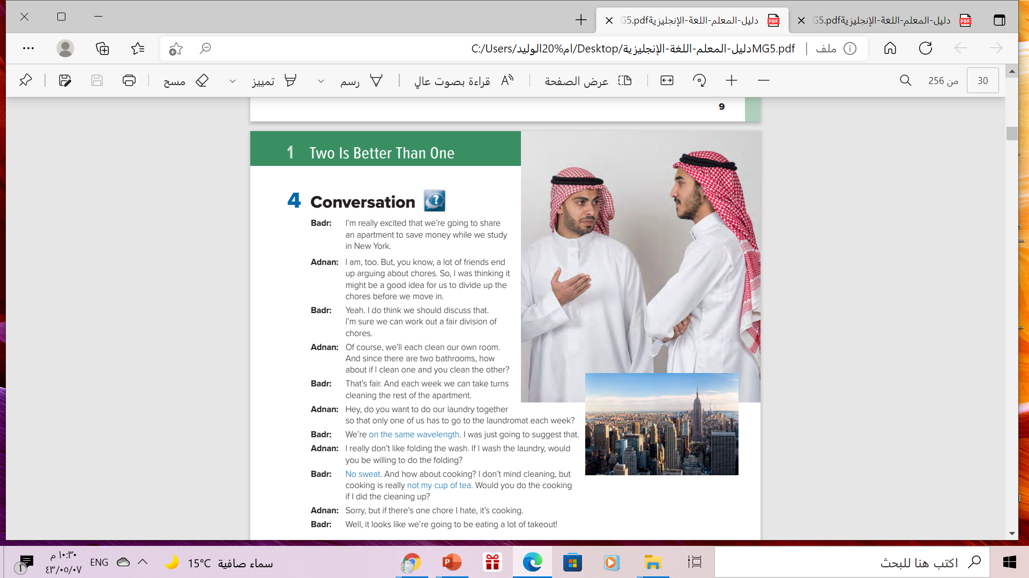
How many persons are there?
There are two persons
Who are they?
They are Bader and Adnan
What are they doing?
They are talking

Slide 5



Read along as you listen

Slide 6
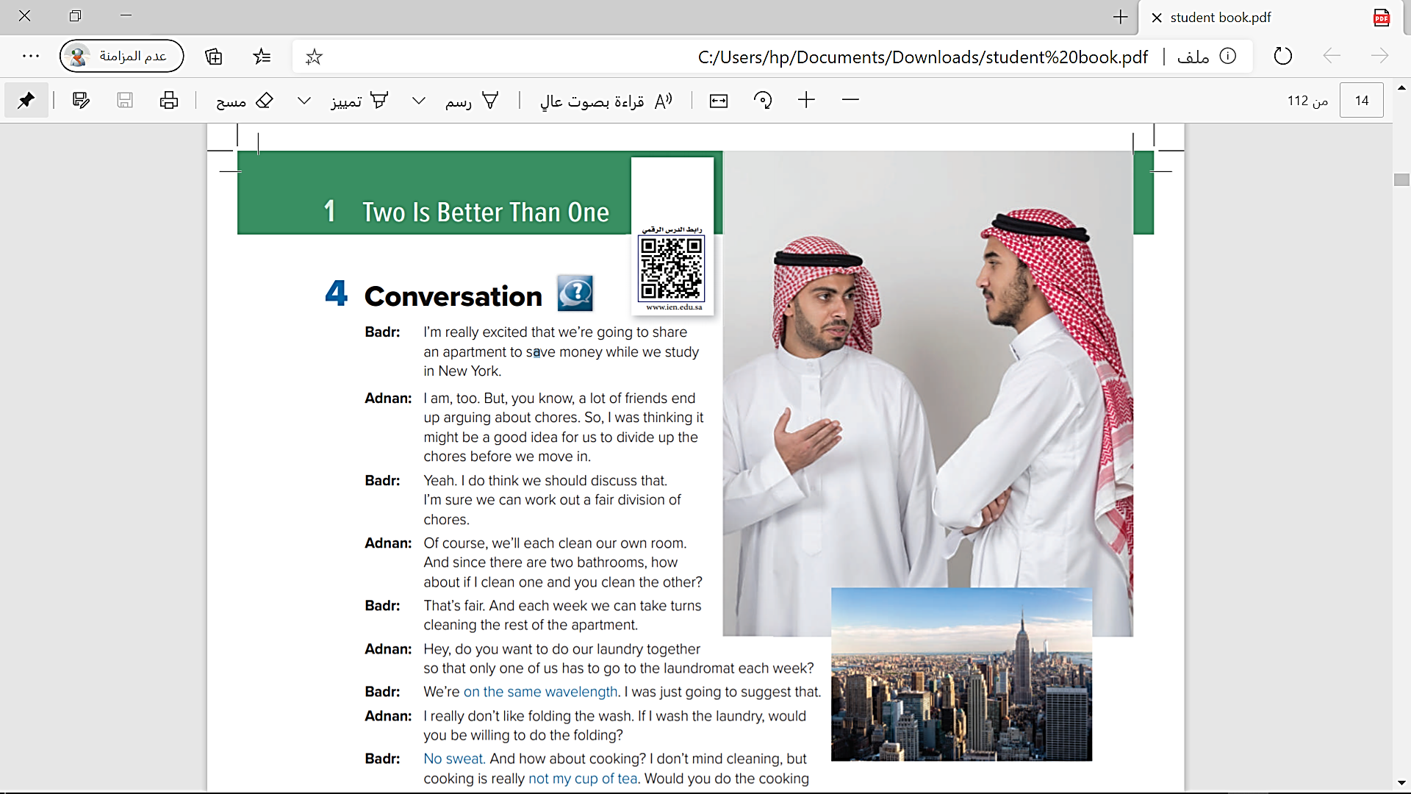
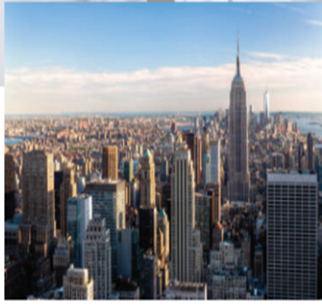
What is the relationship of the boys?
They are going to share an
apartment while they study
Why are they going to share apartment?
To save money
Where will they study ?
They will study in New York

Slide 7
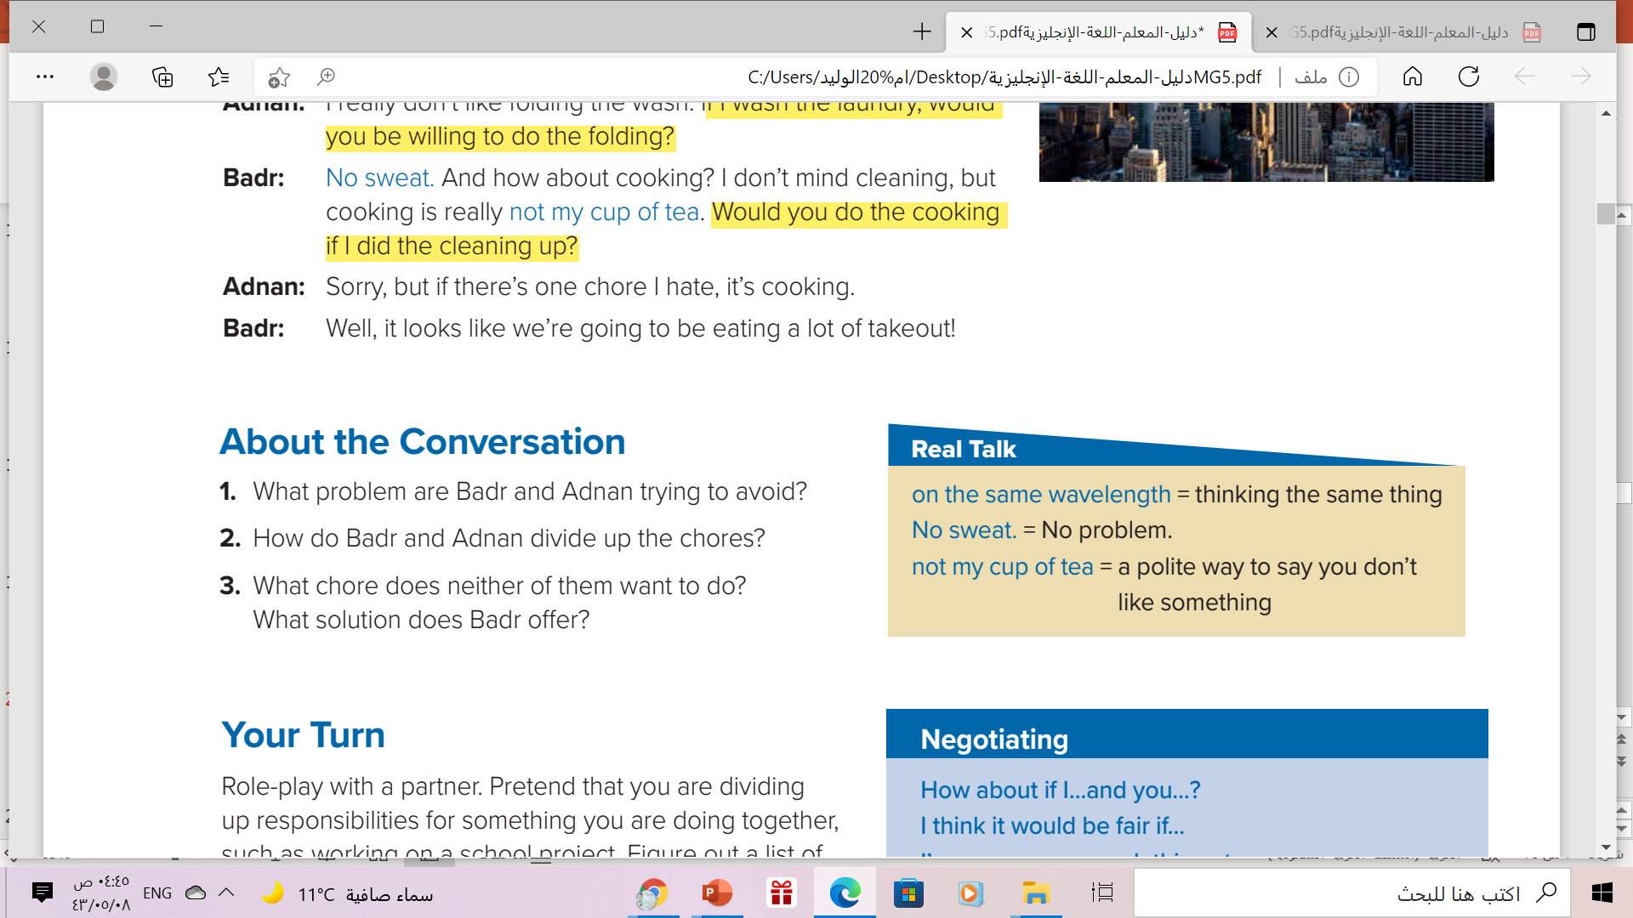
1. They don’t want to argue about chores.
2. They will both clean their own rooms. They will each clean a bathroom. They will
take turns cleaning the rest of the apartment.
Adnan will wash the laundry and Badr will fold it.
3. Neither of them wants to cook. Badr suggests they order takeout food often

Slide 8
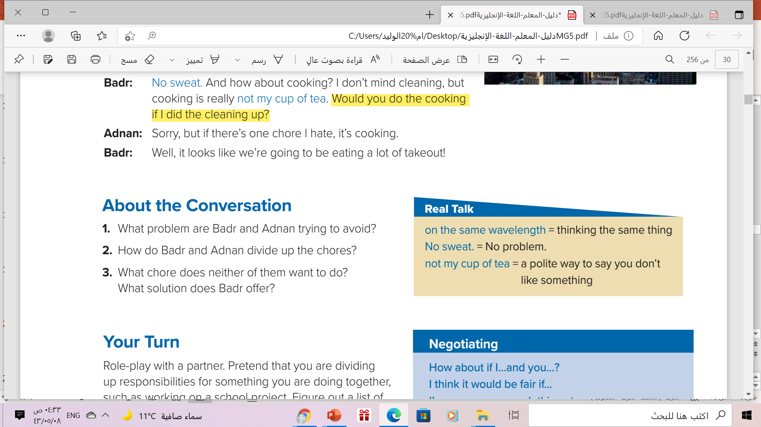
Badr is the one who uses
all of these expressions.

Slide 9
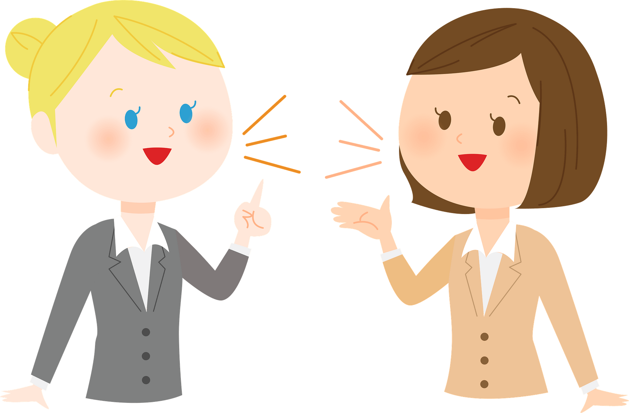
Who says ………
“on the same wavelength”
Badr

Slide 10
Who says ………
“No sweat ”
Badr

Slide 11
Who says ………
“Not my cup of tea”
Badr

Slide 12
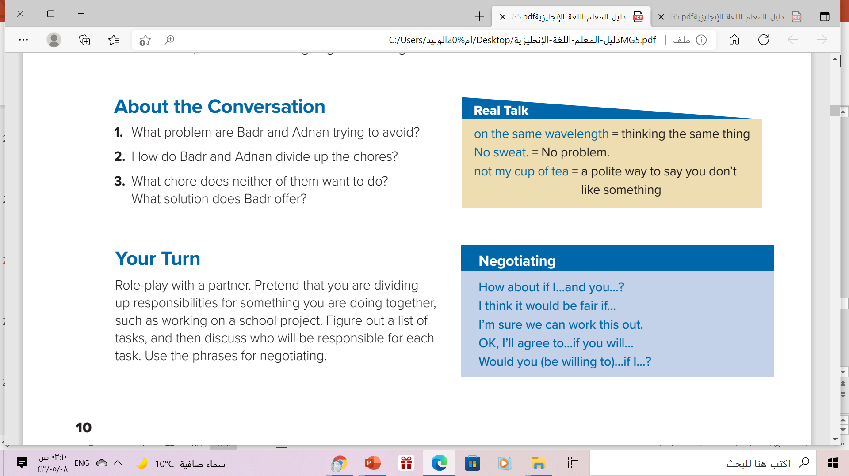

A discussion between two parties for the purpose of reaching
an agreement

Slide 13
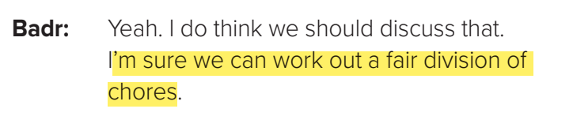
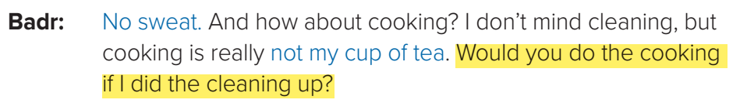
Which phrases in the box were used in the Conversation?
Who says them?
Said by Badr

Slide 14
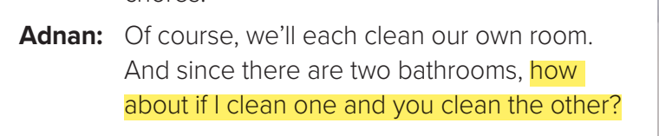
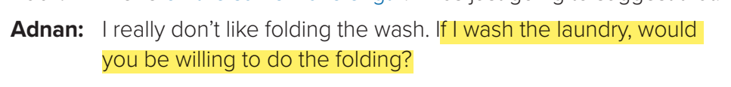
Which phrases in the box were used in the Conversation?
Who says them?
Said by Adnan

Slide 15

Timeline

Slide 16
Book Open
Student’s book ,
Page ( 11 )

Slide 17
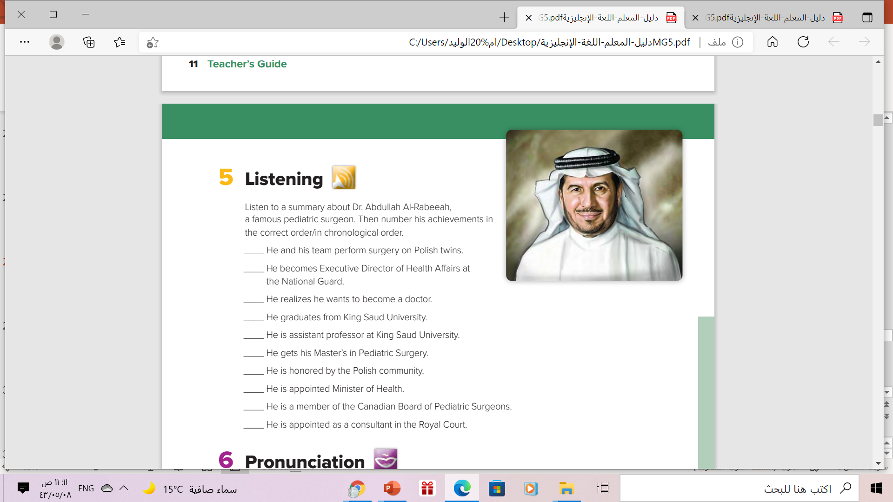
8
6
1
1 He realizes he wants to become a doctor.
2 He graduates from King Saud University.
3 He gets his Master’s in Pediatric Surgery.
4 He is a member of the Canadian Board of Pediatric Surgeons.
5 He is assistant professor at King Saud University.
6 He becomes Executive Director of Health Affairs at the National Guard.
7 He is appointed Minister of Health.
8 He and his team perform surgery on Polish twins.
9 He is honored by the Polish community
10. He is appointed as a consultant in the Royal Court
2
5
3
9
7
4
10

Slide 18
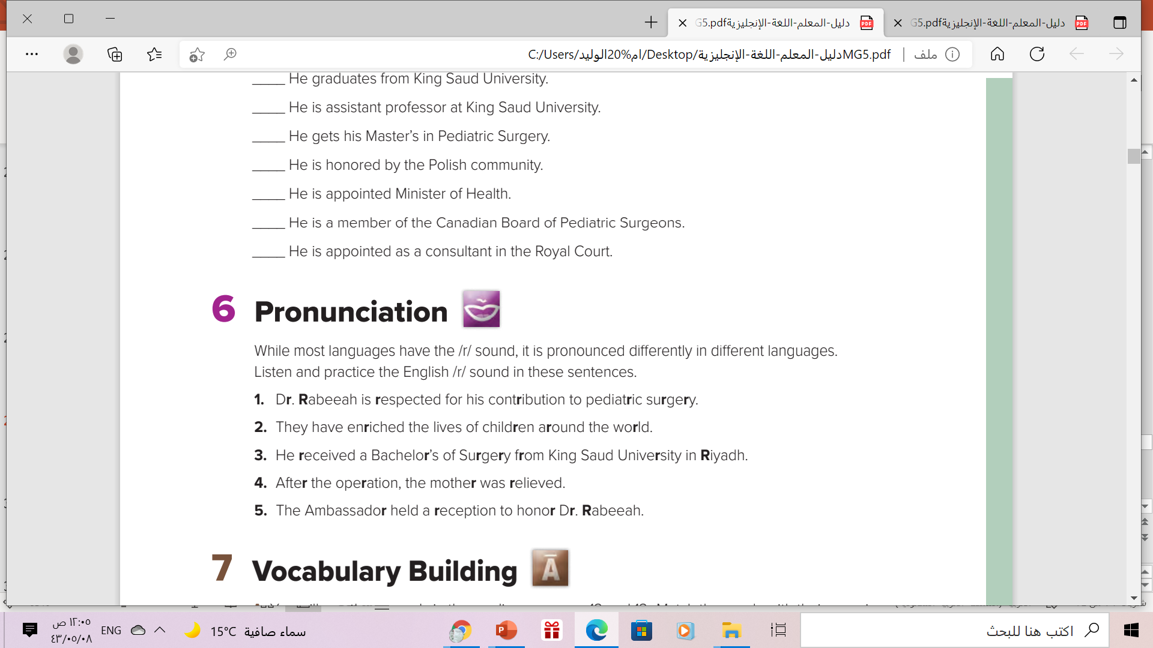

Slide 19
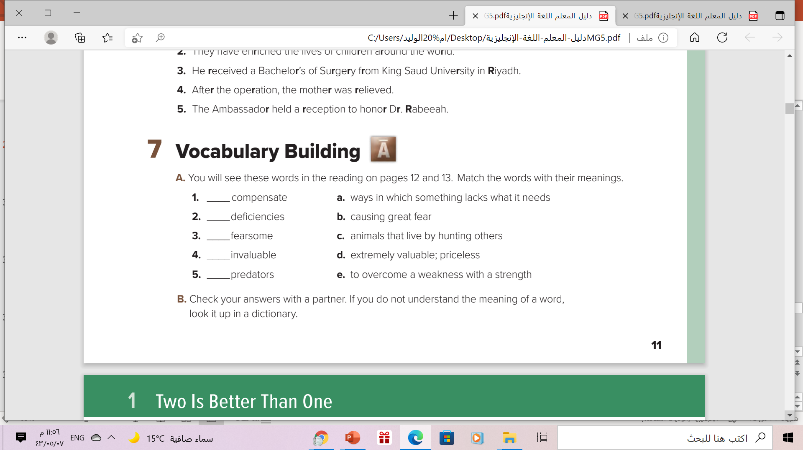
e
a
b
d
c

Slide 20
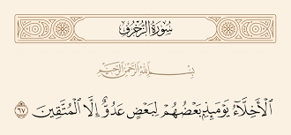

Slide 21

Workbook page ( 4 ) ,
exercises( H )

Slide 22

Thanks!

