Slide 1
Unit 1
There is No Place Like Home
Listen & Discuss
Mega Goal 2.2
Done by : Entisar Al-Obaidallah

Slide 2
Lesson Goals
Differentiate between Home and House
Distinguish between the interior and exterior of a home
Name important things at home
Write a quote about home

Slide 3



Warm Up
What do you think the difference between a house and a home?
House
is a building in which someone
lives . ( It is concrete)
is the Place where someone lives .it
represents safety and comfort.
It can be the town , city or country .
Home

Slide 4
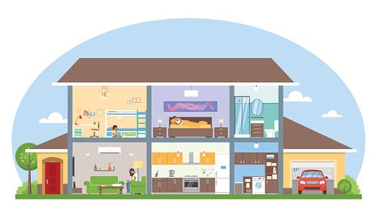
Warm Up
What are the most important things in your house?
Kitchen
bedroom
TV
Living room
computer
fridge
Garage
lights

Slide 5
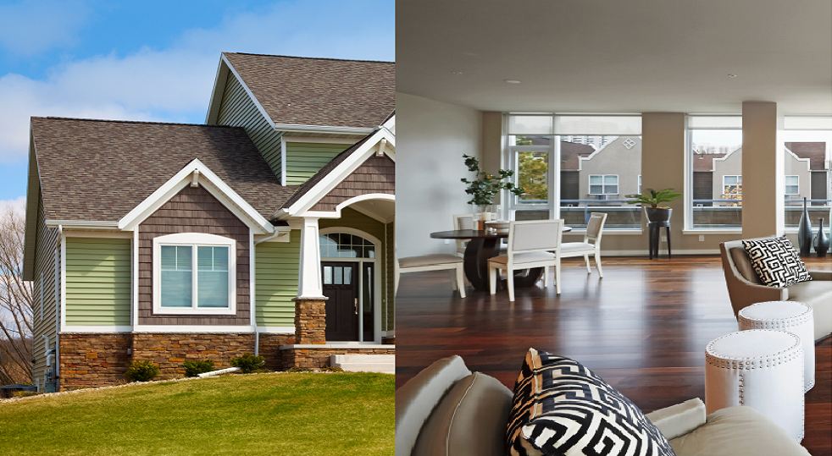
Warm Up
Describe both the interior and the exterior of your dream home ?
exterior
interior
outside the house
Inside the house

Slide 6
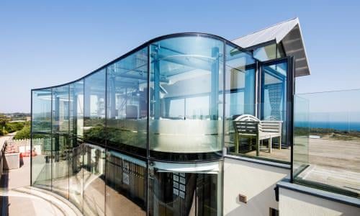
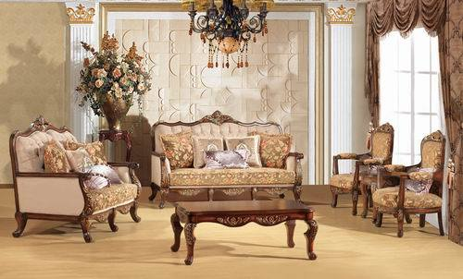
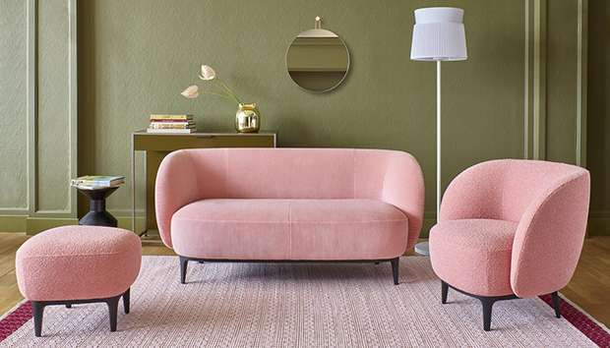
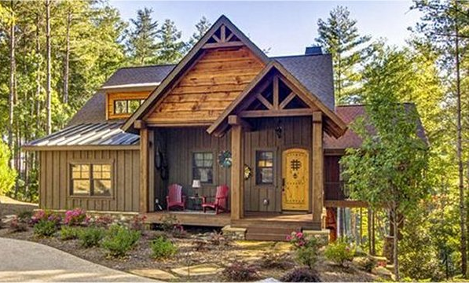
Warm Up
Describe both the interior and the exterior of your dream home ?
exterior
interior
glass house
Classic furniture
Cozy cottage
Modern furniture

Slide 7


Open Book
Pages (30-31)
Listen & Read as long you listen

Slide 8
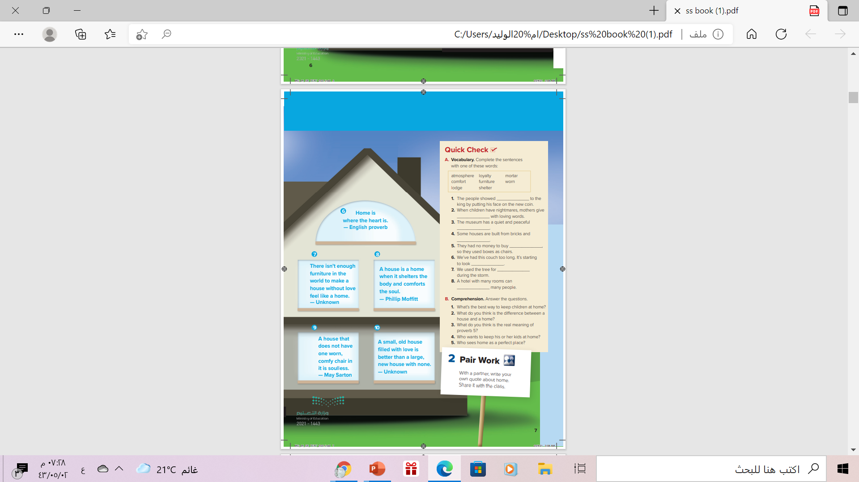
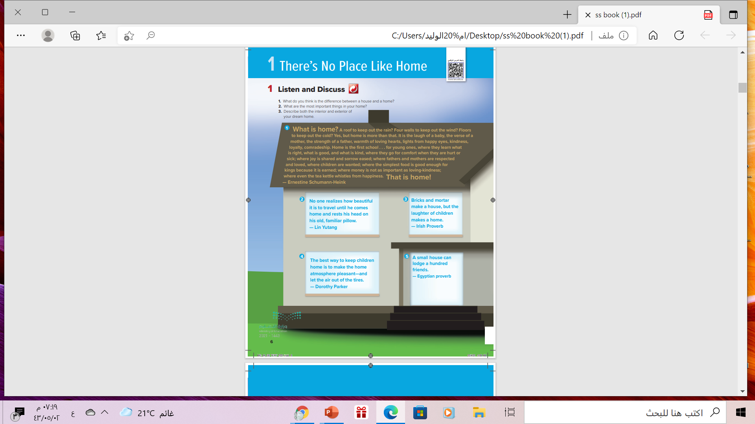
What are these?
quotes
Listen & Discuss
10 quotes
How many quotes are there?
What are these Quotes about?
1
6
About home
7
2
3
8
9
10
4
5

Slide 9


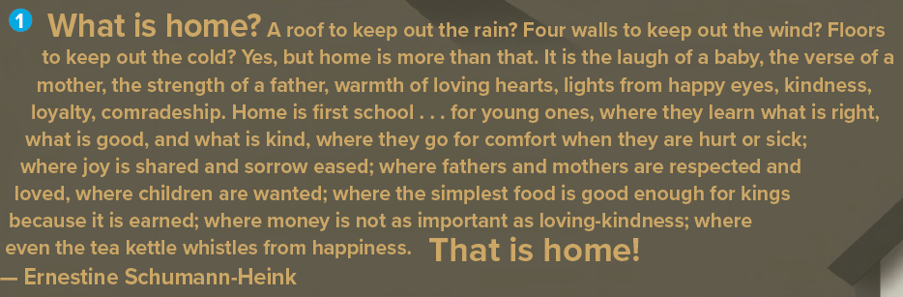


According to the writer Feelings of love is the most important
Who said this quote?
Ernestine Schumann-Heink
the sound indicates to happiness
whistle
to make a high sound by forcing air through a small hole
loyalty
showing honesty support for someone

Slide 10
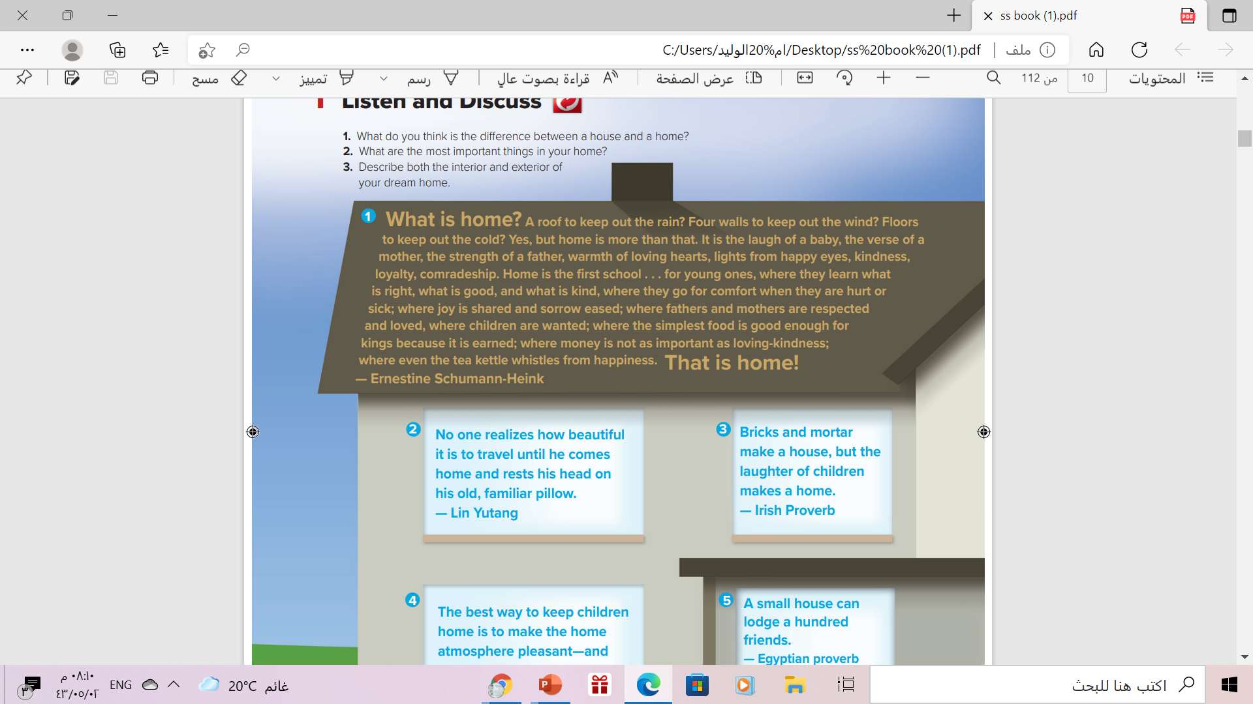
Who said this quote?
Who said this quote?
mortar
= a mixture of lime with cement, sand, and water, used in building to bond bricks or stones

Slide 11
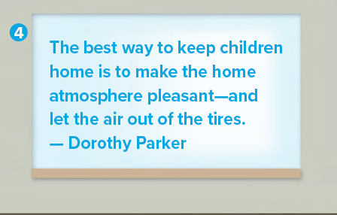

Who said this quote?
No air in the tire = Children never leave the house
atmosphere
the mood or feeling in a place
tires

Slide 12
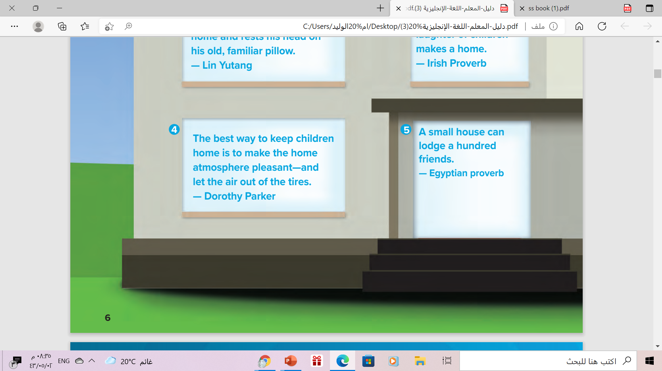
Who said this quote?
What does “ lodge” mean?
to provide (someone) with accommodation

Slide 13
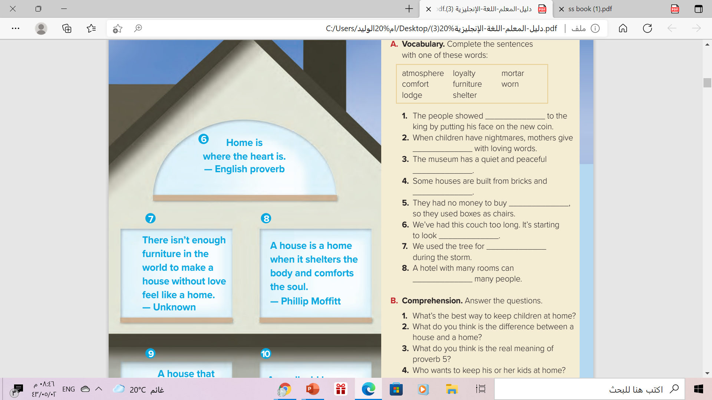
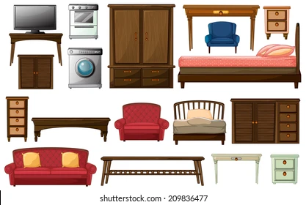
Who said each quote?
furniture
shelter
To protect from something
comfort
help someone who is hurt or feeling bad for some reason

Slide 14
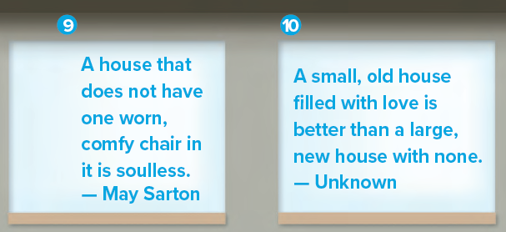

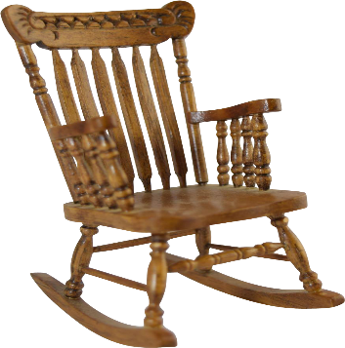

Who said these quotes?
According to the writer
Worn chair is more comfortable
because
feel of trust & old memories
worn
damaged or in poor condition( old & used)
comfy
A short , informal form of “ comfortable”

Slide 15

Which quote do you like best & WHY?

Slide 16


Slide 17
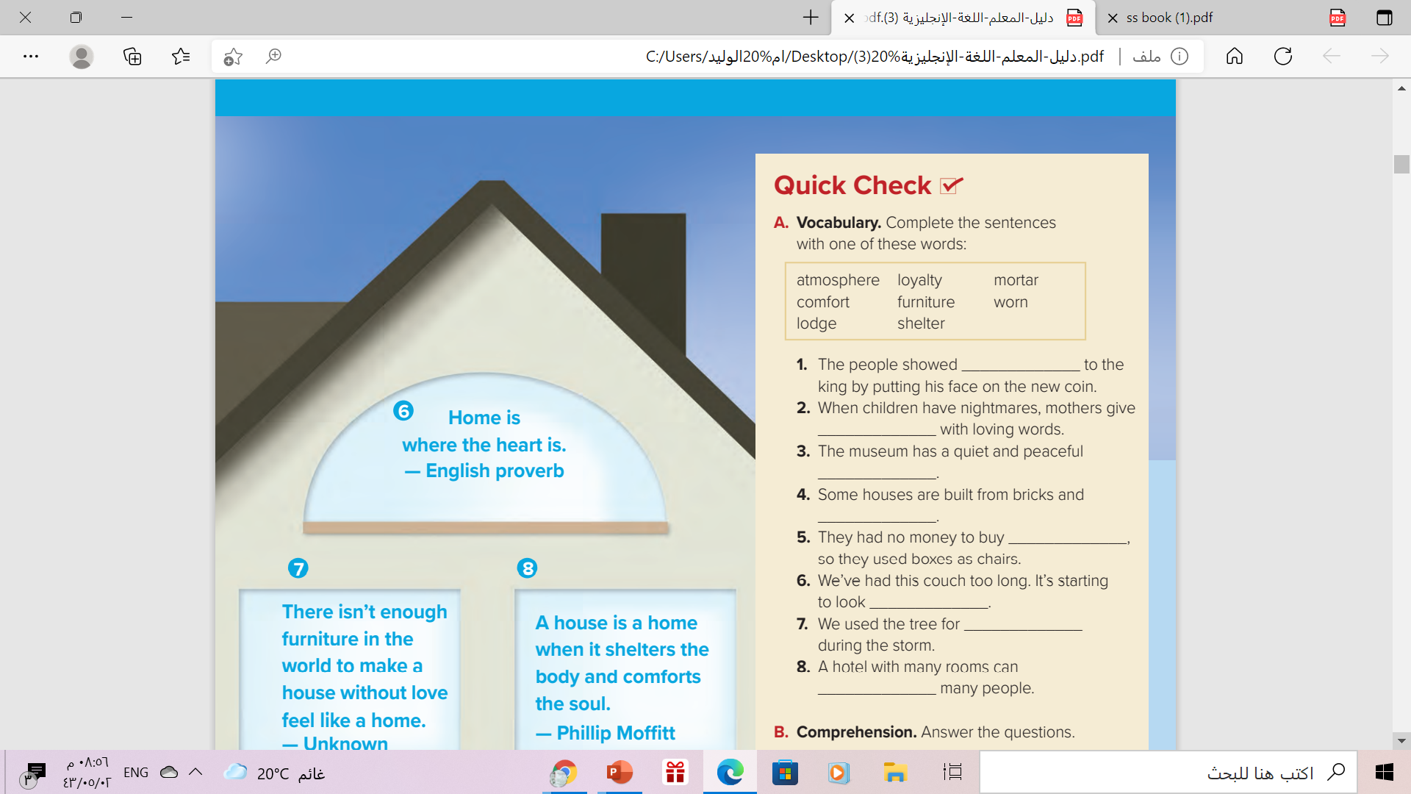
loyalty
comfort
atmosphere
mortar
furnish
worn
shelter
lodge

Slide 18
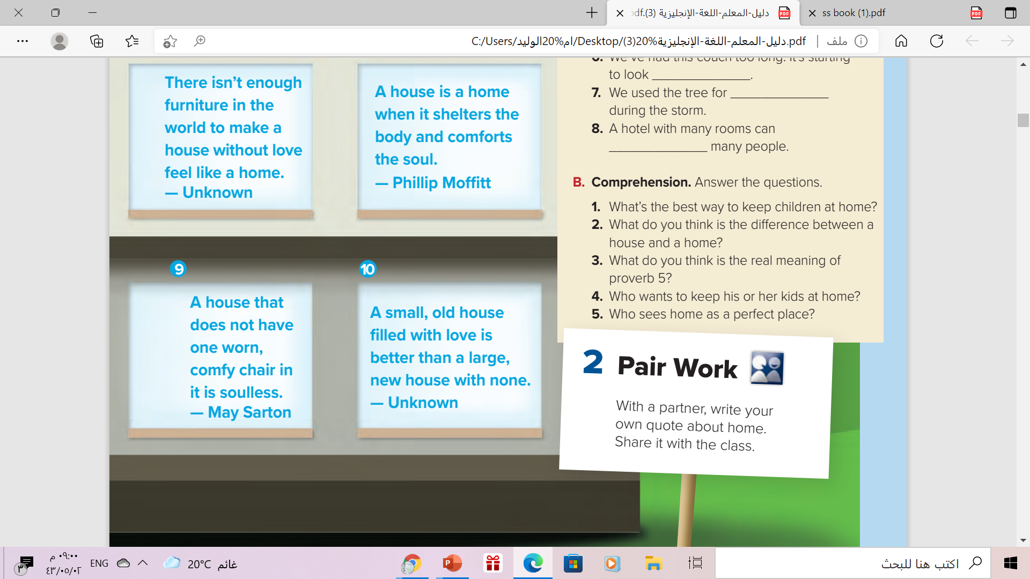


1.Make the home atmosphere pleasant
2. House is a building in which someone lives .Home is the
Place where someone lives
3. The small house can ca hold a lot of friends because of love
4. Dorothy Parker
5. Lin Yutang and Ernestine Schumann-Heink

Slide 19



Your Turn
Write your own QUOTE about home

Slide 20


Slide 21
Homework
Workbook p. (97) , exercise ( a ,b )

Slide 22

Thanks

