Slide 1
Mega Goal 2.2
Revision
Unit 1
Done by: Entisar Al-Obaidallah

Slide 2


Slide 3
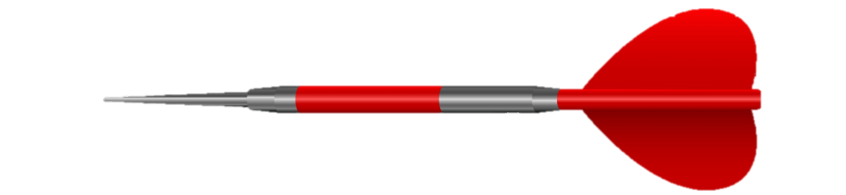
It is important that Ali …..the meeting.
attends
attend
السؤال التالي

Slide 4
Visitors on the hospital….. be silent.
mustn’t
must
السؤال التالي

Slide 5
He listens carefully, …………………?
Does he
isn’t he
Doesn’t he
السؤال التالي

Slide 6
She ………….a teacher, isn't she?
is
does
السؤال التالي

Slide 7
You …….wear a seatbelt when you drive.
should
have to
السؤال التالي

Slide 8
I ……… well with others when I’m in a group.
appreciated
respectful
cooperate
السؤال التالي

Slide 9
The opposite of “identical”………
different
similar
free
السؤال التالي

Slide 10
The meaning of the word “appreciate”..........
to work together well
to be grateful for
To study closely
السؤال التالي

Slide 11
The odd word is……
No parking
nurse
No passing
السؤال التالي

Slide 12

This picture means……
No passing
No entry
No parking
السؤال التالي

Slide 13
I suggest that he ….. harder.
works
worked
work
السؤال التالي

Slide 14
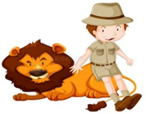
This picture shows………..
zoologist
vet

Slide 15
I try to be ………..… when working with other people
respectful
appreciated
cooperated
The End

