Slide 1

ضرب كثيرات الحدود

Slide 2
درست ضرب وحيدة حد في كثيرة حدود .
فيما سبق
1 ) أضرب كثيرات الحدود باستعمال خاصية التوزيع .
2 ) أضرب ثنائيتي حد باستعمال طريقة التوزيع بالترتيب .
الآن
1 ) طريقة التوزيع بالترتيب
2 ) العبارة التربيعية
المفردات

Slide 3
جدول التعلم
ماذا أعرف ؟ | ماذا أريد أن أعرف ؟ | ماذا تعلمت ؟

Slide 4
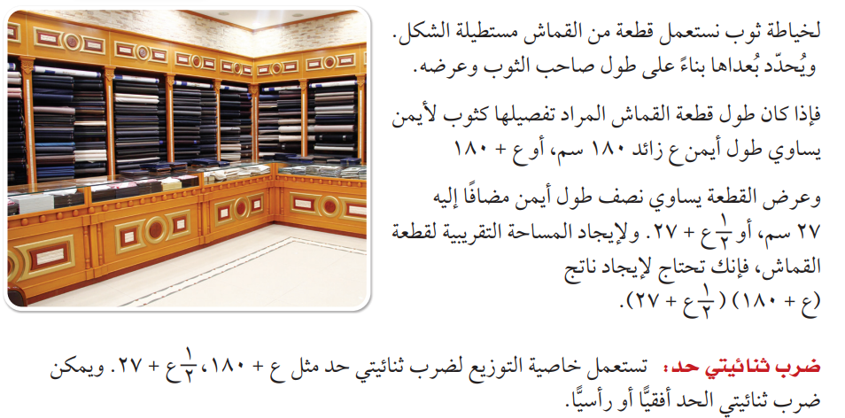
لماذا

Slide 5
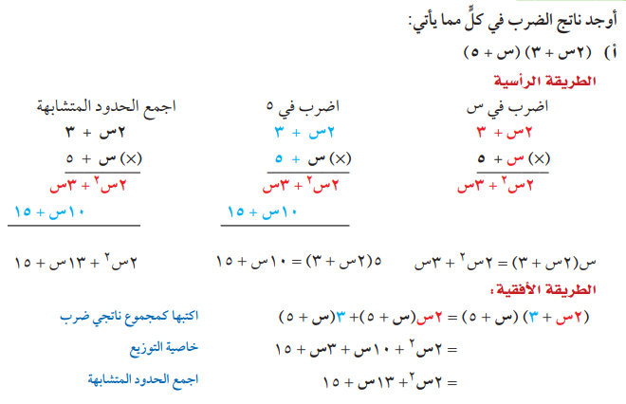
خاصية التوزيع
مثال 1

Slide 6
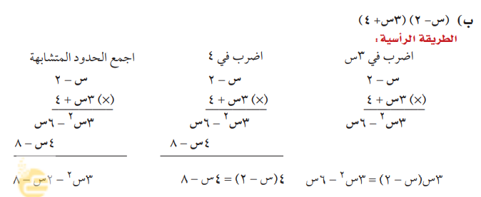
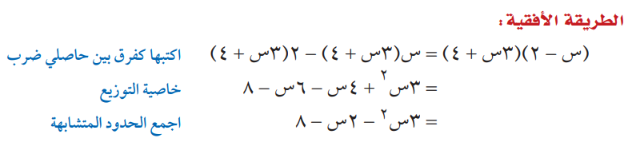
خاصية التوزيع
مثال 1

Slide 7


تحقق من فهمك
...............................................................................................................................................................................................................................................................................................................................................................................................................................................................................................................................................................................................................................................................................................................................................................................................................................................................................................................................................................

Slide 8

تحقق من فهمك
...............................................................................................................................................................................................................................................................................................................................................................................................................................................................................................................................................................................................................................................................................................................................................................................................................................................................................................................................................................

Slide 9
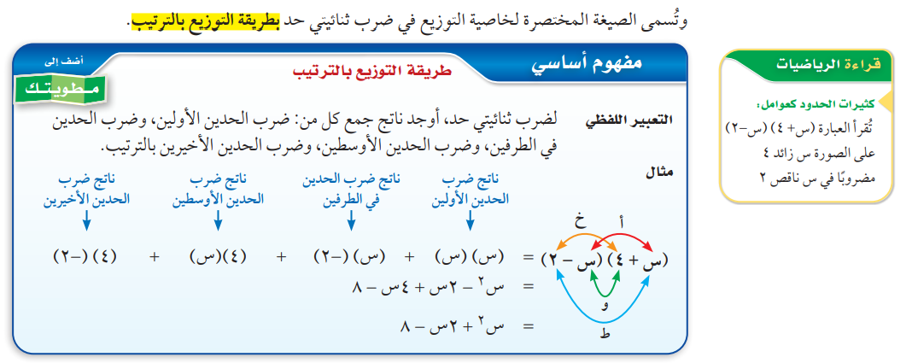

Slide 10
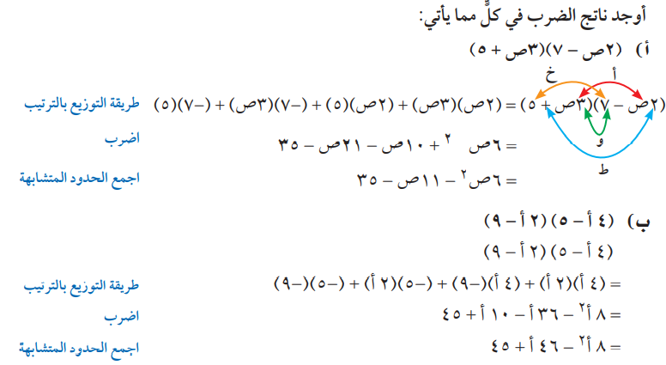
طريقة التوزيع بالترتيب
مثال 2

Slide 11

تحقق من فهمك
...............................................................................................................................................................................................................................................................................................................................................................................................................................................................................................................................................................................................................................................................................................................................................................................................................................................................................................................................................................

Slide 12

تحقق من فهمك
...............................................................................................................................................................................................................................................................................................................................................................................................................................................................................................................................................................................................................................................................................................................................................................................................................................................................................................................................................................

Slide 13
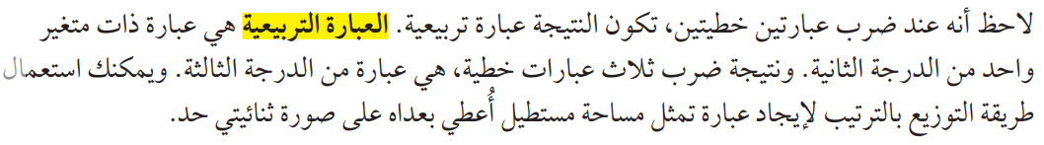

Slide 14
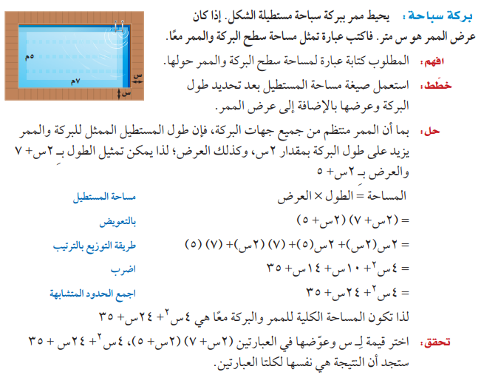

التوزيع بالترتيب
مثال 3
من واقع الحياة

Slide 15
تحقق من فهمك
........................................................................................................................................................................................................................................................................................................................................................................................................................................................................................................................................................................................................................................................................................................................................................................................................................................................

Slide 16
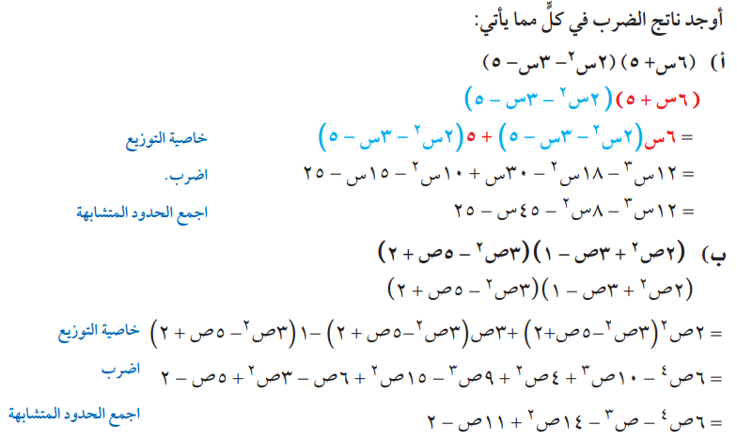
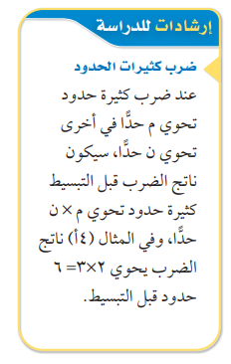
خاصية التوزيع
مثال 4

Slide 17

تحقق من فهمك
......................................................................................................................................................................................................................................................................................................................................................................................................................................................................................................................................................................................................................................................................................................................................................................................................................................................................................................................................................................................................................................................................

Slide 18

تحقق من فهمك
......................................................................................................................................................................................................................................................................................................................................................................................................................................................................................................................................................................................................................................................................................................................................................................................................................................................................................................................................................................................................................................................................

Slide 19


تأكد
...............................................................................................................................................................................................................................................................................................................................................................................................................................................................................................................................................................................................................................................................................................................................................................................................................................................................................................................................................................

Slide 20

تأكد
...............................................................................................................................................................................................................................................................................................................................................................................................................................................................................................................................................................................................................................................................................................................................................................................................................................................................................................................................................................

Slide 21
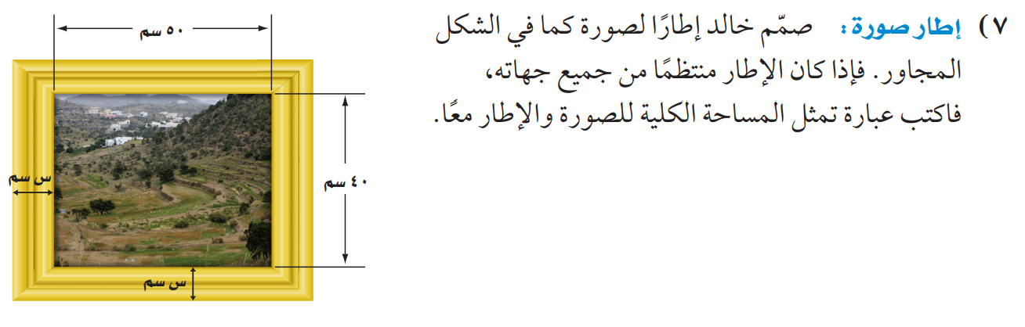
تأكد
..........................................................................................................................................................................................................................................................................................................................................................................................................................................................................................................................................................................................................................................

Slide 22
مهارات التفكير العليا
......................................................................................................................................................................................................................................................................................................................................................................................................................................................................................................................................................................................................................................................................................................................................................................................................................................................................................................................................................................................................................................................................

Slide 23


الواجب
بمنصة مدرستي
تصميم
أ. عثمان الربيعي
@uthman20191
موقع رفعة التعليمية

