Slide 1

ضرب وحيدة حد في كثيرة حدود

Slide 2
درست ضرب وحيدات الحد .
فيما سبق
1 ) أضرب وحيدة حد في كثيرة حدود .
2 ) أحل معادلات تتضمن حاصل ضرب وحيدات حد في كثيرات حدود .
الآن

Slide 3
جدول التعلم
ماذا أعرف ؟ | ماذا أريد أن أعرف ؟ | ماذا تعلمت ؟

Slide 4
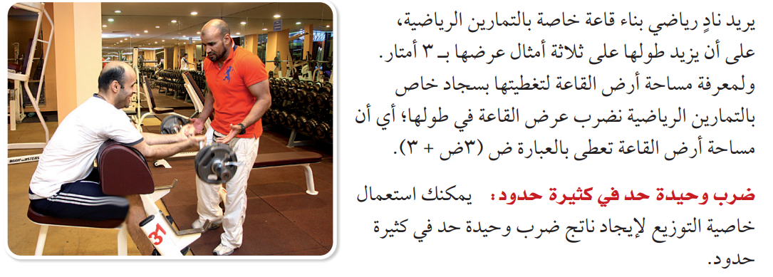
لماذا

Slide 5
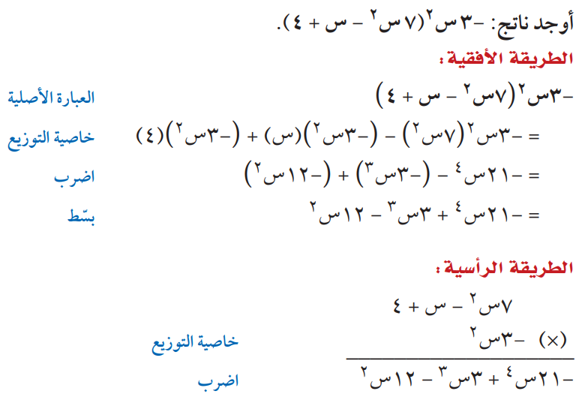
ضرب وحيدة حد في كثيرة حدود
مثال 1

Slide 6

تحقق من فهمك
...............................................................................................................................................................................................................................................................................................................................................................................................................................................................................................................................................................................................................................................................................................................................................................................................................................................................................................................................................................

Slide 7

تحقق من فهمك
...............................................................................................................................................................................................................................................................................................................................................................................................................................................................................................................................................................................................................................................................................................................................................................................................................................................................................................................................................................

Slide 8
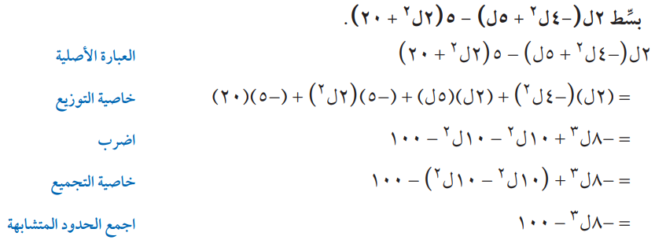
تبسيط العبارات
مثال 2

Slide 9
تحقق من فهمك
...............................................................................................................................................................................................................................................................................................................................................................................................................................................................................................................................................................................................................................................................................................................................................................................................................................................................................................................................................................

Slide 10
تحقق من فهمك
...............................................................................................................................................................................................................................................................................................................................................................................................................................................................................................................................................................................................................................................................................................................................................................................................................................................................................................................................................................

Slide 11
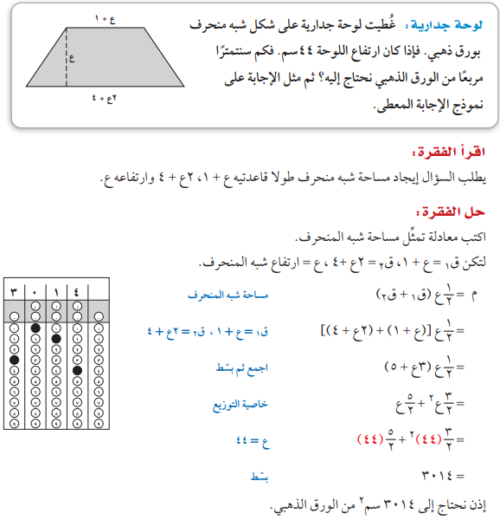
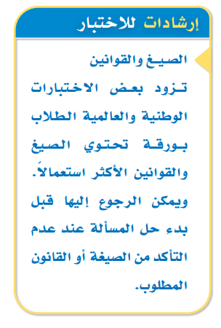
مثال من اختبار
مثال 3

Slide 12
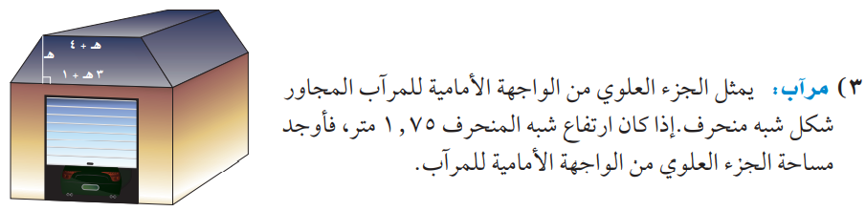
تحقق من فهمك
........................................................................................................................................................................................................................................................................................................................................................................................................................................................................................................................................................................................................................................................................................................................................................................................................................................................

Slide 13
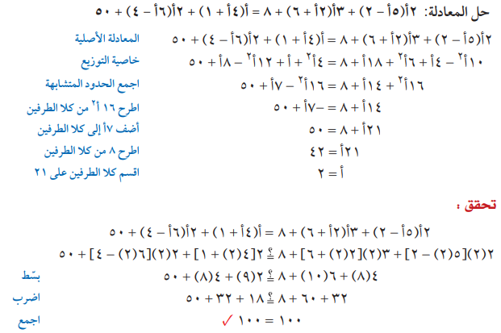
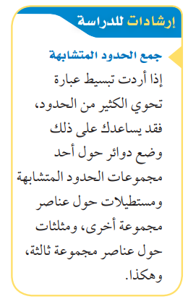
معادلات تتضمن كثيرات حدود في طرفيها
مثال 4

Slide 14
تحقق من فهمك
......................................................................................................................................................................................................................................................................................................................................................................................................................................................................................................................................................................................................................................................................................................................................................................................................................................................................................................................................................................................................................................................................

Slide 15

تحقق من فهمك
......................................................................................................................................................................................................................................................................................................................................................................................................................................................................................................................................................................................................................................................................................................................................................................................................................................................................................................................................................................................................................................................................

Slide 16


تأكد
...............................................................................................................................................................................................................................................................................................................................................................................................................................................................................................................................................................................................................................................................................................................................................................................................................................................................................................................................................................

Slide 17

تأكد
...............................................................................................................................................................................................................................................................................................................................................................................................................................................................................................................................................................................................................................................................................................................................................................................................................................................................................................................................................................

Slide 18


تأكد
...............................................................................................................................................................................................................................................................................................................................................................................................................................................................................................................................................................................................................................................................................................................................................................................................................................................................................................................................................................

Slide 19

تأكد
...............................................................................................................................................................................................................................................................................................................................................................................................................................................................................................................................................................................................................................................................................................................................................................................................................................................................................................................................................................

Slide 20
تأكد
........................................................................................................................................................................................................................................................................................................................................................................................................................................................................................................................................................................................................................................................................................................................................................................................................................................................

Slide 21


تأكد
...............................................................................................................................................................................................................................................................................................................................................................................................................................................................................................................................................................................................................................................................................................................................................................................................................................................................................................................................................................

Slide 22
مهارات التفكير العليا
......................................................................................................................................................................................................................................................................................................................................................................................................................................................................................................................................................................................................................................................................................................................................................................................................................................................................................................................................................................................................................................................................

Slide 23


الواجب
بمنصة مدرستي
تصميم
أ. عثمان الربيعي
@uthman20191
موقع رفعة التعليمية

