Slide 1

جمع كثيرات الحدود وطرحها

Slide 2
درست كتابة كثيرات الحدود بالصورة القياسية .
فيما سبق
1 ) أجمع كثيرات حدود .
2 ) أطرح كثيرات حدود .
الآن

Slide 3
جدول التعلم
ماذا أعرف ؟ | ماذا أريد أن أعرف ؟ | ماذا تعلمت ؟

Slide 4
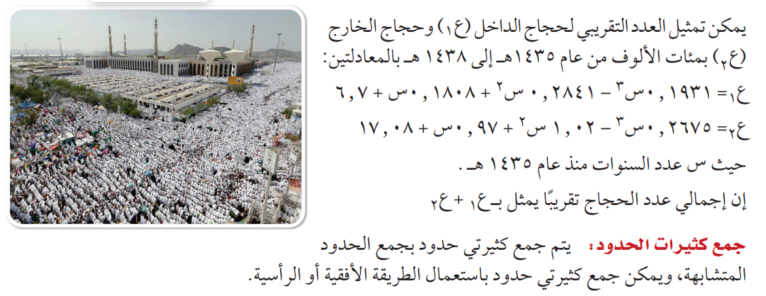
لماذا

Slide 5
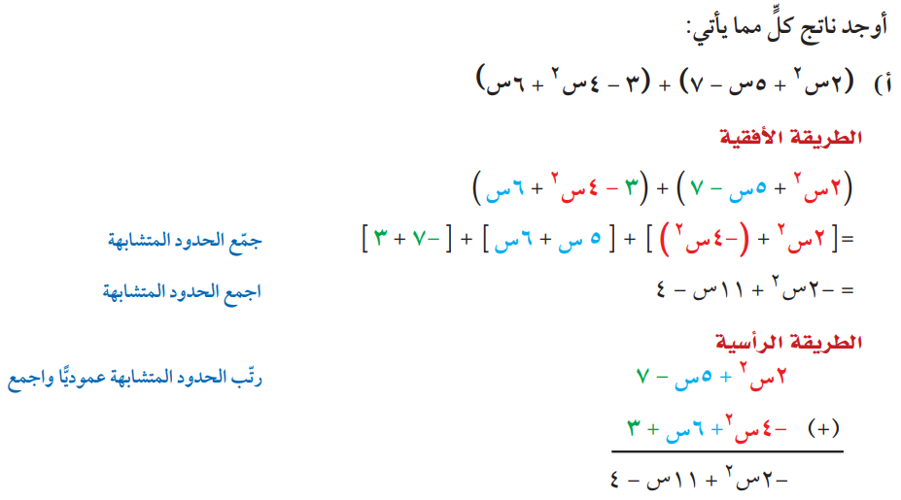
جمع كثيرات الحدود
مثال 1

Slide 6
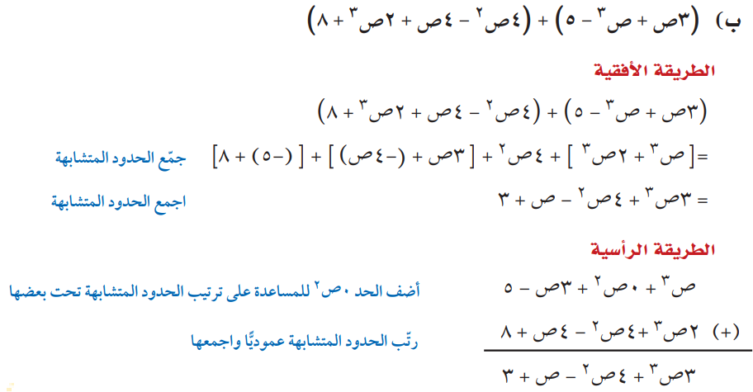
جمع كثيرات الحدود
مثال 1

Slide 7

تحقق من فهمك
...............................................................................................................................................................................................................................................................................................................................................................................................................................................................................................................................................................................................................................................................................................................................................................................................................................................................................................................................................................

Slide 8

تحقق من فهمك
...............................................................................................................................................................................................................................................................................................................................................................................................................................................................................................................................................................................................................................................................................................................................................................................................................................................................................................................................................................

Slide 9
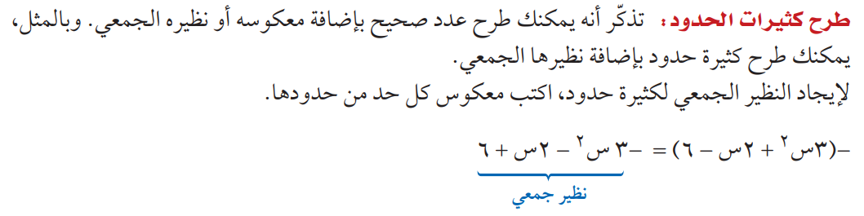


Slide 10
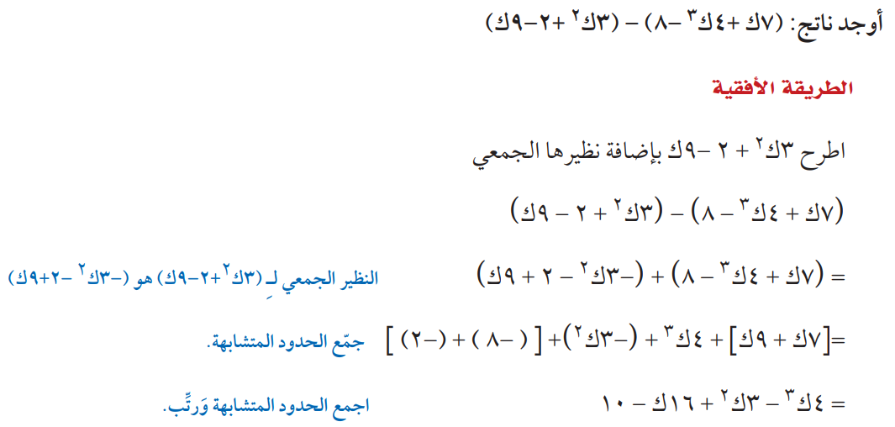
طرح كثيرات الحدود
مثال 2

Slide 11
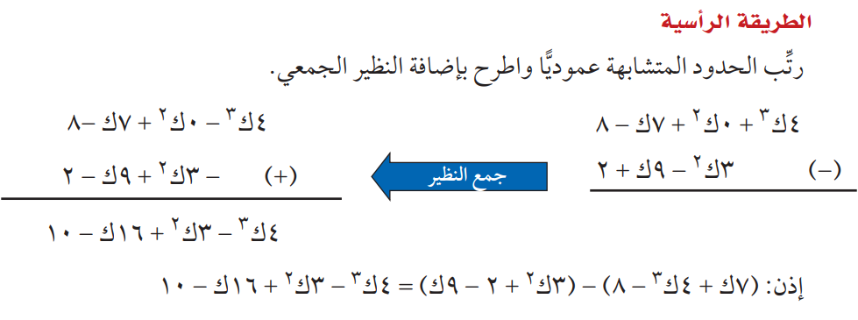
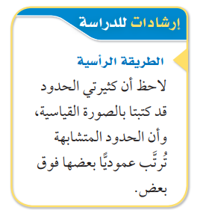
طرح كثيرات الحدود
مثال 2

Slide 12
تحقق من فهمك
...............................................................................................................................................................................................................................................................................................................................................................................................................................................................................................................................................................................................................................................................................................................................................................................................................................................................................................................................................................

Slide 13
تحقق من فهمك
...............................................................................................................................................................................................................................................................................................................................................................................................................................................................................................................................................................................................................................................................................................................................................................................................................................................................................................................................................................

Slide 14
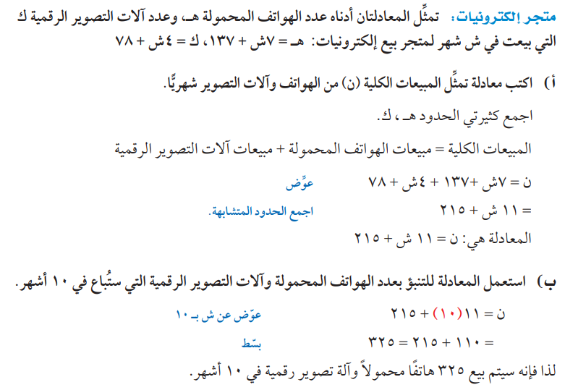
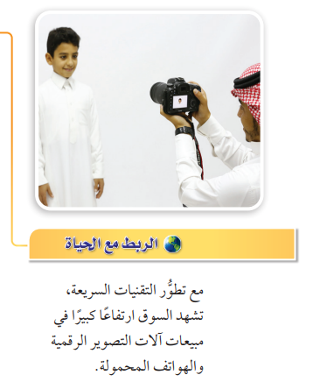
جمع كثيرات الحدود وطرحها
مثال 3
من واقع الحياة

Slide 15
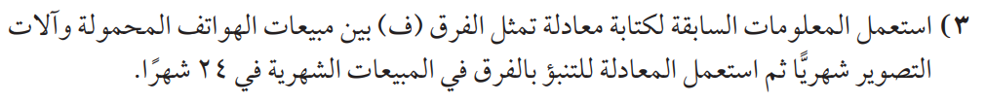
تحقق من فهمك
...............................................................................................................................................................................................................................................................................................................................................................................................................................................................................................................................................................................................................................................................................................................................................................................................................................................................................................................................................................

Slide 16


تأكد
...............................................................................................................................................................................................................................................................................................................................................................................................................................................................................................................................................................................................................................................................................................................................................................................................................................................................................................................................................................

Slide 17

تأكد
...............................................................................................................................................................................................................................................................................................................................................................................................................................................................................................................................................................................................................................................................................................................................................................................................................................................................................................................................................................

Slide 18
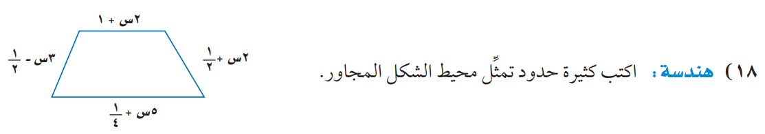
تأكد
........................................................................................................................................................................................................................................................................................................................................................................................................................................................................................................................................................................................................................................................................................................................................................................................................................................................

Slide 19
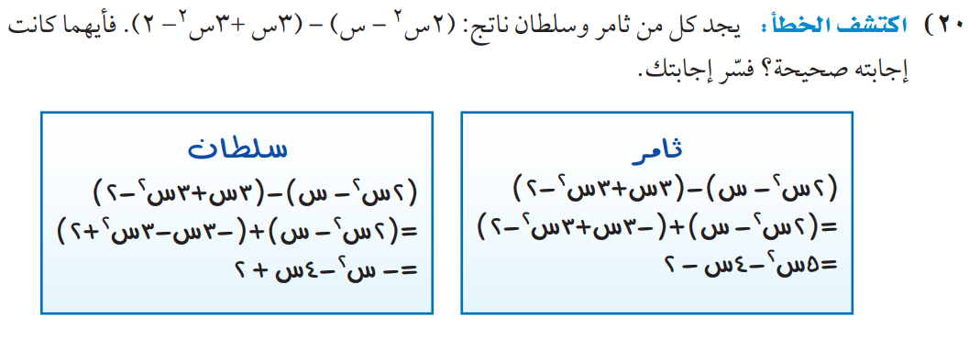
مهارات التفكير العليا

Slide 20
مهارات التفكير العليا
........................................................................................................................................................................................................................................................................................................................................................................................................................................................................................................................................................................................................................................................................................................................................................................................................................................................

Slide 21


الواجب
بمنصة مدرستي
تصميم
أ. عثمان الربيعي
@uthman20191
موقع رفعة التعليمية

