Slide 1

Good
Morning
اللَّهُمَّ انْفَعْنِي بما علمتني، وعلمني ما ينفعني، وَارْزُقْنِي علماً ينفعني

Slide 2
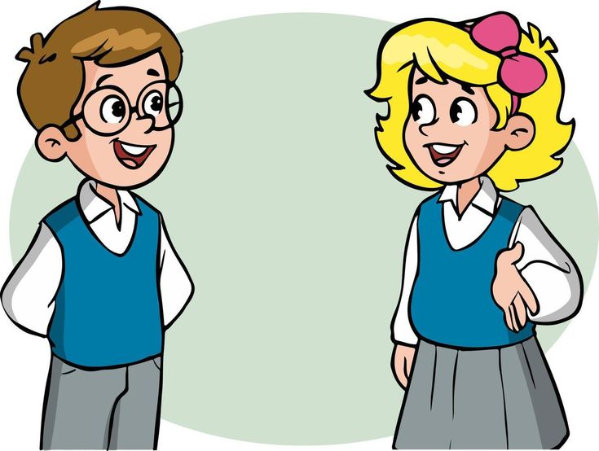
How are you today ?

Slide 3
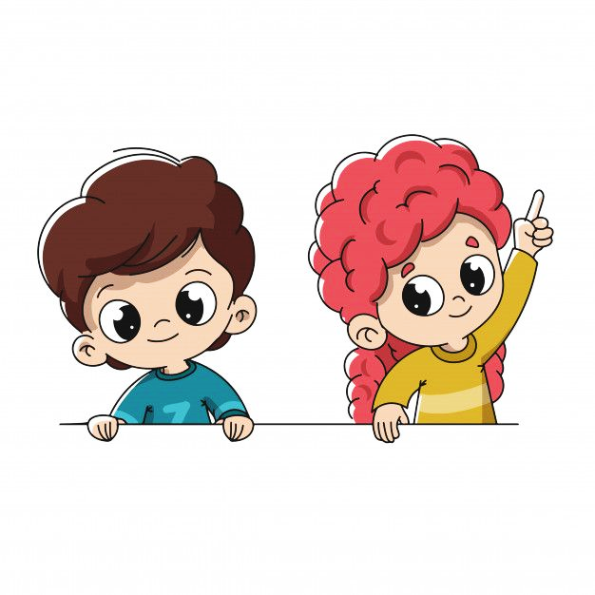

Revision
Listen & Discuss:
Describe everyday activities.
Tell what time it is.

Slide 4
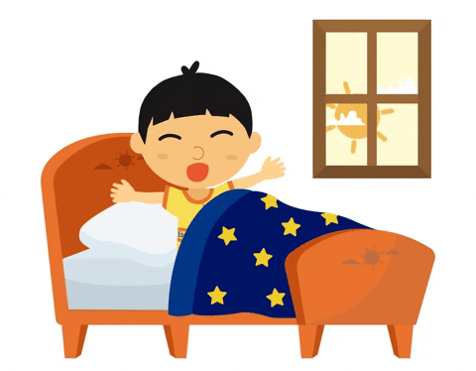
We started our new unit

Slide 5

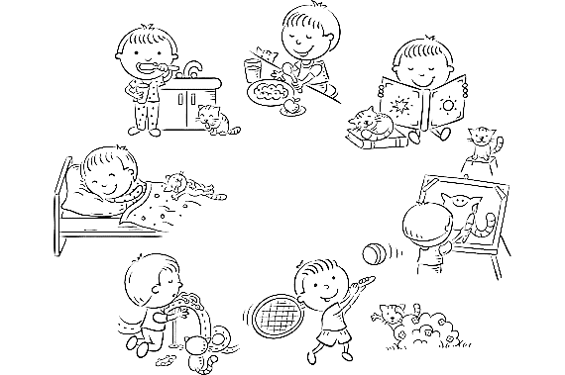
Everyday Activities
I get up at five o'clock everyday.
I have my breakfast at six.
My bus comes to pick me up at seven
After school, i arrive home at twelve.
I go to bed at eight.

Slide 6
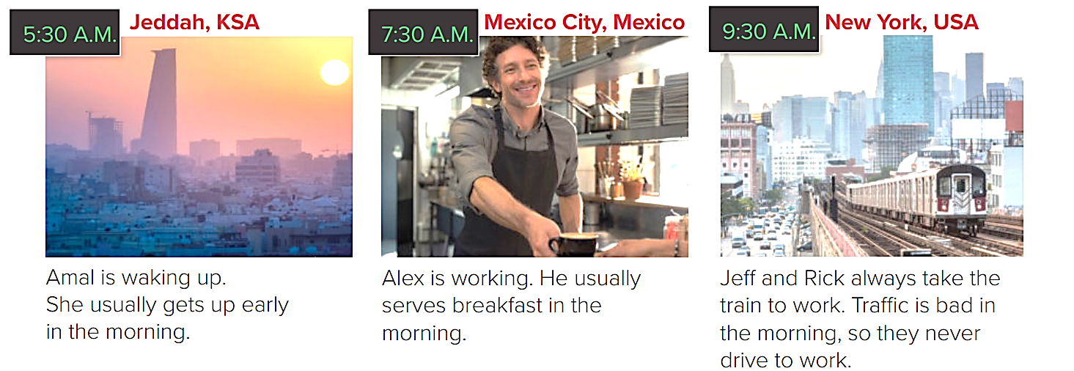
Every Day Around the World
88

Slide 7
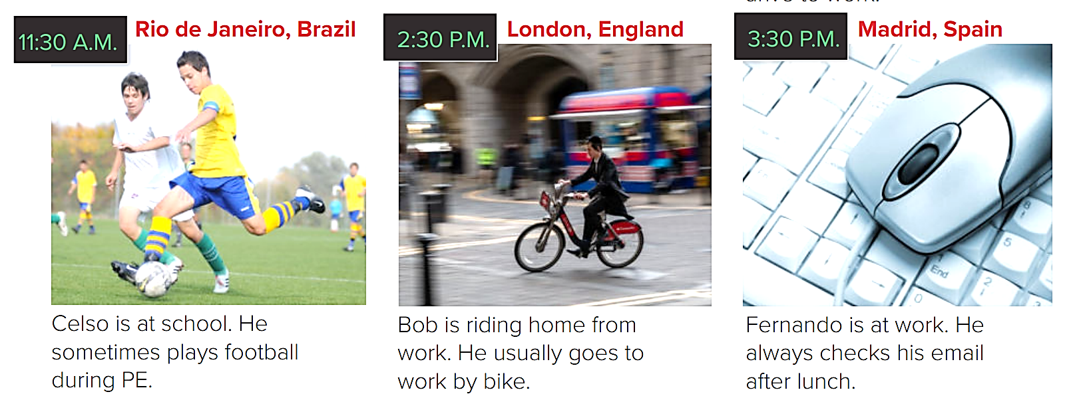
Every Day Around the World
88

Slide 8
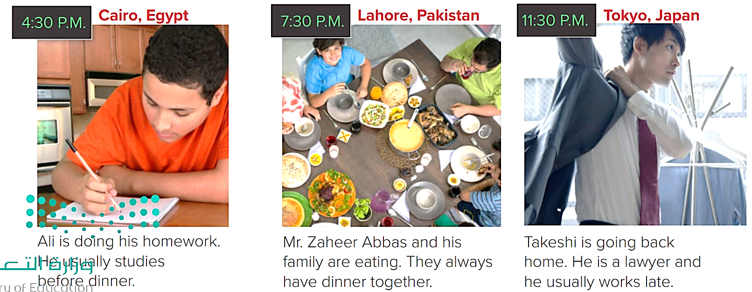
Every Day Around the World
88

Slide 9
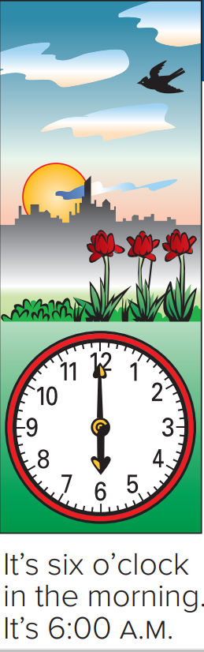
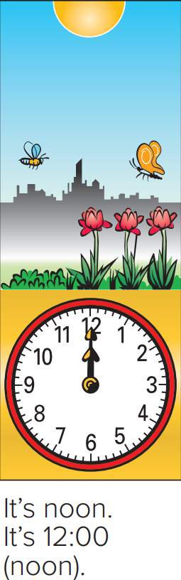
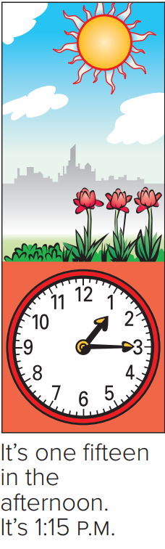
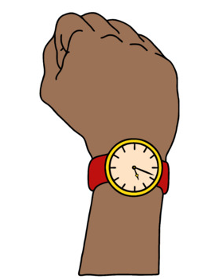
Time

Slide 10
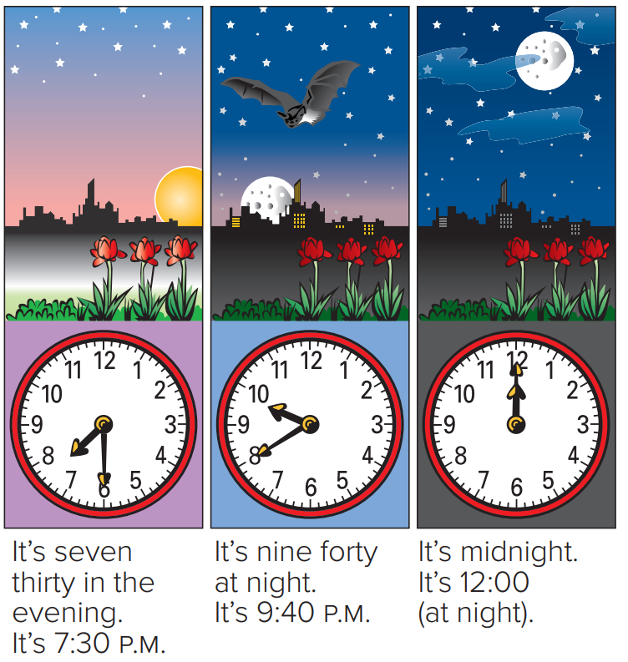
Time

Slide 11
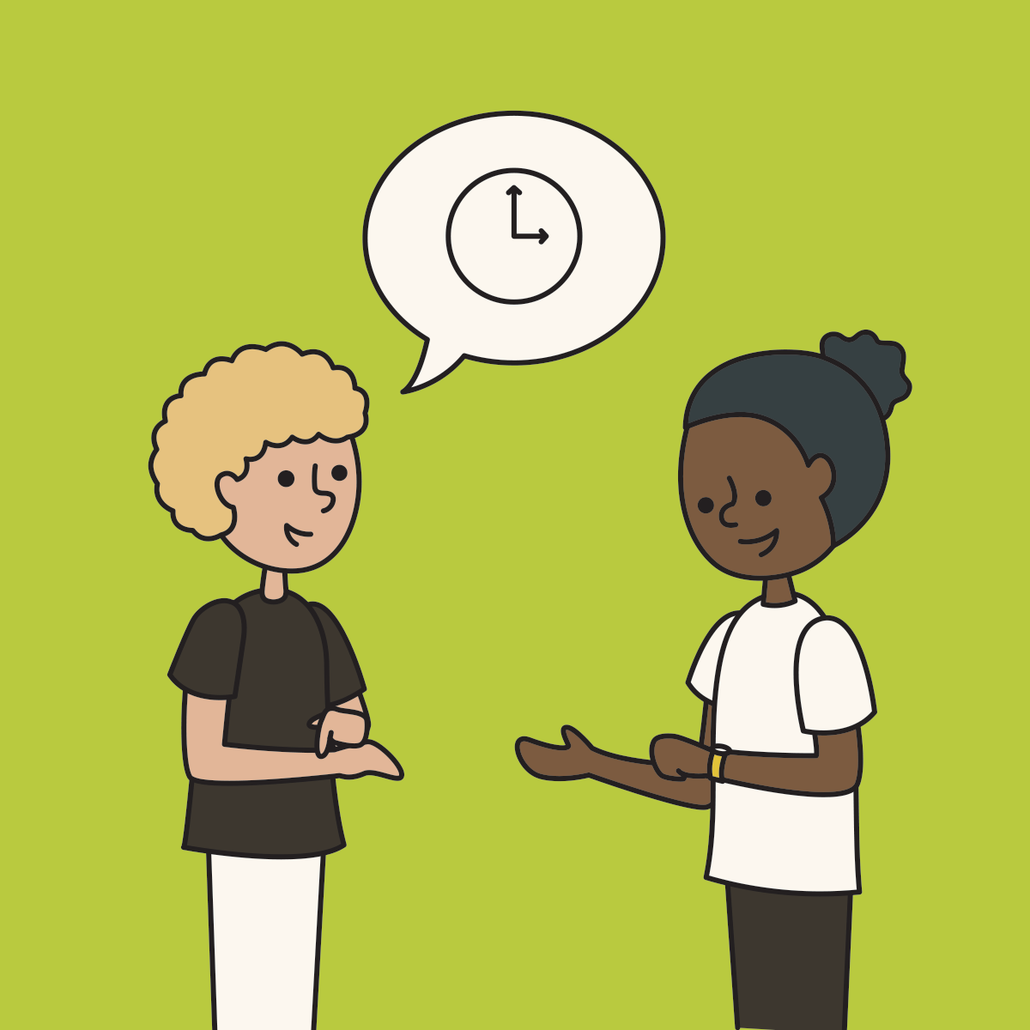
What time is it?
It’s four o’clock.

Slide 12


Vocabulary
A. What activities on page 88 do you do every day? Write them in order from morning to night.
Nice

Slide 13
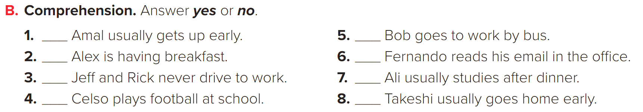
Nice
Yes
No
No
Yes
Yes
No
Yes
No

Slide 14


Slide 15
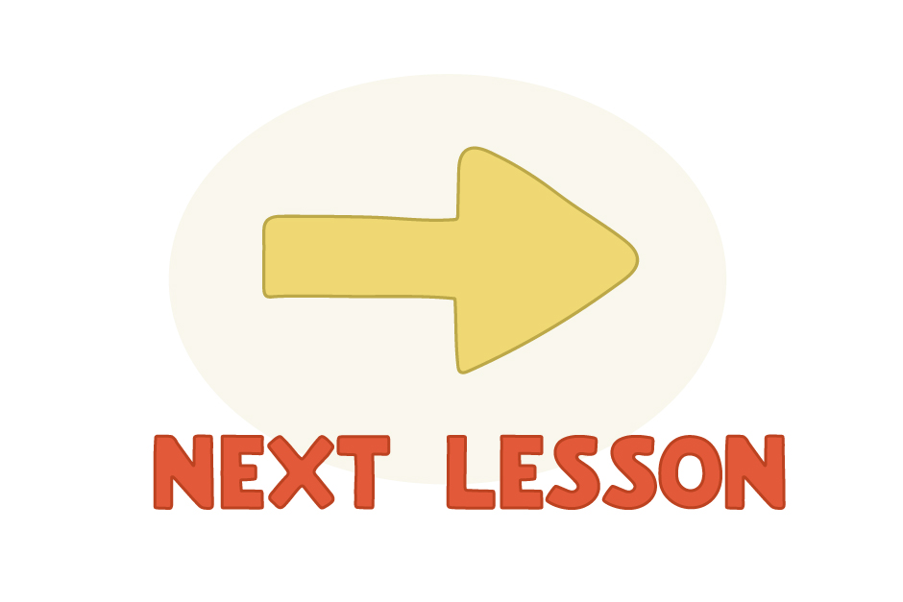

Slide 16


Objectives
At the end of the lesson, you will be able to..
Use adverbs of frequency and time expressions.
Use prepositions.

Slide 17


Slide 18

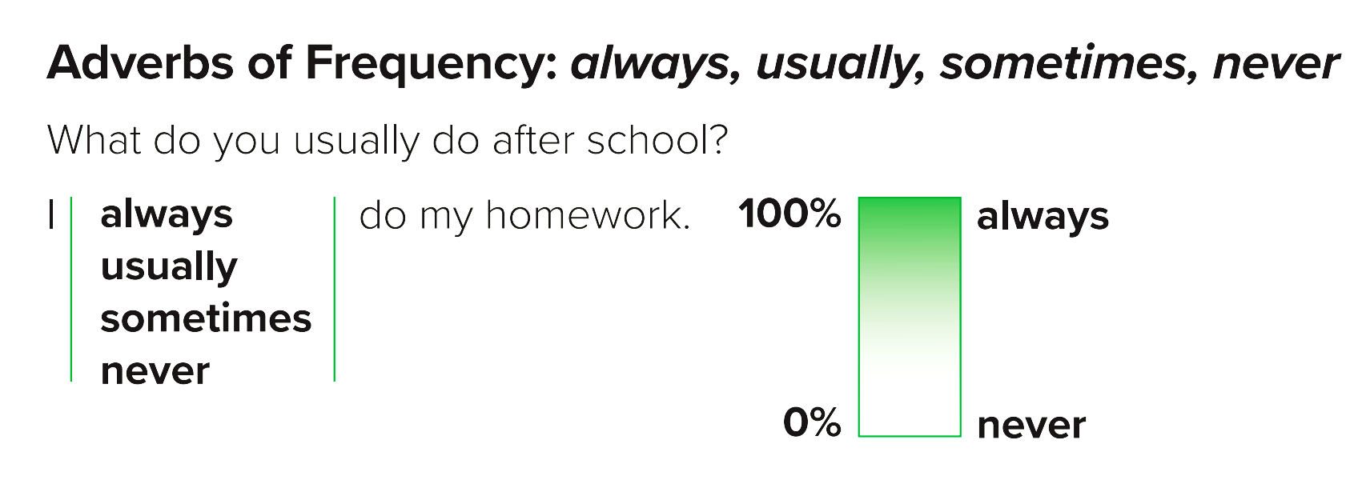

Slide 19

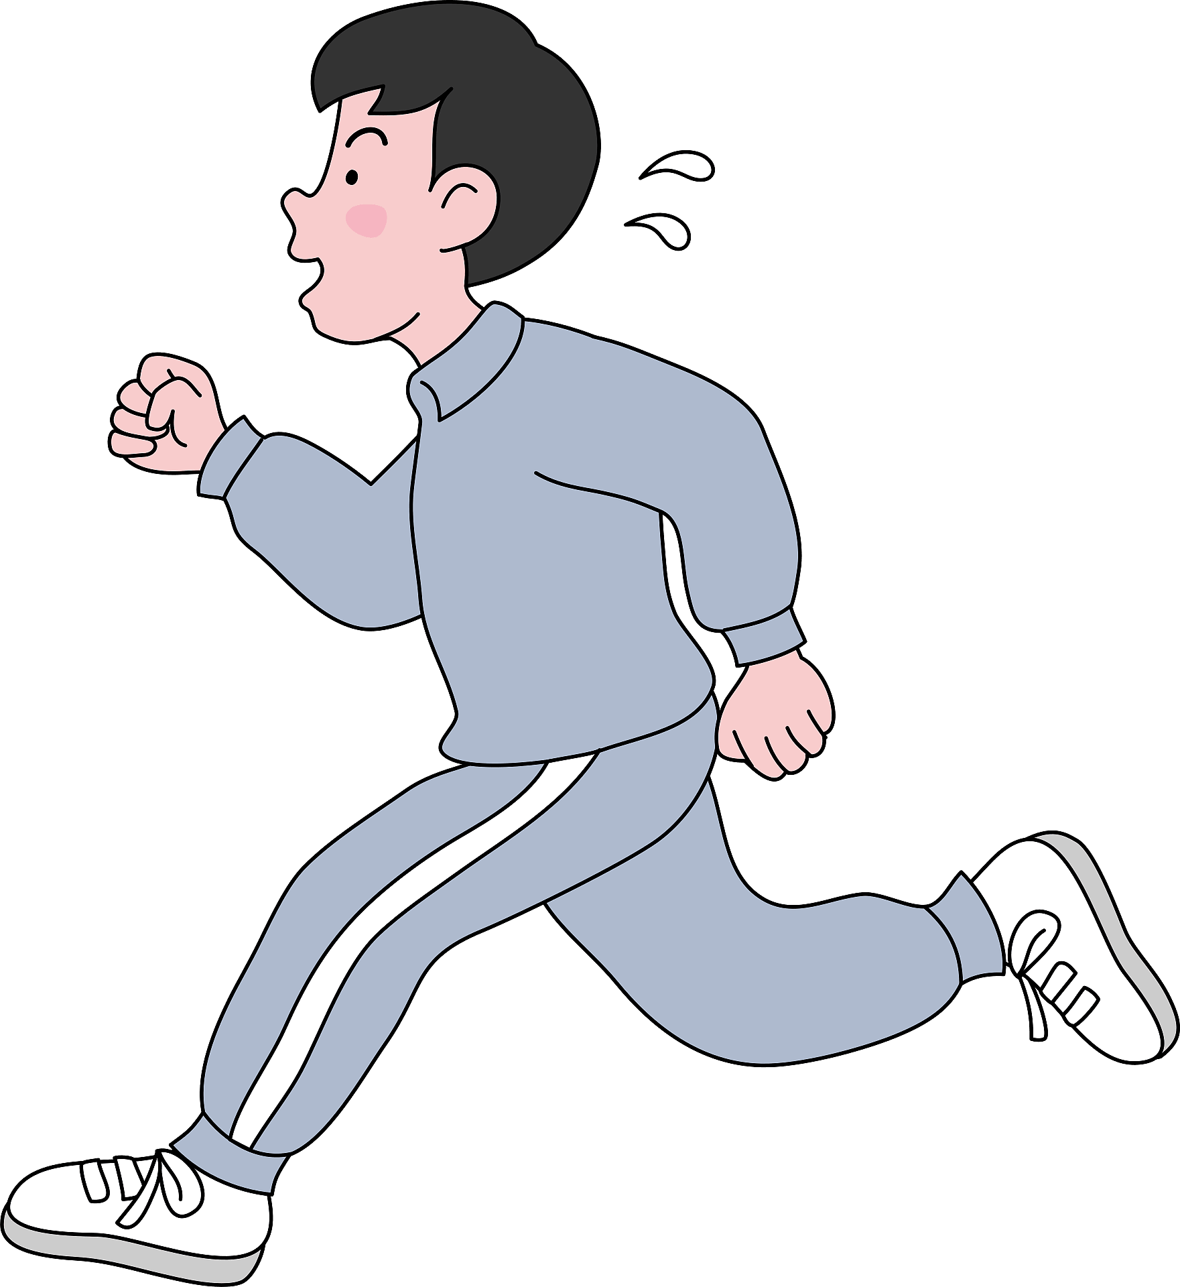
He always goes for a run every day.
100%
Always

Slide 20
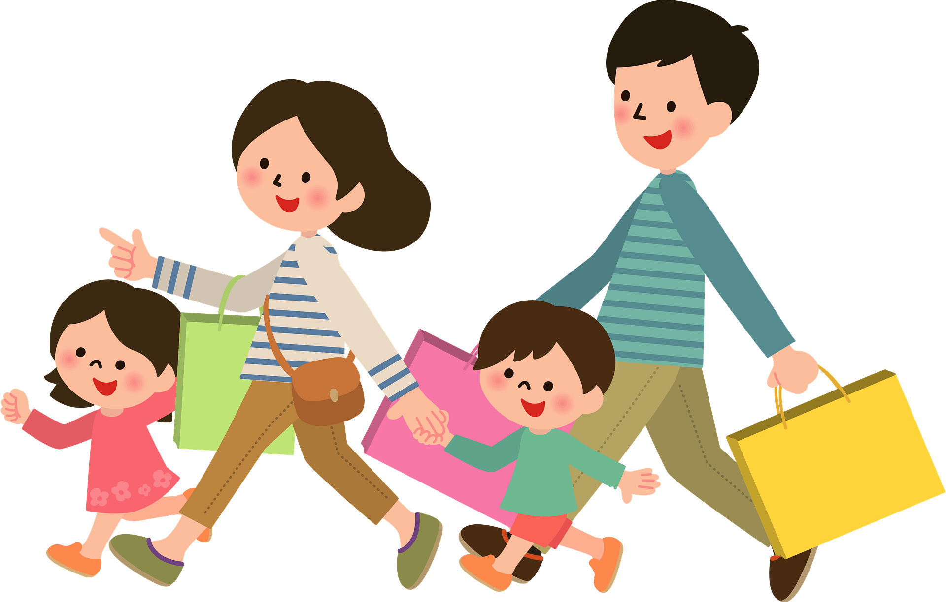
We usually go shopping on Saturdays.
75%
Usually

Slide 21
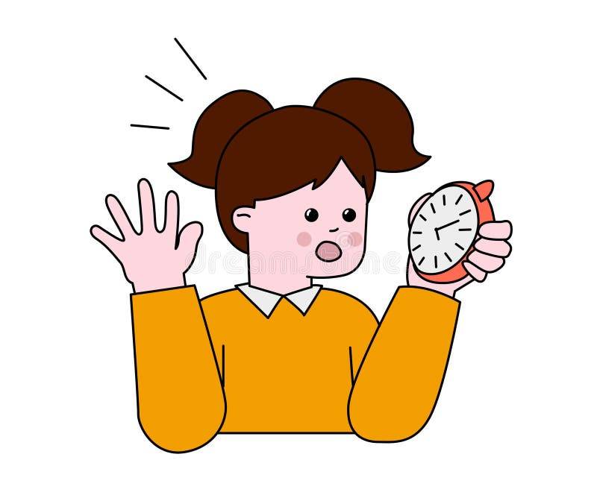
She is sometimes late for school.
50%
Sometimes

Slide 22
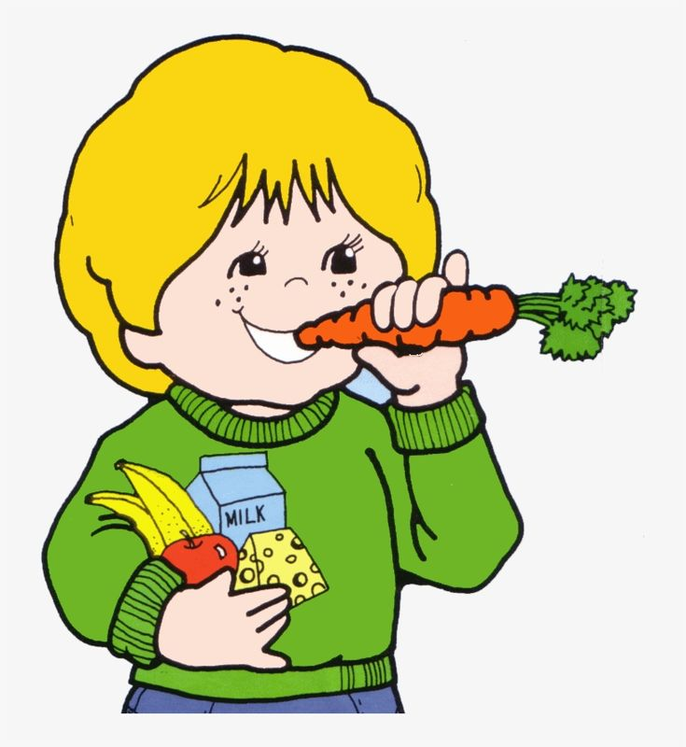

He never eats junk food.
Never

Slide 23

START

Slide 24


Slide 25
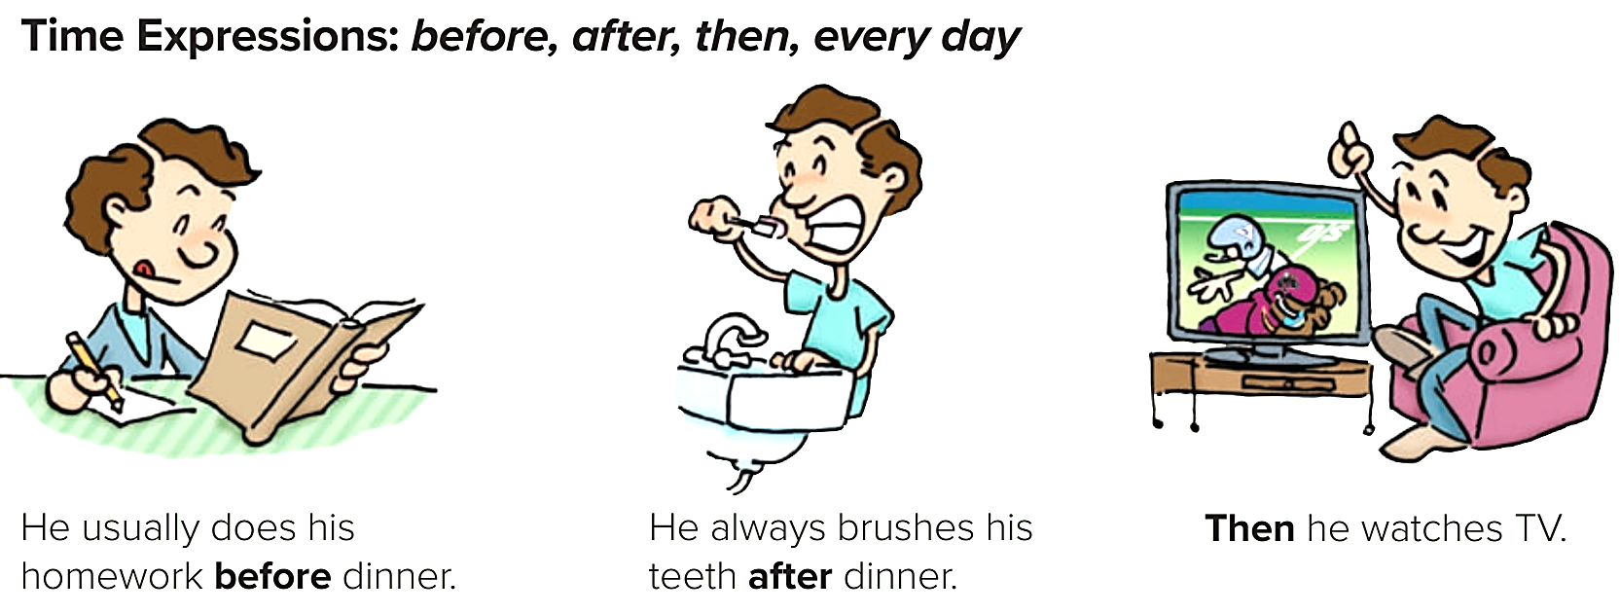

Slide 26
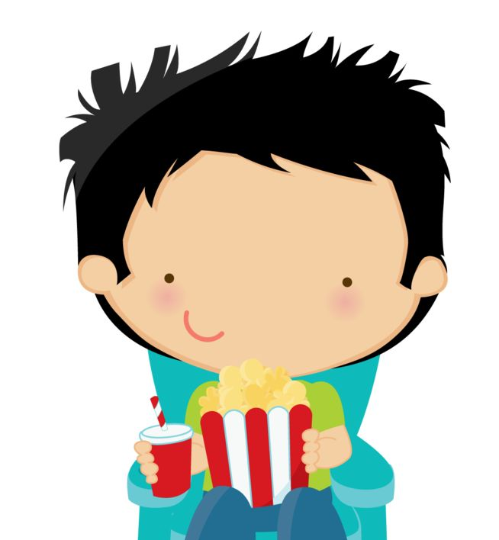

I will finish my homework before going to the movies.

Slide 27

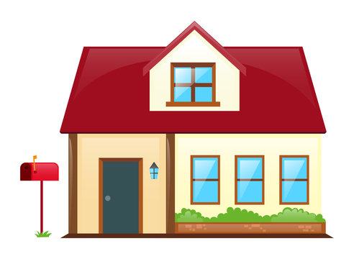
I went to the supermarket, then to home.

Slide 28
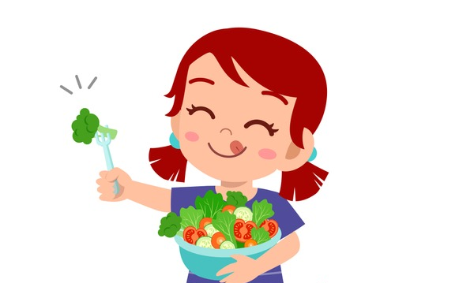
Maryam has a salad for lunch everyday.

Slide 29
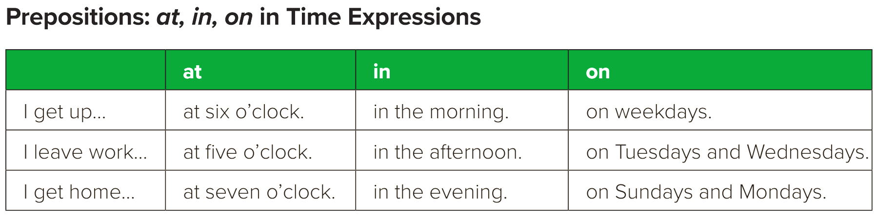

Slide 30
at for a PRECISE TIME
She arrived at 3 o’clock.
The flight took off at 6 o’clock.
He came home at noon.

Slide 31
in for MONTHS, YEARS, CENTURIES and LONG PERIODS
The book was published in May.
I will visit my grandma in the summer.
Black & White movies was favored in the 1930’s

Slide 32
on for DAYS and DATES
I have an exam on Sunday.
Sami will travel to Riyadh on the 6th of march.
You should bring your mother on my graduation party.

Slide 33
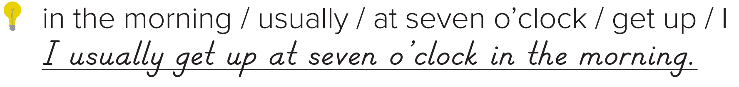
Activity
A. Unscramble the sentences.
1. opens / at nine / usually / The bank.
The bank usually opens at nine.
2. closes / The supermarket / on Sundays / never
The supermarket never closes on Sundays.
Page
90

Slide 34
Activity
A. Unscramble the sentences.
3. to work / drive / always / My brothers
My brothers always drive to work.
4. in our family / go to bed late / The children / never
The children never go to bed late in our family.
Page
90

Slide 35
Activity
A. Unscramble the sentences.
5. always / in the afternoon / do / I / my homework
I always do my homework in the afternoon.
Nice
6. usually / eats dinner / My family / at six
My family usually eats dinner at six.
Page
90

Slide 36

Pair Work

Slide 37

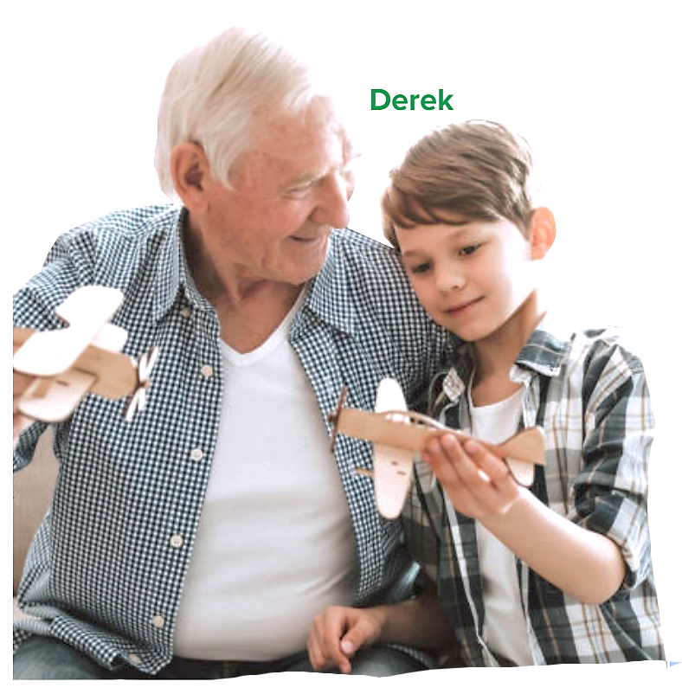

Activity
B. Work with a partner. Talk about the people’s daily activities.
Your Turn

Slide 38
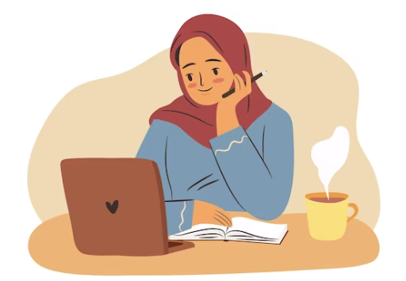
Activity
B. Work with a partner. Talk about the people’s daily activities.
1
Fatimah
always / the evening
Fatimah always studies in the evening.

Slide 39
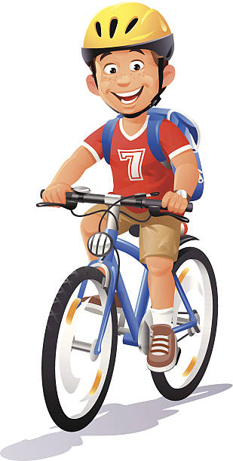
Activity
B. Work with a partner. Talk about the people’s daily activities.
2
Tariq
sometimes / the morning
Tariq sometimes cycles in the morning.

Slide 40
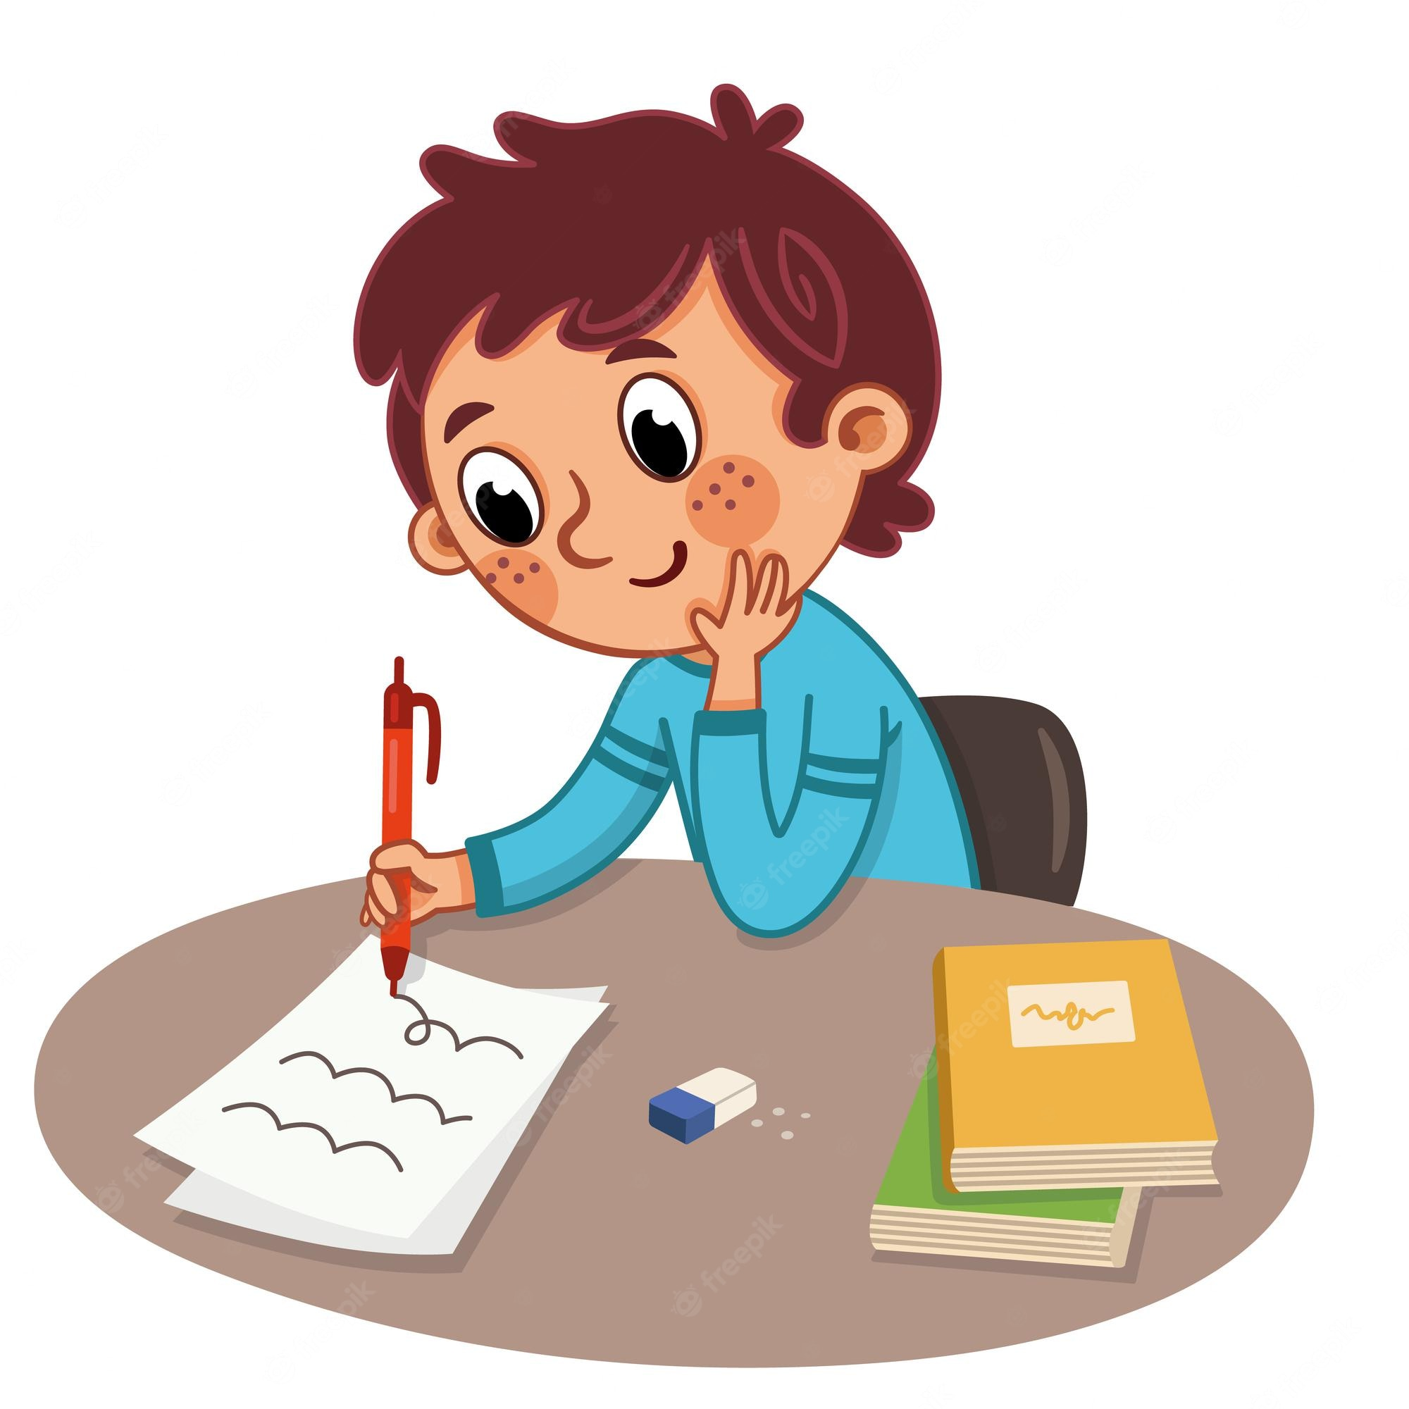
Activity
B. Work with a partner. Talk about the people’s daily activities.
3
Adam
never / weekends
Adam never goes to school on weekends.

Slide 41
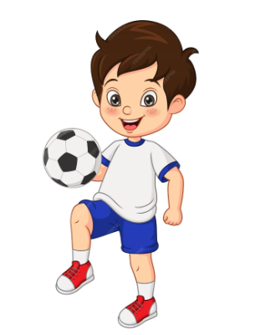
Activity
B. Work with a partner. Talk about the people’s daily activities.
4
Abdullah
usually / Saturdays
Abdullah usually exercises on Saturday.

Slide 42
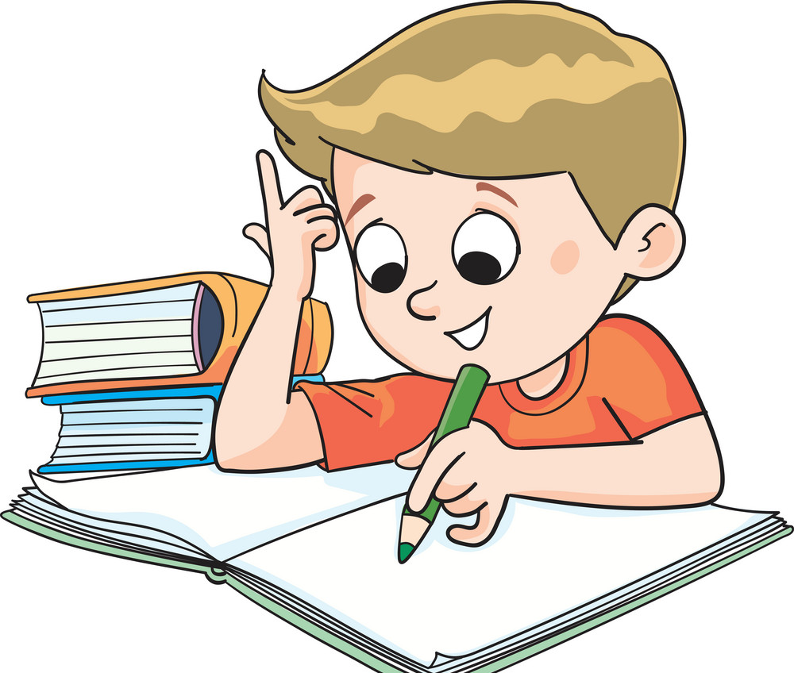
Activity
B. Work with a partner. Talk about the people’s daily activities.
5
khalid
always / after school
Khalid always does his homework in the afternoon.

Slide 43
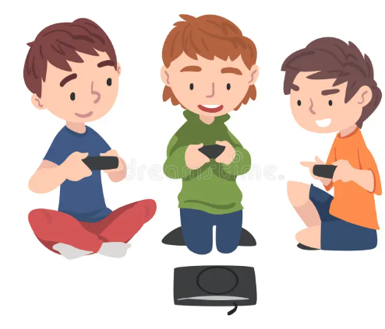
Activity
B. Work with a partner. Talk about the people’s daily activities.
6
Ali and his friends
sometimes / the evening
Ali and his friends sometimes
play video games in the evening.

Slide 44


Slide 45
START

Slide 47
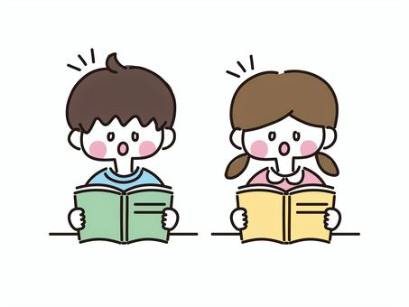
Workbook
Open page 90
Exercise A

Slide 48

Linking this lesson to my Religion.
As muslims we should always say our Athkar daily, in the morning & night times.
Also, after each prayer and at bedtime.
Because saying the Athkar will give you peace, protects you from the bad things.
As Allah almighty say:
قال الله تعالى: "الَّذِينَ آمَنُواْ وَتَطْمَئِنُّ قُلُوبُهُم بِذِكْرِ اللّهِ أَلاَ بِذِكْرِ اللّهِ تَطْمَئِنُّ الْقُلُوبُ".

Slide 49


Slide 50

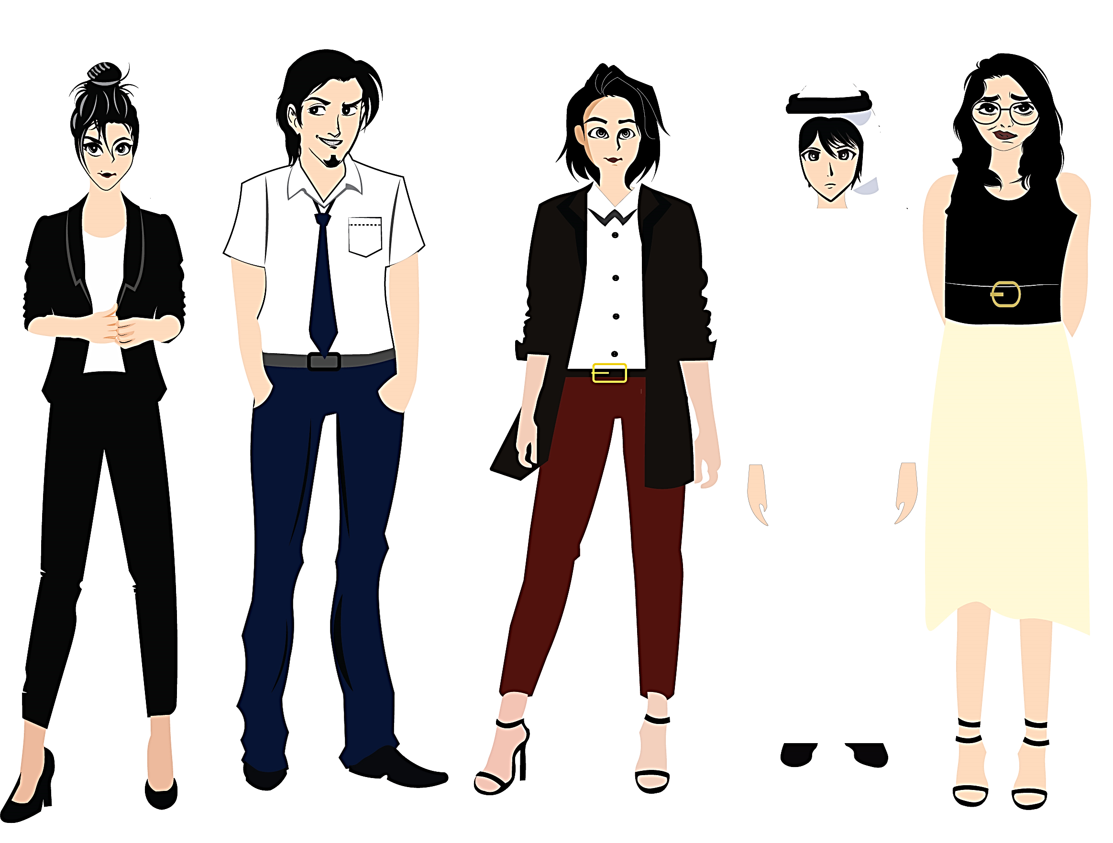


تم تصميم هذا العرض من قبل: فريق عمل البوابة الإنجليزية ، وهو مجاني لكي يستفيد منه معلمي اللغة الإنجليزية.
هذه الشريحة تعتبر كـ"حفظ حقوق" نتمنى عدم حذفها حال مشاركة العرض مع معلمين آخرين.
نسمح بحذف الحقوق في حالة واحدة فقط: اذا أراد معلم الإنجليزي إضافة هذا العرض كـ انتاج معرفي خاص فيه.

