Slide 1

UNIT 3
Form, meaning and function

Slide 2
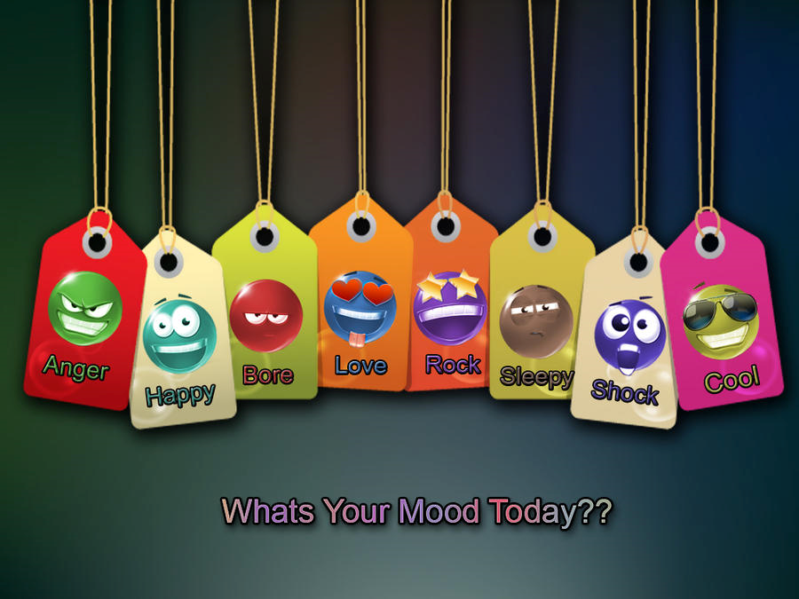

Slide 3

Use so… that
Use such...that
Use so many / so much.

Slide 4
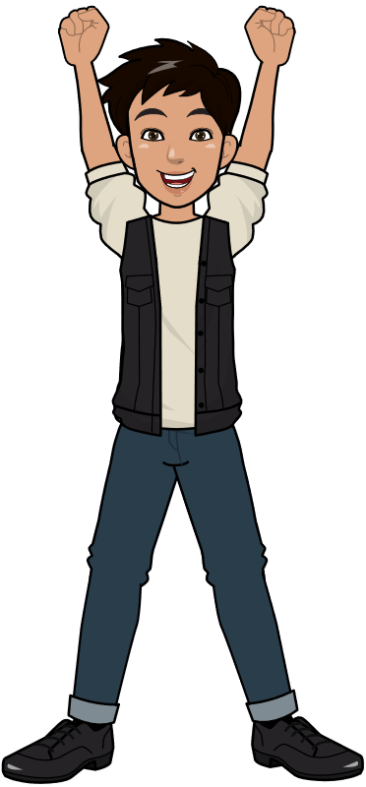
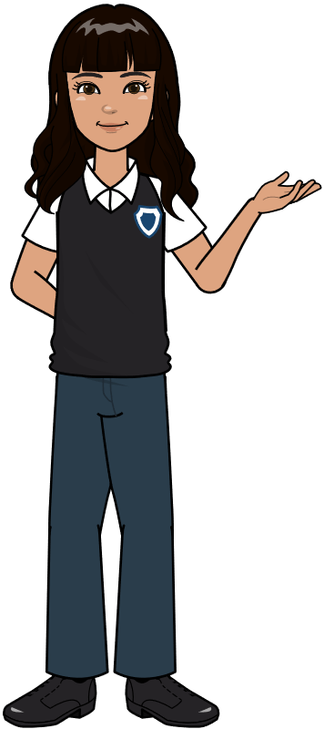
I am so happy
I am such a smart girl

Slide 5

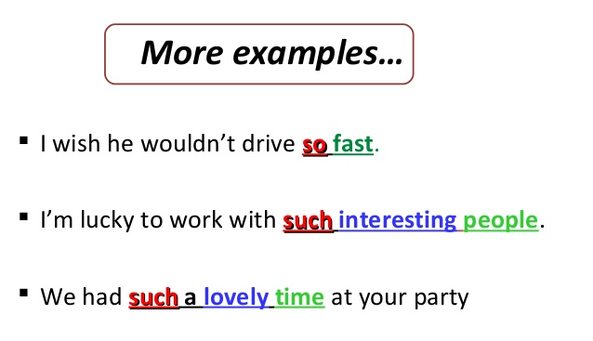
So and such make the meaning of an adjective or adverb stronger

Slide 6


So….That
Adj
Adv
so
that
He is so smart that he pass the exam.
He walked so slowly that he was late.

Slide 7
So..many..that
so
many CN
that
She has so many books that she can hardly carry them.

Slide 8
So..much..that
so
much UN
that
I have so much work that I can’t go out.

Slide 9
Such..adj..N…that
such
Adj
Noun
that
It was such an easy quiz that I did well.

Slide 10
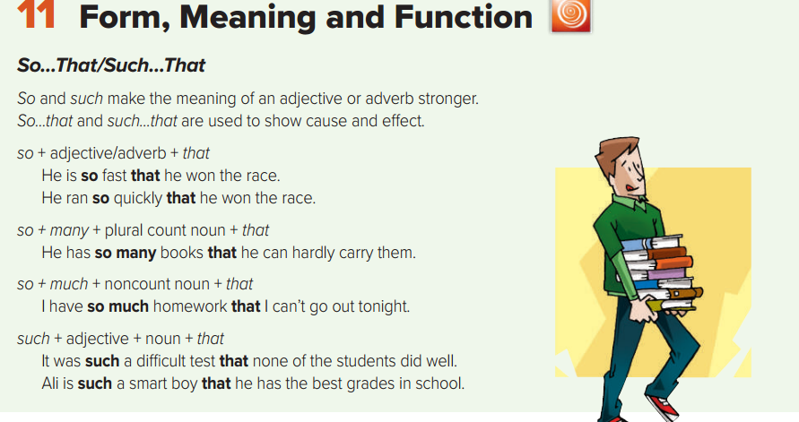

Slide 11
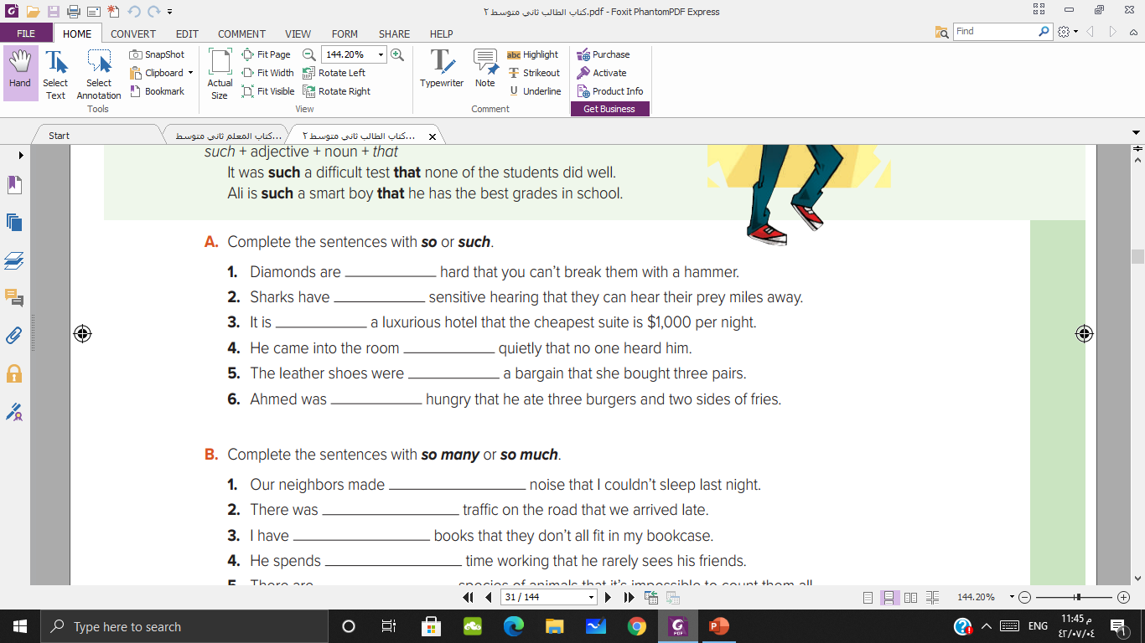
so
such
such
so
such
so

Slide 12
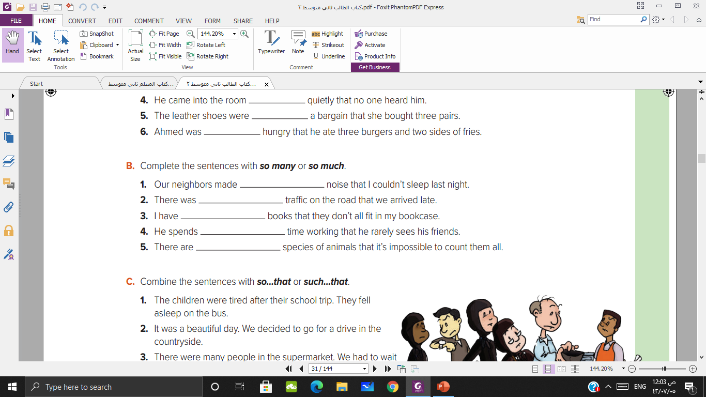
so much
so much
so many
so much
so many
Notes:
بعض الأفعال لا تقبل ing
مثل أفعال المتعلقة بالأفكار و المشاعر والآراء

Slide 13
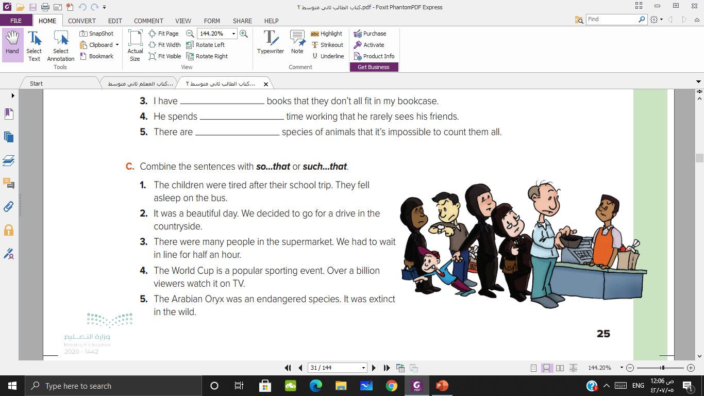

The children were so tired after their school trip that they fell asleep on the bus.
It was such a beautiful day that we decided to go for a drive in the countryside.
There were so many people in the supermarket that we had to wait in line for half an hour.
The World Cup is such a popular sporting event that over a billion viewers watch it on TV.
The Arabian Oryx was such an endangered species that it was extinct in the wild.

Slide 14

I
Activity time

Slide 15
He ate ………. cookies that he felt sick.
so many
such
so

Slide 16
It was ………. a hot day.
so
such
so much

Slide 17
The test was………. difficult.
so many
such
so

Slide 18
She drank ……coffee that she couldn’t sleep.
so
So much
such

Slide 19


Homework

Slide 20


