Slide 1
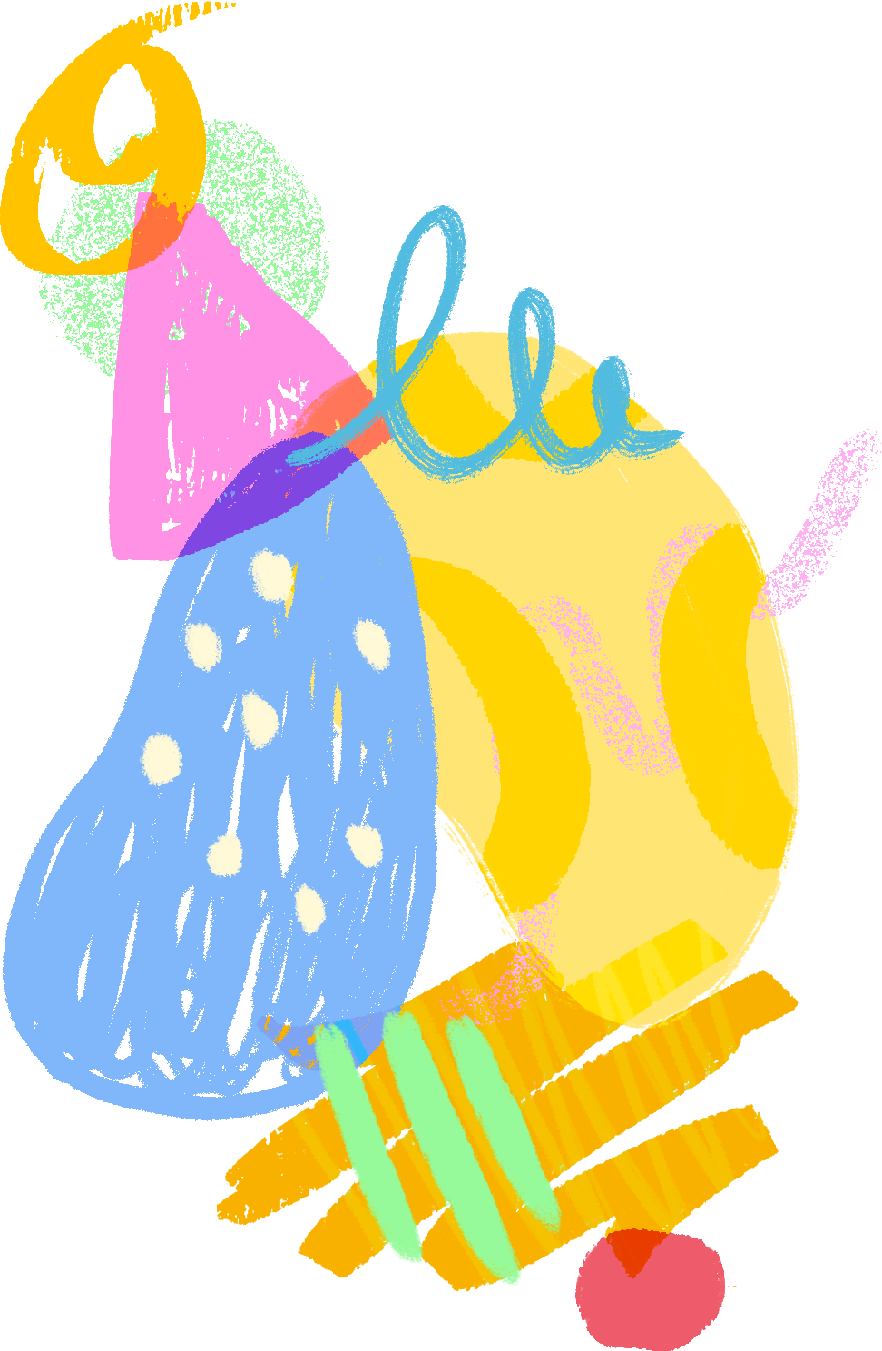
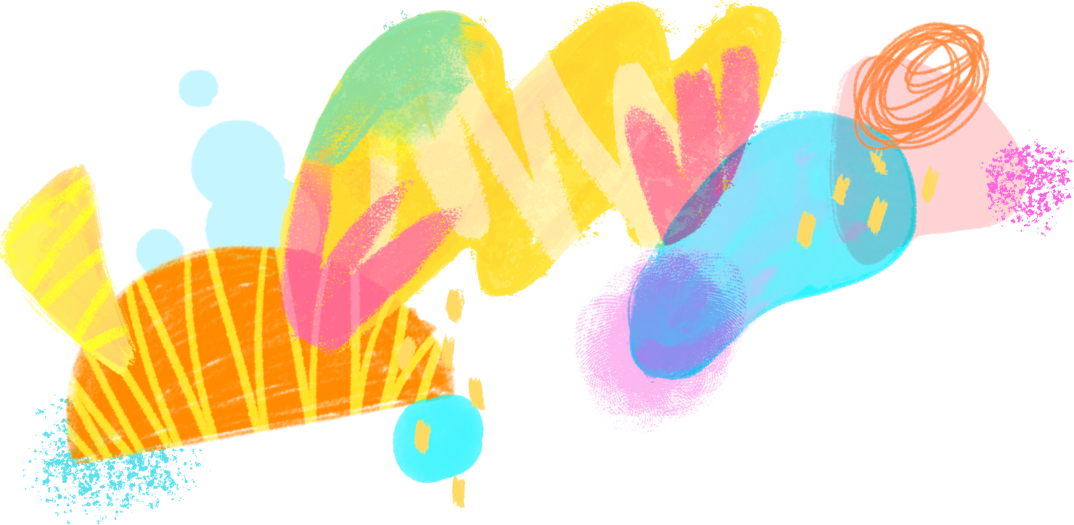
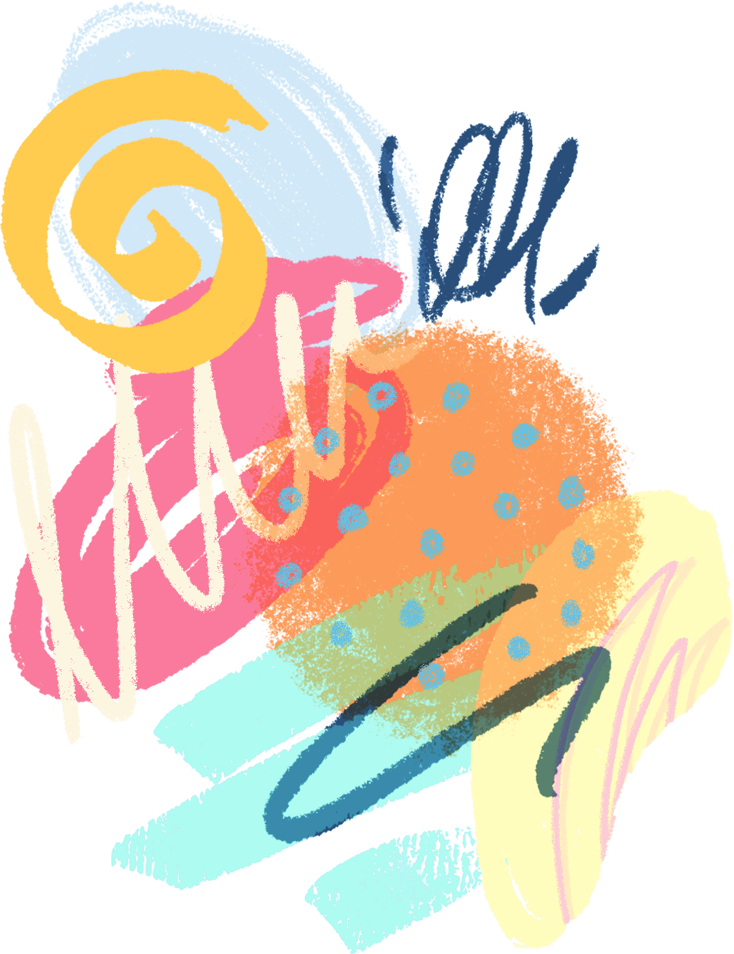


Slide 2



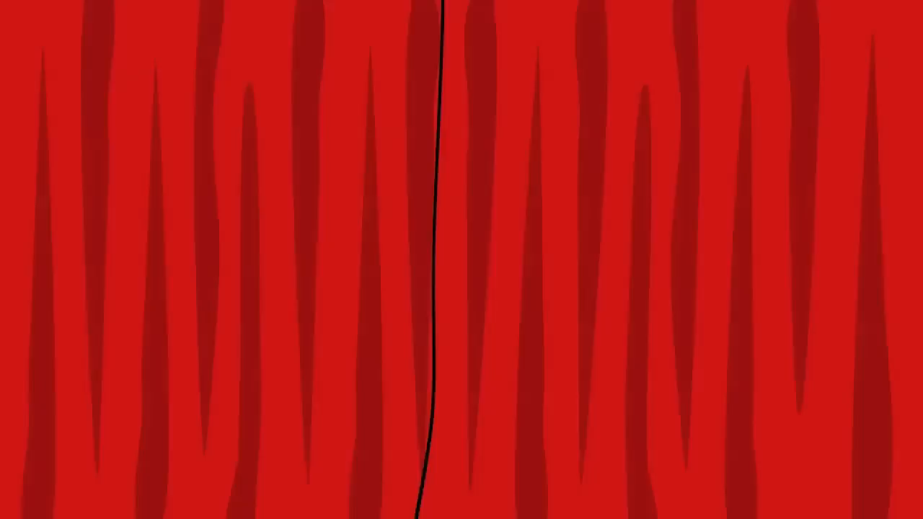
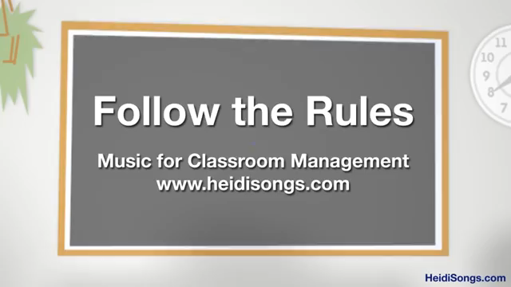
Head, shoulders action chant
Clap along
Singing walrus action chant
Follow the rules

Slide 3

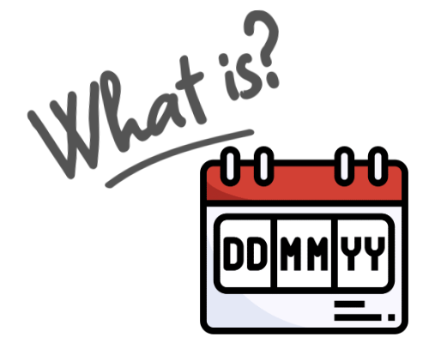


Slide 4
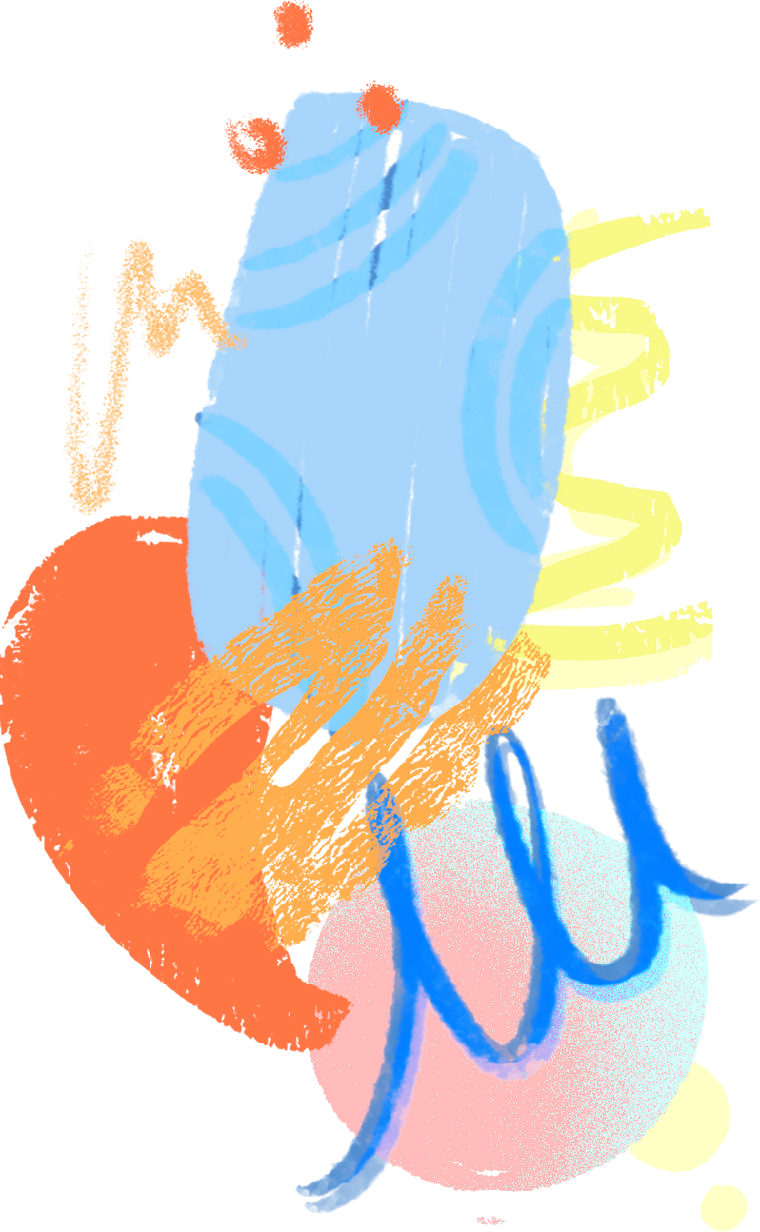


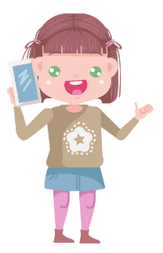
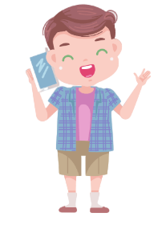

come
went
goes
had
gets
got
came
has
was
is

Slide 5
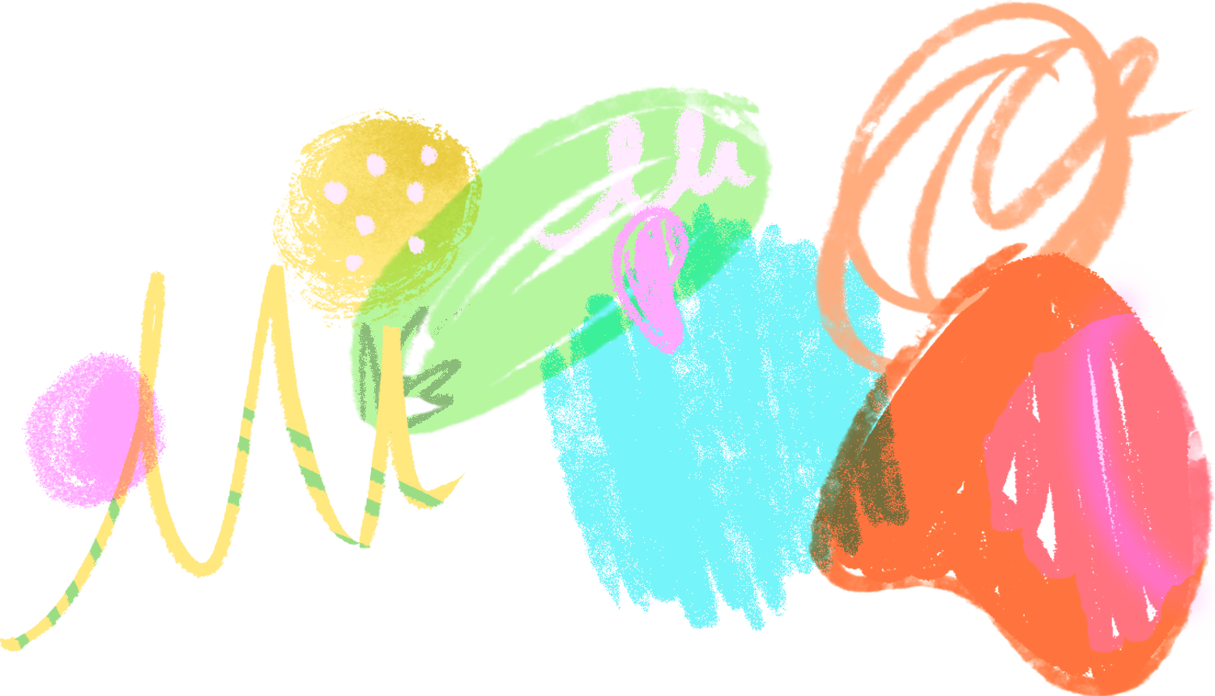
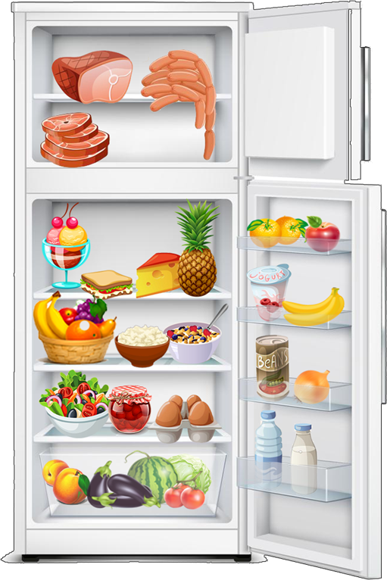





any
There isn’t …………..fish

Slide 6
any
There aren’t ……….. nuggets.

Slide 7
some
There are ………….. eggplants.

Slide 8
some
There is ……………… cheese.

Slide 9
some
There are ……………… apricots.

Slide 10
any
There isn’t ……………… juice.

Slide 11


Slide 12
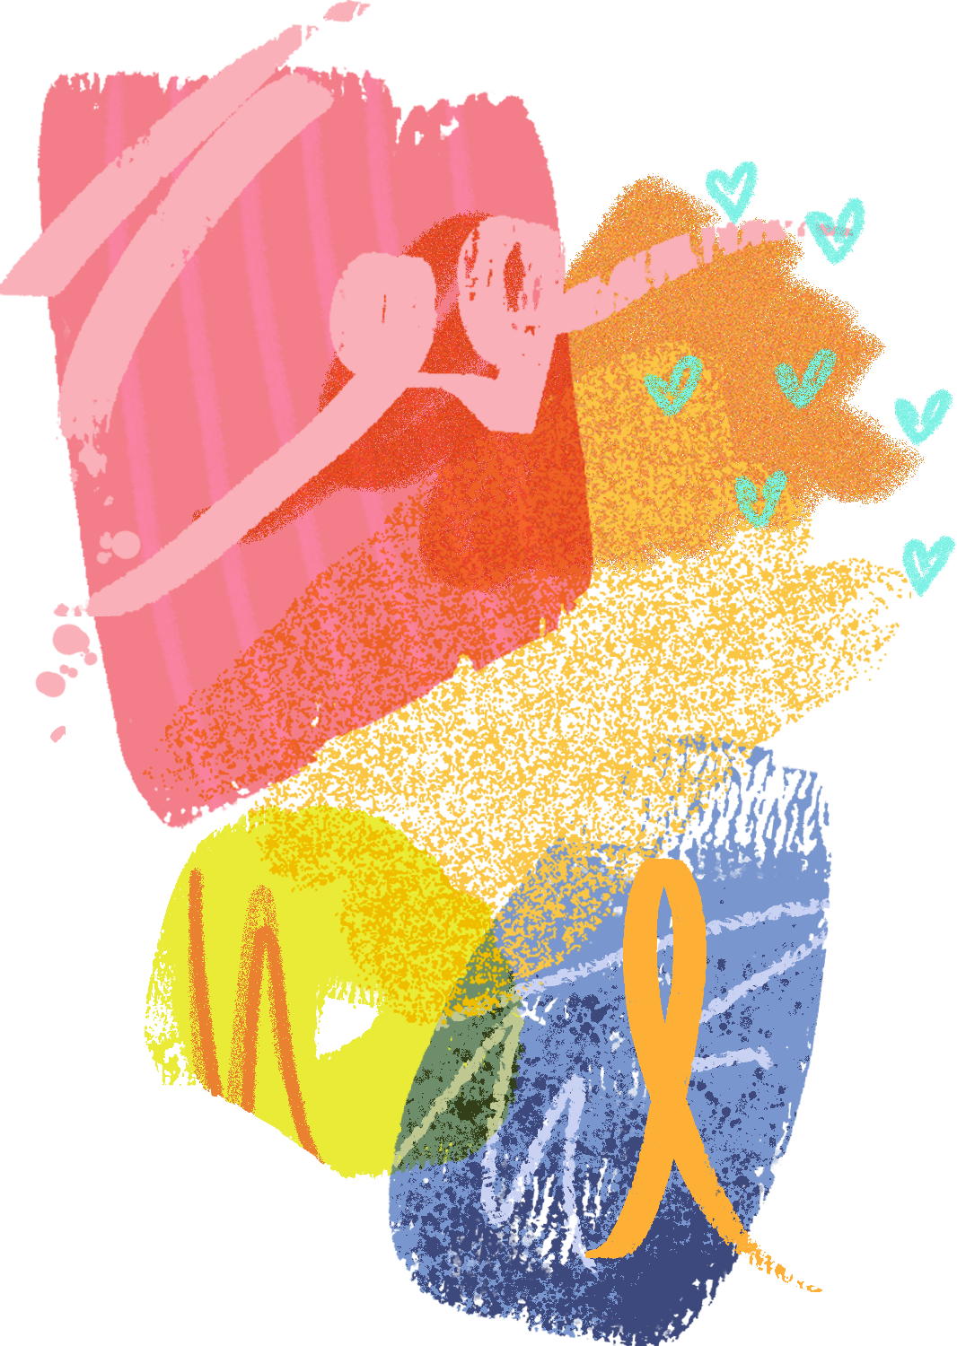
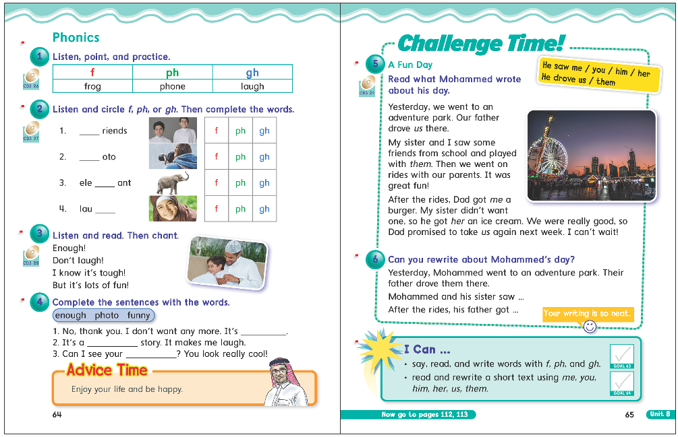
64
65

Slide 13

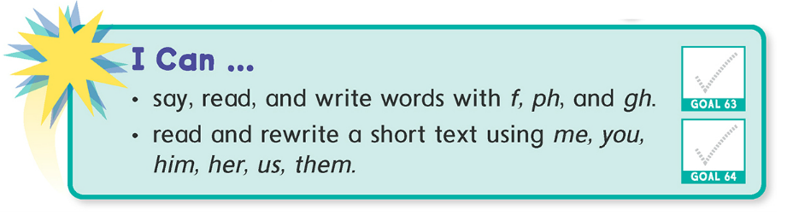

Slide 14
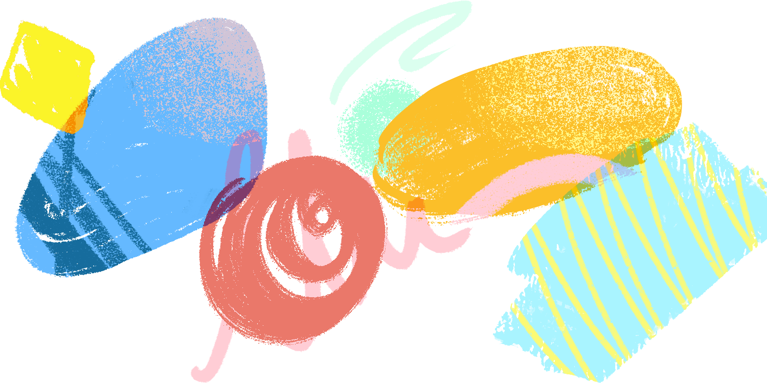

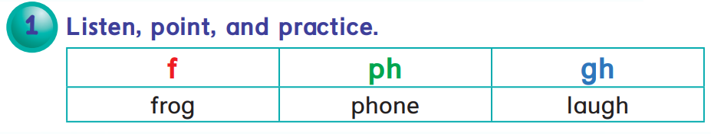

Slide 15

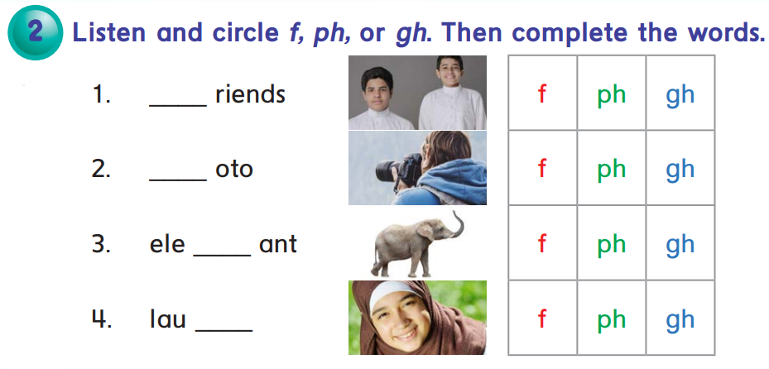


f
ph
ph
gh

Slide 16
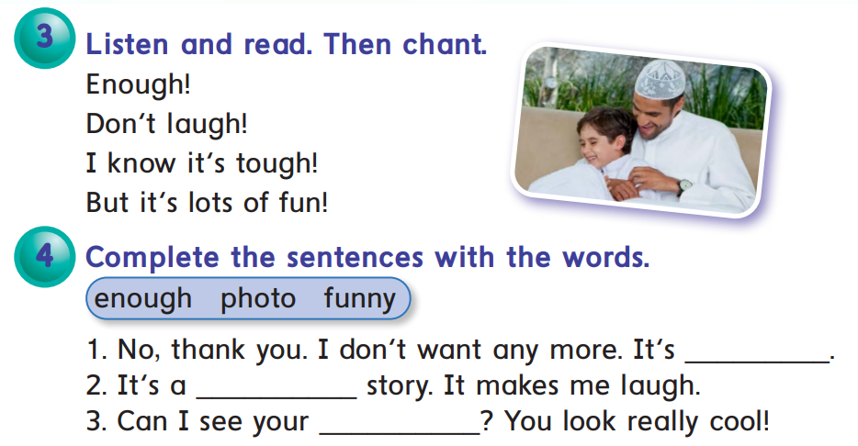
enough
funny
photo

Slide 17
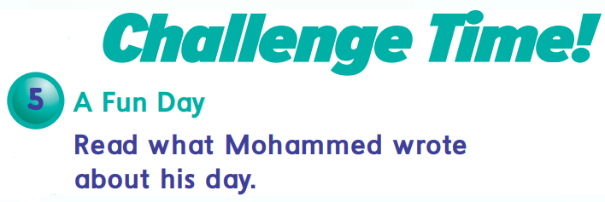
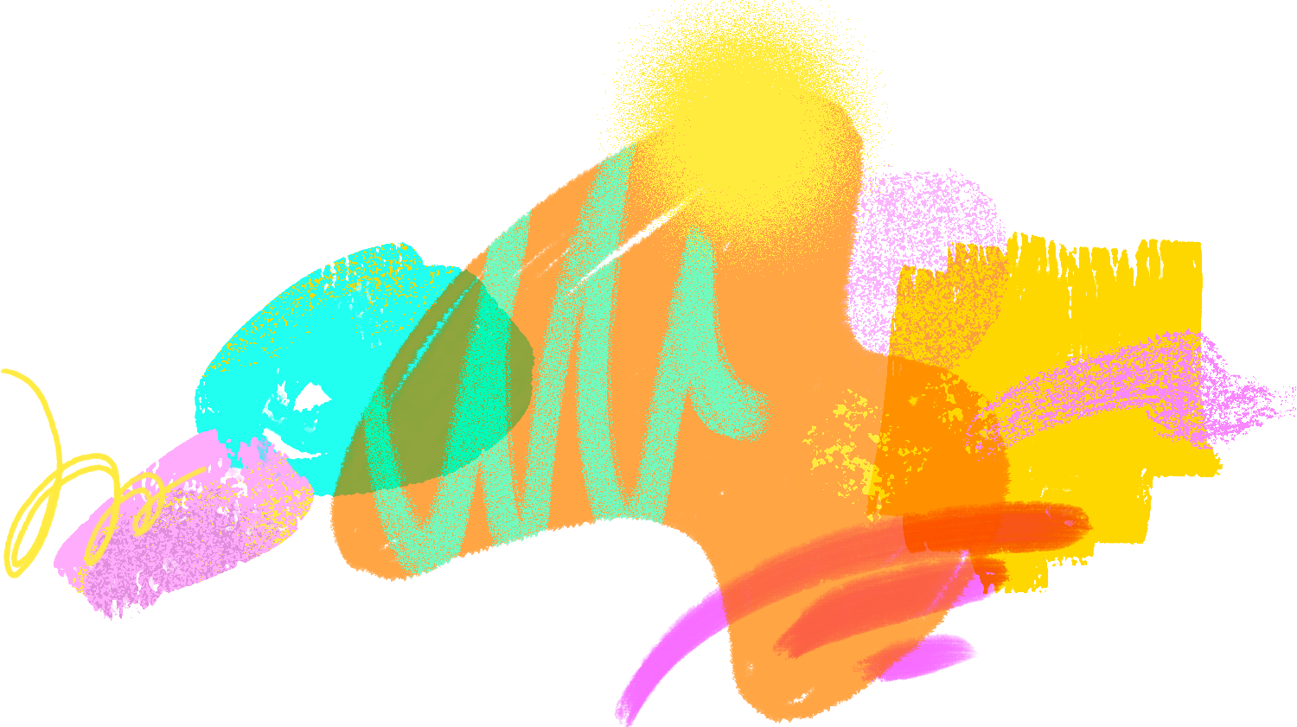
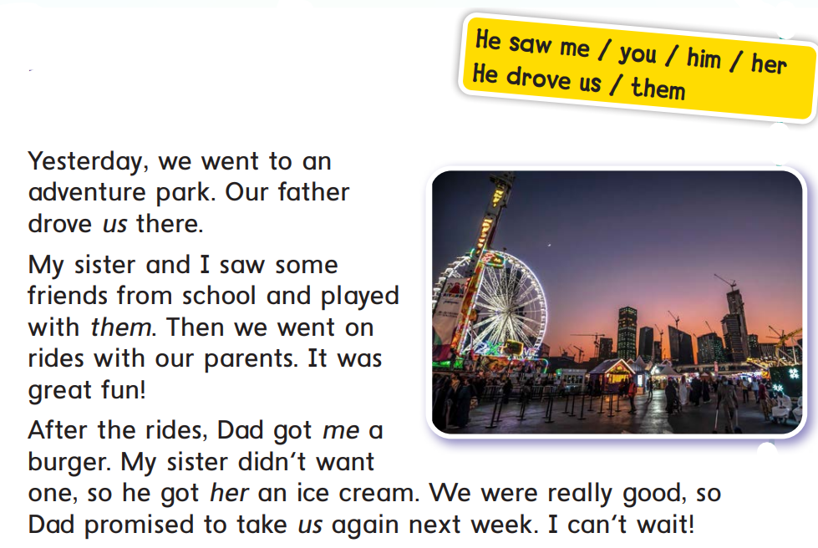
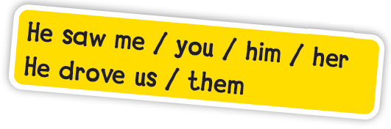

Slide 18
:Objective Pronoun
.She tells me everything
.I prefers to go with you
.I know her well
.I saw him last night
.He feeds it
.He knows us well
.I saw them yesterday

Slide 19

:Objective Pronoun
.She tells me everything
.I prefers to go with you
.I know her well
.I saw him last night
.He feeds it
.He knows us well
.I saw them yesterday

Slide 20
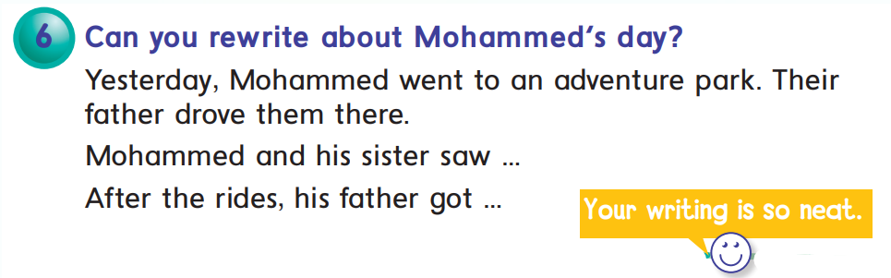

Slide 21
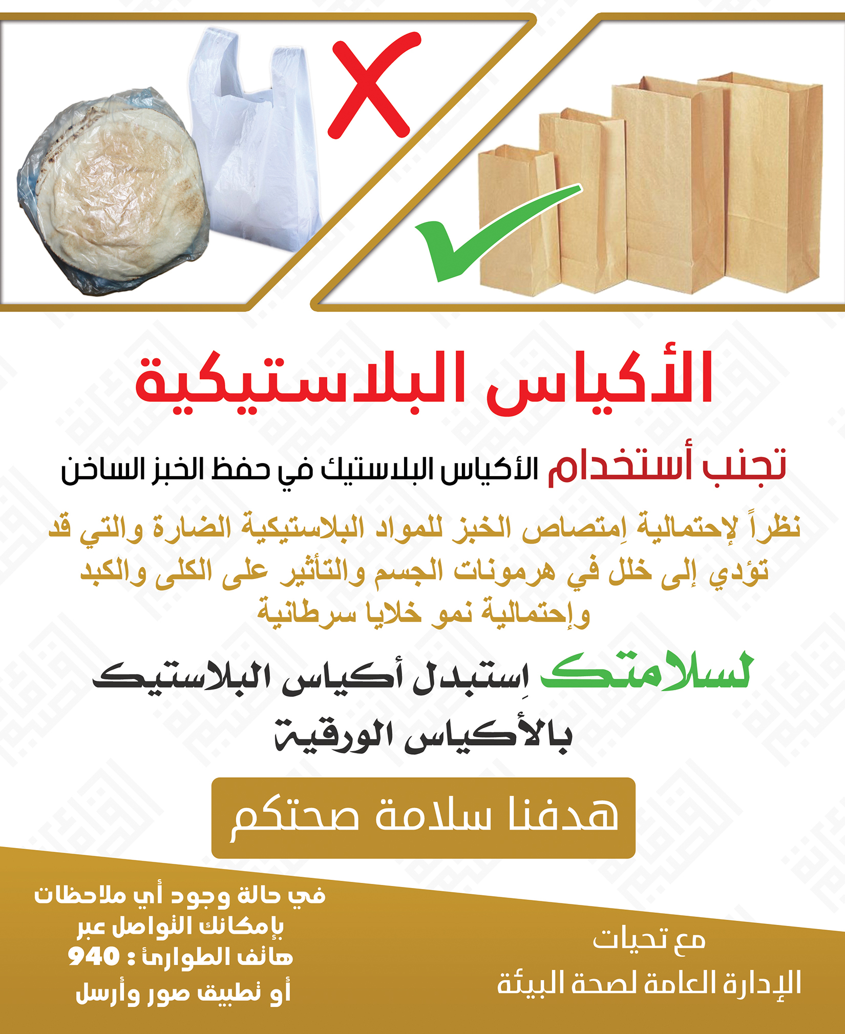

Slide 22


Slide 23
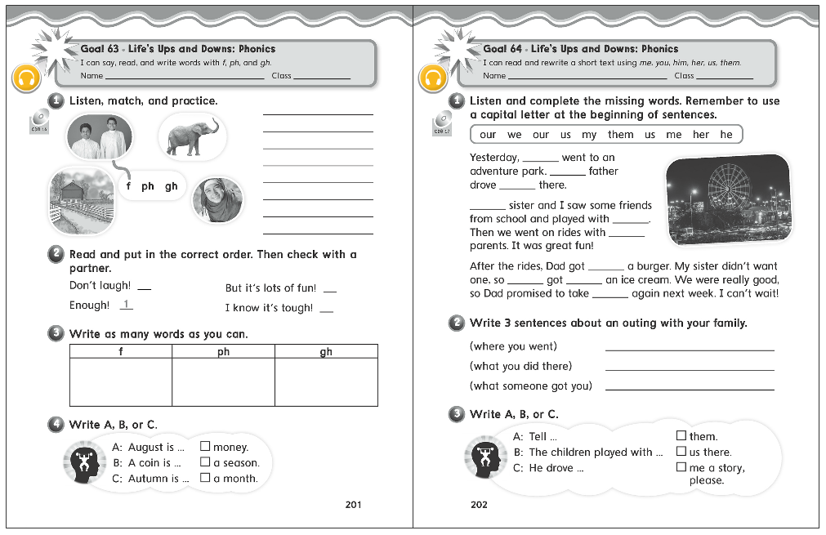
201
202

Slide 24
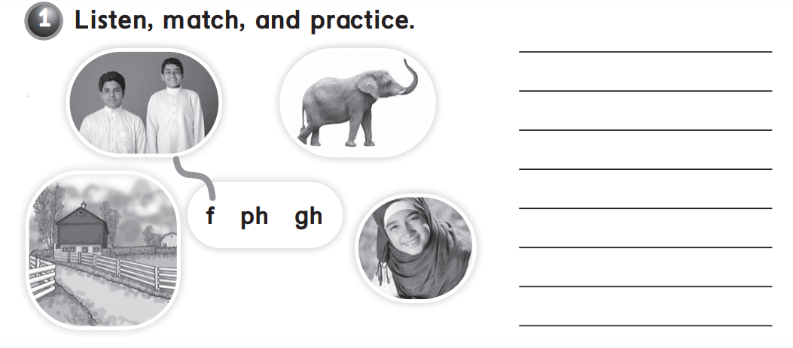

friends
elephant
laugh
farm

Slide 25
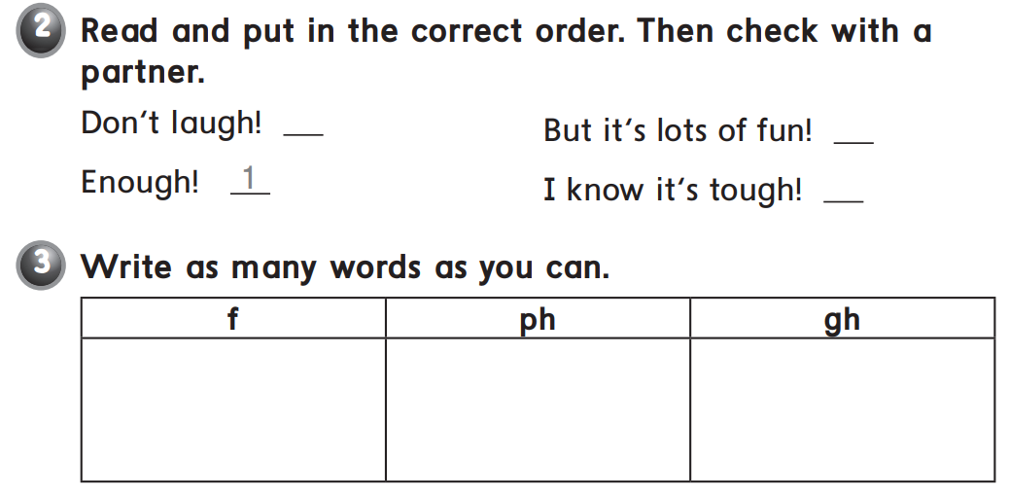
2
4
3
fish
phone
tough
fruit
photo
enough
father
elephant
rough

Slide 26
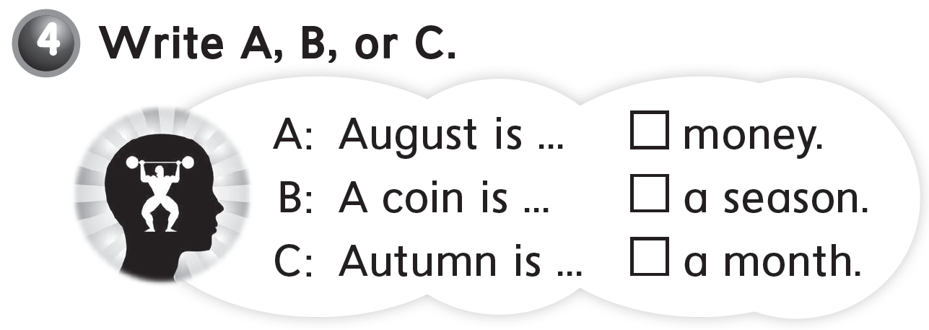
B
C
A

Slide 27
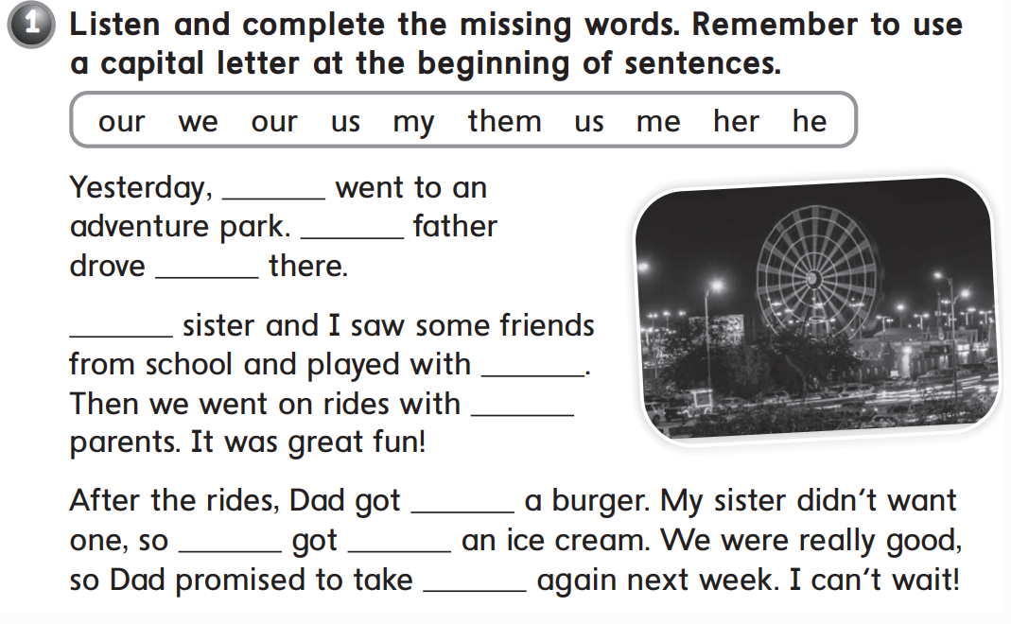

we
Our
us
My
them
our
me
he
her
us

Slide 28
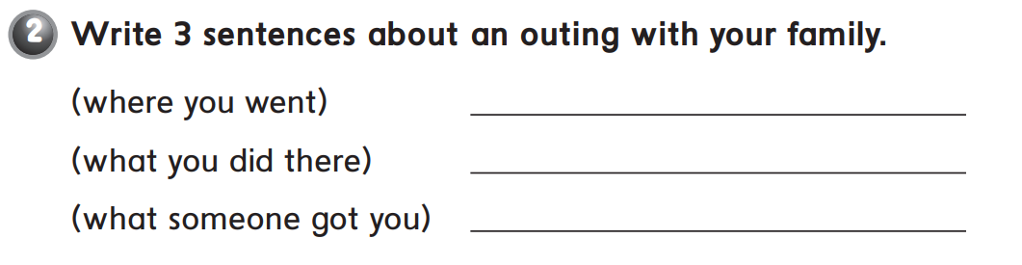
We went to an adventure park
My brother an I played with our friends
They got us some pizza

Slide 29

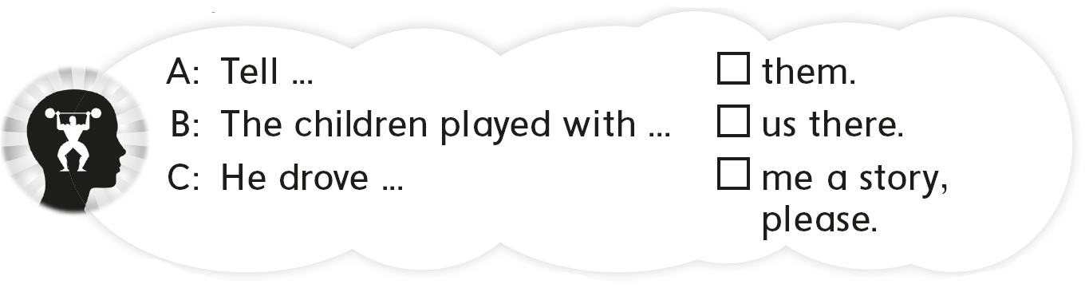
B
C
A

Slide 30
