Slide 1



Slide 2
Mega goal.3.2
Against The Odd

Slide 3
Reading
Speaking

Slide 4
Objectives:
Recognize the main idea of each paragraph
Find the meaning of new words in the text
Summarize the story of Tami Ashcraft survival
Write the way Eric Le Marque find his way
Describe Mitsutaka Uchikoshi's condition
Answer questions about the text
Talk about survival stories

Slide 5
Reading

Slide 6
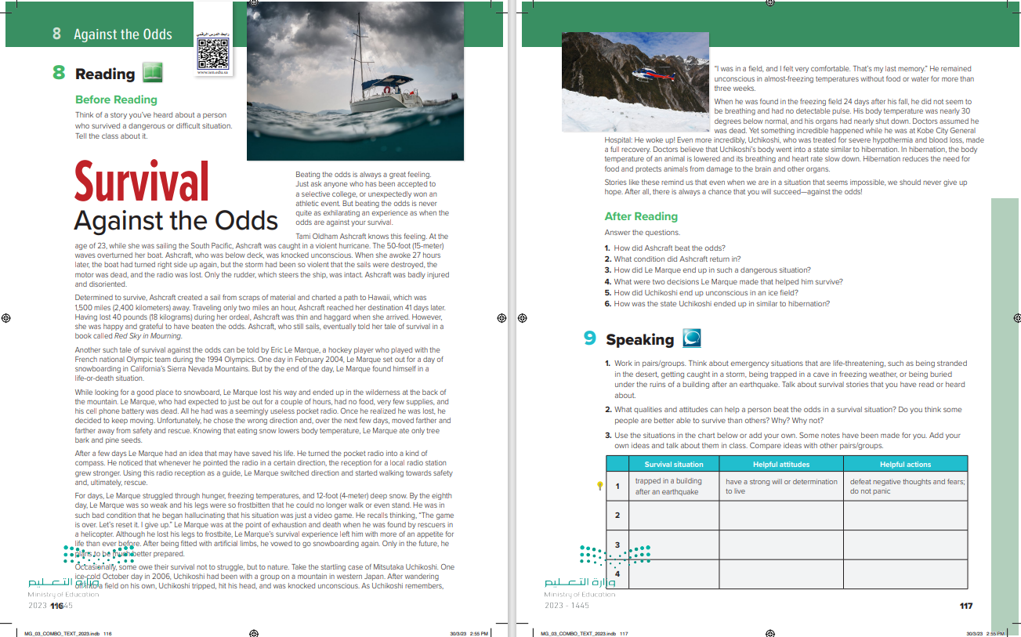

Students Book
P.116-117

Slide 7

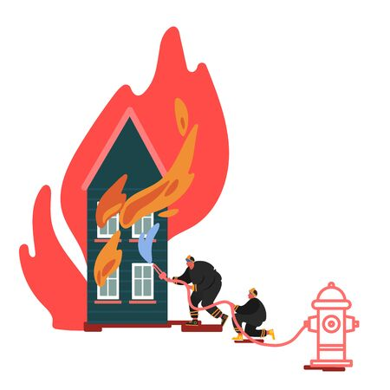
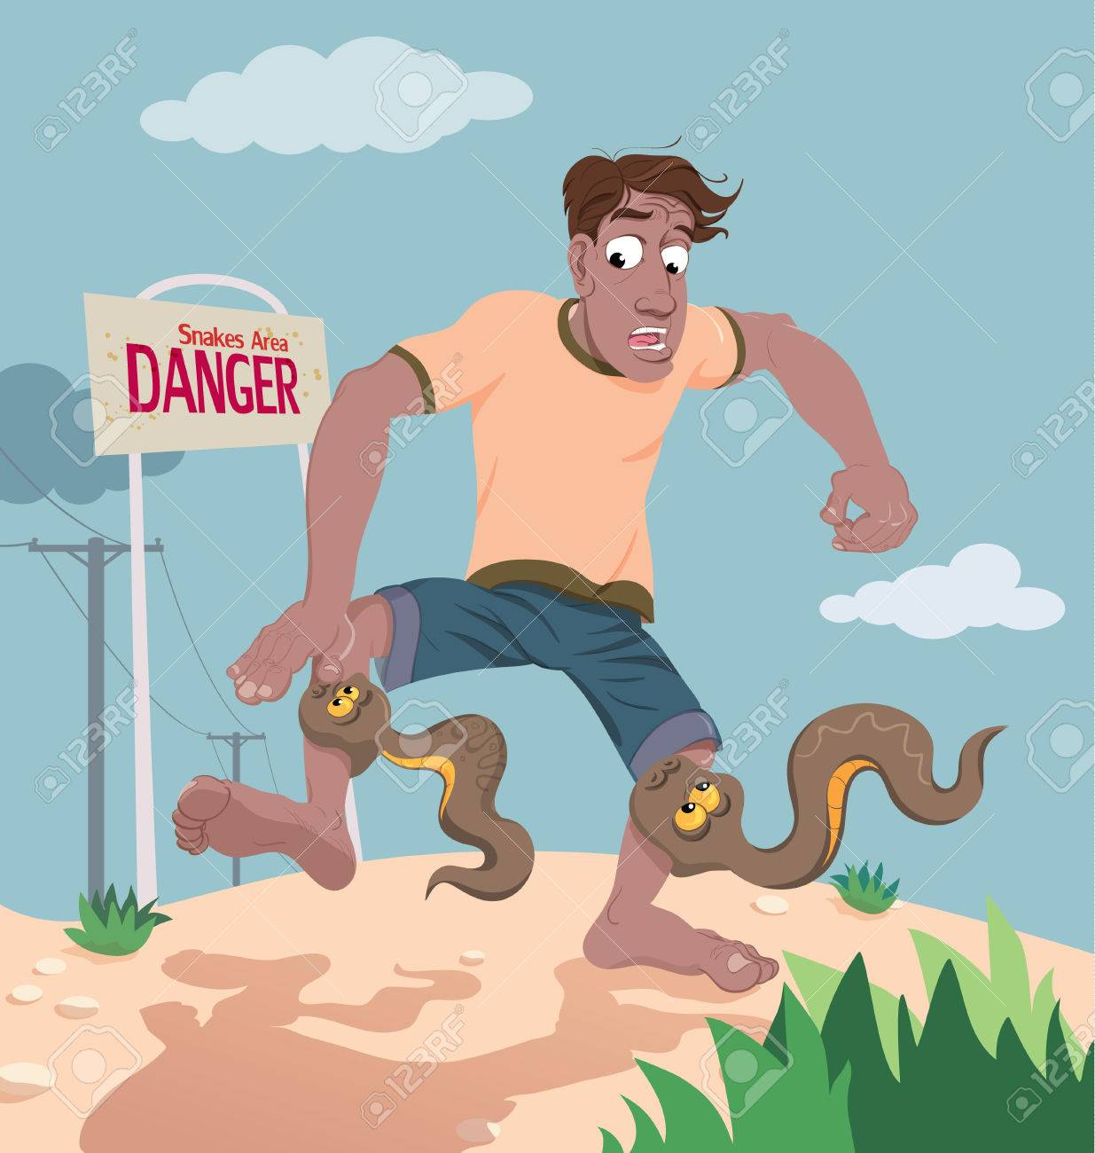

Think of a story you’ve heard about a person who survived a dangerous or difficult situation. Tell the class about it.

Slide 8
9
1
10
What do you think this reading will be about?
………Title ?
……….Paragraphs?
…………….Pictures?
2
3
4
5
6
7
8

Slide 9



Read as long as you listen

Slide 10


READING STRATEGY
Summarizing

Slide 11
What makes a good summary?
1.A summary is shorter than the original text.
2. A summary contains the main ideas of the original text.
3. A summary does not contain opinions or commentary by the summarizer

Slide 12
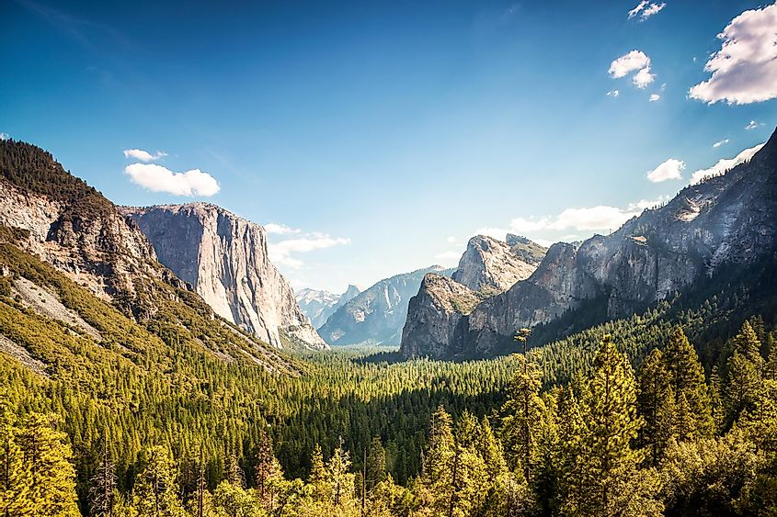
Culture Note
The Sierra Nevada Mountains The Sierra Nevada Mountains are located in the U.S. states of California and Nevada. The range is about 400 miles (650 kilometers) north to south. The highest peak is Mount Whitney, which is 14,505 feet (4,421 meters

Slide 13
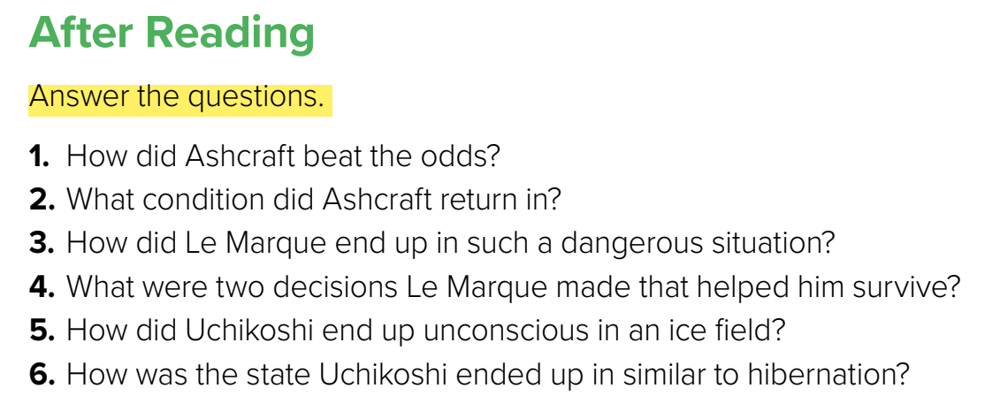
She survived and made it home under very difficult circumstances.
2. She was very thin and tired.
3. He got lost on the mountain and had no supplies or way of calling for help.
4. He did not eat snow, and he used his pocket radio to point him in the right direction.
5. He fell while wandering off alone into a field.
6. His body temperature lowered and his heart rate slowed down

Slide 14
Speaking

Slide 15
