Slide 1
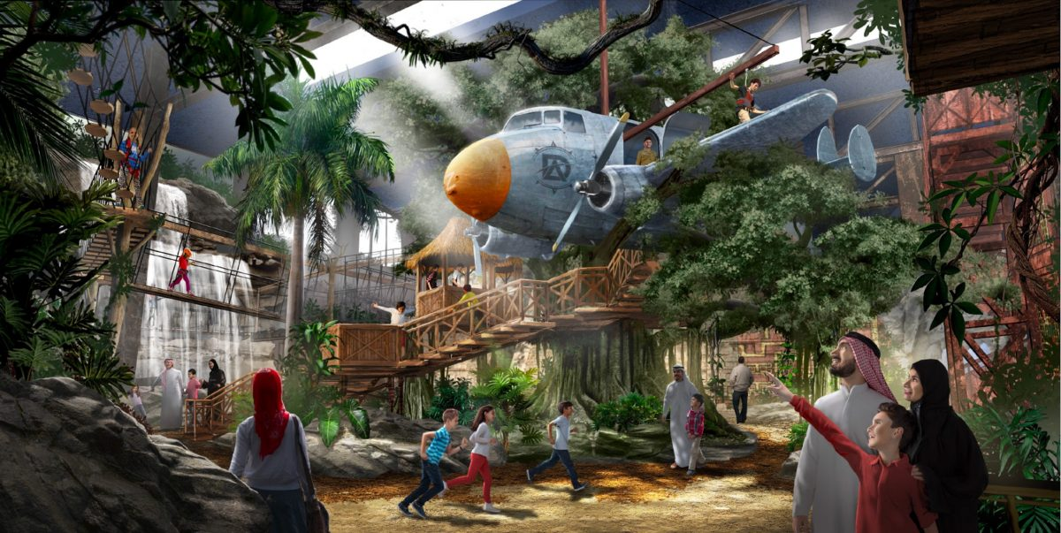
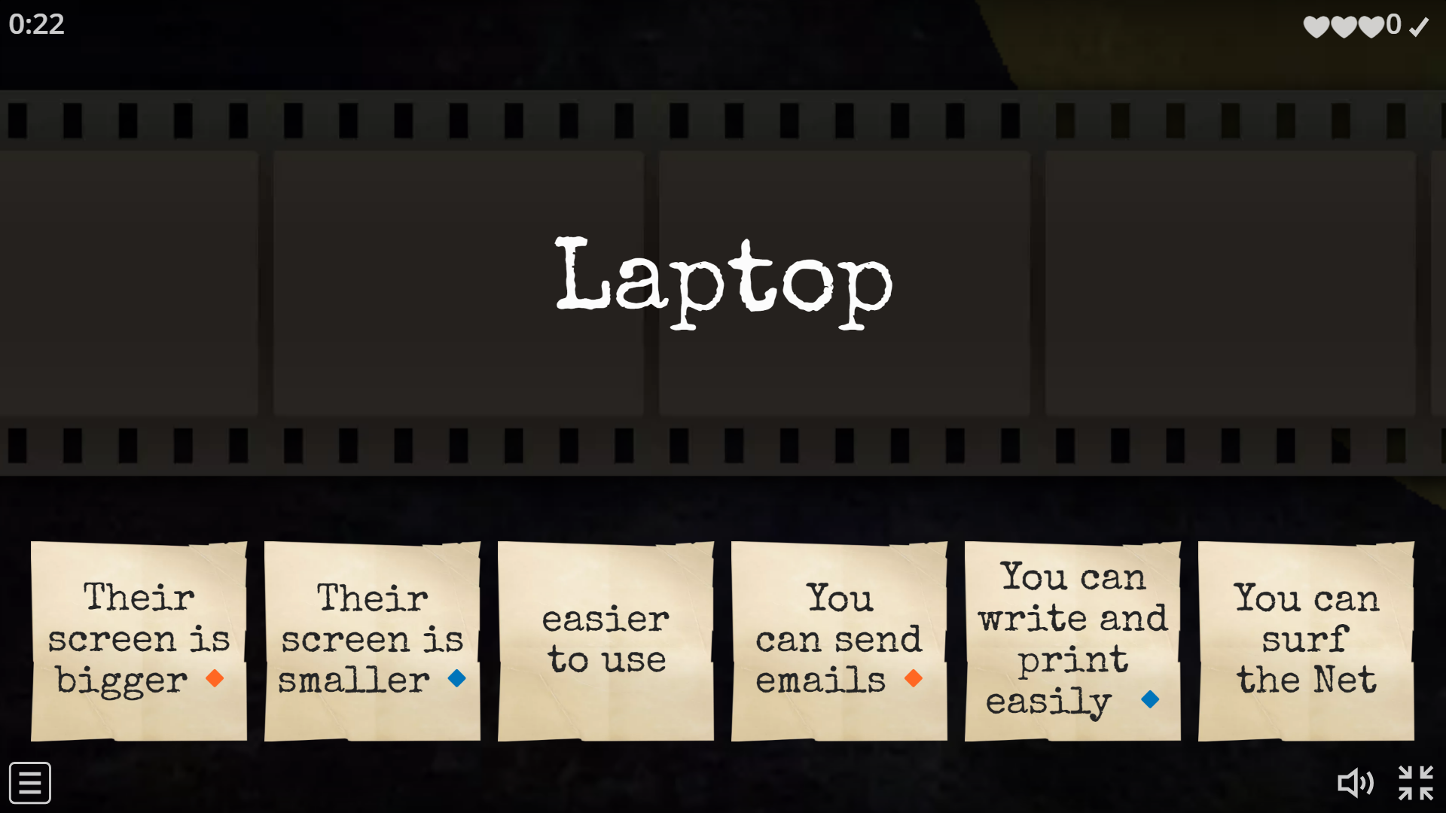
Good morning

Slide 2
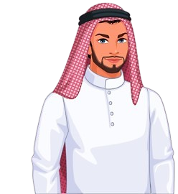
How are you doing today?
I hope you are excited to start a new lesson…
Ready for a quick quiz to refresh our last lesson?

Slide 3
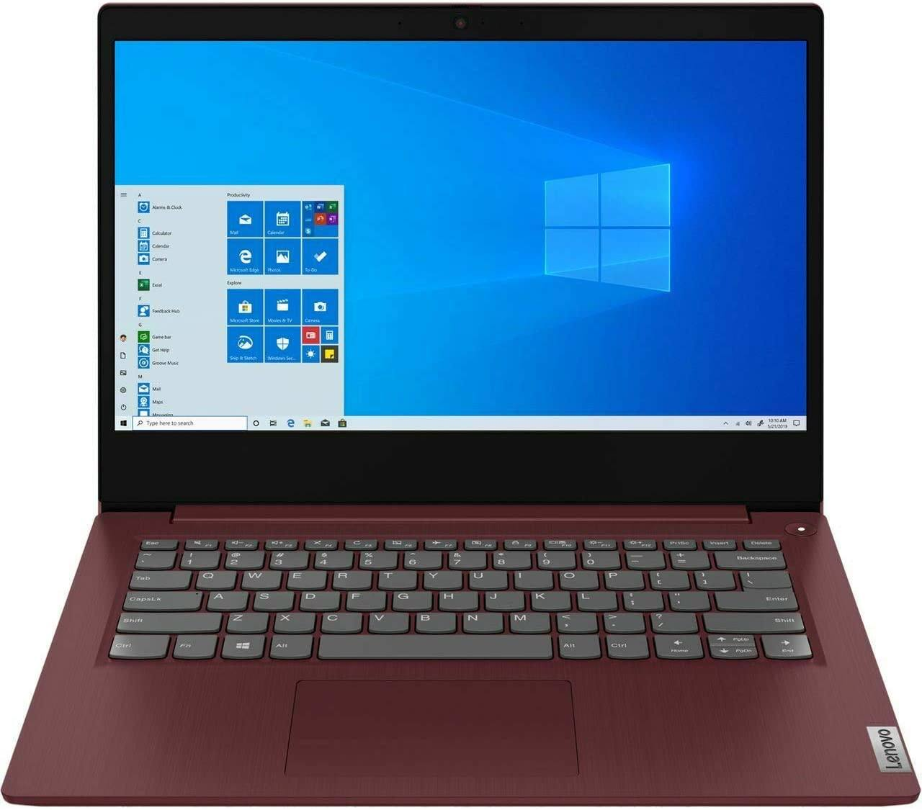

Revision:
(Q.Match)\ Laptop:
screen size is big
screen size is small
expensive

Slide 4
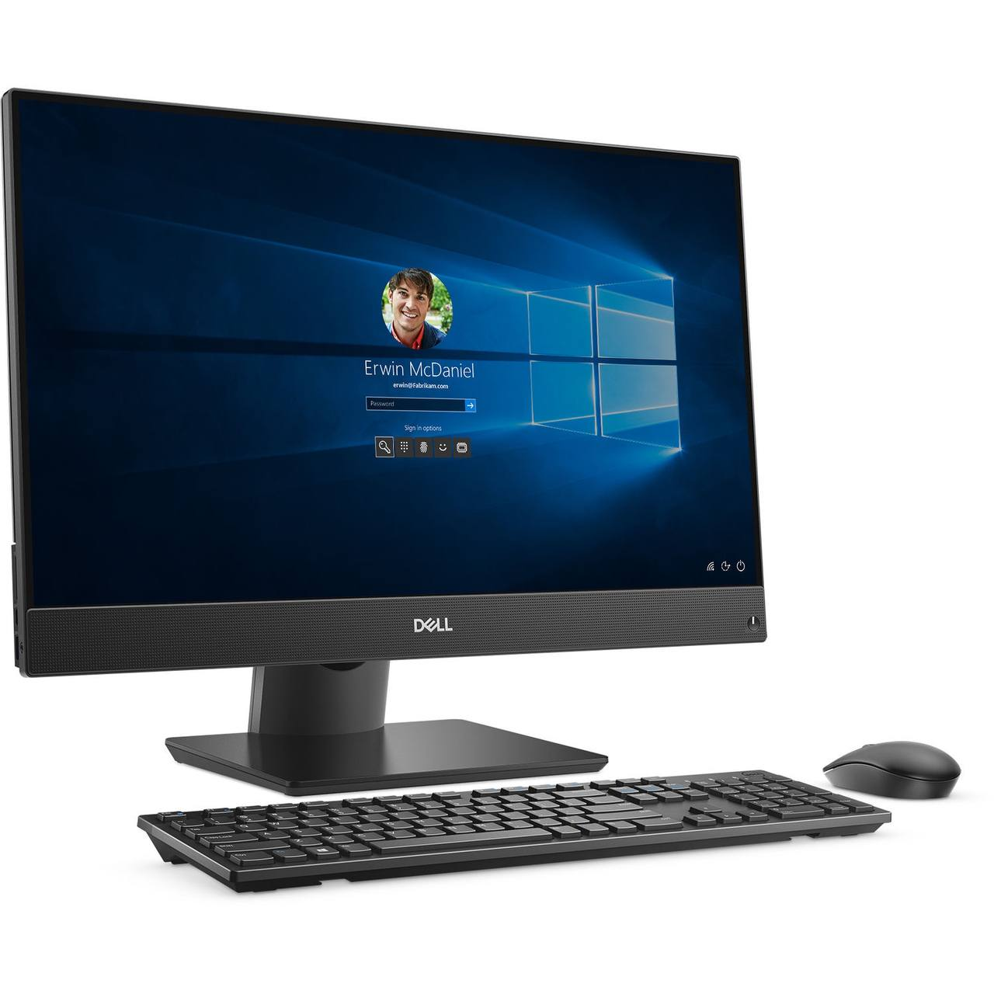
Revision:
(Q.Match)\ desktop:
easier to use if you have to write and print a lot.
screen size is small
cheap

Slide 5
Revision:
(Q.Match)\ Laptop:
expensive
can surf the Net, send emails, and study anywhere
easier to use if you have to write and print a lot.

Slide 6
Great job everyone!
Now, let's get ready to embark on our lesson for today

Slide 7
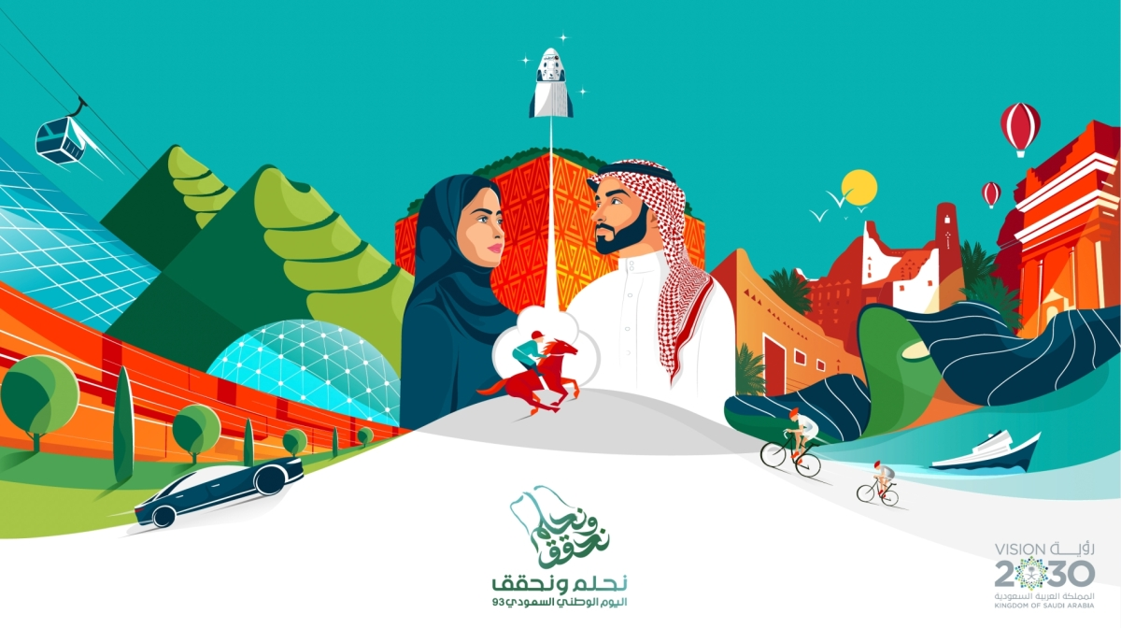
Unit 11
There’s No Comparison
Reading

Slide 8


Objectives
Read
a text about Saudi Vision 2030
Match the new words with their meanings
01
02
03
Answer questions about a text

Slide 9

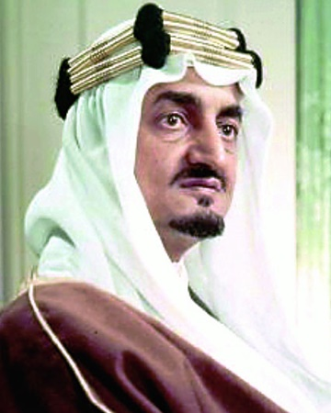
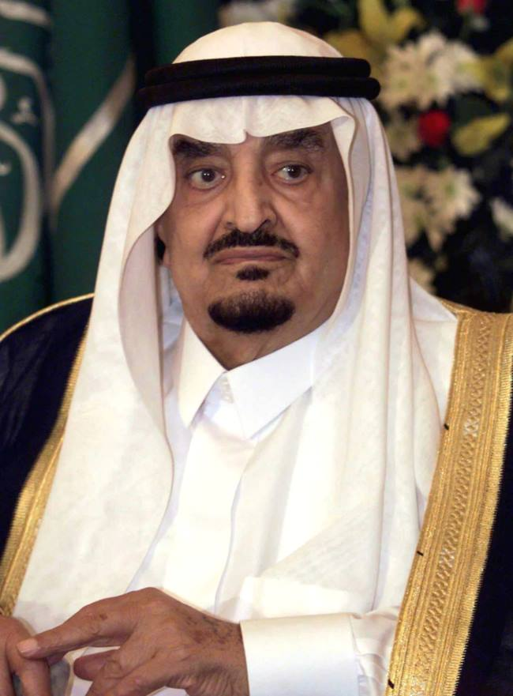
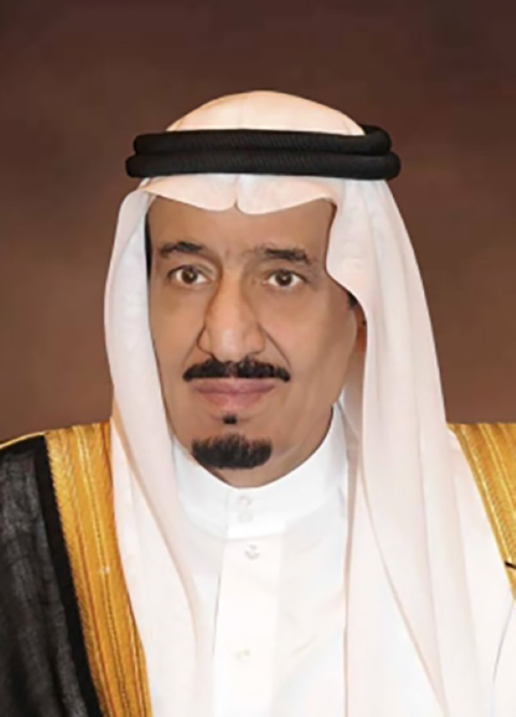
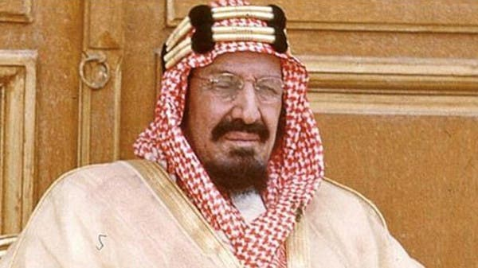
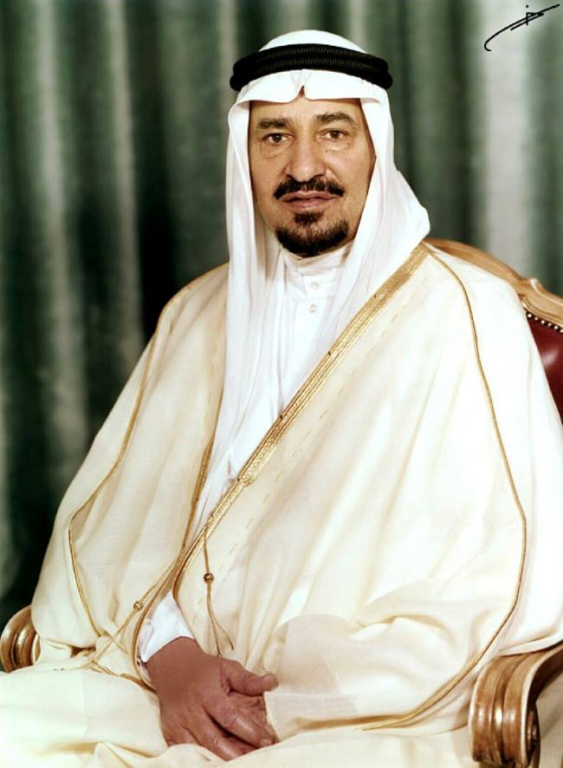
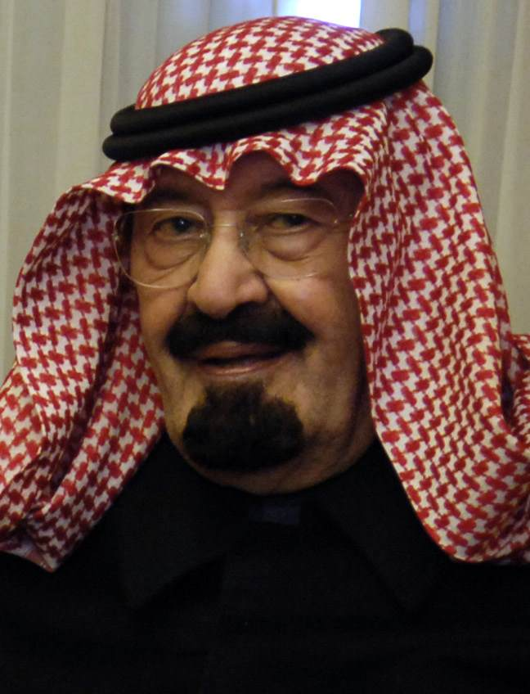
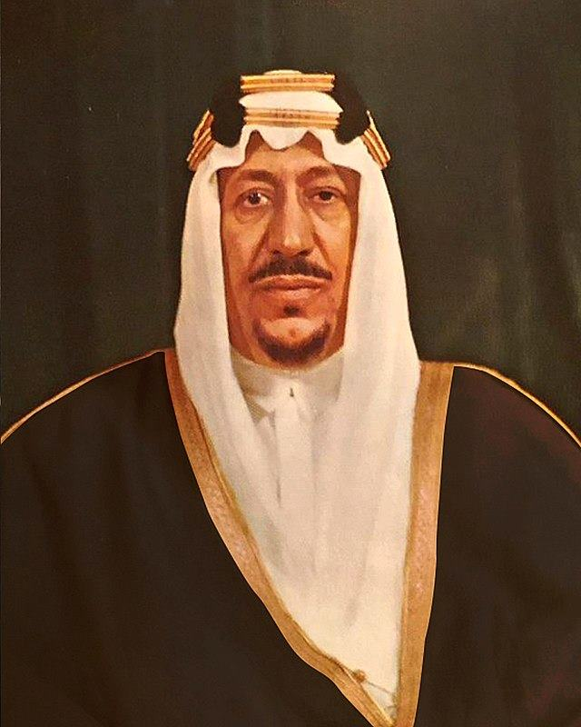
Get ready to flex your historical muscles!
Can you arrange the kings of Saudi Arabia in the correct chronological order?
King Faisal
King Fahd
King Salman
King Abdul Aziz
King Khalid
King Abdullah
King Saud
1
2
3
4
5
6
7
King Abdul Aziz
King Saud
King Faisal
King Khalid
King Fahd
King Abdullah
King Salman

Slide 10
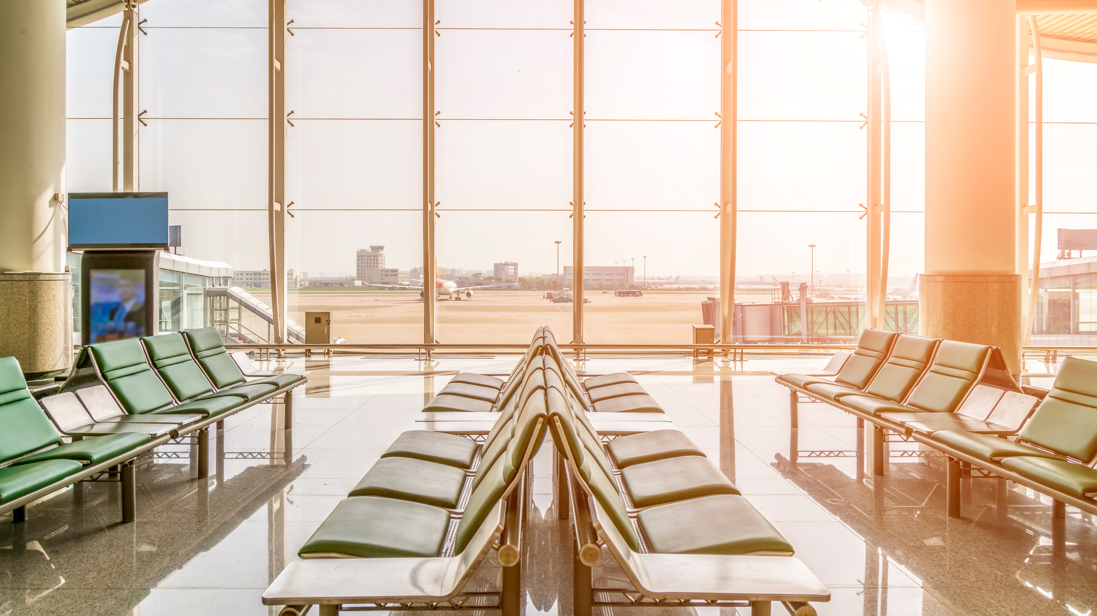

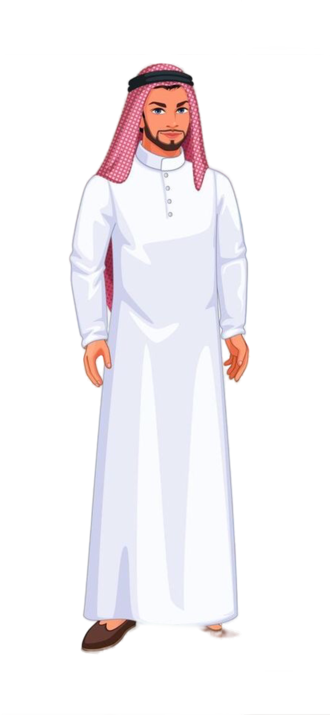
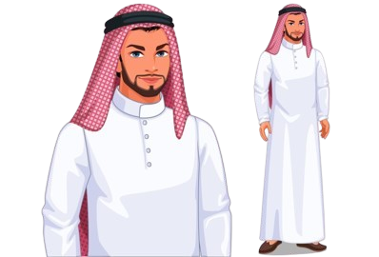
Welcome to our class!
are you ready to fly with us?
Our destination:
Ithra Library in Al Khobar, where we'll uncover the transformations in line with Vision 2030

Slide 11
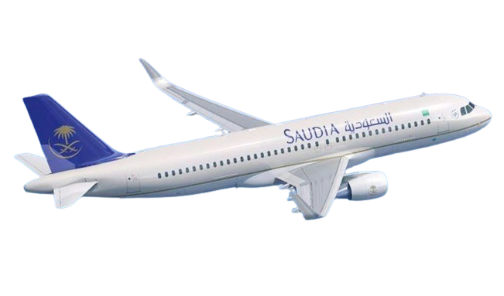
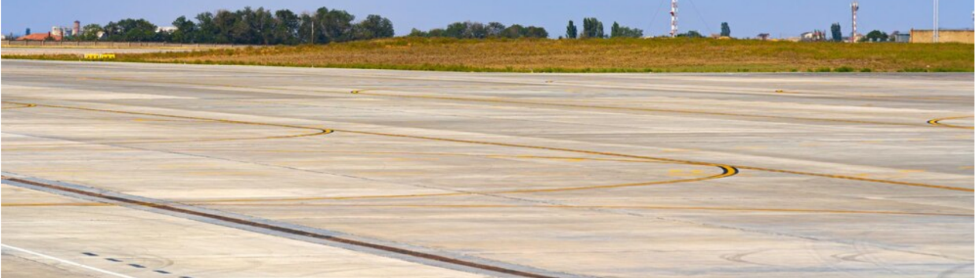

Slide 12
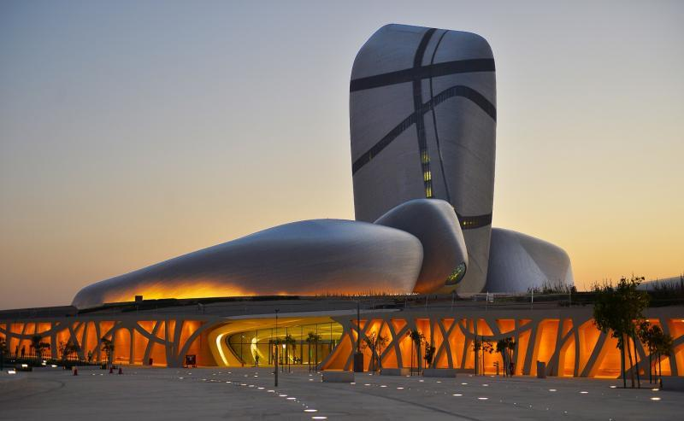
Hello, explorers!
Welcome to Ithra Library.
I'm your guide on this exciting journey. Are you ready to explore the wonders of this place together?

Slide 13
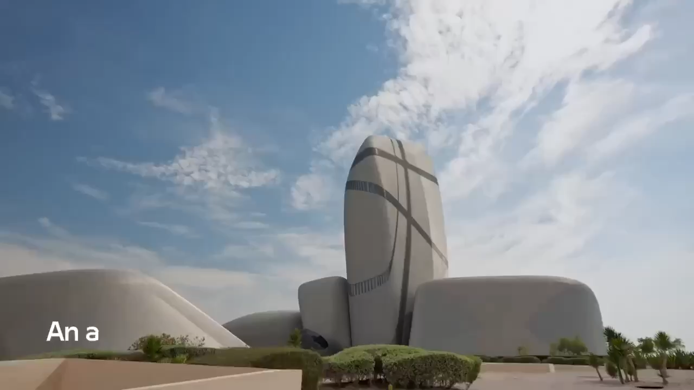

Slide 14
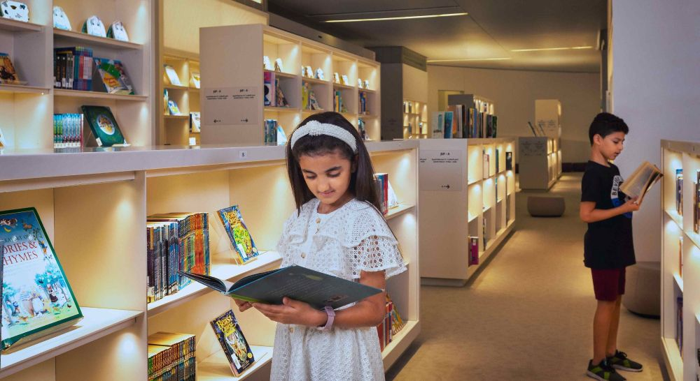
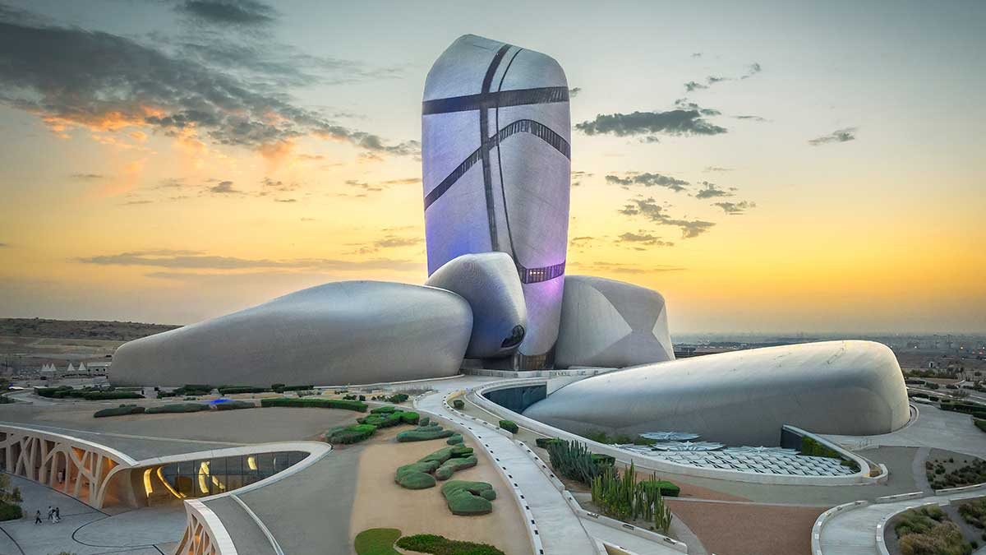
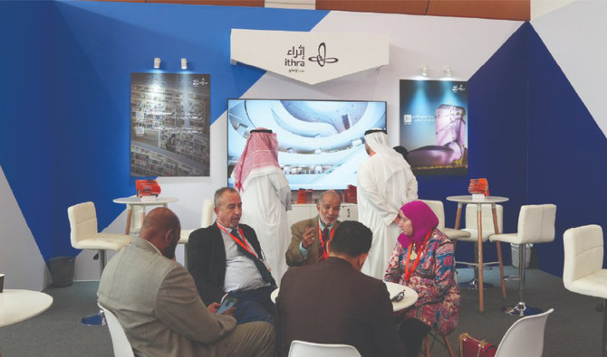
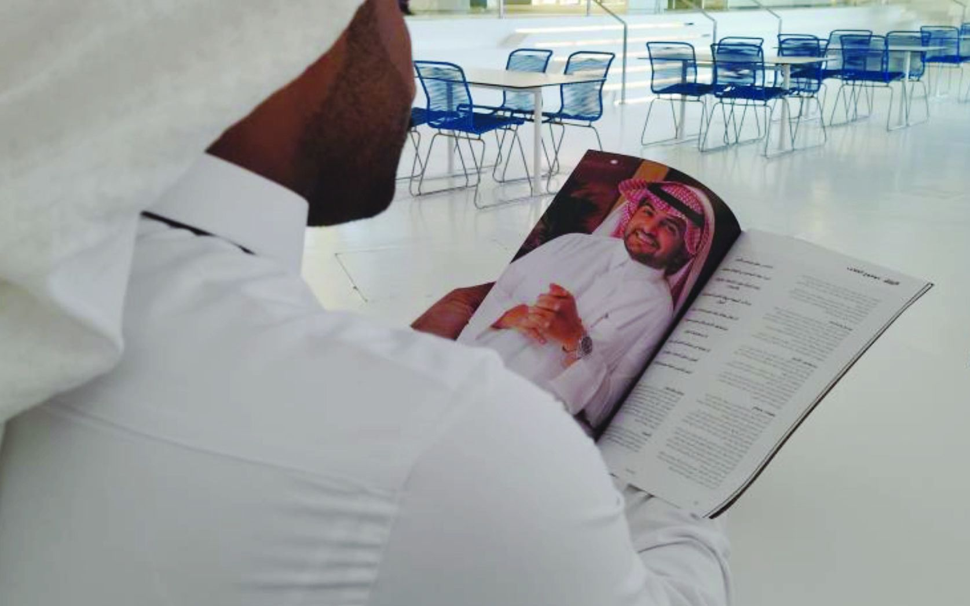
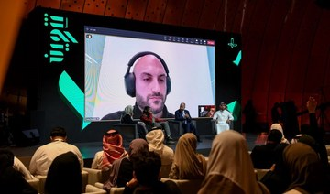
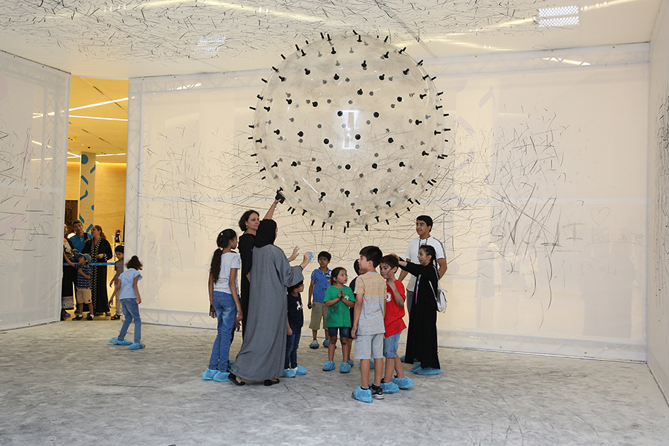
Ithra Library in Al Khobar plays a significant role in reflecting Saudi Arabia's Vision 2030 by embodying the key principles and goals outlined in the vision.
is a place where anyone, young or old, can learn new thing.

Slide 15
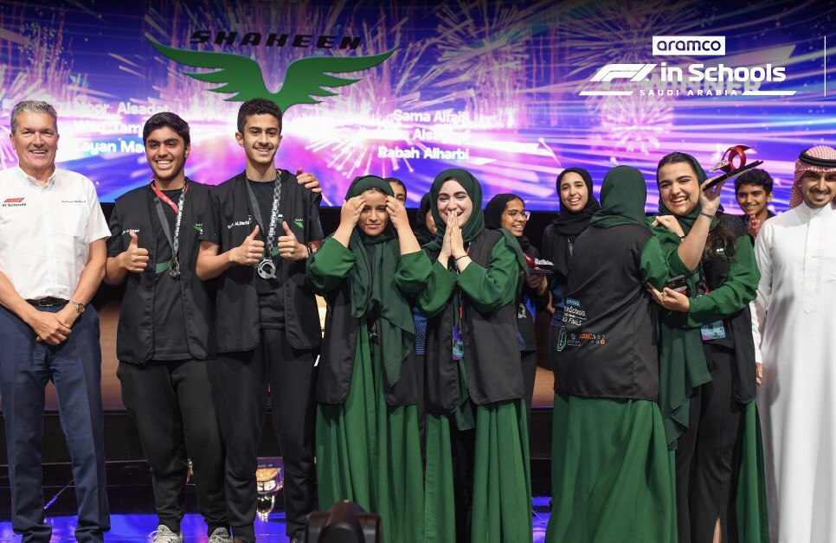
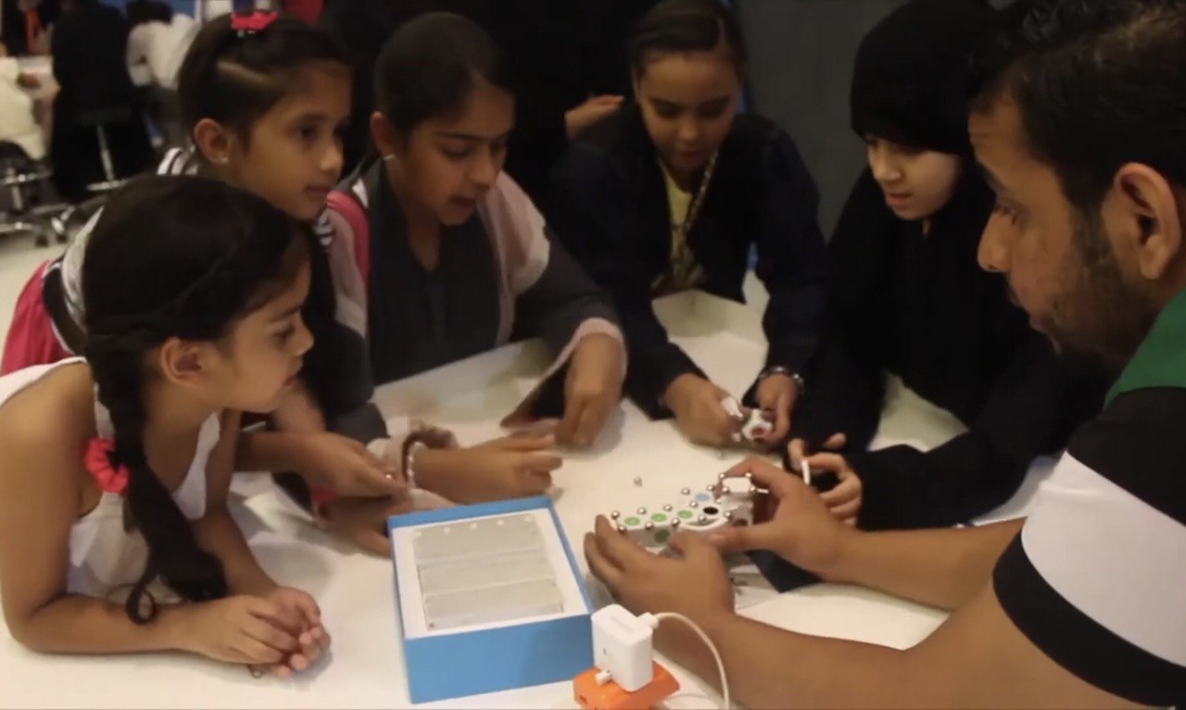
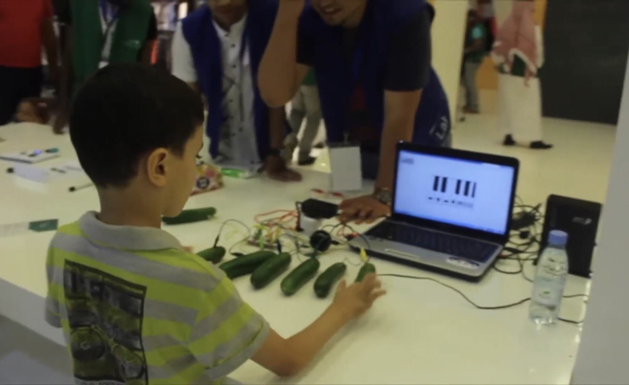
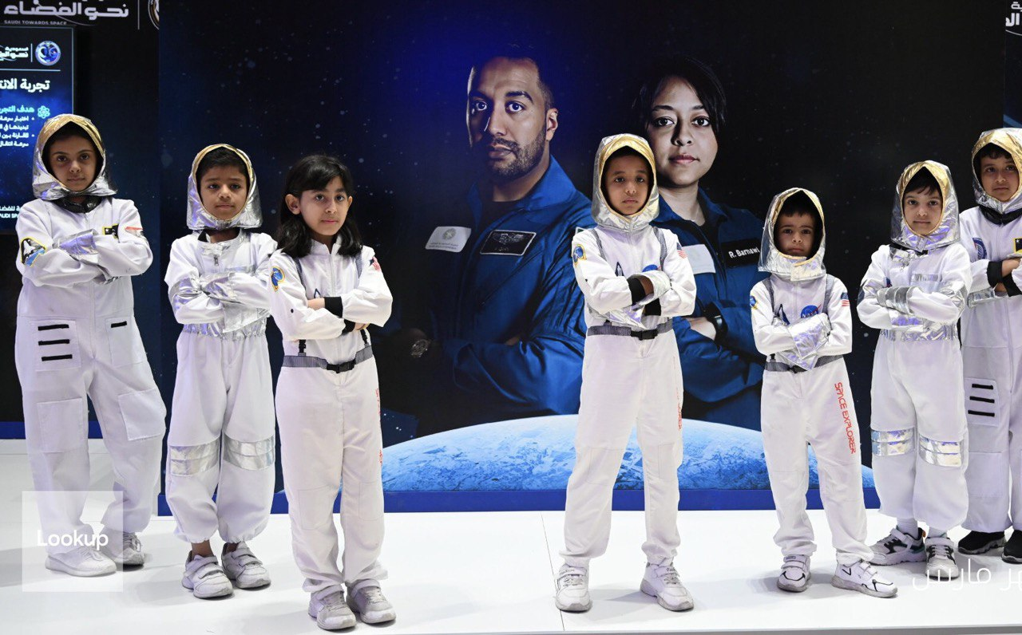
serves as a space for innovation and creativity, supporting the development of new ideas and perspectives.

Slide 16
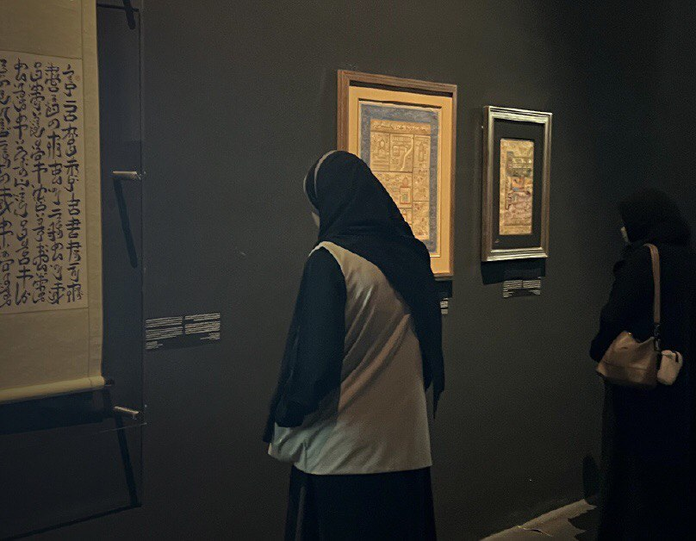
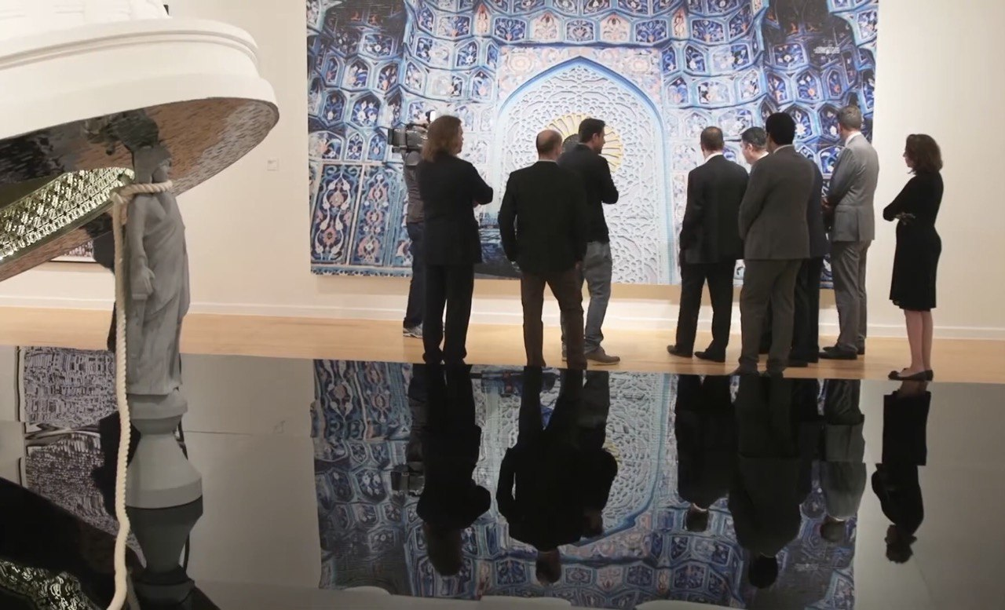
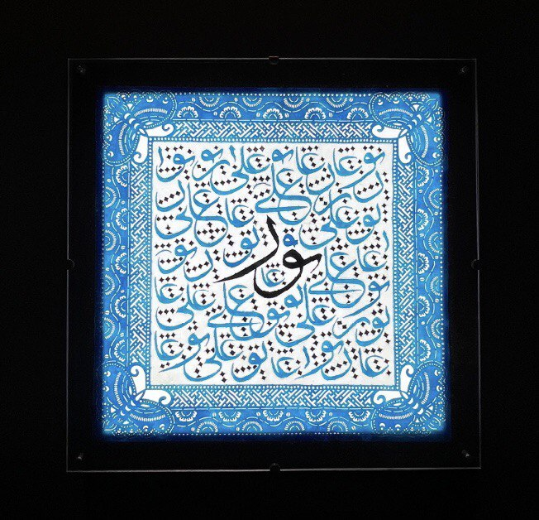
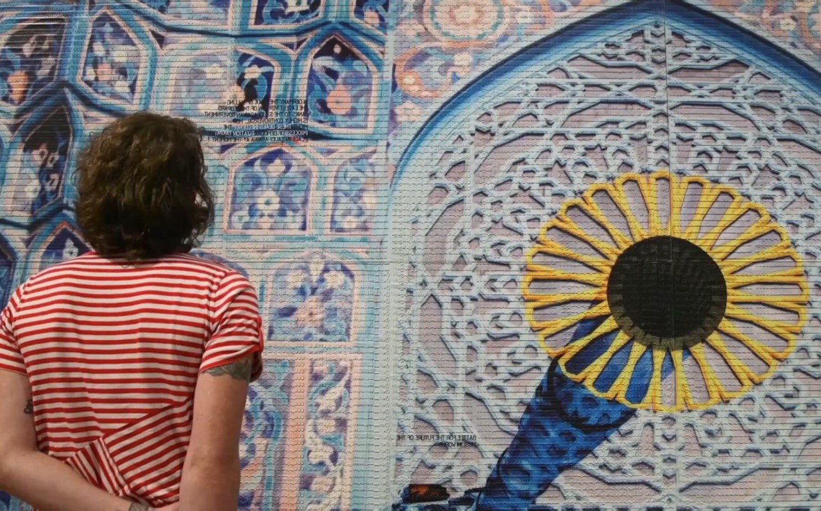
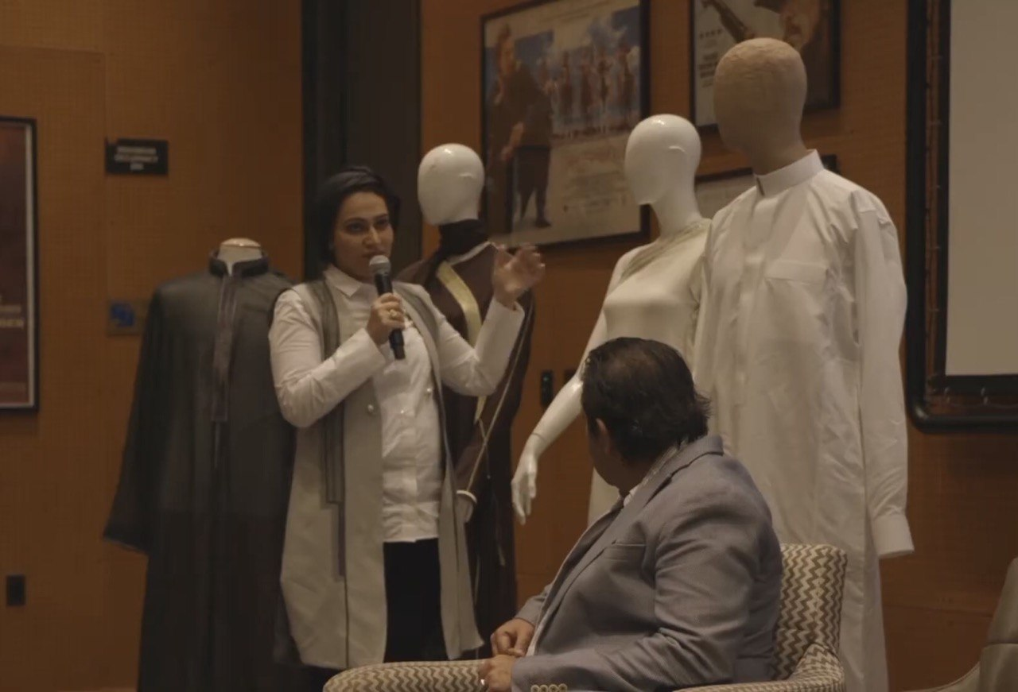
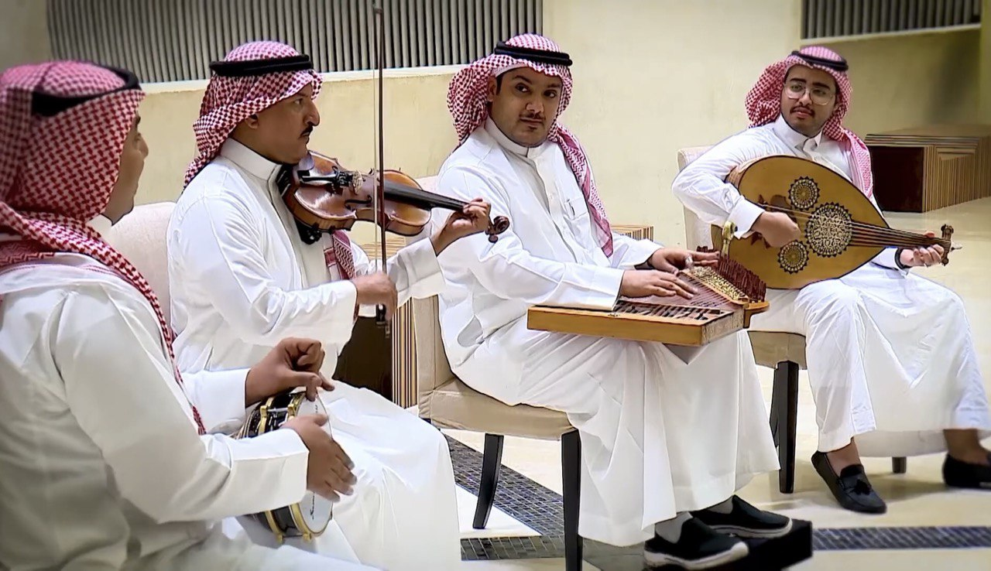
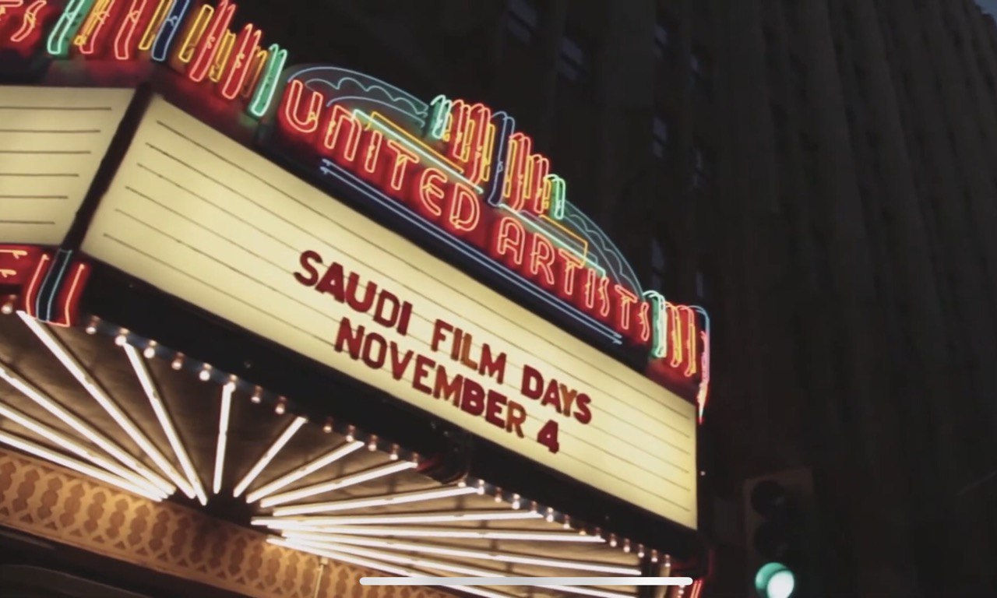
makes our culture better by having lots of different things like stories, art, and old stuff from the past

Slide 17
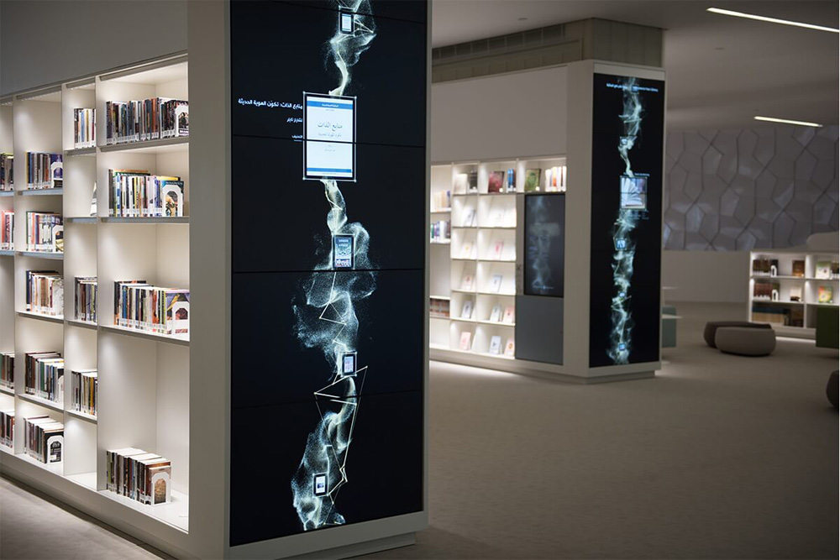
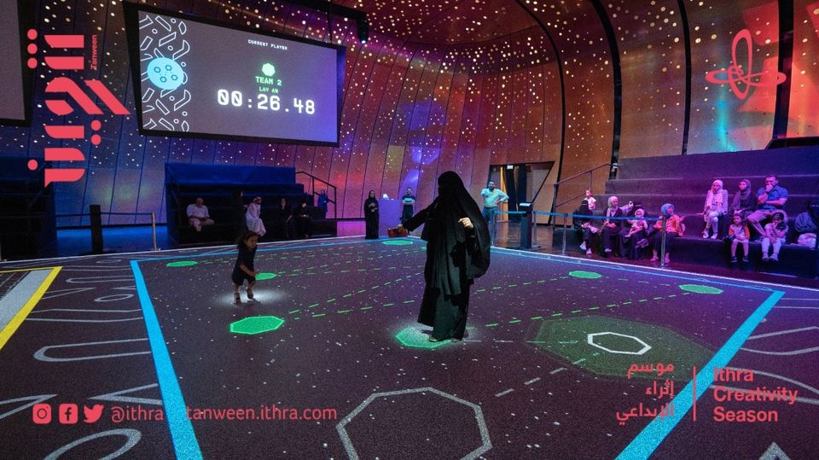
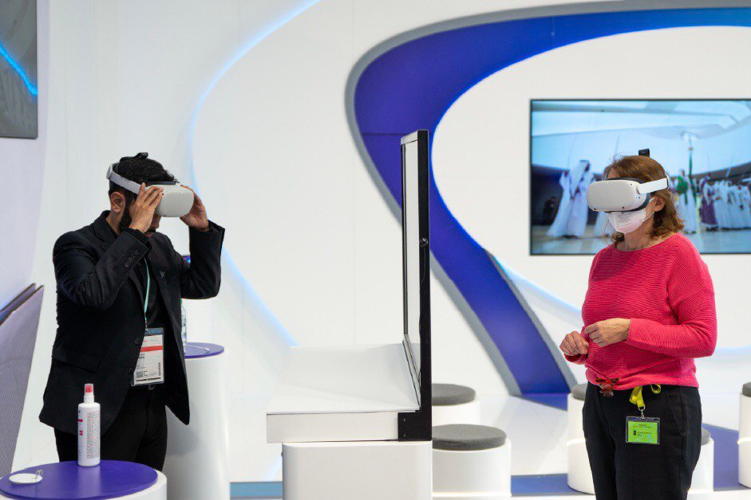
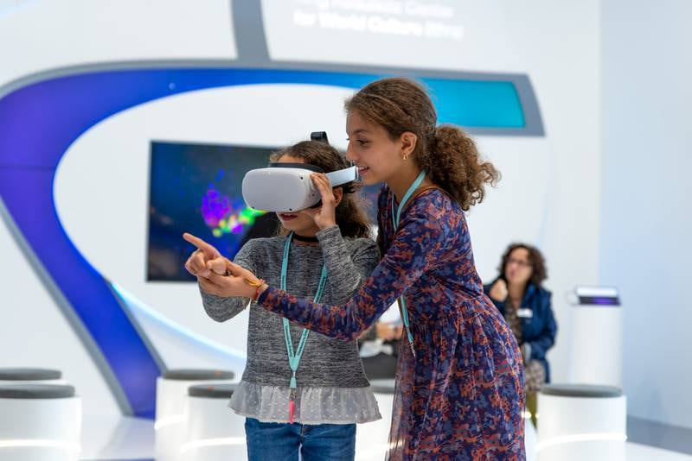
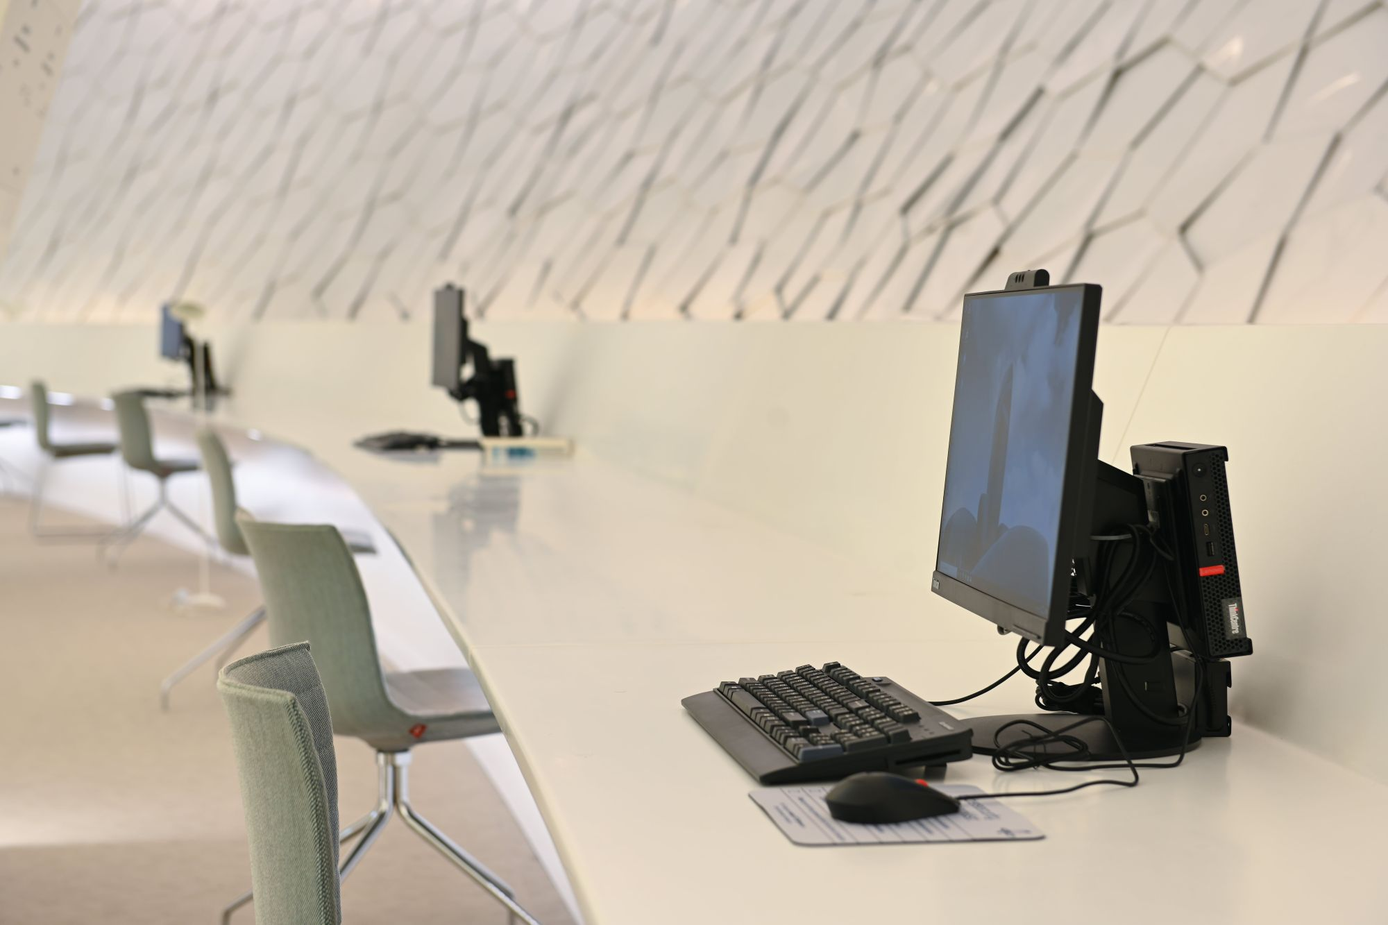
incorporates technology in its services
incorporates technology in its services

Slide 18
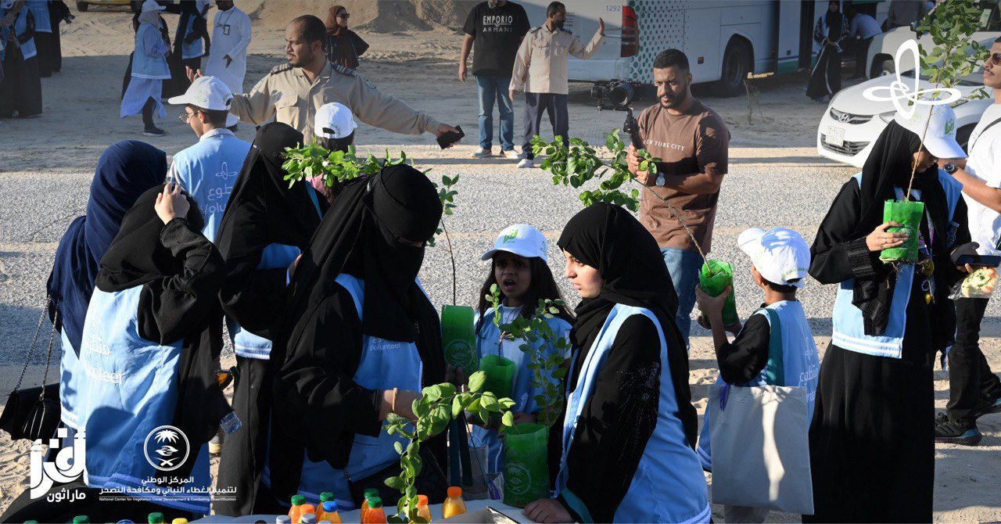
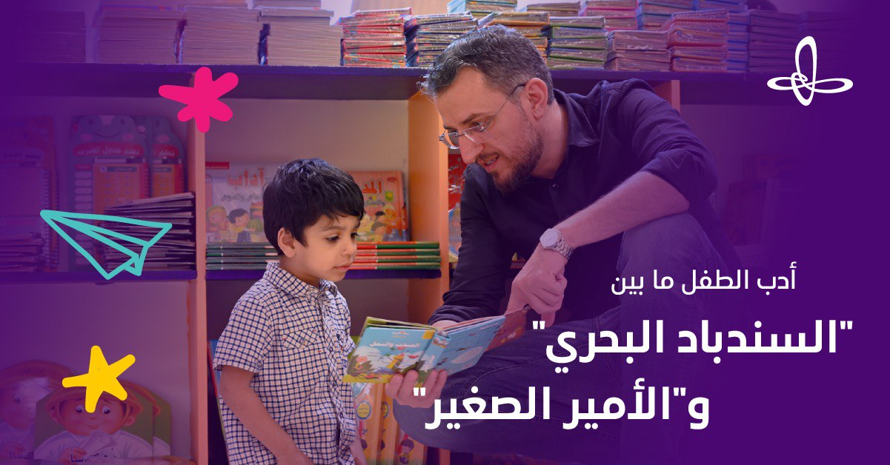
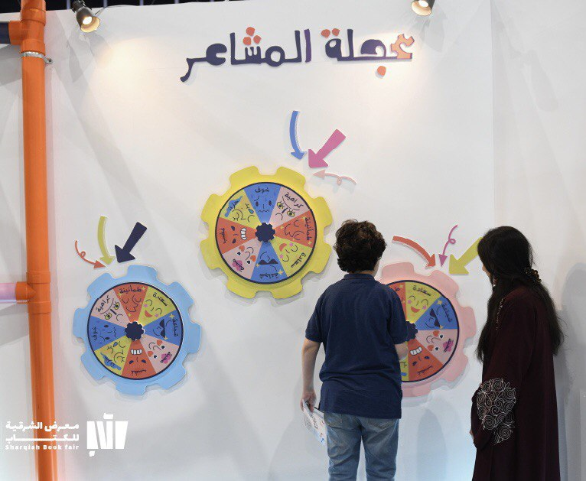
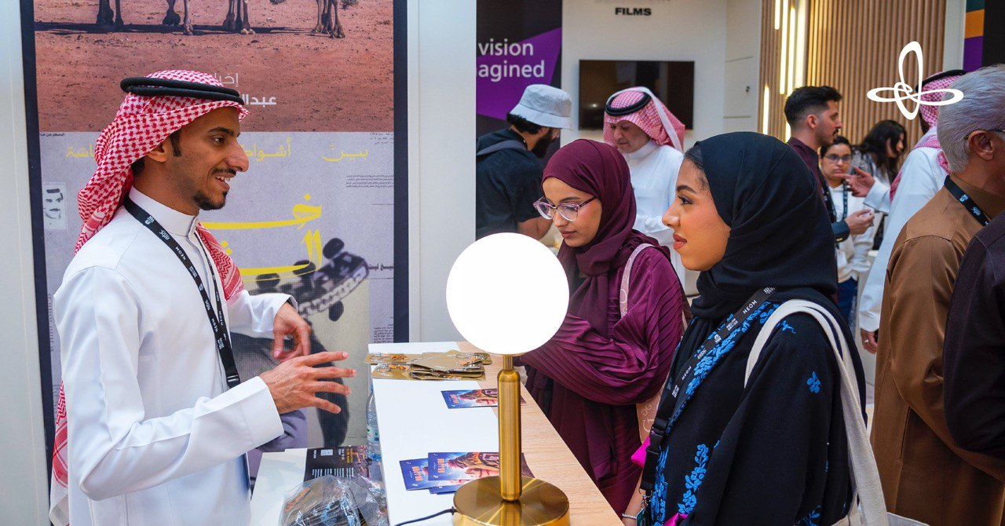
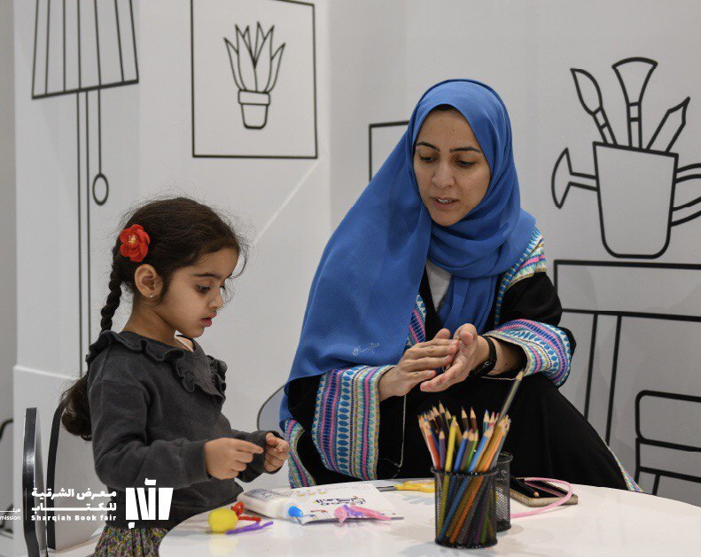
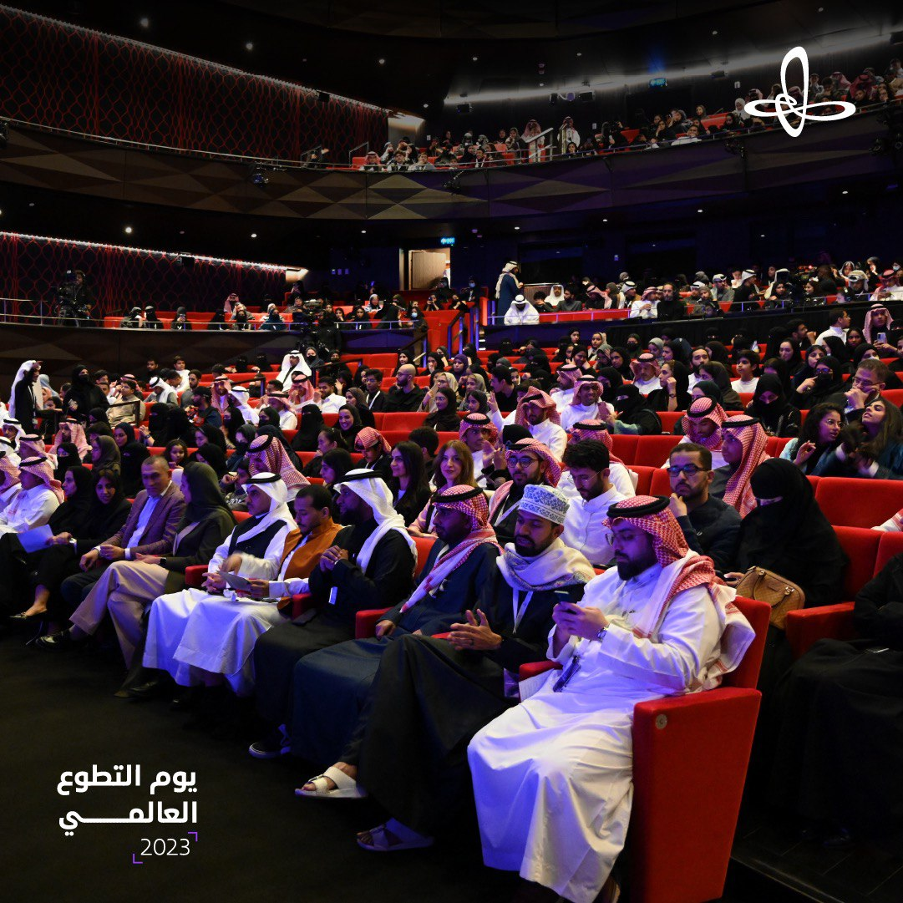
Fun Events and Workshops

Slide 19
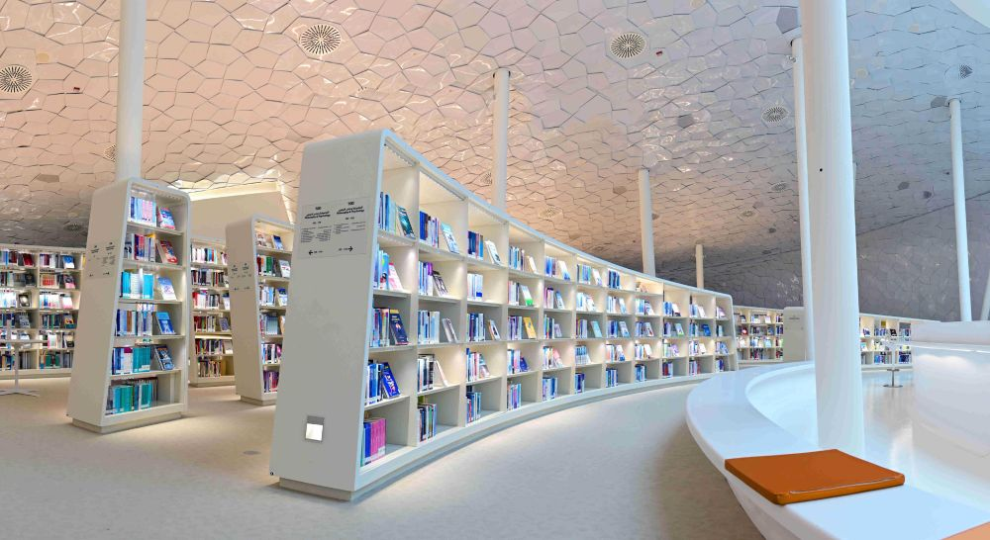
So, Ithra Library is like a big friend helping Saudi Arabia become a smarter, happier, and more creative place – just like Vision 2030 wants
!

Slide 20


Now, let's dive into the core of our reading lesson
Books Open 95

Slide 21
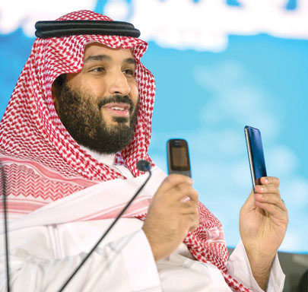


Warm Up
WHOSE idea is 2030 Vision?
?

Slide 22



Warm Up
What does the word Vision refer to?
(a picture of the future)

Slide 23

Warm Up
How old will you be then? (2030)
Where do you think you will be?

Slide 24




There will be more libraries, galleries, and museums in different areas.
Technology will be developed in and around cities.

Slide 25


Reading

Slide 26

New words with their meanings
Choose
The meaning of valuable
worth a great deal of money
2. has many disadvantages

Slide 27

New words with their meanings
The Force of the Future
Saudi Arabia isn't just about valuable things in the ground. It's also about amazing people, like families and kids
These children will grow up to be the force that makes Saudi Arabia even better. They will learn, dream, and build a bright future for our country!

Slide 28

Reading

Slide 29
New words with their meanings
Choose
The meaning of receive
Getting a gift
2. Flying a kite

Slide 30
New words with their meanings
Choose
The meaning of 'raise'
Taking a nap
Helping someone grow

Slide 31
New words with their meanings
Choose
The meaning of entertainment
Learning new things
Having fun

Slide 32

New words with their meanings
Saudi Arabia is making sure everyone has what they need to grow up happy and more secure by:
Everyone gets good care for staying healthy and can go to school to learn
Families get lots of help to raise kids
Cultural Events and Activities
More Libraries, Galleries, and Museums

Slide 33

Reading

Slide 34
New words with their meanings
Choose
The meaning of opportunities
duties
2. chances

Slide 35





New words with their meanings
Good services attract friends from around the world to invest
Fresh work opportunities for everyone
Schools teach what's needed for great jobs.
A healthy economy helps businesses grow

Slide 36


Reading

Slide 37

Reading

Slide 38
New words with their meanings
Choose
The meaning of Telecommunications
talking nearby using phones or the internet.
2. talking far away using phones or the internet

Slide 39
New words with their meanings
Choose
The meaning of Organizations
groups of people working together to do good things.
2. individuals playing games by themselves

Slide 40

New words with their meanings
Vision 2030 transforms Saudi Arabia with advanced Telecommunications and IT, using technology to connect, innovate, and propel the nation into a brighter future.
The government is a big helper, supporting businesses , big and small businesses will have lots of chances to do great things and grow

Slide 41



Find out
- Places to visit in Saudi Arabia
- Names of continents

Slide 42



Valuable minerals, for example, oil, gold, phosphate, uranium.
The Kingdom has a strong, family oriented, Islamic society.

Slide 43

Social services will include health care and high quality education for all the citizens as well as libraries, galleries, and museums. There will also be cultural events and entertainment activities.
There will be opportunities for large and small businesses, new investors from other countries and professional opportunities for all citizens.

Slide 44
Technological development will improve communication and make it possible for people to access information through the internet.
Quality services and facilities will attract investors from different countries.

Slide 45
Let’s have a break and play a game
Start

Slide 46
Workbook exercise

Slide 47




Page 232
no
yes
yes
yes
no
yes
yes

Slide 48
Linking this lesson to my religion
In Islam, the love for one's country is tied to self-love, and the love for one's homeland is connected to the love for one's religion. Both are deeply rooted in our souls and cherished. Today, we've learned to work diligently for the betterment of our country.
Let's remember our duty to positively contribute, following the teachings of Islam

Slide 49
Linking this lesson to my country
Saudi vision 2030 will build the best future for our county

Slide 50

End of the class

Slide 51




تم تصميم هذا العرض من قبل: فريق عمل البوابة الإنجليزية ، وهو مجاني لكي يستفيد منه معلمي اللغة الإنجليزية.
هذه الشريحة تعتبر كـ"حفظ حقوق" نتمنى عدم حذفها حال مشاركة العرض مع معلمين آخرين.
نسمح بحذف الحقوق في حالة واحدة فقط: اذا أراد معلم الإنجليزي إضافة هذا العرض كـ انتاج معرفي خاص فيه.

