Slide 1

Good morning
Everyone!

Slide 2


1
2
3
4
5
6

Slide 3

Revision:
In our last lesson, we studied about modal verbs like
( can, may, and could), especially when asking for permission
Consider this question, choose the correct verb form:
May I ………to bathroom?
1- going 2- go 3-goes

Slide 4
Revision:
Q\ reorder:
1-Could \ open \ the \ you \ door \ ?
………………………………………………………………
Could you open the door?

Slide 5
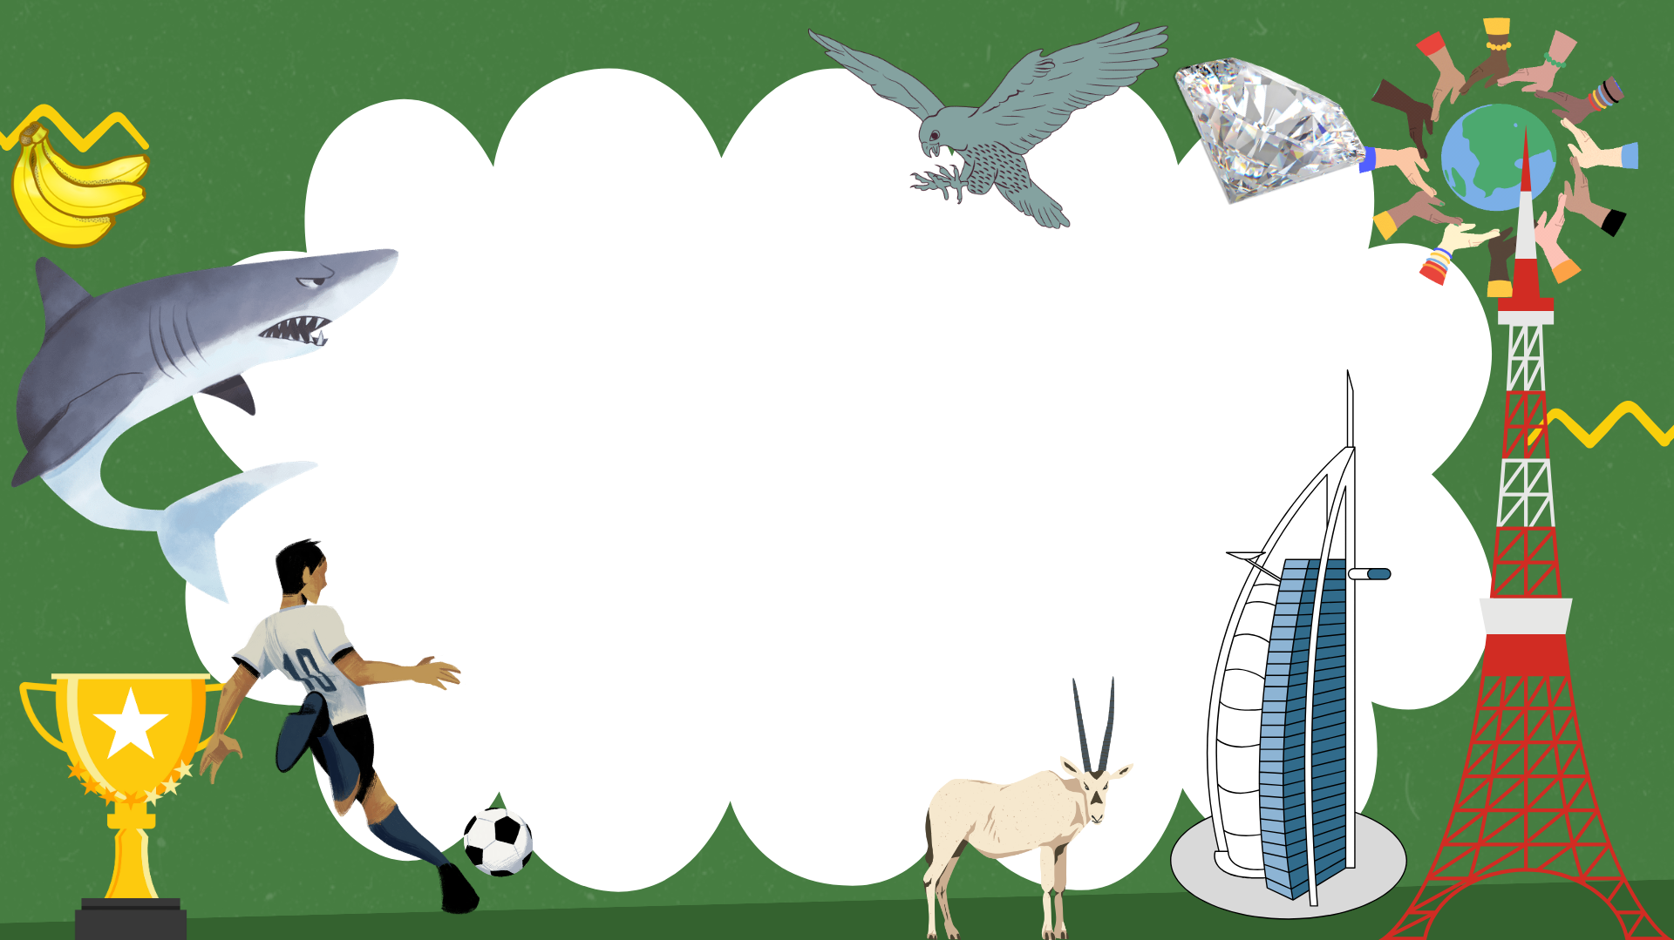
Unit 11
There’s No comparison
Listen and discuss

Slide 6

Give examples about facts around the world
Judge the given information
The objectives of the lesson :

Slide 7


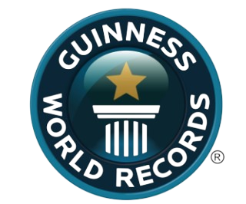
Before we start the lesson Let's explore some record holders from both the natural world and the human world

Slide 8
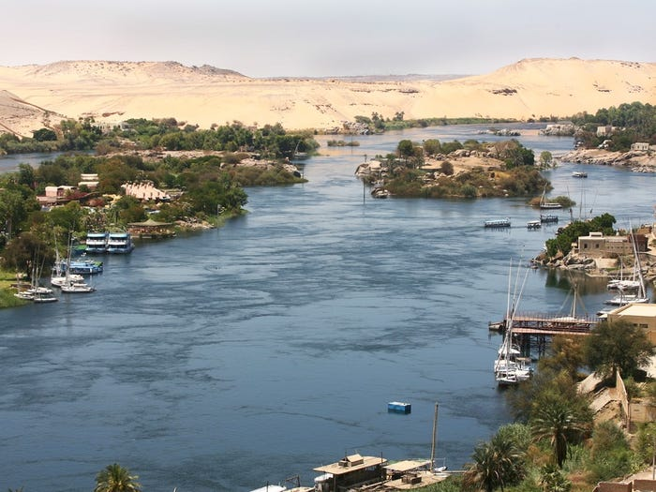
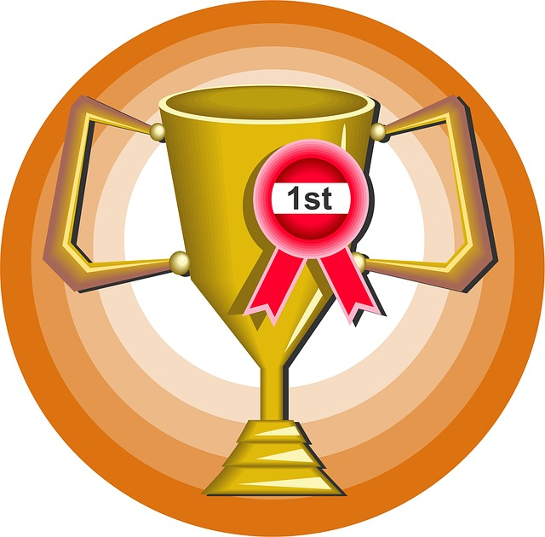

The Nile River
is 4,160 miles long,
earning it the title of the world's longest river

Slide 9
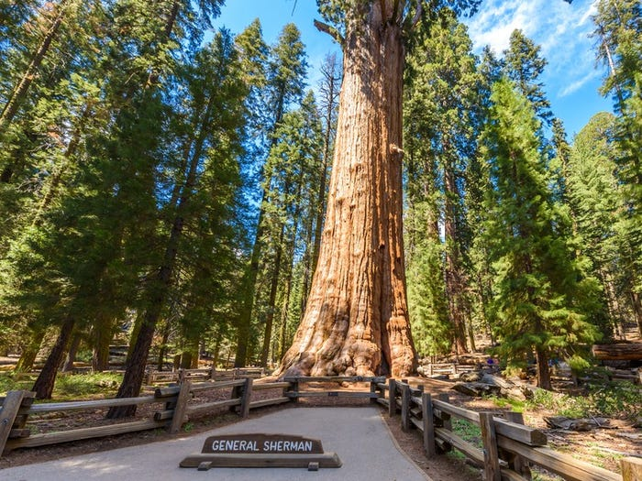
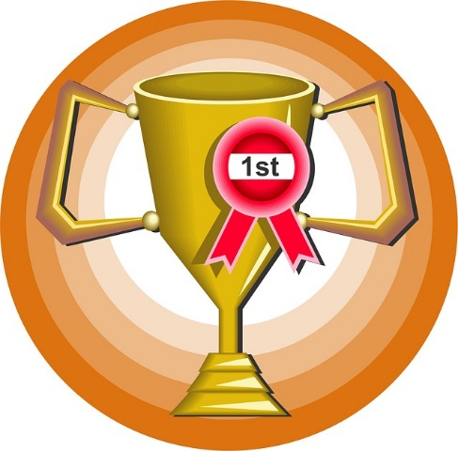

The General Sherman Tree found in Sequoia National Park, holds the record for the world's largest tree.

Slide 10
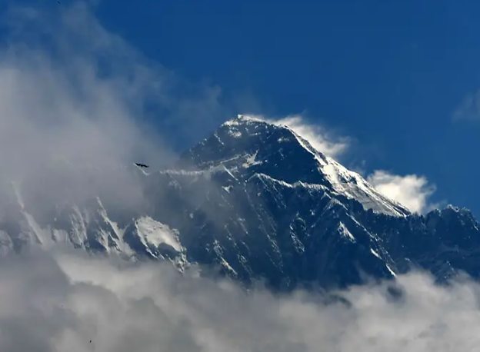
Asia is also home to the highest mountain in the world,
Mount Everest.

Slide 11
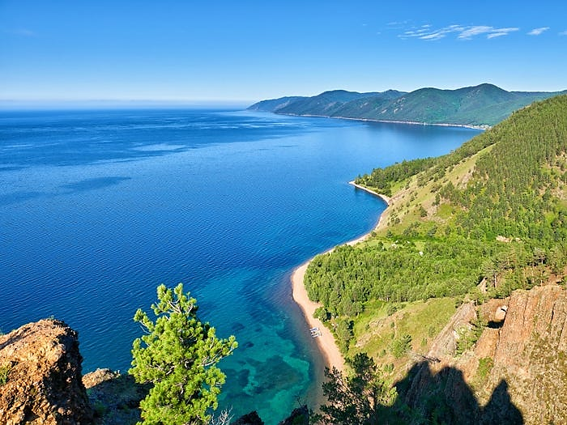

Another enormous, record-holding body of water is Lake Baikal in Russia,
which is the world's largest and deepest lake.

Slide 12
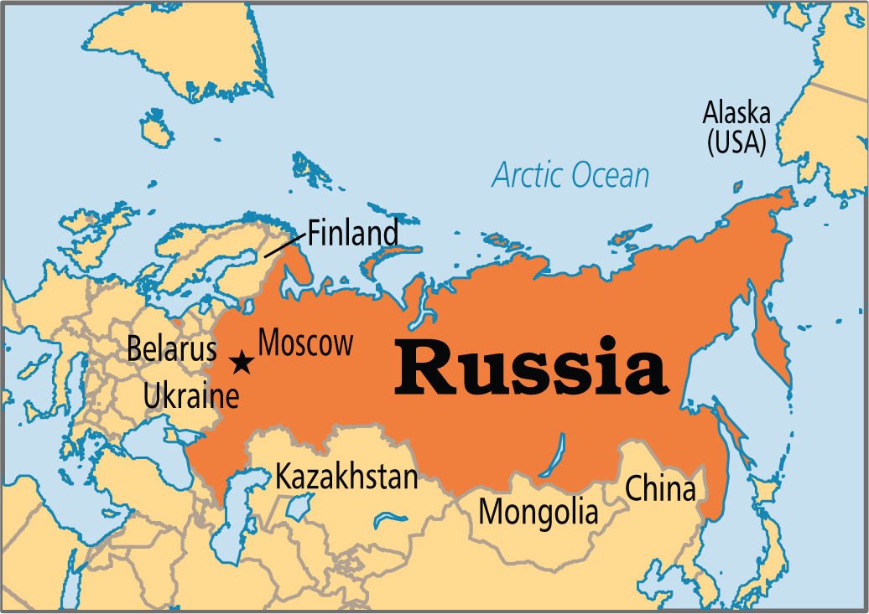
Russia is the largest country in the world.

Slide 13
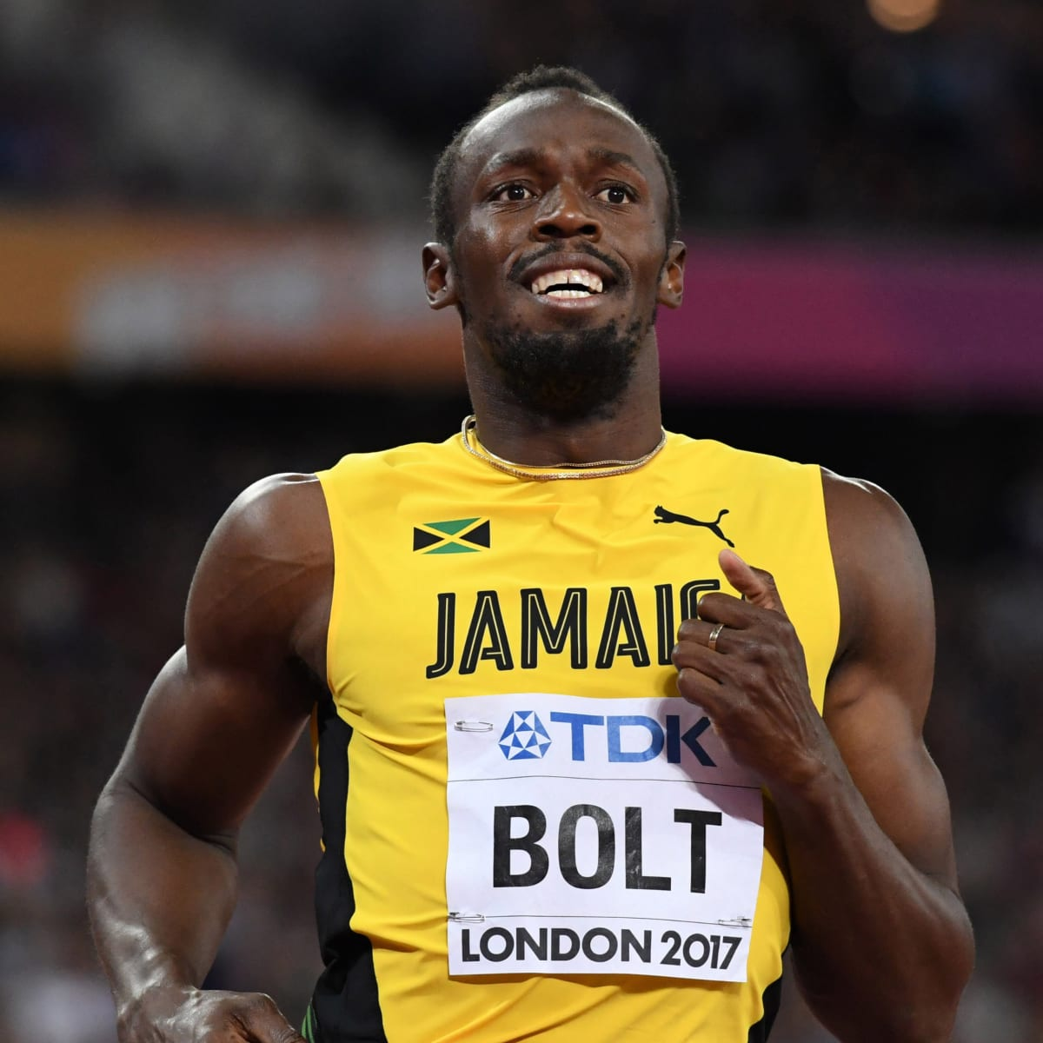
Jamaica's Usain Bolt
is an Olympic legend who has been called "the fastest man alive"
for smashing world records and winning multiple gold medals at the 2008, 2012 and 2016 Summer Games.

Slide 14
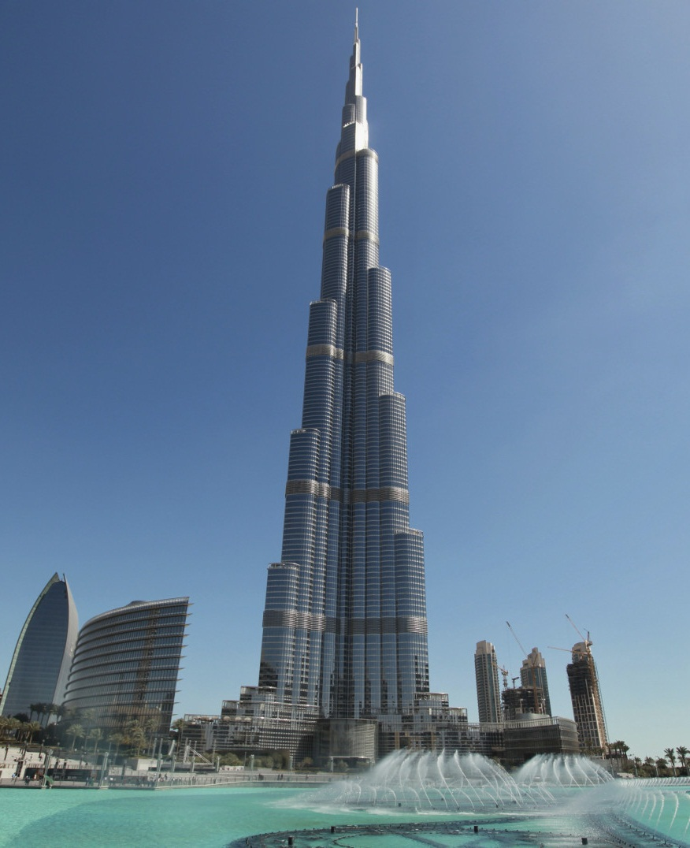
Burj Khalifa the World's Top 10 Tallest Buildings

Slide 15

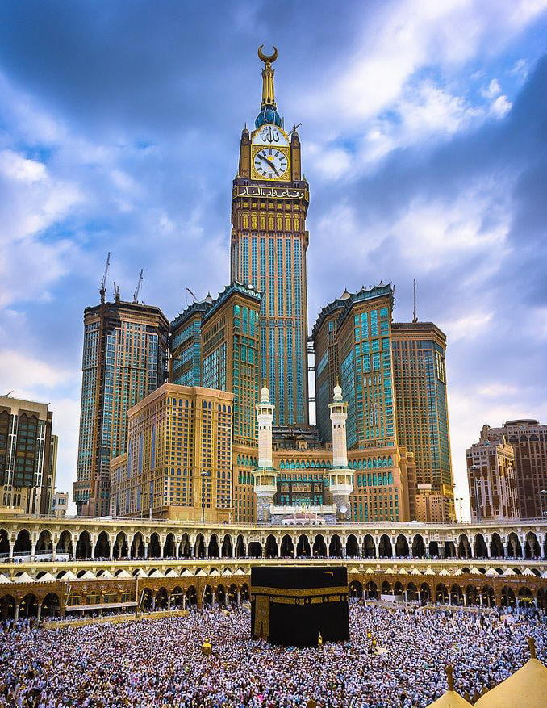


What is the tallest tower in Saudi Arabia?
The clock tower

Slide 16
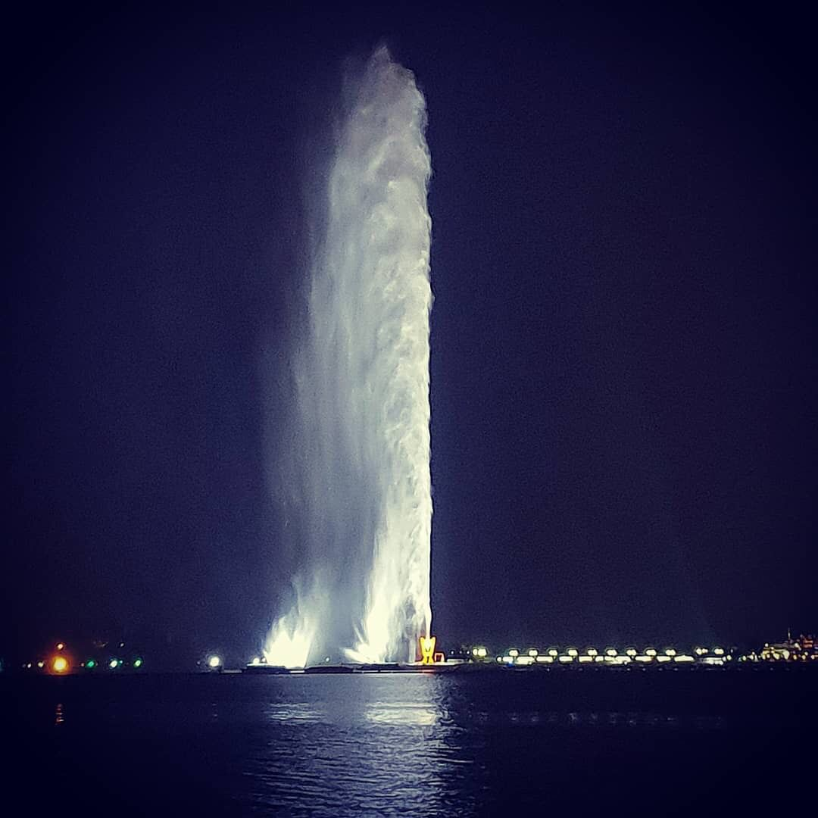
What is the tallest fountain in the world?
King Fahd's Fountain

Slide 17
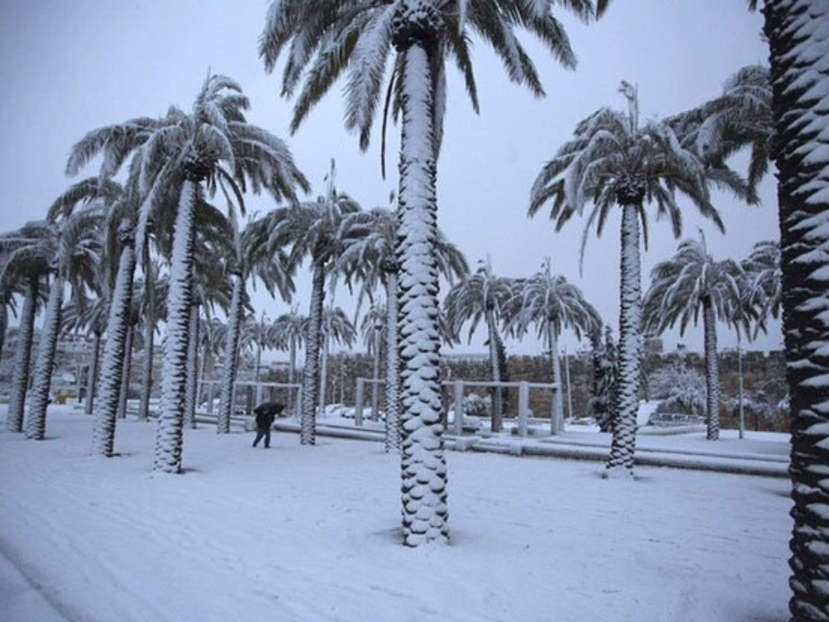
What is the coldest city in Saudi Arabia?
The clock tower
Turaif

Slide 18



Leader Name: __________ Group No. (___)
Anticipation guide
Read
Before Reading |  | Statement | After Reading
Agree | Disagree |  | Agree | Disagree
 |  | The Burj Al Arab Hotel in Oman.
 |  | Football is the most popular international team sport.
 |  | The Arabian Oryx can dive.
 |  | Sharks can smell a tiny drop of blood from miles away.

Slide 19

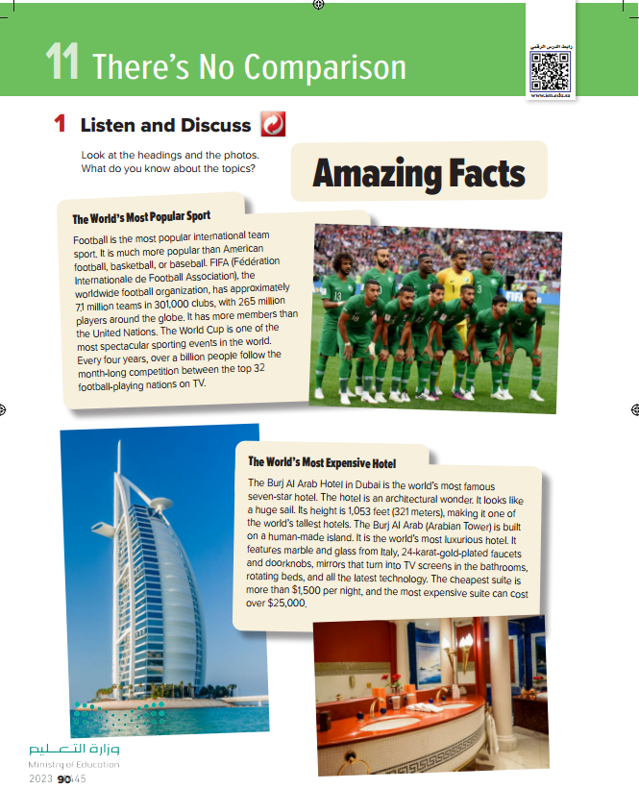
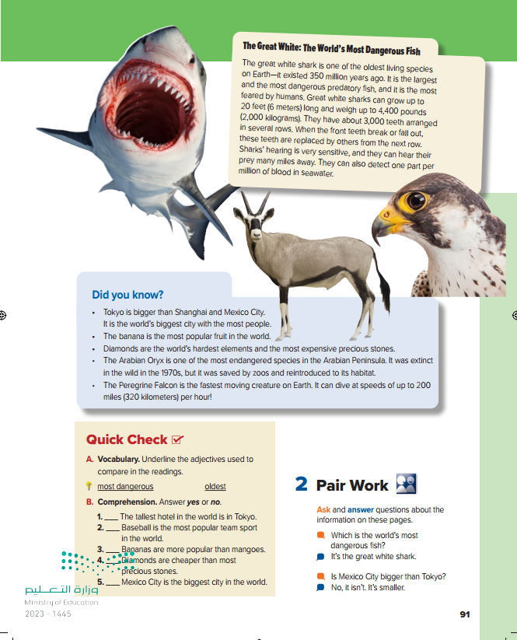
Open your book page 90

Slide 20

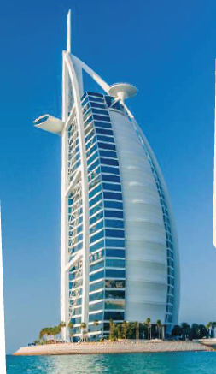


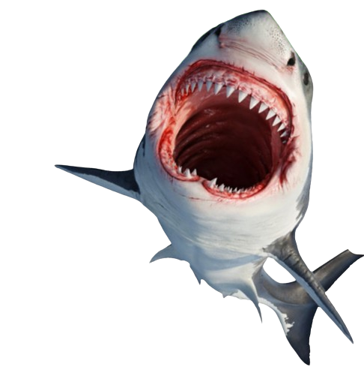
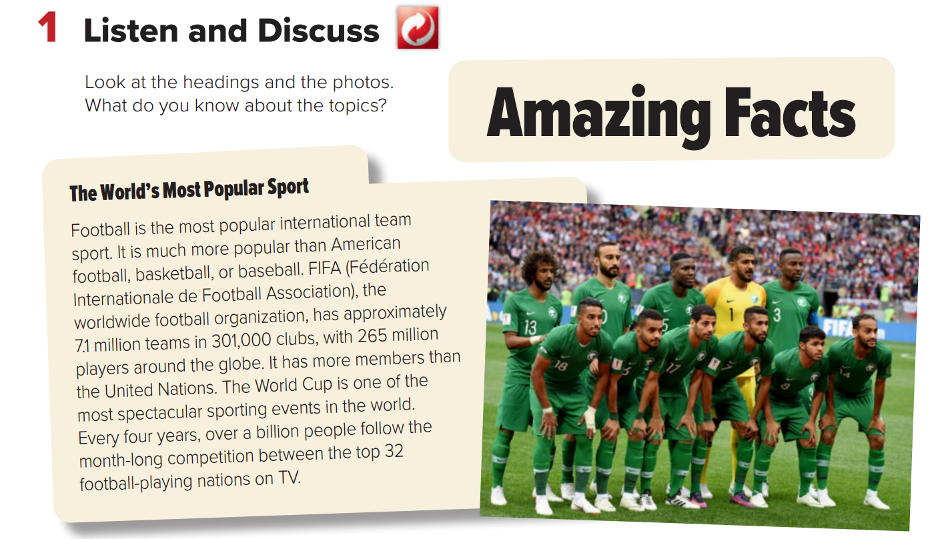
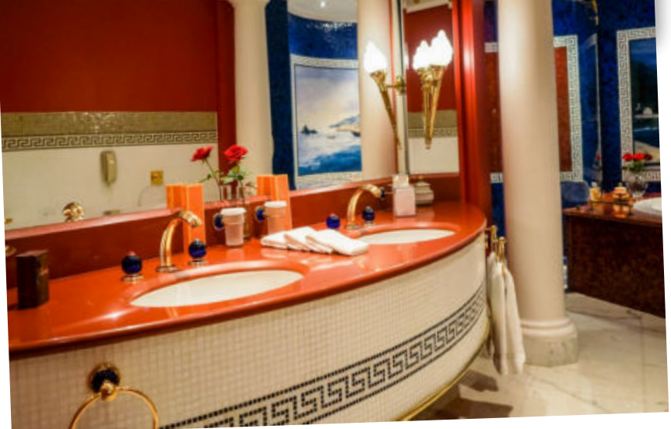
Page 90
a "fact" is something that is true and can be proven. So, when you say "amazing facts," it means interesting and true information that you can learn or discover

Slide 21




Page 90

Slide 22

Page 90

Slide 23

Page 90
1.What makes football different from all other sports?
It is the most popular international team sport
2.How many teams are there around the world?
7.1 million teams
3.How many clubs are there?
301,000 clubs

Slide 24
Page 90
4.How many players are there?
265 million players around the globe
5.How many teams play in the World Cup?
There are 32 national teams in the world cup
6.How many people watch the World Cup around the globe?
Over a billion viewers.

Slide 25
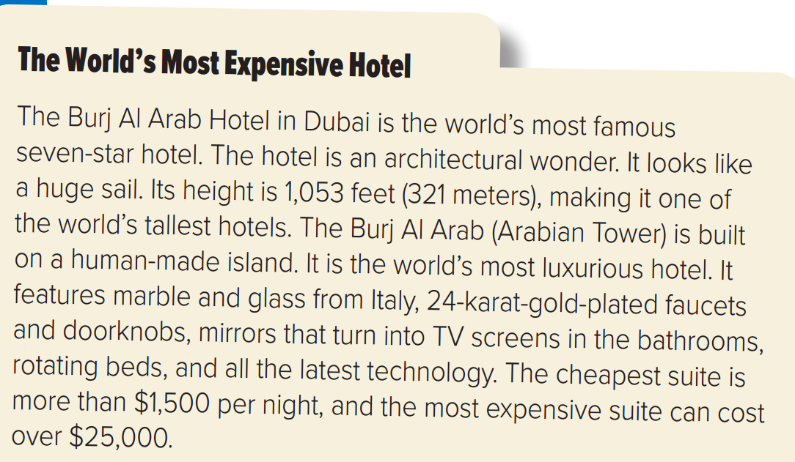
Page 90

Slide 26
Page 90
1.What makes the hotel special?
The world’s most famous 7 star hotel
2.Where is it located?
In Dubai
3.How tall is it?
Its height is 1.053 feet (321 meters),
4.What makes the hotel rooms special?
24-kart-gold plated faucets and doorknobs, rotating beds
5.How much does it cost to stay there for a night?
Between 1500$ – 25000$

Slide 27
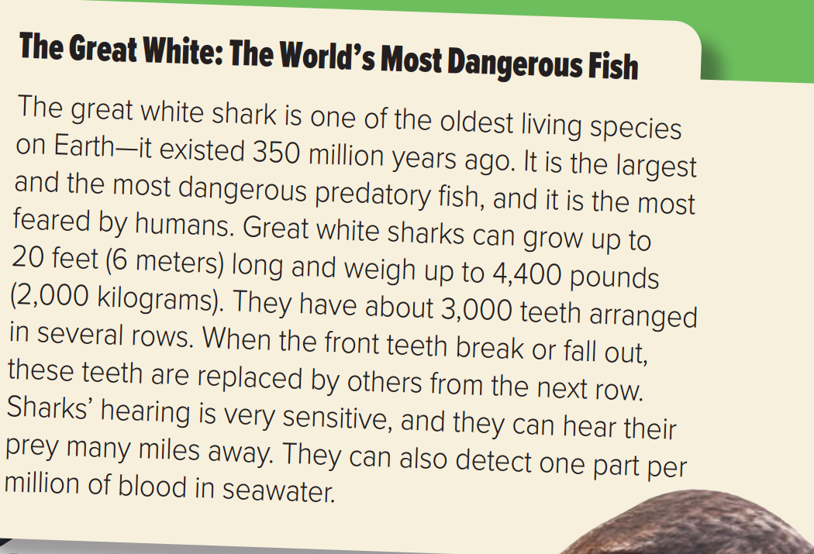
Page 91

Slide 28
Page 91
1.What do you think makes the great white shark so special?
The oldest living species on Earth.
2.How long do you think great white sharks are?
6 meters long.
3.How much do you think they weigh?
weigh up to 4,400 pounds

Slide 29
Page 91
4.How many teeth do you think they have?
About 3000 teeth
5.Do you think they have good or bad hearing?
Good hearing
6.Do you think they have a good or bad sense of smell?
Good sense of smell

Slide 30

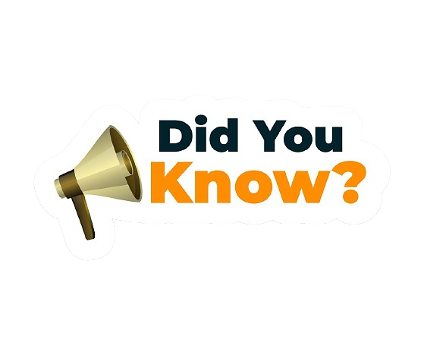
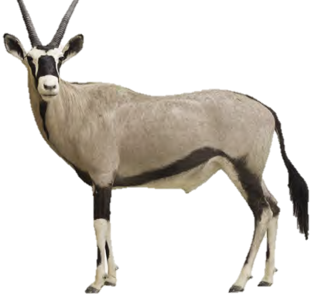
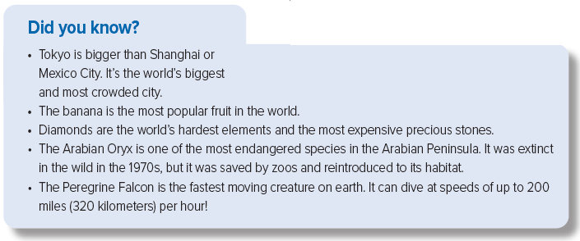

Slide 31


Slide 32
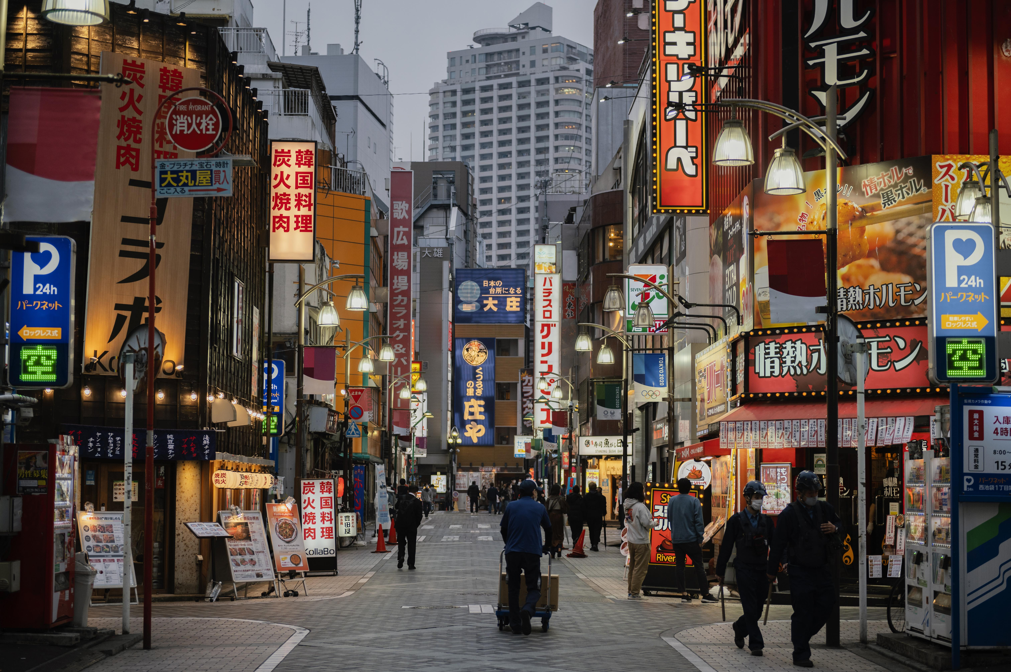
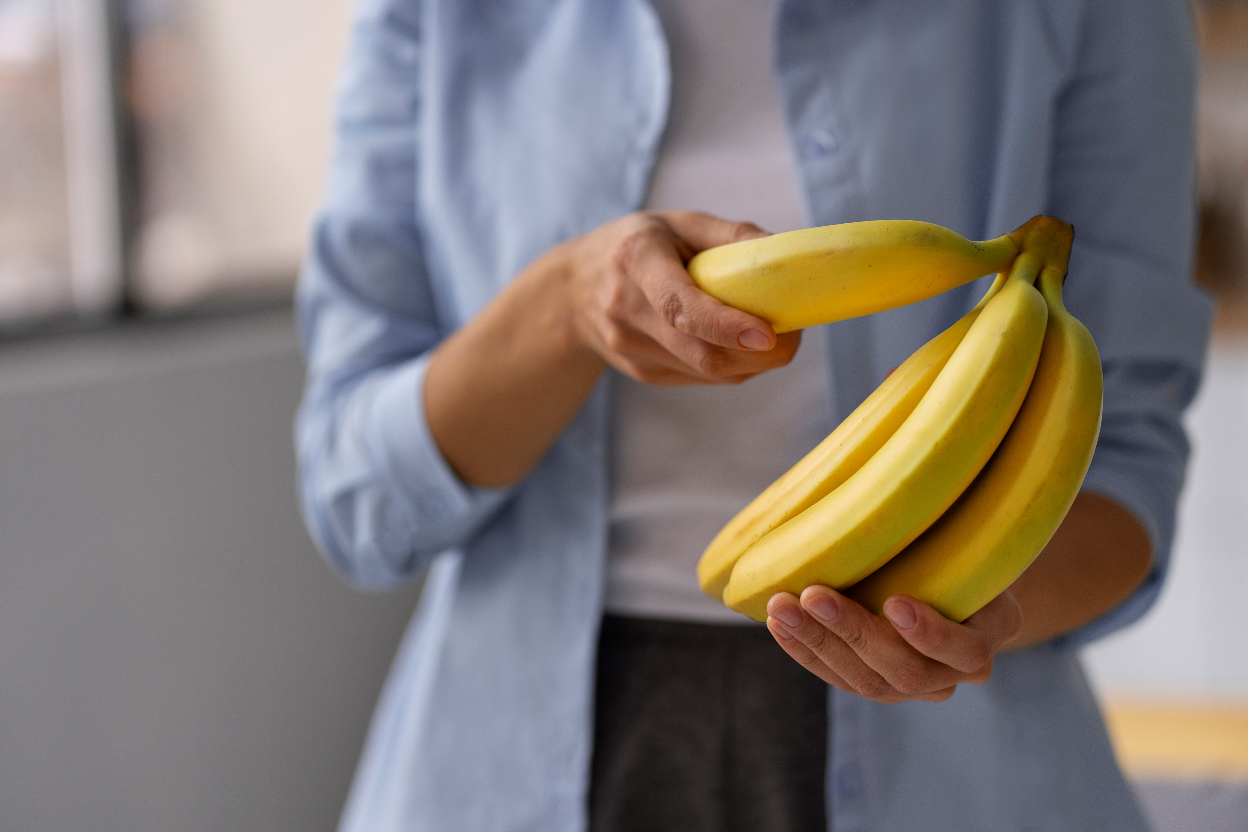
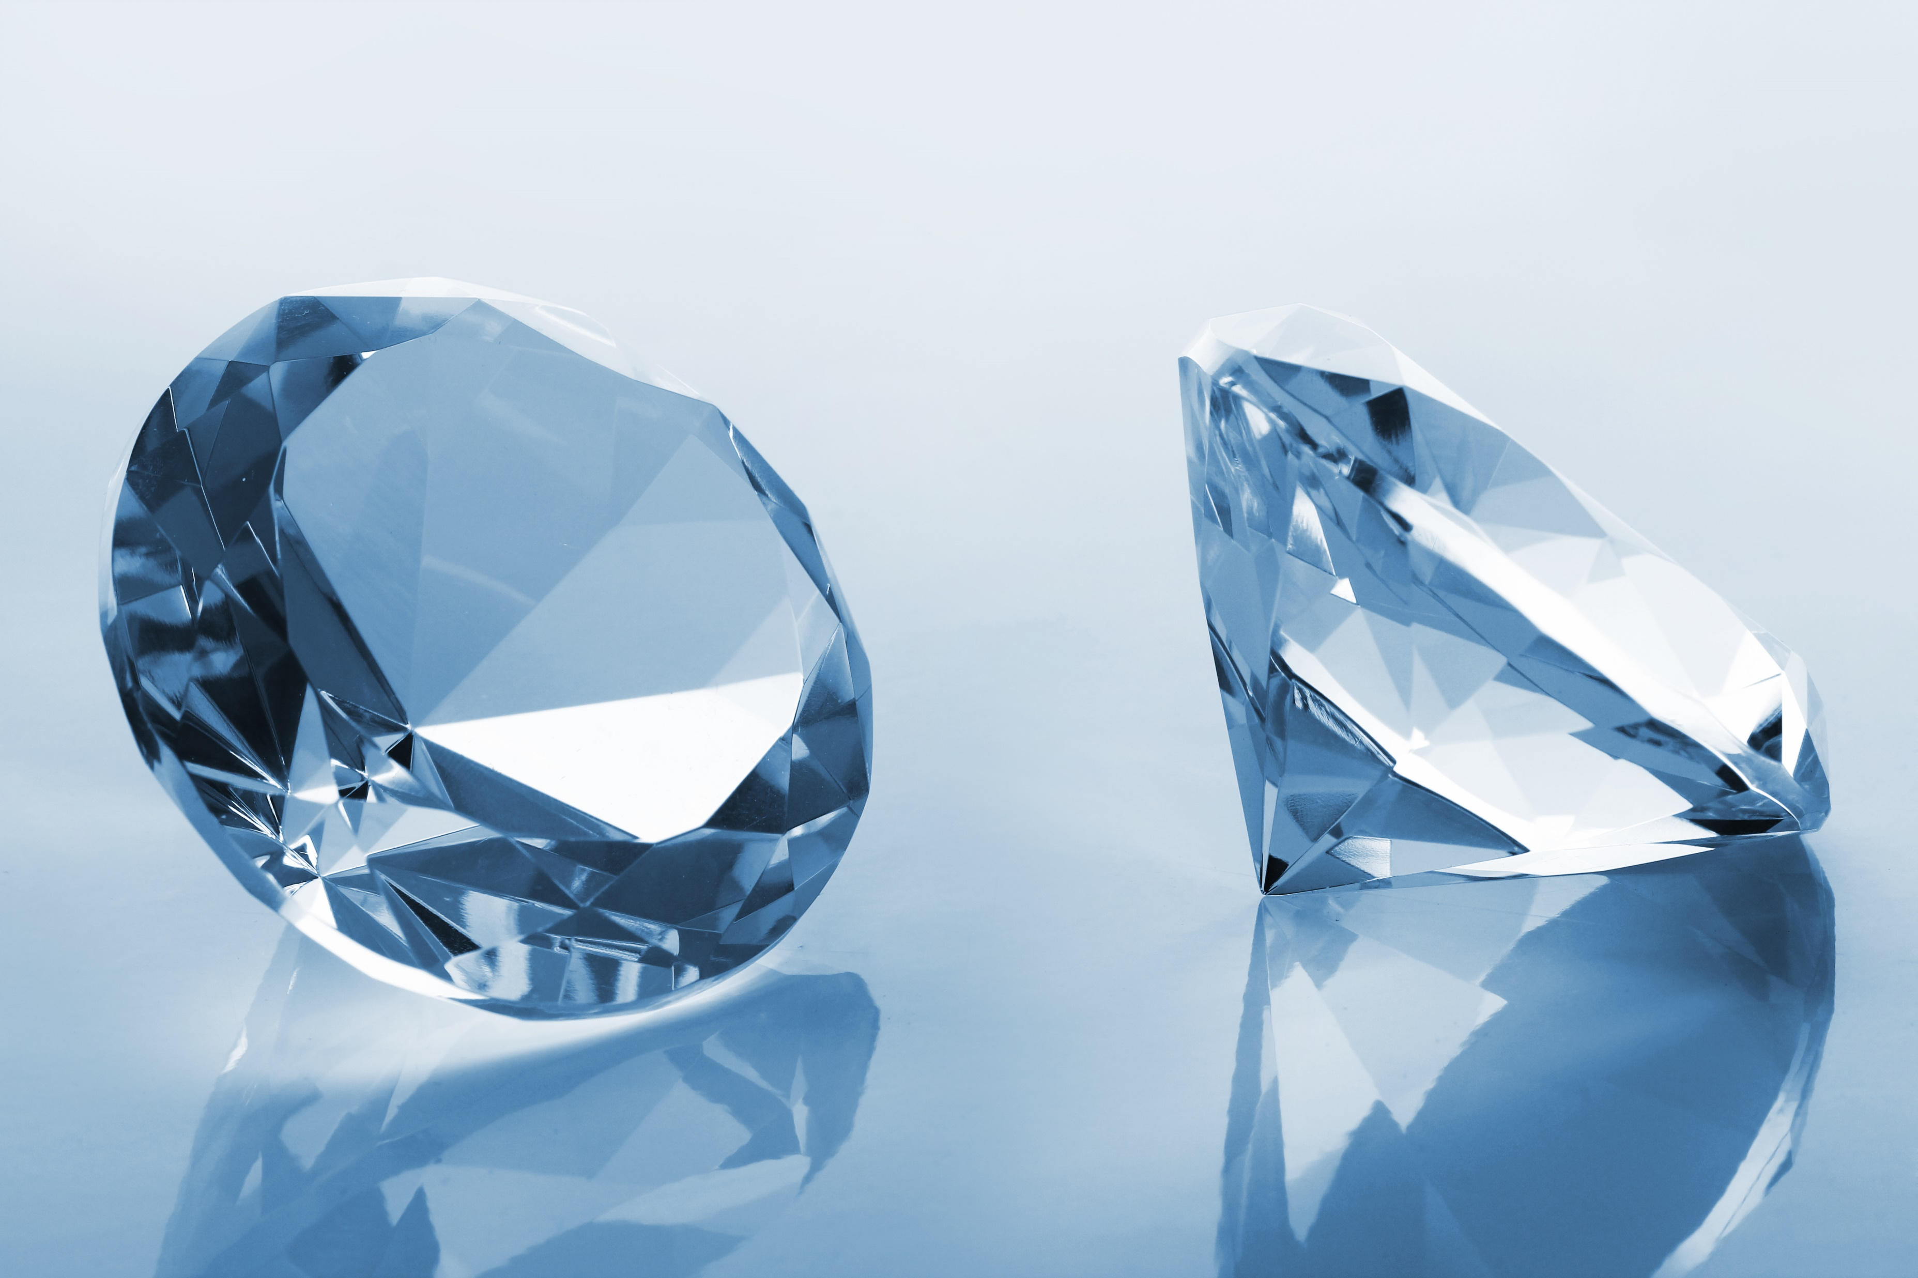
Page 91
Tokyo
is bigger than Shanghai and Mexico City.
It is the world's biggest city with the most people.
The banana is the most popular fruit in the world.
are the world's hardest elements
the most expensive precious stones.
Diamonds

Slide 33

Page 91
The Arabian Oryx is one of the most endangered species in the Arabian Peninsula
The Peregrine Falcon is the fastest moving creature on Earth

Slide 34




Page 91
Page 19
(superlative with the most and –est)
most dangerous
most spectacular
most famous
most luxurious
most expensive
the most feared
most crowded
more popular.
the tallest
the latest
the cheapest
the oldest
the largest
The biggest
(comparative with more and -er)

Slide 35

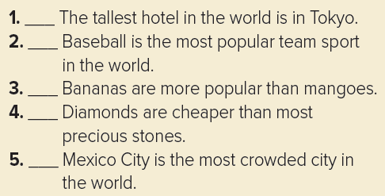
Page 91
no
no
yes
no
no

Slide 36
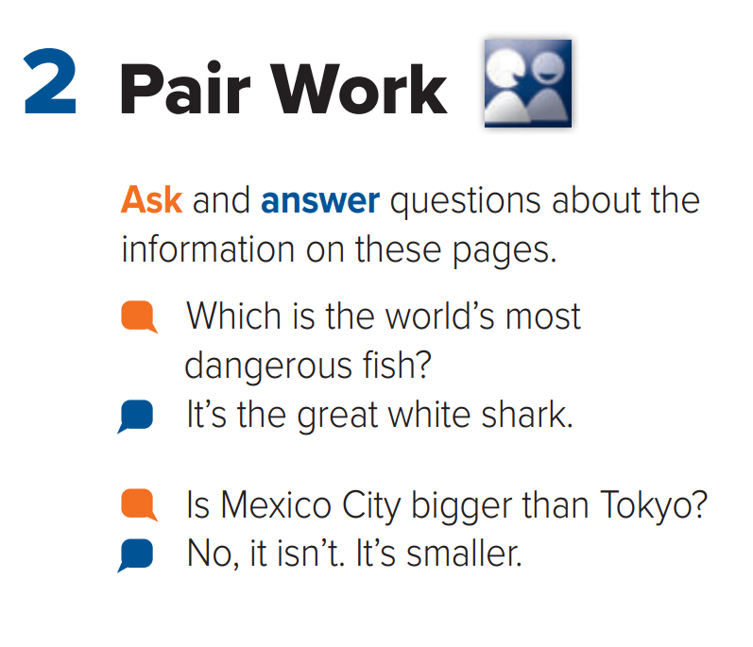
Page 91

Slide 37
The most dangerous fish in the world is………………….
White shark

Slide 38
The biggest city in the world is ………………..
Tokyo

Slide 39
The most popular fruit in the world is ………………..
Banana

Slide 40

Workbook exercise

Slide 41
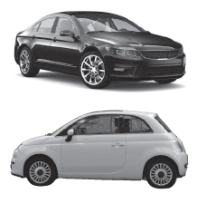
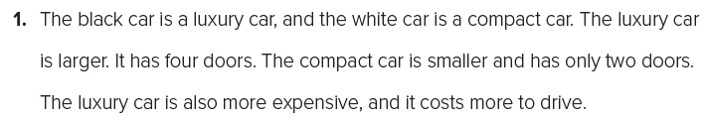
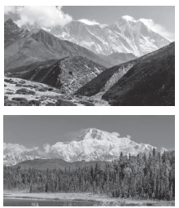
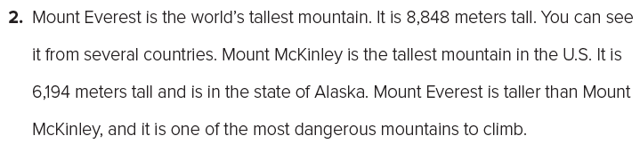
Page 229
1. larger, smaller, more expensive
2. the…tallest, the tallest, taller, the most dangerous

Slide 42
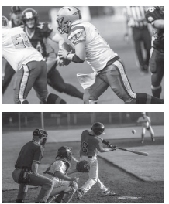
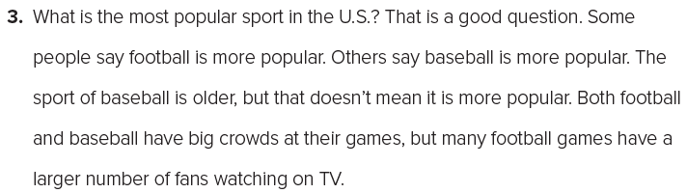
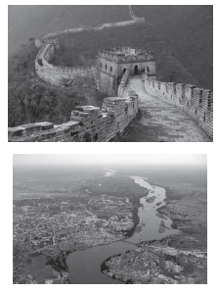
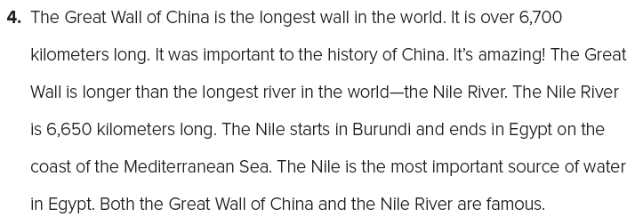
Page 229
3. the most popular, more popular, more popular, older, more popular, larger
4. the longest, longer, the longest, the most important

Slide 43

Linking this lesson to my country
Do you know what’s the biggest project in Saudi Arabia?
NEOM is the biggest project in Saudi Arabia
It a huge plan in the northwest part of Saudi Arabia.
It wants to be a super cool place for new ideas, tech, and green living
NEOM covers many things like energy, science, and fun tourist stuff
The idea is to make a city that changes how we live in the future

Slide 44


The biggest project in Saudi Arabia
Click here

Slide 45

Linking this lesson to my religion
In Islam, the Quran is the final divine scripture, protecting the wisdom of earlier books. While we marvel at unique discoveries in science, let's also appreciate the timeless guidance found in the Quran, our ultimate source of knowledge.

Slide 46
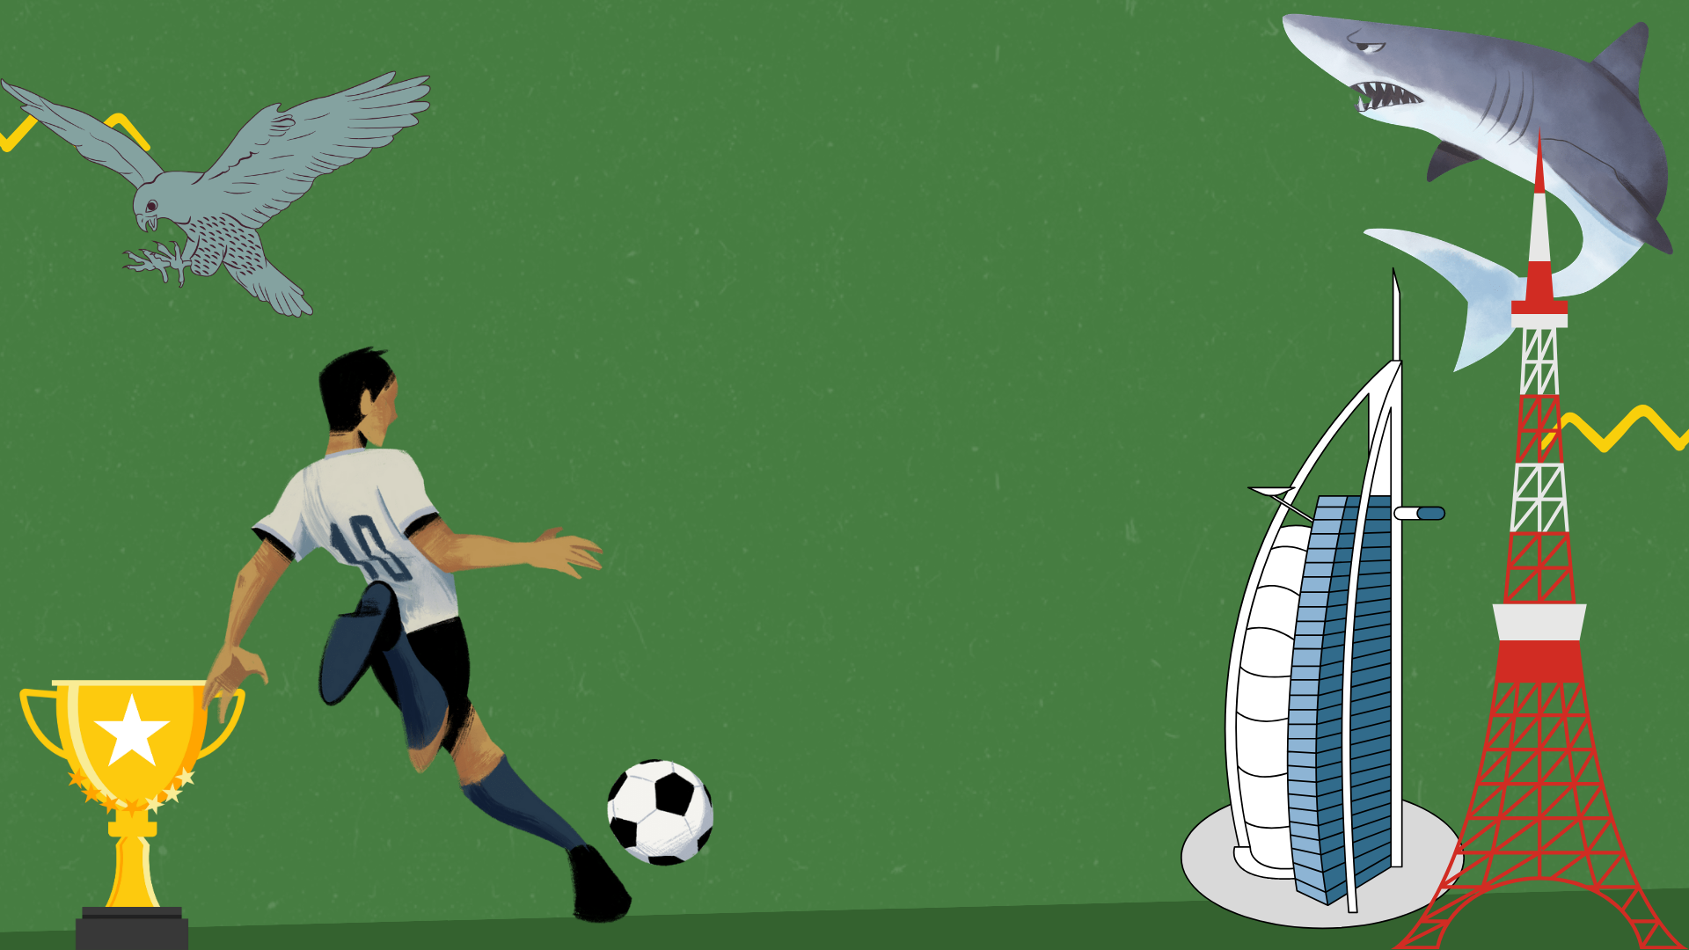
End of the class

Slide 47

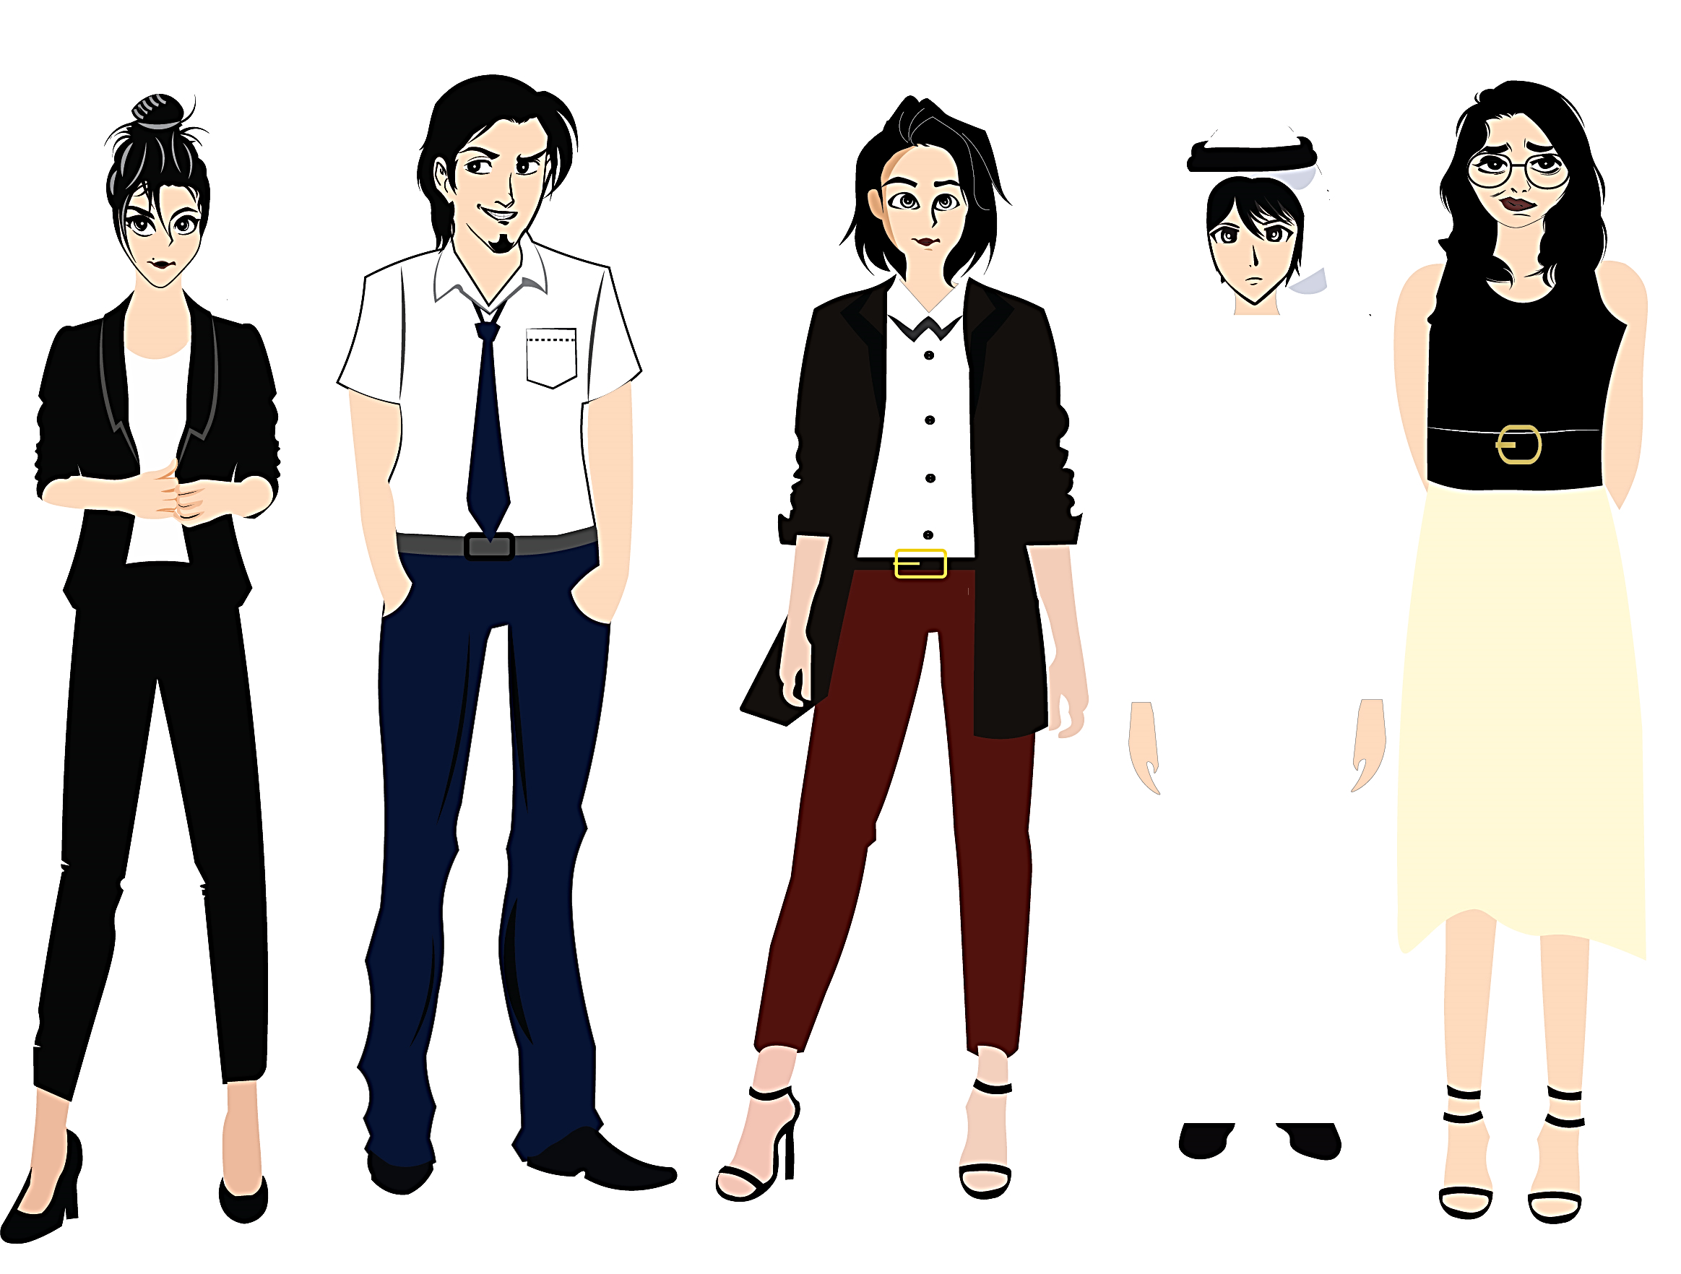


تم تصميم هذا العرض من قبل: فريق عمل البوابة الإنجليزية ، وهو مجاني لكي يستفيد منه معلمي اللغة الإنجليزية.
هذه الشريحة تعتبر كـ"حفظ حقوق" نتمنى عدم حذفها حال مشاركة العرض مع معلمين آخرين.
نسمح بحذف الحقوق في حالة واحدة فقط: اذا أراد معلم الإنجليزي إضافة هذا العرض كـ انتاج معرفي خاص فيه.

