Slide 1
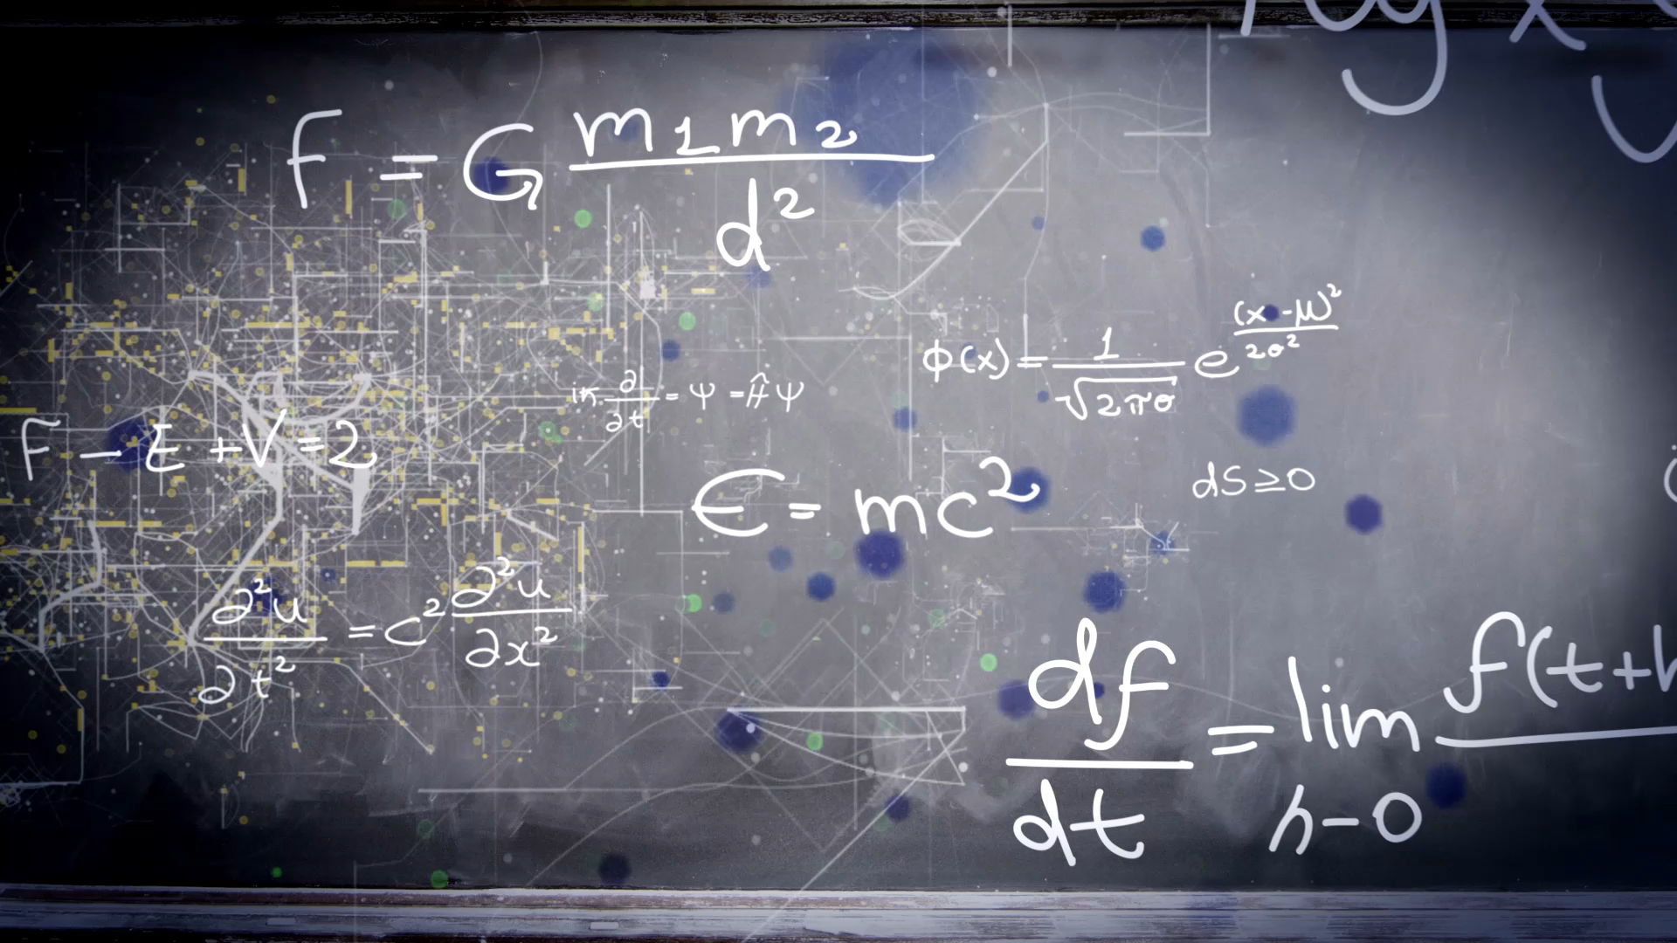
Unit 10
What’s school like?
Workbook pages (225 – 228)

Slide 2
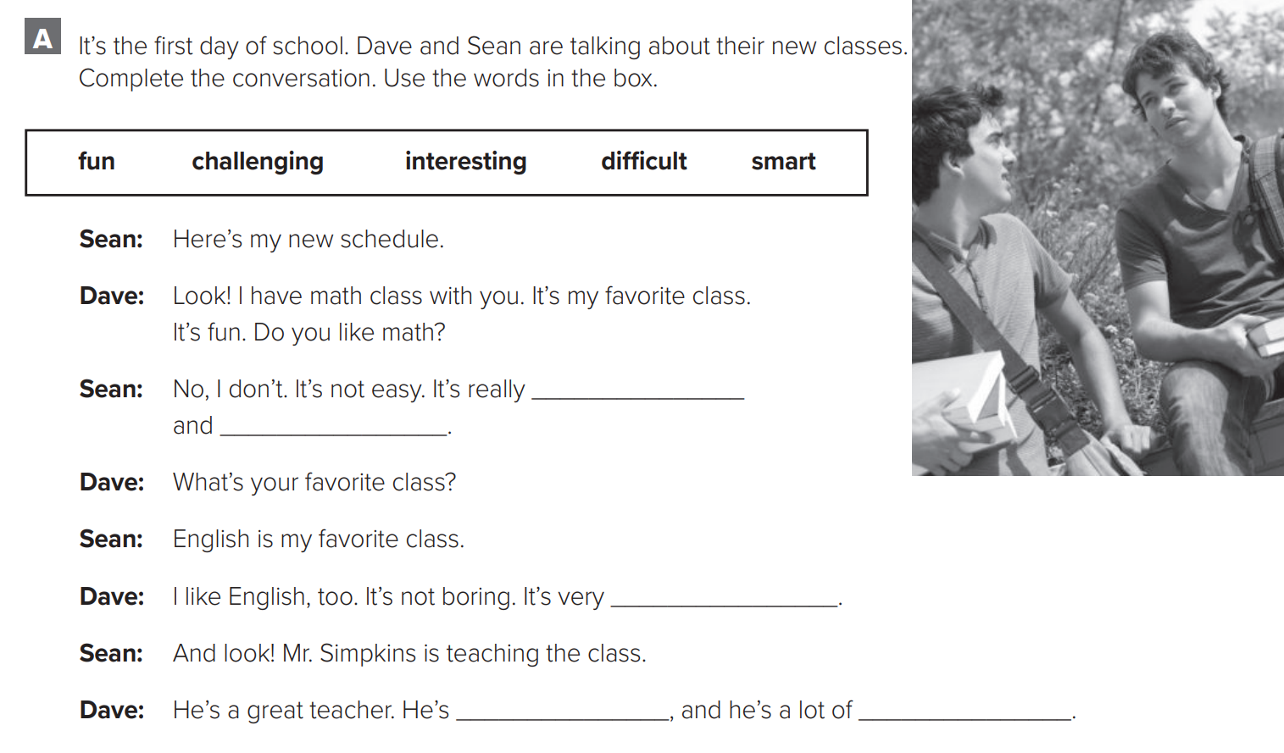

p.225
difficult
challenging
interesting
smart
fun

Slide 3
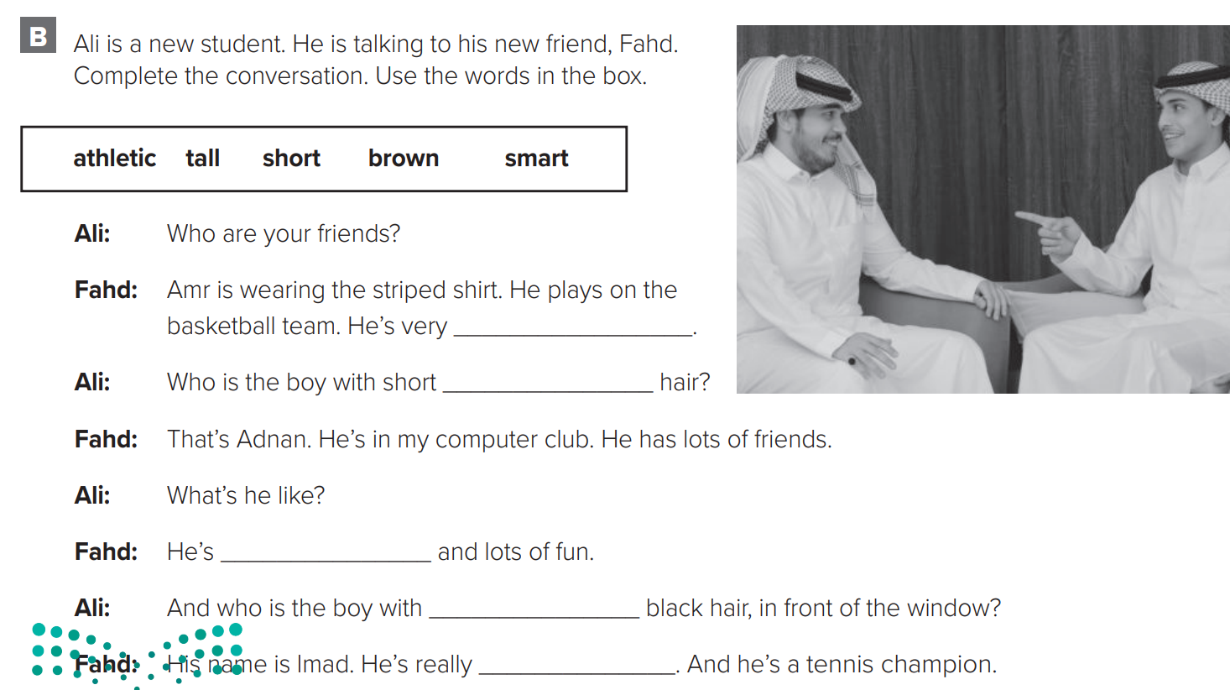

p.225
tall
brown
smart
short
athletic

Slide 4
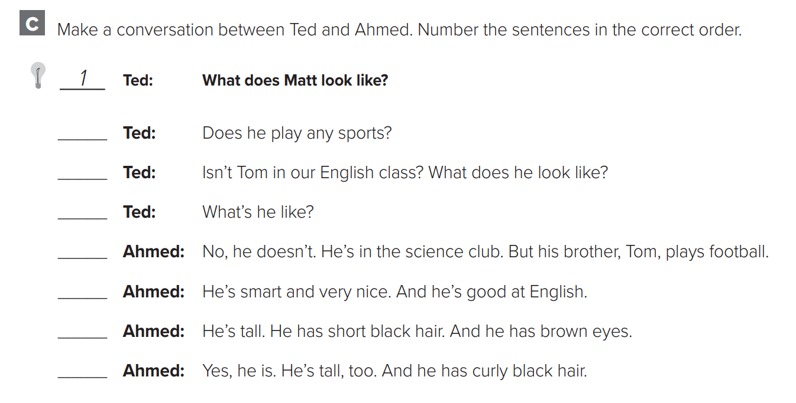

p.226
3
5
7
4
8
2
6

Slide 5
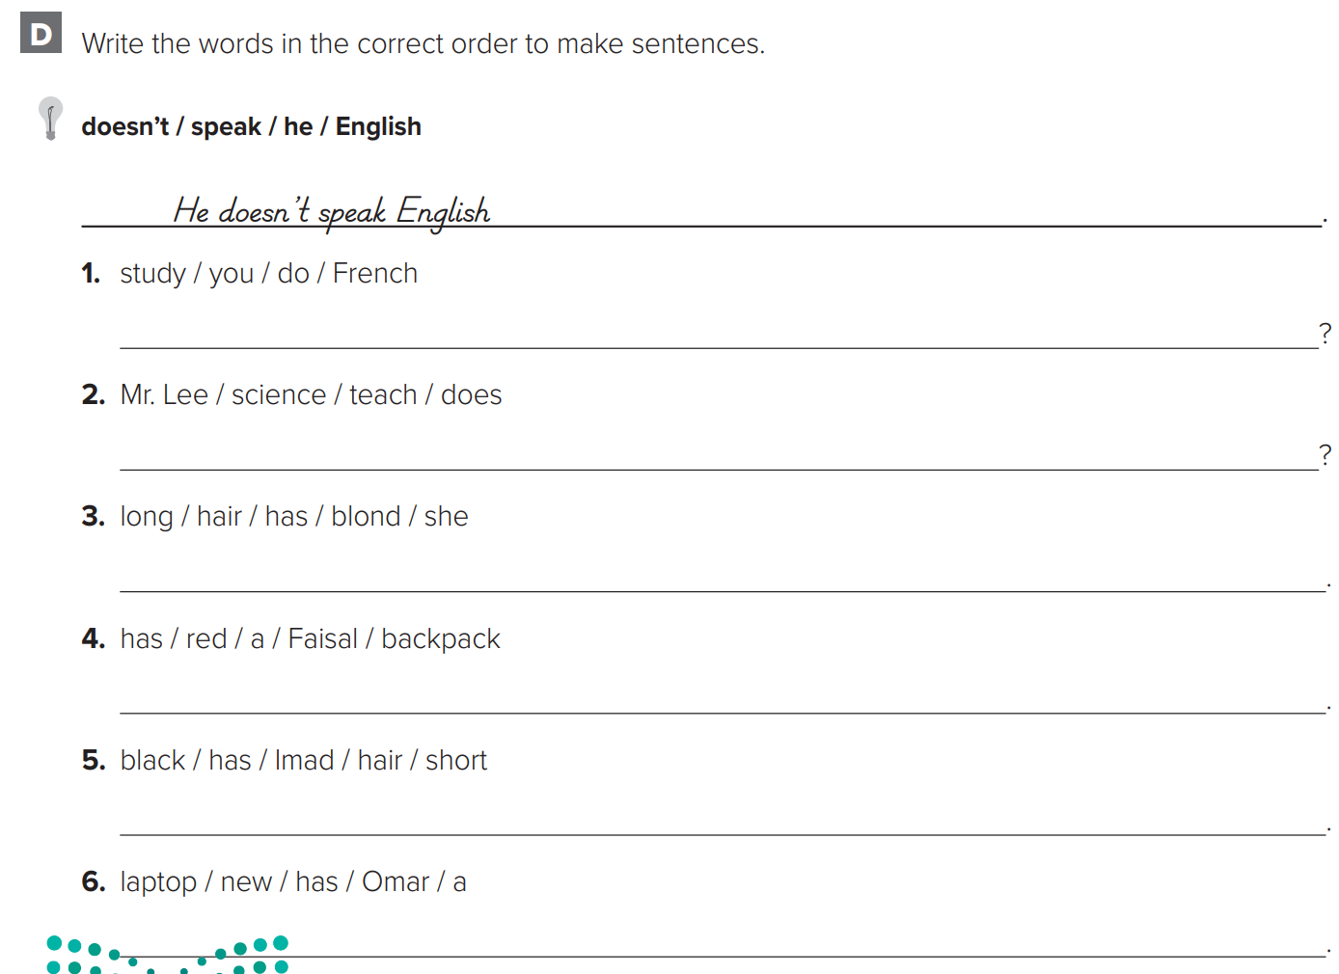

p.226
Do you study French?
Does Mr. Lee teach science?
She has long blond hair.
Faisal has a red backpack.
Imad has short black hair
Omar has a new laptop.

Slide 6
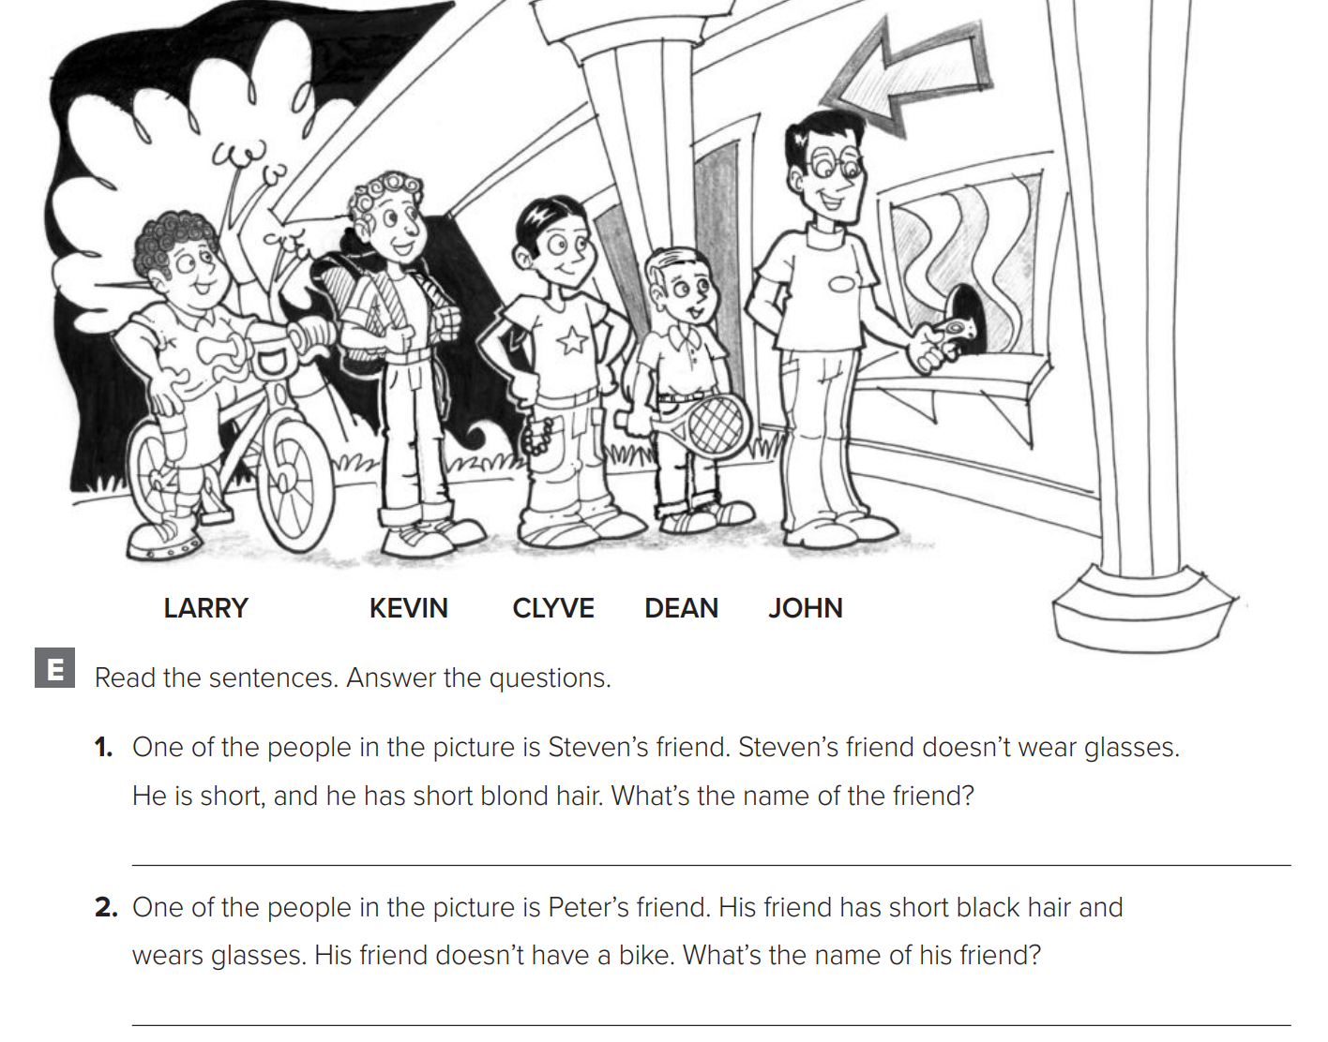

p.227
Dean
John

Slide 7
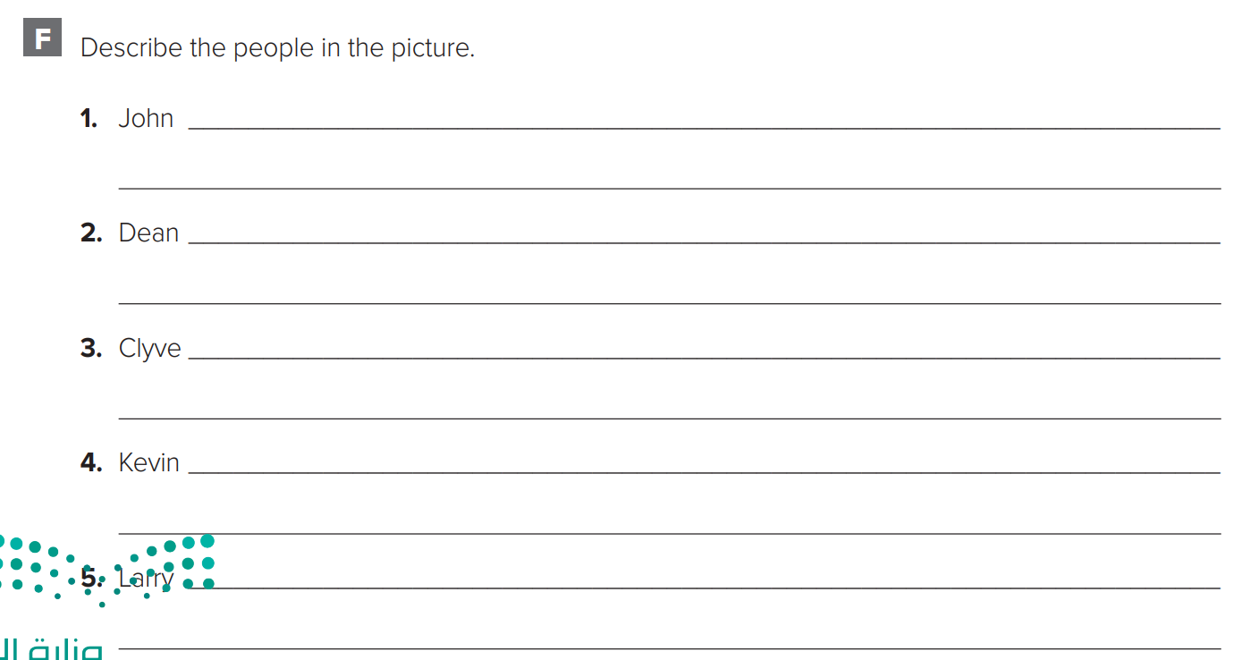
p.227
is tall. He wears glasses. He has short black hair.
is short. He has short blond hair. He plays tennis.
has short black hair. He isn’t very tall.
is tall. He has curly hair. He has a backpack.
has short curly hair. He has a bike.

Slide 8
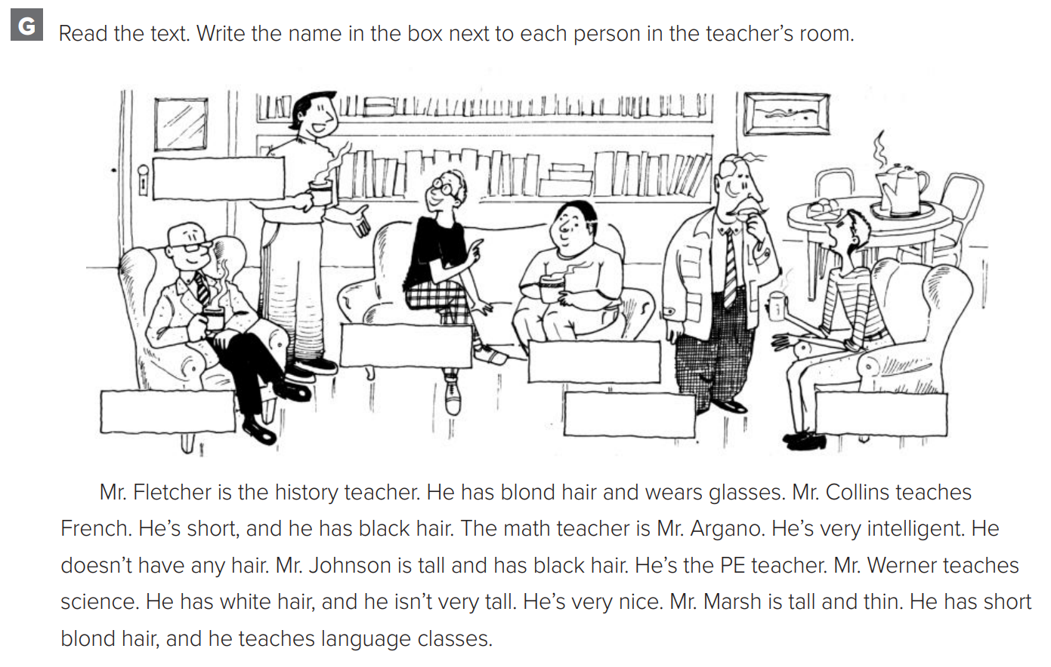

p.228
Mr. Johnson
Mr. Fletcher
Mr. Collins
Mr. Argano
Mr. Werner
Mr. Marsh

Slide 9
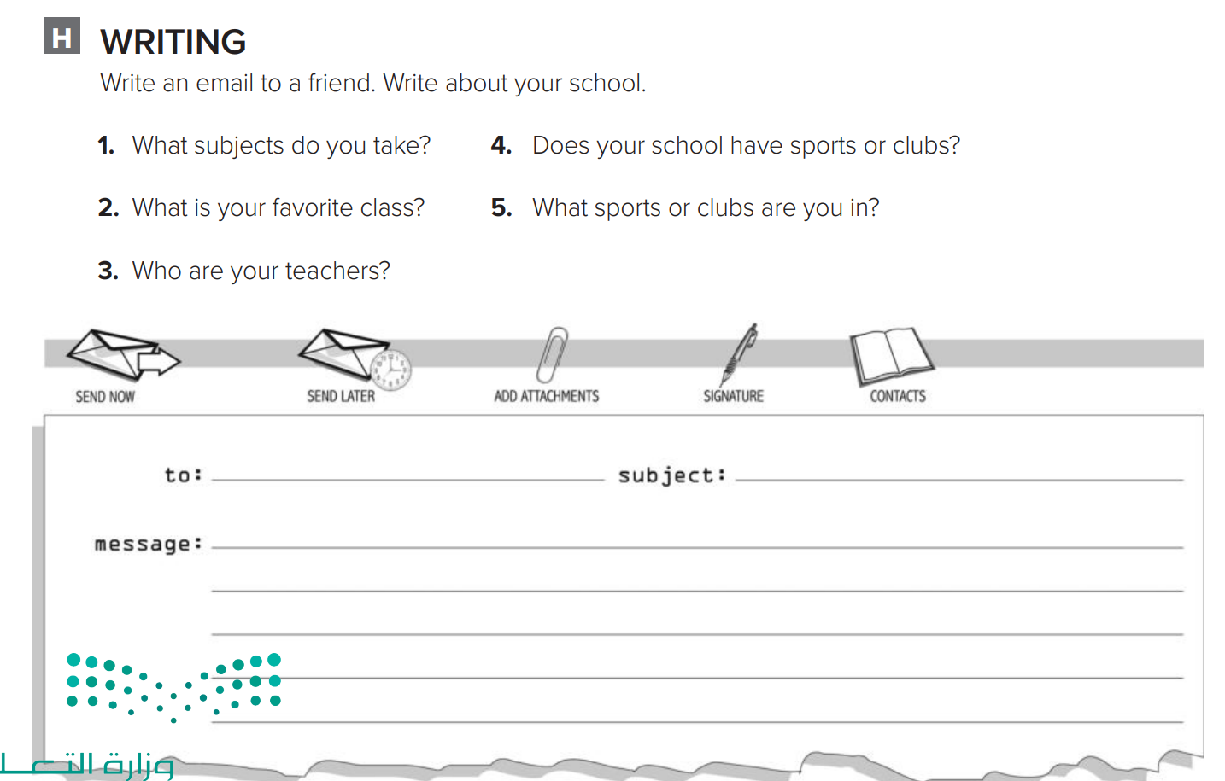
p.228
Hi Sara,
School is fun. I’m taking math, English, history, computer science, physical education, and art. My favorite class is art. My teachers are Miss Nouf , Miss Dalal , Miss Sabah , Miss Hind and Miss Amal. In school, I play on the football team. It’s great! I’m also in the Drama Club and the Computer Club.
Haneen

