Slide 1
WE Can 3 Unit8 -Lesson4 Phonics
T.

Slide 2

I Can …
• say, read, and write words with
f, ph, and gh.

Slide 3


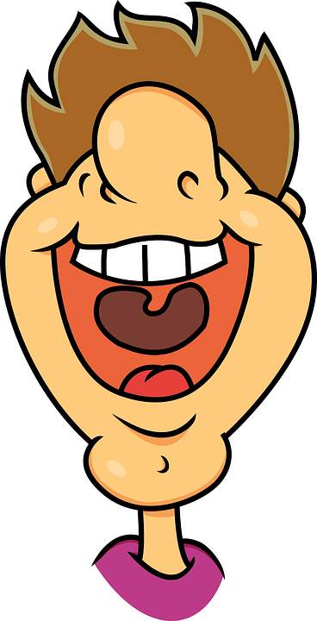
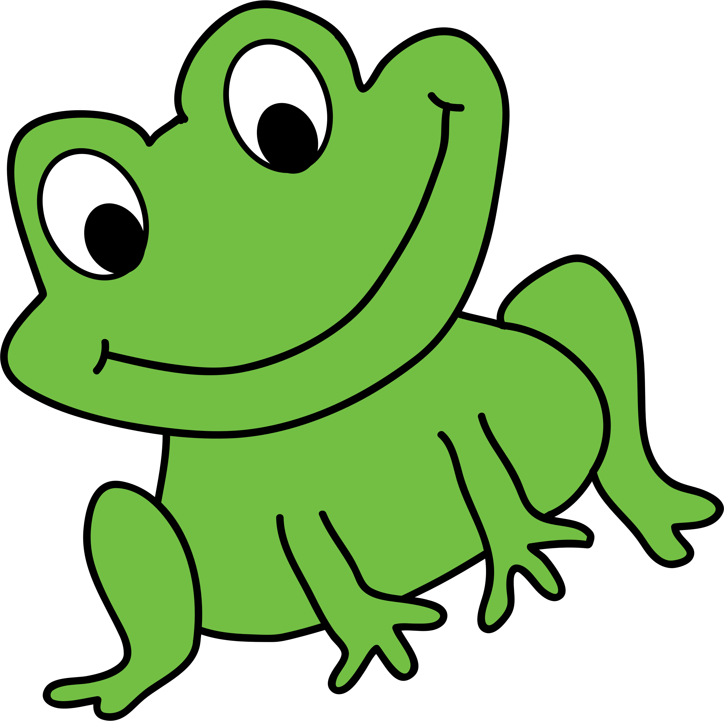

Listen, point, and practice.
f
ph
gh
phone
laugh
frog
They all make the same sound

Slide 4

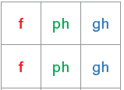
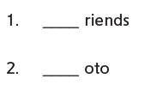



Listen and circle f, ph, or gh. Then complete the words.

Slide 5

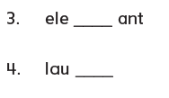



Listen and circle f, ph, or gh. Then complete the words.

Slide 6
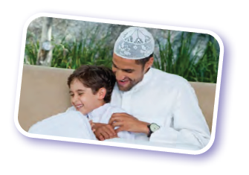
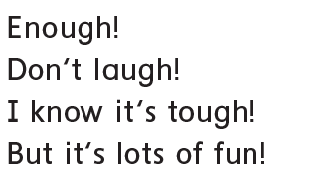
Listen and read. Then chant.

Slide 7
Complete the sentences with the words.
enough
photo
funny
enough
1.No, thank you. I don‘t want any more. It‘s _________.
2. It‘s a __________ story. It makes me laugh.
3. Can I see your __________? You look really cool!
funny
photo

Slide 8
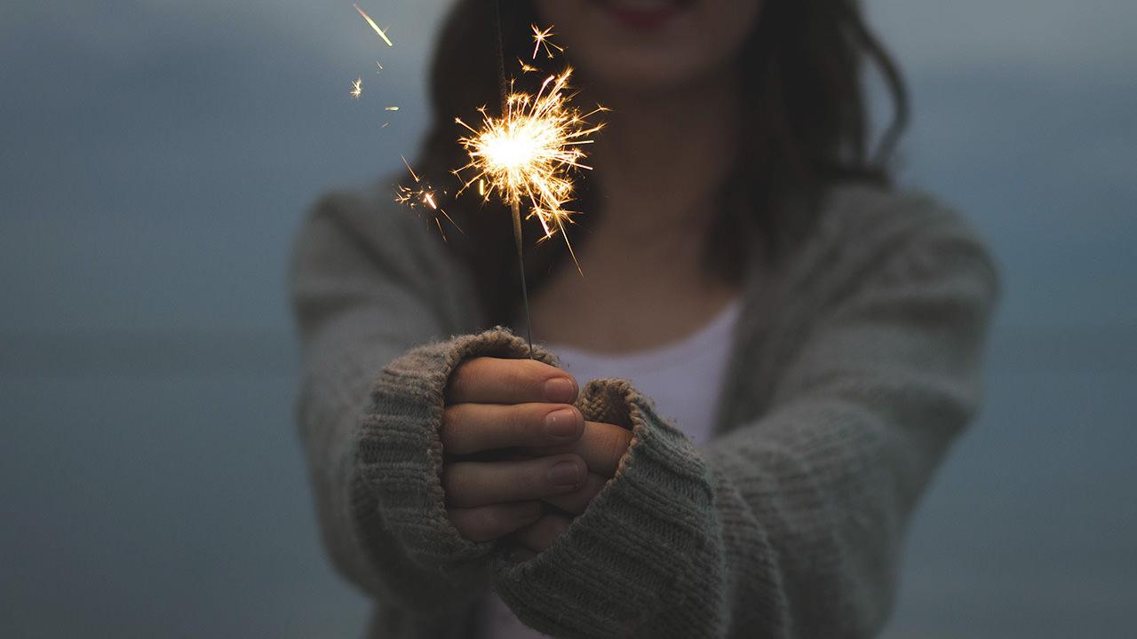
Object Pronouns

Slide 9
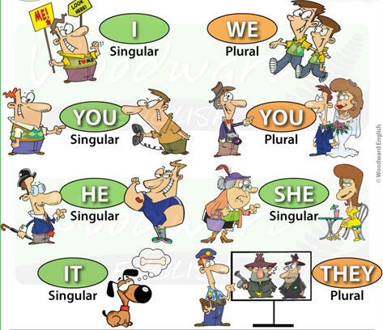
Subject Pronouns
Quick Reminder!

Slide 10
S + V + O
Look at the Sentence structure
مفعول به + دفعل + فاعل
Amal likes pizza.

Slide 11
S + V + O
Subject pronouns Object pronouns
I
you
She
He
It
We
they
me
you
her
him
It
us
them

Slide 12
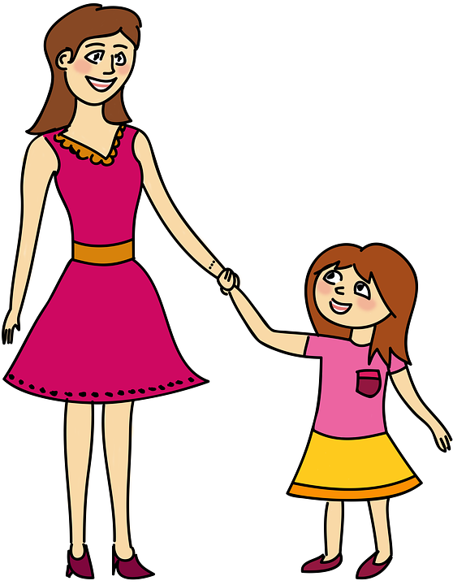


I love my mother.
I love she.
I love her.
This Photo by Unknown Author is licensed under CC BY-SA

Slide 13
My mother loves I .
My mother loves me.
She loves me.
This Photo by Unknown Author is licensed under CC BY-SA

Slide 14
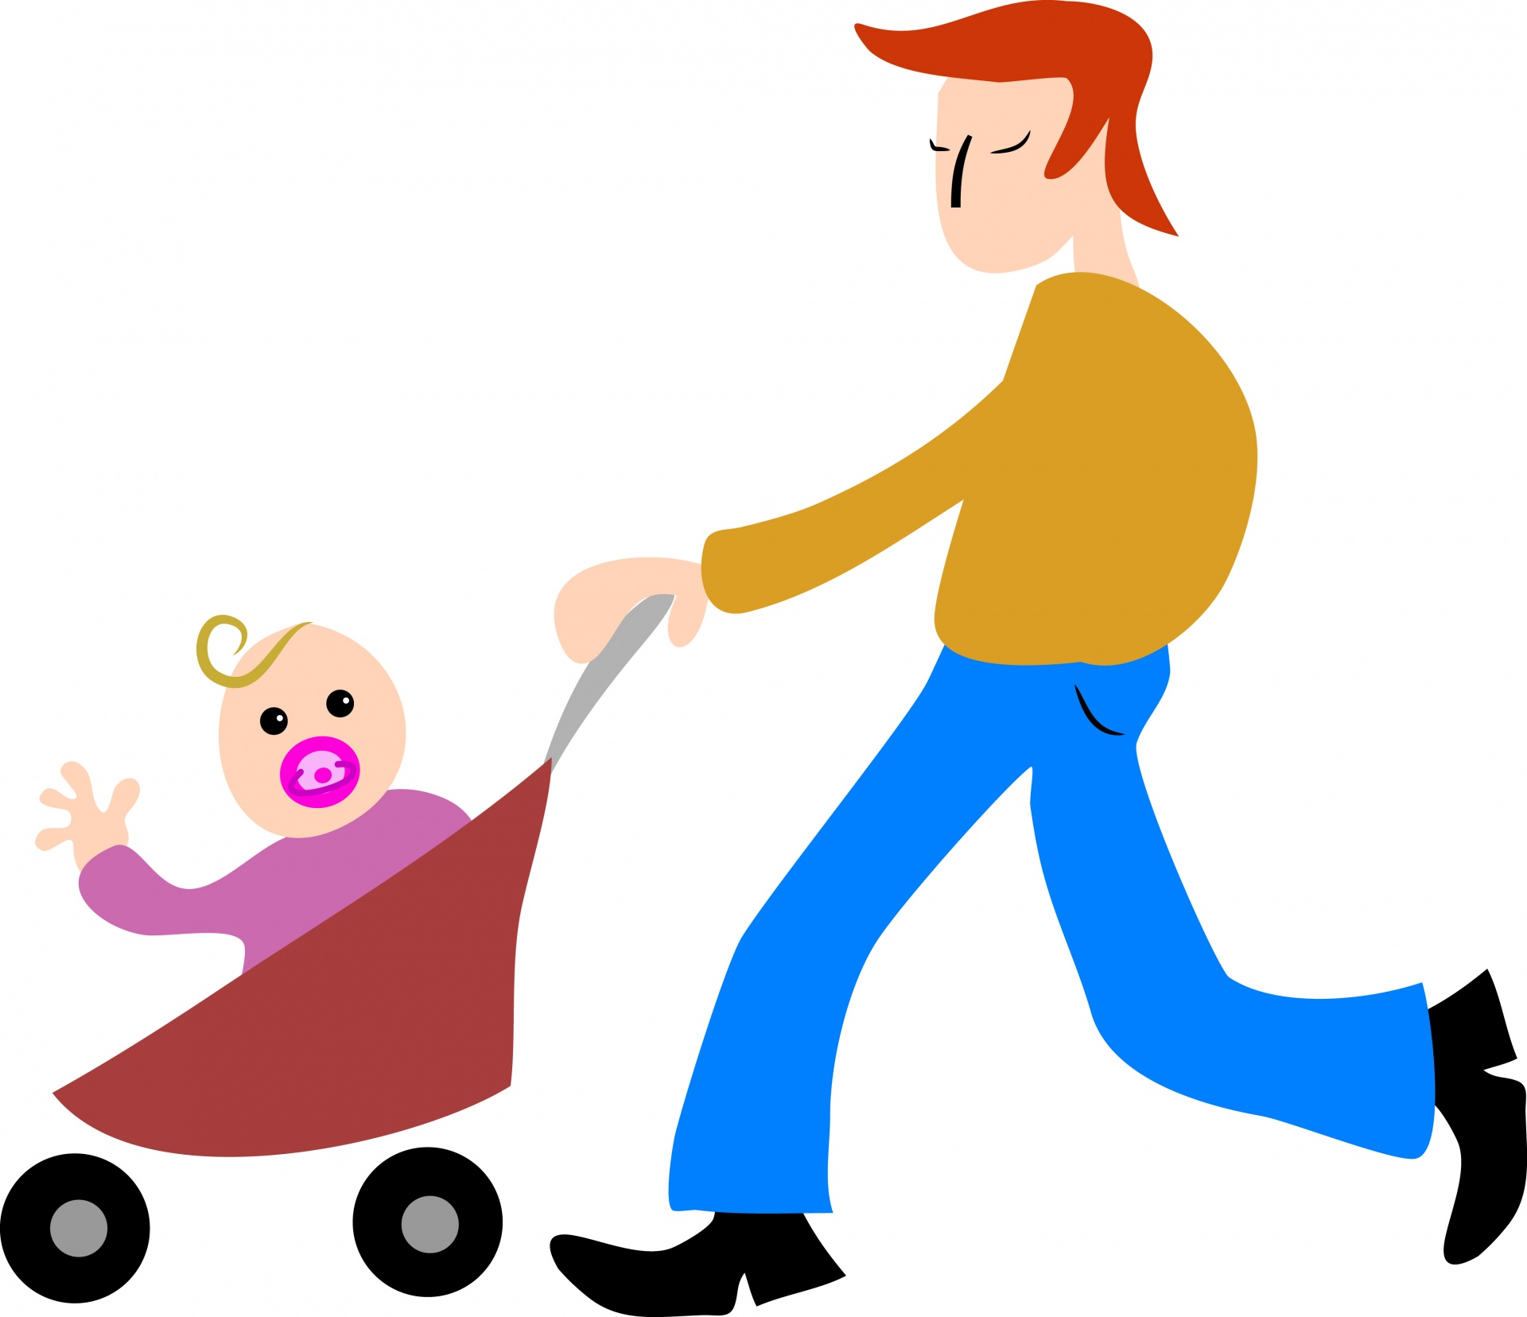

I love my father.
I love he.
I love him.
He loves ( I , me) .
This Photo by Unknown Author is licensed under CC BY-SA

Slide 15

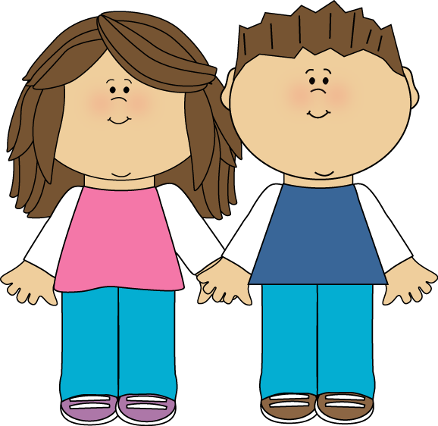




My sister loves ( me , I ) .
Test your understanding
( I , me) love ( she , her).

Slide 16
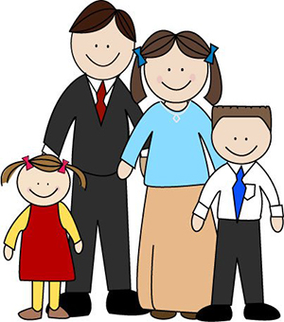





My brother and I love our parents .
We love they.
We love them.
This Photo by Unknown Author is licensed under CC BY-SA

Slide 17
Our parents love me and my brother .
They love we.
They loves us.
This Photo by Unknown Author is licensed under CC BY-SA

Slide 18
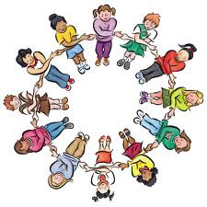


Test your understanding
My brother and I love our friends .
( We , us , They) love (they , them ,us ).

Slide 19
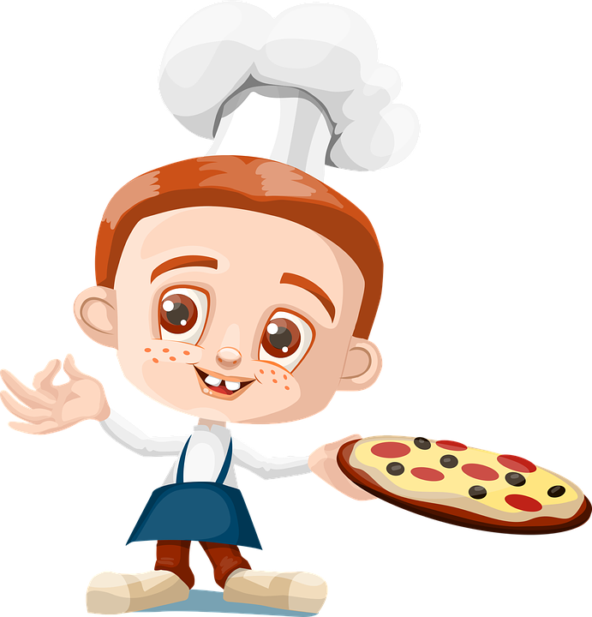
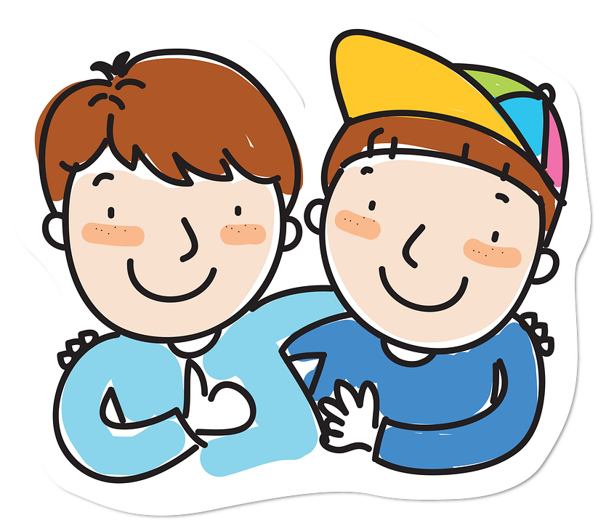
Ali loves pizza .
He loves it.
You are my friends.
I love you.

Slide 20
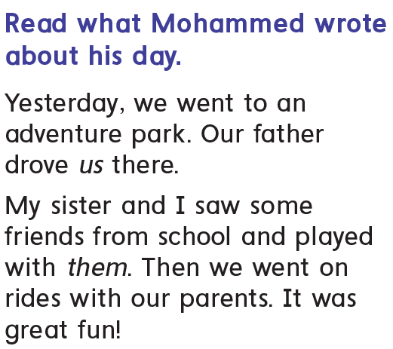
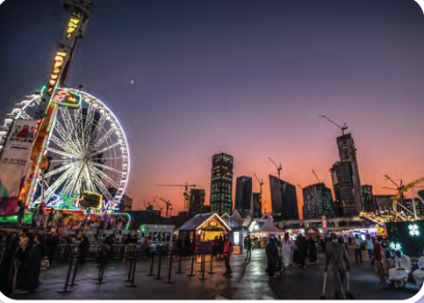

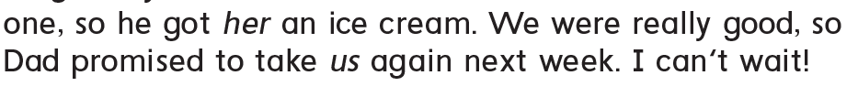


A Fun Day

Slide 21

https://www.liveworksheets.com/vb1558917au

Slide 22


