Slide 1
We can 2 Unit 4 lesson4 Phonics

Slide 2







say, read, and write the sounds bl, cl, fl, gl, pl.
Today you`ll learn HOW to
black
clock
flag
glass
plane

Slide 3

Let`s watch a video!

Slide 4

Listen, say, and match. Then write the missing letters.

Slide 5


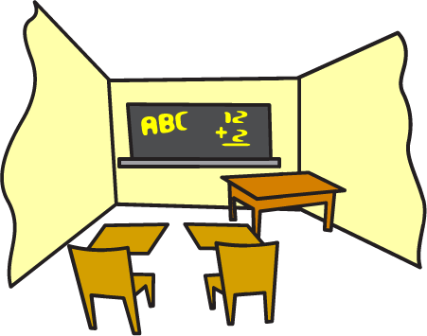





bl, cl, fl, gl, pl
___ant
___ass
___ue

Slide 6

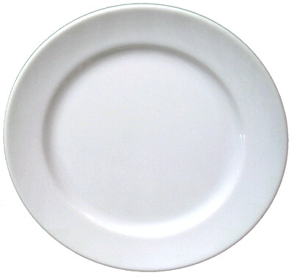







bl, cl, fl, gl, pl
___ue
___y
___ate

Slide 7

Fun time

Slide 8
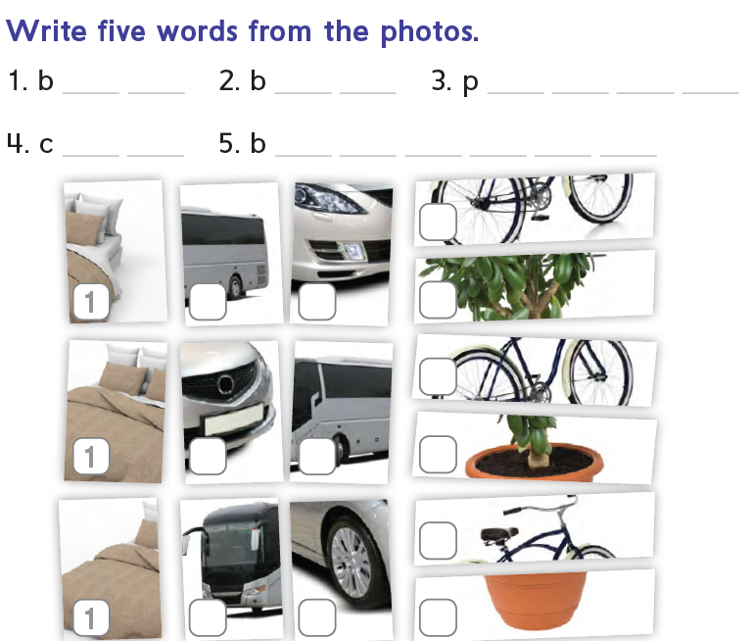
Picture Puzzle P17

Slide 9
Go to page 46

Slide 10
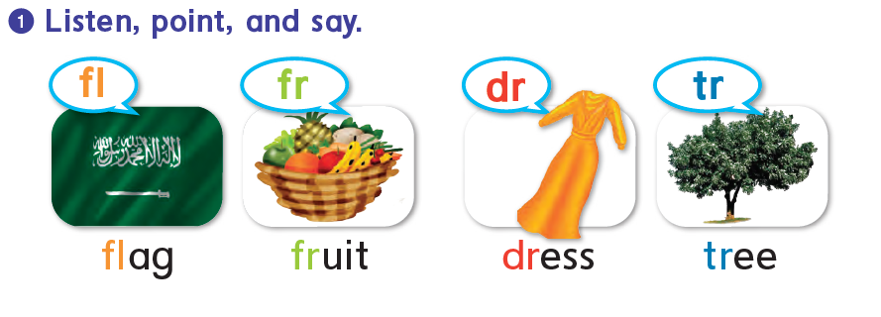
Words with fl, fr and dr, tr

Slide 11
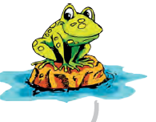

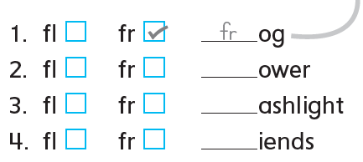

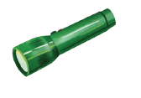

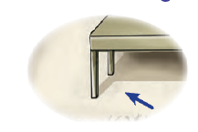





Listen to the sound, check Q, and write. Then draw a
line to the right picture.

Slide 12


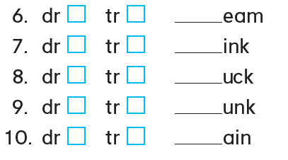

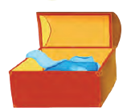
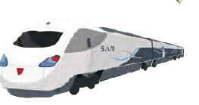







Listen to the sound, check Q, and write. Then draw a
line to the right picture.

Slide 13

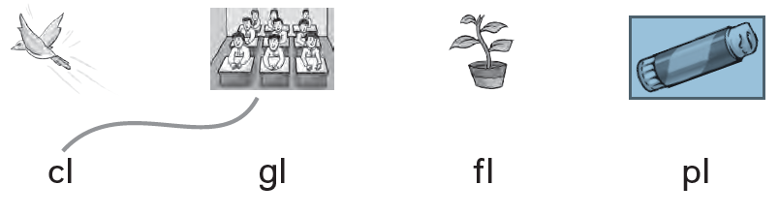




Say and match
class
glue
fly
Plant

Slide 14
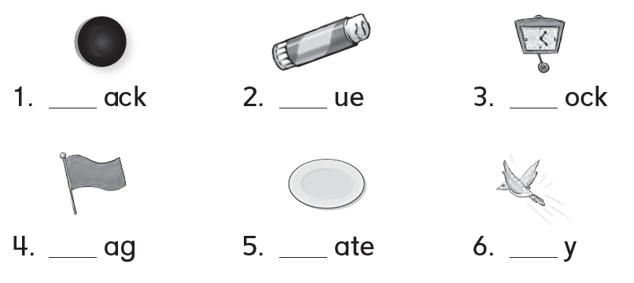







Write the missing letters
bl, cl, fl, gl, pl

Slide 15
Well done !

