Slide 1
Unit 8 Against The Odds Conversation+ Listening
Mega Goal 3.2
Done by: Entisar Al-Obaidallah

Slide 2
Lesson Objectives
01
02
Listen
Answer
03
04
05
Use
Practise
Match
For specific information
Some questions about the conversation
“ Real Talk” phrases in meaningful sentences
Dropping final consonants
The words with their meanings correctly

Slide 3
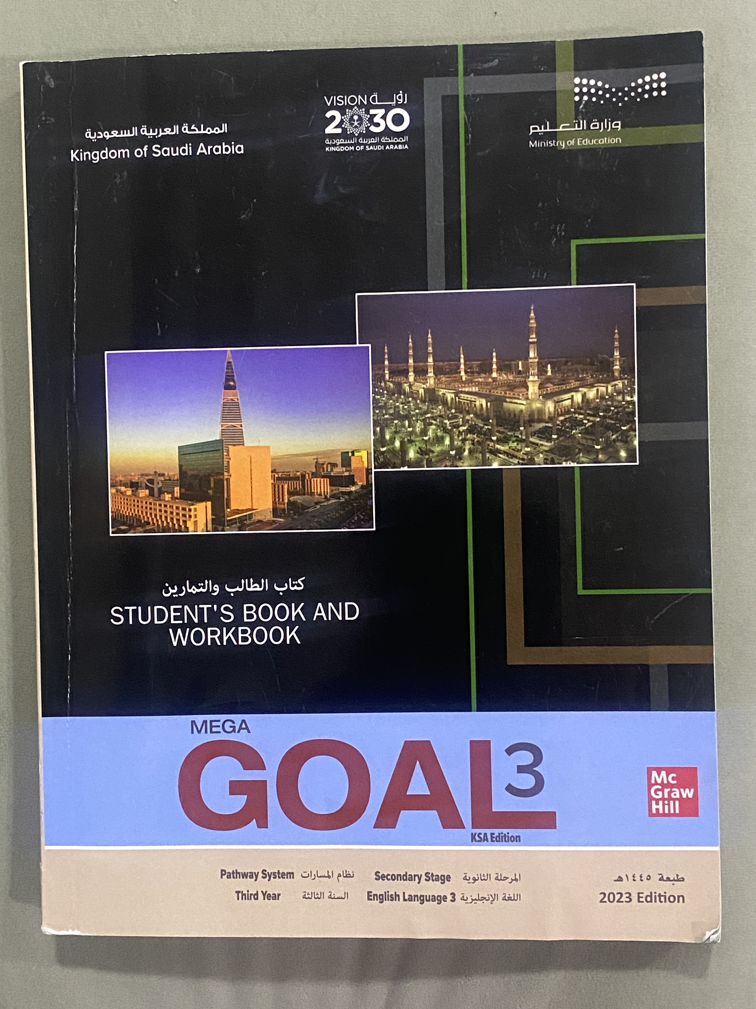
Open
Your student’s book , p.( 114)

Slide 4
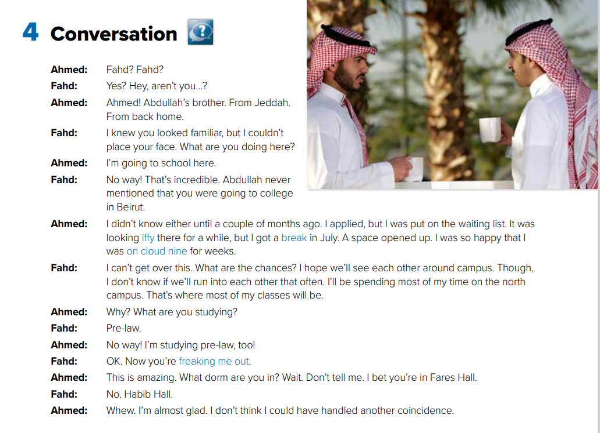


What can you guess about these people?
They must know each other well. They might be friends

Slide 5


Open your book p.(114)
Read along as you listen

Slide 6

What is Ahmed’s lucky break?
A space opened up at the college
Why was Ahmed on cloud nine?
He was accepted at the college
What is freaking Fahd out?
finding out about
all of the coincidences between himself and Ahmed

Slide 7


Slide 8


Who says ………
e freaking me out.
Who says ………
break
Who says ………
on cloud nine
Who says ………
iffy
Ahmad
Fahad
Ahmad
Ahmad

Slide 9
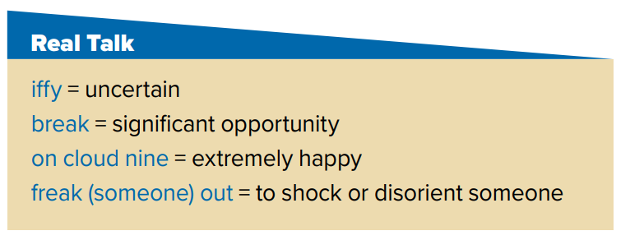
Read the words and their meaning

Slide 10

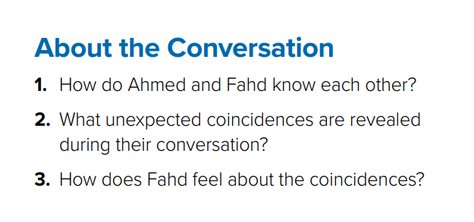
1. They are both from Jeddah. Fahd is friends with Ahmed’s brother.
2. They are both studying pre-law at the same college in Beirut.
3. He feels shocked about the coincidences.

Slide 11

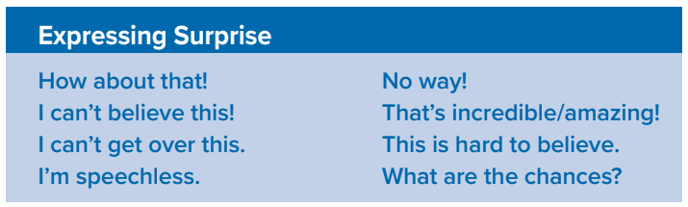

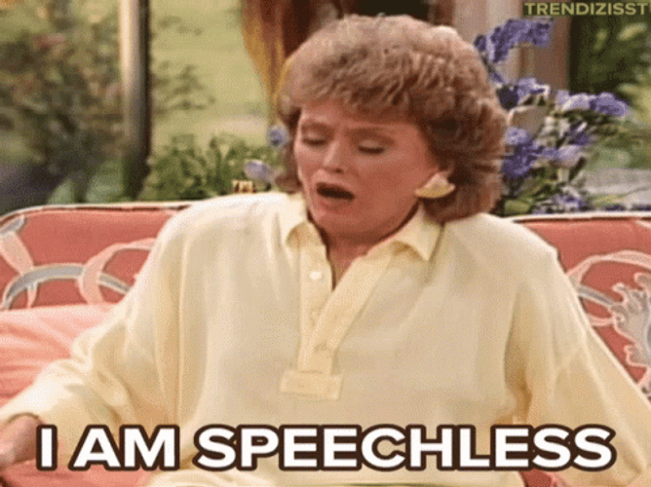
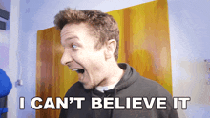

Slide 12
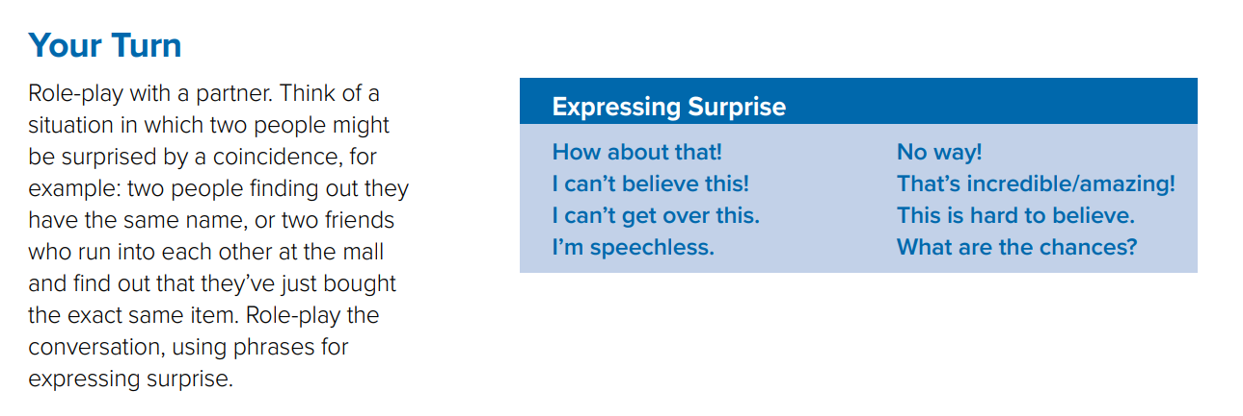


Slide 13
Open
Your student’s book , p.( 115)

Slide 14
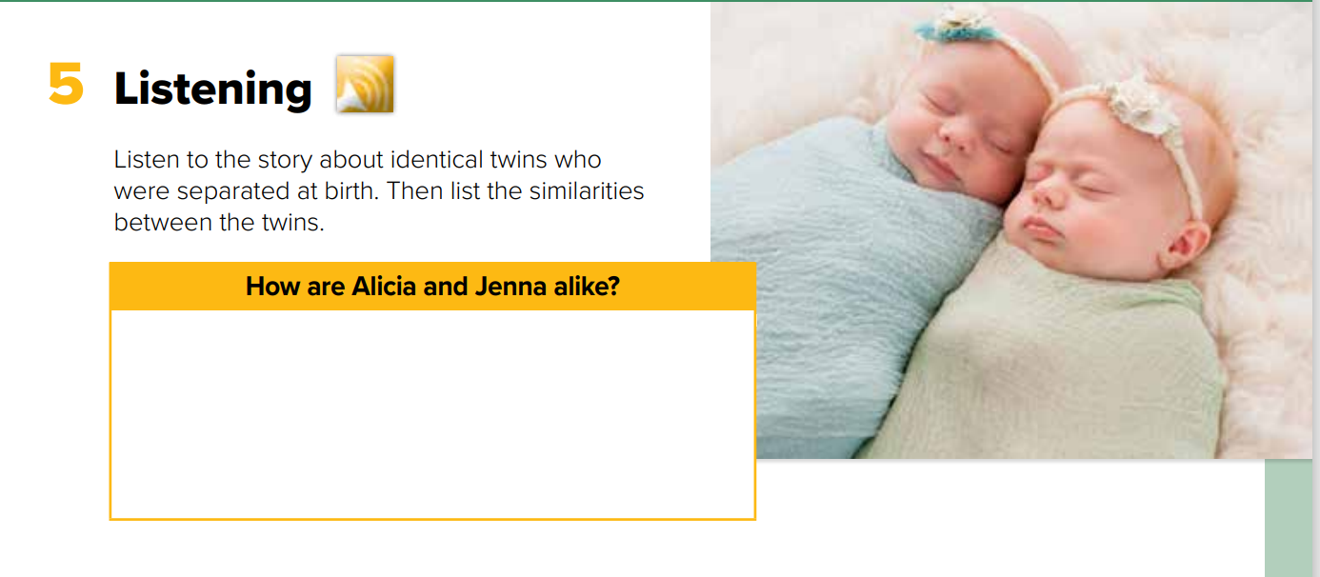
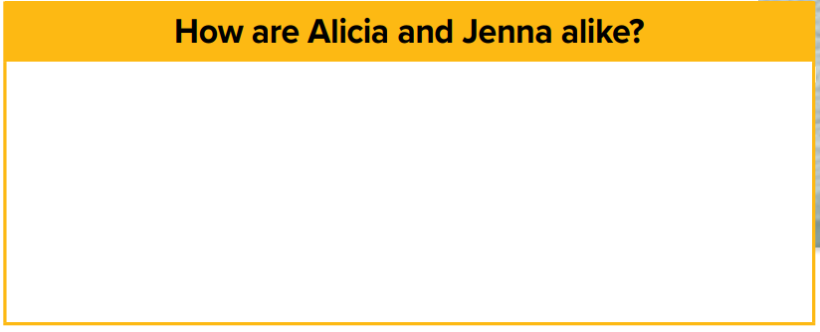

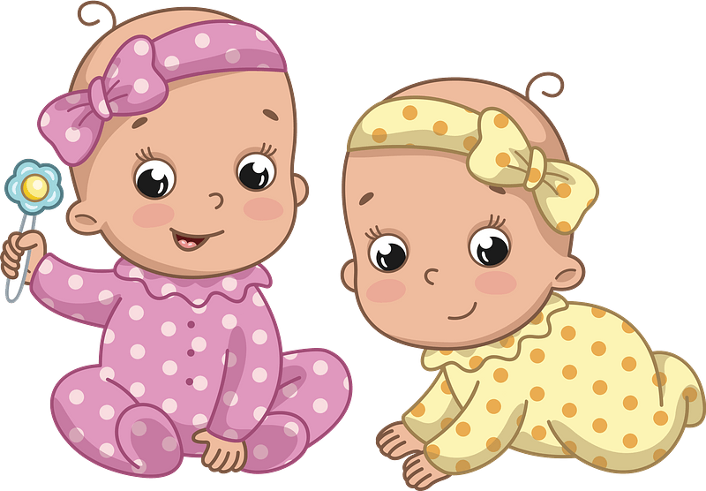
are studying psychology
have similar accents and mannerisms
have been painting since they were five
liked horses
planned to study teaching
volunteered at the community support center
have the same recurring dream

Slide 15
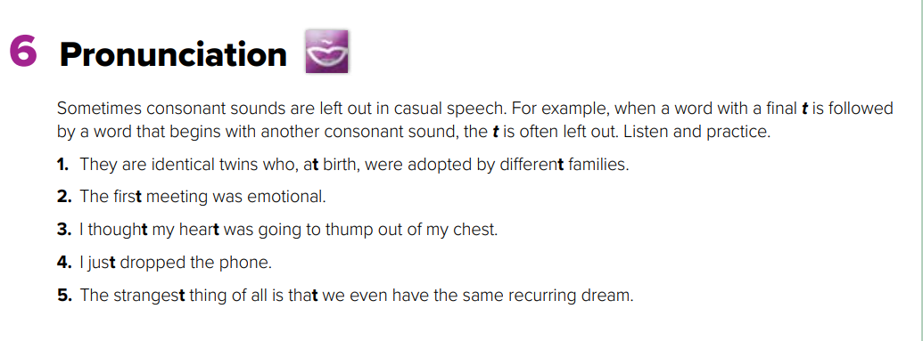
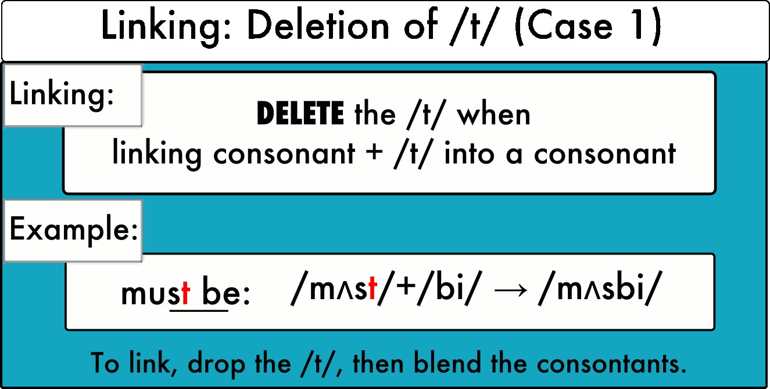

Slide 16
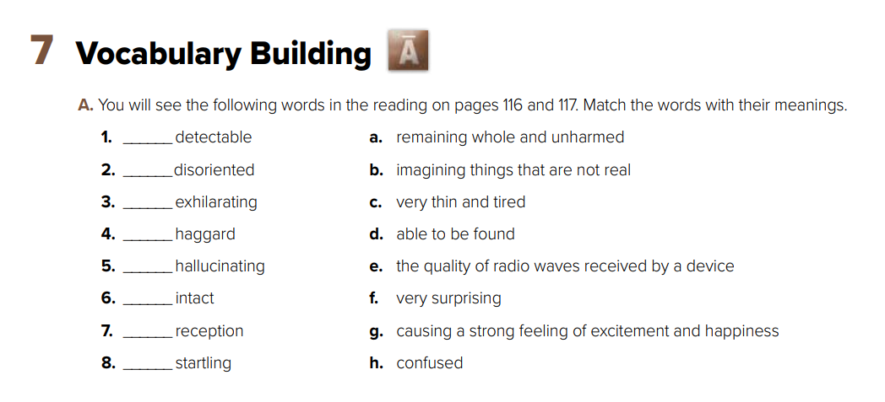
d
h
g
c
b
a
e
f

Slide 17
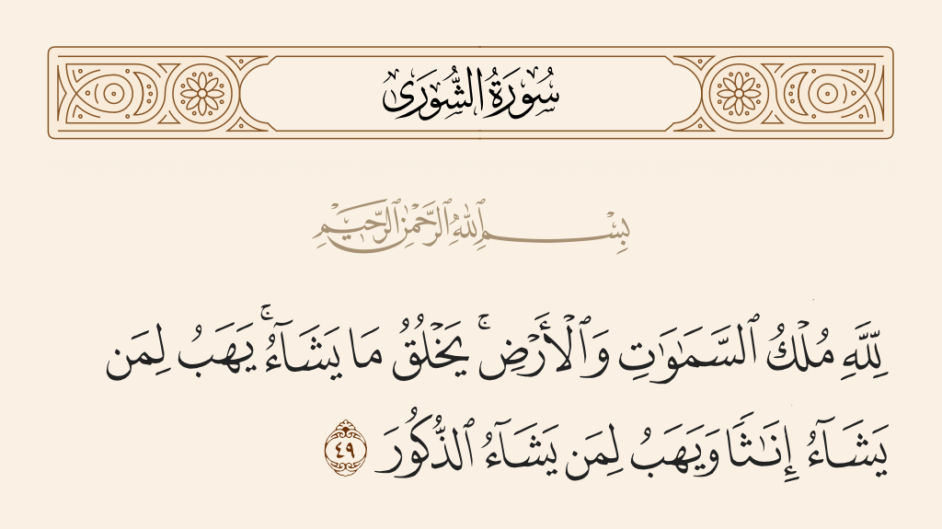
From The Holy Quraan

Slide 18
Homework
On workbook, p. ( 300) ,
Exercises ( C)

Slide 19

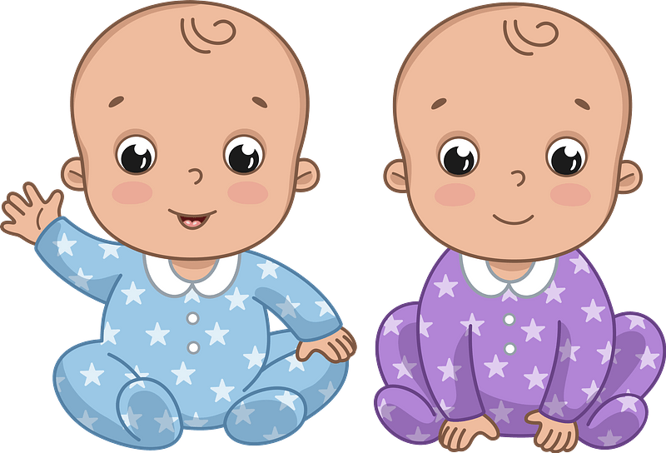
Thanks!

Slide 20
Alternative resources
Here’s an assortment of alternative resources whose style fits that of this template:
Hand drawn flat design childbirth scenes
Free vector hand drawn breastmilk illustration

