Slide 1
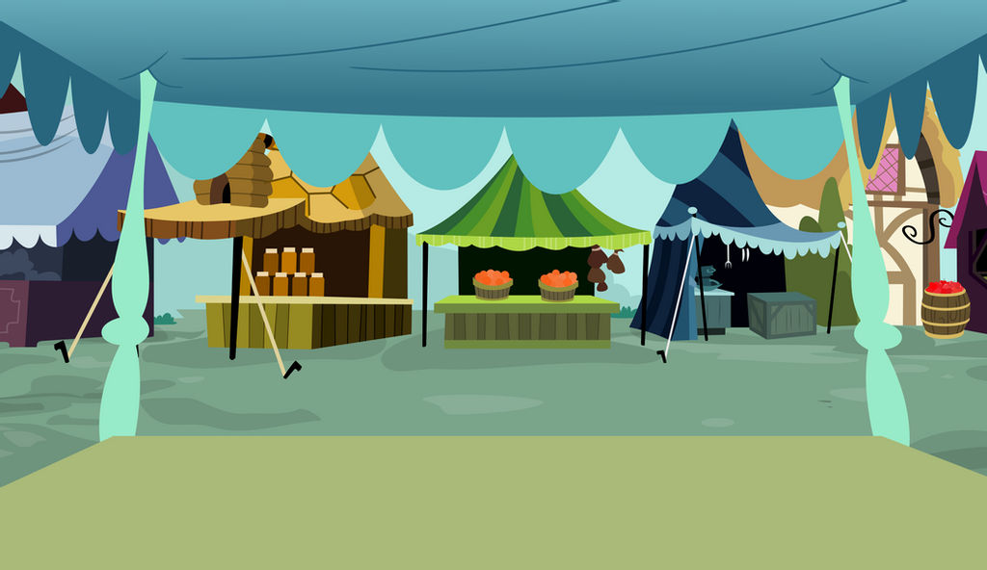
Unit 2 It’s a bargain!
Reading

Slide 2
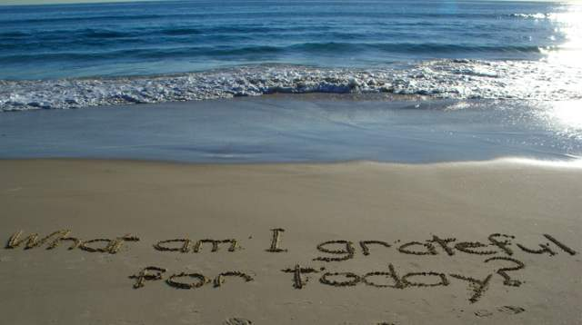

Slide 3

Read a passage about local shops using “predicting strategy”
Answer some questions about the passage

Slide 4

What’s your favorite place to shop?

Slide 5
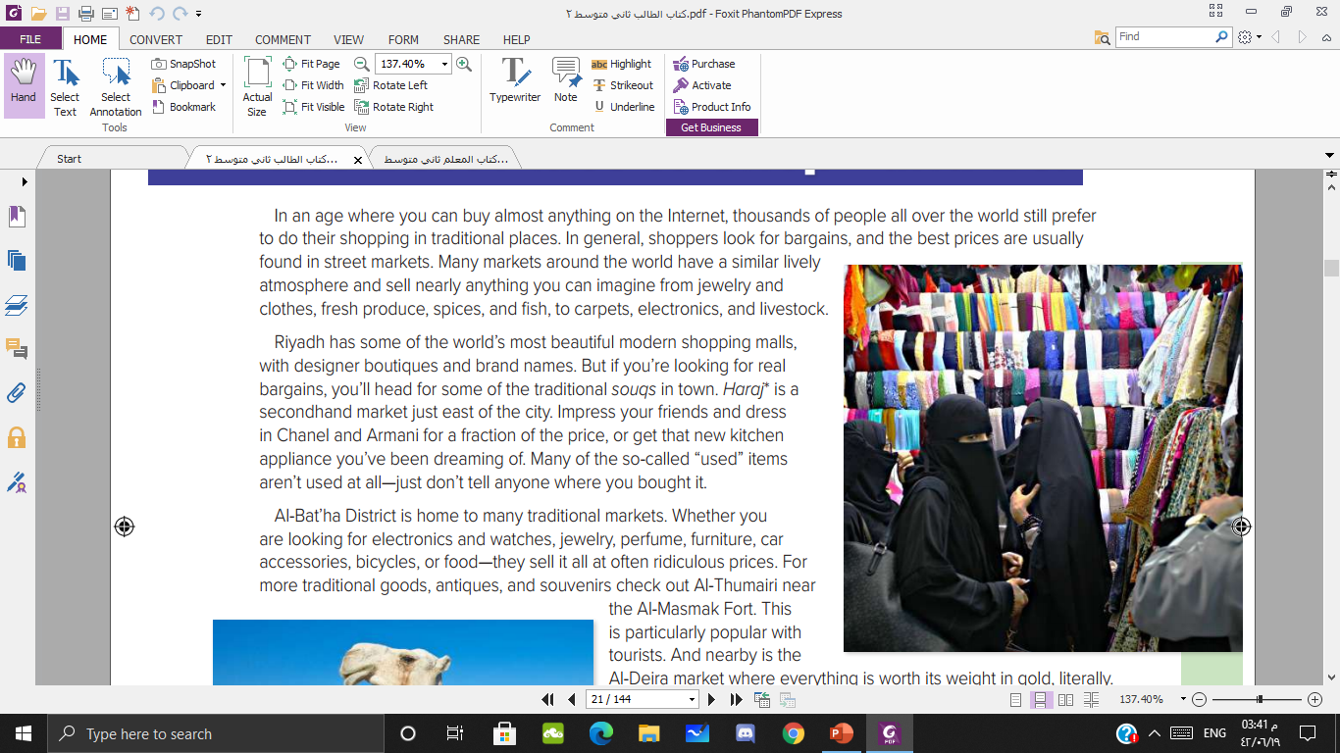
Where are the people?
What can people buy in this place?
Do you like to shop at street markets? Why?

Slide 6
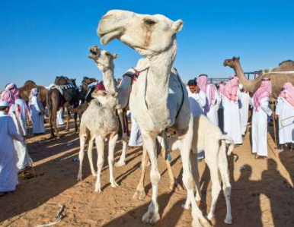
Where are the people?
What can people buy in this place?

Slide 7


Surveys
bargains
A lot of stuff stores
lively
expensive
secondhand
Cultural experience
Brand names
Predict the five words you expect to be in the reading passage

Slide 8
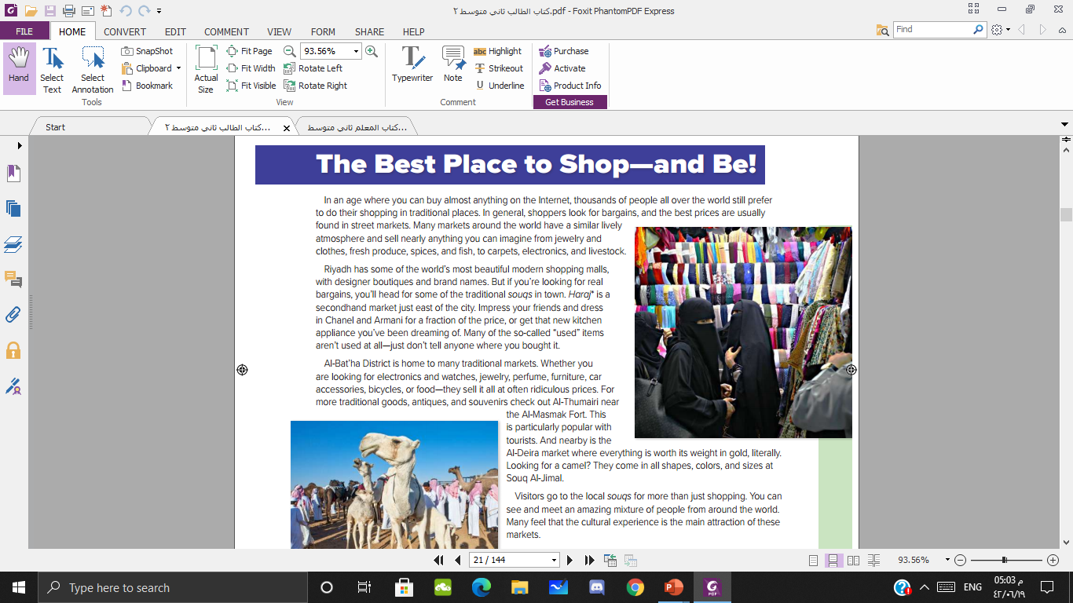
What’s the title?

Slide 9
Which the markets are mentioned in the passage?

Slide 10


Slide 12

Surveys
bargains
A lot of stuff stores
lively
expensive
secondhand
Cultural experience
Brand names

Slide 13

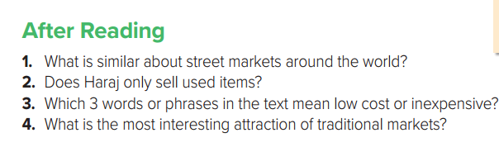

Slide 14
1
3
2
5

Slide 15
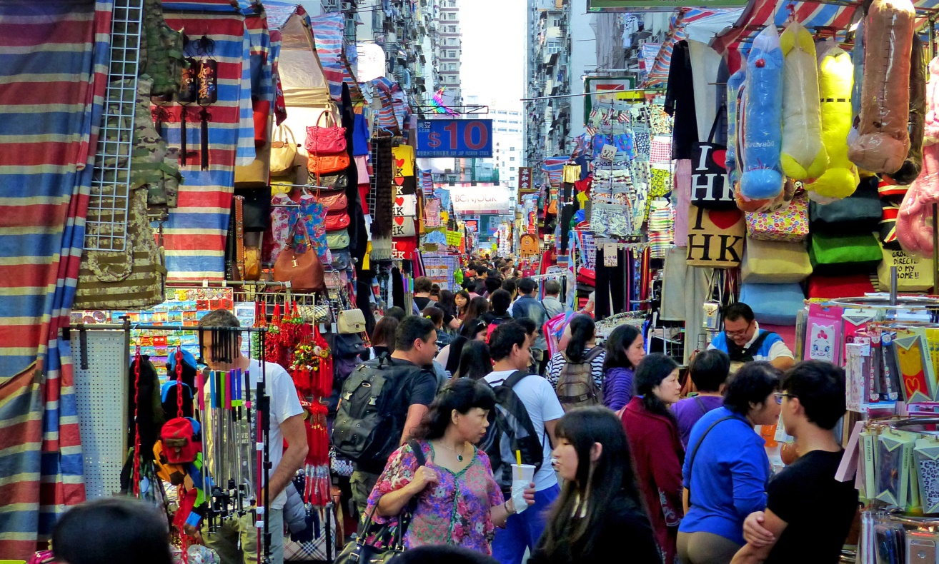
Street market
Shopping mall
Boutique

Slide 16

None used
Used
Not for sale

Slide 17
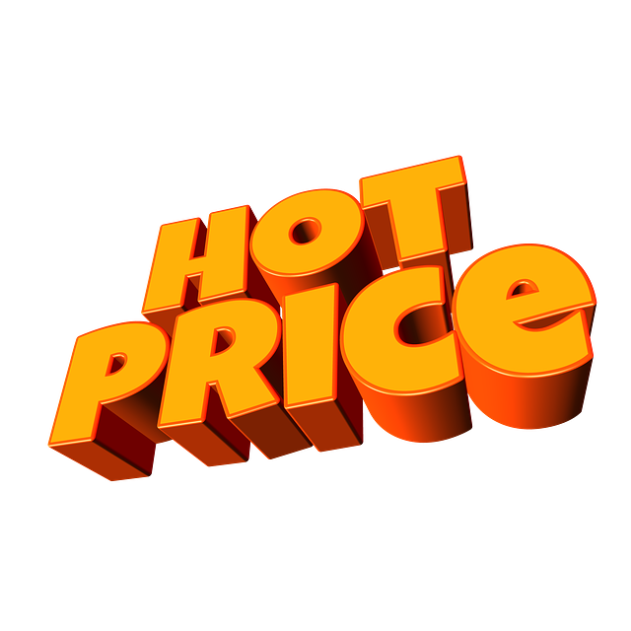
Bargain
Expensive
For sale

Slide 18
Shopping
Malls
Boutiques
Street markets
Soques
Haraj
Online

Slide 19
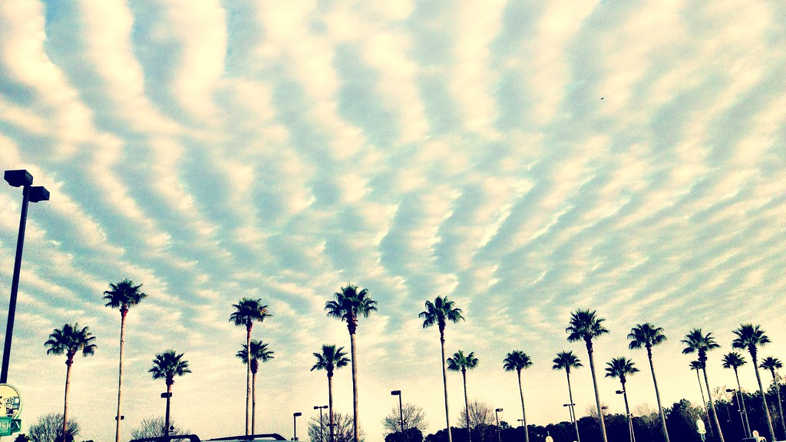
Have a nice day

