Slide 1
Mega Goal 2.2
U: 4
The Sporting Life
Conversation + Listening
By: Yousef Hilal Alyazedi

Slide 2
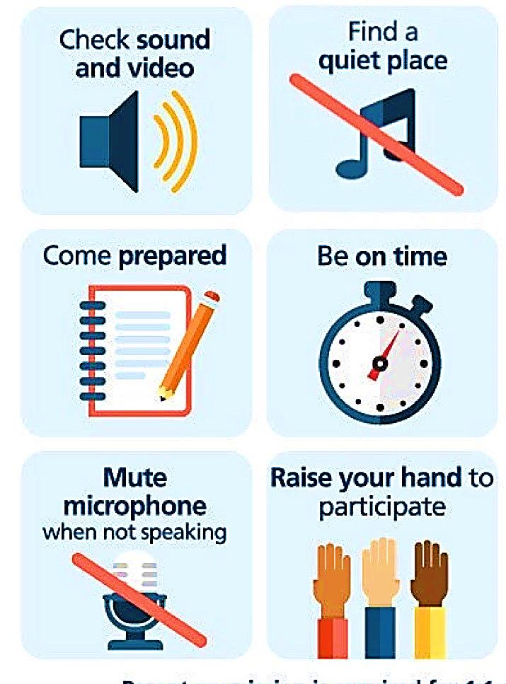
Online Classroom Rules

Slide 3
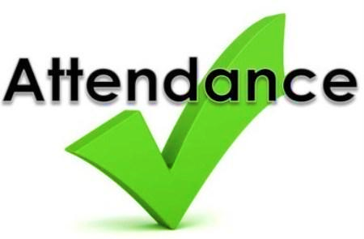
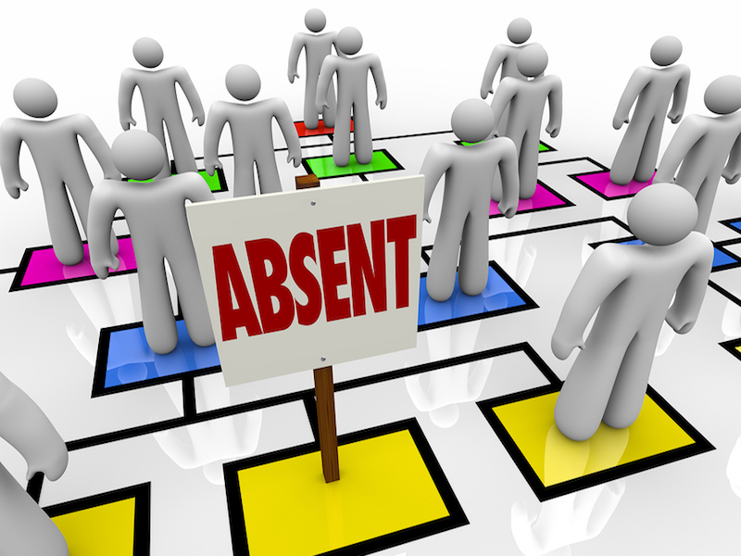

Slide 4


Lesson Objectives
The students will be able to :
1 – Listen for specific information.
2 – Use ‘’ Real Talk ‘’ phrases in correct sentences .
3 – Express confidence in someone .
4 – Complete the chart according to the profile’s audio .
5 – Find the meaning of new words .

Slide 5
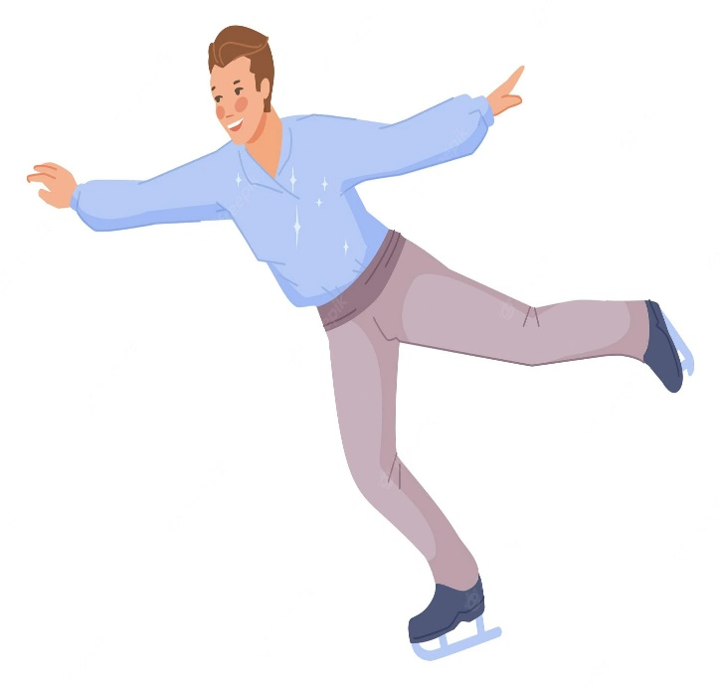
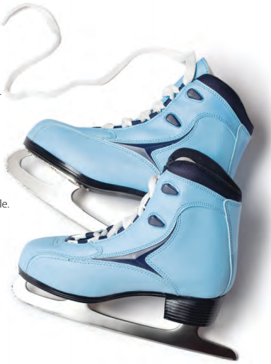
What sport are these for ?
Figure skating

Slide 6
Books Closed

Slide 7



Listen to someone who is about to skate in an important competition talking to his coach.

Slide 8
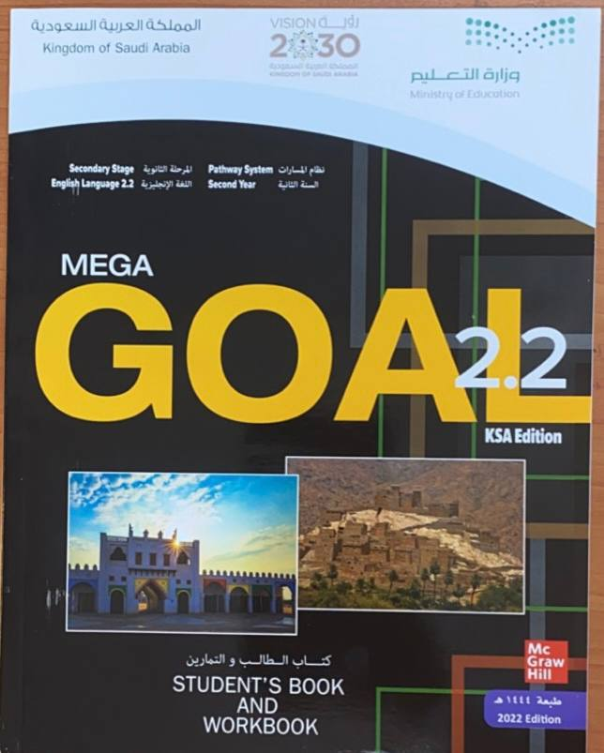

Open your Student’s book at page: 118

Slide 9
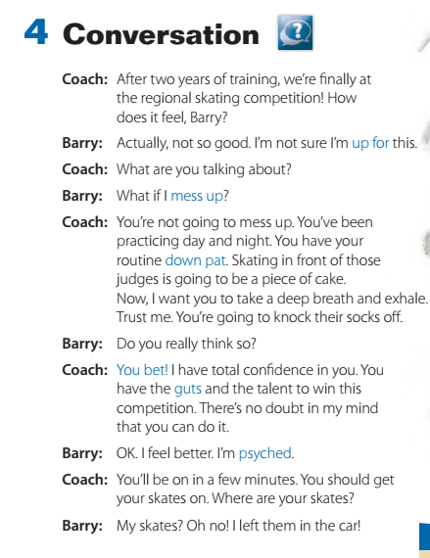
Read along

Slide 10
How many persons in this conversation ?
Two persons .
Who are they ?
The coach & Barry .
What are they talking about ?
about skating in an important competition .

Slide 11
How many years of training ?
How does Barry feel ?
How does the coach help Barry ?
Does the coach trust Barry ?
What did he say ?
Does he bring his skates ?
Where ?

Slide 13
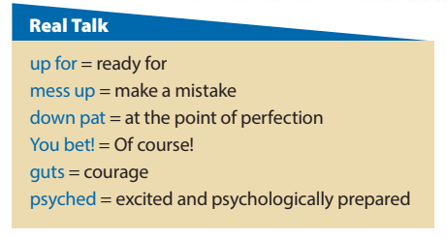
We’re going to the cinema later – are you up for it ?
I think he will mess up on the last question .
Make sure you practice these equations until you have them down pat .
‘’ Are you coming up to the party ?‘’ You bet! .
He has a lot of guts to stand up to management .
We are so psyched about this new project .

Slide 14
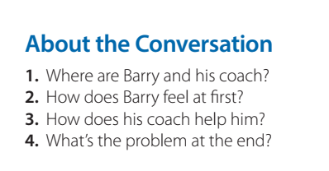
1. They are at an ice-skating competition.
2. He is nervous.
3. His coach encourages him and gives him more confidence.
4. Barry forgot his skates in the car

Slide 15
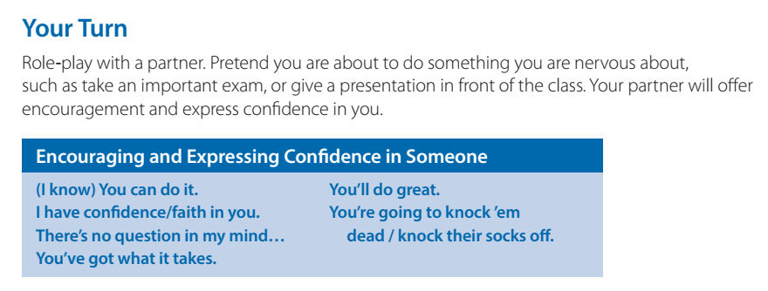

Which expressions does the coach use to encourage Barry?

Slide 16
Open your Work Book at page: 298

Slide 17
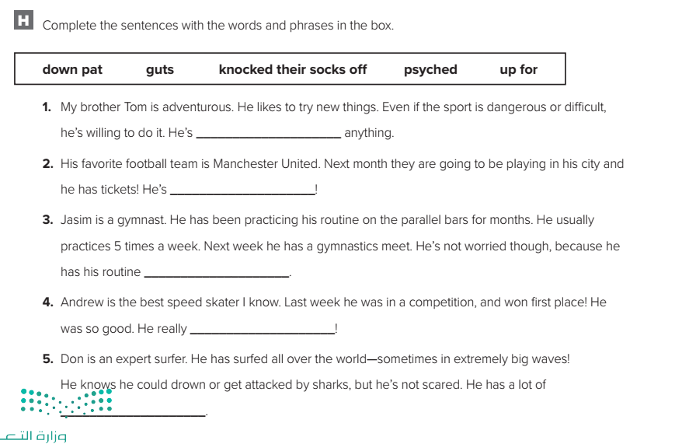
up for
psyched
down pat
knocked their socks off
guts

Slide 18
Open your Student’s book at page: 119

Slide 19
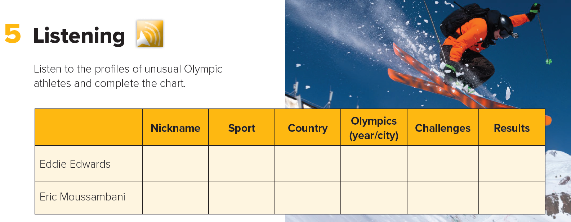

Slide 20
Complete the chart:
Results | Challenges | Olympics (year/city) | Country | Sport | Nickname
 |  |  |  |  |  | Eddie Edwards
 |  |  |  |  |  | Eric Moussambani
finished last in event
*heavier than competitors
* near-sighted
*Only practiced
for 2 seasons
The Eagle
Ski jumping
Great Britain
1988, Calgary
*only been swimming for
8 months
*Never seen an Olympic-sized pool
finished a full
minute behind
any
competitive time
Swimming
Equatorial Guinea
The Eel
2000, Sydney

Slide 21
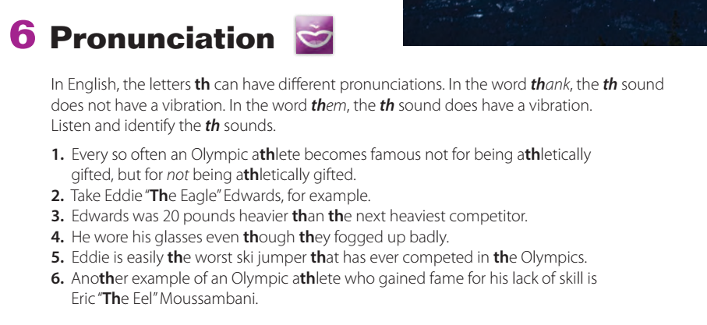

Slide 22
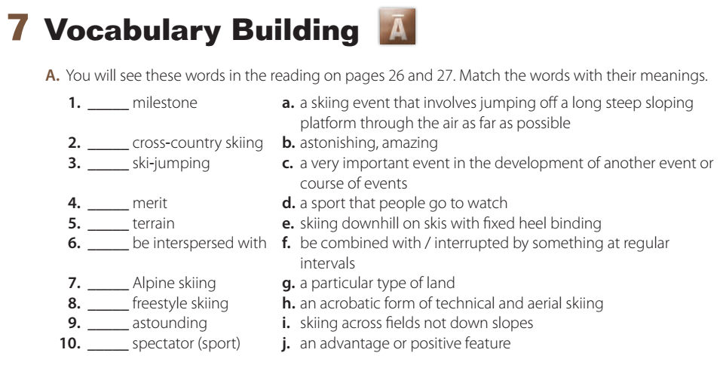
c
i
a
j
g
f
eh
b
d

Slide 23

Workbook P. 298
Exercise G

Slide 24

