Slide 1
We can
6
hello

Slide 2
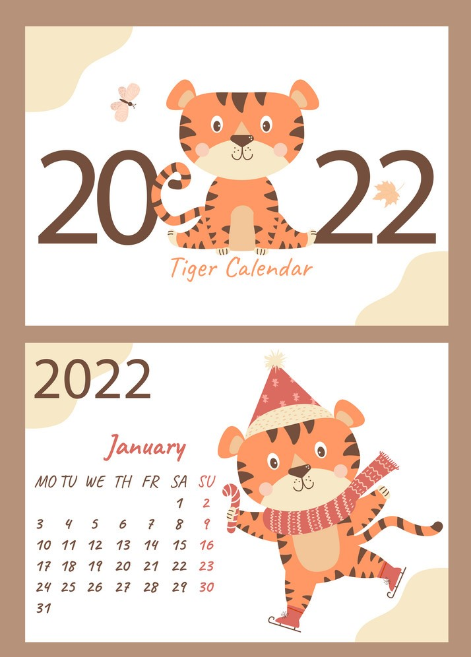
Day :
Date :

Slide 3
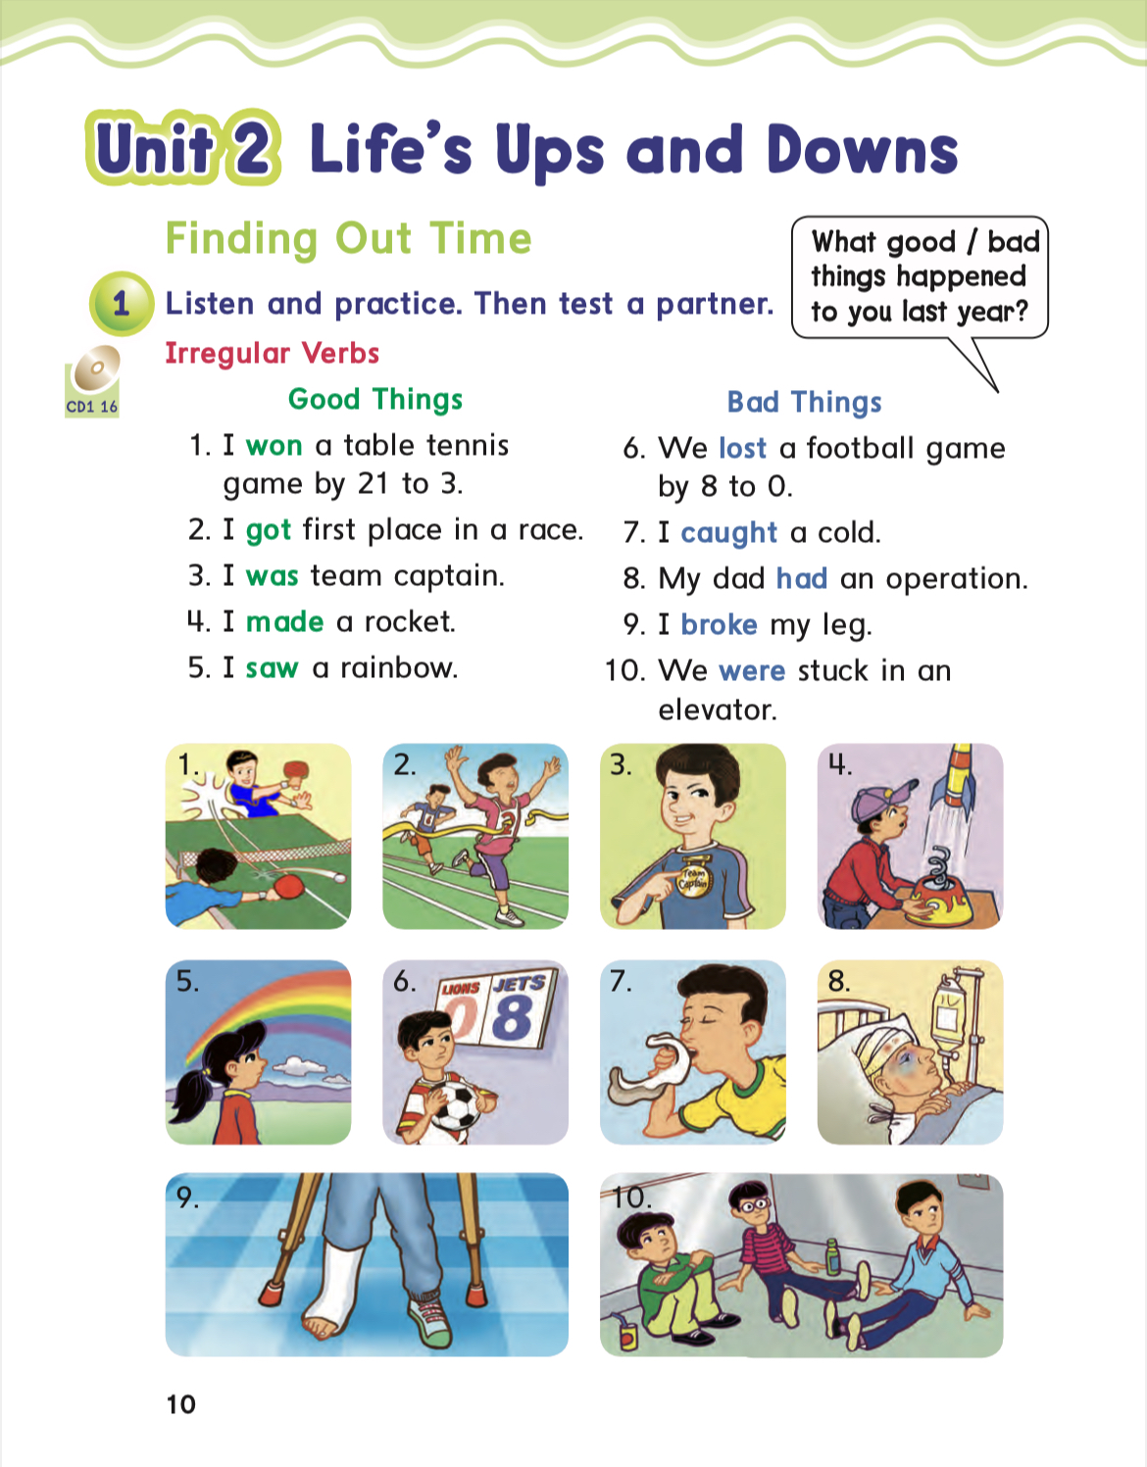
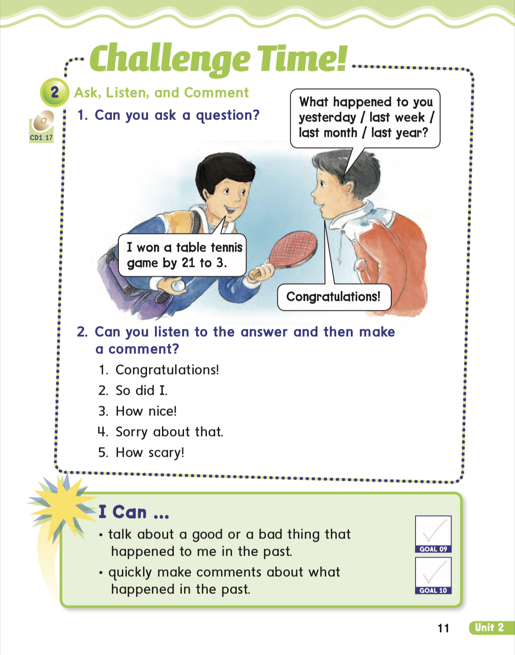
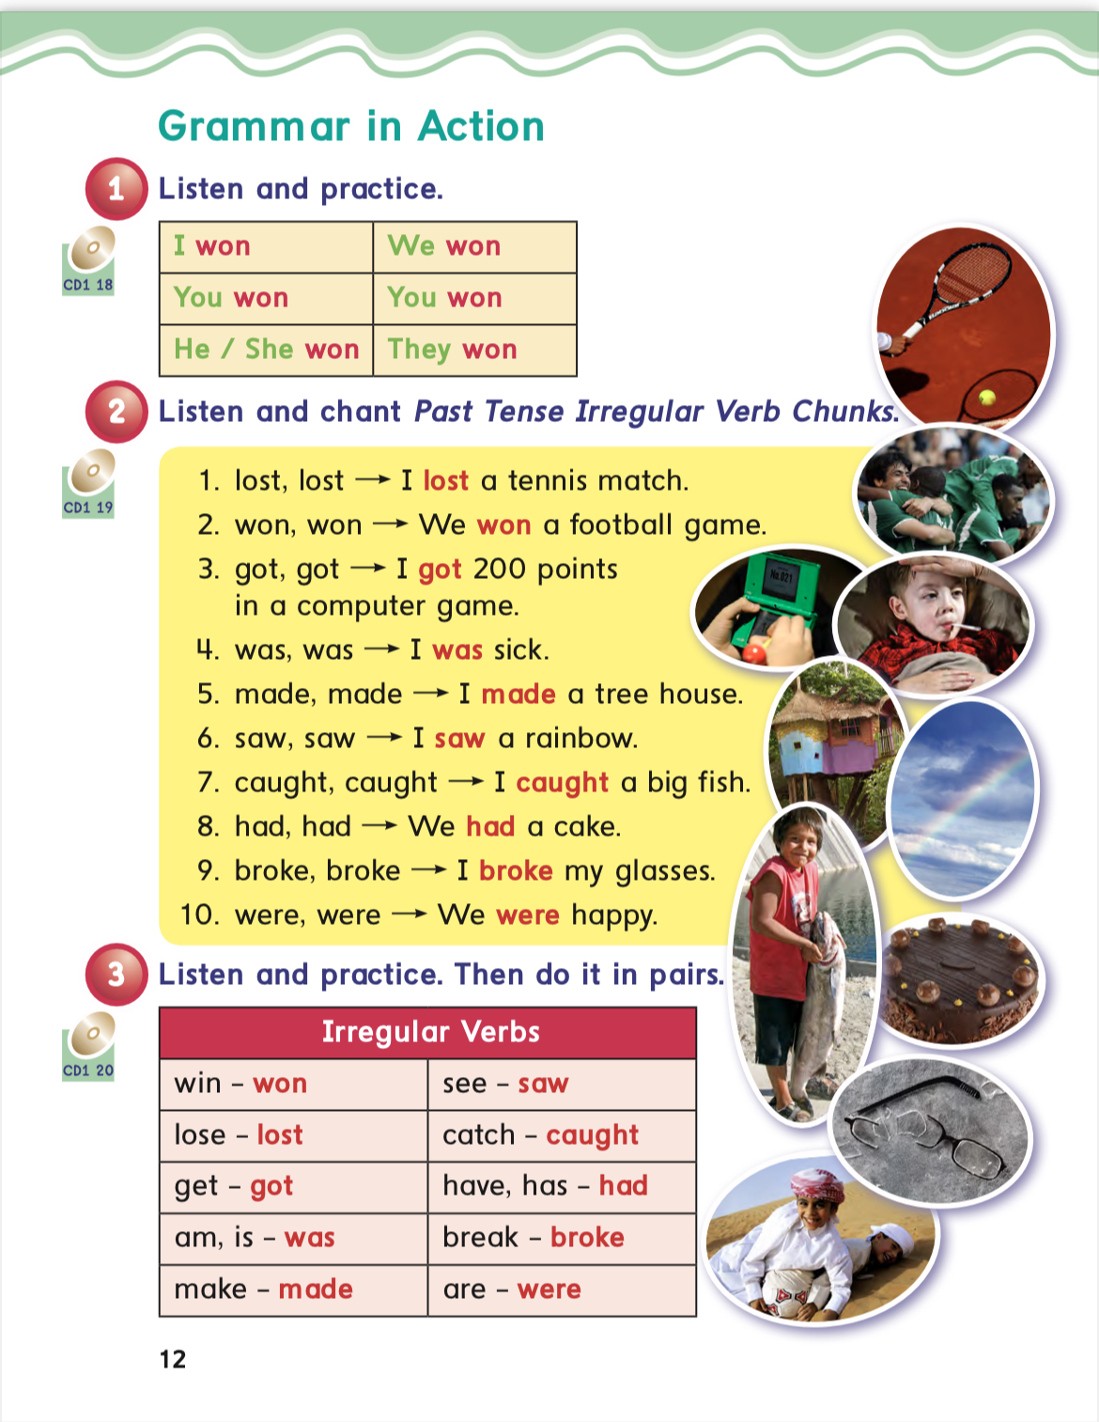
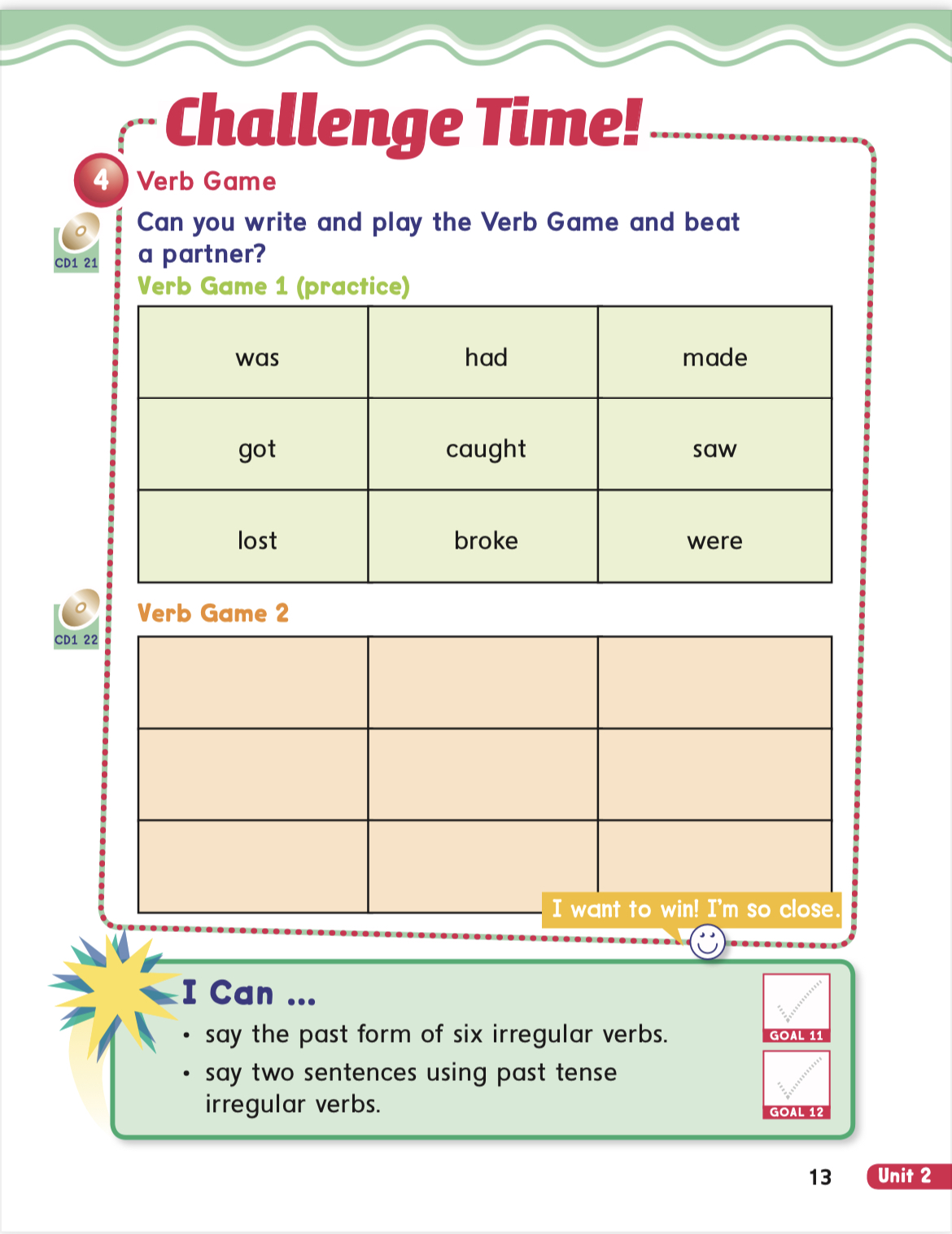
8,
9,
10
&
11

Slide 4






I can….
.talks about a good or bad things that happened to me last year.
-quickly make comments about what happened in the past.
Say the past form of six irregular verbs.
Say two sentences using past tense irregular verbs.

Slide 5

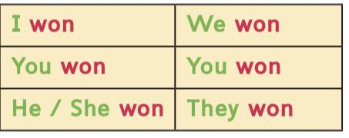
win
S +v (past form )

Slide 6
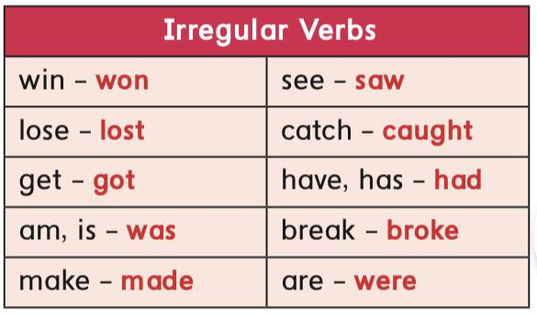

Slide 7


What good things happened to you last year?

Slide 8






we won
a football game.
win
win

Slide 9


I got first place
in a race.
get
win

Slide 10
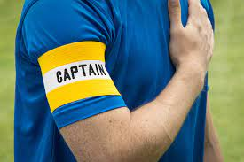
I was the
team captain.
am
win
So I did

Slide 11

I had
a cake.
have
win

Slide 12
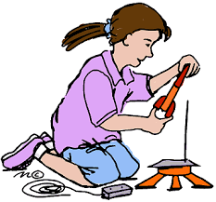

I made
a rocket.
make
win

Slide 13

I caught
a big fish.
catch
win

Slide 14

I made
a tree house.
make
win

Slide 15


I saw
a rainbow.
see
win

Slide 16

we were
happy.
are
win

Slide 17

What bad things happened to you last year?

Slide 18
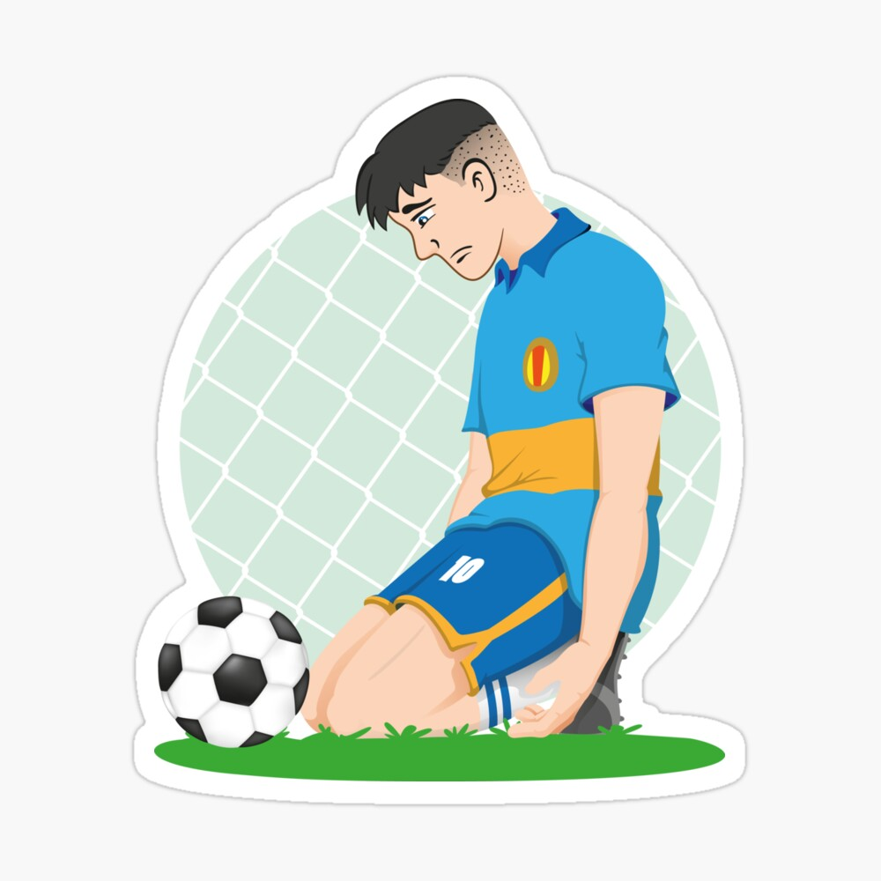
I lost
a football game
by 8 to 0.
lose
win
Sorry about that

Slide 19
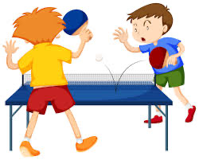
I lost
a tennis game
.
lose
win
Sorry about that

Slide 20

I caught
a cold.
catch
win
So I did

Slide 21

My dad had
an operation.
have
win
Sorry about that

Slide 22

I was
sick.
am
win

Slide 23
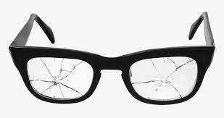
I broke
my glsses.
break
win
Sorry about that

Slide 24
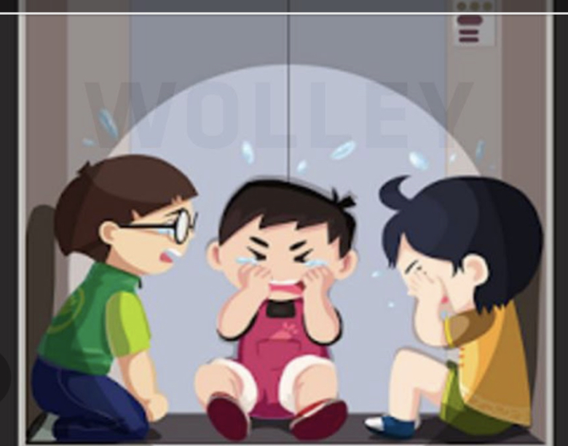
we were
stuck in
an elevator.
are
win
How scary!

Slide 25
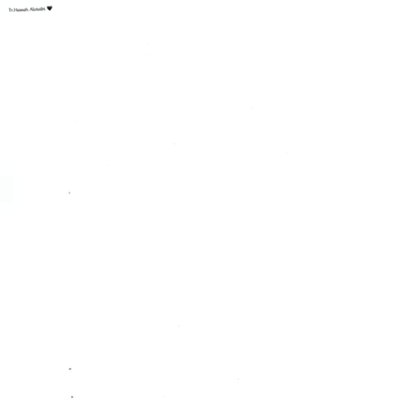

Slide 26
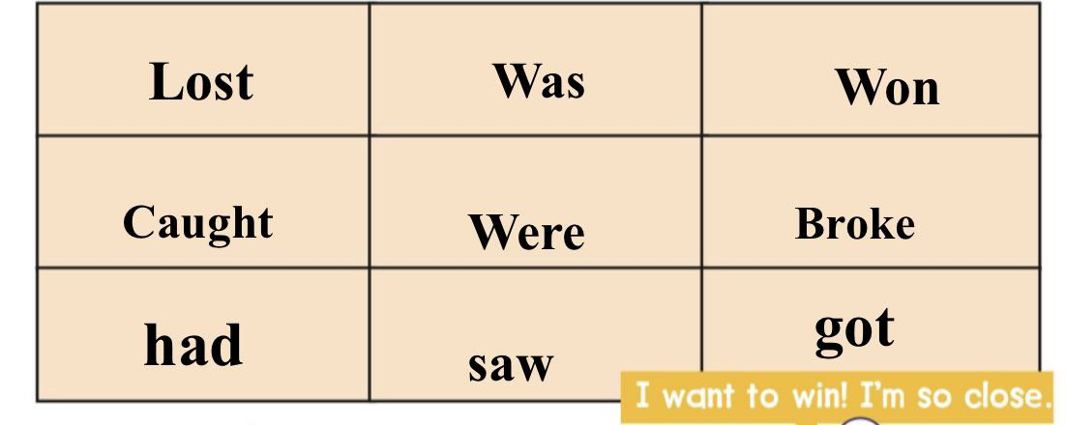

Slide 27


Slide 28

Choose the past form of the verb
1
won
2
win

Slide 29

Choose the past form of the verb
1
lost
2
lose

Slide 30
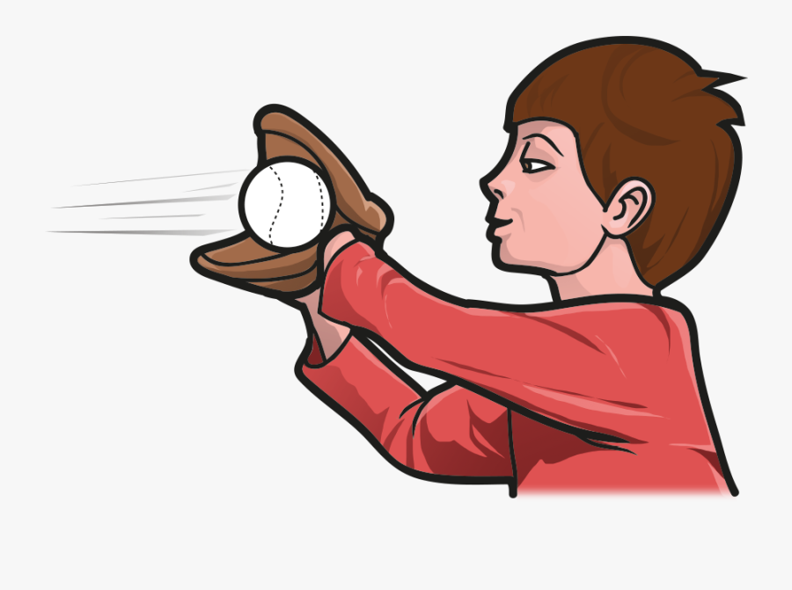
Choose the past form of the verb
1
catch
2
caught

Slide 31

Choose the past form of the verb
1
saw
2
see

Slide 32

Choose the past form of the verb
1
break
2
broke

Slide 33
the past form of the verb
win

Slide 34
the past form of the verb
won

Slide 35
the past form of the verb
am

Slide 36
the past form of the verb
was

Slide 37
the past form of the verb
make

Slide 38
the past form of the verb
made

Slide 39
the past form of the verb
lose

Slide 40
the past form of the verb
lost

Slide 41
the past form of the verb
see

Slide 42
the past form of the verb
saw

Slide 43
the past form of the verb
are

Slide 44
the past form of the verb
were

Slide 45
the past form of the verb
break

Slide 46
the past form of the verb
broke

Slide 47
the past form of the verb
have

Slide 48
the past form of the verb
had

Slide 49



Slide 50



Slide 51


Home work at

