Slide 1



T.

Slide 2
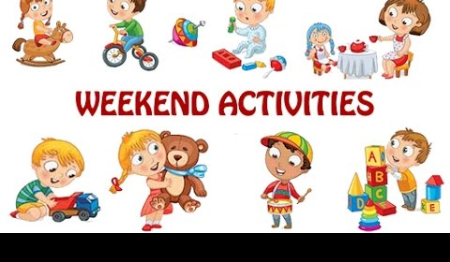



Fun on the weekend

Slide 3


Unit 1
Fun on the weekend
Lesson 4

Slide 4


By the end of the lesson
You will be able to …….
Say, read and write words ending in nd and nt
Read English store signs in town.

Slide 5
Open your book
page 8

Slide 6
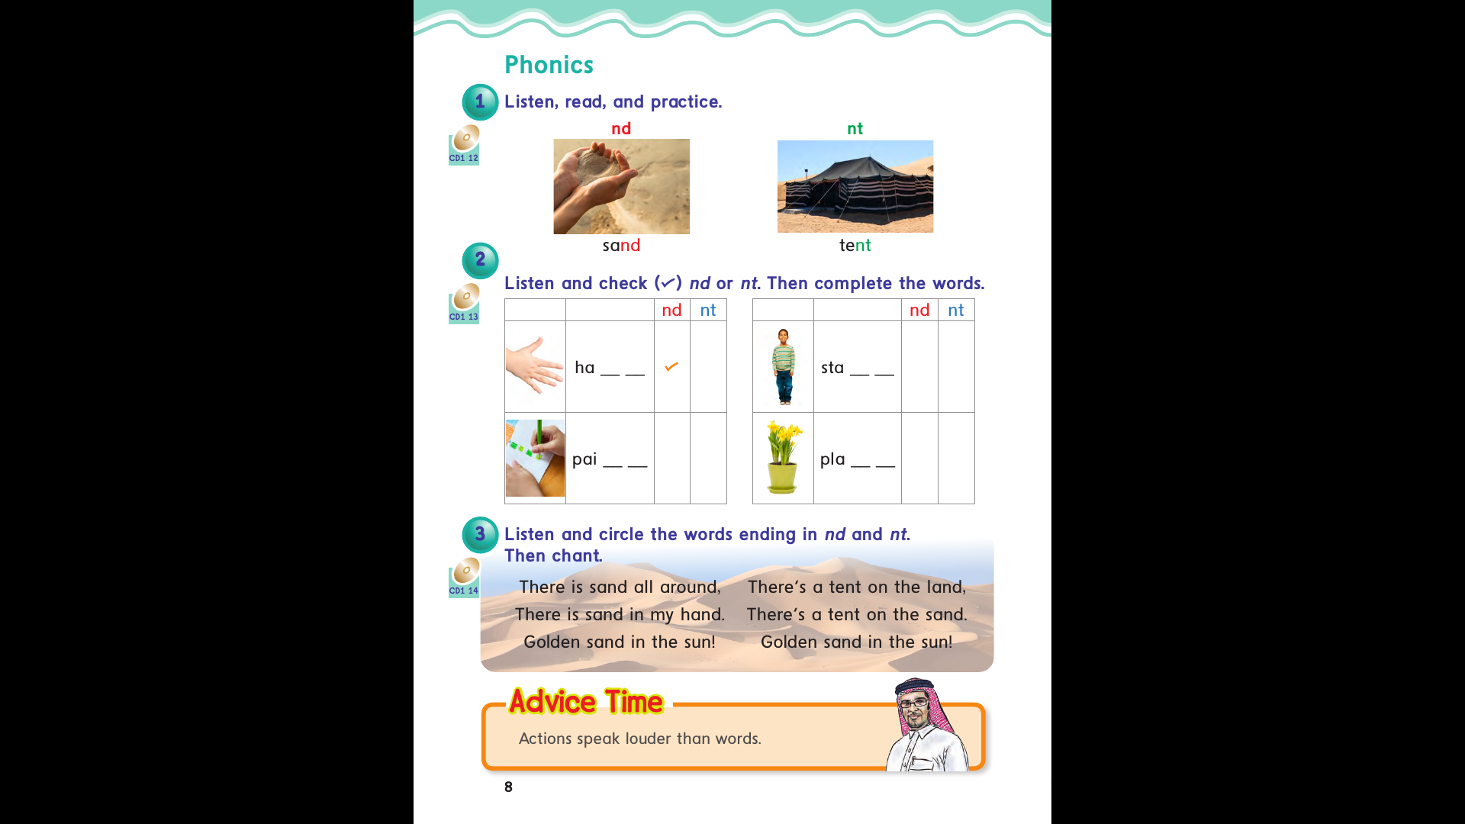

Slide 7


Slide 8


Slide 9











Slide 10


Slide 11
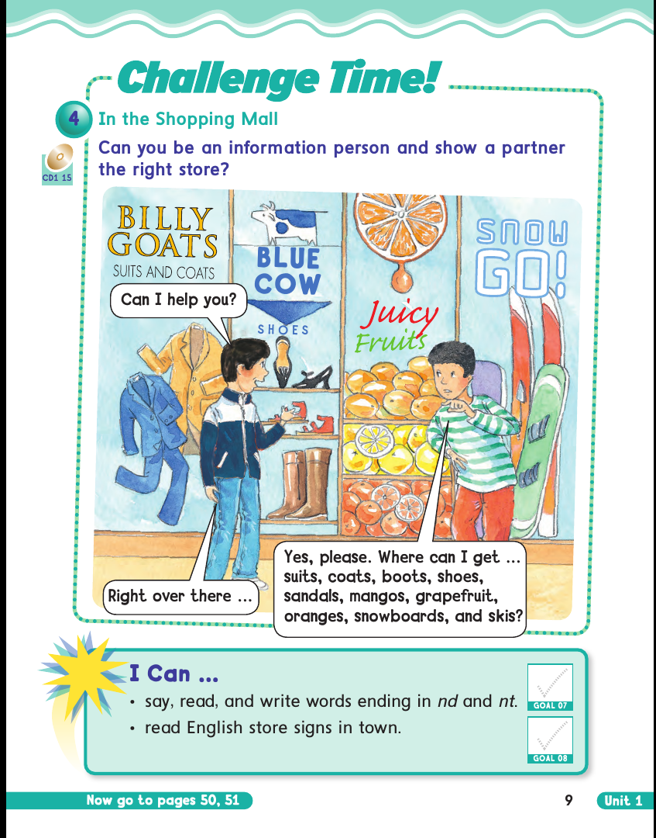

Slide 12

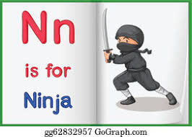
Let’s Practice

Slide 13
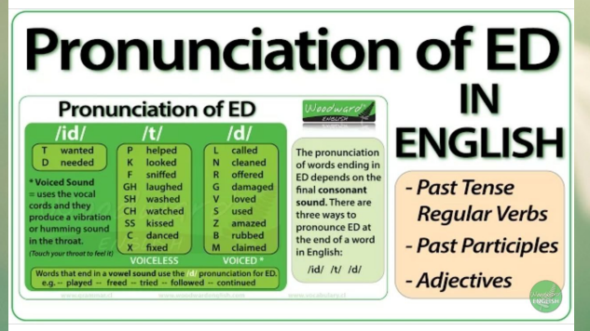

Slide 14
Open page :50,51

Slide 15
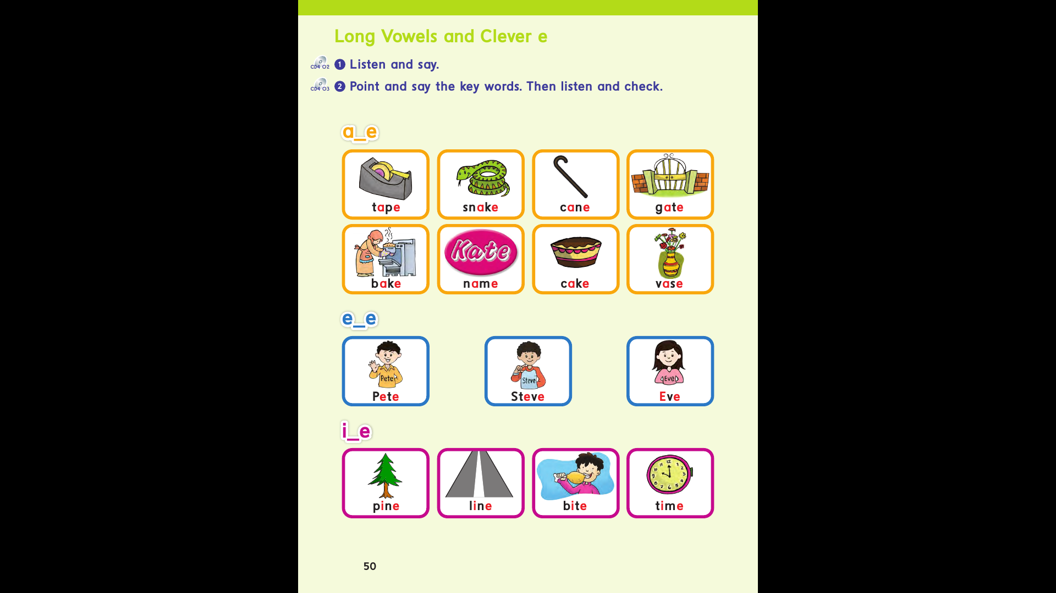
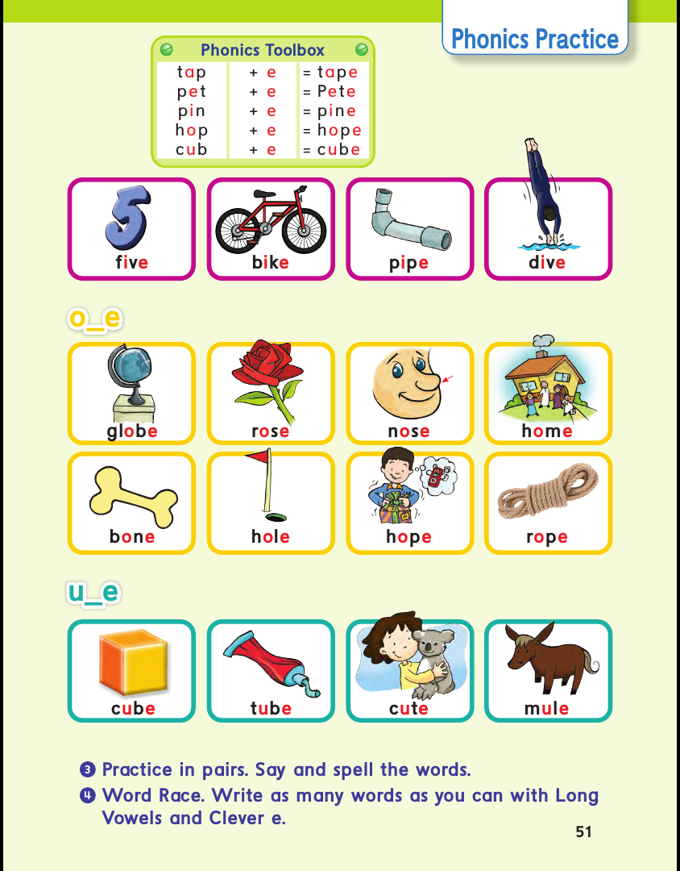

Slide 16
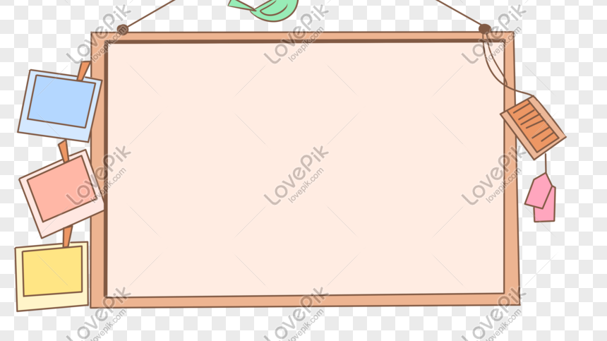

T.Noura A
Al-Nejaim
H.W Page:77+78

