Slide 1




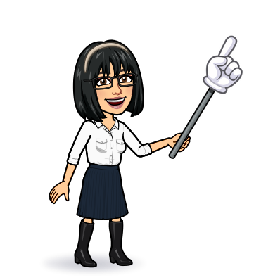

8 reading
Today:
Date:
- -
Page 77
By: Dalal Al-Juaid

Slide 2


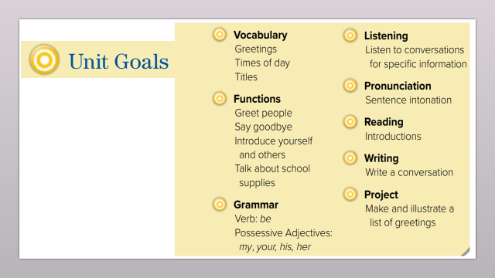
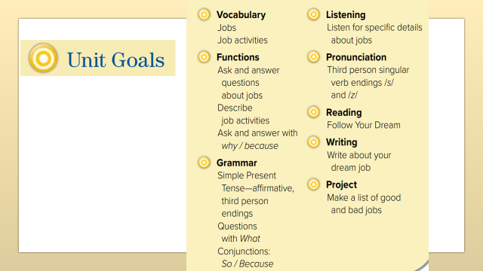
read a text for specific information
use personal notes to write about their dream job
Warm up
compare a list of good and bad jobs with classroom members
find out the meaning of new words

Slide 3
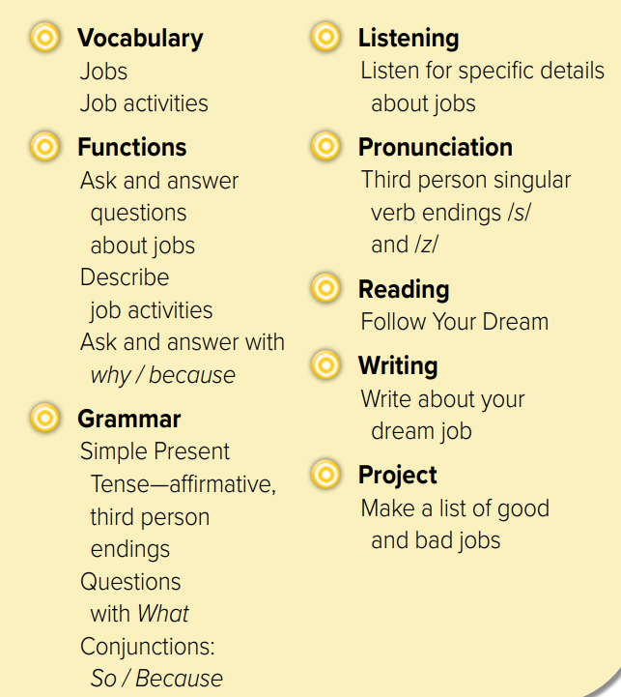
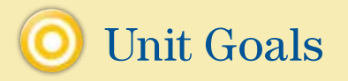

Slide 4
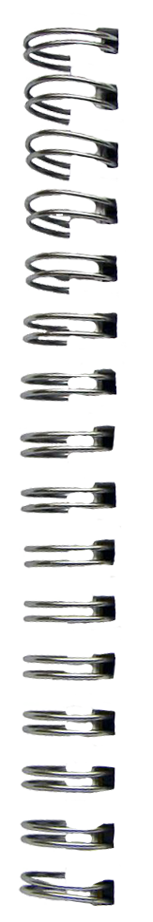

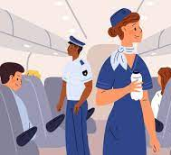




Revision
design clothes : ………
takes photo: ………
We read a book
She
reads a book
….
…..
….
……

Slide 5






Warm up

Slide 6

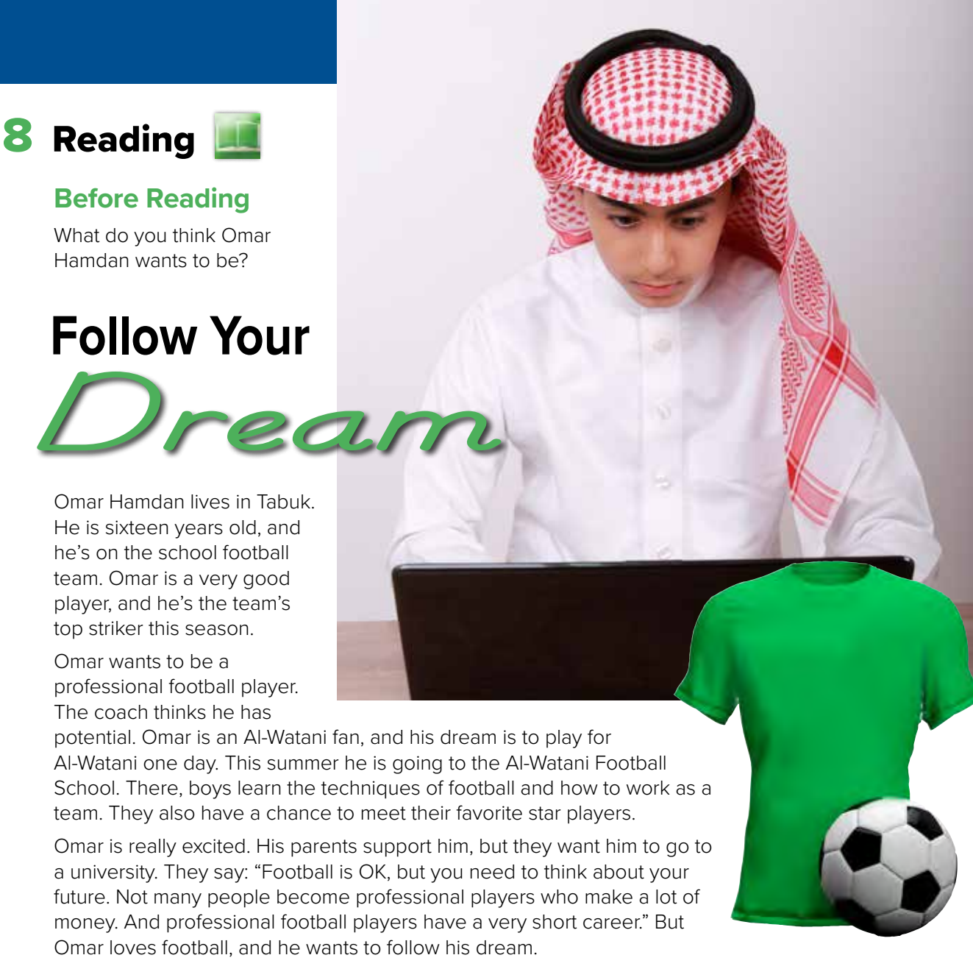

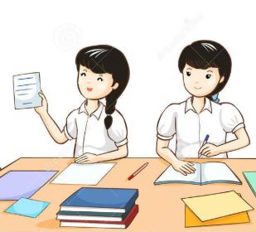

Page 77
Warm up
Where do you think the people are?
Think pair share
H.W

Slide 7


Page 77
scanning
Where does Omar live?
What’s his favorite football team?
Warm up
H.W

Slide 8
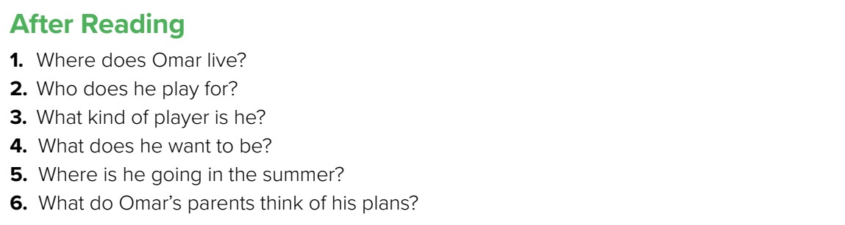
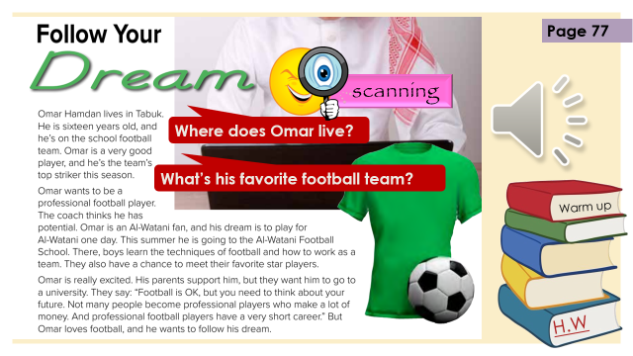
in Tabuk, Saudi Arabia
He plays football for his school
A good player. A striker.
A professional football player
To a football school
They want him to go to university
Warm up
Think pair share
H.W

Slide 9

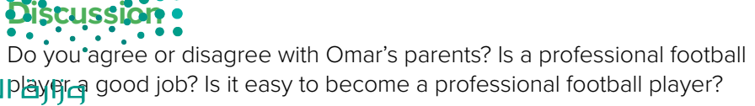

Talk in groups
Warm up
How is your future important for your counrty?
H.W

Slide 10

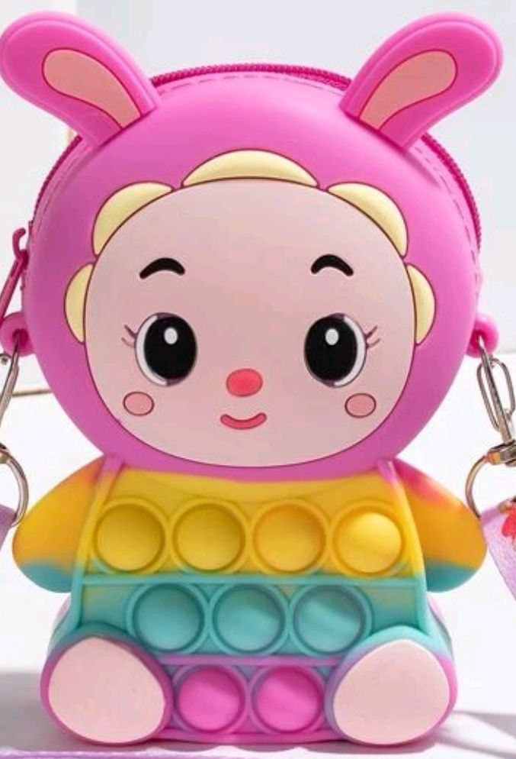
Lets play with LuLu
Warm up
H.W

Slide 11
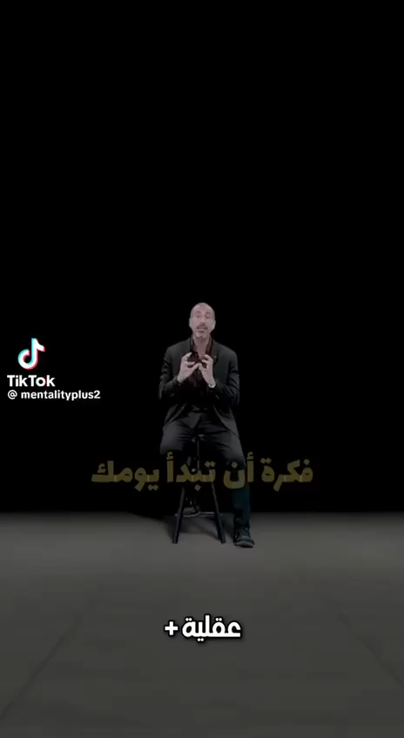

Lets play
Warm up
H.W

Slide 12
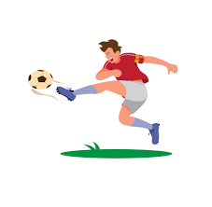

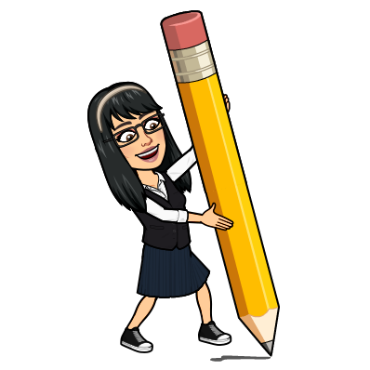
New Words
striker
Who makes goals
professional
The best - skilled
potential
Ability - talent
techniques
How to do
career
job

Slide 13
Write in your notebook
Like final test أسئلة للاختبار النهائي
Choose:
Mmmmmmm ………. mmmmmmm
( ssss – ssss – sssss)
Make a question

Slide 14





page 224 Ex(E)
for practice reading
Warm up
H.W

Slide 15
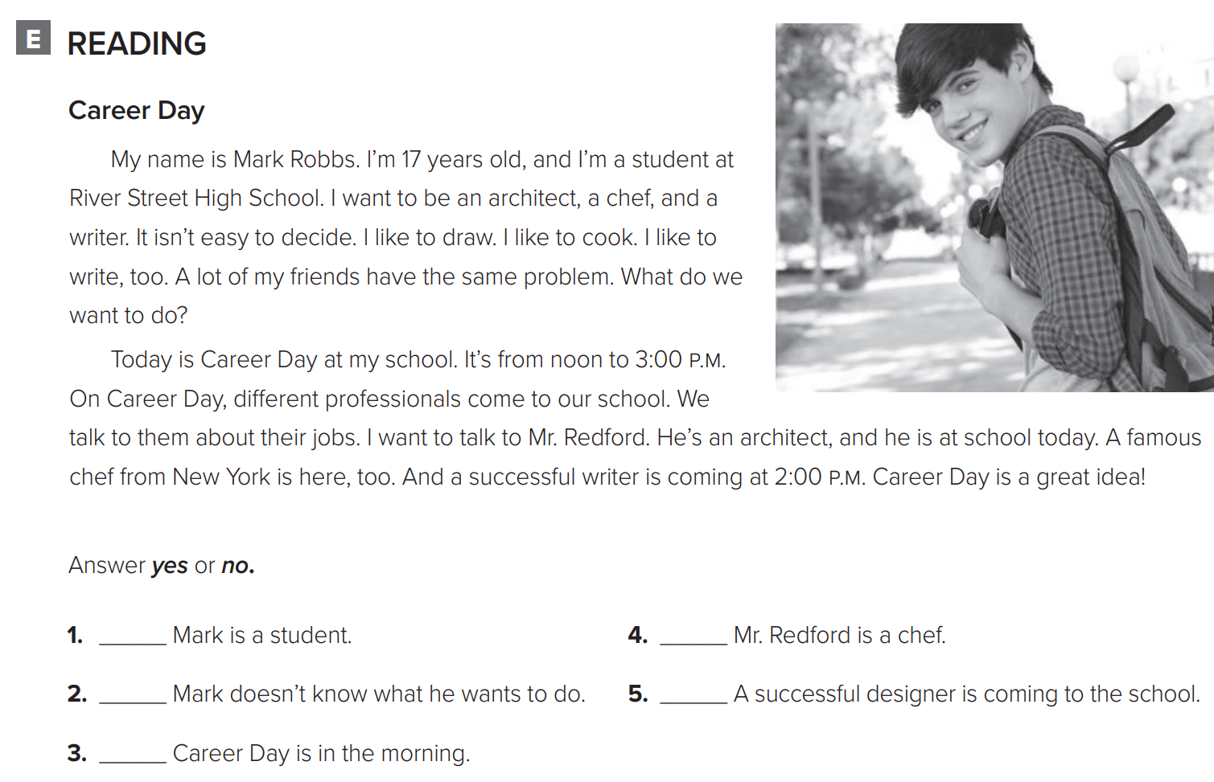
p.224
Warm up
yes
no
yes
no
no
H.W

