Slide 1

Unit 8
Life’s Ups and Downs
Finding Out Time

Slide 2
بسم الله الرحمن الرحيم
Day:
Date:

Slide 3
Learning Objectives
Give quick comments
Write some sentences in the past
Differentiate between regular and irregular verbs correctly

Slide 4
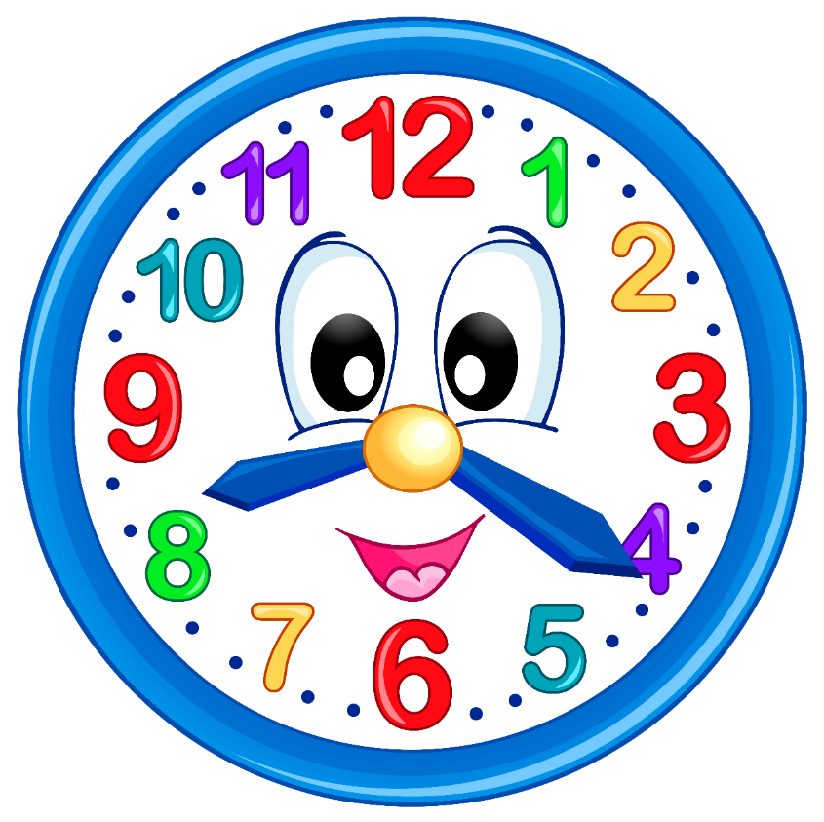
What time is it?

Slide 5


Revision

Slide 6
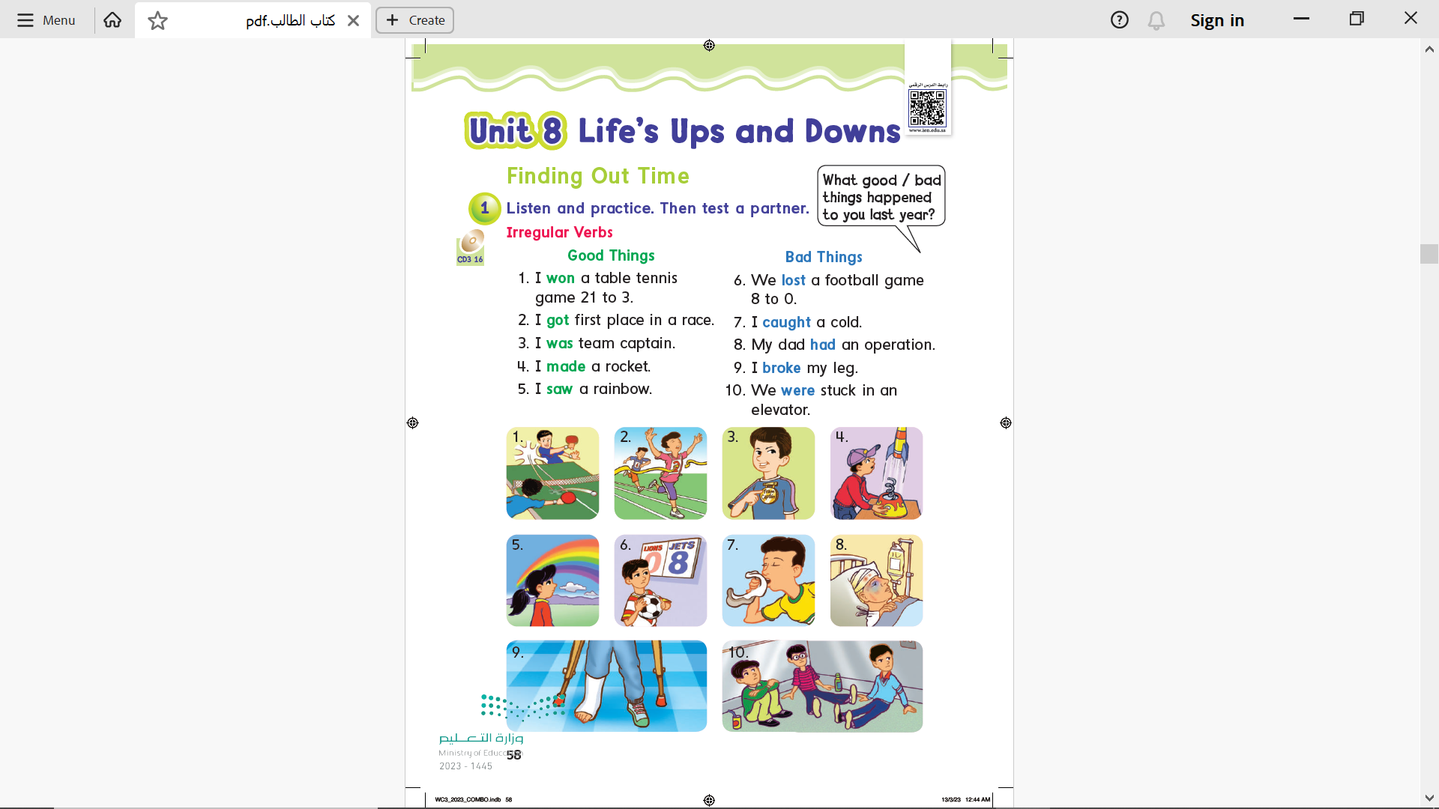

Page 58

Slide 7


What good things happened to you last year?

Slide 8
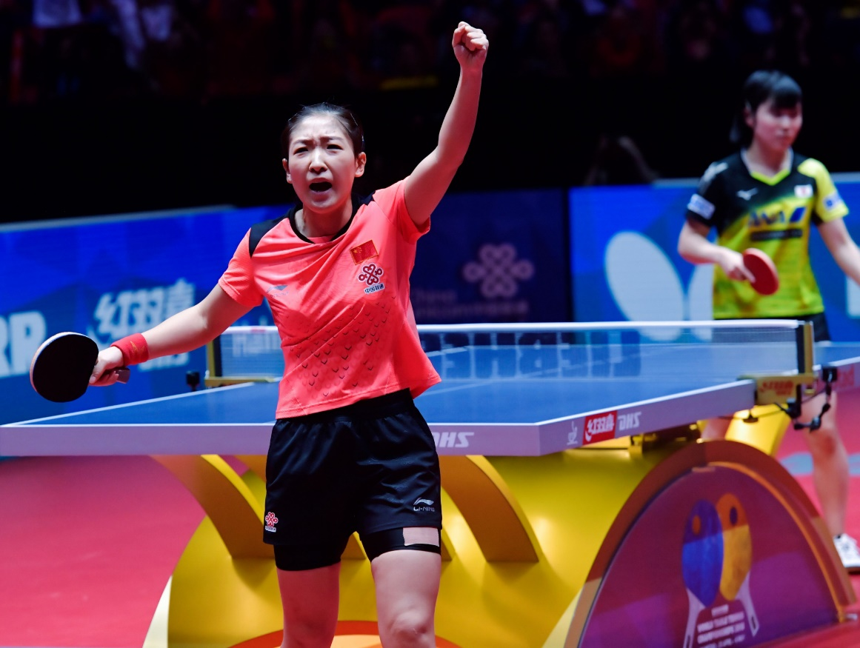
win -won
I won
a table tennis
game 21 to 3.

Slide 9
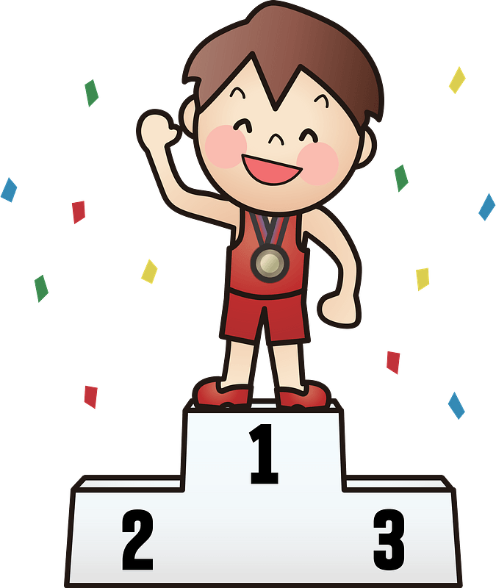
get -got
I got first place
in a race.

Slide 10
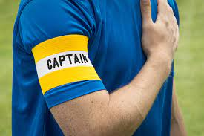
am -was
I was the
team captain.

Slide 11
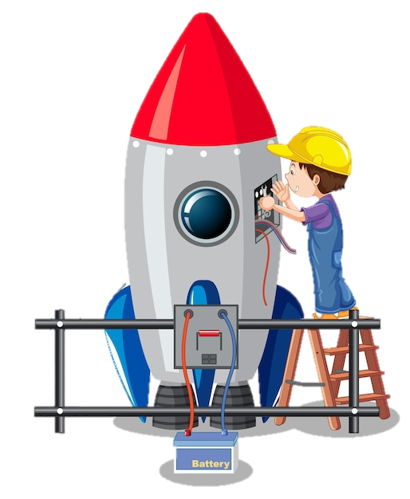
make -made
I made a rocket.

Slide 12
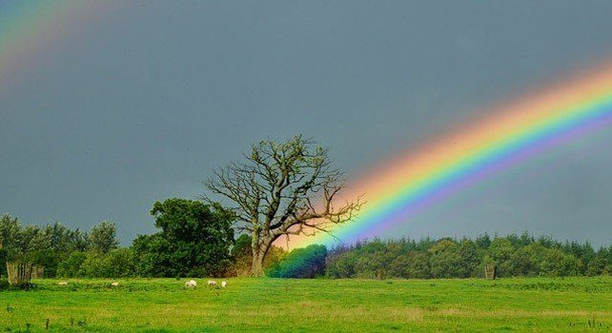
see -saw
I saw a rainbow.

Slide 13

What bad things happened to you last year?

Slide 14
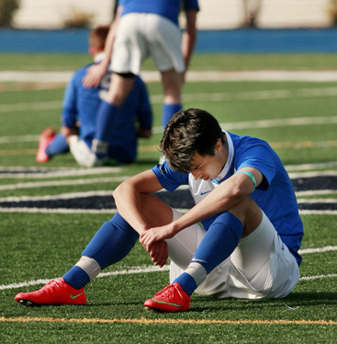
lose -lost
We lost a football game by 8 to 0.

Slide 15

catch -caught
I caught a cold.

Slide 16
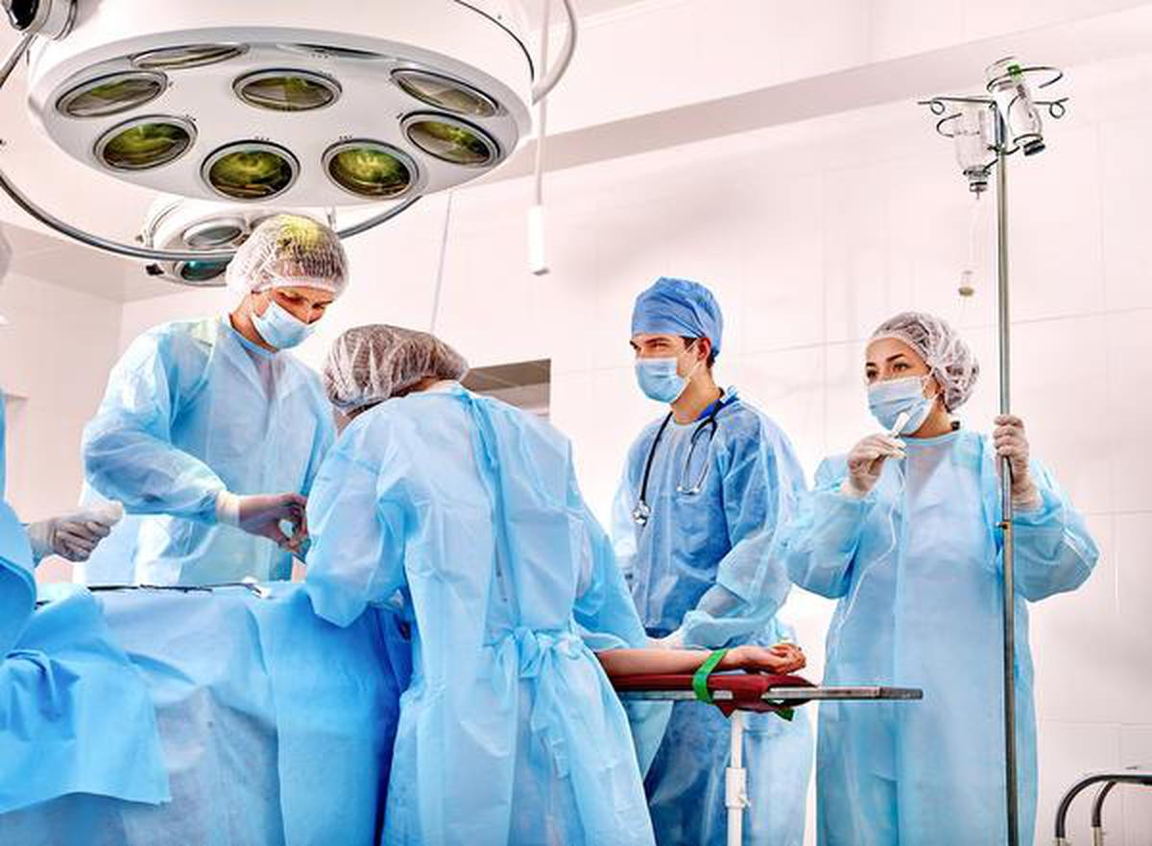
have -had
My dad had an operation.

Slide 17
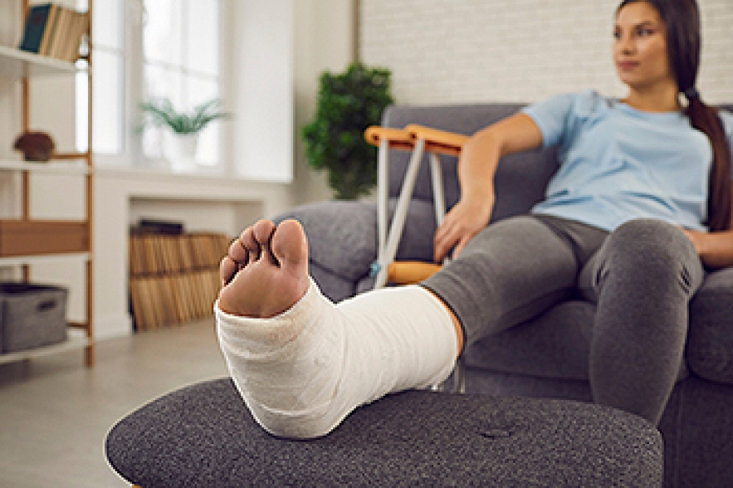
break -broke
I broke my leg.

Slide 18
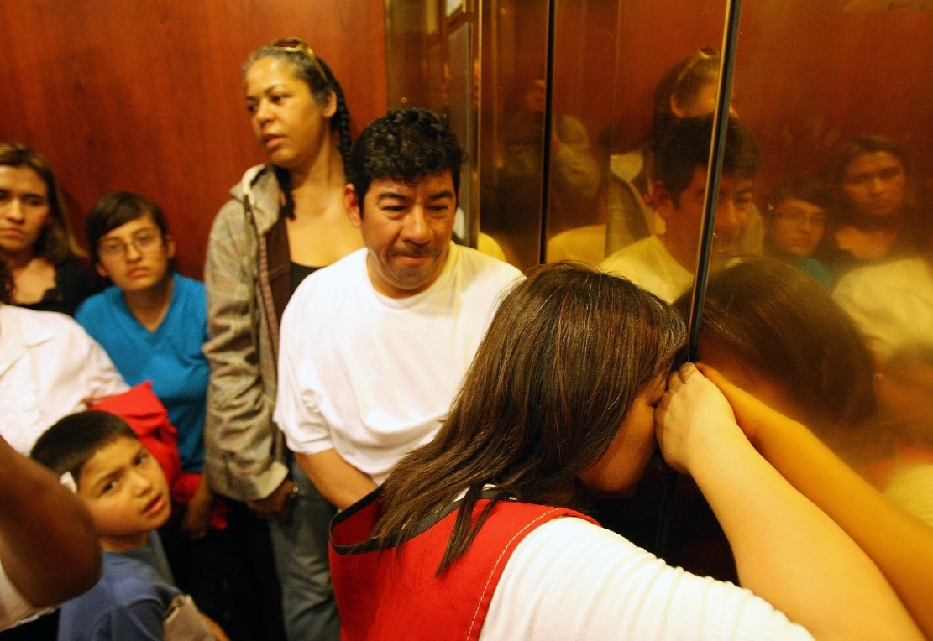
break -broke
We were stuck in an elevator.

Slide 19
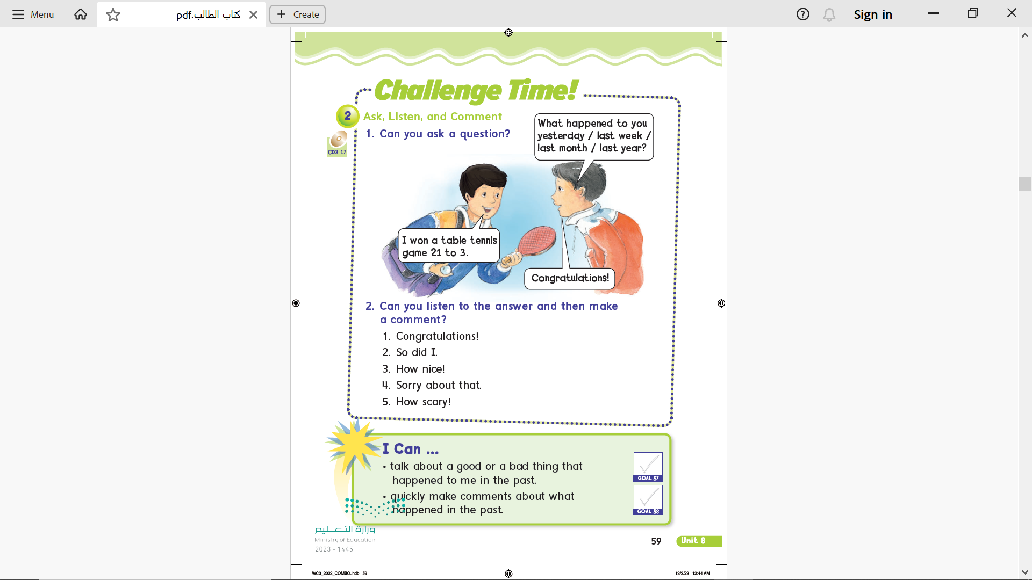
Page 59

Slide 20
Page 59

Slide 21
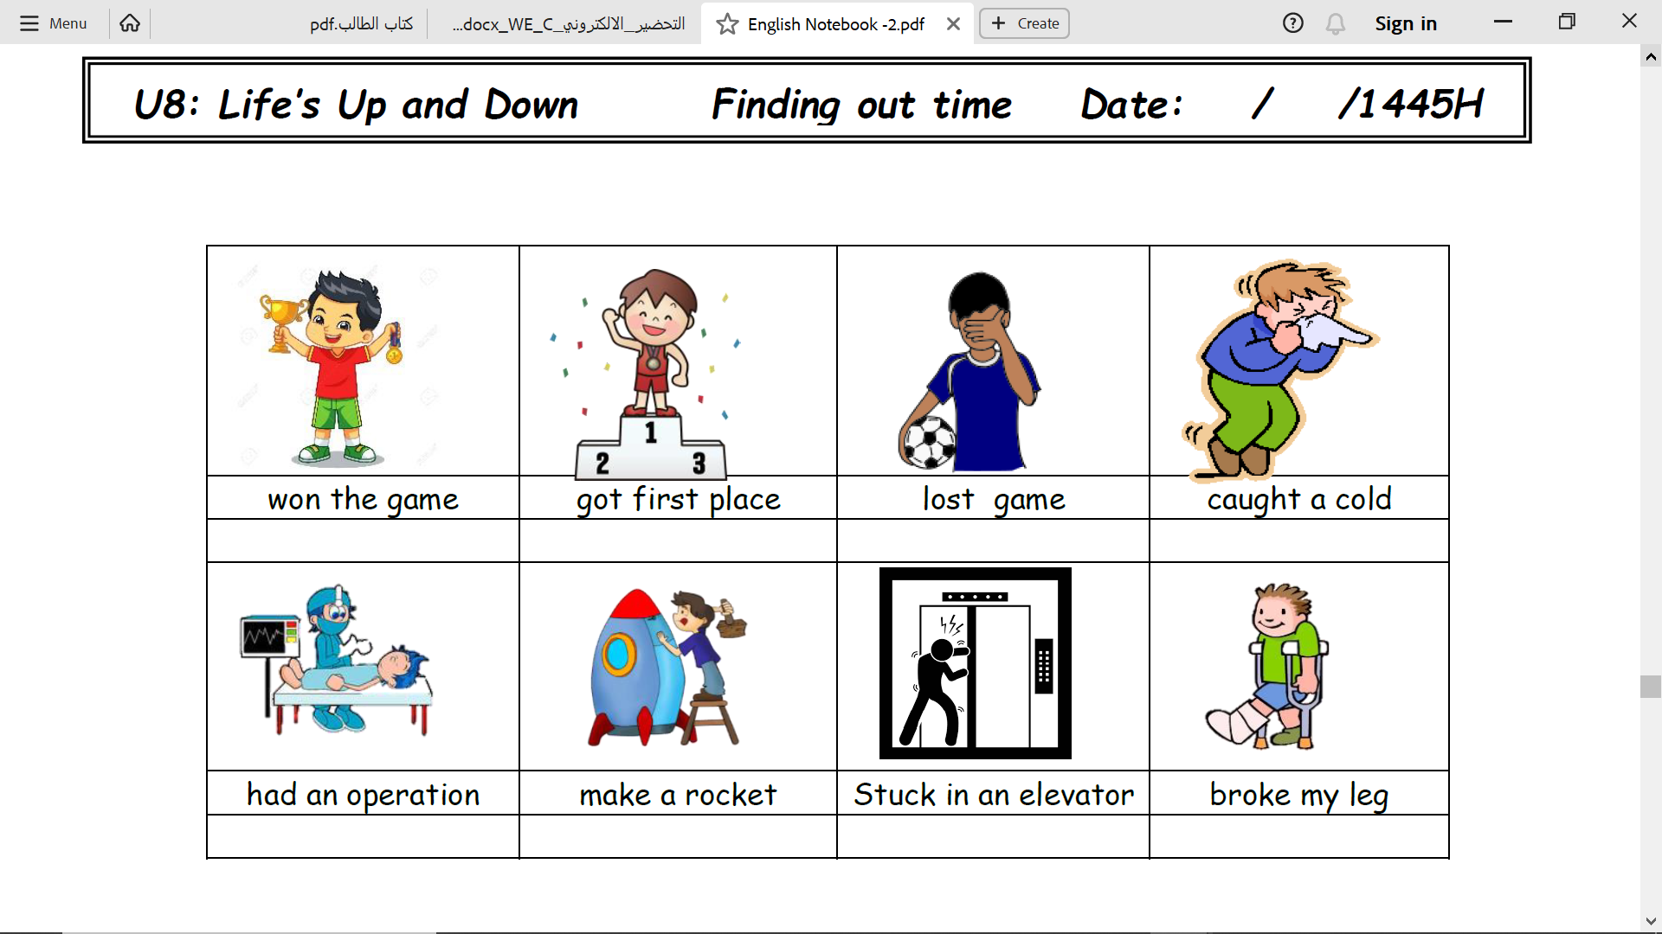
Notebook
Page 14

Slide 22
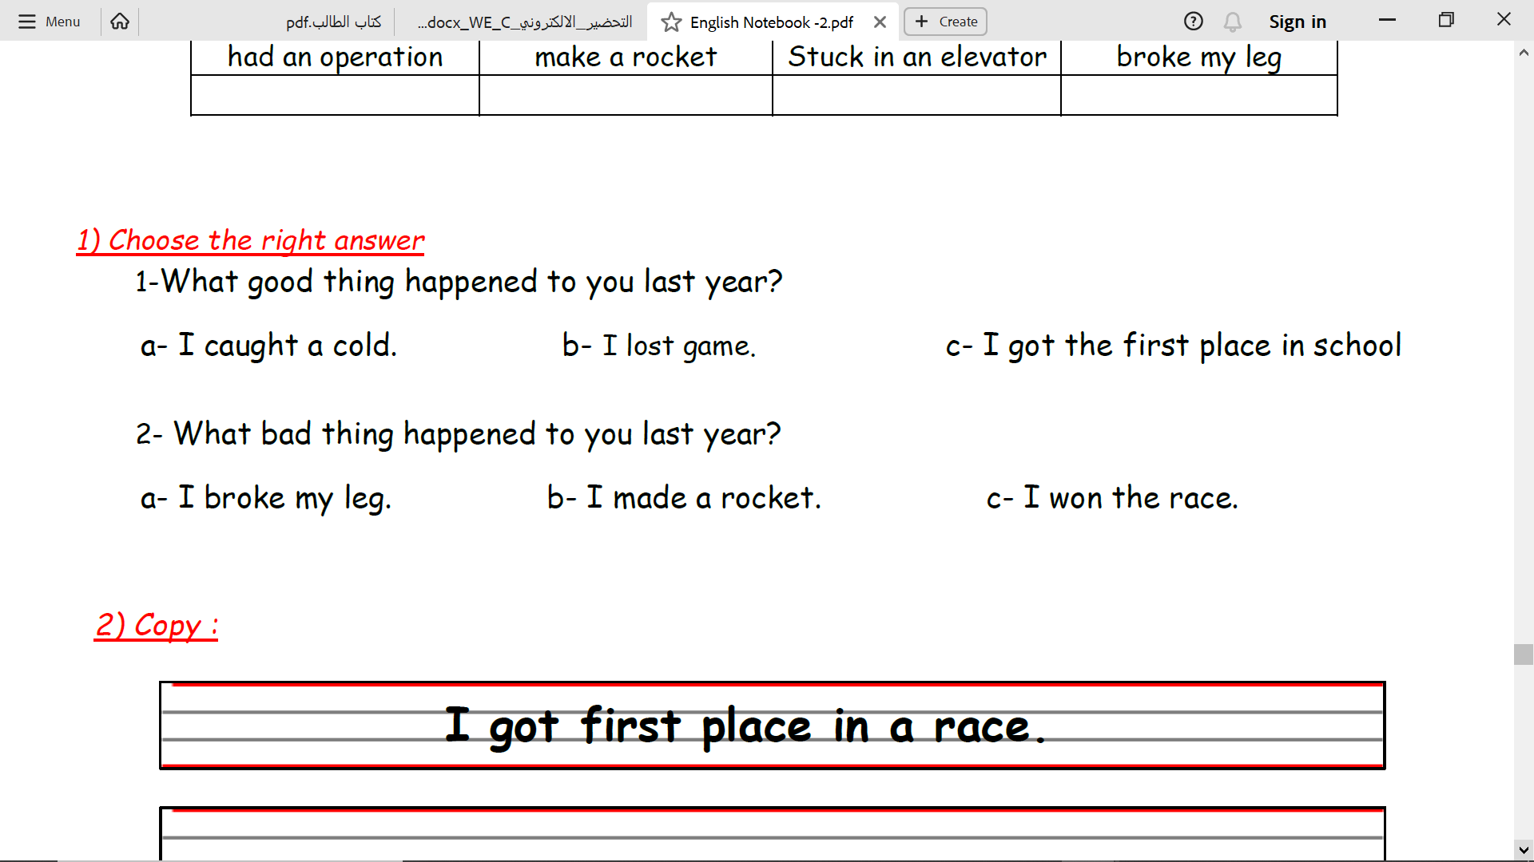
Notebook
Page 14

Slide 23
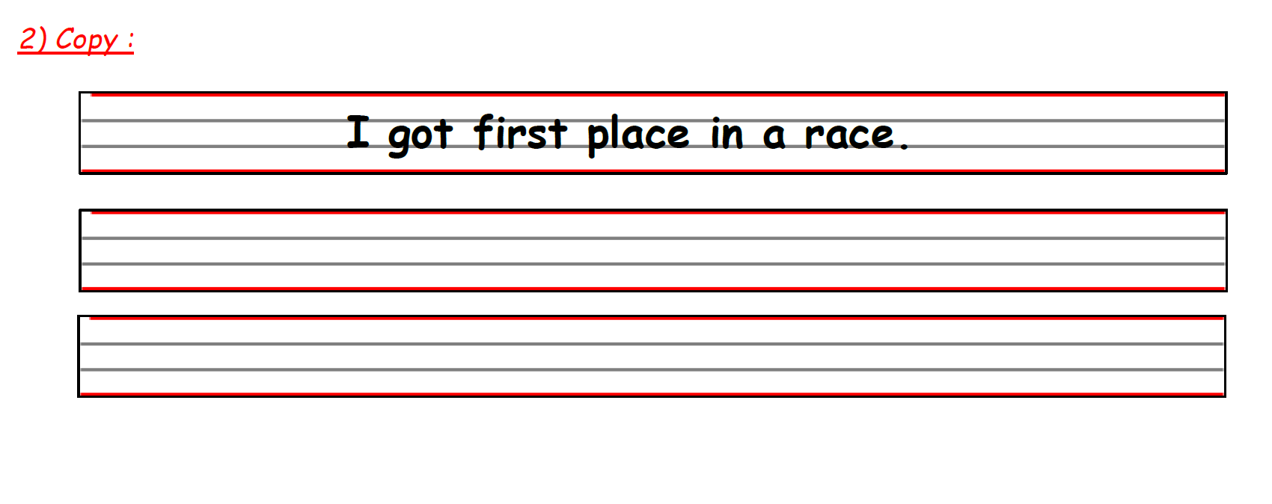
Notebook
Page 14

Slide 24

Practice

Slide 25
Homework
Pages 195 & 196

Slide 26
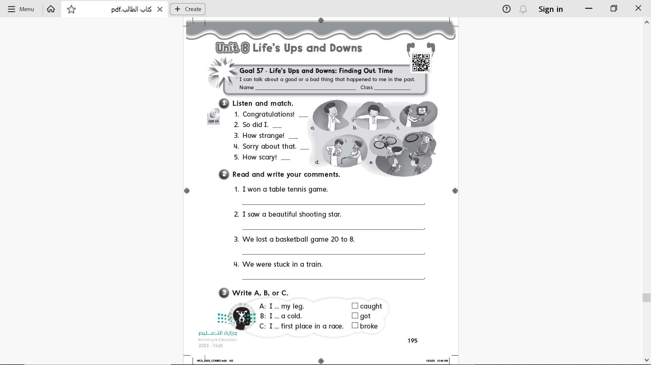
c
e
b
d
a
Page 195

Slide 27
Congratulations!
So did I
Sorry to hear that
How scary
Page 195

Slide 28
B
C
A
Page 195

Slide 29
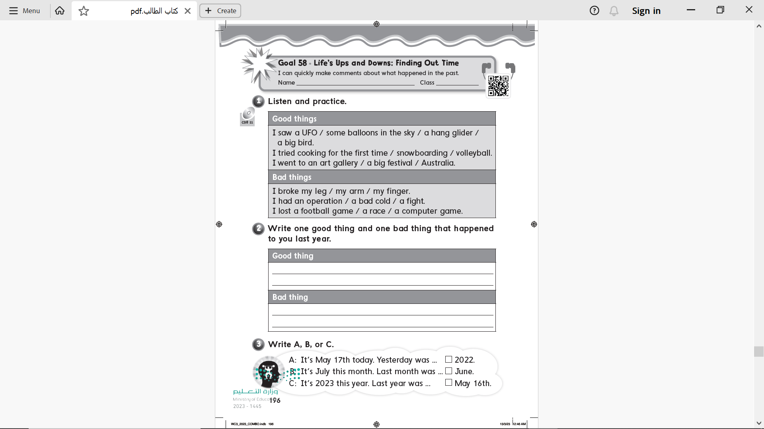
Page 196

Slide 30
I saw a rainbow
I learned swimming
I lost a basketball game
I broke my arm
Page 196

Slide 31
C
B
A
Page 196

