Slide 1
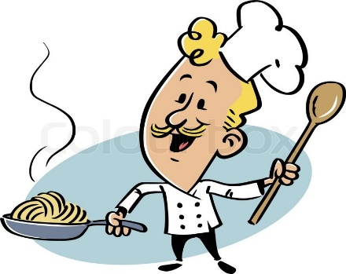
Food
We can 2
Unit : 2
Lesson : 1
Tr: Kholoud AlGhamdi

Slide 2
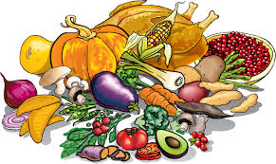
Food

Slide 3
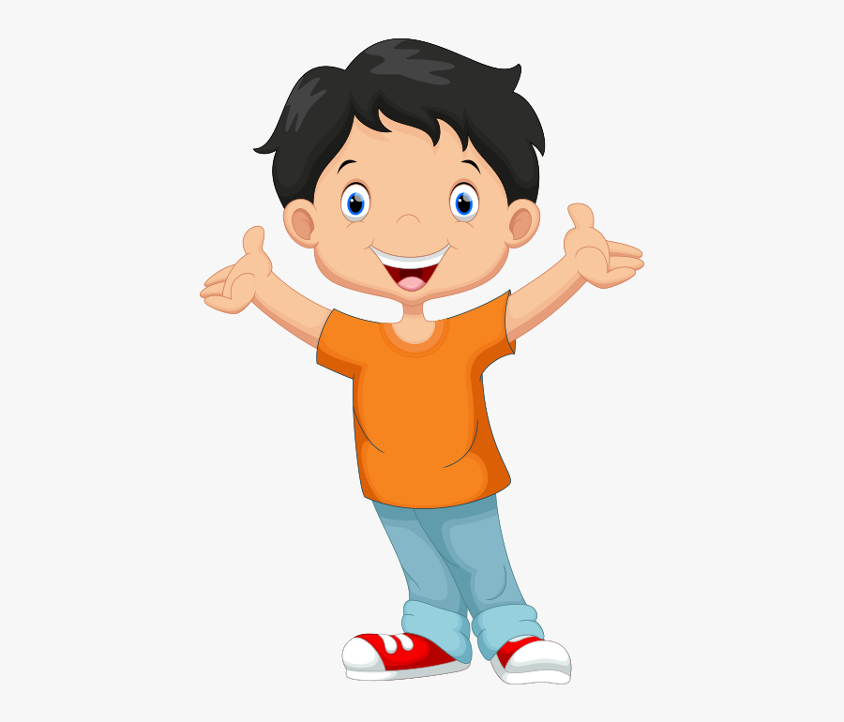
What is your favorite
Food ?
Do you like burger ?
Do you like cheese sandwich ?

Slide 4

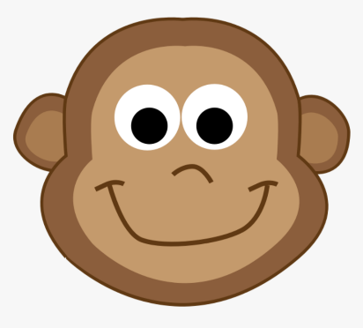
Pizza
Do you like pizza ?
What’s this ?
How many slices of pizza there ?

Slide 5

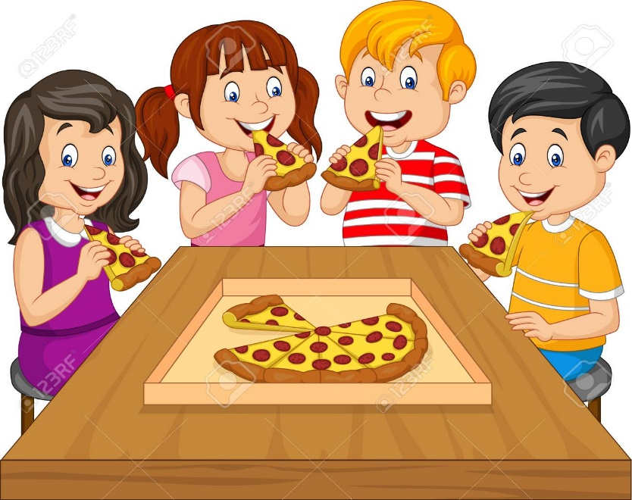
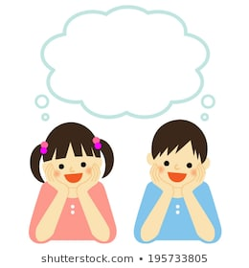
Ask your friend now ..
Do you like pizza ?
Yes , I like pizza
Or
No , I don’t like pizza

Slide 6
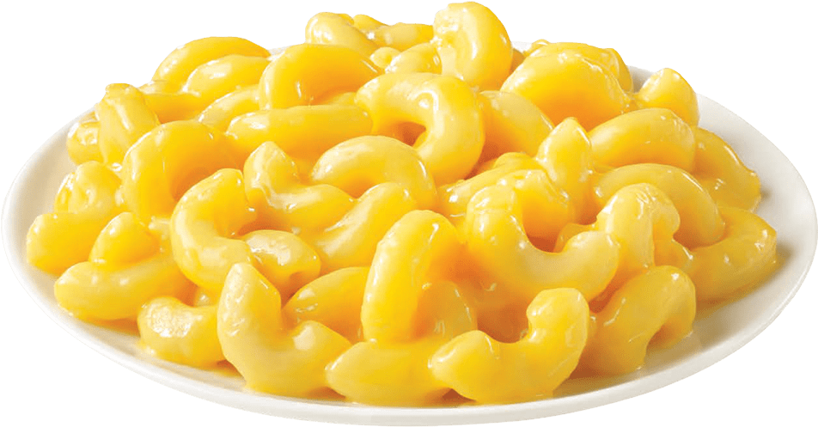
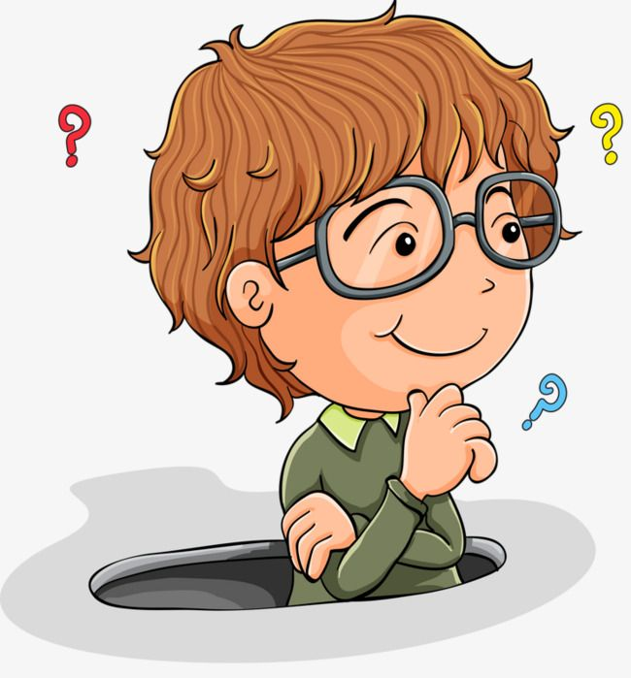
Macaroni
Do you like Macaroni?

Slide 7
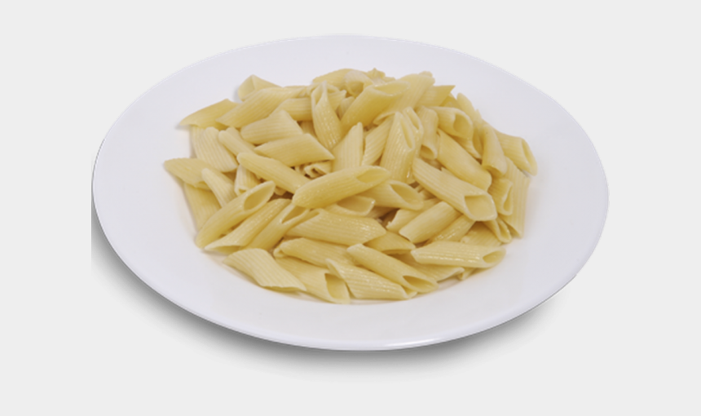


Ask your friend ..
Do you like macaroni ?
Yes , I like macaroni
No , I don’t like macaroni

Slide 8
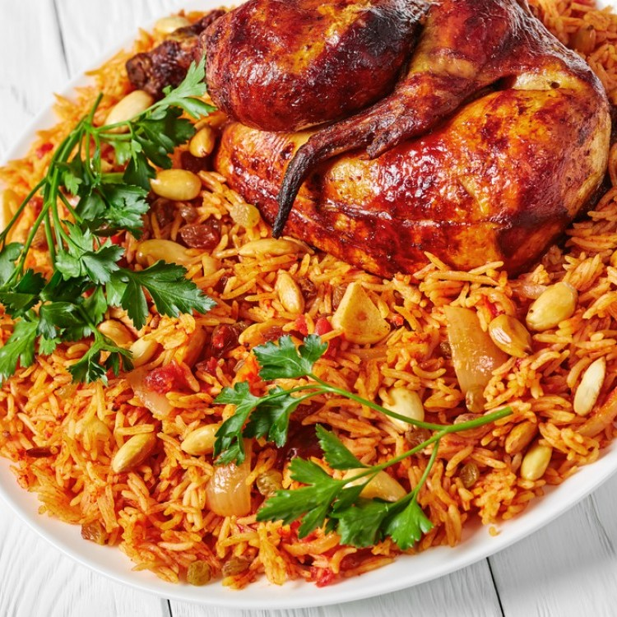

Kabsah
Ask your friend …
I don’t like kabsa
I like kabsa

Slide 9
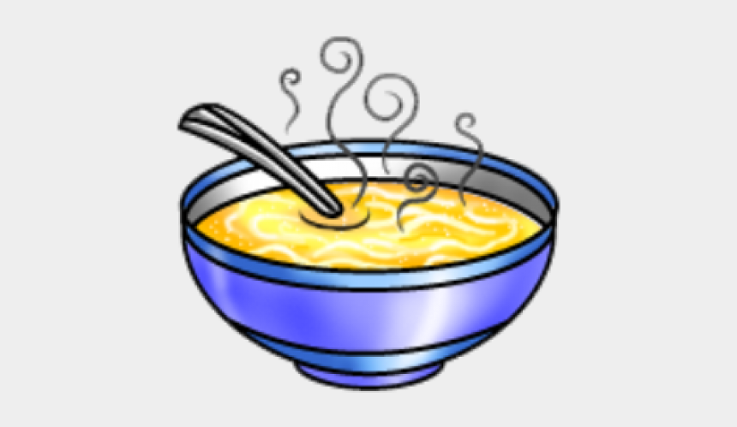
Soup

Slide 10
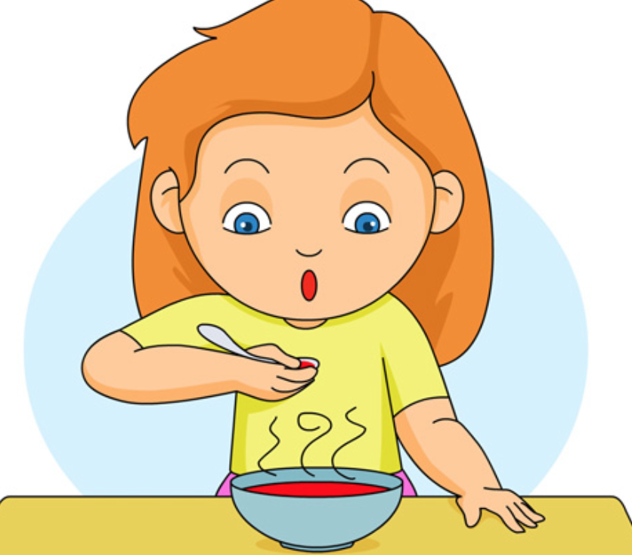
Do you like soup ?
Is it hot or cold ??
Soup is good for your health

Slide 11
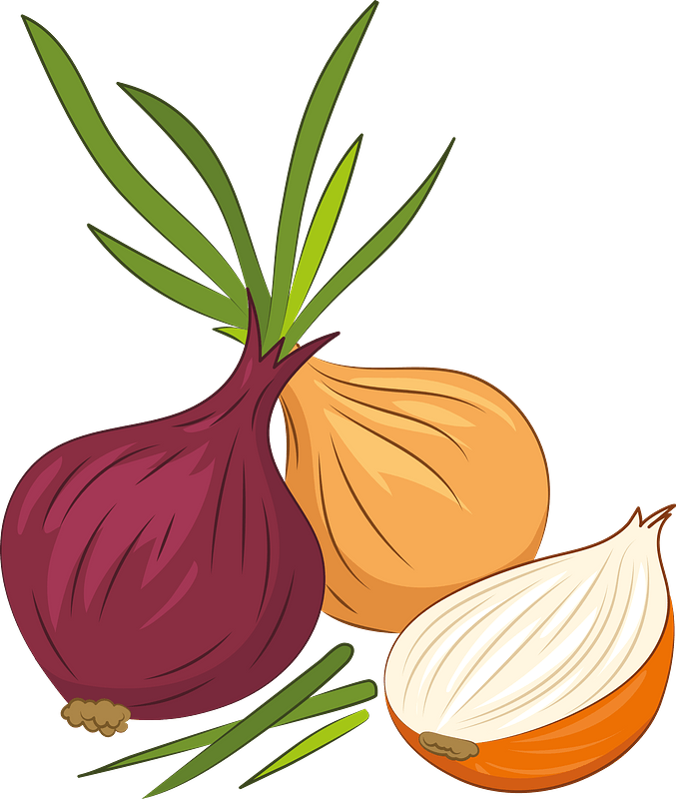
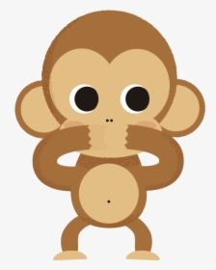
Onions
What are these ?
Do you like onions ?

Slide 12
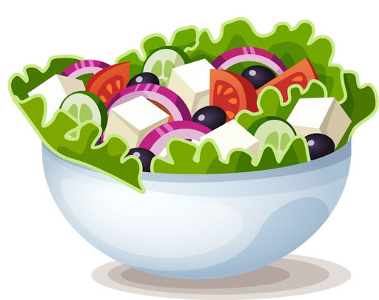
Salad

Slide 13
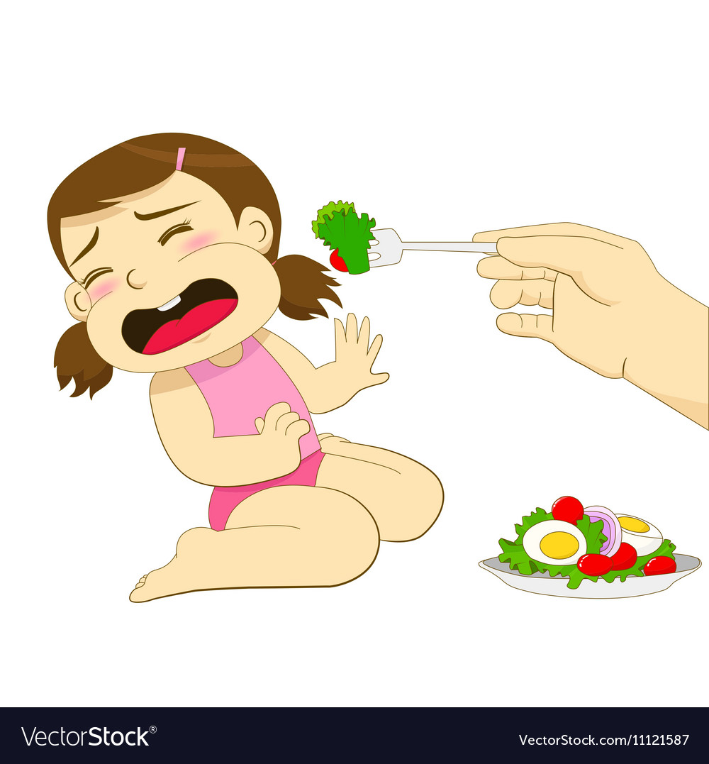
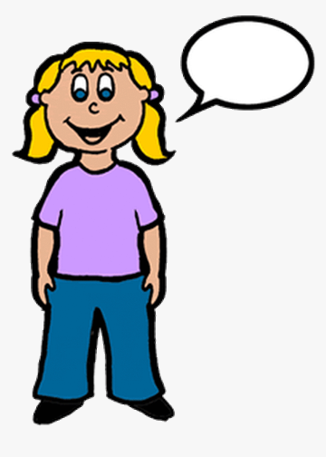
What can you say to her ?
Does she like salad ?
Salad is good for you

Slide 14

What should we say before eating ?
After eating ?

Slide 15

https://www.liveworksheets.com/aa1558579ty
https://www.liveworksheets.com/rj1558461rd

Slide 16

Open your book page 10

Slide 17
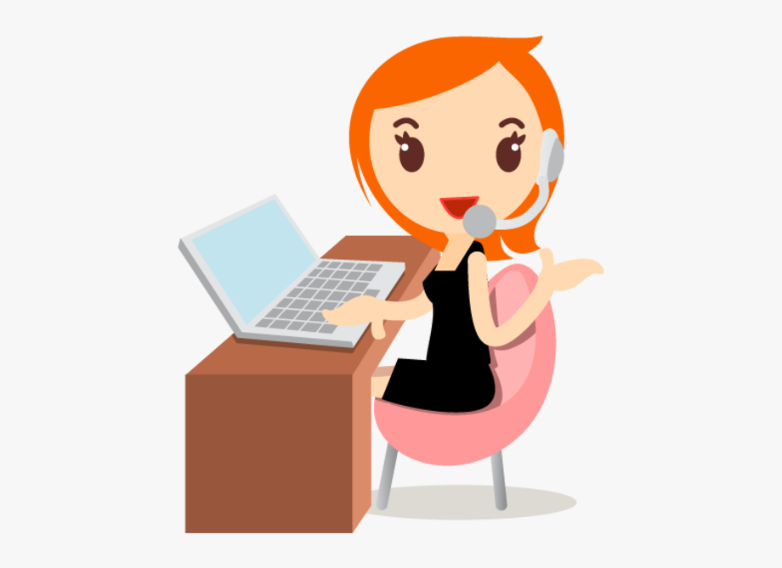
Have a nice day Tr: Kholoud ALGhamdi

