Slide 1



Slide 2
Mega goal.3.2
Against The Odd
Conversation

Slide 3
Objectives:
Use the "real talk" in short conversation
Express surprise in a conversation
Answer questions about the conversation

Slide 4
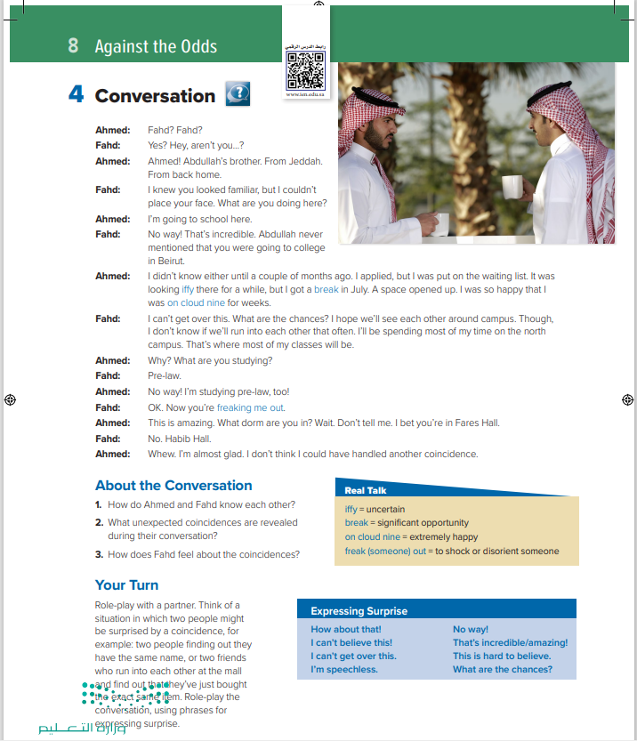

Students Book
P.114

Slide 5

What can you guess about these people?
They must know each other well. They might be friends.

Slide 6


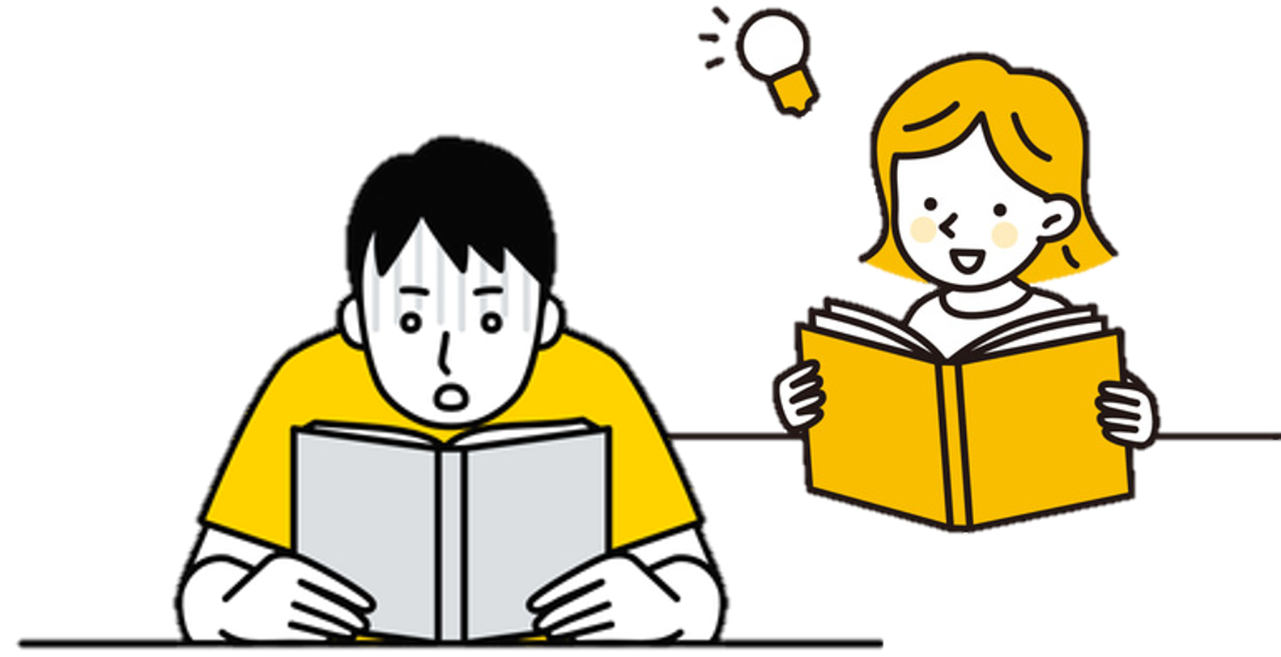
Close Your books & Listen

Slide 7
Read as long as You listen

Slide 8
What was iffy?
What is Ahmed’s lucky break?
Why was Ahmed on cloud nine?
What is freaking Fahd out?

Slide 9
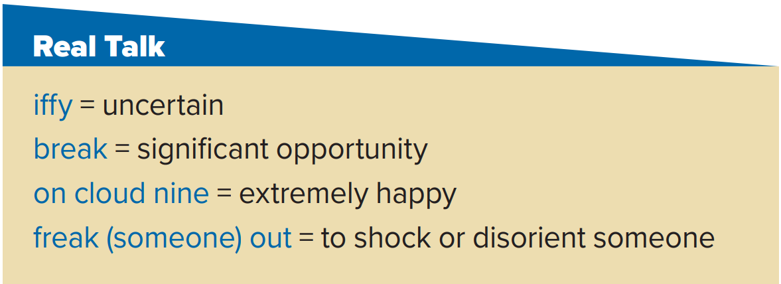
The weather is iffy today. It may rain, but it may not.
I was on cloud nine when I got the exam results.
The author got his lucky break when an agent read his book.
I was freaked out to discover that we had enrolled in all of the same classes at the same college.

Slide 10
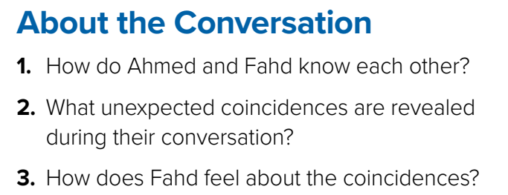
1.They are both from Jeddah. Fahd is friends with Ahmed’s brother.
2. They are both studying pre-law at the same college in Beirut.
3. He feels shocked about the coincidences.

