Slide 1

Unit 7
Fun on the weekend
Phonics

Slide 2


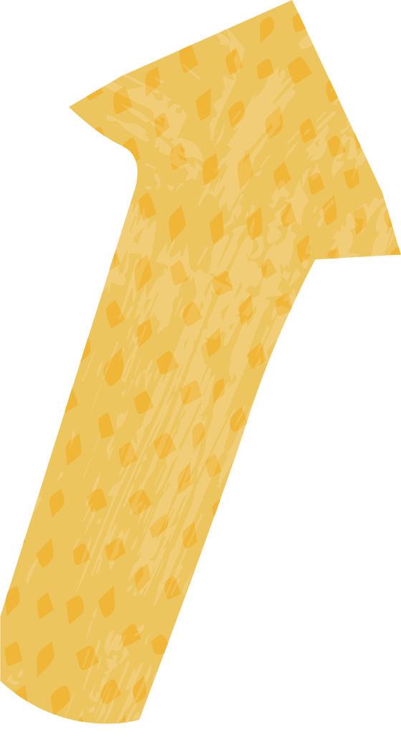

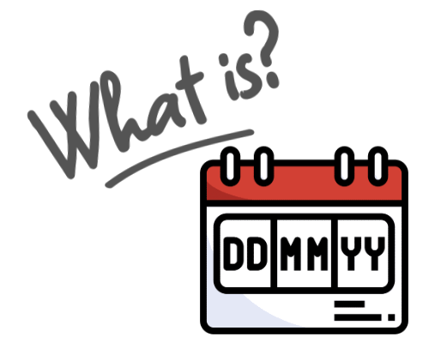




Slide 3

Homework

Slide 4
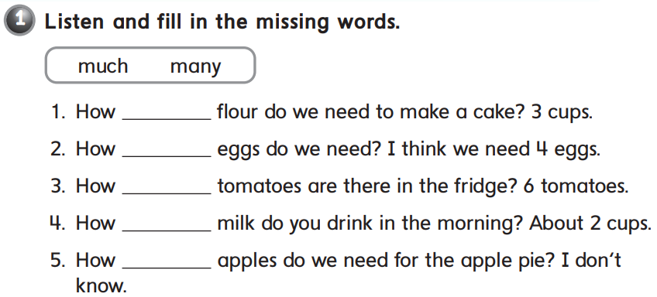
much
many
many
much
many

Slide 5
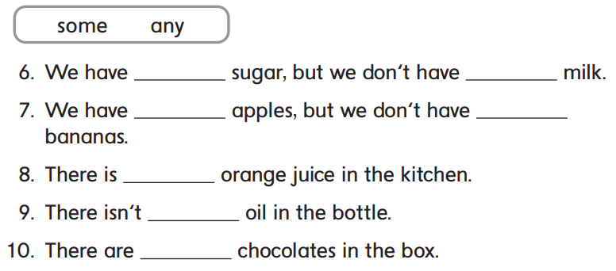

some
any
some
any
some
any
some

Slide 6


B
A
C

Slide 7


would
burger
fries
moment

Slide 8
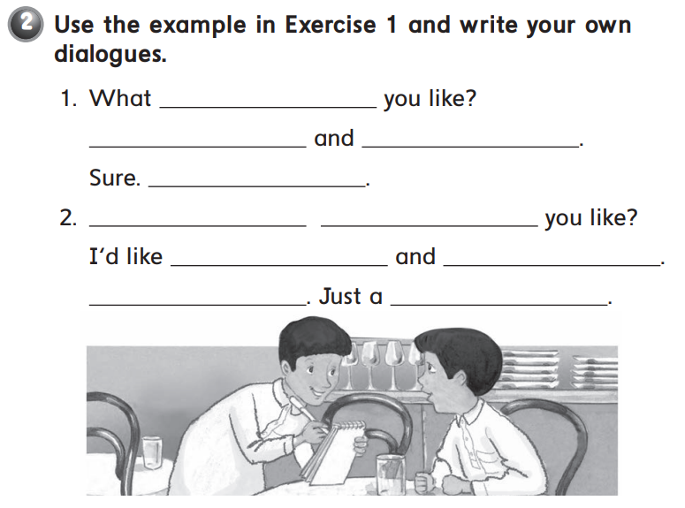
would
I’d like kabsa
soda please
Just a moment
What
would
pizza
a salad please
sure
moment

Slide 9


B
C
A

Slide 10



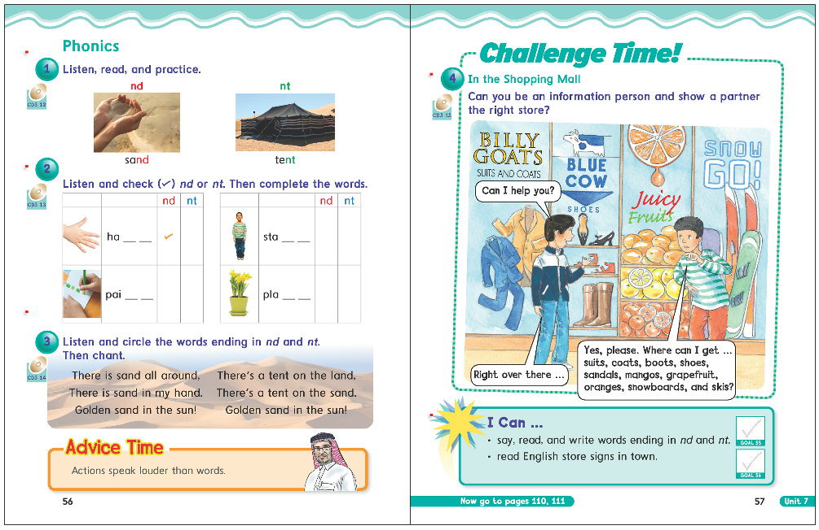

56
57

Slide 11








Slide 12
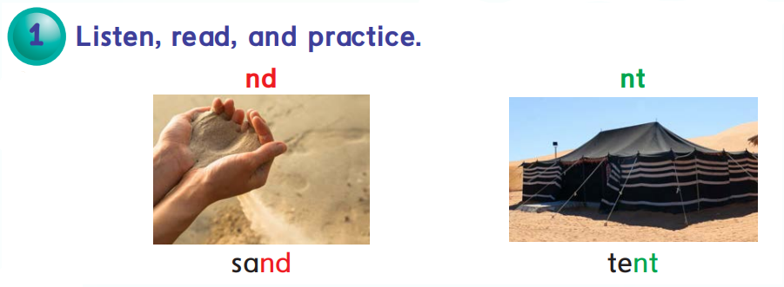


Slide 13

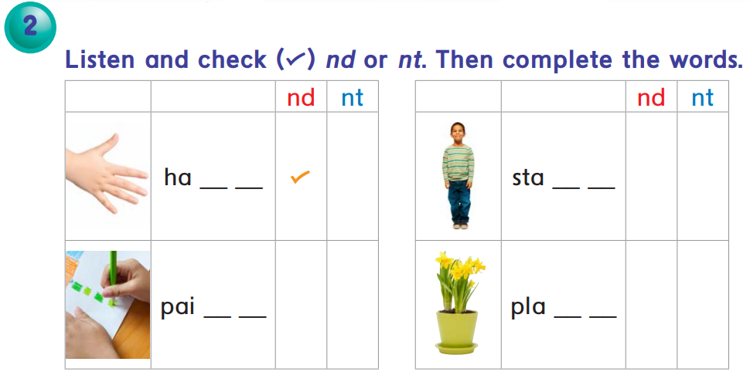

n d
n d
n t
n t

Slide 14


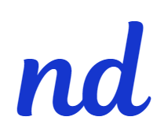



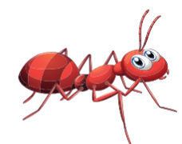
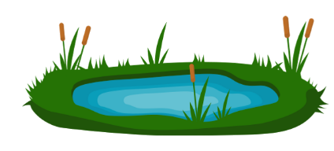





Keywords*: stand – ant – paint – pond – bend – mint – faint - find

Slide 15



Slide 16
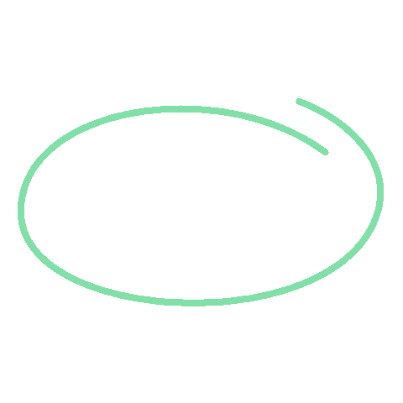






Slide 17



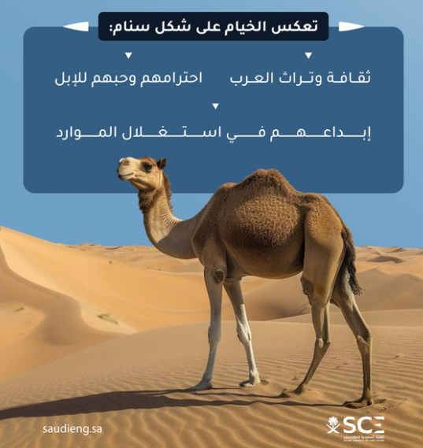


Slide 18

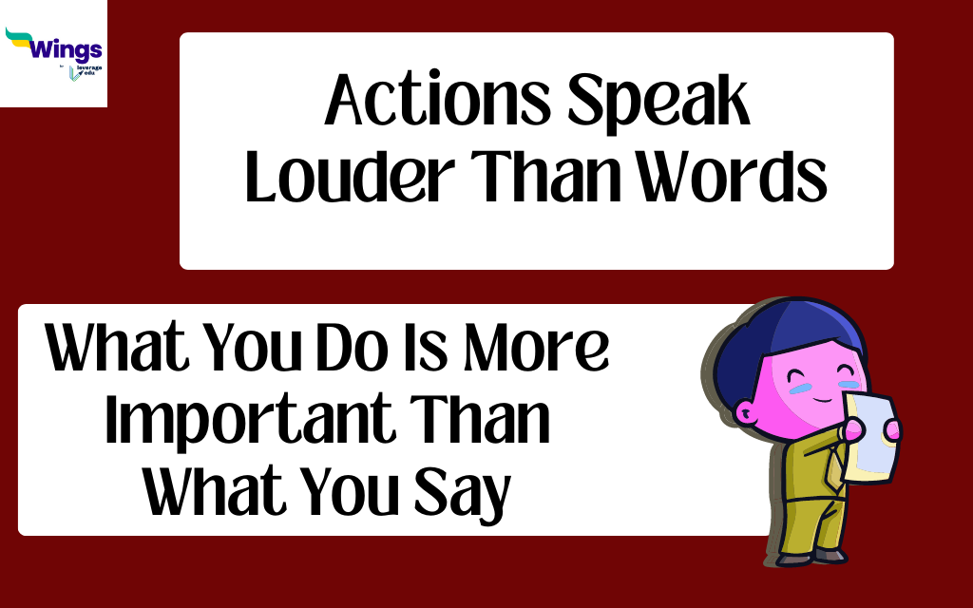

Slide 19
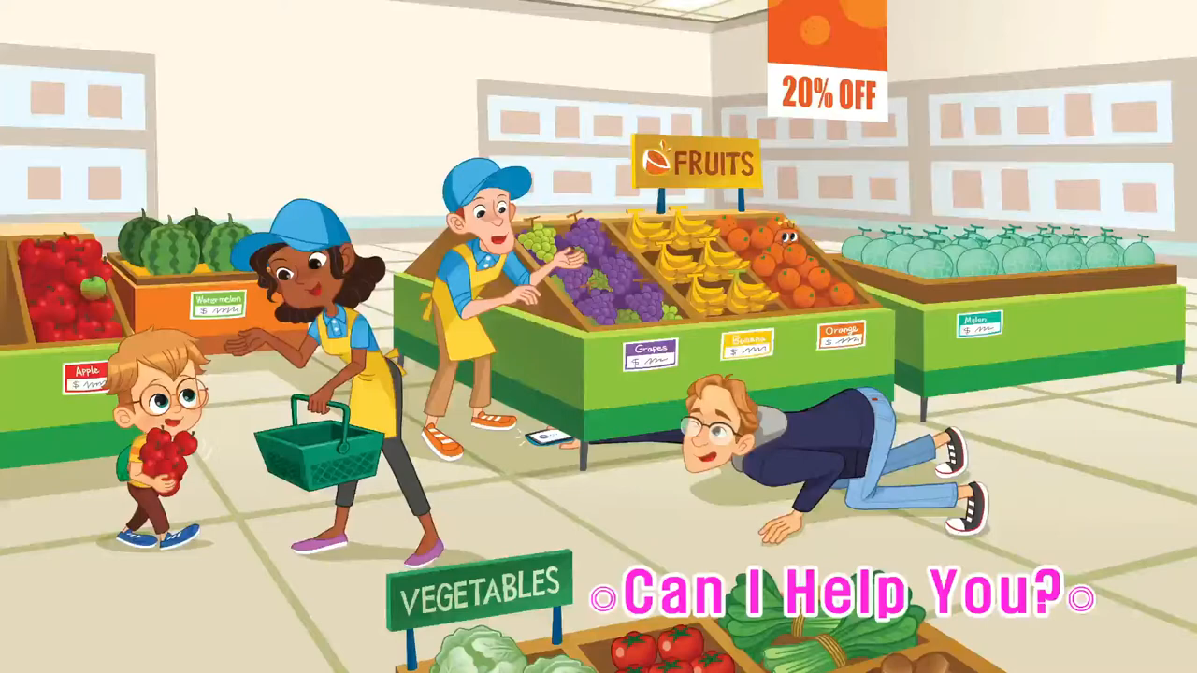

Slide 20


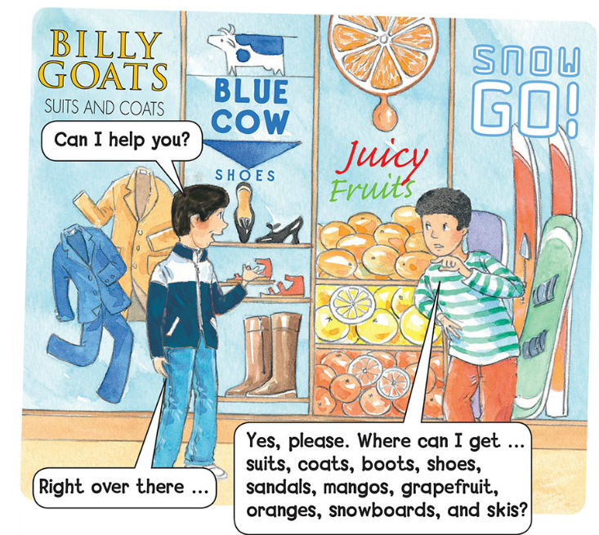

Slide 22


Open your book and write down on a paper all the words you can find ending in nd and nt

Slide 23


Slide 24
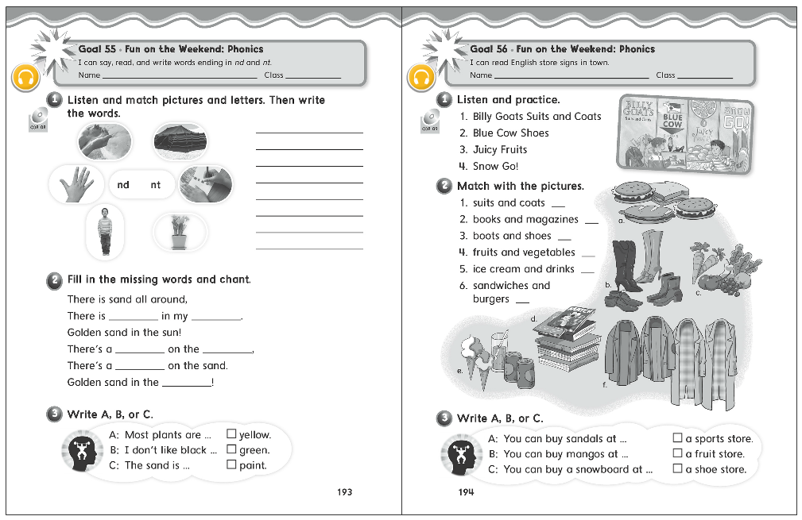
193
194

Slide 25
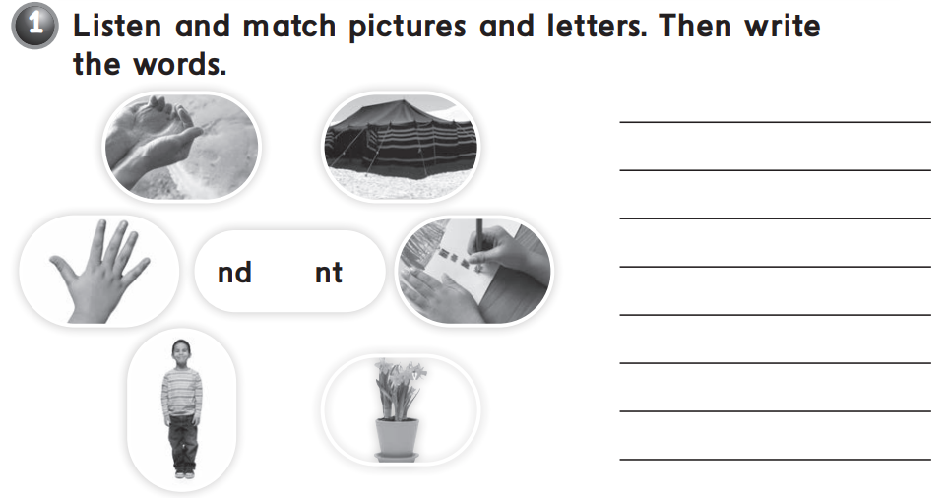

nd :
sand
stand
hand
nt :
plant
tent
paint

Slide 26
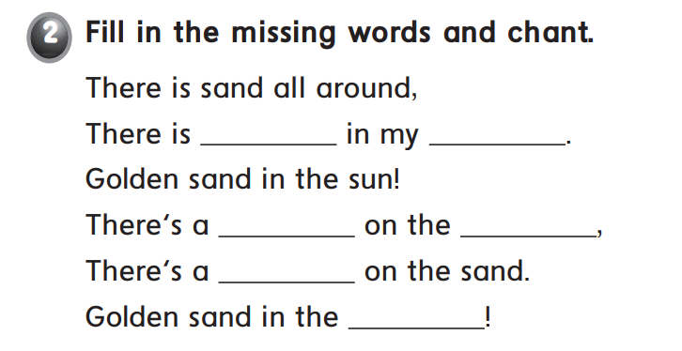
sand
hand
tent
land
tent
land

Slide 27


C
A
B

Slide 28



Slide 29
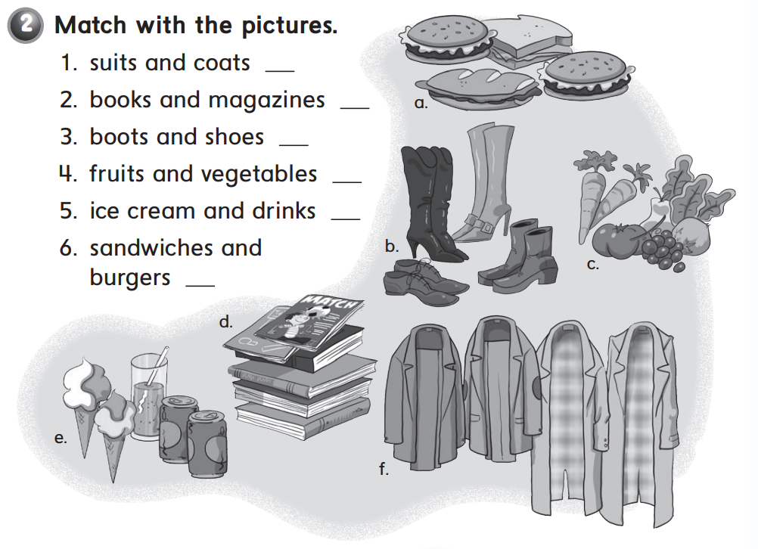
f
d
b
c
e
a

Slide 30


C
B
A

Slide 31
Thank you!

